Slide 1
Ten ‘ingredients’ for a successful low carbon change recipe
Peter Reason
Lowcarbonworks
University of Bath

Slide 2
The Lowcarbonworks project
‘What is it that helps and hinders the adoption of low carbon technologies?’
There are scientific and technical dimensions to this question and scientific and technical research will remain important.
But this is also a question about
human skills and motivations
cultures and organisations
professional and social conduct
how we see and define the issues
how we mobilise information, energy and resources
institutional structures
power, politics and vested interests

Slide 3
Assumptions of the project
The barriers to low carbon economy are not primarily technological
Technological, economic and human factors are systemically interlinked and may be ‘locked in’
Significant human factors in enabling change include awareness of the issues, membership of a community of practice, and a sense of agency
There are fleeting windows of opportunity for techno logical transformation
Individuals can only act when an opportunity arises in their actual environment
Notes:
Our purposes was to understand better the linking of human and other factors and contribute to abilities to change in practice

Slide 4
Action research projects with
Ginsters
from compliance to state of the art waste to power technology
Holsworthy anaerobic digestion
a pioneering biogas initiative in a UK farming community
Compair Airworx
the challenges developing a compressed air service business
Air Cycle
tracks the story of a ‘niche’ technology
Thurulie
design and build of an eco-factory
Southampton
collaboration to build and operate a district energy scheme
TDG
decarbonising cold food storage and distribution
Notes:
Ginsters tells how a food manufacturing company moved from compliance with waste regulations to investing in state of the art waste to power technology
Holsworthy anaerobic digestion is about a pioneering biogas initiative in a UK farming community
Compair Airworx explores the challenges facing a compressed air equipment manufacturer attempting to establish a compressed air service business
Air Cycle tracks the story of a ‘niche’ technology, as a small group try to exploit a low carbon heating & cooling technology for applications in the food industry
Thurulie eco-factory tells how a Sri Lankan apparel manufacturer commissioned and built an iconic low carbon factory to produce lingerie for Marks and Spencer
Southampton is the story of collaboration between diverse stakeholders to build and operate a district energy scheme drawing on geothermal energy.
TDG: Invisibly decarbonising cold food storage and distribution

Slide 5
The resulting picture…
… is that of fallible humans innovating together with tenacity and vision in the face of shifting agendas and changing fortunes.
… innovation occurs in the micro-practice of the mundane moment, in well-timed ‘different moves’ involving non-heroic actors embedded with each other and with technology
Margaret Gearty, 2009

Slide 6
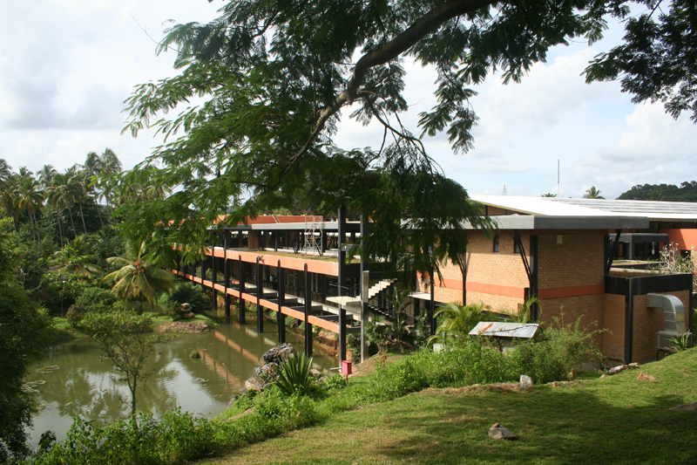
MAS Intimates Thurulie Ecofactory

Slide 7
I could tell you about the technology
A low carbon factory
Sitting lightly on the site, with minimal disturbance to the ecology, on two floors to minimize footprint
Set in a microclimate of lake & native plants to minimize “heat island” effect and maximize comfort and air quality
Reflective roof and partial green roof to minimize heat absorption
Roof overhangs provide shade, allow natural light and open windows
Evaporative cooling and low energy lighting
Consuming some 40% less power than an equivalent factory
The remaining power requirements are met by renewables: small hydro and solar panels
Structure of re-usable steel framework and timber to upper floors
Walls and roadways made of cement stabilized soil with low embodied energy and high heat coefficients

Slide 8
And I can also tell you the story of “a wonderful experience”:
MAS decided to try to create an iconic factory
in that others would want to copy
that would be ahead of the game for 2-3 years
Worked with local expertise
Built coalition within and outside the organization
Very creative response to challenging market conditions, despite tight supply chain ‘lock-in’
Went from first concepts to working factory in a year
Featured on M&S website, aiming for highest (platinum) LEED accreditation
Notes:
MAS decided to try to create an iconic factory in response to Marks & Spencer Plan A
that others would want to copy
that would be ahead of the game for 2-3 years
Found all the technical expertise they needed in the local university engineering department, a multi-disciplinary group who were already working together
Went from first concepts to working factory in a year
Very creative response to challenging market conditions, despite tight supply chain ‘lock-in’
Featured on M&S website, aiming for highest (platinum) LEED accreditation

Slide 9
And also…
Learning History uncovered the personal passions of two key figures in the team
They all remarked on the unprecedented goodwill and excitement – “attractor”
Experimental, problem-solving, learn-by-doing approach: experts prepared to ‘not know’
Key role of the translator, boundary-spanner
Significant relational work (which is normally ‘disappeared’ by the sociotechnical system)

Slide 10
We tell these as narrative because stories are
The primary way we make sense of our experience, giving meaning and significance to our lives
A vital means of building relationships, bringing groups and communities together
A powerful force in the world, acting on our imaginations to shape, constrain and free our sense of what is desirable and possible.
Notes:
a narrative retains the character, detail and drama
informs us on the level of human experience .
Stories can show the way different issues come together to form a particular unique situation in which events are unfolding and those engaged are doing their best with what they understand and can do at the time.
They can show the messiness of the situation and the inevitable inadequacy of understanding.
Narratives serve not only to engage the audience but to
help that audience to connect their own experience to the narrative in whatever way they wish and so learn on their own terms. Most large organizations are “mythically” deprived.
Official documents and presentations are bereft of stories;
managers talk in terms of highly rationalized, abstract explanations that do not typically tell how their numbers of policies really evolved…

Slide 11
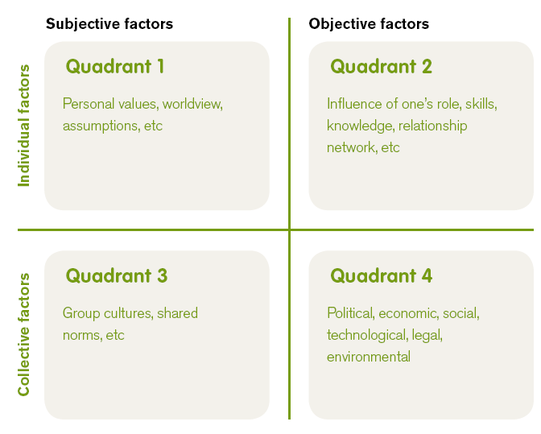
Complementarities matrix

Slide 12
Relational practice
Relationship is a key part of work getting done and helping innovation take place
the importance of the way people work together is noticeable in all our research
It involves a particular kind of work
the capacity to create and sustain relationships
crossing professional and/or organisational boundaries
sharing ownership of a task
communicating openly and directly
finding activities that are mutually rewarding and energizing
finding ways to learn deeply together.

Slide 13
Relational practice is expressed in..
Actions that are task-oriented, yet have qualities of reciprocity:
working with stakeholders
mobilizing teams
having dialogues with people who hold different views
getting people to commit to take action
negotiating roles and priorities
getting efforts aligned
Requires certain strengths of empathy, vulnerability, ability to experience and express emotion, ability to participate with others and learn together

Slide 14
Relational work ‘gets disappeared’
We may pay lip service to ‘good human relationships’ and ‘getting on with people’
But the public world of work is instrumental, rational and objectively task-focussed
This relationship-oriented work takes place without people noticing or valuing it
Is not generally rewarded as an organisational asset
Becomes hidden and unacknowledged

Slide 15
Construction site manager
“I don’t know, somehow we had this cohesiveness in the team. At the end of the day what struck me was… this is the first time I’m having site meetings of this nature. Its usually far more aggressive - ‘You should have done this’, ‘Why didn’t you do that?’, that kind of thing. Here it’s not like that, here even if something is not done we sort it out in a reasonable way-- I thought that was a very good approach”

Slide 16
What we have learned
… far from being strategically, politically or technologically driven, innovative projects erupt dynamically when contextual factors meet capable coalitions that exhibit certain complex qualities, that include: actors’ attitudes to risk, the flow of knowledge and trust and the ability to build capacity against shifting agendas.
Margaret Gearty, 2009

Slide 17
Ten ‘ingredients’ for a low carbon initiative
Diverse coalition
Systemic understanding and timeliness
Translator go-between
Wide vision
Agency
Enabling Culture
Daring not to know
External networking
Amplifying feedback
Tenacity
Notes:
Diverse coalition
There is a coalition of people which may cross professional and/or organisational boundaries and which possesses relevant skills, knowledge and political positioning; and who are not constrained by normal functional boundaries and so clearly focus on the issue nor usually within an organization function. They develop strong trusting relationships within this team
Systemic understanding and timeliness
The group works to develop an understanding, at least implicitly, of the broadest systemic context of the work,—the technological choices, the economic opportunities and constraints, the cultural enablers, and so on. Within this context they are able to identify a clear opportunity and seize the moment for initiating change.
Translator go-between
At least one person is able and willing to act as translator and intermediary between different expert-knowledge groups – technical/scientific, business, activist etc. This is a really important role (which may be filled by more than one person)
Wide vision
People within the collation are able to act strategically, with a clear sense of purpose and with an eye on the bigger picture: They understand that different people bring different perspectives and value that; they spot opportunities and make good use of chance and serendipity; they find people to help make sense of things and support outside the immediate professional environment.
Agency
Individually and collectively this group is able to see opportunities in which to exercise ‘agency’, to be proactive. Together, they are willing to take risks, to experiment. They are able to live with some uncertainty and ambiguity.
Enabling culture
They are operating inside an organisational culture that in some way enables proactivity, or at least does not squash it. This may include creating a protected space and enabling alliances with powerful individuals who can protect experiments
Daring to not know
They know they do not have all the answers, that they are not experts following a clearly laid down path. In consequence, they approach their work together in a spirit of collaborative learning, developing an active culture of discussion
External networking
As part of this they link to and consciously build wider networks outside their immediate organization
Amplifying feedback
They are in an environment that in some way rewards and amplifies the innovation (there are positive feedback loops) so that room for manoeuvre gets larger as the project progresses. As this happens others are attracted into it so the project develops a reputation or story which is told positively outside the immediate circle
Tenacity
They are prepared and able to exert influence on the constraints that they encounter. They are willing where necessary to seek to change or challenge rules, standards and procedures that are potential barriers. They show tenacity in this.

Slide 18
The contribution of action research
…is not future-oriented. It is not seeking a way to purposefully ‘manage a transition to a desired point (a decarbonised economy, a low carbon future etc)’. Instead it is present oriented and presuming some kind of transition is underway. It is seeking a way to ‘ride this ongoing unknowable transition’ in an elegant way. This implies a switch in orientation from theory to practice, from objective policy-making to participative learning and, lastly, crucially from the analytical to… a return to stories and themes and vignettes of practice that rehumanise and colour the world of system innovation
Margaret Gearty, 2009

