Slide 1
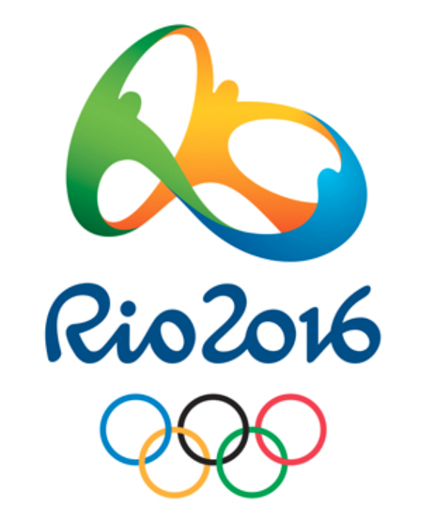
Rio Olympics 2016

Slide 2
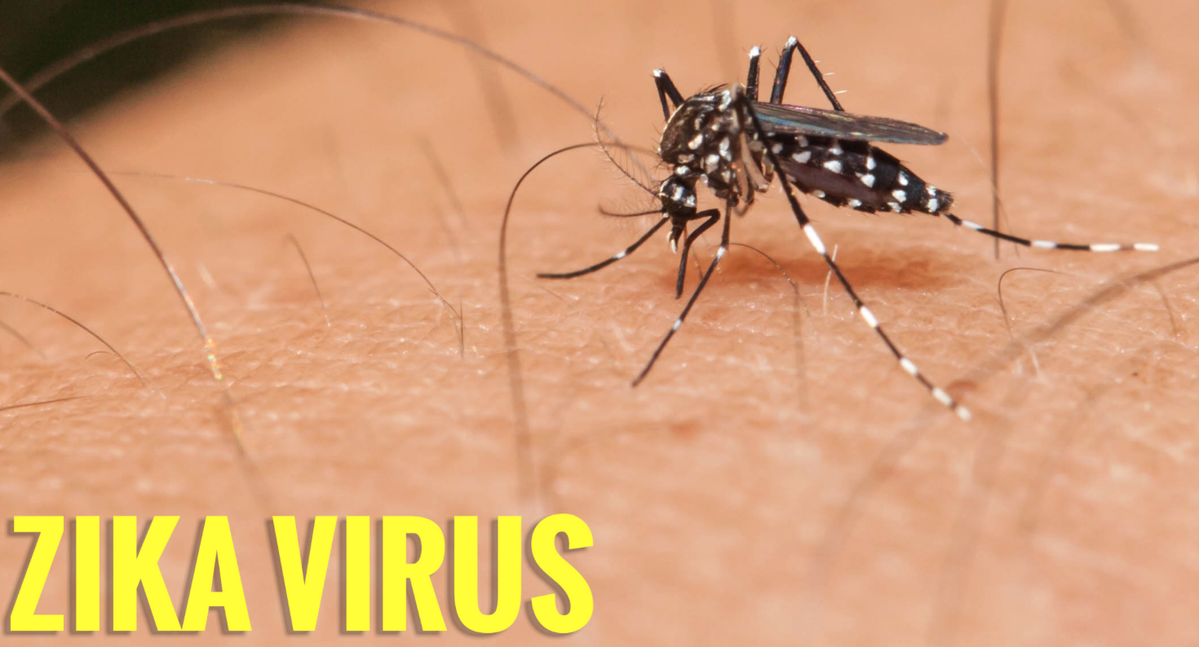
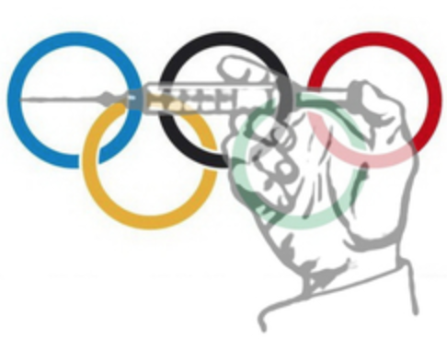
What we’ll Cover:
Biological Interests Surrounding the Olympics
Zika Virus
The use of performance enhancing drugs in sport
TBC - either issues surrounding gender or the environmental impacts of the Olympic games

Slide 3
What is a Virus?
A virus is a small, infectious agent that can only replicate inside the living cells of other organisms.
It is made up of a core of genetic material, either DNA or RNA.
The virus is protected by a protein coat called a capsid.
Viruses can infect all types of organisms, including animals and plants as well as bacteria.

Slide 4
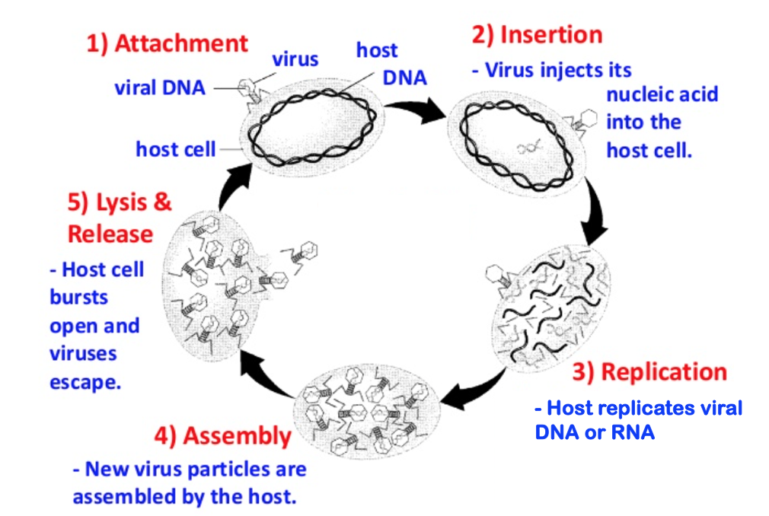
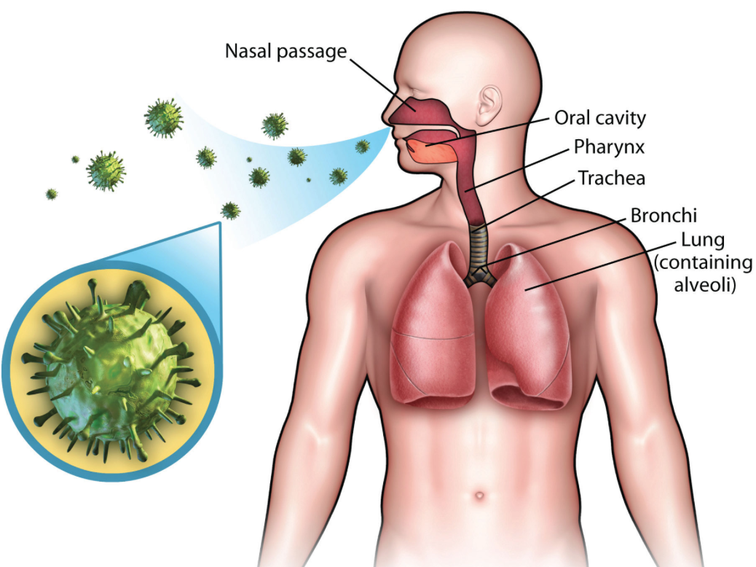
Life Cycle of a Basic Virus
First, the virus enters the body from the environment or another organism via the nose, mouth or breaks in the skin.

Slide 5
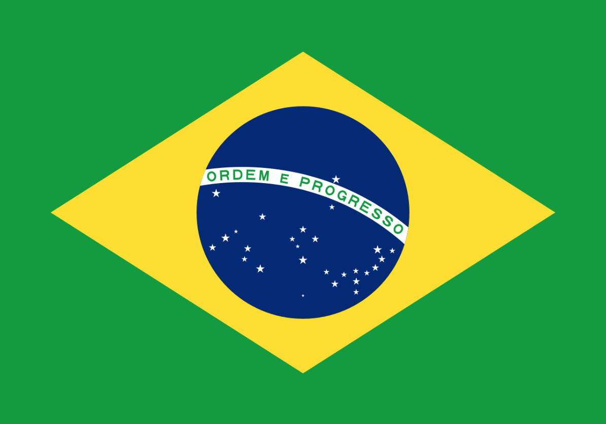
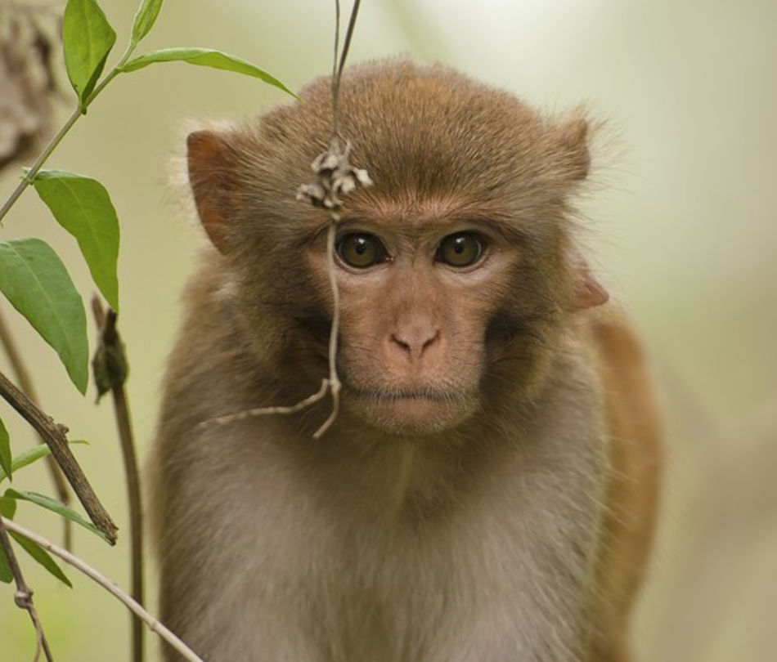
Zika Virus - The Facts
1. Caused by a virus transmitted by Aedes mosquitoes.
2. No specific treatment or vaccine currently available.
3. Originated in Africa but spread to the Americas, Asia and the Pacific.
4. First identified in Uganda in 1947 in rhesus monkeys.
5. Large outbreak (epidemic) recently in Brazil as it can spread rapidly in densely populated areas.

Slide 6
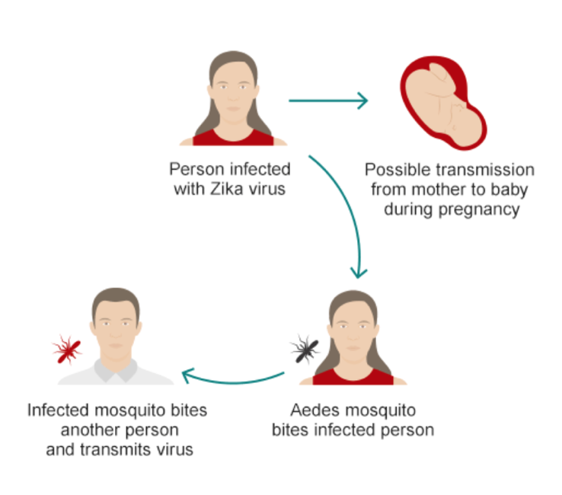
Zika Virus Transmission
It should also be noted that sexual transmission of the virus has been reported.
“Interim Guidelines for Prevention of Sexual Transmission of Zika Virus — United States, 2016” (CDC).
The most recent case occurred in February 2016, which involved a patient in Texas, who became infected via sexual contact after their partner returned from Venezuela.
Oster, A et al. (2016). Interim Guidelines for Prevention of Sexual Transmission of Zika Virus — United States, 2016.

Slide 7
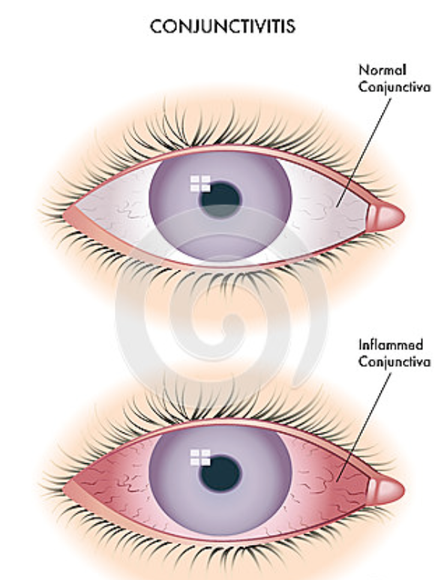
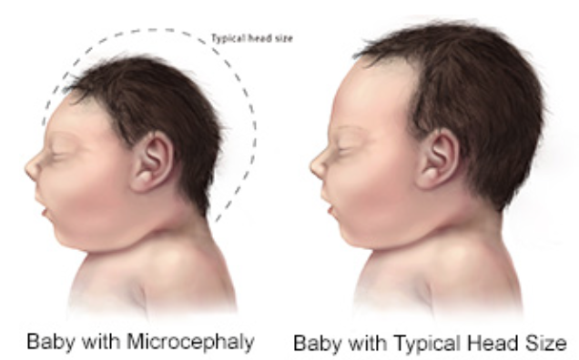
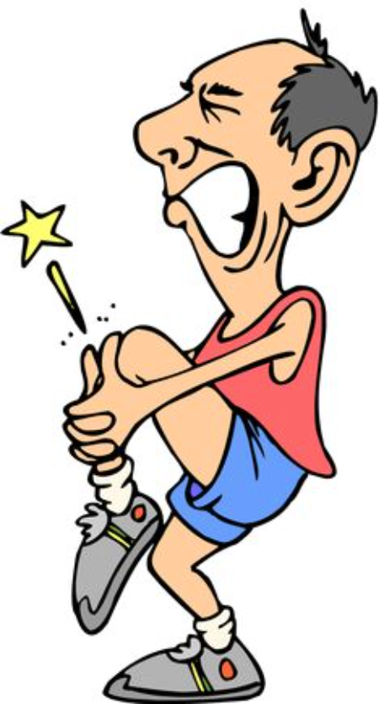
Effects of Zika
The illness is usually mild and symptoms last around a week.
Common symptoms include:
Fever
Rash
Joint pain
Conjunctivitis
The most dangerous effect of Zika occurs in pregnant women. Zika can result in birth defects, including microcephaly (abnormal smallness of the head).
Centers for Disease Control and Prevention. (2016). Symptoms, Diagnosis, & Treatment.
Centers for Disease Control and Prevention. (2016). For Pregnant Women.

Slide 8
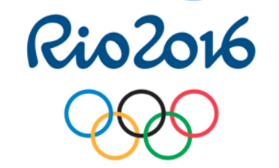
Concerns Over the Olympics
BBC Sport - Zika virus: Olympic venues to be inspected daily before and during Games (29/01/2016)
Forbes - Zika outbreak means it is now time to cancel the Rio Olympics (03/02/2016)
BBC News - Zika outbreak: Will Rio 2016 Olympics be affected? (05/02/2016)
Kenya’s Olympic Committee - Kenya could pull out of this summer's Rio Olympics if the Zika virus in Brazil reaches "epidemic levels" (09/02/2016)
But, the International Olympic Committee says:
“Olympics will be safe despite Zika outbreak”

Slide 9

Treatment Options
No vaccine or medications are currently available to treat Zika.
Rest and preventing dehydration are useful for reducing symptoms.
However, vaccines for Zika are in development.
Bharat Biotech has two vaccine candidates in development;
though they may take a number of years to reach the market.

Slide 10
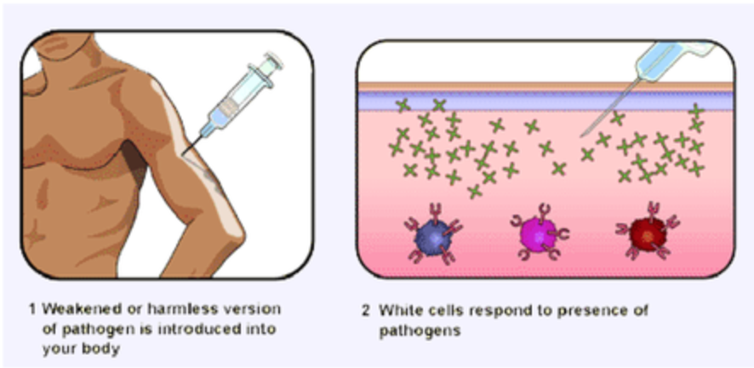
Vaccines
Work by creating a mild immune response to a particular disease in a patient.
This happens because a vaccine typically contains a weakened or harmless version of the pathogen.
Enough of this weakened pathogen is introduced to cause an immune response but not so much that the person becomes ill.
Therefore, the person develops white blood cells against the pathogen.
These cells remain in their body and fight off the pathogen if they become infected in the future.

Slide 11
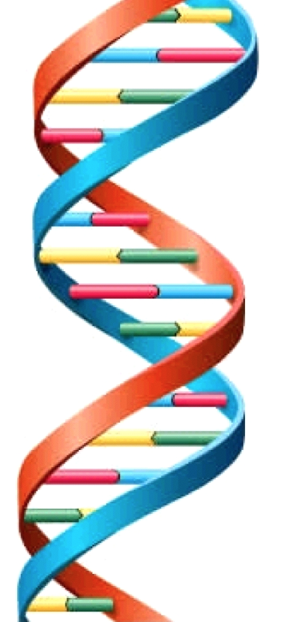
Zika Vaccine Development
Bharat Biotech has two vaccine candidates in development:
The first is based on using strands of DNA from the Zika virus.
This type of vaccine is easier to create.
However, they don’t always produce a strong enough immune response.
The second uses an inactivated version of the Zika virus.
This produces a more specific, stronger immune response.
However, it cannot be used in babies or those with already weakened immune systems, as they are unable to fight the pathogen.
Karnik, M (2016). An Indian biotech company has been developing Zika vaccines for over a year.

Slide 12
Herd Immunity
Some individuals cannot receive vaccinations and are left unprotected against diseases:
Newborn babies and elderly people
Those without a properly functioning immune system
Those with autoimmune diseases (e.g. HIV)
Those undergoing a medical treatment which affects their immune system
Herd immunity can protect these individuals.
It works on the principle that if you vaccinate enough of the population, the disease will not be able to spread easily and will therefore be contained.
E.g. if someone with measles is surrounded by people who are vaccinated against measles, it will not be able to spread.
NB. Herd immunity only works for diseases that are spread from person to person. It does not work for diseases like tetanus, which are caused by bacteria from the environment.
Vaccines.gov. (2015). Community Immunity ("Herd Immunity")

Slide 13
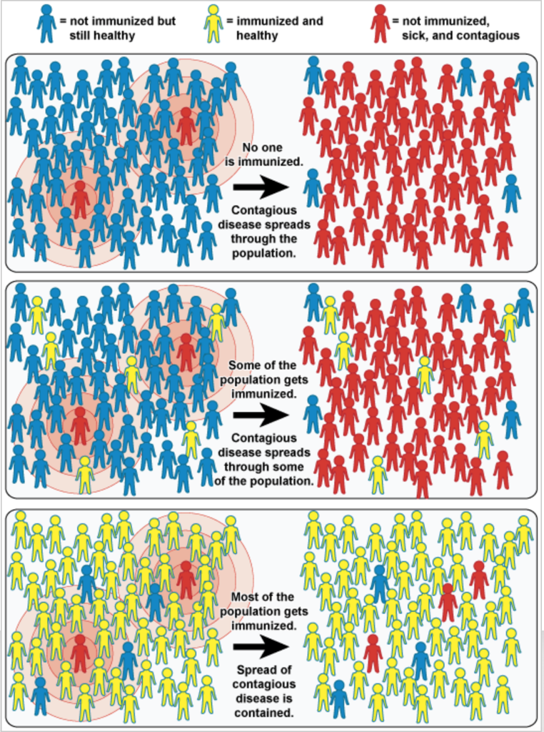
Herd Immunity
Few individuals vaccinated so a small number of unhealthy individuals can spread the disease to many others.
Before the vaccination has become widespread, the disease is still able to spread rapidly.
Most individuals are vaccinated and herd immunity is achieved.
Loving, S. (2015). Herd Immunity (Community Immunity)

Slide 14

Contagion Movie Clip
Notes:
Contagion 2011 Clip #StandFor #PhrasalVerb

Slide 15
Exercise
Get into four groups. Thinking about what we have covered today…
Two of the groups should write down the reasons why they think the 2016 Olympics should go ahead as planned.
The other two groups should write down the reasons why they think the 2016 Olympics should be cancelled.
In ten minutes we will discuss the reasons you have come up with and vote on what we would do!
Notes:
Why it should go ahead:
With the exception of pregnant women, Zika is a relatively mild disease.
Symptoms are mild and disease usually clears within about a week.
It is transmitted mainly via mosquito bite (sexual transmission has been reported) so measures can be taken to reduce chance of mosquito bites.
People know the risk, they can choose not to visit.
Economy boosted in Brazil
Encourages investment in transport and infrastructure in the country
Job creation
Tourist attraction now and in future (olympic village)
Seasonal weather changes – could be fewer mosquitoes in their winter which is when the olympics will be held.
Why it should be cancelled:
Zika has serious effects on babies and it is not fair to put athletes and spectators at that risk.
No treatment available against Zika which means the side effects
If the disease can be transmitted sexually then thousands of people will be at risk, regardless of whether or not they travel to Rio. The men and women who contract the disease in Rio will potentially infect partners in their home countries. This means the virus could spread internationally and become a global pandemic.
There are high costs associated with the Olympics and there is a possibility this investment may not be returned.
Infrastructure built specifically for Olympics may not be used after the games.
Aedes mosquito are daytime active and are highly prevalent in densely populated areas – this is a large risk for the daytime-running olympic games which bring in large crowds.

Slide 16
Homework
We will split you into three groups and assign you a disease to research. Please find at least two facts about your given disease.
Ebola
Malaria
HIV
E.g. What causes it? How is it transmitted? What are the outcomes of disease? Is it a virus? Are there available treatments or vaccines? Etc.
We will be covering these three diseases in our next lesson and will have a discussion about the facts you find.

Slide 17
References
Oster, A et al. (2016). Interim Guidelines for Prevention of Sexual Transmission of Zika Virus — United States, 2016. Morbidity and Mortality Weekly Report (MMWR). 65 (5), 1-2.
Centers for Disease Control and Prevention. (2016). Symptoms, Diagnosis, & Treatment. Available: http://www.cdc.gov/zika/symptoms/index.html. Last accessed 8th Feb 2016.
Centers for Disease Control and Prevention. (2016). For Pregnant Women. Available: http://www.cdc.gov/zika/pregnancy/index.html. Last accessed 8th Feb 2016.
Karnik, M. (2016). An Indian biotech company has been developing Zika vaccines for over a year. Available: http://qz.com/609291/this-indian-biotech-firm-is-the-worlds-first-to-ready-a-zika-vaccine-for-testing/. Last accessed 7th Feb 2016.
Vaccines.gov. (2015). Community Immunity ("Herd Immunity"). Available: http://www.vaccines.gov/basics/protection/. Last accessed 7th Feb 2016.
Loving, S. (2015). Herd Immunity (Community Immunity). Available: http://www.ovg.ox.ac.uk/herd-immunity. Last accessed 7th Feb 2016.

