Slide 1

Pathogens and the Olympics

Slide 2
A virus is a small infectious agent replicating inside the living cells of the host organism
Life cycle: Attachment > Insertion > Replication > Assembly > Lysis and Release
Zika virus is causing a huge concern for the 2016 Rio Olympics
Mild disease but can cause microcephaly of babies in pregnant women
Transmitted by daytime active Aedes mosquito in densely populated areas.
No vaccine for Zika virus. A vaccine works by creating a mild immune response to a weakened or harmless pathogen.
If enough of a population are vaccinated, herd immunity occurs as the disease cannot be transmitted between people.

Slide 3
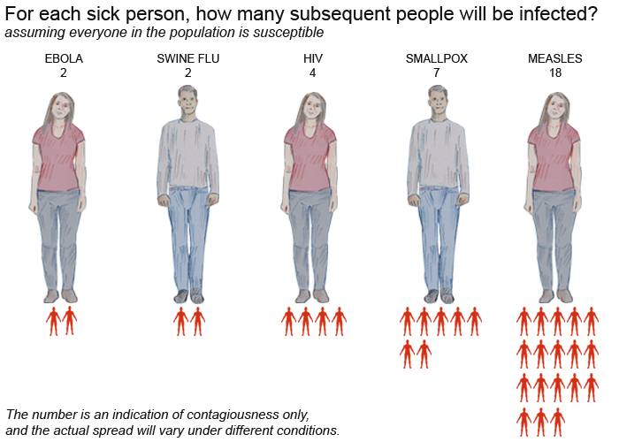

Slide 4
Pathogenesis
Disease causing pathogen?
Transmission Method?
Prevalence?
Vaccine or available treatment?
Symptoms?

Slide 5
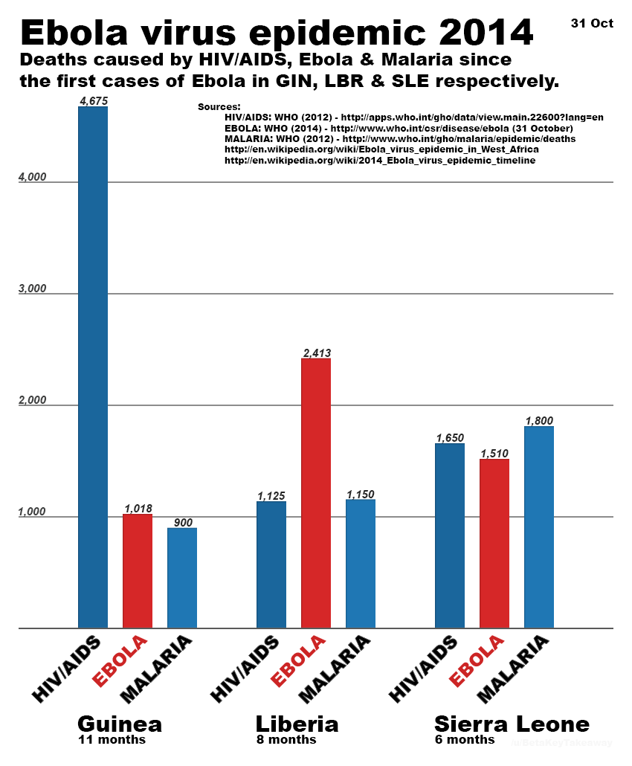
Name 3 major diseases of Africa?

Slide 6
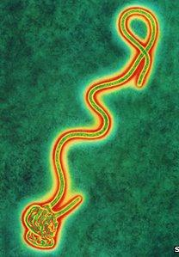
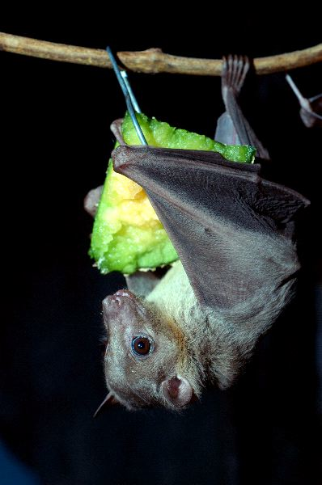
Ebola
Ebola is an RNA virus with a zoonotic origin.
First cases emerged in 1976 in Africa, near Ebola river.
Five species of ebolavirus: Zaire, Sudan, Bundibugyo, Tai Forest and Reston.
Close relative of the Marburg virus, found in fruit bats.
Initial symptoms: Fever, sore throat, and weakness.
Later: Diarrhoea, vomiting, dysentery and haematemesis. It can then cause acute haemorrhaging, sudden organ failures and death
Virus spreads through close contact with bodily fluids of infected people e.g. blood, sweat, urine, semen, saliva, faeces.
Notes:
Being an RNA virus, this allows it to adapt to changing environments more quickly than a DNA virus can. This is because RNA is easier to alter more quickly. This is vital for a virus with zoonotic origin because it must move between species and therefore adapt rapidly in order to survive.
Zaire is the most dangerous. Reston has never caused disease in humans.
Rossettus Aegypticus – fruit bat. Ebolavirus has not yet been isolated in bats – cannot say for sure that ebolavirus comes from bats. But a risk factor is the consumption of bushmeat which does include bats so it could be the case.
Haematemesis = bloody diarrhoea and vomit.
Ebolavirus spreads more effectively in social animals exhibiting care behaviour as they often engage in close contact with ill relatives.
Even after death the body is still highly infectious - this is highly problematic in cultures where they have intimate funeral ceremonies.

Slide 7
Characteristics of the Ebolavirus
Entry and Adherence – Ebolaviruses enter the body through exposed wounds, mucosal routes or ingestion. Poor hygiene dramatically increases risk of infection.
Invasion – Ebolaviruses enter white blood cells and hijack their replication machinery.
Establishment of Infection - These infected white blood cells produce chemicals that promote inflammation which then attracts other types of white blood cells to the area.
Dissemination – Spread by all body fluids and tissues from infected people.

Slide 8
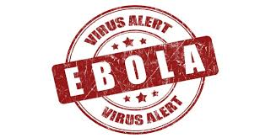
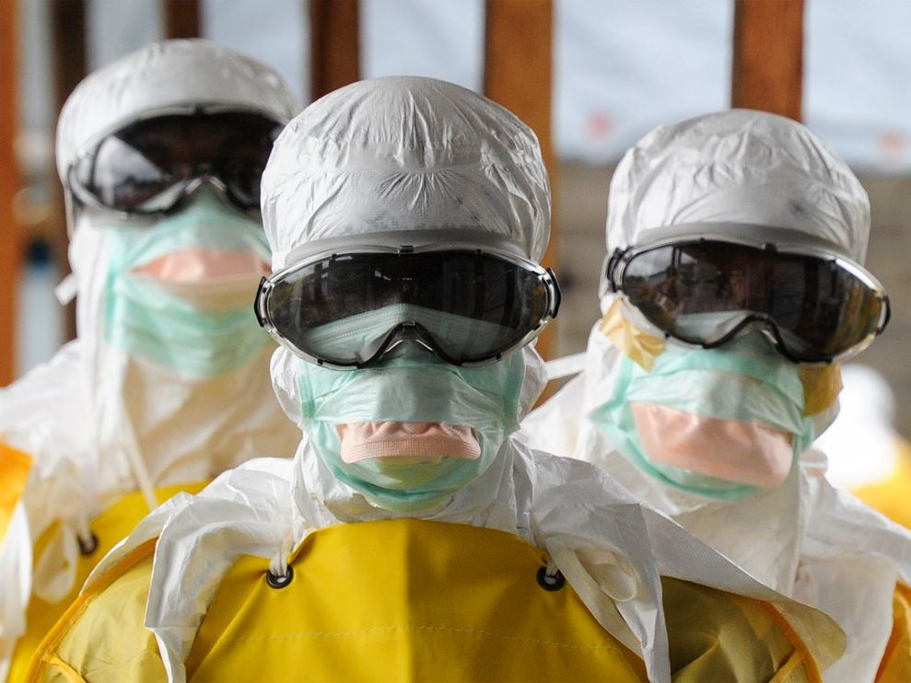

Treatment and Prevention Methods
INFORMATION
INVESTIGATION
INTERVENTION
ISOLATION
4 Key factors in controlling the spread of Ebola:
Inform the locals about ebola and ppe
Investigate community deaths, intervene and isolate.
Operate behind cordon sanitiere. Low and High risk areas.
No FDA-approved vaccine or medicine (e.g., antiviral drug) is available for Ebola.
Two of the most promising are Ebola treatments are brincidofovir and favipiravir but effectiveness is unknown.
Notes:
Doctors without borders

Slide 9
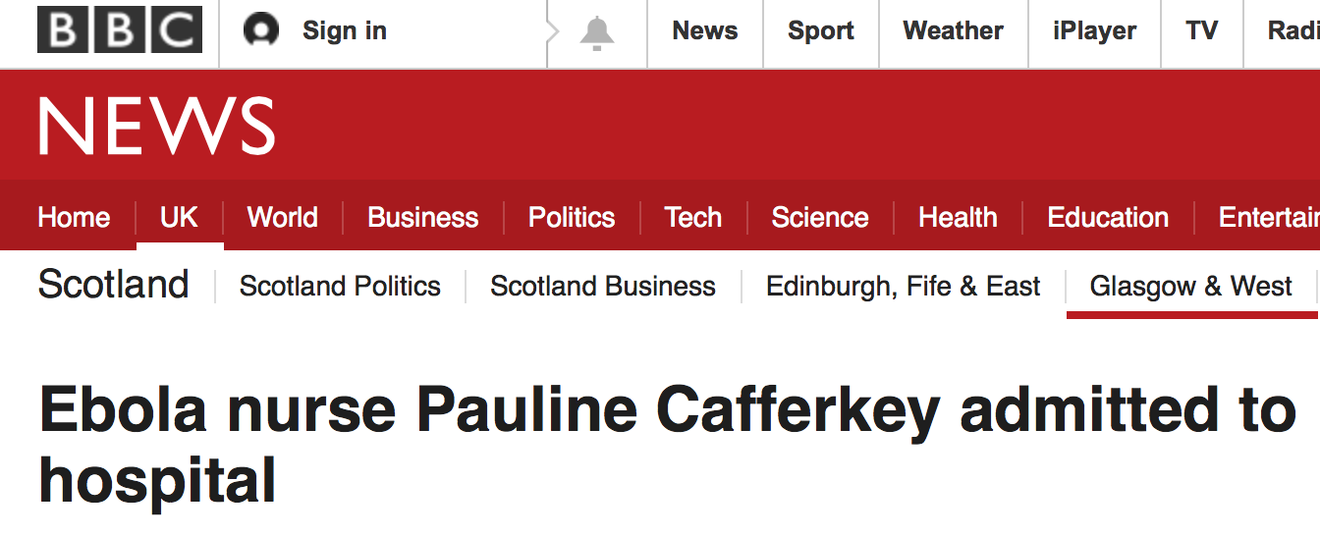
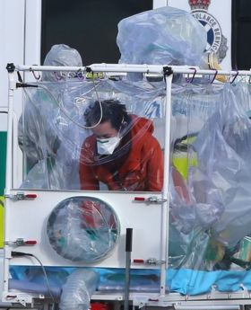
30 December 2014 - Ebola nurse Pauline Cafferkey transferred to London unit
31 December 2014 - Experimental drug for Ebola patient Pauline Cafferkey
4 January 2015 - UK Ebola nurse Pauline Cafferkey 'in critical condition’
24 January 2015 - Ebola nurse: Pauline Cafferkey 'happy to be alive’
10 October 2015 - Ebola nurse Pauline Cafferkey remains 'serious’
14 October, 2015 - Ebola nurse Pauline Cafferkey now 'critically ill’
21 October 2015 - Ebola caused meningitis in nurse Pauline Cafferkey
12 November 2015 - Ebola nurse Pauline Cafferkey 'has made full recovery'
23 February 2016 - Ebola nurse Pauline Cafferkey flown to London hospital

Slide 10
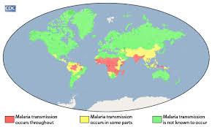
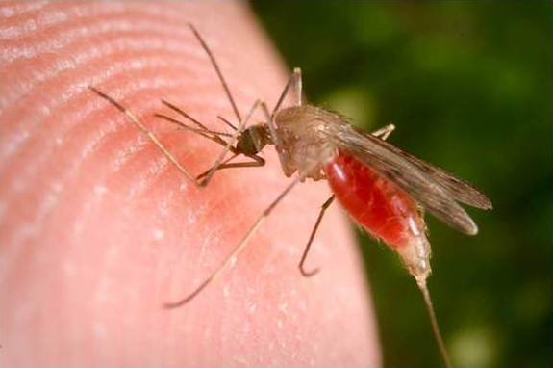
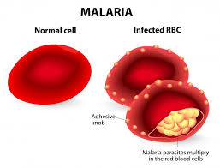
Malaria
In 2015, there were 214 million cases of malaria worldwide. This resulted in an estimated 438,000 deaths (90% in Africa).
It is caused by the Protist Plasmodium of which there are 5 species infecting humans: falciparum, vivax, malariae, knowlesi and ovale.
It is transmitted via contact with a female Anopheles mosquito which are nighttime active.
Symptoms include: fever, chills, sweating, nausea and vomiting, headaches and fatigue. Severe disease results in cerebral malaria and cardiovascular collapse.
The life cycle of the parasite involves 3 stages; the exo-erythrocytic cycle, the erythrocytic cycle and the sporogonic cycle.
Notes:
Fever in the form of paroxysms: paroxysms are periods of intense fever followed by periods of recovery. The fever occurs in line with the cyclic release of immature malaria into the blood stream. This usually happens once every 24-72hrs. In between fever the temperature is normal and patient generally feels well.

Slide 11
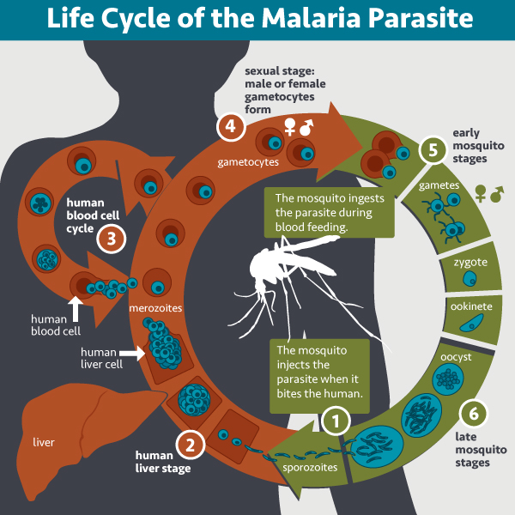
Notes:
During a blood meal, injects sporozoites into the human host in her saliva.
Sporozoites migrate to liver and infect liver cells. They replicate in liver and then burst out as schizonts.
Schizonts enter the erythrocytic cycle and infect the blood.
In the blood cells they mature into trophozoites, again replicate into schizonts and then rupture again.
Every infected RBC ruptures at the same time which leads to the massive spike in fever we mentioned earlier.
Sexual stage of the parasite results in the production of male and female gametes. These gametes are ingested by a new mosquito during a blood meal.
Male gamete enters the female gamete and the gametocyte develops into an ookinete, then an oocyst.
Oocysts grow, rupture, and release sporozoites, which make their way to the mosquito's salivary glands.
These are then injected into new human host during the mosquito’s next blood meal.

Slide 12
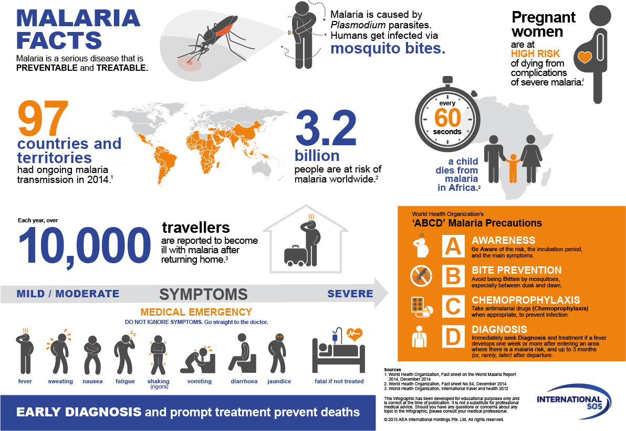

Slide 13
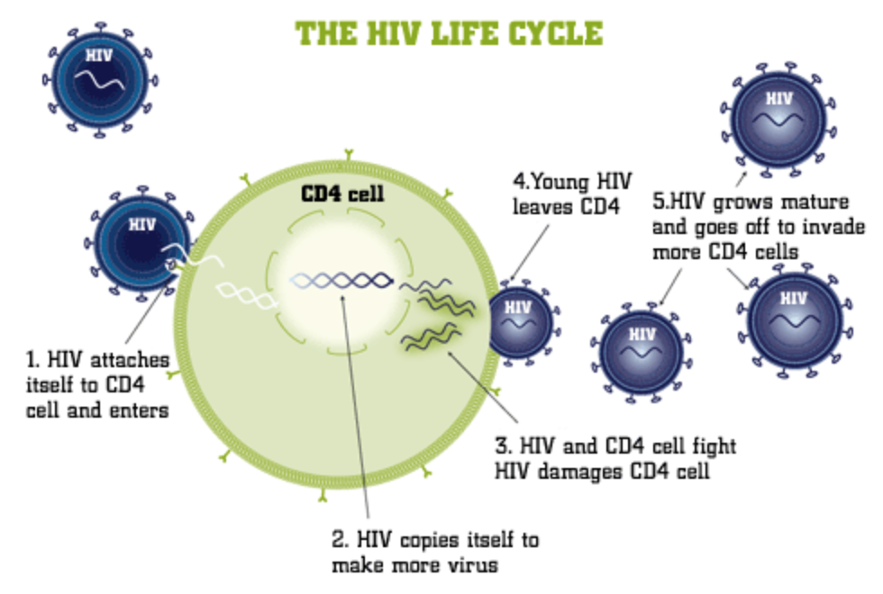
Human Immunodeficiency Virus (HIV)
A retrovirus that is spread through bodily fluids.
It attacks the immune system, specifically your CD4 T cells.
Under normal conditions, these CD4 T cells help the immune system to fight infections.
Over time, if left untreated HIV can destroy so many CD4 cells that the body can’t fight off infections and disease.
When this happens, HIV infection leads to AIDS.
CDC (2015)
Notes:
AIDS = acquired immunodeficiency virus.

Slide 14
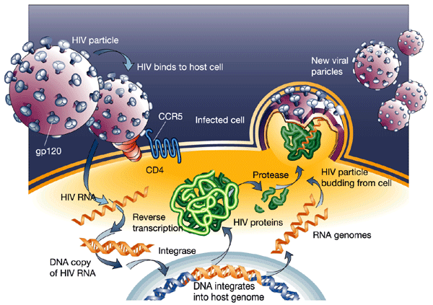
Progression of HIV Disease
HIV-1 is the most common form of the disease. It crossed over from the great apes on more than one occasion.
The virus contains two identical RNA strands and various outer membrane proteins that improve its ability to infect.
Once infected, you are infected for life – there is no cure and it cannot be cleared by our immune system.
Vaccine development is very difficult.
Notes:
There is HIV-1 and HIV-2. HIV-2 is closely related to simian immunodeficiency virus which is transferred from monkeys.
Vaccine development hard because:
There are no animal models
The virus proteins can vary massively so we can’t make a “one vaccine fits all”
As it is not cleared by the immune system, we have no natural examples of how to defeat it
HIV attacks the CD4 cells of our immune system which leaves us vulnerable.

Slide 15
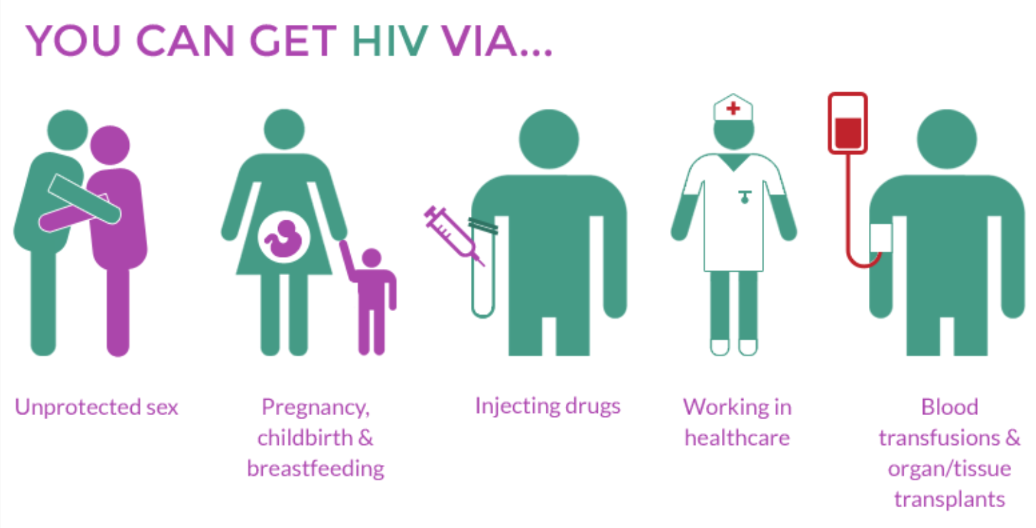
HIV Transmission

Slide 16
Transmission Match Game
Get into groups of 5
In each pack you have a list of diseases, pathogen types, and transmission methods
Match them up
The first team to finish correctly gets a prize

Slide 17

Summary
Pathogenesis refers to the development of a disease; from the initial infection to its final stages.
A pathogen can have more than one transmission method and there are a number of different methods.
Ebola, HIV and Malaria are all highly prevalent diseases in many African countries.
Ebola is spread through contact with bodily fluids of infected individuals.
Malaria is carried by a mosquito vector and spread via bites.
HIV can be transmitted in a number of ways, though the most common is sexually.

Slide 18
Transmission Game Answers
Virus | HIV | Sexual Transmission
Virus | Influenza | Airborne Transmission
Virus | Zika | Mosquito Vector
Virus | Ebola | Contaminated Bodily Fluids
Virus | HPV (Verruca/Warts) | Surace Contact (Fomites)
Virus | Glandular Fever | Saliva
Bacteria | Salmonella | Oral/Faecal Route
Bacteria | Cholera | Oral/Faecal Route
Bacteria | Bubonic Plague | Flea and Rat Vector
Bacteria | Lyme Disease | Tic Vector
Bacteria | Chlamydia | Sexual Transmission
Fungal | Athletes Foot | Surface Contact (Fomites)
Protist | Malaria | Mosquito Vector

Slide 19
References
Centers for Disease Control and Prevention. (2015). About HIV/AIDS. Available: http://www.cdc.gov/hiv/basics/whatishiv.html. Last accessed 20th Feb 2016.
Medecins Sans Frontiere. (2016). Ebola Emergency. Available: http://www.msf.org.uk/ebola. Last accessed 20 Feb 2016.
World Health Organisation. (2016). Malaria. Available: http://www.who.int/entity/malaria/en/. Last accessed 21 Feb 2016.

