Slide 1

Performance Enhancing Drugs

Slide 2
In today’s session…
Performance enhancing drugs (20 minutes)
Ethical matrix (10 minutes)
Debate (30 minutes)
Summary (5 minutes)
Feedback (5 minutes)
Next week… (5 minutes)

Slide 3
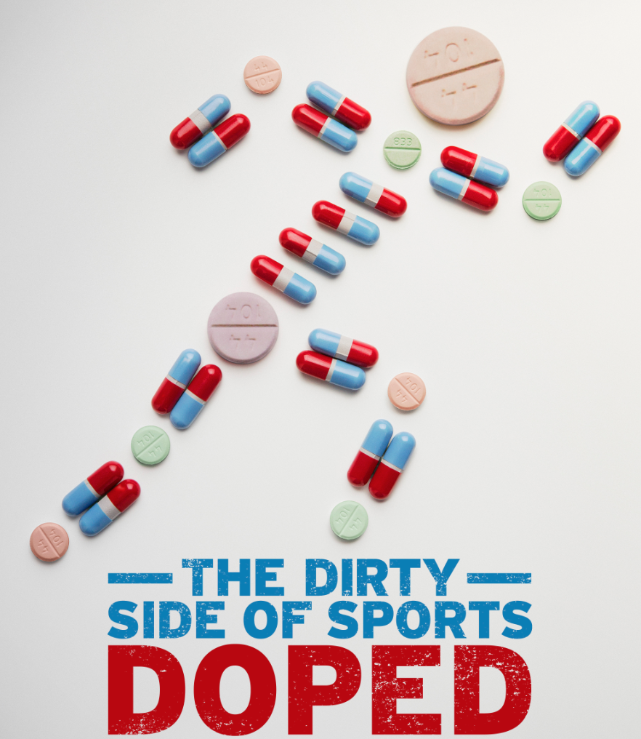

Slide 4
Definition of Performance Enhancement
“The use of any support or practice that improves athletic performance or physical work capacity. It can be achieved through physical, pharmacological, psychological, nutritional or mechanical means” (Katch et al 2007).

Slide 5
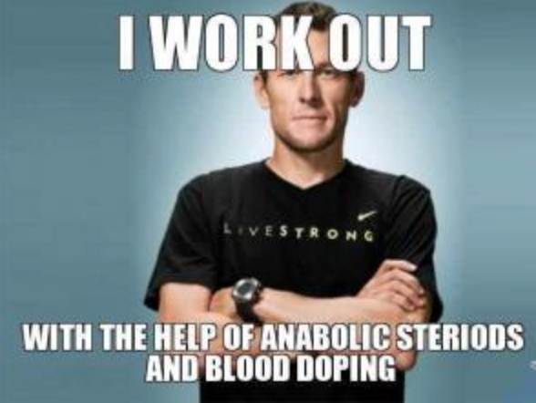
Can anyone name one high profile doper?

Slide 6

Prohibited Substances…
The World Anti-Doping Agency (WADA) publishes a list of prohibited substances and methods known as the WADA code:
Androgenic Anabolic Steroids
Human Growth Hormone (HGH)
Blood Doping
Erythropoietin (EPO)
Stimulants
Diuretics
https://wada-main-prod.s3.amazonaws.com/resources/files/wada-2016-prohibited-list-en.pdf

Slide 7
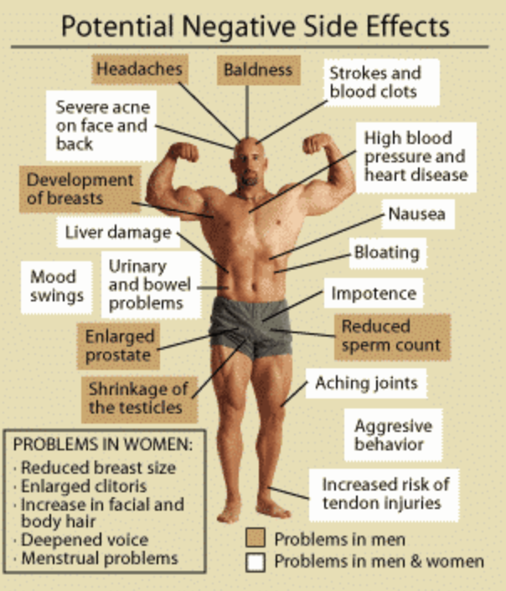
Androgenic Anabolic Steroids
Around 60,000 people are thought to take them.
They mimic the effects of the male hormone testosterone and are designed to:
Increase muscle mass
Help sports players train harder and for longer
Reduce recovery time

Slide 8





Human Growth Hormone (HGH)
HGH is produced normally by the pituitary gland and stimulates growth in children and adolescents.
But, synthetic HGH is also available and some sportspeople abuse it.
Speeds muscle development, reduces body fat and strengthens muscles.
Side Effects:
Diabetes
Muscle/joint pain
Hypertension
Cardiovascular disease
Decreased life expectancy

Slide 9

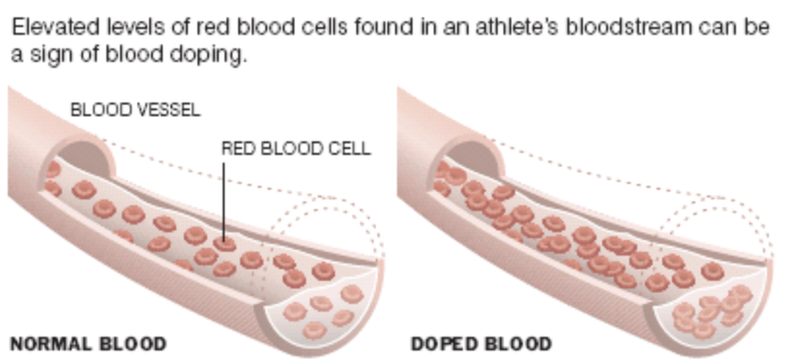
Erythropoietin (EPO)
A protein hormone produced naturally by the kidney which stimulates the production of red blood cells (RBCs).
It can also be manufactured and injected into the body.
Increasing RBCs can dramatically improve an athlete’s aerobic capacity and delay fatigue. It also improves metabolism and muscle recovery.
Side effects:
Quick increases in blood pressure
Convulsions
Influenza-like symptoms
Increased cancer risk
Liver damage
Increased viscosity of blood

Slide 10
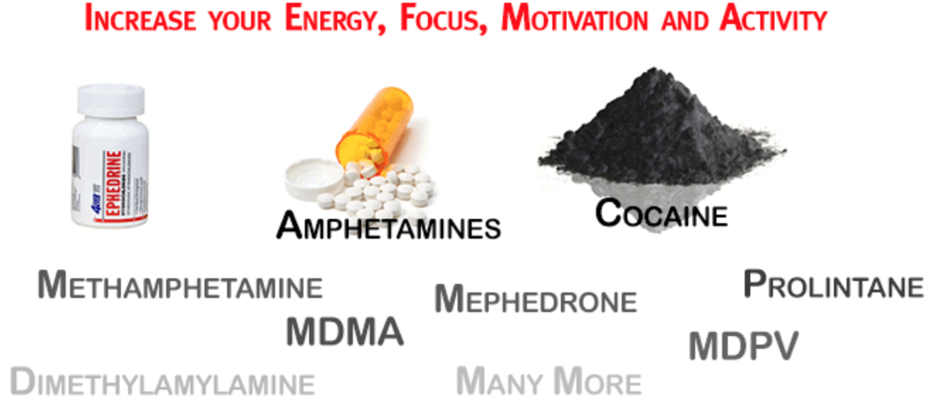
Stimulants
Substances that elevate the level of physiological or nervous action in the body.
Athletes use various stimulants to increase alertness and boost general performance.
Examples: adrenaline, amphetamines and cocaine.
Side effects:
Anxiety
Headaches
Hypertension
Nerve Damage
Physical collapsing
Irregular heartbeat
Increased blood pressure
Notes:
Nicotine and caffeine are two legal stimulants (legal in terms of olympics).

Slide 11
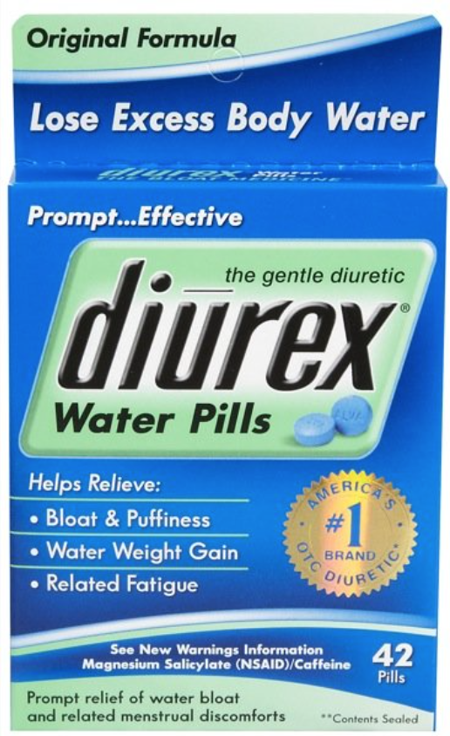
Diuretics
Pills that help to rid the body of sodium, taking water with it when it is excreted in the urine.
It can result in rapid weight loss as your water stores are depleted.
Most commonly used by sportspeople needing to reach a certain weight class e.g. jockeys and boxers.
Side Effects:
Headaches
Muscle cramps
Dizziness
High blood sugar levels
Abnormal heart rhythm
Fatigue

Slide 12
Ethical Matrix
 | Wellbeing (safety, welfare and health) | Autonomy (freedom and choice) | Justice (fairness)
Athletes | Harmful side effects and repercussions | Freedom to choose whether or not to use PEDs | PEDs used as a way to level out genetic differences between athletes
Other competitors | Psychological damage – feeling inferior. Health maintained by not taking PEDs | Right to choose not to take them which should not be undermined by others | The right to compete on a level playing field
Olympic Committee | Looking out for welfare of all athletes | Right to test athletes despite it sometimes being invasive | Eliminate cheating from the World’s largest sports event
Spectators | Bad role models for children who aspire to their idols | Right to know about the athletes’ drug use | Paying to see true competition or best possible competition

Slide 13

Debate and Discussion
Should the use of performance enhancing drugs be legalised in the Olympics?
FOR
Assign yourselves the following roles:
1 athlete on PEDs
1 head coach
1 spectator
1 Olympic committee member
You are all debating for the legalisation of PEDs in professional sport.
AGAINST
Assign yourselves the following roles:
1 athlete not on PEDs
1 head coach
1 spectator
1 Olympic committee member
You are all debating against the legalisation of PEDs in professional sport.
Both groups have 5 minutes to plan your arguments and your reasons behind them. Then we will have the debate and open the floor to questions.
Notes:
In the first 5 mins we get the audience to think of questions.

Slide 14
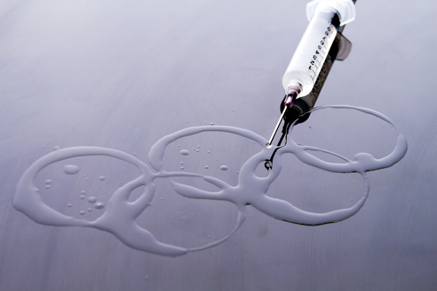

Summary
One major challenge concerning the Olympic Games is preventing the use of PEDs.
PEDs are becoming harder to detect – Lance Armstrong continued for several years before being found out.
There are a wide variety of prohibited substances, the most common of which we have covered in this lesson.
Though they can improve sporting performance, many of these drugs go hand in hand with severe side effects e.g. cardiac problems, infertility and cancer risk.
WADA continues to fight against the use of PEDs in sport – their motto ‘play true’ reflects this.
Notes:
Email abby for debate ideas and pre reading

Slide 15
References
World Anti-Doping Agency. (2016). Prohibited List. Available: https://wada-main-prod.s3.amazonaws.com/resources/files/wada-2016-prohibited-list-en.pdf. Last accessed 28th Feb 2016.
Fong, J. Drugs in Sport. Available: https://www.tes.com/lessons/Q-R1f__LbjD2wA/drugs-in-sport. Last accessed 28th Feb 2016.
Ratini, M. (2014). Human Growth Hormone (HGH). Available: http://www.webmd.com/fitness-exercise/human-growth-hormone-hgh. Last accessed 28th Feb 2016.
Stimulants - World of Sports Science 2013. Stimulants - World of Sports Science. Available at: http://www.faqs.org/sports-science/Sp-Tw/Stimulants.html. Last accessed 28th Feb 2016.

