Slide 1
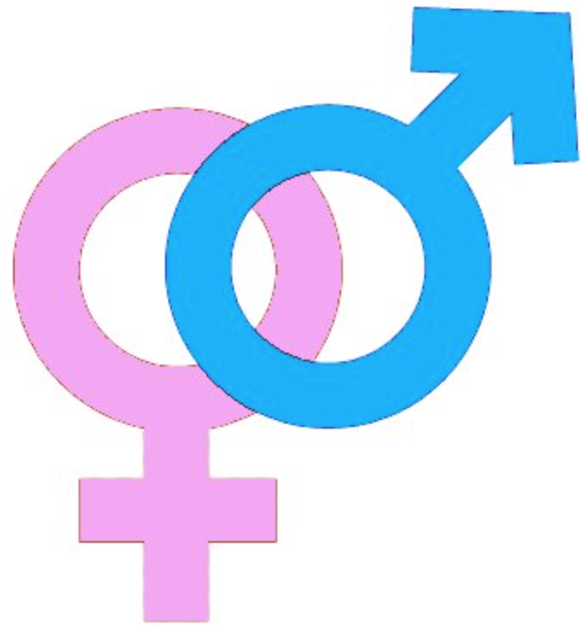
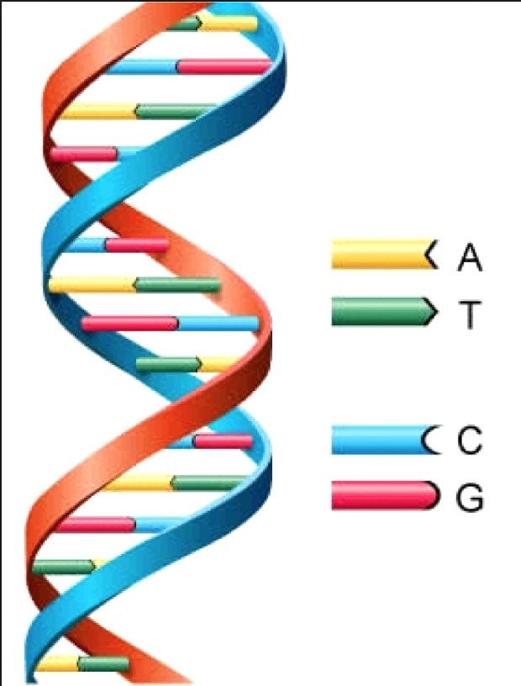
DNA, Gender and Hormones

Slide 2
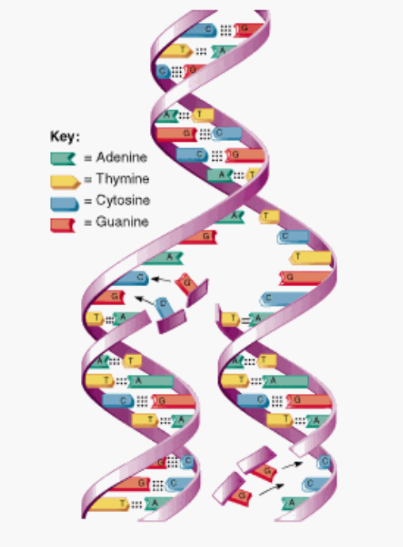
Deoxyribonucleic Acid (DNA)
The DNA double helix structure was discovered in 1953 by James Watson and Francis Crick.
The DNA strands are made up of four nucleotides:
Adenine (A)
Thymine (T)
Guanine (G)
Cytosine (C)
Specific base pairing means A will only bind T in the opposing DNA strand and C will only bind G.
Notes:
RNA is also assembled as a chain of nucleotides but unlike DNA, it is single-stranded, not double-stranded.
In DNA, adenine will bind the complementary base, thymine. However, in RNA, adenine binds uracil instead – this is the unmethylated form of thymine.
Many viruses encode their genetic information using an RNA genome, though some do use DNA.

Slide 3
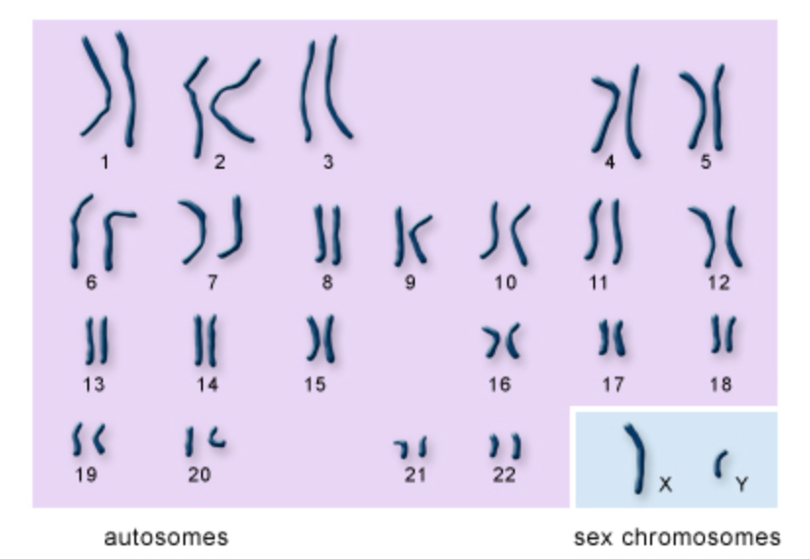
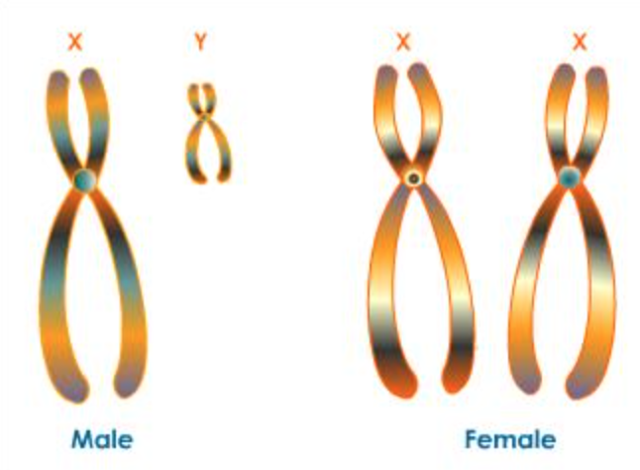
The DNA codes for genes which code for the proteins we make.
DNA molecules are packed into compact structures called chromosomes.
Humans have 23 pairs of chromosomes – 22 of these pairs are called autosomes.
Does anyone know what the last set of chromosomes is?

Slide 4
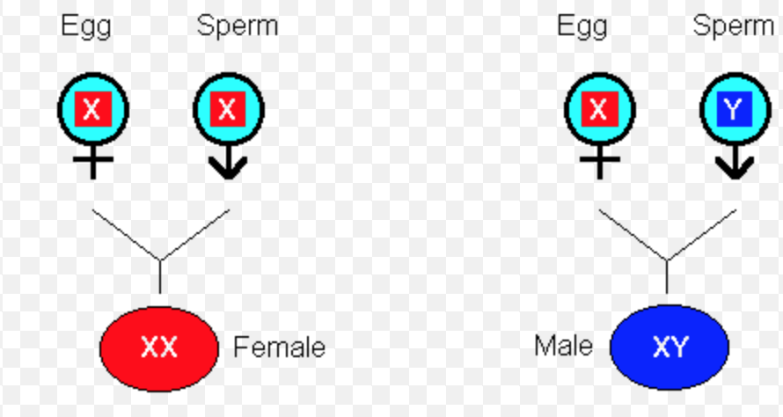
Gender
Our gender is determined by the sex chromosomes we receive from our parents:
If both the egg and the sperm carry an X chromosome, the child will be female.
However, if the sperm carries a Y chromosome, the child will be male.

Slide 5
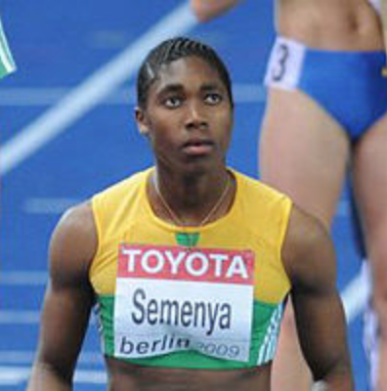
Gender Verification
Verifying the eligibility of an athlete to compete in a sporting event that is limited to a single sex.
It has arisen in the Olympics due to allegations of male athletes attempting to compete as women.
However, gender verification is not as simple as checking for XX vs XY.
South African athlete Caster Semenya was cleared to continue competing as a woman after gender testing by the IAAF.

Slide 6
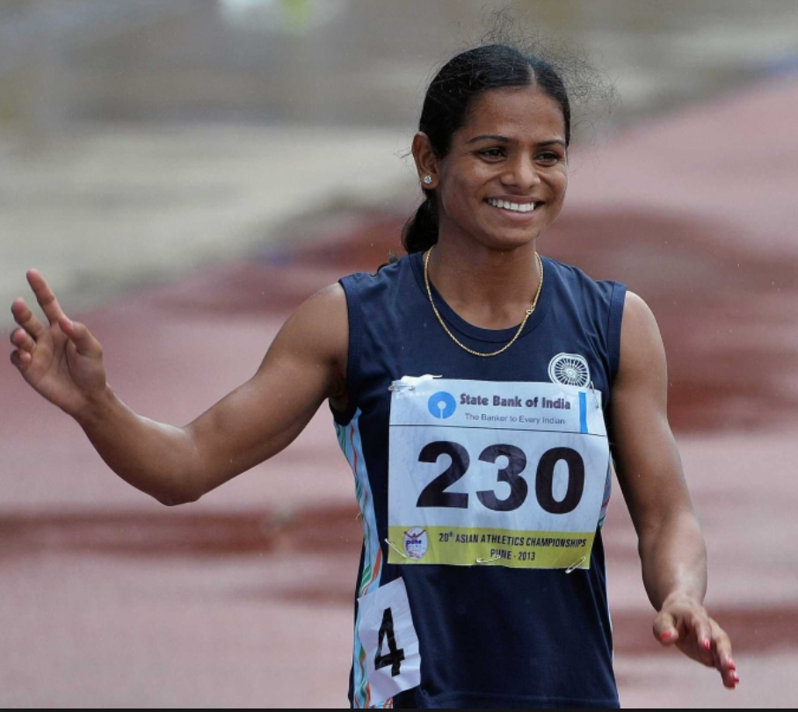
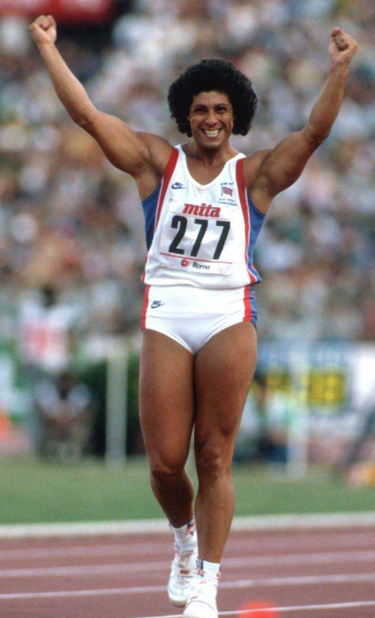
The X and Y chromosomes switch on different hormones.
However, this doesn’t always occur properly:
Someone with two X chromosomes could develop hormonally as a male and vice versa.
The IOC also released regulations on female hyperandrogenism.
This is a condition characterised by excess levels of androgenic hormones e.g. testosterone.
Dutee Chand, a sprinter from India was banned in 2014 due to hyperandrogenism but has since been reinstated.
Fatima Whitbread, a British former Javelin thrower was regularly accused of not being female. However, no tests ever proved otherwise!

Slide 7
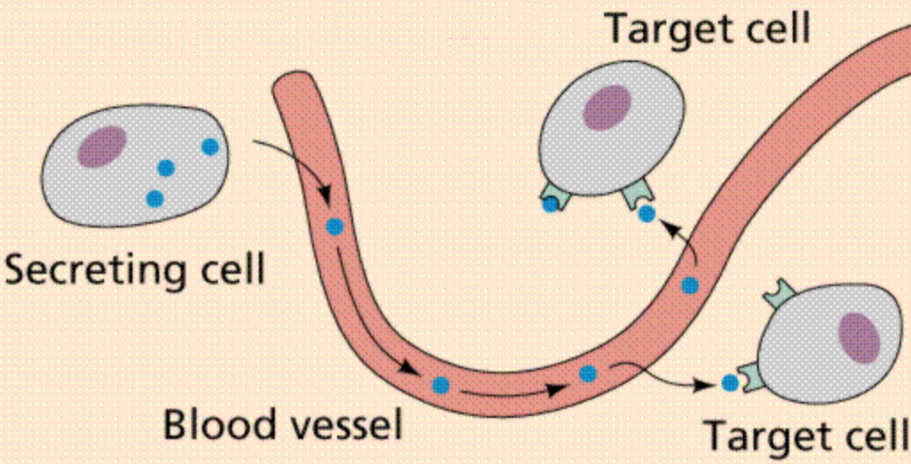
Hormones
Chemical messengers secreted directly into the blood, which carries them to specific organs and tissues to exert their functions.
When a hormone binds its specific receptor, this triggers a signalling pathway.
The response varies depending on the hormone - it can be fast or slow.
E.g. Adrenaline is associated with the “fight or flight” response. It is released in response to danger, giving the person more energy.

Slide 8
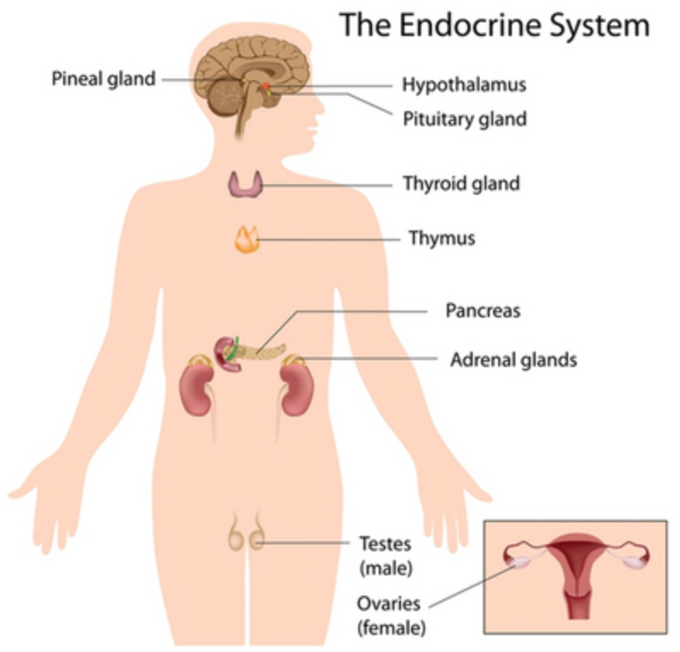
Signalling involves the following steps:
Biosynthesis of the hormone in a particular tissue e.g. insulin is made in the pancreas.
Storage and secretion of the hormone - after eating, cells of the pancreas are signalled to release insulin.
Transport of hormone to target cells – insulin is released into the bloodstream.
Recognition of hormone by receptor – insulin binds cell-surface receptors.
Relay and amplification of hormone signal – insulin helps store excess sugar.
Breakdown of the hormone.

Slide 9
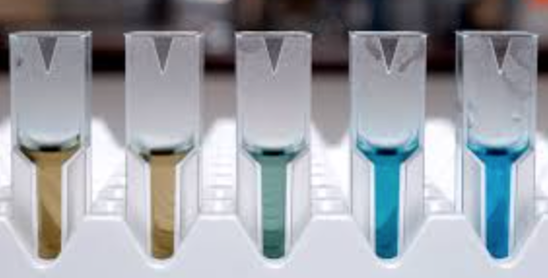
Hormones and Olympics
As we already know, many of the substances banned by the IOC have an effect on the athletes’ hormone levels:
The experiment you carried out last week involved investigating whether different athletes had been doping using EPO by measuring the level in their “urine” samples.
Can anyone guess which sample is which in the picture?

Slide 10
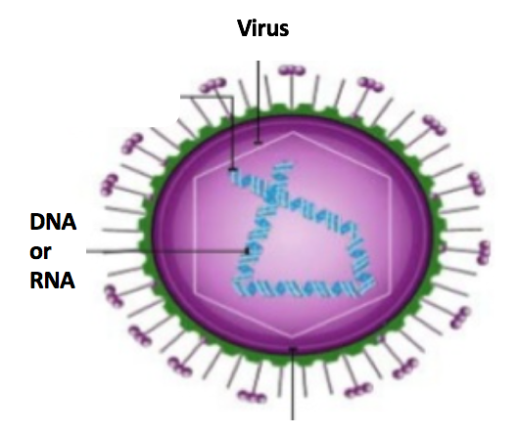
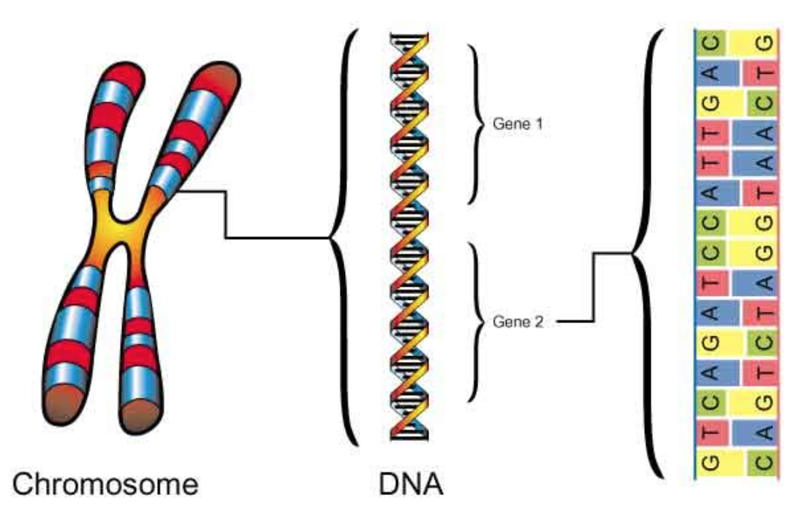
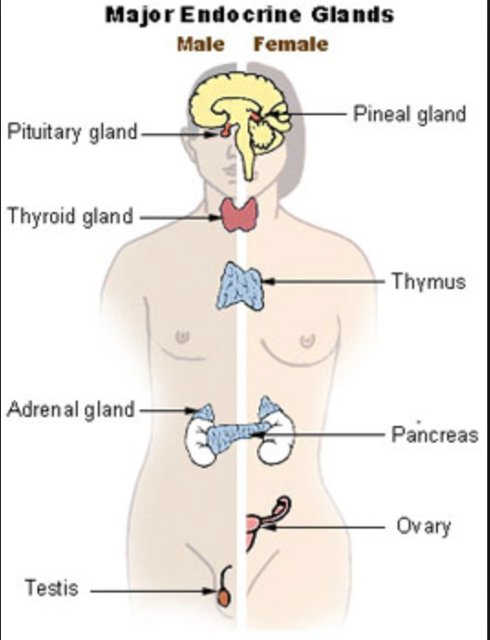
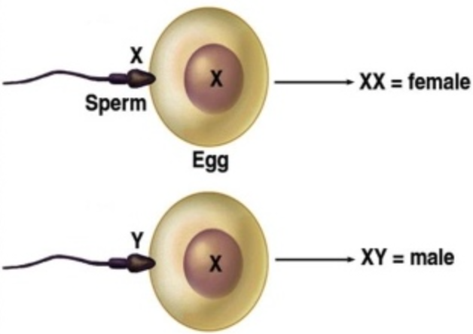
Summary
DNA carries the genetic information in all cellular forms of life, and some viruses.
Humans have 22 pairs of autosomes and 1 pair of sex chromosomes, made up of DNA.
Males have an X and a Y chromosome (X_{Y}). Females have two X chromosomes (XX).
Issues over gender verification have arisen in the Olympics and some athletes have been banned on the grounds of hyperandrogenism.
The endocrine system is responsible for producing the hormones we need.

