Slide 1
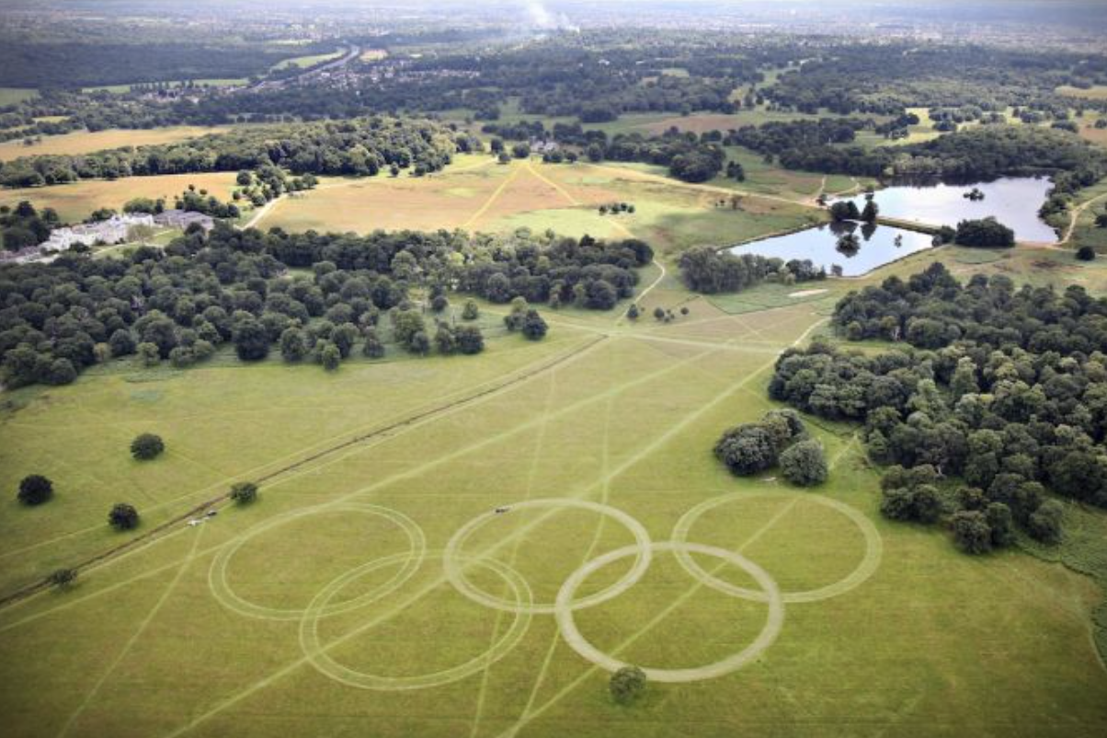
The Olympics and the Environment

Slide 2

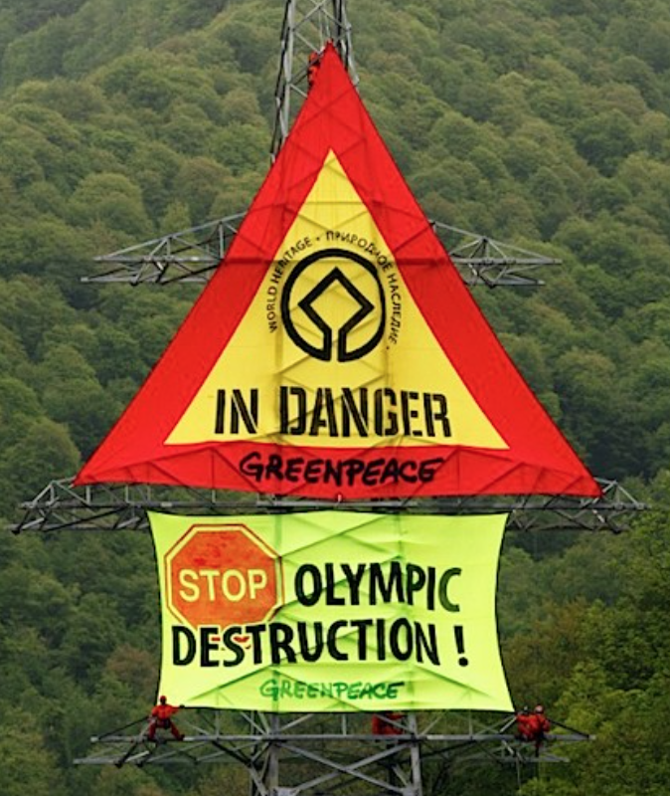
History
When the games began, concerns over the environment were limited.
Probably because the games were smaller and unlikely to have large impacts.
But, since the first “big” games, hosted by Berlin in 1936, the Olympics has become a spectacle, requiring major infrastructure.
Up until the 1990s, new building works for the games were undertaken with little regard for the environment.

Slide 3
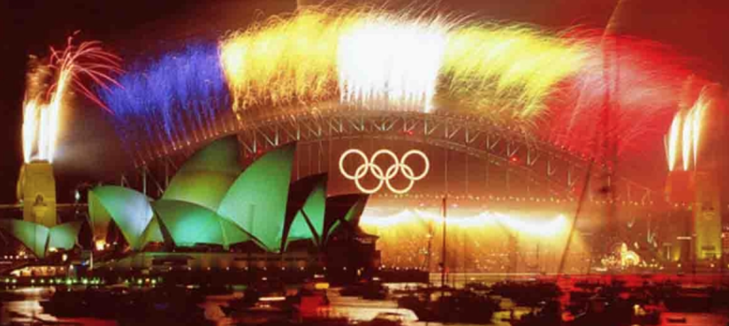
Regulations…
In 1996, the Olympic charter was amended to address the issue of sustainable development.
Cities have since had to address issues of sustainability in their bid documents.
E.g. The main site of the Sydney Games of 2000 was built on Homebush Bay, an inner city contaminated site.
This was part of city-wide remediation and greening projects

Slide 4
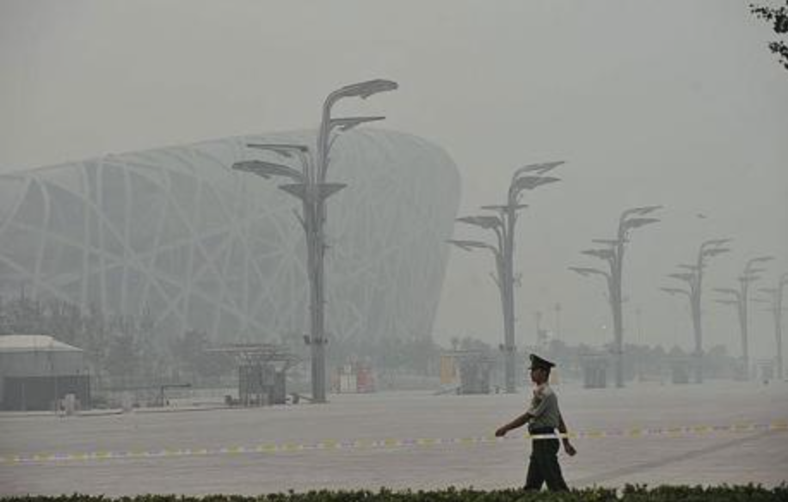
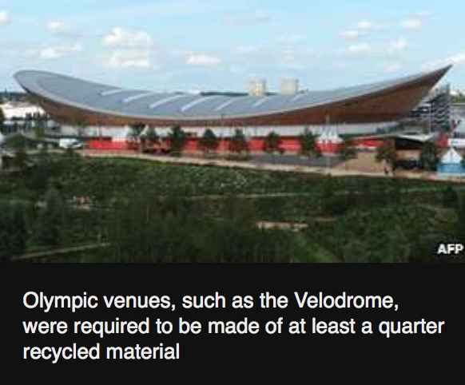
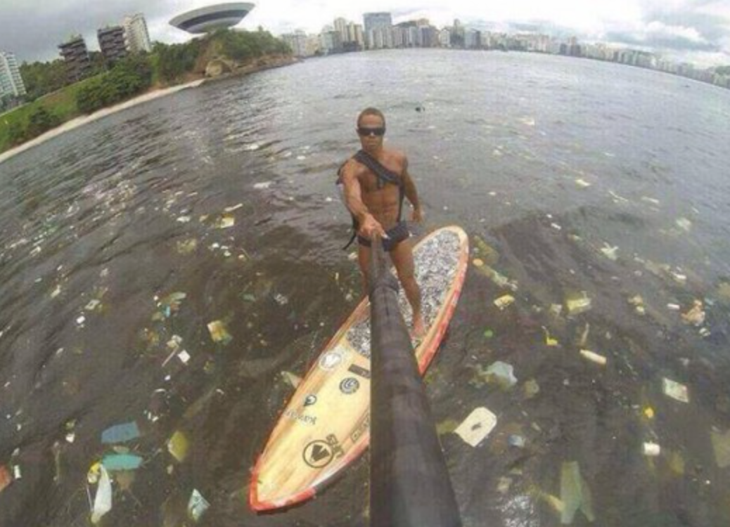
But, work still needs to be done…
The Beijing Olympics in 2008 were “the most polluted games ever with athletes and spectators exposed to dangerous level of smog.”
The 2012 London Olympics was promoted as a green games, but still generated around 3.45m tonnes of CO₂!
Swimmers and boaters will be competing in highly polluted waters in the 2016 Rio games.

Slide 5
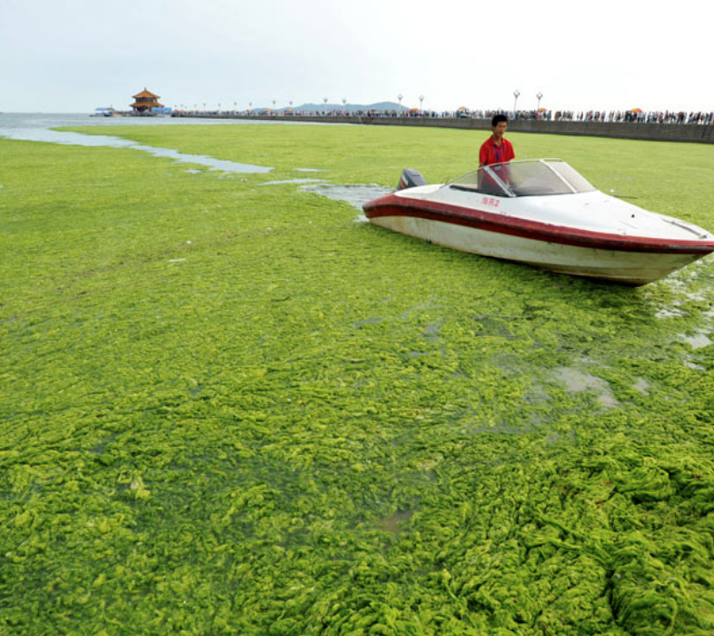
Impacts of such conditions...
Deforestation to make room for Olympics can have disastrous effects:
Loss of habitat for many species → decreased genetic diversity
Fewer trees to absorb CO₂ in atmosphere → increased global warming
Increased leaching as chemicals in the soil are washed away by heavy rain
This leads to eutrophication → a build up of chemicals in water = algal blooms
Notes:
e.g. ski runs for the 2018 winter Olympics in South Korea.
Eutrophication:
Leaching results in mineral build up in surrounding waters (nitrates and phosphates are most damaging)
These minerals cause aquatic plant growth of algae and other plants.
As the algae blooms, this leads to a reduction in oxygen levels in the water.
The increased algae on the waters’ surface reduces the amount of sunlight able to reach the other plants below the surface.
These plants die and oxygen in the water is depleted even further as the process of decomposition uses it up.
Environment becomes anoxic - oxygen levels have reached the point at which no life can be supported.
Death of the ecosystem - fish and other organisms die.

Slide 6
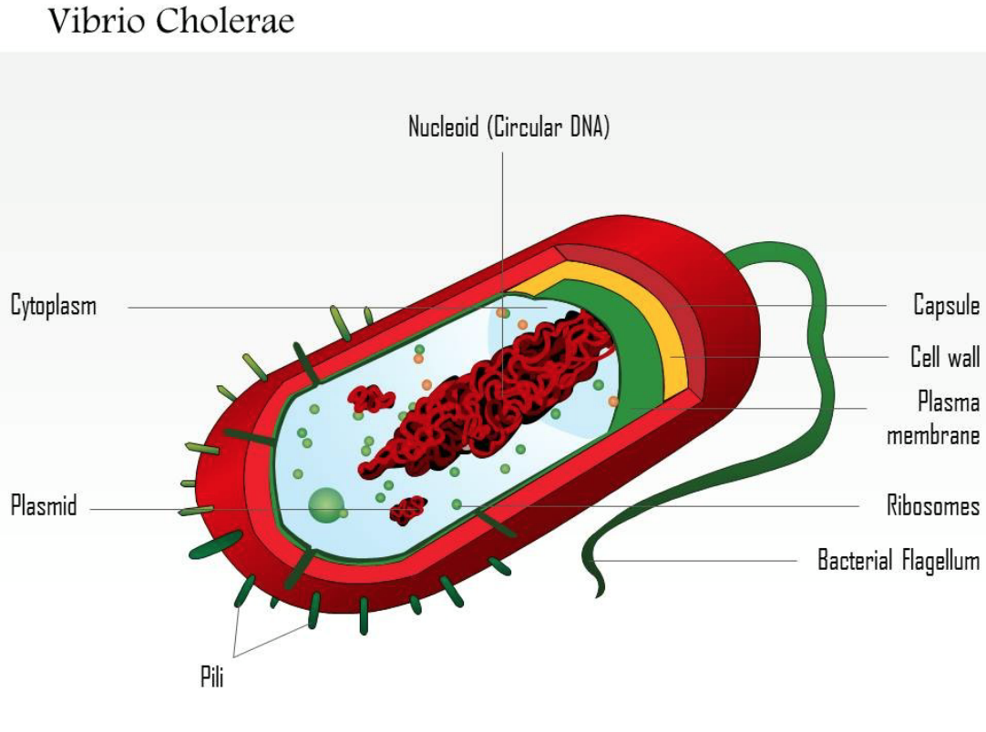
Impacts continued…
Pollution is one of the main problems associated with the games:
Water pollution - Cholera, dysentery and typhoid are all associated with polluted water
Cholera:
Caused by the bacterium Vibrio cholerae.
How does it cause infection?
Dysentery:
Caused by the Shigella bacteria.
Works in a similar fashion to cholera, resulting in severe diarrhoea.
Typhoid:
Bacterial infection caused by Salmonella typhi.
Notes:
It enters the body mainly via contaminated water
It passes through the stomach and then attaches to cells of the small intestine.
Once here it releases a toxin that causes various ions to leak out of the cells and into the lumen of the small intestine.
An increase in sodium and chloride ions in the lumen makes the lumen particularly “salty”
Therefore, due to osmosis, water moves from an area of high concentration (in the cells) to an area of low concentration (in the lumen), down the water potential gradient.
This results in watery diarrhoea and rapid dehydration in the body which can result in death if left untreated.

Slide 7
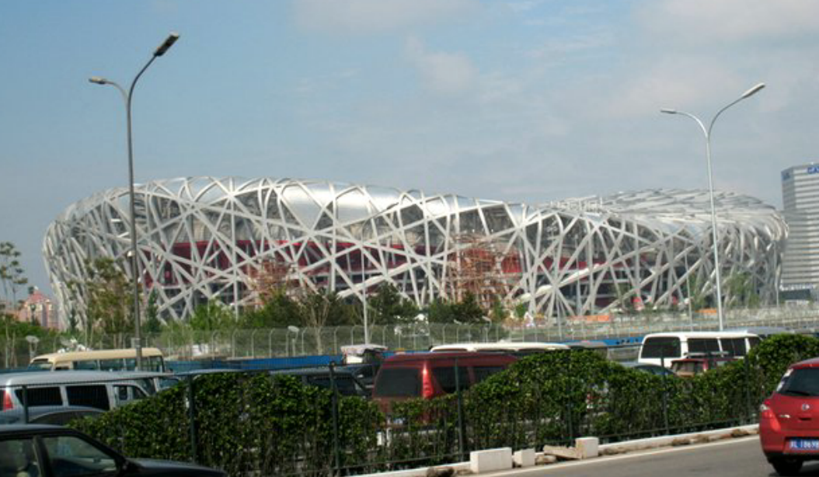
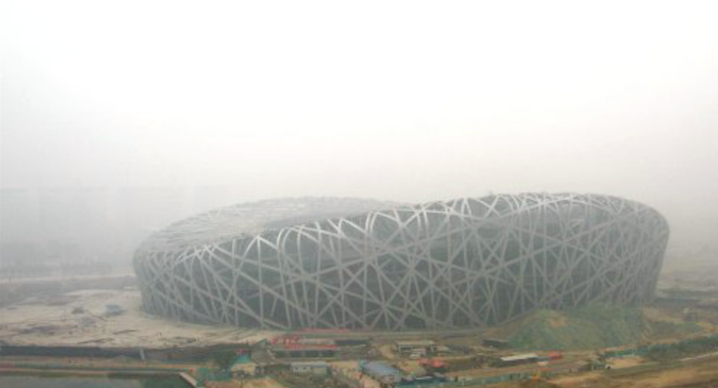
Impacts continued…
Air pollution - The 2008 Beijing Olympics presented an example of severe air pollution.
It can be highly damaging to both athletes and spectators.
Air pollution can result in respiratory and cardiovascular problems.
Also been linked to problems in pregnancy, including pre-term births.

Slide 8

What should be done…
Hosting a green games is more expensive – but hosting a cheaper but environmentally damaging Games is also unacceptable.
Some suggestions have been put forward..
Cities to make a bid that allows a green reimagining of the city, regardless of whether they actually get to host the games.
Have a permanent site for the Olympics. This could be a city or alternatively a small island, which would become an International Convention Centre for Sports.
Notes:
E.g. In their bid for the 2016 Olympics, Chicago went through the exercise of planning for city improvements.

Slide 9
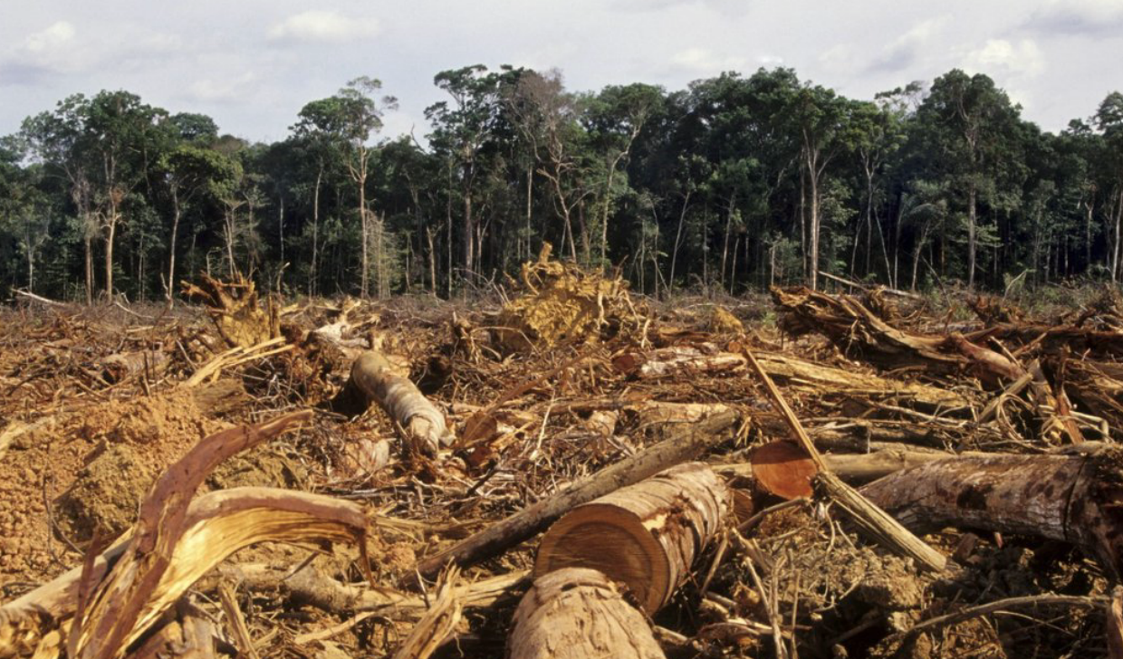
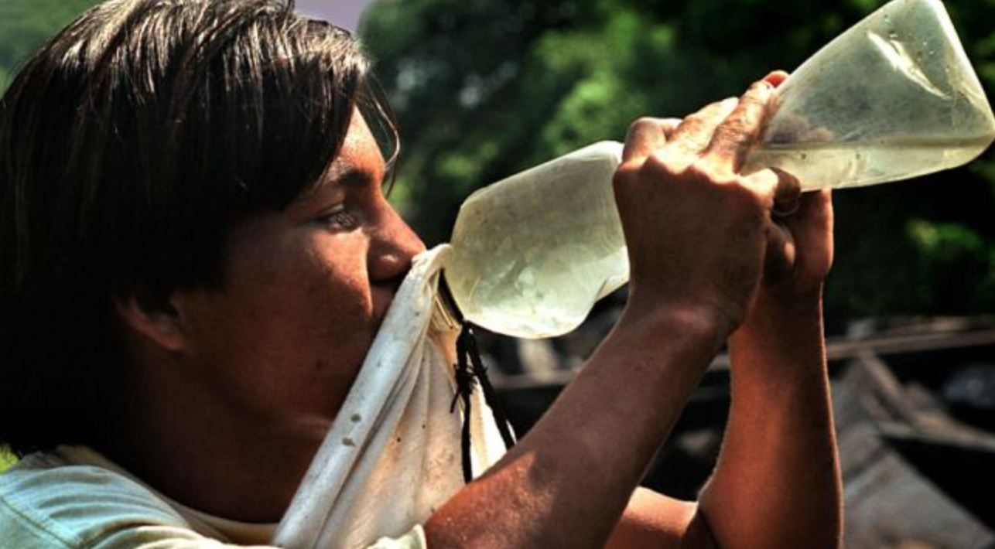
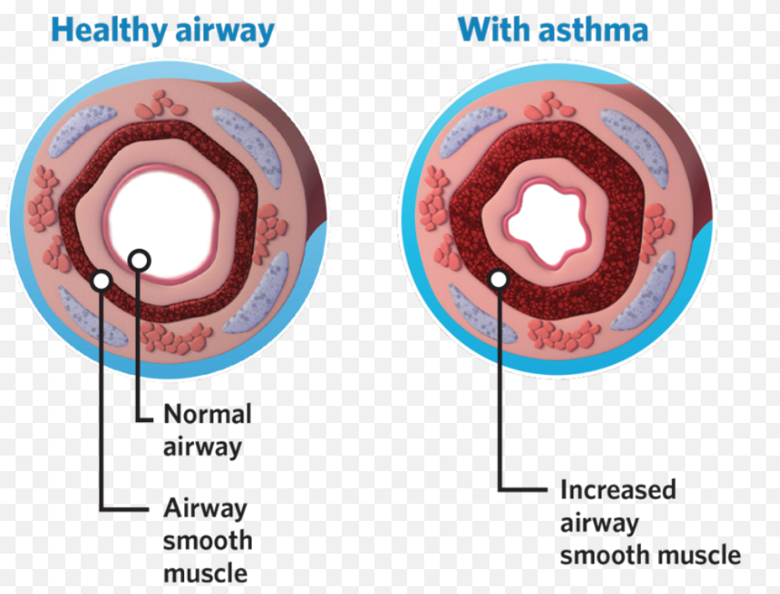
Summary
The Olympics can have major environmental impacts
Deforestation and pollution are big problems
Deforestation → leaching → eutrophication
Deforestation also increases global warming
Cholera, dysentery and typhoid are all associated with water pollution
Air pollution is damaging to the respiratory and cardiovascular systems
Having a permanent site is one idea for keeping the games green

