Slide 1
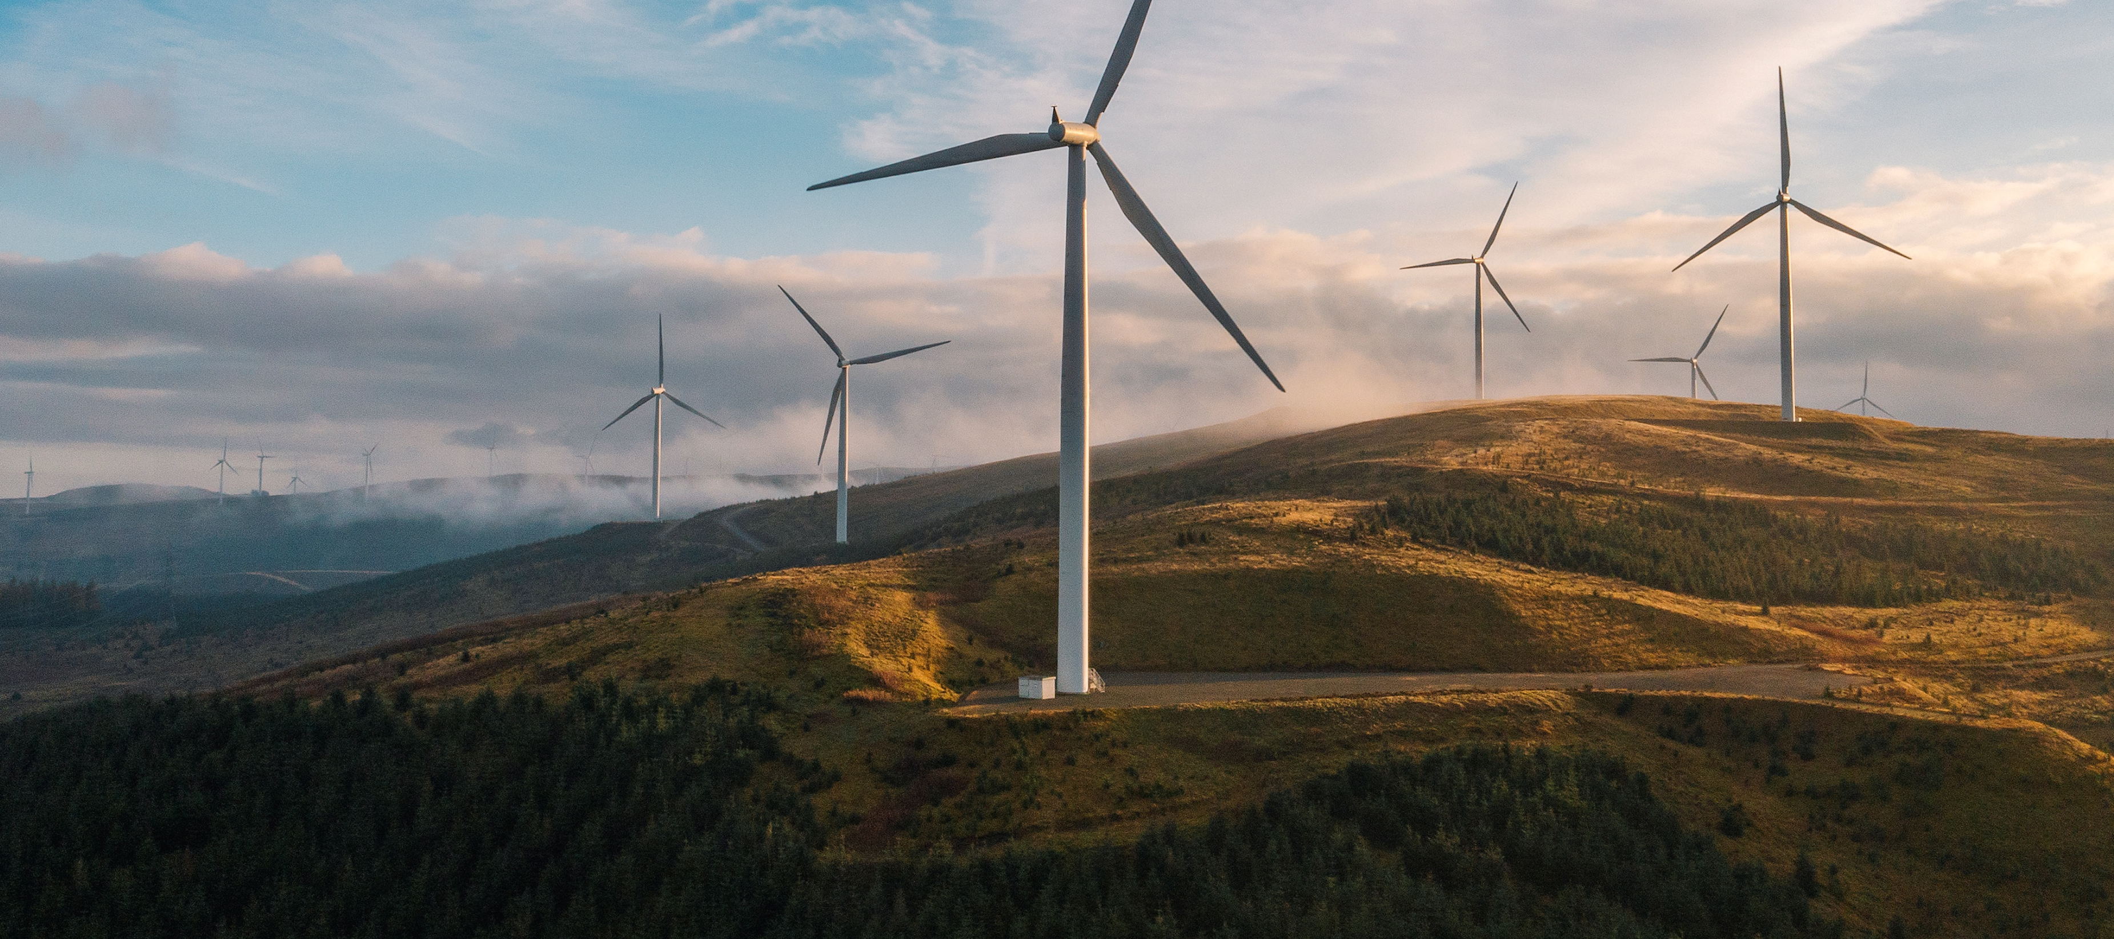
KS3-4 Green Lesson
Exploring Green Jobs
50-60 minute lesson

Slide 2
Teacher Notes
The following slides have animations and are intended to be delivered as a PowerPoint presentation.
Each slide has notes with suggestions of points of discussion.
Individual online access is needed for the job research task.
Time | Slide | Activity
5 mins | Slide 3-4 | Introduction
5 mins | Slide 5-8 | Context to green agenda and targets for Net Zero
5 mins | Slide 9-10 | TASK: How can YOU be more green? 5 mins to think of green things everybody could do
10 mins | Slide 11-12 | How anyone can be more green in ANY job. TASK: How can a workplace be more green?
5 mins | Slide 13-17 | What is a green job? 6 sectors and 60 jobs explained
15 mins | Slide 18-19 | Identify 1-2 jobs from the list of 60 that are of interest and research them online.
10 mins | Slide 20-21 | Plenary and Feedback

Slide 3




The lesson will help you learn:
Why be green, as individuals and in jobs?
Where will the green jobs be?
Exploring green jobs of interest to you?

Slide 4
Do you know?
What a green job is?
What job sectors will offer green jobs?
What will be involved in different green jobs and the pathways you can take to get there?
By the end of this session the answer will be YES!

Slide 5
What does it mean to be green?
It means taking actions or making choices to help protect the environment and reduce pollution
What do we mean by NET ZERO?
Net zero means the point at which the amount of greenhouse gases (such as carbon dioxide) being put out into the atmosphere through human activity, is equal to the amount taken out of the atmosphere.
Notes:
Click to ask question
Click to give answer
Reminder that Greta has raised awareness of the need to protect the planet and has been a key advocate for getting young people involved.

Slide 6

Watch a video about being green
https://youtu.be/VqZD-mnC5Gk

Slide 7

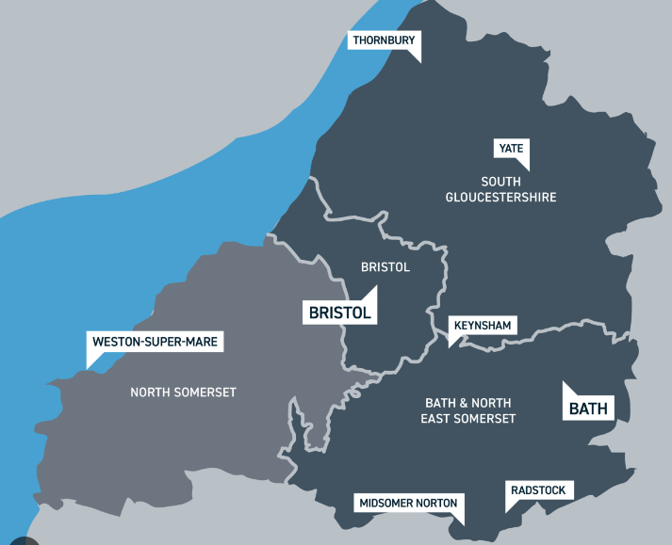


Why being more green matters and what needs to happen?
We need to look after the planet
So every area of the country needs to be more green
So every country needs to be more green
So all of us need to be more green
Notes:
Click for ‘So every country ‘Like UK’ needs to be more green
Click – for ‘So every area of a country …’ Talk about where they live and that the area is called West of England
Click for ‘So all of us need to be more green’

Slide 8

What’s happening about it?
Because this is such an important issue everybody is working towards it…
The National Picture
'The Government is committed to achieving net zero emissions by 2050.'
In your area
Different regions of the UK have their own climate action plans and targets. For example, the West of England Combined Authority
aims to make the region net zero by 2030, 20 years ahead of the UK Government's target.
Notes:
Click through and explain each.
Make sure students know that WECA will be more ambitious than national – should celebrate being in this area as taking this very seriously.
For further explanation of net zero and climate change you might use these websites:
https://www.bbc.co.uk/bitesize/articles/zcxmtrd#zpwdqfr
https://www.nationalgrid.com/stories/energy-explained/what-is-net-zero

Slide 9

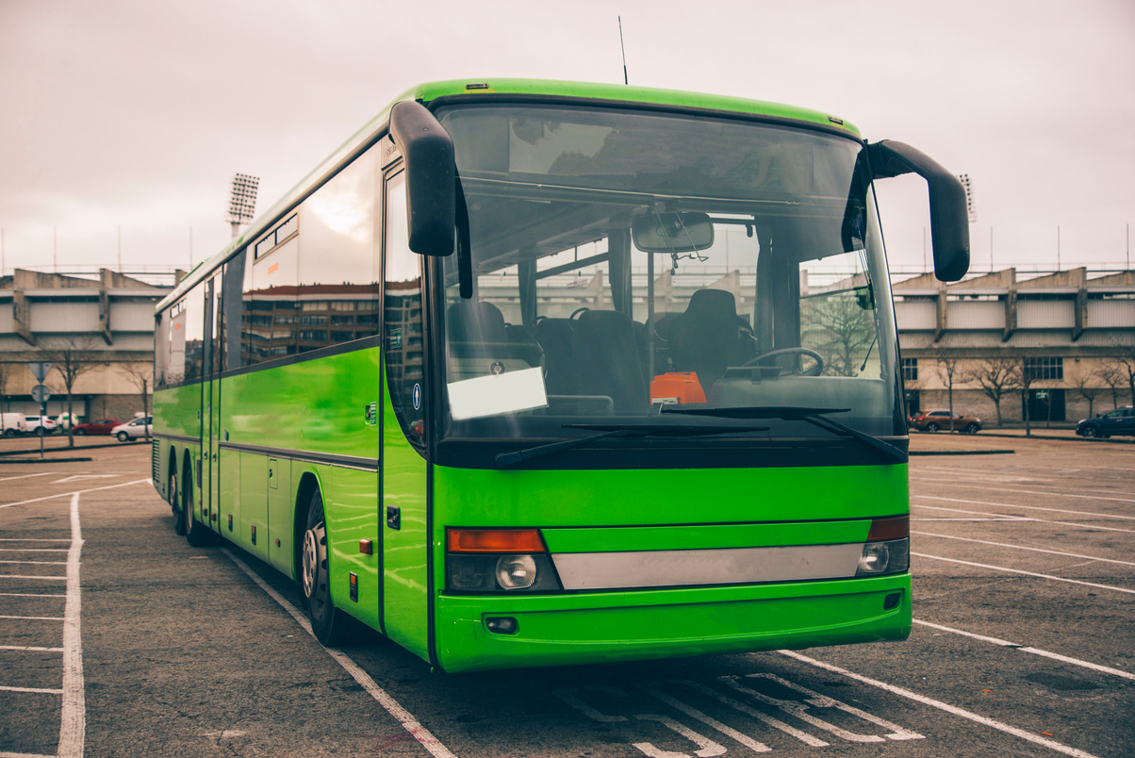
TASK: How can YOU be more green?
Got some ideas?
Got some ideas?
5 mins
Notes:
Click for ‘Got some ideas?’
Discussion Point – as a class group or in pairs make a list of any ideas of how an individual could be more green
Click to see suggestions to check have some of these ideas on their list
Just a 5 minute activity to needs to be quick!

Slide 10

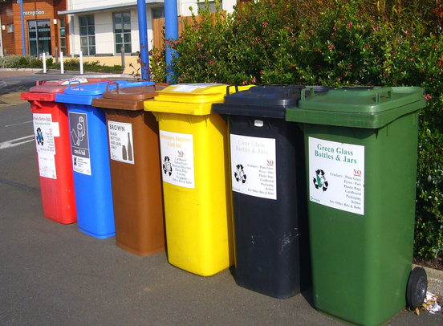


TASK: How can YOU be more green?
Did you get any of these?
Use public transport
Sort to recycle
Use less plastic
Got some ideas?
Use less water
Turn off lights
Notes:
Click for ‘Got some ideas?’
Discussion Point – as a class group or in pairs make a list of any ideas of how an individual could be more green
Click to see suggestions to check have some of these ideas on their list
Just a 5 minute activity to needs to be quick!

Slide 11
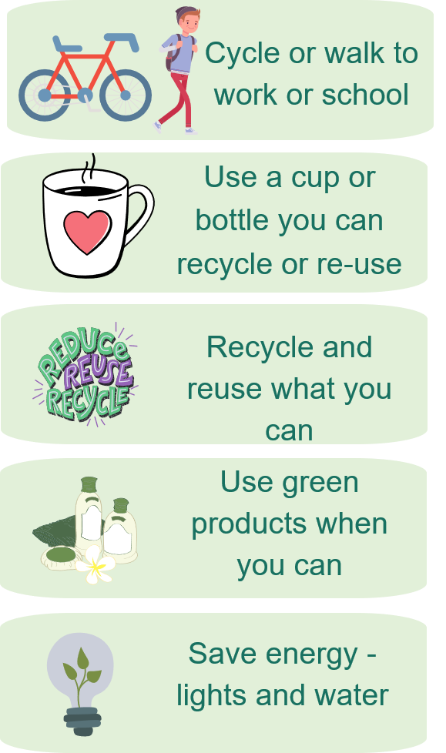
Be green, work green
We all need to be more green in ANY job
There will be lots of green jobs
Could be up to 50,000 green jobs in the West of England region by 2030.

Slide 12

TASK: How can a workplace be more green?
Pick a workplace and think of ways this job has become more green, or could be made more green. It could be about what the people who work there do, the buildings they work in, or the actual work then do.
Choose one of these or your own:
School canteen
Sports centre
Supermarket
Hospital
Vets
5 mins
Notes:
In small group students choose a workplace and identify how it could be more green

Slide 13

What is a green job?
A green job is one that contributes towards reducing emissions, lowering the carbon footprint and protecting the environment.

Slide 14

6 green employment sectors
LOW CARBON
BUILDINGS
AND PLACES
RENEWABLE
ENERGY
LOW CARBON
BUSINESS
NATURE
RECOVERY
These sectors are all predicted to grow
LOW CARBON
TRANSPORT
CLIMATE RESILIENCE
Notes:
There are 6 employment sectors that are predicted to grow in the West of England (there might be others but theses are the main 5)
Click and explain>
Nature Recovery
Protect the natural environment and increase habitat spaces for wildlife in the West of England region.
Low Carbon Transport
Decarbonise emissions from the transport system, reduce car dependency and increase cycling and walking and the use of public transport
Low Carbon Buildings and Places
Increase the energy performance of existing buildings and develop low carbon standards in new developments.
Renewable Energy
Decarbonise the energy system and increase local renewable energy production, including nuclear, solar and onshore wind.
Low Carbon Business
Help business and local people benefit from growth in the green economy
Climate resilience
Climate Resilience means being able to adapt to, prepare for and effectively respond to natural hazards caused by climate change.
Click for these will all grow

Slide 15
60 Green Jobs
NATURE RECOVERY
LOW CARBON TRANSPORT
Ecologist​
Landscaper​
Countryside Ranger
Animal Care Worker
Outdoor Activities Instructor
Biologist
Beekeeper​
Tree Surgeon
Arboricultural Officer
Hydrologist
Forest Worker
Horticultural Manager
Farmer
Horticultural Therapist
Argonomist
Mechanical Engineering Technician
Aerospace Engineering Technician​
Bus or Coach Driver
Cycle Mechanic
Automotive Engineer
Electronics Engineer​
Transport Planner
Notes:
There are 60 jobs in these 6 employment areas that will be needed to help meet Net Zero over the coming years – there will be others so these are just examples. Show the list but say coming back to this in a later slide as they will start to look at some of the jobs in detail

Slide 16

60 Green Jobs
LOW CARBON BUSINESS
LOW CARBON BUILDINGS AND PLACES
Environmental Consultant
Corporate Responsibility and Sustainability Practitioner
Business Development manager
Solicitor - Environmental Law
Marketing Manager
Software Developer
Charity Fundraiser
Data Scientist
Management Consultant
Building Services Engineer
Architect
Civil Engineer
Building Control Officer
Landscape Architect
Smart Meter Installer
Heating and Ventilation Engineer
Recycling Operative
Recycling Engagement Officer
Roofer
Electrician
Plumber
Stonemason
Heat Pump Engineer
Notes:
There are 60 jobs in these 6 employment areas that will be needed to help meet Net Zero over the coming years – there will be others so these are just examples. Show the list but say coming back to this in a later slide as they will start to look at some of the jobs in detail

Slide 17
60 Green Jobs
CLIMATE RESILIENCE
RENEWABLE ENERGY
Electrical Engineering Technician
Engineering Maintenance Technician
Wind Turbine Technician
Nuclear Engineer
Nuclear Technician
Energy Engineer
Community Development Worker
Community Education Co-ordinator
Meteorologist
Civil Service Manager
Microbiologist
Broadcast Journalist
Food Scientist
Research Scientist
Notes:
There are 60 jobs in these 6 employment areas that will be needed to help meet Net Zero over the coming years – there will be others so these are just examples. Show the list but say coming back to this in a later slide as they will start to look at some of the jobs in detail

Slide 18
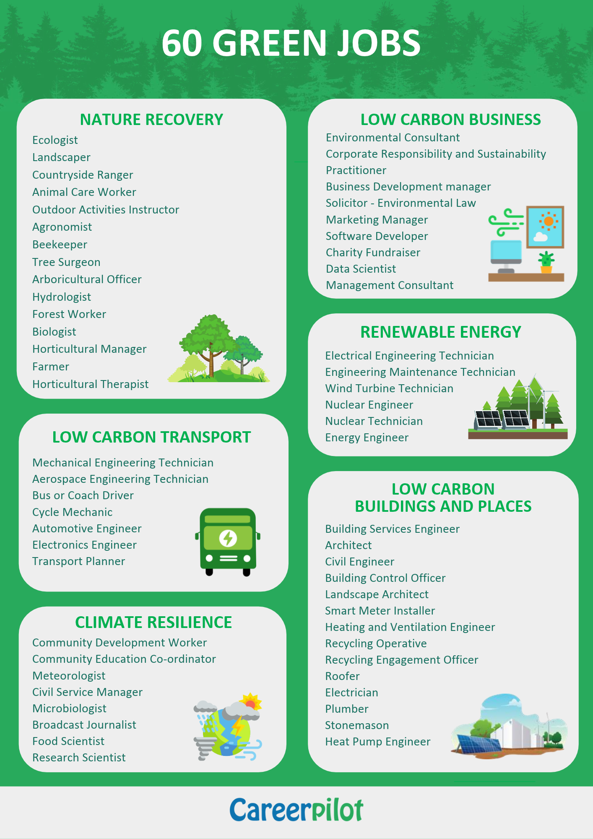
Here are 60 green jobs we have identified that are predicted to grow (there will be others).
Look at the list and identify 1 or 2 you would like to find out about
Write them down.
Task

Slide 19
Task
Spend 10 minutes researching the green jobs you’re interested in online.
Make a note of:
the day-to-day tasks for the job roles
the average salary
the pathways you could take to get into the job roles – courses, apprenticeships?
You may use the National Careers Service to support your research online.
10 mins

Slide 20
Do you know?
What a green job is?
What job sectors will offer green jobs?
What will be involved in different green jobs and the pathways you can take to get there?
Notes:
Elicit the answers from the class….
A green job is one that contributes towards reducing emissions, lowering the carbon footprint and protecting the environment.
The following job sectors will offer green jobs: Nature Recovery
Protect the natural environment and increase habitat spaces for wildlife in the West of England region.
Low Carbon Transport
Decarbonise emissions from the transport system, reduce car dependency and increase cycling and walking and the use of public transport
Low Carbon Buildings and Places
Increase the energy performance of existing buildings and develop low carbon standards in new developments.
Renewable Energy
Decarbonise the energy system and increase local renewable energy production, including nuclear, solar and onshore wind.
Low Carbon Business
Help business and local people benefit from growth in the green economy
Climate resilience
Climate Resilience means being able to adapt to, prepare for and effectively respond to natural hazards caused by climate change.
Go to next slide to answer the third question.

Slide 21



Share your knowledge
In a pair or small group share which green jobs you looked at and what you found out.
Skills this activity will help you develop:
10 mins

