Slide 1


KS4-5 SUBJECT-SPECIFIC
SLIDE RESOURCES
Slide pack to support linking careers to the curriculum
The Careerpilot website is now closed. This resource has been adapted to signpost to alternative careers resources.

Slide 2




Introducing Careers for Subject Teachers
Slides can be used as a quick starter activity, or as a longer session as required.
Pick a subject to explore.
Ask students for ideas of careers linked to subject area, then reveal examples.
Click on the job titles to explore related job profiles.
Introduce some examples of related academic, vocational and technical courses and apprenticeships.
Discuss local education providers and course options.
The Careerpilot website is now closed. This resource has been adapted to signpost to alternative careers resources.

Slide 3





Contents

Slide 4


Where could you take your love of
Art & Design?
Future Careers Ideas
  Animator
  Art Therapist
  Architect
  Advertising Art Director
  Fashion Designer
  Illustrator
  Interior Designer
  Photographer

Slide 5

What pathways could you take to get there?
Post-16 Options
Post-18 Options
Courses:
  A-level Art and Design
  A-level Fashion and Textiles
  T-Level Craft and Design
Apprenticeships:
  Community Arts
  Fashion Studio Assistant
Courses:
Foundation Diploma in Art
HND Fine Art
BA (Hons) Fashion Design
BA (Hons) Drawing
Apprenticeships:
  Junior Animator
  Photographer

Slide 6

Where could you take your love of
Computing?
Future Careers Ideas
App Developer
Artificial Intelligence (AI) Engineer
Forensic Computer Analyst
Software Developer
IT Support Technician
Web Developer
Computer Games Developer
Cyber Intelligence Officer

Slide 7

What pathways could you take to get there?
Post-16 Options
Post-18 Options
Courses:
A-Level Computer Science
T-Level Digital (Data Analytics, Digital Software Development or Support & Security)
Apprenticeships:
Digital Support Technician
Cyber Security Technician
Courses:
HNC/HND Digital Technologies
FdSc Digital & Technology
BSc (Hons) Computer Science
BSc (Hons) Cyber Security
Apprenticeships:
Software Developer
Digital & Tech Solutions

Slide 8

Where could you take your love of
English?
Future Careers Ideas
Advertising Copywriter
Arts Administrator
Broadcast Journalist
Copy Editor
Marketing Executive
Film Critic
Secondary School Teacher
Writer

Slide 9
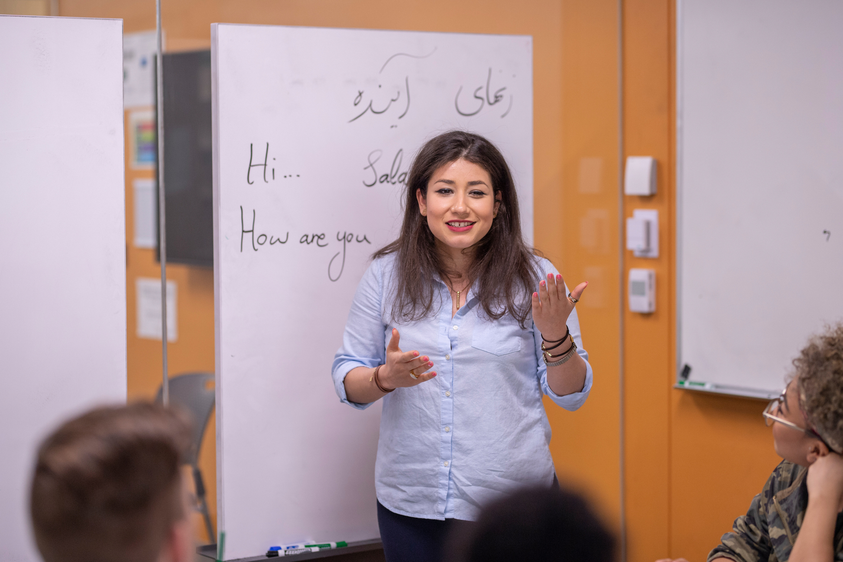
What pathways could you take to get there?
Post-16 Options
Post-18 Options
Courses:
A-Level English
T-Level Marketing
Level 2-3 Creative Media
Apprenticeships:
Broadcast Production Assistant
Digital Marketer
Courses:
CELTA Teaching English as a Foreign Language
BA (Hons) Journalism
BA (Hons) English Literature
Apprenticeships:
Public Relations Assistant
Journalist
Notes:
You may discuss post 16 pathways and/or post 18 pathways (delete section if not relevant to your students). You may mention local providers that you know offer some of these courses.

Slide 10
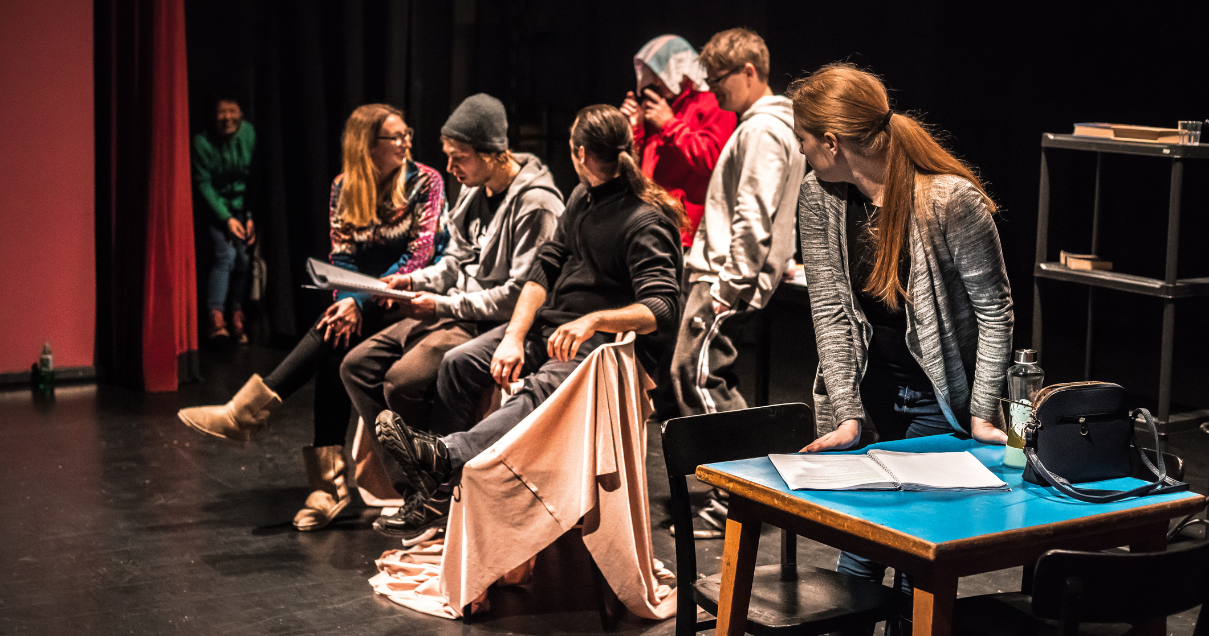
Where could you take your love of
Drama?
Future Careers Ideas
Arts Administrator
Choreographer
Community Arts Worker
TV or Film Assistant Director
TV Presenter
Actor
Dramatherapist
Stage Manager

Slide 11
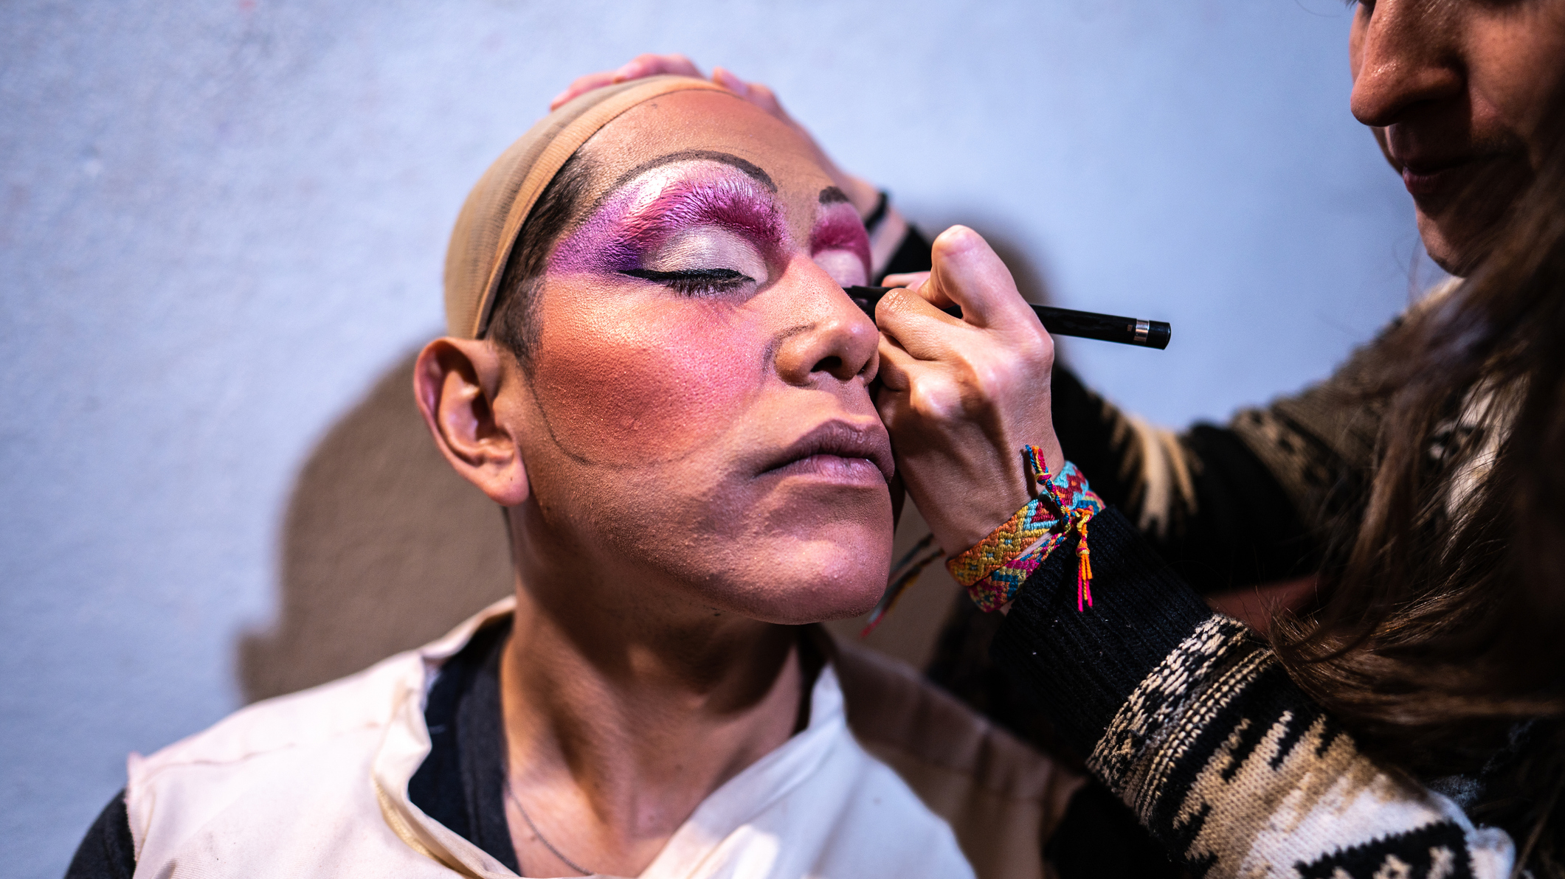
What pathways could you take to get there?
Post-16 Options
Post-18 Options
Courses:
A-Level Dance
A-Level Drama
BTEC Performing Arts
Apprenticeships:
Community Activator Coach
Cultural Learning and Participation Officer
Courses:
HND Performing Arts
BA (Hons) Theatre Studies
BA (Hons) Dance & Choreography
Apprenticeships:
Teacher
Arts Therapist
Notes:
You may discuss post 16 pathways and/or post 18 pathways (delete section if not relevant to your students). You may mention local providers that you know offer some of these courses.

Slide 12
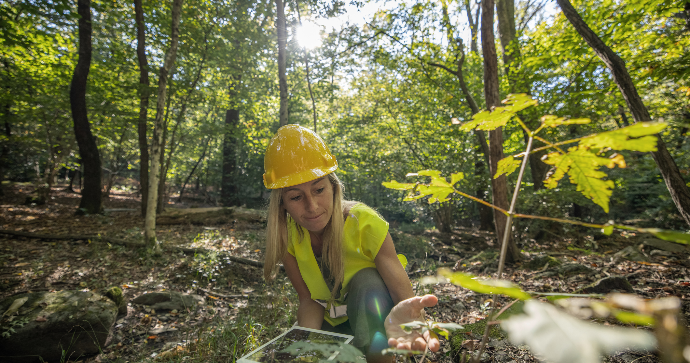
Where could you take your love of
Geography?
Future Careers Ideas
Climate Scientist
Countryside Ranger
Ecologist
Professional Forester
Geoscientist
Land Surveyor
Landscape Architect
Town Planner

Slide 13

What pathways could you take to get there?
Post-16 Options
Post-18 Options
Courses:
A-Level Geography
A-Level Environmental Science
T-Level Agriculture
Apprenticeships:
Water Environment Worker
Countryside Worker
Courses:
BSc (Hons) Agriculture
BSc (Hons) Geography
BSc (Hons) Geography with Ocean Science
Apprenticeships:
Environmental Practitioner
Professional Forester
Notes:
You may discuss post 16 pathways and/or post 18 pathways (delete section if not relevant to your students). You may mention local providers that you know offer some of these courses.

