Slide 1


KS4-5 SUBJECT-SPECIFIC
SLIDE RESOURCES
Slide pack to support linking careers to the curriculum
The Careerpilot website is now closed. This resource has been adapted to signpost to alternative careers resources.

Slide 2




Introducing Careers for Subject Teachers
Slides can be used as a quick starter activity, or as a longer session as required.
Pick a subject to explore.
Ask students for ideas of careers linked to subject area, then reveal examples.
Click on the job titles to explore related job profiles.
Introduce some examples of related academic, vocational and technical courses and apprenticeships.
Discuss local education providers and course options.
The Careerpilot website is now closed. This resource has been adapted to signpost to alternative careers resources.

Slide 3





Contents

Slide 4
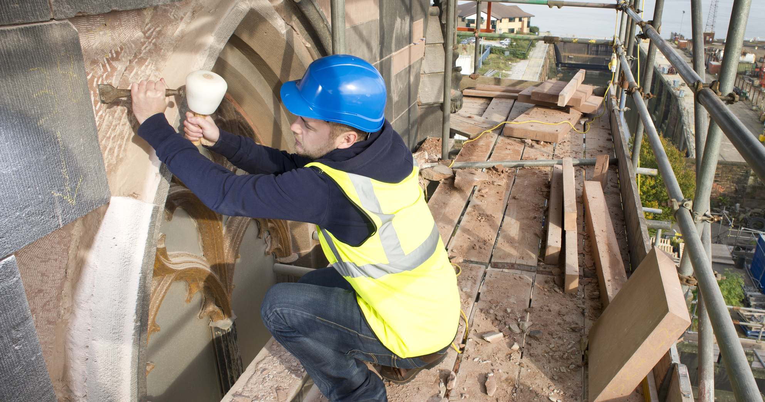

Where could you take your love of
History?
Future Careers Ideas
Antique Dealer
Archivist
Archaeologist
Conservator
Heritage Officer
Museum Curator
Palaeontologist
Tourist Guide

Slide 5
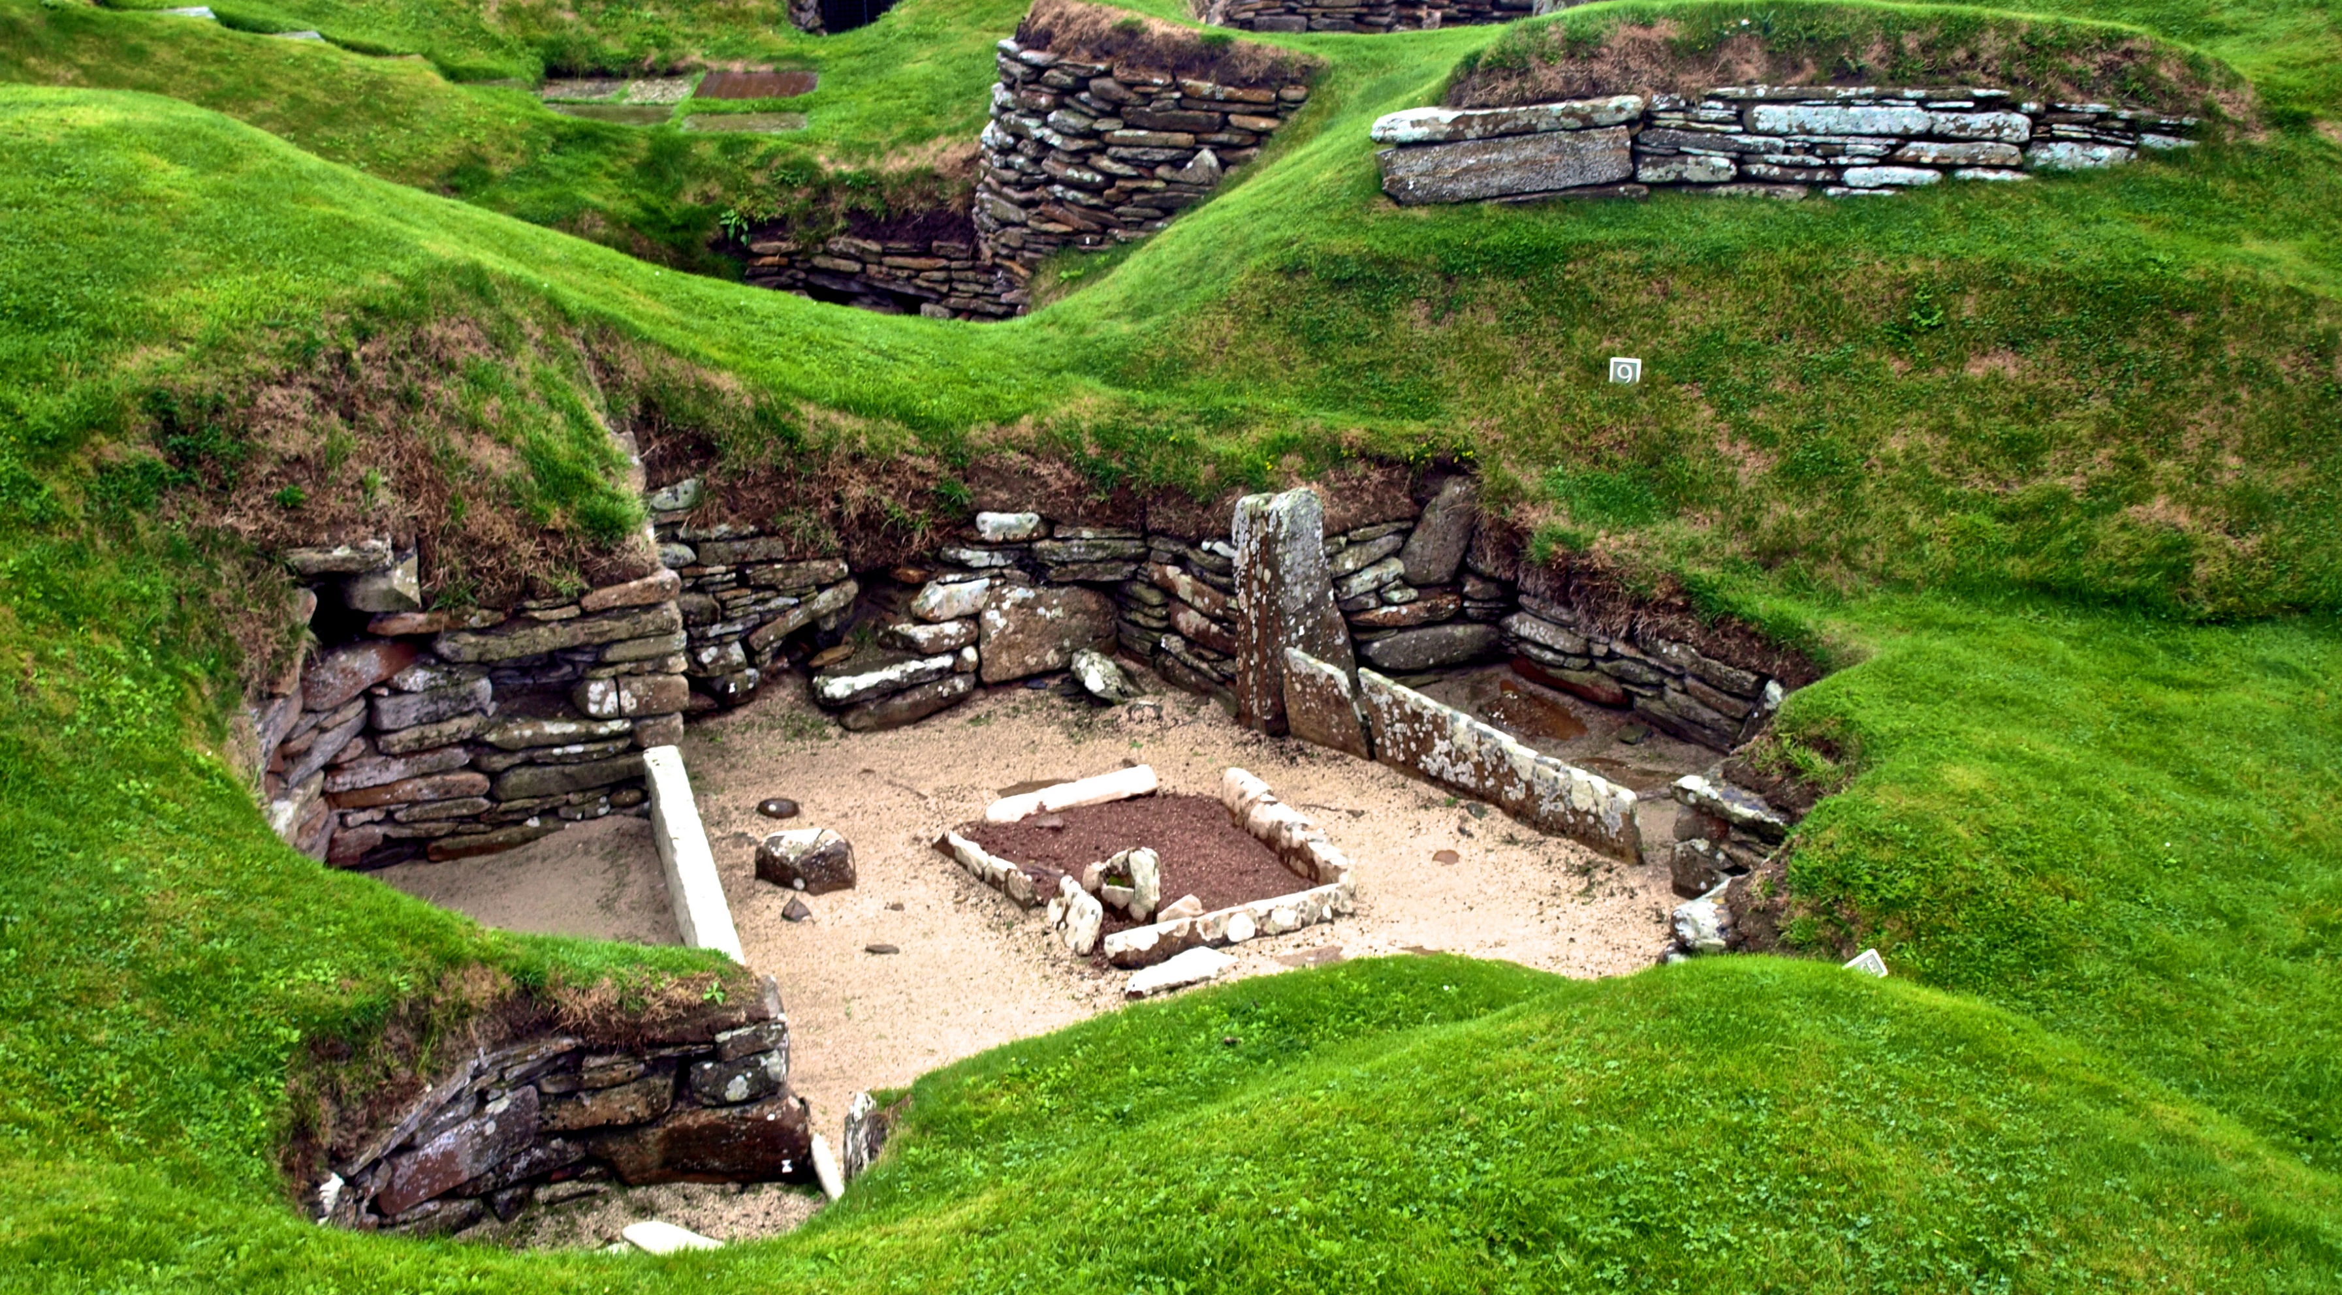
What pathways could you take to get there?
Post-16 Options
Post-18 Options
Courses:
A-Level History
A-Level Classic Civilisation
A-Level Geology
Apprenticeships:
Archaeological Technician
Cultural Learning and Development Officer
Courses:
FDA History, Heritage & Culture
BA (Hons) Ancient History and Archaeology
Apprenticeships:
Cultural Heritage Conservation
Historic Environment Assistant
Notes:
You may discuss post 16 pathways and/or post 18 pathways (delete section if not relevant to your students). You may mention local providers that you know offer some of these courses.

Slide 6

Where could you take your love of
Languages?
Future Careers Ideas
Bilingual Secretary
Diplomatic Services Officer
Hotel Manager
Interpreter
EFL Teacher
Online Tutor
Tourist Guide
Translator

Slide 7
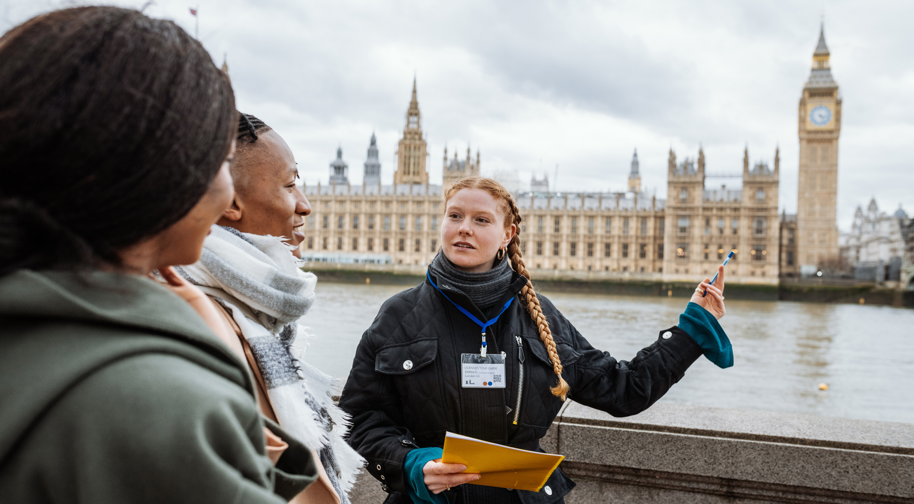
What pathways could you take to get there?
Post-16 Options
Post-18 Options
Courses:
A-Level French
A-Level Spanish
Level 2-3 Travel and Tourism
Apprenticeships:
Cultural Learning and Development Officer
Cabin Crew
Courses:
CELTA Teaching English as a Foreign Language
BA (Hons)Modern Languages
BA (Hons) Communications and Modern Languages
Apprenticeships:
Teacher
Hospitality Manager
Notes:
You may discuss post 16 pathways and/or post 18 pathways (delete section if not relevant to your students). You may mention local providers that you know offer some of these courses.

Slide 8

Where could you take your love of
Maths?
Future Careers Ideas
Actuary
Civil Engineer
Data Analyst-Statistician
E-commerce Manager
Air Traffic Controller
Mortgage Advisor
Public Finance Accountant
Stockbroker

Slide 9

What pathways could you take to get there?
Post-16 Options
Post-18 Options
Courses:
A-Level Maths
T-Level Accounting
T-Level Management and Administration
Apprenticeships:
Assistant Accountant
Payroll Administrator
Courses:
AAT Level 4 Accounting
BSc (Hons) Mathematics with Statistics
BSc (Hons) Mathematics and Data Science
Apprenticeships:
Actuarial Technician
Financial Services Professional
Notes:
You may discuss post 16 pathways and/or post 18 pathways (delete section if not relevant to your students). You may mention local providers that you know offer some of these courses.

Slide 10

Where could you take your love of
Music?
Future Careers Ideas
Acoustics Consultant
Audio Visual Technician
Live Sound Engineer
Musician
Music Promotions Manager
Music Therapist
Studio Sound Engineer
TV or Film Sound Technician

Slide 11

What pathways could you take to get there?
Post-16 Options
Post-18 Options
Courses:
A-Level Music
Level 3 Music Performance and Production
Level 3 Music Technology
Apprenticeships:
Live Event Technician
Event Assistant
Courses:
HNC/HND Music
BA (Hons) Music
BSc (Hons) Audio and Music Technology
Apprenticeships:
Postproduction Technical Operator
Audiovisual Technician
Notes:
You may discuss post 16 pathways and/or post 18 pathways (delete section if not relevant to your students). You may mention local providers that you know offer some of these courses.

Slide 12

Where could you take your love of
the Sciences?
Future Careers Ideas
Chemical Engineer
Dentist
Renewable Energy Engineer
Forensic Scientist
Hydrologist
Pharmacist
Laboratory Technician
Sonographer

Slide 13
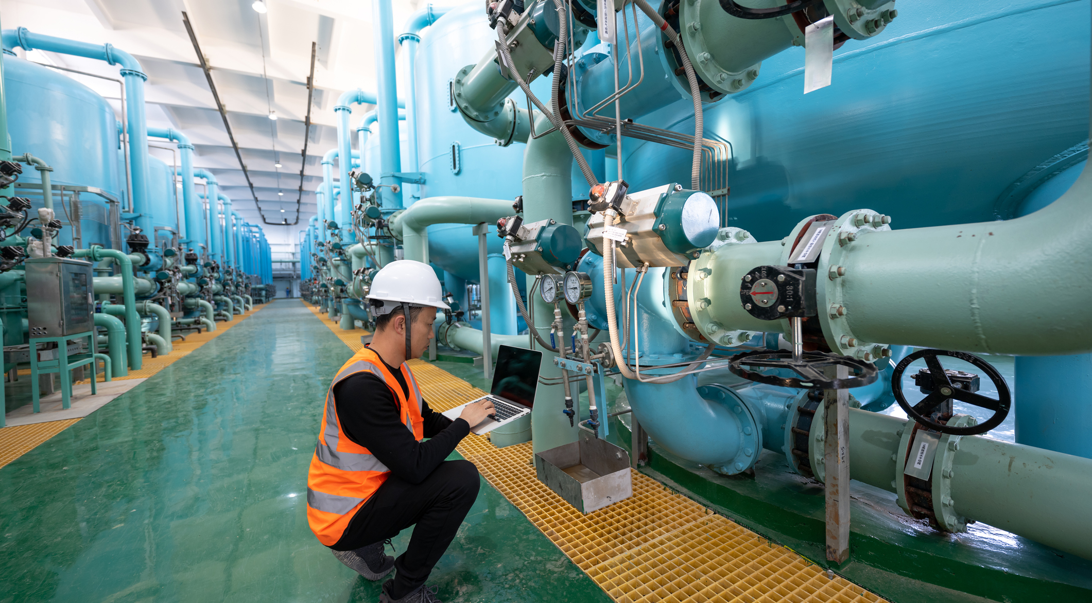
What pathways could you take to get there?
Post-16 Options
Post-18 Options
Courses:
A-Level Chemistry, Physics or Biology
T-Level Science
T-Level Engineering
Apprenticeships:
Science Manufacturing Technician
Laboratory Assistant
Dental Nurse
Courses:
HTQ Applied Science
BSc (Hons) Forensic Science
BSc (Hons) Marine Biology
BSc (Hons) Astrophysics
Apprenticeships:
Materials Science Technologist
Nursing Associate
Laboratory Scientist

