Slide 1
PUBLIC
Collaboration on an Industrial Scale: Innovating to Deliver Net Zero
Jo Dally, Chief Business Officer
March 2025
PUBLIC
Notes:
Who we are and what we do – to include our role as part of HVM Catapult and the Uni Bristol
Capabilities beyond composites – (end-to-end engineering, opportunities opened up by our hosting Isambard-AI)
Impact - nationally and regionally

Slide 2








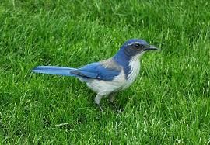


PUBLIC
About me
Dr Jo Dally
Chief Business Officer at NCC

Slide 3
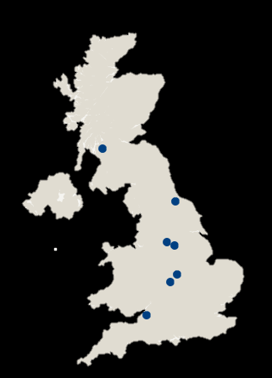





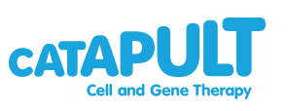



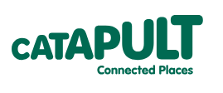



PUBLIC
High Value Manufacturing Catapult
Established by Innovate UK in 2011
6 Centre's of industrial innovation across 25 sites working together on the
future of manufacturing.
Delivering impact:
£500m+ generated R&D spend each year
£609m net additional GVA each year
5,500+ businesses worked with (60% SMEs)
Part of the UK Catapult Network
Largest advanced manufacturing capability in Europe
PUBLIC

Slide 4








PUBLIC
NCC at a glance…
10
State-of-the-art, tailor-made technologies
2
locations,
NCC HQ and
NCC Filton
£200m
invested in
capabilities
£40m
turnover
Over 80 members and
8 major sectors supported
Over 400
specialist engineers
60+
university
partners
21,500m²
facility at NCC HQ
PUBLIC
Notes:
Who we are and what we do – to include our role as part of HVM Catapult and the Uni Bristol
Capabilities beyond composites – (end-to-end engineering, opportunities opened up by our hosting Isambard-AI)
Impact - nationally and regionally

Slide 5
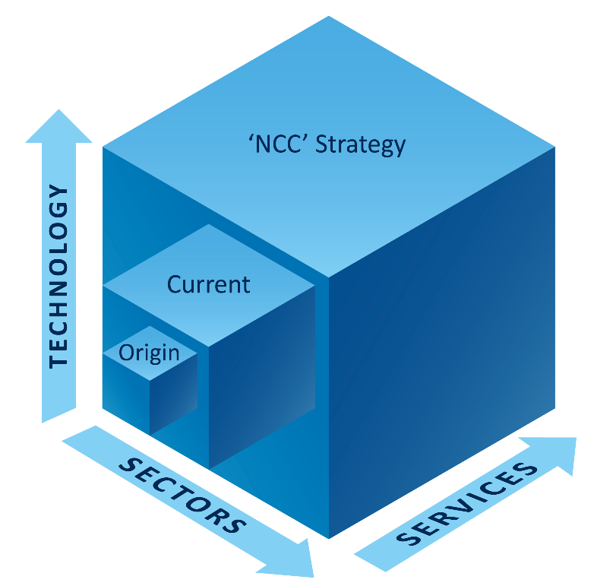
PUBLIC
NCC Progression & ‘Innovation Platform’ Strategy
Innovation Platform
Strategy Development & Influence
Multiple sectors
Adjacent Technologies
SME & Skills Services
Rebrand
Innovation Services
Broad impact
70+ members
400+ employees
£41.6m turnover
Sustainability & materials
Culture & Values
National Missions
Digital engineering
‘end to end’
Increasing impact
Regional Cluster
3 extensions
2nd site
<£5m turnover
6 members
50 employees
Joined HVMC
Expanded composites capability
New facility
Growth sectors e.g wind
2009 UK
Composites
Strategy
Opened 2011
NCC Evolution – ‘More than composites’
2024
2025
Future

Slide 6

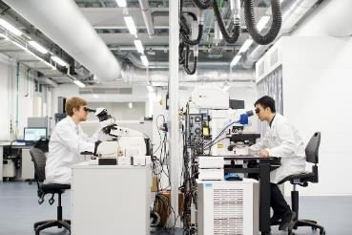
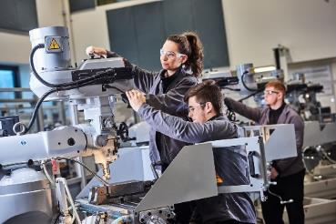
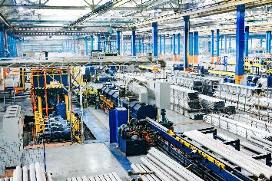
PUBLIC
Delivering industrial transformation
Addressing the three key elements in industrial transformation:
Solving technology problems
Providing future skills
Developing supply chains
PUBLIC

Slide 7
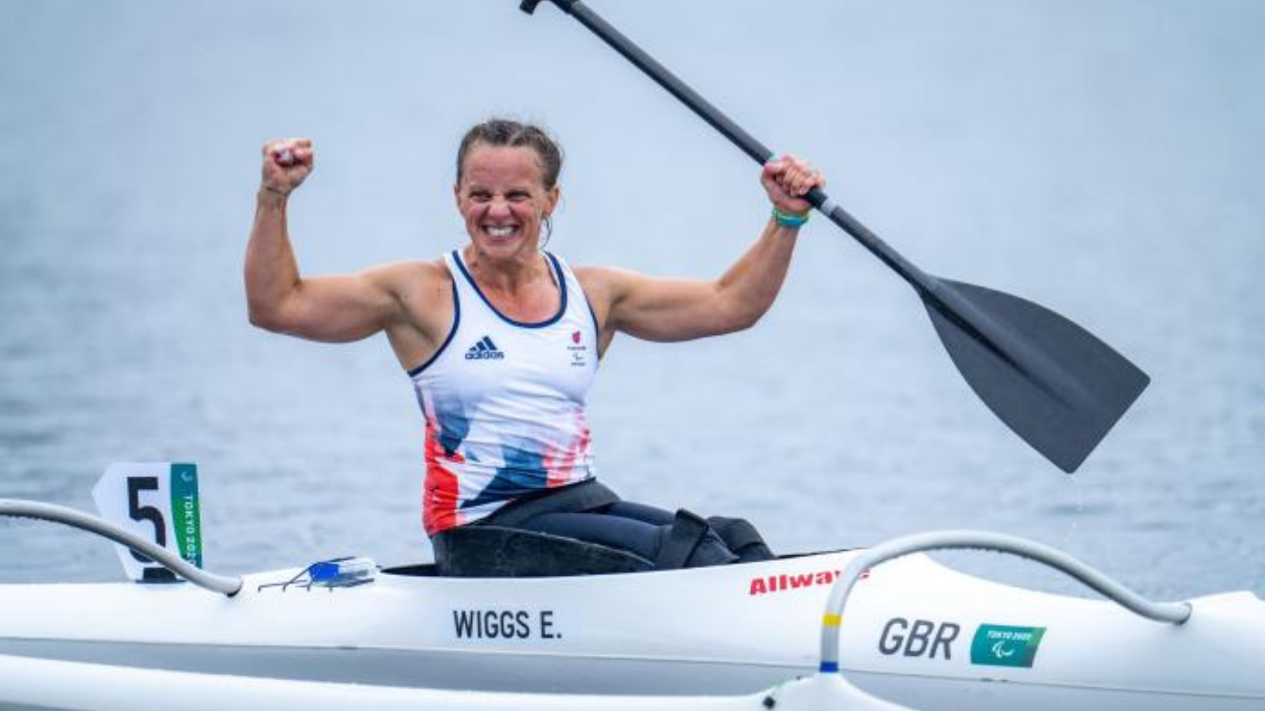
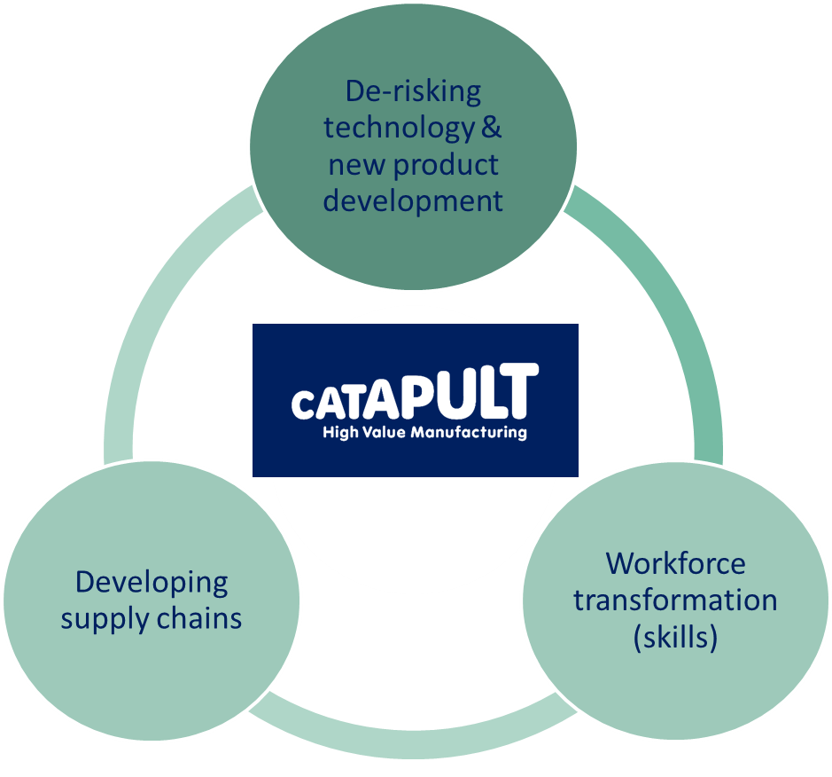


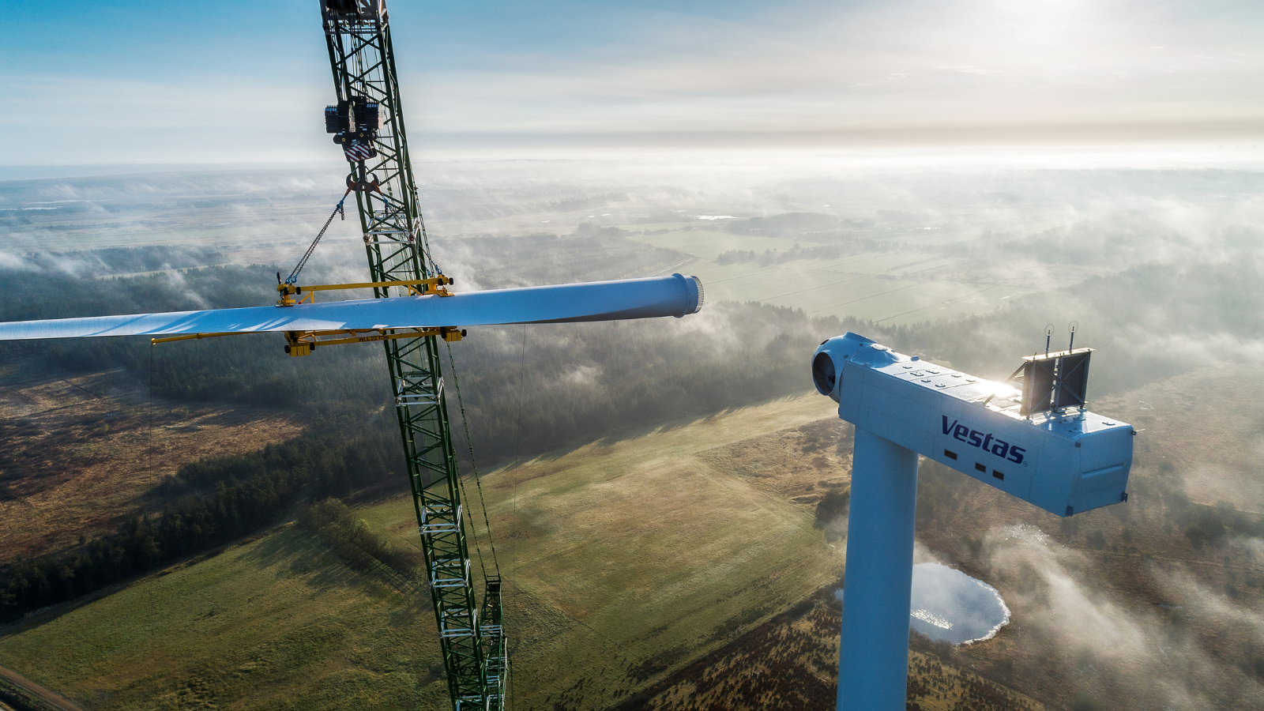
PUBLIC
Delivering industrial transformation
Delivery partner to help deliver UK industrial priorities: Net Zero, Resilience, Competitiveness
Independent of industry, not for profit organisations
Full scale industrial demonstration capabilities
Extensive industrial & academic networks
PUBLIC
Notes:
Emma Wiggs’ Gold & Silver medal winning paracanoe seat: Whilst this work focusses on a sports application, the digital capability to track the health of parts will feed powerfully into other sectors, be it smarter and more sustainable through-life wind turbine blades or hydrogen storage solutions.
Hydrogen Skills Alliance’s new Hydrogen Strategic Skills Plan report that calls for a dedicated Hydrogen Skills Academy to be established with industry support to realise the UK’s clean energy ambitions.
HALOS Blade: Work with UK SME Carbon ThreeSixty to develop new braided composite rotor blades suitable for an electric vertical take-off and landing (eVTOL) aircraft.
Vestas innovation partnership (with BCI) to anchor UK’s sustainable offshore wind industry
(Alternative: Airbus’ Wing of Tomorrow unlocks very high deposition rate wing technology to meet the global demand for narrowbody aircraft)

Slide 8
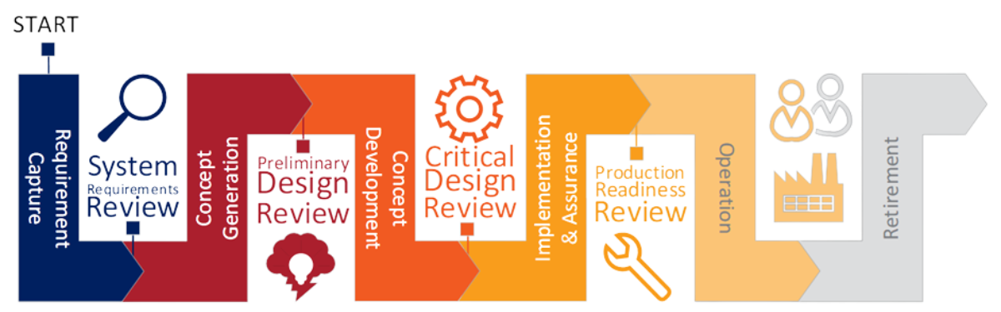
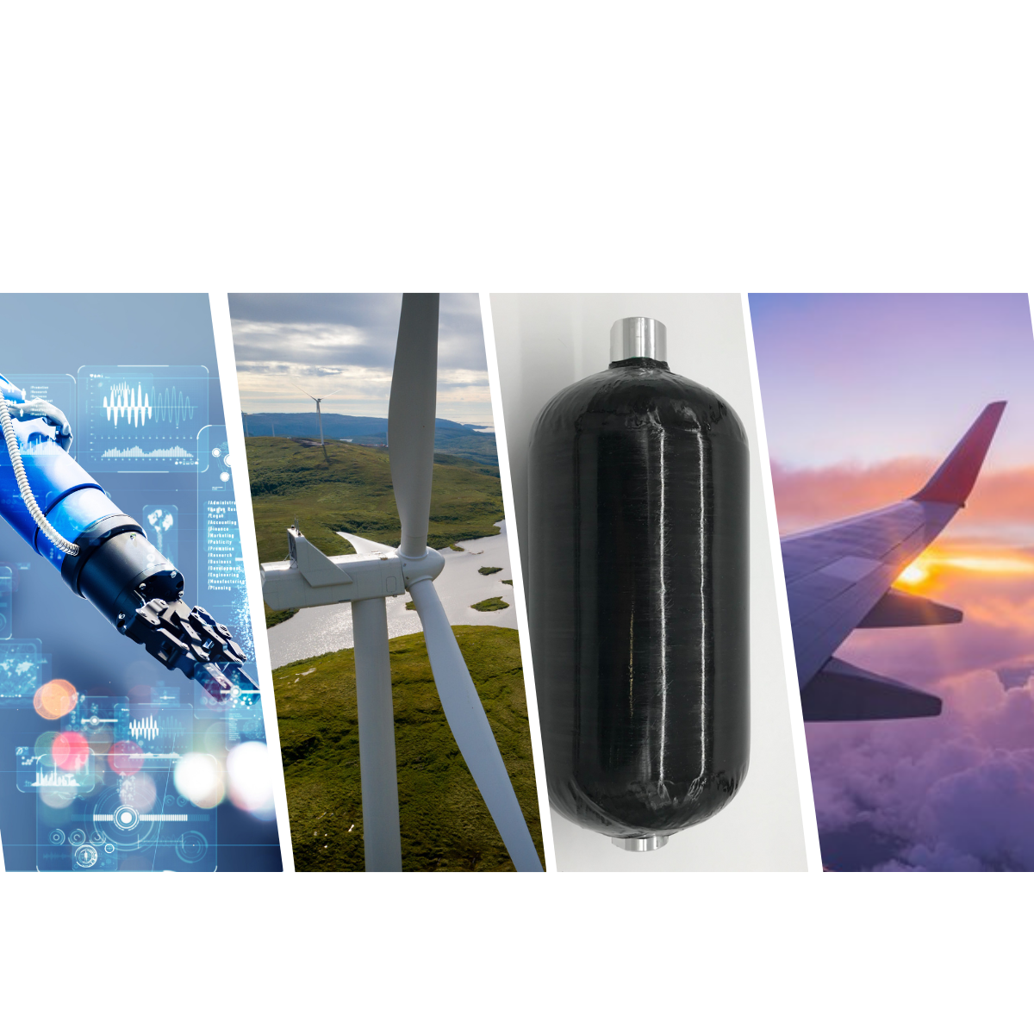
PUBLIC
End-to-end engineering capability
Engineering Development
Turning ideas into reality through advanced engineering and digital simulation.
Sustainable Composites
Driving the industry towards net zero industrial technologies.
More than manufacturing and composites
Concept Engineering
A world-leading authority on the adoption of material technologies.
Engineering Operations
Delivering operational efficiency and customer satisfaction with world-class facilities and people.

Slide 9
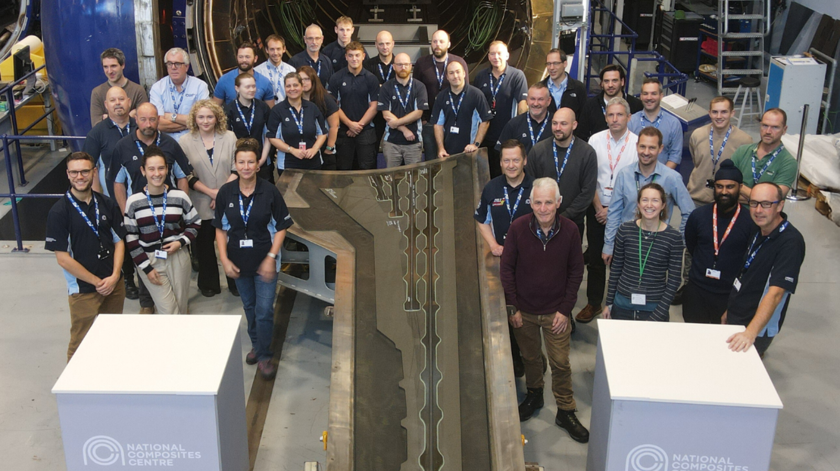
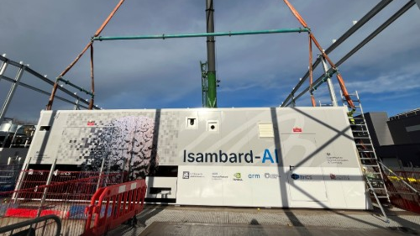
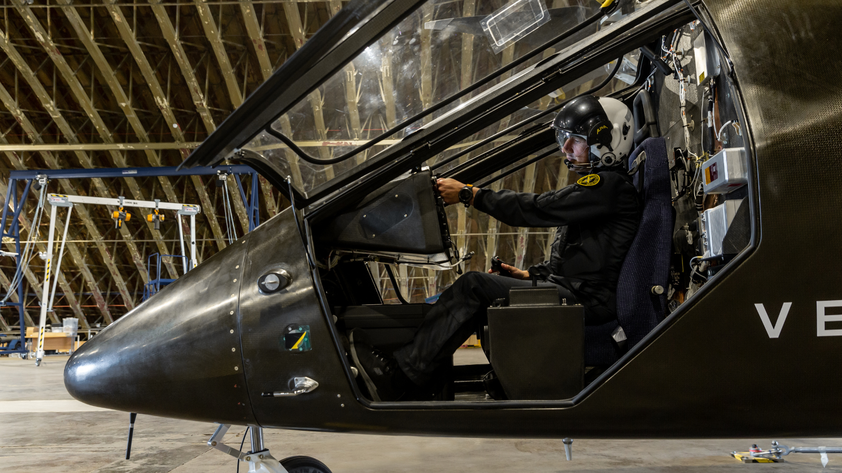
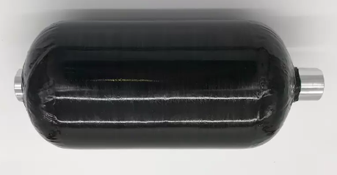
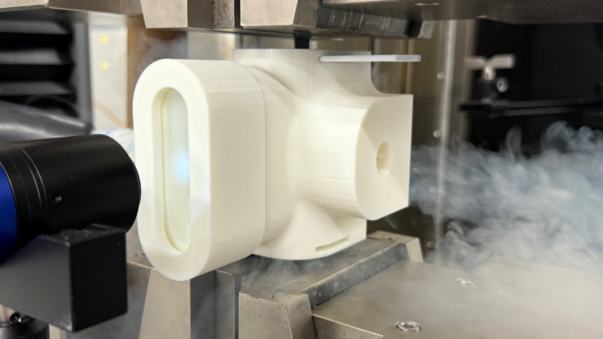
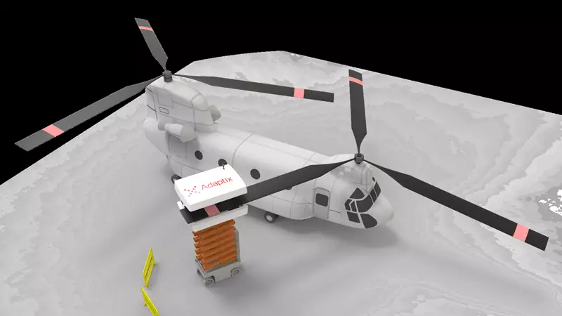
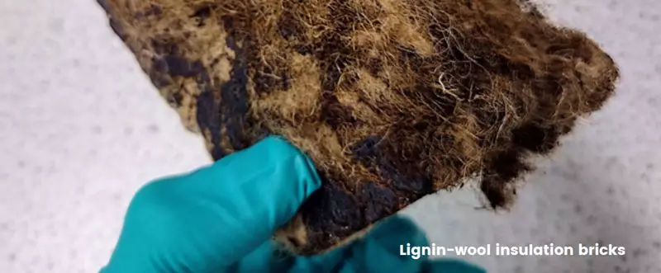
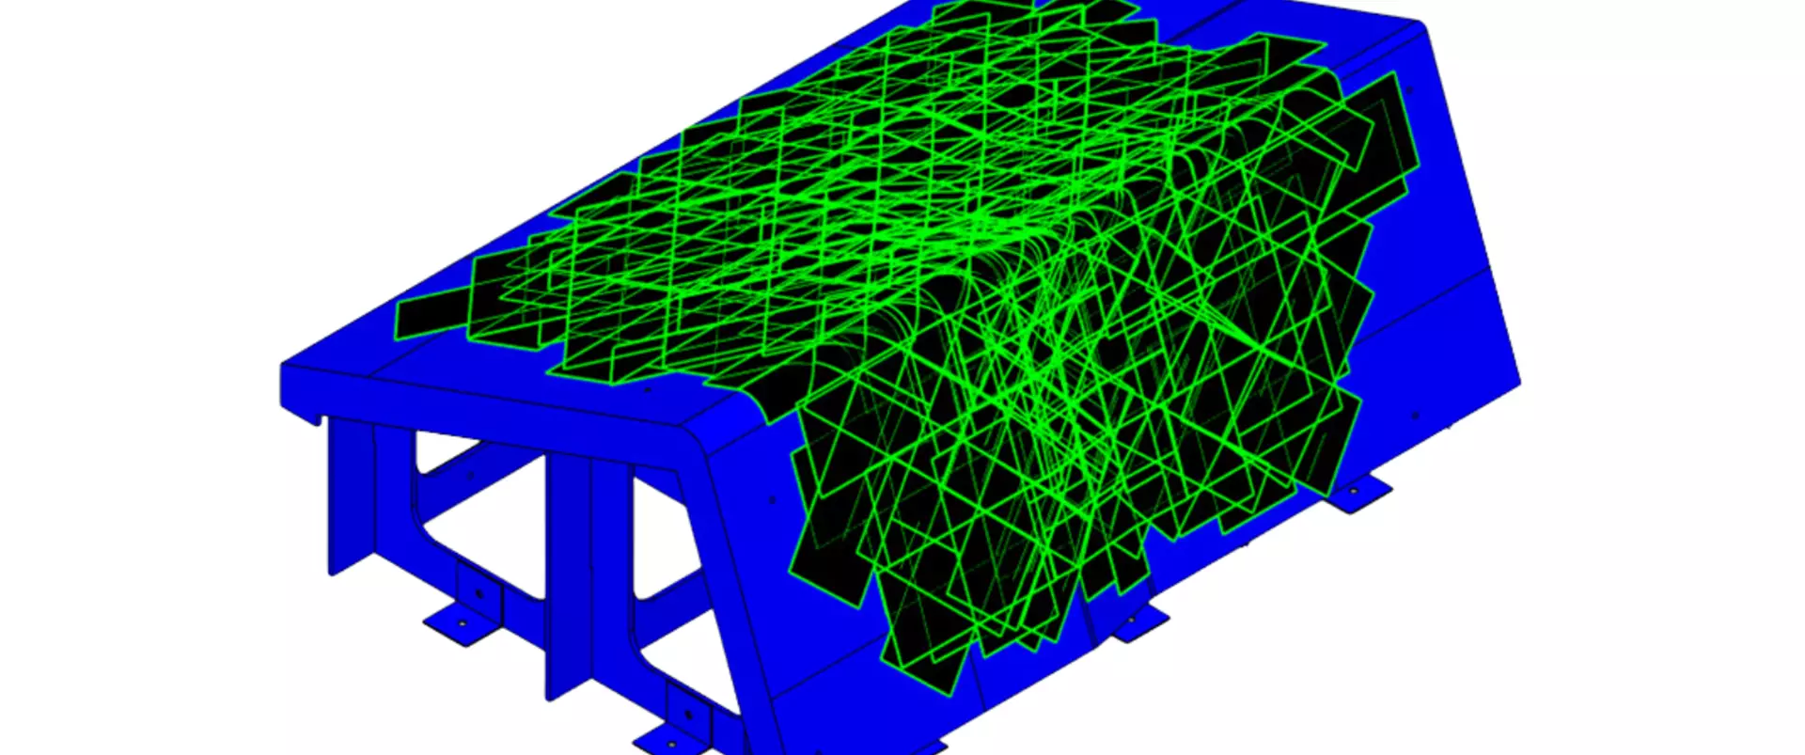

Our impact and innovations
Notes:
Airbus eXtra Wing: As a centre of excellence for wing technology, NCC delivers the design and manufacture of vital one-off flying parts to enable innovations in net zero aviation. Source: https://www.nccuk.com/xwing
Isambard AI set to become the UK’s fastest and most powerful supercomputer, purpose-built for AI research following completion in Summer 2025.
Vertical Aerospace: From design to certification. Source: https://www.nccuk.com/vx4
Enabling the clean energy transition: (1) Hydrogen tank (2) Novel 3D cryostat (verification) to screen a wide selection of materials at cryogenic temperatures quickly and at low cost. Source: https://www.nccuk.com/news/novel-cryostat/
AdaptixNDE: NCC enabled SME to extend medical imaging expertise into non-destructive testing (NDT) for the aviation industry, with the potential to break into a market estimated at £1.5 billion annually.
Material science with Sonichem: Transforming Lignin into Sustainable Materials as an Alternative to Fossil-Derived Materials
Sustainability solutions using aircraft wing offcuts with Civotec
Space: NCC’s work with BCI has ‘next-generation' space materials being tested at the International Space Station. Source: https://www.nccuk.com/news/bristol-composites-institute-advances-space-research-with-successful-falcon-9-launch/

Slide 10











PUBLIC
‘One of the UK’s best innovation ecosystems’
Application
Application
Research
Business
Universities
Translation & Incubation
Bristol research ranked 2nd full-discipline HEI, 5th overall
Highly ranked in many disciplines
Leading position in 5 UK priority technologies
Highest number of CDTs (Bristol & Bath combined)
Home to numerous research institutes & partnerships
#1 university incubator – Set Squared
Largest aerospace cluster in Europe
Largest defence cluster in UK
Largest creative cluster outside London
Largest cyber industrial cluster in UK
Key nuclear energy cluster
2nd in UK for tech start ups
1/3 of all UK quantum start ups
Centre for professional & financial services
Home to many leading companies
2 of the UK’s largest urban regenerations

Slide 11
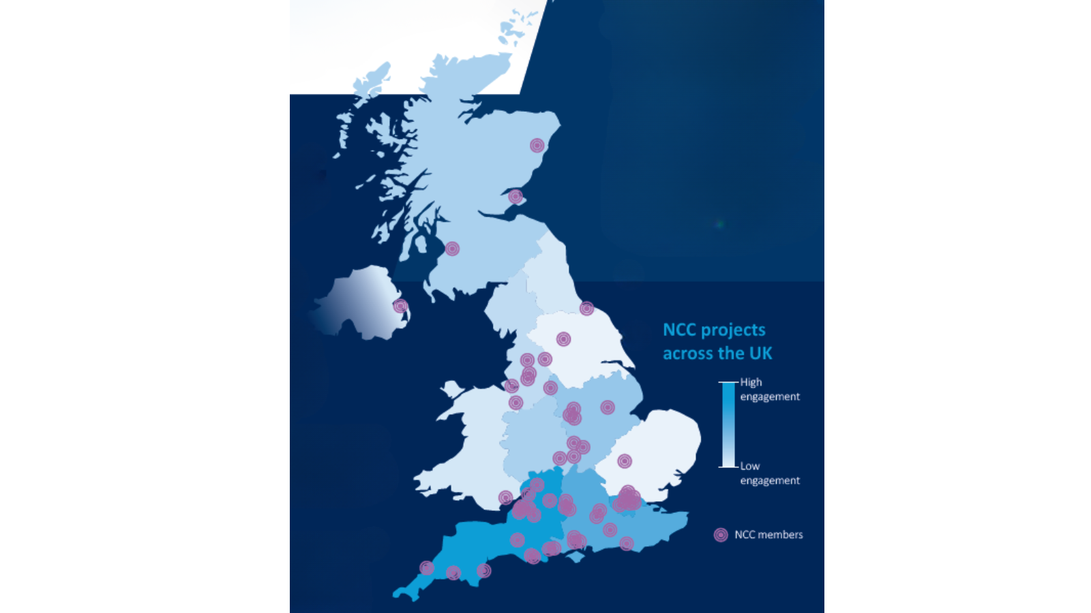
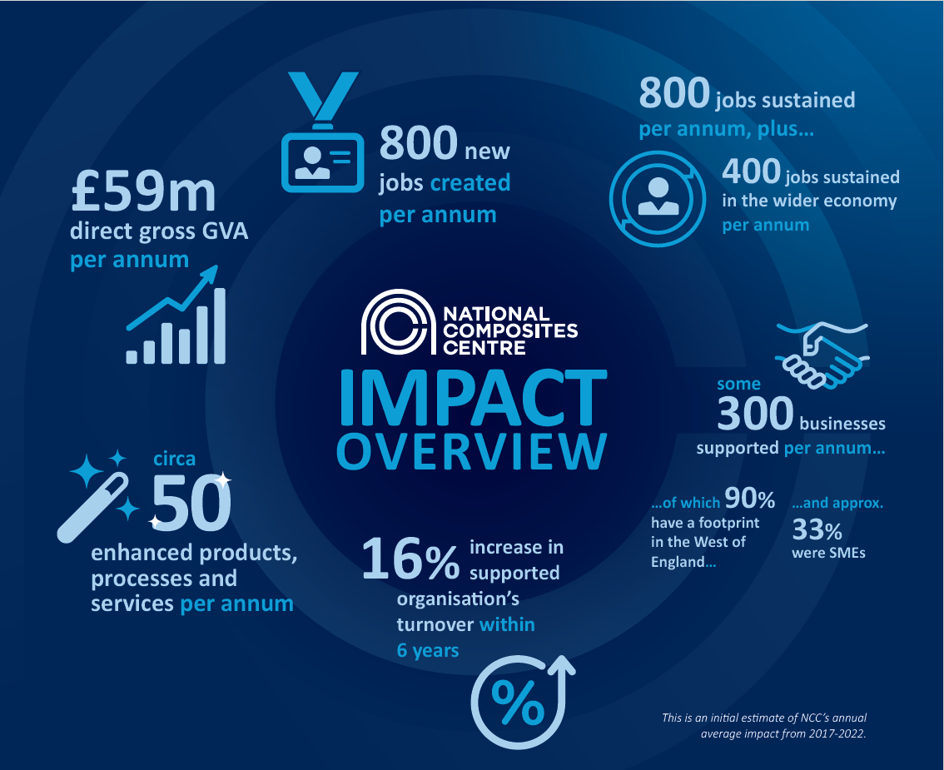
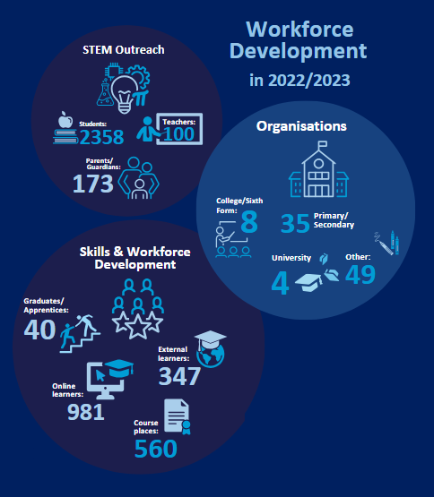
public
Our impact footprint
90% of supported SMEs have a footprint in the West of England,
NCC contributes £40m GVA per annum
public

Slide 12

Public
A connected pathway: Research to manufacture
Expand Research Portfolio
Innovation Scale Up & Derisking
Full Scale Demonstation
University / RTO
RTO / Catapult
Late stage R&D facility
UK Manufacturing
Test & Validation
‘Industrial-scale’ Prototype
Product & Process Innovation scale-up
Lab scale
Skills
Supply chain
1
3
TRL
6
9
Industrial match & Inward investment and export-led growth
Government Research & Development
Technology push
Technology pull

