Slide 1
Contractor Health & Safety Induction
Department of _______________

Slide 2
Welcome
We consider all people who work, study, visit or who make use of University facilities to me members of our community
We are committed to providing a safe and healthy environment for all members of our community
In return, we expect all members of our community to:
  Respect the policies, rules and regulations of the University
  Act reasonably, be well-behaved and show respect to others
  Carry out their work or activities in a way that safeguards:
    their own health and safety
    the health and safety of anyone else who could be affected

Slide 3

What we expect of contractors
When you work for the University you are representing us.
You should always be dressed appropriately and wear company ID so that you can be easily identified
You need to be wearing – and using – the required Personal Protective Equipment to do your job safely
Work safely and think about the safety of others who may be affected by your works
Follow any local rules or procedures set by the department you are working in

Slide 4
Working Safely
Follow these safety guidelines.
If you fail to do so you (and your company) may be removed from site permanently.
If you have any doubts about what is required of you, please ask your University contact.
Remember –ALWAYS WORK SAFELY

Slide 5

Risk Assessments and Method Statements (RAMS)
The University requires contractors to provide written risk assessments and method statements whenever there is a significant risk of injury associated with a job or activity.
RAMS identify the things that could cause harm and injury and what needs to be put in place to protect you, your workmates and others from harm.
You should NOT start any work until these have been provided to your University contact.

Slide 6
Risk Assessments and Method Statements (RAMS)
You must make sure that you have read and understood any RAMS for your work.
You must make sure that you properly follow the RAMS including properly implementing identified control measures.
Report any concerns to your supervisor

Slide 7
Works on Building Fabric and Services
Works on University building fabric, services and infrastructure is tightly controlled.
Regardless of who you are working for, all such work has to be approved by the Department of Estates.
Your University contact is responsible for gaining approval for this work to be done.
Estates will need to be provided with your RAMS so that they can confirm they are happy for you to proceed.
You may be required to attend an induction provided by Estates.

Slide 8
Works on Building Fabric and Services
You should not start any such work until you have the necessary permissions in place. Types of work falling under this include (but are not restricted to):
  Drilling, penetrating, attaching to, rubbing down, painting, taking down, altering existing or constructing new walls, partitions, ceilings and all other parts of a building’s structure
  Anything that could compromise fire safety (compartments, fire doors, means of escape and alarm systems)
  Accessing above suspended ceiling or risers or ducts, including floor ducts
  Works on the fixed electrical system (including any equipment hard-wired into the system)
  Works on University heating systems including any associated pipework
  Plumbing work that alters or connects into a building’s hot or cold water systems
If in doubt speak to your University Contact

Slide 9
Permits to Work
The University operates a number of permits to work. These are issued by the Department of Estates. Your University contact will need to arrange the issue of permits in advance of you carrying out any works.
You will need to provide RAMS for the work that you will be carrying out and these will need to be approved by Estates before a permit is issued.
Permits are required for each of the following:
Roof works / access
Electrical works
Works on building gas supplies
Excavations / Ground penetrations
Asbestos Works
Hot Work
Work on pressure systems
Isolation of fire alarms
Powering down safety critical equipment such as fume cupboards

Slide 10
ASBESTOS
Many University buildings contain asbestos.
Asbestos does not pose a risk unless it is disturbed or damaged.
The Department of Estates holds the University’s asbestos register. No works should be carried out on building fabric, services and infrastructure unless the asbestos register has been checked to confirm that it is safe to proceed.
If you discover asbestos whilst working:
  Stop work immediately
  Make the work area as secure as possible
  Alert your University contact immediately and the Department of Estates

Slide 11

Fire Safety
  Never cover smoke or fire detectors unless you have been specifically authorised to do so
  Remember, Hot Works may only be done under a permit to work
  Keep fire exits and routes clear at all times
  Do not wedge fire doors open
  Tidy up as you go – waste should be put in appropriate bins
  Store flammable materials as directed
  Smoking is not allowed:
    in any University buildings
    Within 5 metres of any buildings
    on the Parade or in the underdeck

Slide 12

Fire Safety Arrangements
University buildings are fitted
with automatic fire detection
and audible alarms
We carry out weekly fire alarm
tests in all buildings. Testing is
carried out Wednesdays and
Thursdays.
We have fire wardens in all buildings. Fire wardens will check designated areas to make sure that everyone has left the building in the event of an alarm.
There is a designated assembly point for all buildings
Information on tests and assembly points should be provided by your University contact.
Make sure that you know where your nearest exits are.

Slide 13
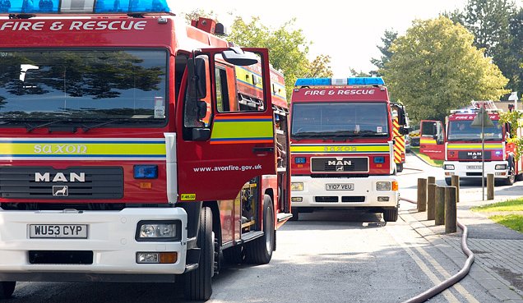
Fire evacuation
If you discover a fire:
  Activate the alarm by pushing a red call point
  Fire extinguishers are provided in all buildings – you should only tackle a fire if you are confident in the use of an extinguisher and it is safe to do so
  Exit by the nearest fire escape route and go to the assembly point.
If you hear the alarm
  Stop working and make your area safe
  Do not take possessions with you
  leave the building by nearest available route closing doors and windows behind you
  Go to the assembly point and await further instructions
  Wait at the assembly point until informed otherwise
Never put yourself or anyone else at undue risk

Slide 14
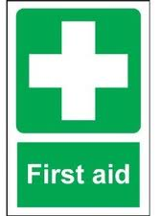
First Aid
First Aiders
  Our security team act as the University’s First Response in the event of an emergency.
  If you require first aid or if you need an ambulance:
    Call security
    If an ambulance is required contact security rather than calling 999. They will call the emergency services and will meet them on arrival to direct them to where you are working
  We also have first aiders in each of our buildings. You should check contact details with your University contact.
  All first aiders are fully trained and have access to a first aid kit
Defibrillator available on site
  Sports Training Village and Security (dial 666 or01225 383999)

Slide 15
Incident Reporting
All accidents, near misses and incidents must be reported to the University as soon as possible after they have happened.
You should do this by telling your University Contact. They will complete the University’s online report form but they may need certain details from you:
  What happened
  Details of who was involved
  Any injuries or damage caused
  What has been done to make the situation safe or prevent a recurrence.
Remember
First Responders (Security) will attend all incidents
  If requested to do so by phoning 666 or 01225 383999
  In the event of a fire alarm being actuated
DO NOT CALL THE EMERGENCY SERVICES DIRECT

Slide 16
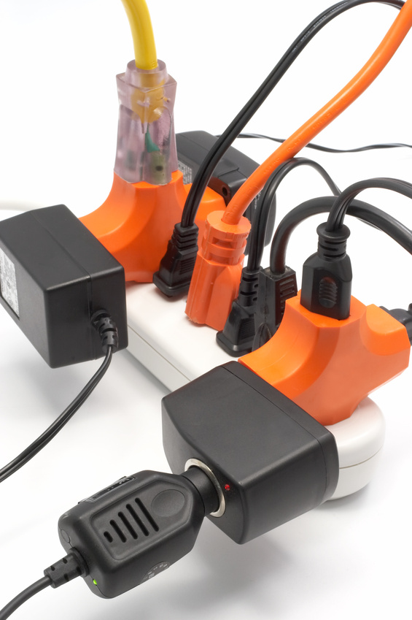
Electrical Equipment
Appliances
  Wherever practicable use battery operated equipment. Where this is not possible, 110v equipment should be used.
  All electrical equipment should have an in- date PAT Test
Extension Cables
  Use wisely
  Never use more than one extension cable at a time with each appliance
  Avoid using extension cables with high wattage appliances such as kettles
Portable heaters should not be used.

Slide 17
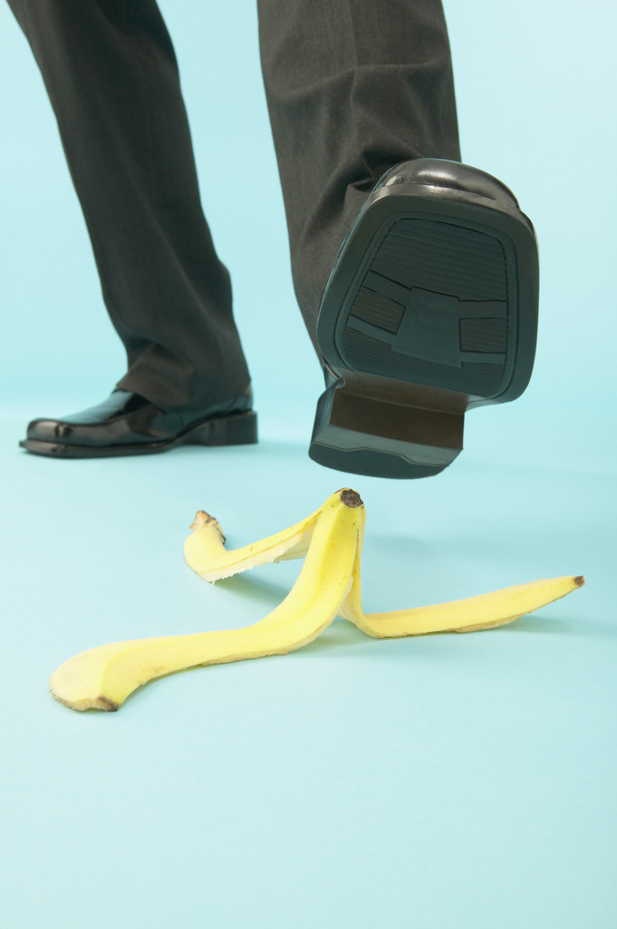
Housekeeping
Keep floors clear to avoid slip, trip or fall
Tidy and restrict cables to prevent them from becoming a hazard
Clear up spills immediately
Do not leave work equipment or materials unattended
Tidy rubbish as you go
Do not obstruct corridors or doorways
Make sure that fire exits are kept clear

Slide 18
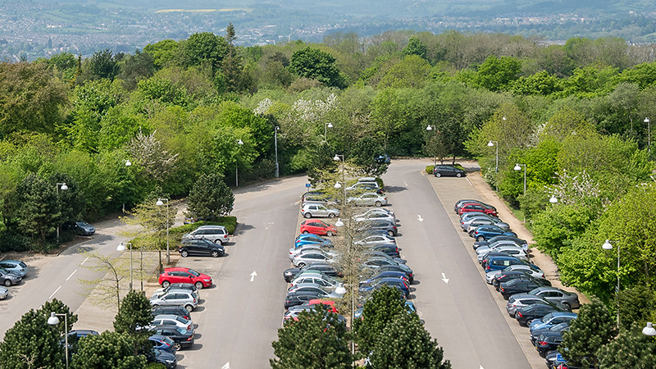
Parking and Driving on Campus
Contractors can use Pay and Display car parks.
You must not park on:
  Pavements or in reserved, named
  or car share bays
  Hatched areas
  Double yellow lines
  In front of emergency exits
Spaces reserved for electrical vehicles
must only be used for parking or
charging electric vehicles
Accessible parking spaces can only be used by people with a “Blue badge”
Drive slowly when on campus and observe all speed and road traffic signs.
Take particular care when driving in the underdeck.
Be aware of pedestrians and cyclists
Failure to follow parking or driving regulations may result in you being issued with a Fixed Penalty Notice. If in doubt, please speak to your University contact.

Slide 19
Acceptable behaviour
We expect all members of our community to treat each other with dignity and respect.
We will not tolerate unacceptable behaviour and anyone found to have broken this rule will be removed from site.
Whilst on site we expect you to observe our site rules. In particular:
  Do not smoke in or round buildings, the Parade or the underdeck
  Do not use mobile phones when working at heights, driving or doing other work tasks that require your proper attention
  When you are in and around University buildings, please be considerate of other users, especially when using phones or having conversations with other people
  Radios and similar should not be used on site
Where appropriate clothing at all times and your ID card where applicable

Slide 20
Checklist
You should now be aware of:
  Our commitment to health and safety
  Your responsibilities including Acceptable behaviour (conduct, smoking and working on site)
  Risk Assessments and Method Statements
  Rules for working on building fabric, services and infrastructure
  Parking and Driving on site
You should now know what to do if:
  You discover asbestos
  You hear the fire alarm
  You discover a fire
  You need to report an incident
  You need first aid treatment or the emergency services
  Remember, if you have any concerns about working at the University then please speak to your University contact.
  THANK YOU

