Slide 1
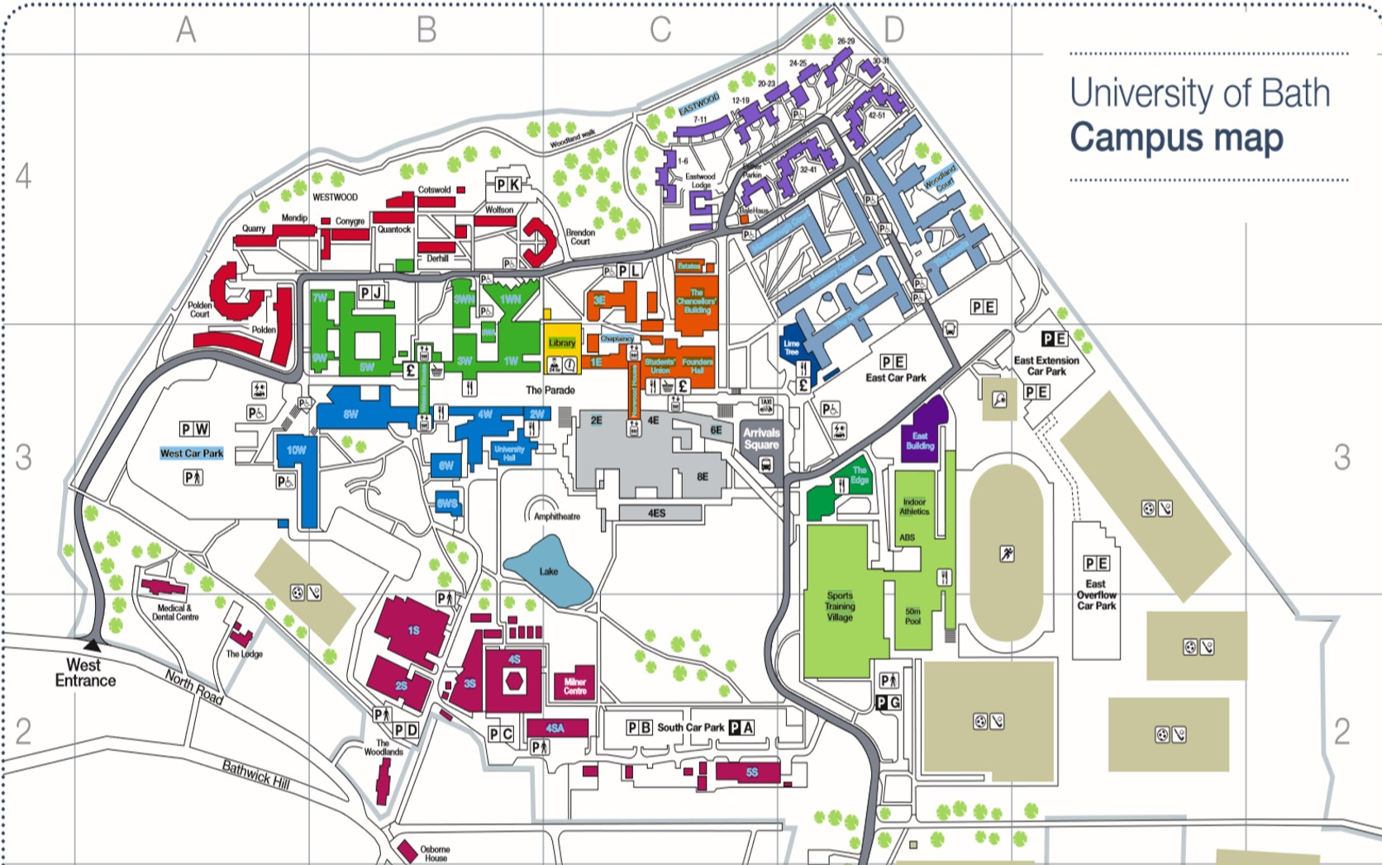
1W: 2.101, 2.102, L3 stairs, L3- 1WN, L2 stairs, L3 stairs & foyer, L4 stairs
1WN: L2 & L3 foyer, L2 Corridor
Chancellors Building: L1(left/right of stairs) L2 stairs & L2 pod
1. Arrival Square: Bus Stop
2. 6E: Foyer
3. 4E: L2 Foyer
4. 2E: L2 Foyer
5. Norwood House: Comms Room
6. 3S: 0.05
7. 1S: Foyer
8. 8W: L1 Reception
9. 9W: L2 Foyer
Student Union: 1, 2, 3
3E: L2, L3, L4 Foyer
5W: L2 & L3 Foyer
Edge Café: L2, café, ext. left and right
10W: L1 Foyer, L2 stairs & L2, L3, L4, L5 Drinking Fountain
9
5
8
4
3
2
1
4ES: L1 Foyer, L2 Computing Services Reception, L2, L3, L4, L5 & L6 stairs
7
4W: L2 Foyer, Student Services & Graduate Centre
6
Library: ITP shop
L1 PC lab, L2 foyer, L3, L4 & L5 PC area
L0 Foyer/ stairs & L1 foyer/ stairs
STV: Foyer, walkway, café & sports injury clinic, reception desk
4S: Foyer & Corridor

