Slide 1






Supporting Doctoral Researchers
A workshop for supervisors
This workshop:
Themes
Expectation Setting
Keeping on Track
Developing and Supporting Doctoral Researchers (and relationships)
Objectives
Aligning with University Objectives
Enhancing Your Supervision Practice
Peer Learning
Understanding Expectations
Accessing Resources
The big picture:
Supporting the Doctoral Strategy (2022-2027)
The doctoral strategy aims to nurture and enhance doctoral research excellence by growing research quality, achievement and impact, and promoting an inclusive and collaborative research community. This is anchored in a commitment to build a research culture that promotes collaboration and networking; encourages new ideas and innovation; nurtures leadership talent; coordinates the delivery of cutting-edge training; and provides a challenging and enriching researcher experience. Through these commitments, we look to raise the profile of doctoral research across the University, and be recognised, nationally and internationally, as a centre of excellence for doctoral education. The doctoral strategy implies a multi-stakeholder commitment involving Faculties/School, academic departments, professional services, and the Doctoral College.
Four objectives of the strategy:
Enhance the doctoral experience through an inclusive and engaged research culture.
Increase doctoral performance and submission rates.
Improve doctoral students’ skills and employability.
Increase the number of doctoral students in a sustainable and inclusive manner.

Slide 2
1. Expectation setting
Supervisors, co-supervisors and doctoral researchers often have differing expectations of supervision. Although there are expectations in the QA7, they are often open to very different interpretations.
ACTIVITY Part 1:
Write a brief response to each question, thinking about a current doctoral researcher.
(If you have several students, focus on the one that is nearest the start of their doctorate)
What is the most important role that your co-supervisor plays?
What do you consider to be a reasonable response time when a doctoral researcher has a non-urgent question?
How would you interpret ‘regular formal meetings’? How frequently should they take place?
How do you prefer meetings and decisions about the research be documented?
How do you prefer to give feedback on a: written work? and b: the researcher’s skills?
What do you hope to be the potential publishable outputs from your doctoral researcher’s projects?
What would you expect a normal working pattern for a doctoral researcher to look like?
What are the arrangements for taking holiday? e.g. process / number of days they are entitled to?
What are the expenditure arrangements for any budget associated with your doctoral researcher’s project?
What would you add to these topics for clarification and negotiation with either your students or co-supervisors?
ACTIVITY Part 2
In trios/pairs compare some of your answers to Part 1 and consider these Part 2 questions. Be ready to feedback one or two examples of topics you would add to the list.
Do you have any differing perspectives?
Where might your co-supervisors or doctoral researchers have different opinions? Do you know with certainty what their view might be?
What would you add to these topics for clarification and negotiation with either your doctoral researchers or co-supervisors?
Personal Reflection:
Is there anything that you feel requires clarification, negotiation or confirmation with:
Your current doctoral researchers?
Your co-supervisors?

Slide 3
2. Keeping on track
3. Developing and supporting doctoral researchers (and relationships)
ACTIVITY: Group practice sharing: Getting unstuck
Think of an example when a doctoral researcher you have supervised stalled or got stuck at some stage in their progress. Or think of a time that you yourself stalled as a doctoral researcher.
Briefly share your thoughts with your group:
What happened/ what was the context?
What factors led to the doctoral researcher stalling in their progress?
What was needed to get them back on track?
Nominate someone to briefly feedback on:
A common cause of stalling and the signs to look out for
One thing a supervisor can do to support a doctoral researcher getting back on track
ACTIVITY: Group practice sharing: relationships
Think of an example of a conflict or breakdown in communication with a doctoral researcher. Or think of a time from your own experience as a doctoral researcher.
Briefly share your thoughts with your group:
What happened/ what was the context?
What factors led to the conflict/breakdown?
What was needed to get back on track?
What could have prevented it?
Nominate someone to briefly feedback on:
A common cause of conflict and the signs to look out for
A suggestion for what can help to get things back on track

Slide 4

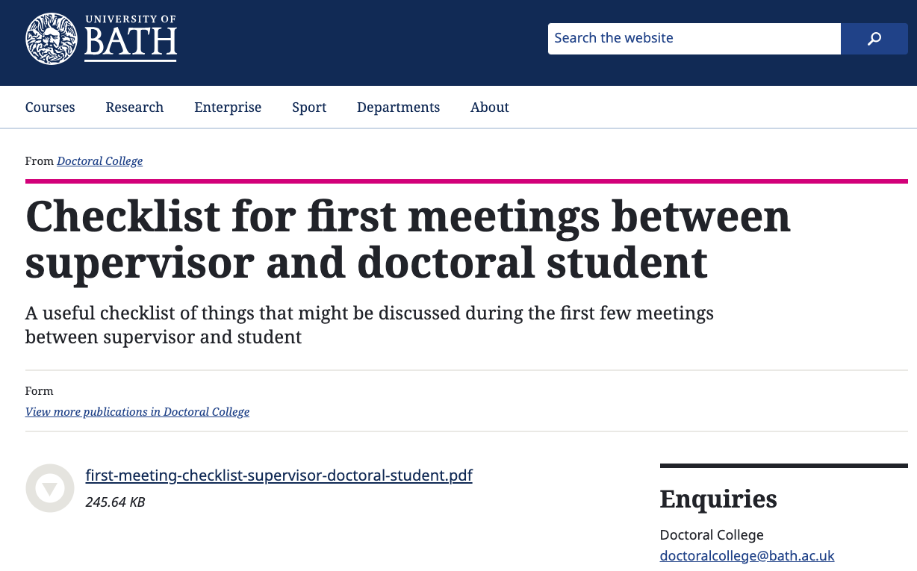
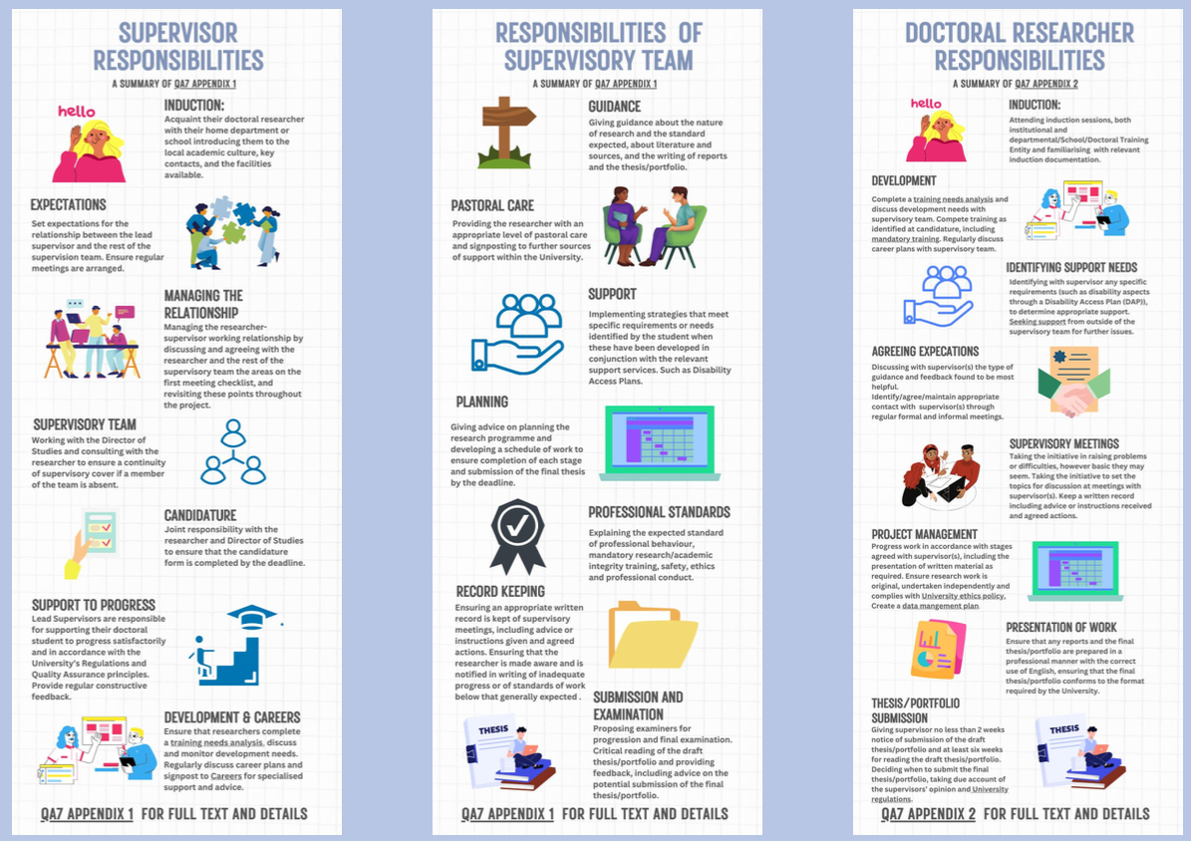
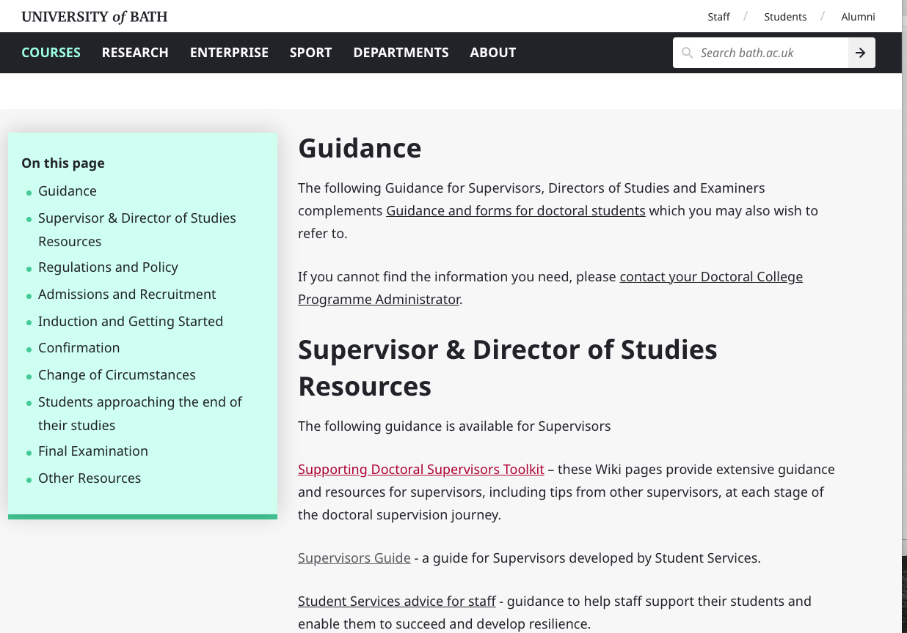

Reminders, resources and signposting:
Expectation Setting
Code of practice:
QA7 Section 9 states that the Lead Supervisor is responsible for:
Clarifying the role of supervisory team members, but also the DOS, HOD, and other staff
Signposting non-academic support services and supporting reasonable adjustments both before and after a Disability Action Plan
Agreeing a clear and auditable programme of work including e.g., frequency and reporting of meetings, work patterns, timing of milestones and completion (see Section 9 for detailed list)
Ensuring expectation setting includes training and career planning
Reassuring and supporting doctoral candidates in preparing for Candidature
All internal members of a supervisory team are expected to be actively involved in the direction of the research and support the doctoral researcher experience.
(see QA7 Appendix 1 for full list of supervisory team responsibilities).
Notes:

Slide 5
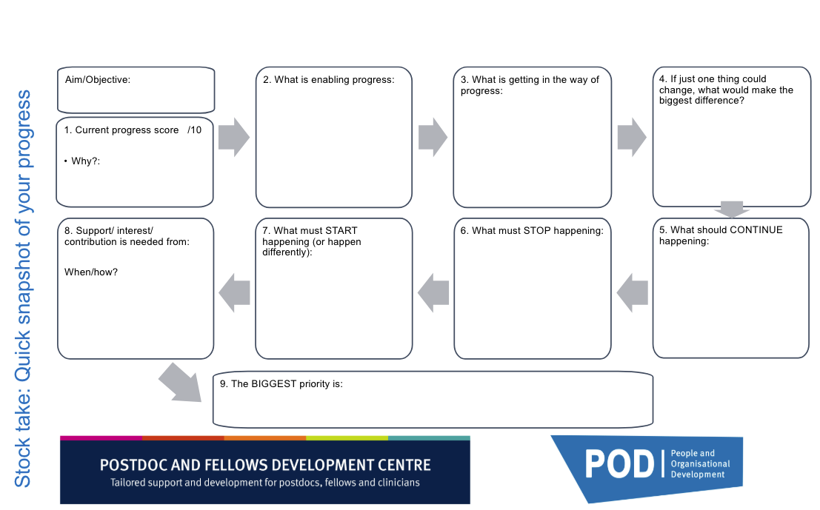
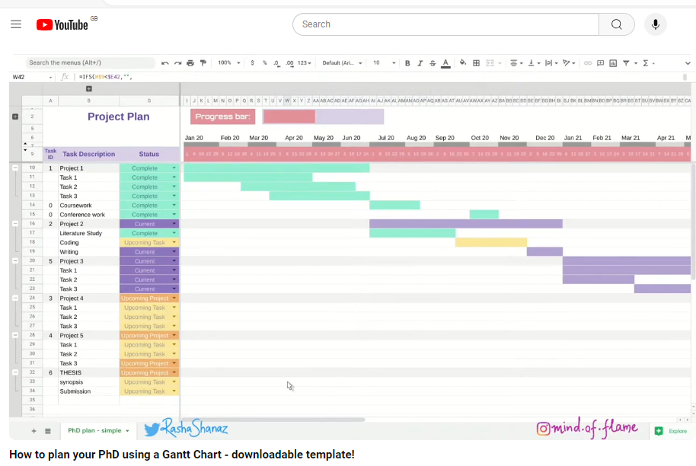
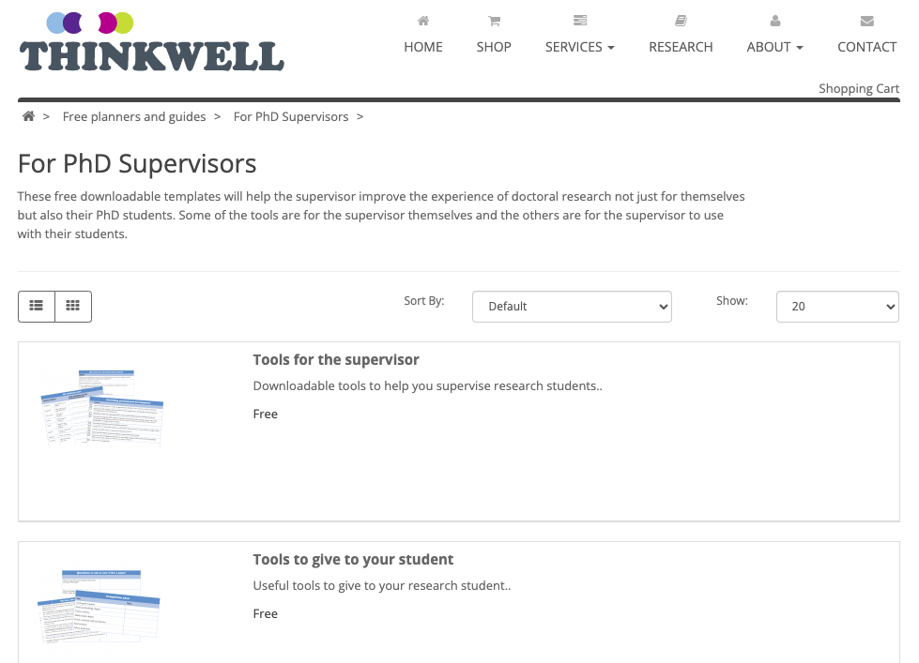
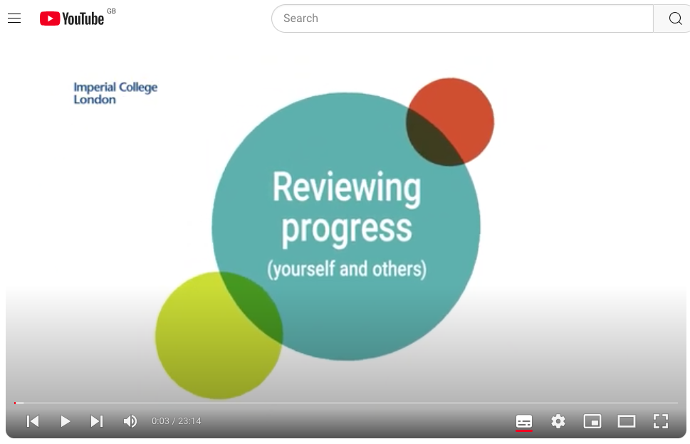
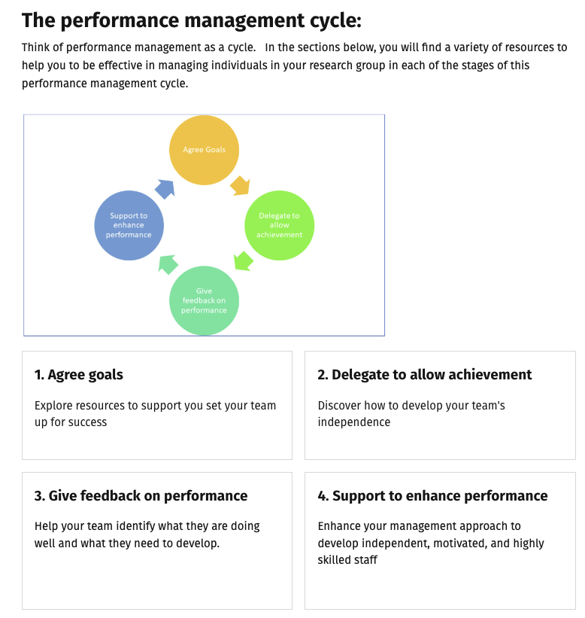
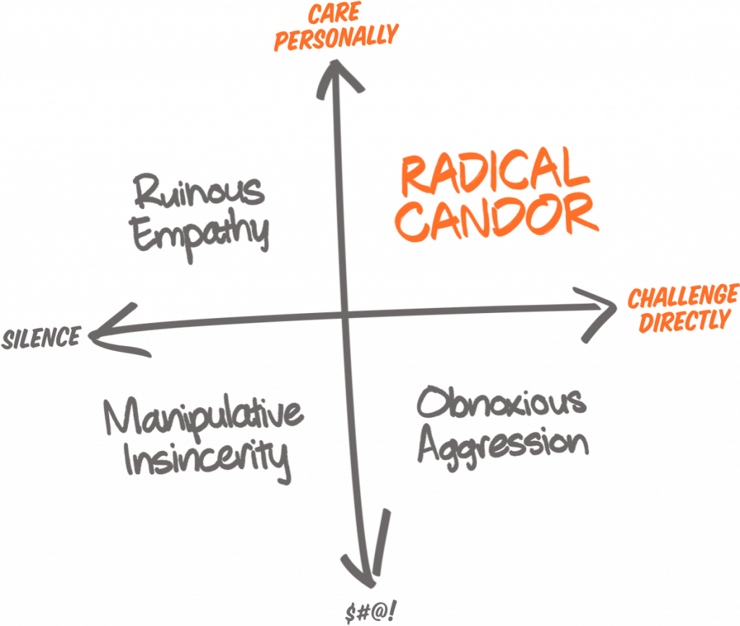
Reminders, resources and signposting: Keeping on Track
Code of practice:
QA7 states that the Lead Supervisor is responsible for:
Periodically reviewing expectations set at start of programme (9.2)
Discussing appropriate thesis format and potentially publishable outputs (9.3)
Completing candidature with doctoral researcher (6.5; joint responsibility)
Bringing any dissatisfaction with progress to researcher’s attention ahead of formal progress reports (10.7)
Completing six-monthly progress reports on time (10.9)
Ensuring doctoral researchers are aware of central/local confirmation report guidance (11.8)
Carrying out a critical reading of the draft thesis, advising on changes that should be made (12.8). Should be given minimum 6 weeks for this!
Notes:

Slide 6
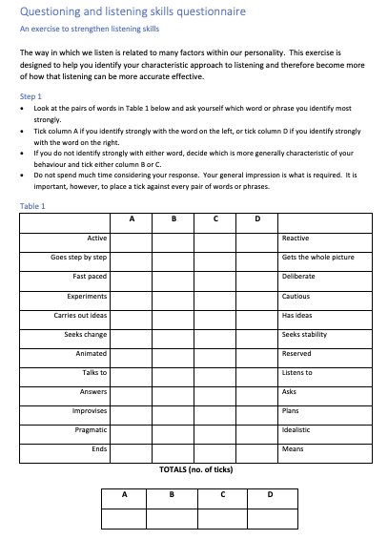
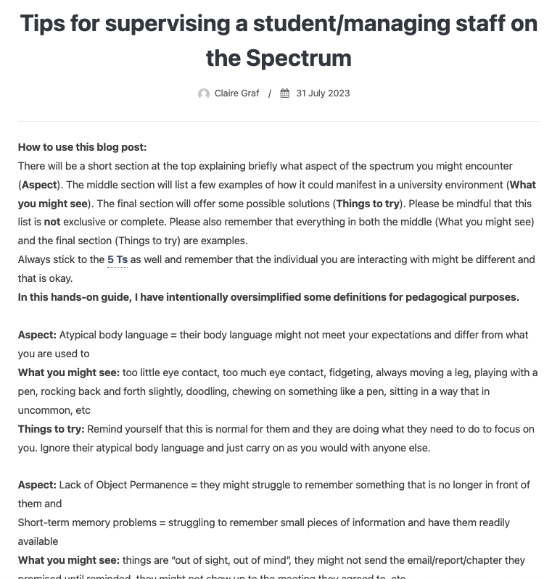
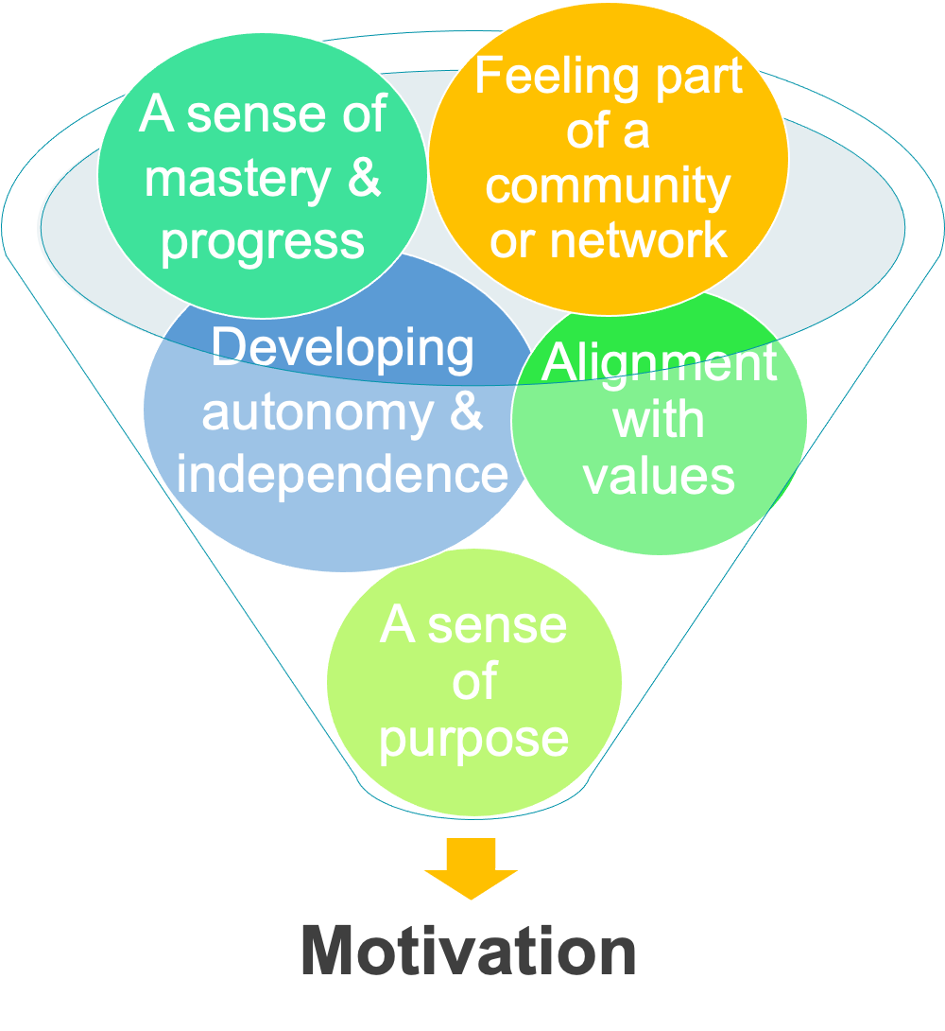
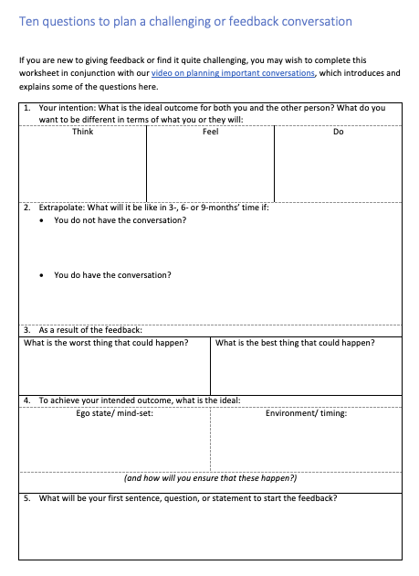
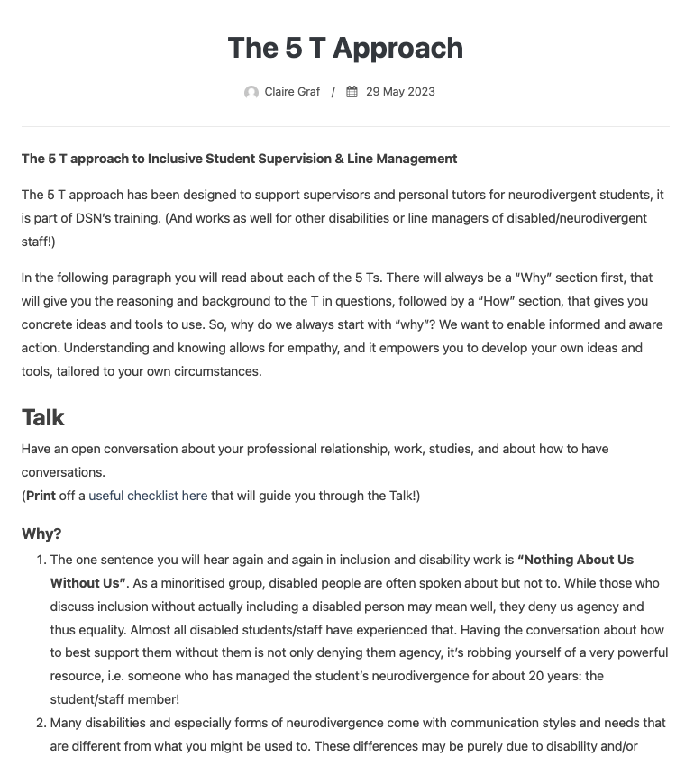
Reminders, resources and signposting: Developing and supporting students (and relationships)
Code of practice:
QA7 Section 9: For career development:
Put doctoral researchers in touch with their Faculty/School Careers Consultant
Share the Employability Map as a tool to plan in bite-size careers steps
Remind doctoral researchers that they can drop in to the Careers Centre (near Fresh) every weekday, 10-4, and access opportunities via MyDoctoral Development
QA7 Section 9: Lead Supervisor is responsible for:
Undertaking a Training Needs Analysis and Professional Development Plan (at start and at least annually)
Signposting appropriate internal and external training opportunities
Encouraging them to complete required research integrity training and have oversight of ethics applications
Pastoral care and relationship management
Separate course on Pastoral support for doctoral supervisors and personal tutors: https://www.bath.ac.uk/guides/student-support-staff-training/
If a relationship breaks down, route of support: DoS/HoD, then Faculty DoS, then Independent Advisors.

Slide 7


Case Studies
Case study discussion 1
In groups, discuss the scenario you are given.
Nominate a spokesperson to briefly feedback on:
What is the main problem?
(How) could the supervisor or doctoral researcher have prevented the problem?
What could be done now to improve the situation?
Who else could help or offer support?
Case study discussion 2
In groups, discuss the scenario you are given.
Nominate a spokesperson to briefly feedback on:
What is the main problem?
(How) could the supervisor or doctoral researcher have prevented the problem?
What could be done now to improve the situation?
Who else could help or offer support?
Notes:
Signposting: QA7 Statements on relationships
22.1 Students Complaints Procedure
22.3 Dignity and Respect Policy
22.6 Personal and Professional Relationships Policy
23 Declaration of Interests

Slide 8
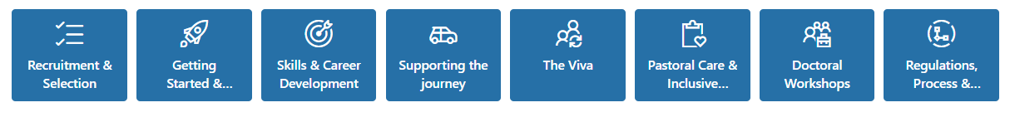

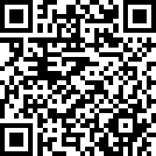
General Resources and Signposting
Following the workshop, you can access the slides and resources referenced throughout this workshop on the Doctoral College webpages.
We are in the process of finalising a Doctoral Supervisors Resources Hub (on Sharepoint) due for December 2024 launch. This will contain further resources on doctoral supervision as indicated in the boxes below:
Please let us know if you have any questions or requests for support to enhance your supervisory practic
Feedback Survey on the workshop
https://app.onlinesurveys.jisc.ac.uk/s/bathreg/doctoral-supervision-workshop
Next steps? What one thing will you do to adapt your supervision practice to take account of the ideas and reminders discussed today?

