Slide 1

Engage and Involve Grants
November 2023
Dean Veall
Deputy Head of Public Engagement
dwv20@bath.ac.uk
Rob Cooper
Public Engagement Officer
rwc31@bath.ac.uk

Slide 2
Summary of Engage and Involve Grants funding call
£20,000 available to fund 10 projects, each up to £2,000
Funding a portfolio of projects across the Faculties and the School and types of activities.
Improve connections between University of Bath research and wider society
All staff members in the Research & Education and Technical & Experimental job families and doctoral students
Deadline for the call is Friday 8 December 2023 at 4pm

Slide 3
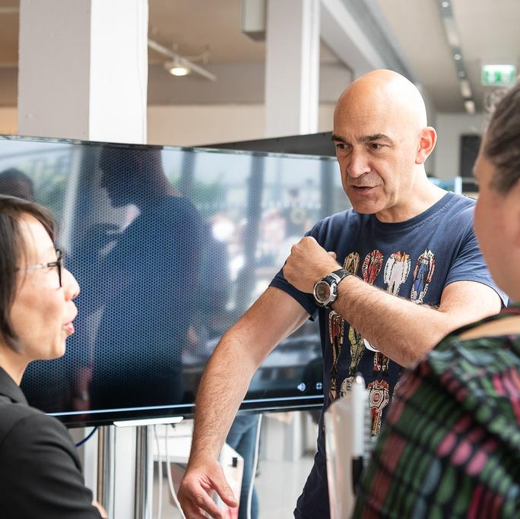
Public engagement with research
We define public engagement with research as:
Involving people outside of academia in places and at times where they are able to choose whether or not participate.
Engagement as a process where benefits are generated to both yourself (and/or your research) and the people you are engaging.
Involving specific and active research

Slide 4
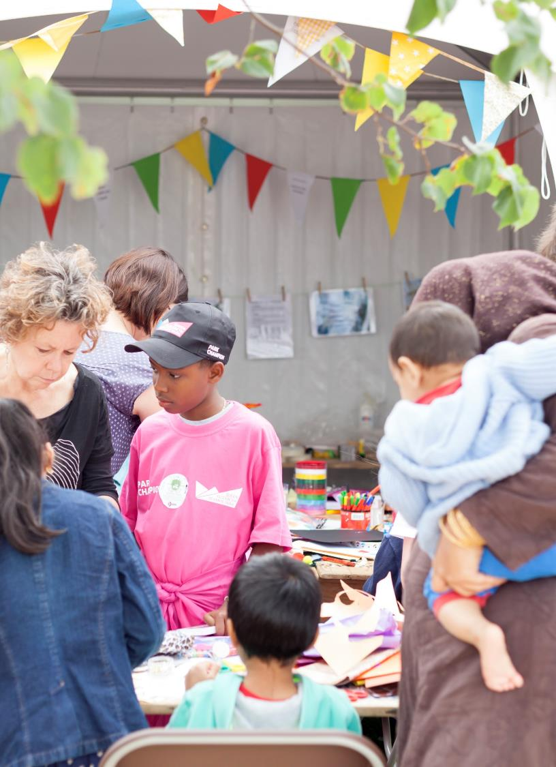
Who are the ‘public’?
Anyone outside academia acting in a non-professional capacity. This could be defined by:
Where they live
How they identify (age, gender, ethnicity etc)
Their interests
Their lived experience of for example an event or a health condition
Public can also ’include organisations that may be intermediaries working in a professional capacity such as charities or cultural organisations.

Slide 5
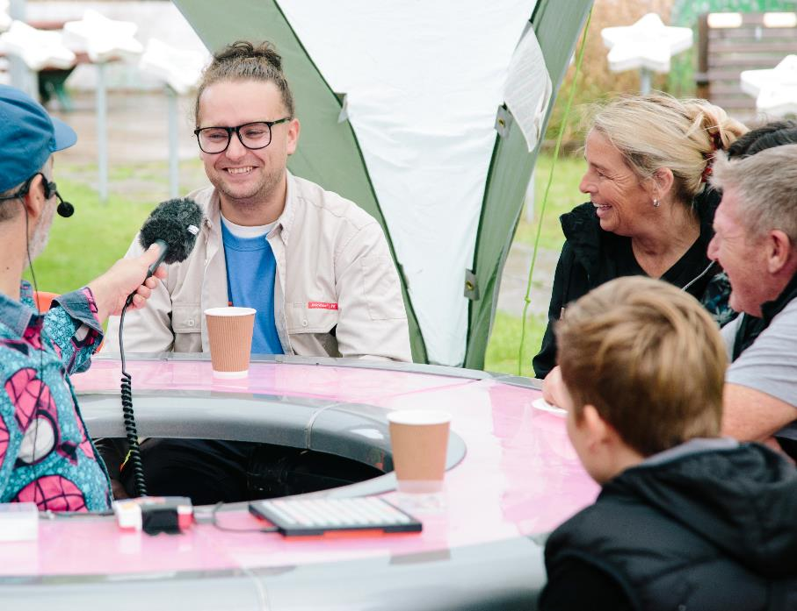
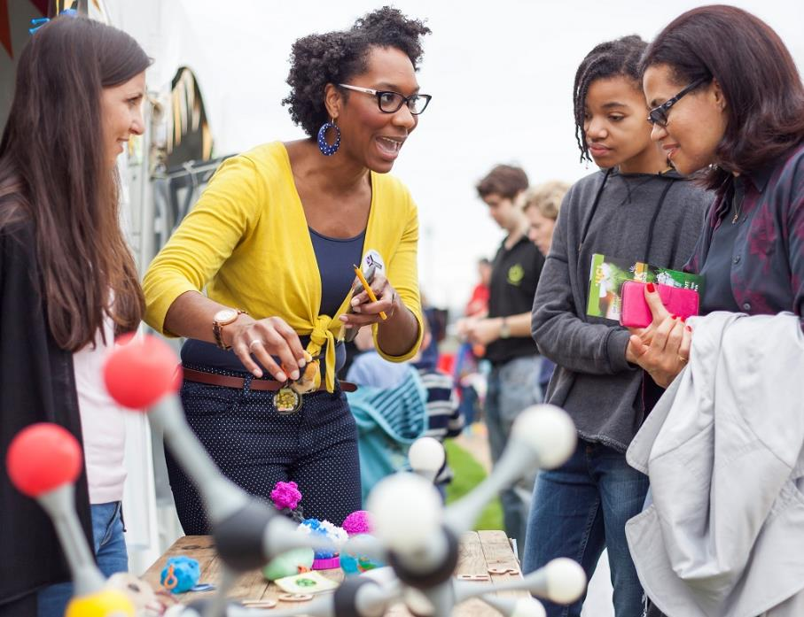
What we’re looking to fund
Any activities that improve connections between University of Bath research and wider society.
Notes:
We are looking to fund activities that seek to improve the connections between research and wider society.
For us high-quality public engagement allows people to discover, discuss, participate in, create, or use research in ways that are meaningful for them. Activities should not only benefit you and your research but also help people to meet their goals as individuals and within their communities.
For this call we’d like you to think about how the activity you would like to do provides an opportunity to test ways to either engage people with your research or involve them in it I like this detail.

Slide 6
What we’re looking to fund
Spectrum of purposes of public engagement
Informing | Listening | Involving | Working Together | Empowering
International Association of Participation’s Participation Spectrum Tool
Notes:
To help you think about the purpose or aim of your activity we’ve adapted the International Association of Participation’s Participation Spectrum Tool and as part of the application process asking you think about where you’d place yourself on that spectrum. It’s important to remember that this is a spectrum and the categories aren’t discrete and a project could include different purposes at different stages.

Slide 7

Informing
Activities that share and tell people about research
Notes:
An example of this could be working with a museum to develop activities together that shares your research with their audiences.

Slide 8
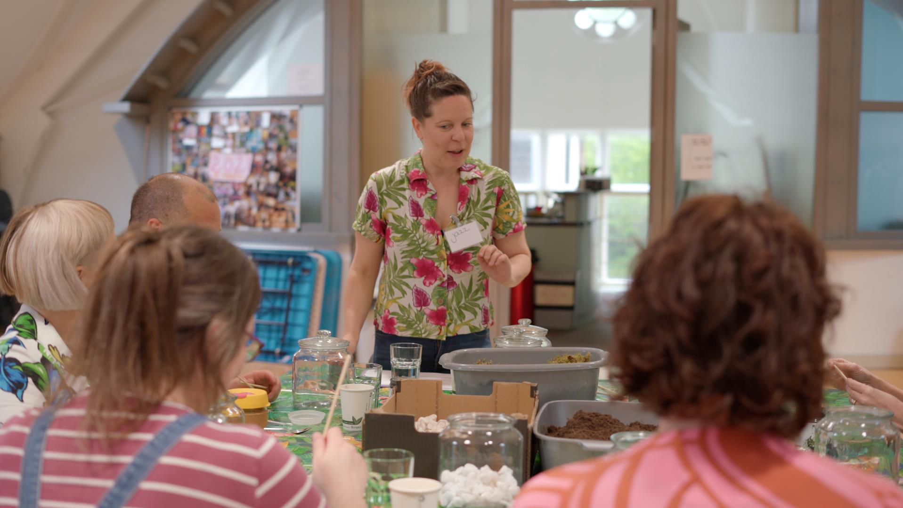
Listening
Activities that seeks to gather perspectives and insight from people about your research
Notes:
For example, you could be a chemical engineer who is developing a device to test for a certain type of cancer and you want to understand how that public group might use such a device and to do that you work with an artist to run an art session where through the process of making you have conversations with the participants addressing the questions you’re interested in.

Slide 9
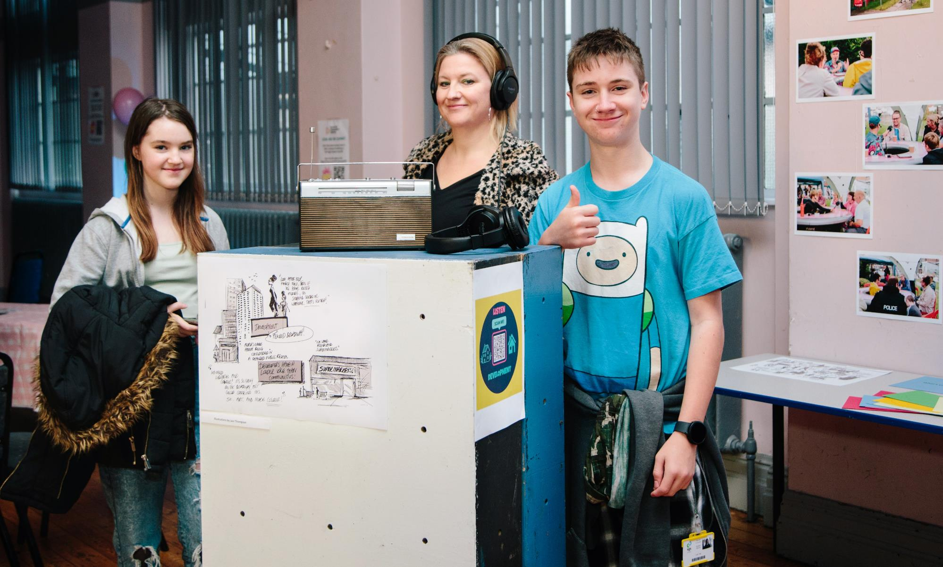
Involving
Activities that enable people to have meaningful roles to work with you in research
Notes:
This, for example could be hosting a series of events or activities targeted at young people with mental health issues in partnership with a local youth club with the aim of raising awareness of the opportunity for young people to join an advisory board on your research project.

Slide 10

Working Together
Activities that enable people to make decisions with you about research
Notes:
You could test out an idea you’re interested in developing into an externally funded project. This could be for example where you work with a number of residents who live next to a water source to train them to be co-researchers to identify some key issues about water quality that they and their neighbours are interested in. Working together you could then prioritise the topics that could be worked up to a research proposal.

Slide 11
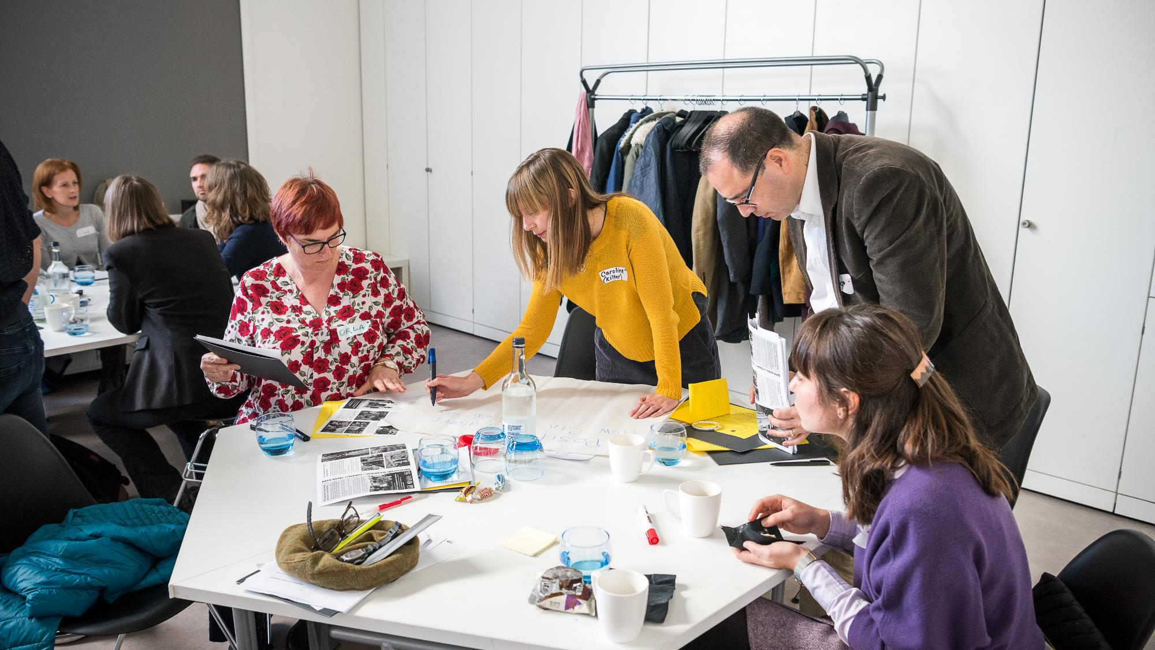
Empowering
Activities that enable people to have control over decisions made about research
Notes:
An example here could be research prioritisation, where patients tell you the areas of work that are important to them. An example of this drawn from colleagues at the University of Exeter is where researchers in the dental school wanted to do work with parents of autistic children about going to the dentist , but the parents said that basic oral hygiene was more important and work was needed to understand why autistic children struggled with oral hygiene. The dental school researchers changed their research to support the parents and their children.

Slide 12
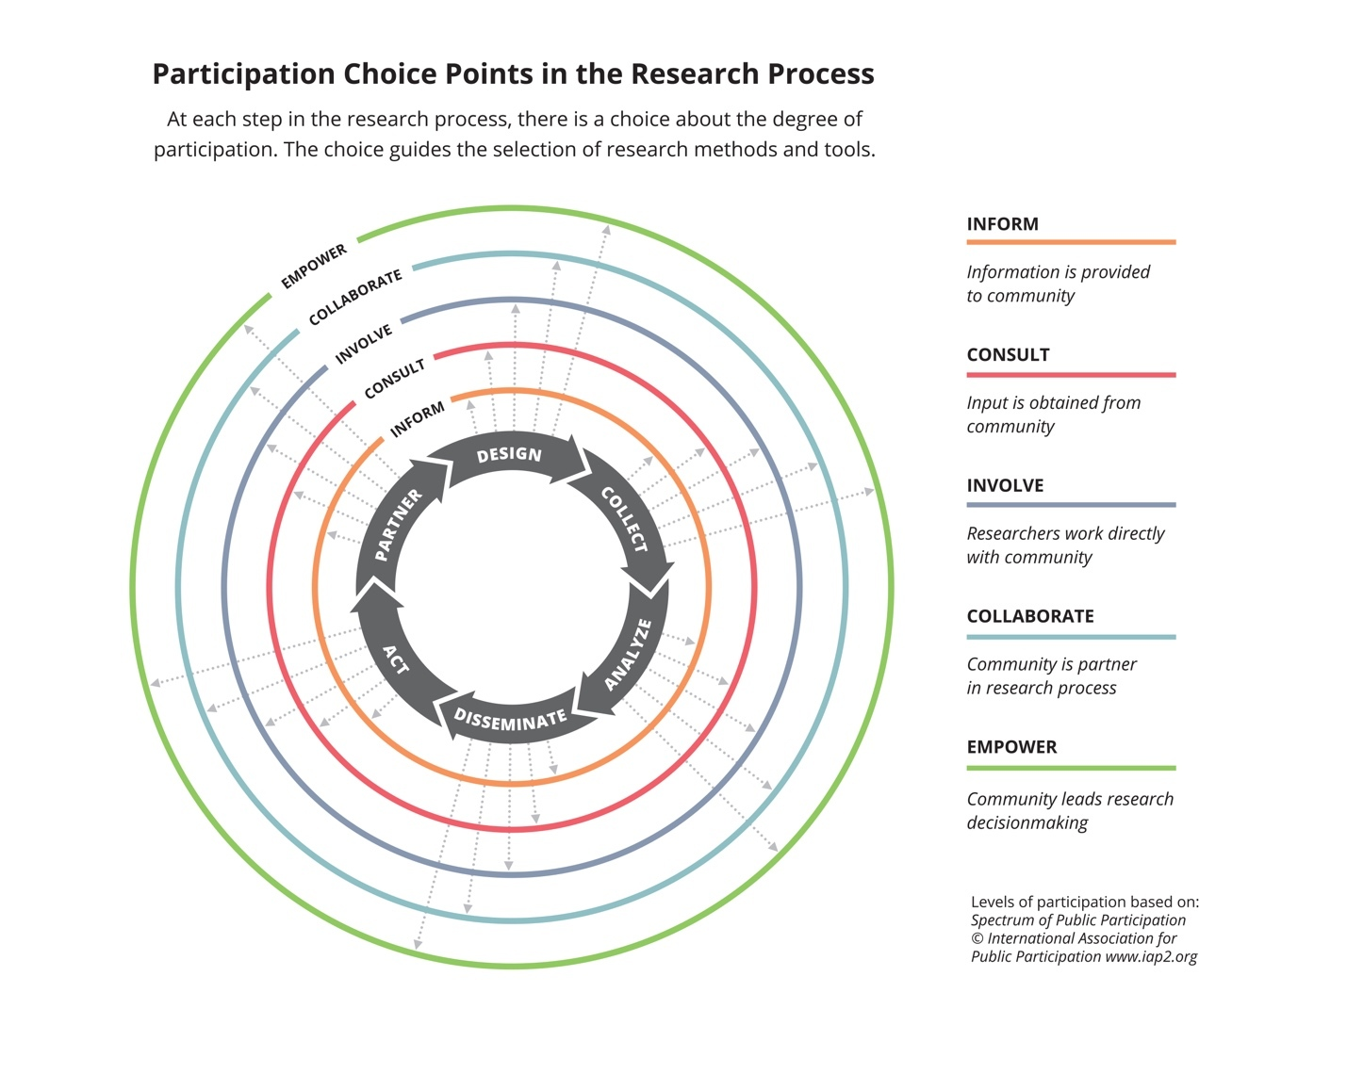
LISTEN
WORKING TOGETHER
From Participatory Research Methods – Choice Points in the Research Process (https://doi.org/10.35844/001c.13244)
Notes:
Public engagement activities eligible for this funding call can take place at any point in the research process.

Slide 13
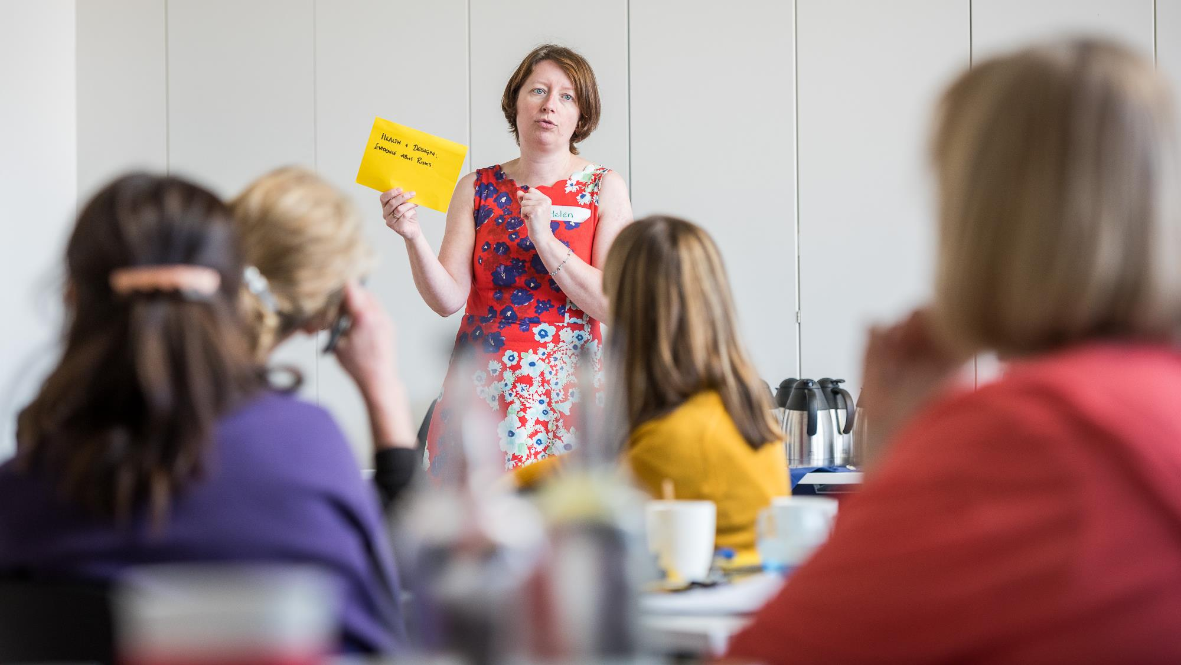
Working with us
Notes:
We’re interested in working with you to continue to better understand what public engagement with research here at the University looks like.
In the past colleagues have told us that working with a creative practitioner helped them think differently about engaging and involving people in and with their research. As part of the support we’re offering funded projects we’re hosting a session with creative practitioners to help you refine your project ideas . Therefore, we are looking to fund applicants who are willing to work with us and a creative practitioner to refine their ideas.
Is this compulsory?
Make it clear that this doesn't come out of the £2k.

Slide 14
Application process
We’ll be assessing those applications against three criteria:
An idea for an activity you would like to deliver that engages public groups with or involves them in your research.
An identified public group you want to engage with or involve in your research.
A willingness to try new things and think creatively about public engagement with and involvement in research including working with the Public Engagement Unit and a creative practitioner.
Eligible costs
Mostly anything except your time
Deadline
Friday 8 December 2023, 4pm
Notes:
We will be taking a portfolio approach to this call. We anticipate funding projects from the three Faculties and the School of Management and across different sorts of engagement activities.

Slide 15
Questions?
Drop us a line any time before the deadline on public-engagement@bath.ac.uk
Engage and Involve Grants Guide
go.bath.ac.uk/engage-grants

Slide 16
Bookable slots
w/c Monday 6 November 2023
Wed 8 Nov - 11:00 – 13:00, 15:30 – 17:00
Fri 10 Nov – 15:00 – 17:00
w/c Monday 13 November 2023
Mon 13 Nov – 12:00 – 13:00, 15:00 – 17:00
Wed 15 Nov – 15:00 – 17:00
Fri 17 Nov – 11:00 – 13:00, 15:00 – 17:00
w/c Monday 20 November 2023
Mon 20 Nov – 15:00 – 17:00
Tues 21 Nov – 12:15 – 13:15, 14:45 – 15:15
Wed 22 Nov – 11:00 – 13:00, 15:00 – 17:00
Thurs 23 Nov – 11:00 – 12:00, 15:00 – 17:00
Fri 24 Nov – 11:00 – 13:00, 15:00 – 17:00

