Slide 1
ICHEM CONFERENCE 2023

Slide 2
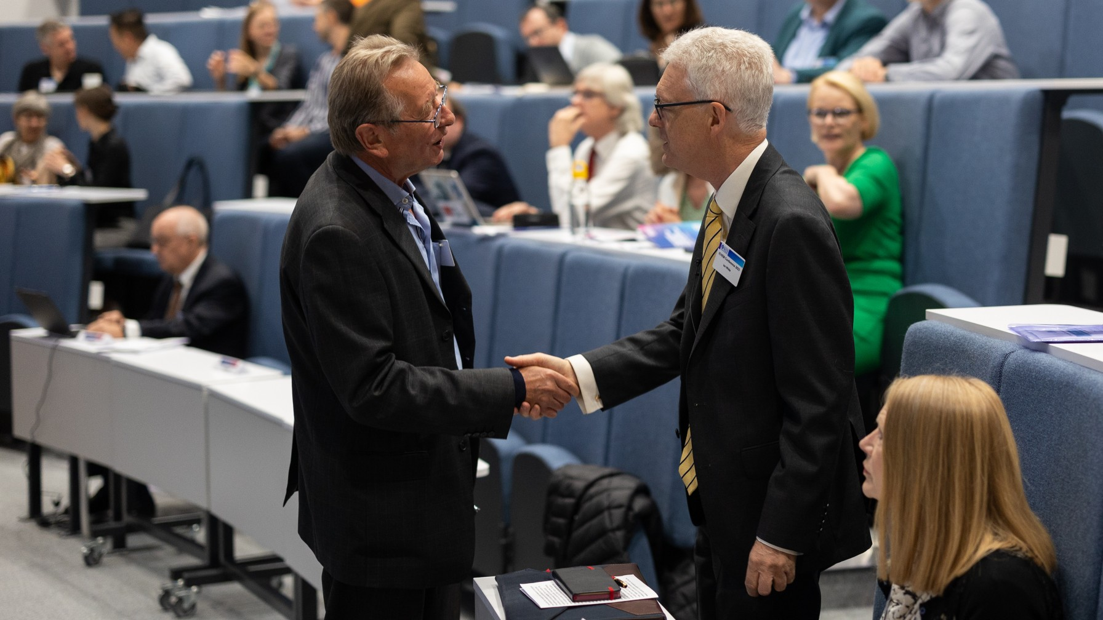

Slide 4
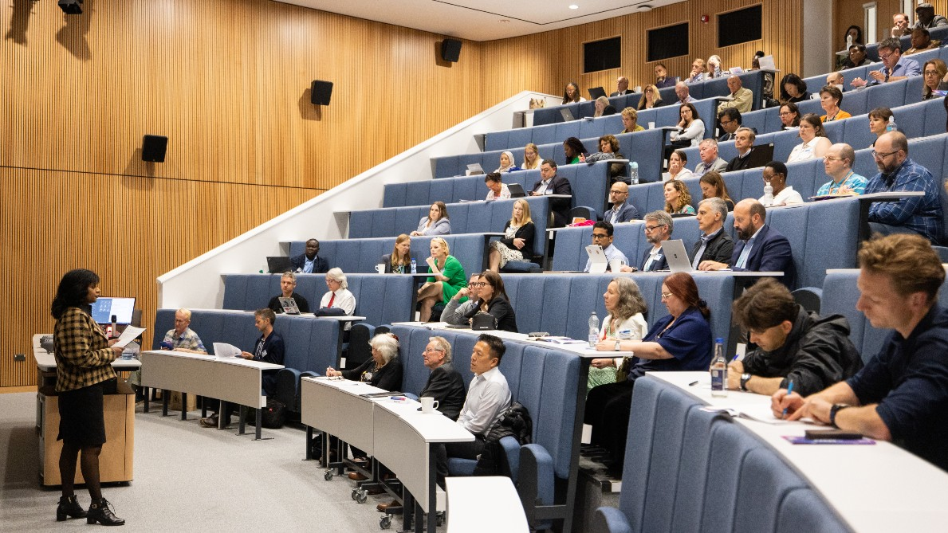

Slide 6
