Slide 1
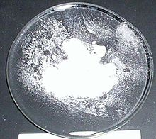
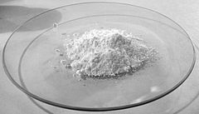
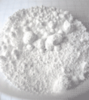
BARIUM
Barium Chloride
Barium Chloride is used to harden steel and is used to produce a green colour in fireworks.
Barium Chloride is very toxic and if eaten could cause death.
Barium Carbonate
Barium Carbonate is used in the ceramic industry and in the preparation of bricks and cement.
Barium Carbonate is used in rat poison. If a large amount is eaten by a human it can cause heart issues and paralysis.
Barium Sulphate
Barium Sulphate is used when patients have x-rays. It coats the inside of the stomach or intestines and means they show up easier on scans.
Barium Sulphate is not toxic to humans

Slide 2
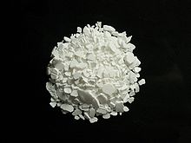
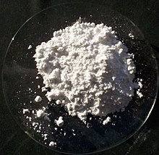
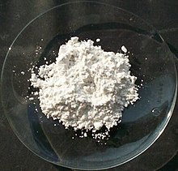
CALCIUM
Calcium Chloride
Calcium Chloride is used as a strong de-icer and is used in dehumidifiers to stop rooms being damp.
If calcium chloride is eaten is can cause burns in the mouth and make people sick.
Calcium Carbonate
Calcium Carbonate is used in the building industry in cement it is also used as an antacid to stop heartburn.
Calcium Carbonate is not dangerous to humans in small doses.
Calcium Sulphate
Calcium Sulphate is used in chemical reactions and to make food like Tofu
Calcium Sulphate is not toxic to humans

Slide 3
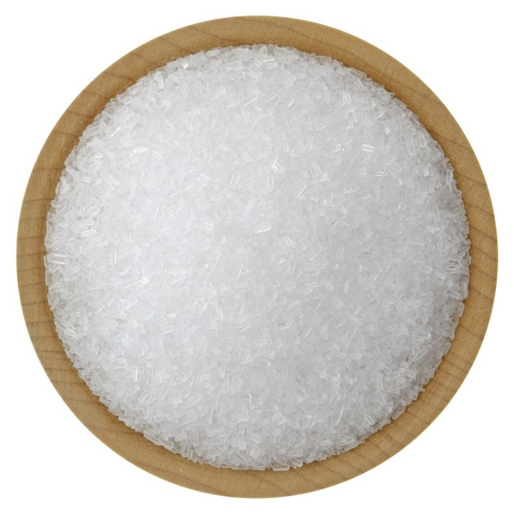
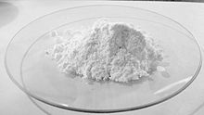
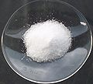
SODIUM
Sodium Chloride
Sodium Chloride is table salt and is used daily be many people in lots of food.
Sodium Chloride is not toxic
Sodium Carbonate
Sodium Carbonate is to produce glass and as a water softener
Sodium Carbonate is not toxic in small doses, but large amounts can cause people to be sick
Sodium Sulphate
Sodium Sulphate is used in the lab to dry solvents and is used in the textile industry to allow dyes to be applied evenly
Large amounts of Sodium Sulphate can cause diarrhoea.

Slide 4
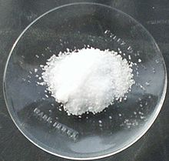
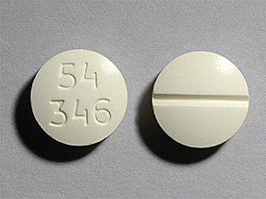
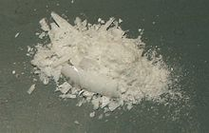
LITHIUM
Lithium Chloride
Lithium Chloride is used to reduce water in the air and is used in fireworks to produce the red colour
Lithium Chloride is toxic and if eaten could cause a person to be very ill.
Lithium Carbonate
Lithium Carbonate is used as a treatment for people with bipolar disorder and other manic disorders.
Lithium Carbonate is not toxic to humans.
Lithium Sulphate
Lithium Sulphate is used as a treatment for patients with bipolar disorder and is used as an additive in cements to make them set faster
Lithium Sulphate is not toxic to humans

