Slide 1
Use the samples of hair to work out who was in Mary’s house.
There are samples of hair from all the suspects and the unknown samples. Compare them to work out who was in the house.
Look at each hair
How long is it?
What colour is it?
Is there anything identifying about it?
Look at the hair under the microscope
Does it look different?
Can you match the hair to one of the suspects?

Slide 2
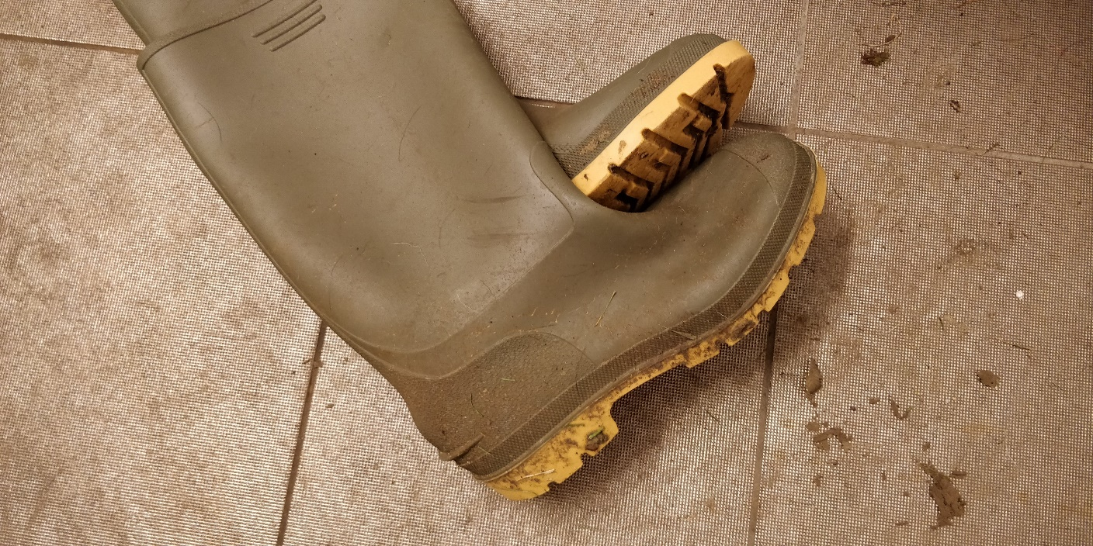
Use the samples of soil to work out whose wellies are in Mary’s house.
There are samples of soil from all the areas the suspects live in and the unknown sample from the wellies. Compare them to work out who was in the house.
You have samples of soil from Bath, Wiltshire, Bristol and Gloucestershire.

Slide 3
Soil Analysis
Soils from different areas have different characteristics.
Some soils have things in them. Have a look for things like:
Moss
Leaves or twigs
Sand
Clay
Plant roots
Look closely at each sample and see if you can match them to the unknown

Slide 4
Fingerprint Analysis
In your book you have the fingerprints taken from the salt shaker. Compare them to fingerprints from the suspects and write the name of the suspect under each unknown fingerprint in your book.
Remember not all the fingerprints will be from the suspects.

Slide 5
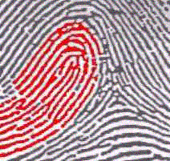
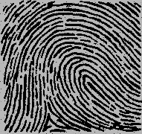
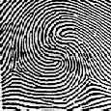
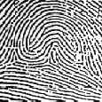
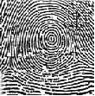
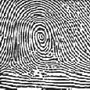
Fingerprint Patterns There are three main fingerprint patterns: arches, loops and whorls.
Arches
These are quite rare and only seen in about 5% of fingerprints
The lines run from one side of the print to the other
Some arches look short or tall. Both these prints are called arches
Loops
These are the most common pattern seen in about 60-70 % of fingerprints
The lines start and finish on the same side of the print.
Some loops start on the right and some on the left. Both these prints are called loops
Whorls
These are seen in about 25-35 % of fingerprints
The lines include at lest one complete circle
Both these prints are called whorls
Other types
Some people have prints which are a mixture of two different types of pattern.
These are some examples
Double loop whorl
Accidental whorl

Slide 6
Microscopes
Use the microscopes to have a look at the different slides.
Select a slide and put it onto the microscope. Use the wheels on the side to focus.
Have a look at the identifying features and record your observations by drawing what you see using the paper, pens and pencils provided.

Slide 7
Interviews
You can interview the suspects if you wish.
Decide on your questions you want to ask each of the suspects before you go into the interview room
Use the notes boxes in your book to record the answers to your questions.

Slide 8
