Slide 1
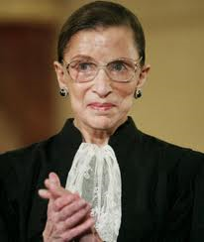
MURDER
Mrs Mary Smith was murdered at her home a week ago and we need your help to process the evidence.
Watch the video to find out more about the murder and then use the evidence book to process all the samples we have found.
Once you are done tell the police officer who it was that murdered Mrs Smith.

Slide 2
Interview
Room

Slide 3
Briefing
Room

Slide 4
Briefing
Room

Slide 5
Briefing
Room

Slide 6
Evidence
Room

Slide 7
Evidence
Room

Slide 8
Fingerprints

Slide 9
Hair Samples

Slide 10
Soil Samples

Slide 11
Chemical
Analysis

Slide 12
Chemical
Details

Slide 13
Exit
via interview room

Slide 14
Exit

Slide 15
NO Exit

Slide 16
Murder Mystery
Experience

Slide 17
Murder Mystery
Experience
Please Queue
Here

