Slide 1

Employability and Student Success
2026-27

Slide 2
Key Employability Initiatives
Initiative | In a nutshell
The Bath Award | An annual programme that recognises your extra-curricular achievements and helps you build skills valued by employers.
My Employability Profile | An online tool that helps you assess, evidence, and develop your employability skills.
Micro Internships | Short-term, paid work experience that lets you gain professional experience with real employers.
Languages & Employability | Develop language and intercultural skills that help you stand out in a global job market.
Student Success Stories | Real examples of how Bath students have used employability initiatives to achieve their career goals.

Slide 3



The Bath Award
An annual programme that encourages you to get involved in activities beyond your studies and supports your professional development
Reflect on skills gained through work and extracurricular activities
Dedicated workshops to support your development
Helps you articulate your skills to employers
Certificate signed by the University of Bath Vice-Chancellor and the SU President
thebathaward@bath.ac.uk
go.bath.ac.uk/the-bath-award

Slide 4

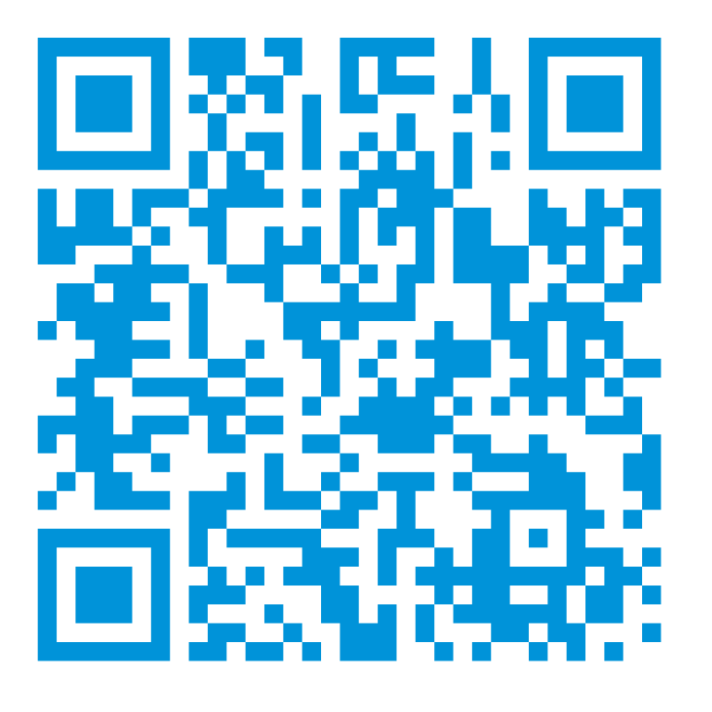
My Employability Profile (MEP)
Online tool to help you assess and evidence your skills across key employability capabilities
Personalised recommendations for activities and development opportunities
Record experiences from study, work, volunteering and societies
Track your progress throughout your time at Bath
employability@bath.ac.uk
go.bath.ac.uk/mep
Notes:
!! QR code to be updated following publication of new MEP webpage.

Slide 5

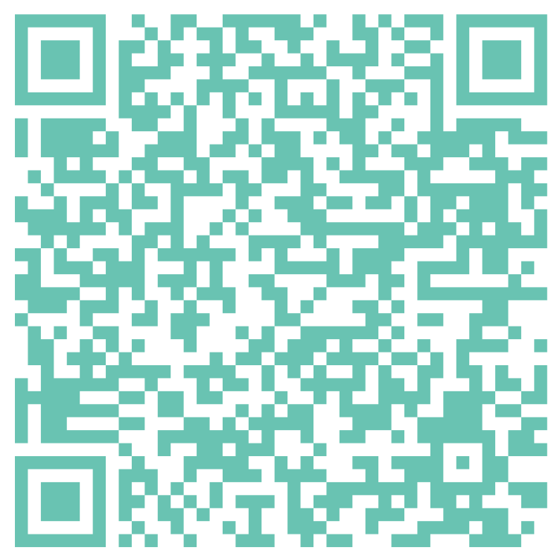
Micro Internships
Short-term, paid projects with employers
Flexible opportunities that fit around your studies
Available across a range of sectors and organisations
Gain real-world experience and develop professional skills
Build your CV and explore potential career paths
internships@bath.ac.uk
go.bath.ac.uk/careers

Slide 6


Languages &
Employability
10-week courses in 6 languages, from Beginner to Advanced
Globally recognised language qualifications
Language Cafés, cultural events, and Virtual Language Exchange opportunities
Webinars
Language-skills@bath.ac.uk
bath.ac.uk/foreign-languages

Slide 7

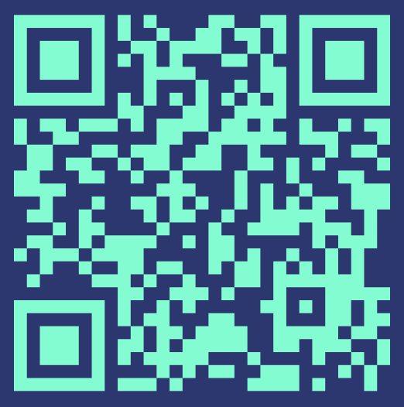
Student Success Stories
Real student experiences of placements, internships and graduate careers
Insights from students across different courses and industries
Inspiration and advice from your peers
Examples of how we can support your career success
Practical tips on applications, interviews and workplace skills
employability@bath.ac.uk
blogs.bath.ac.uk/careers/

