Slide 1
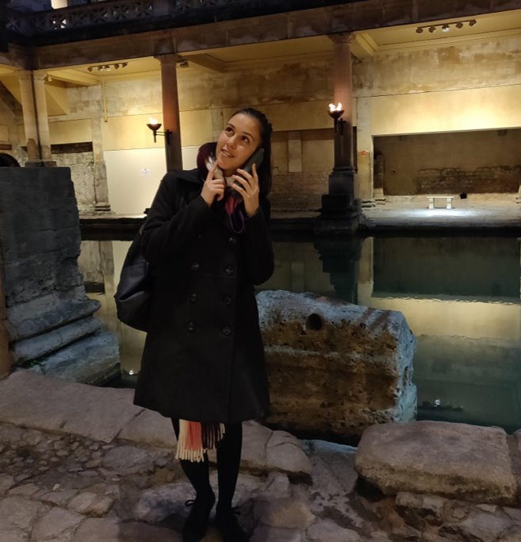
Petya Zhechkova
Student Recruitment Officer
University of Bath

Slide 2

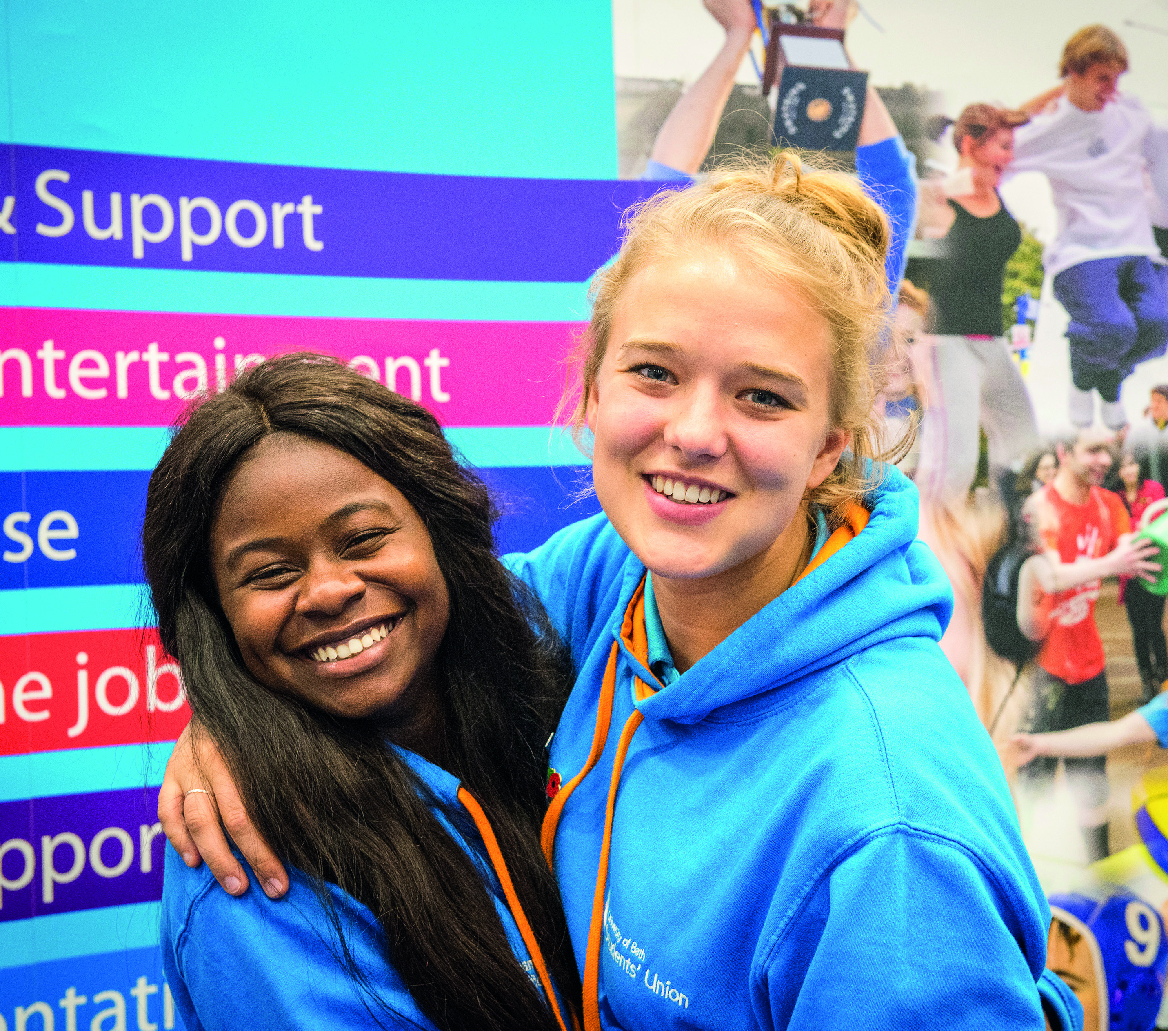
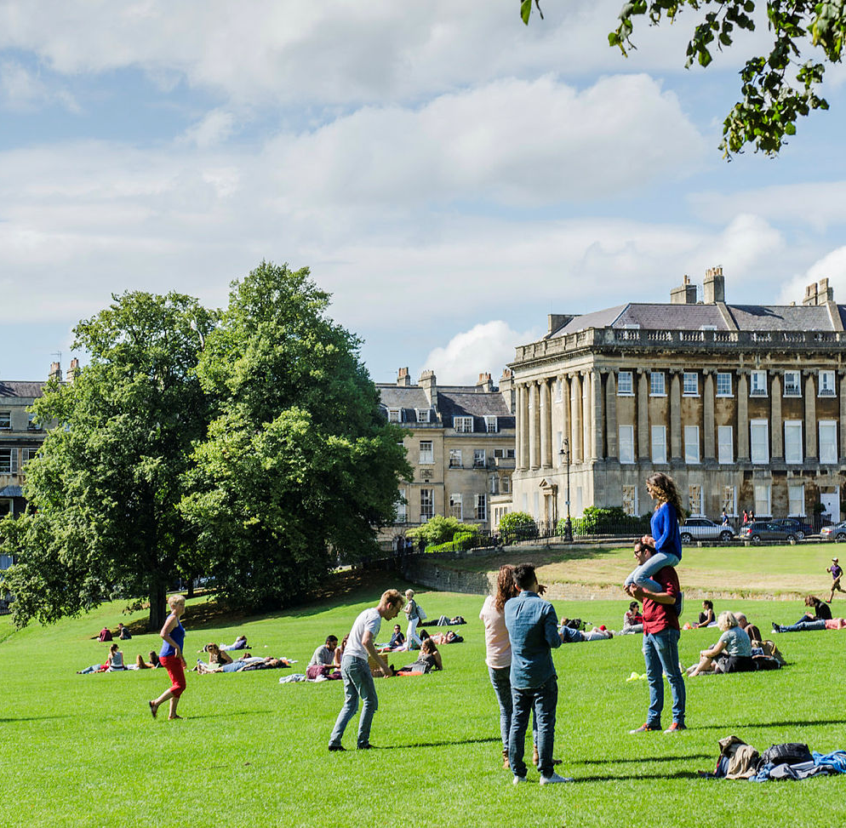

A warm welcome

Slide 3
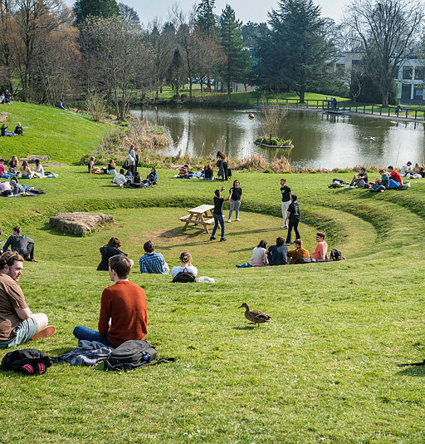
Housekeeping
All sessions will be recorded and made available after the event
You will be able to interact and ask questions (and please do!)
In case you have technical difficulties/can’t join: pz317@bath.ac.uk OR LP658@bath.ac.uk

Slide 4
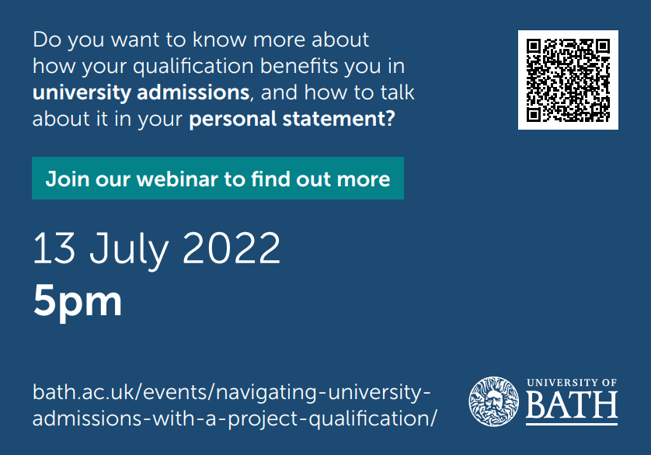

Slide 5
Project qualifications and admissions

Slide 6
What we'll be covering
What are the admissions benefits of project qualifications?
Alternative offers – what are they and why do they make a difference?
How to use a project qualification to strengthen a personal statement

Slide 7

Why do we as universities value project qualifications?
An opportunity to complete an independent project
  Mimicking university-style learning
Development of transferable skills
  Independent research
  Reflection
  Critical thinking and evaluation
Translation to performance at university

Slide 8
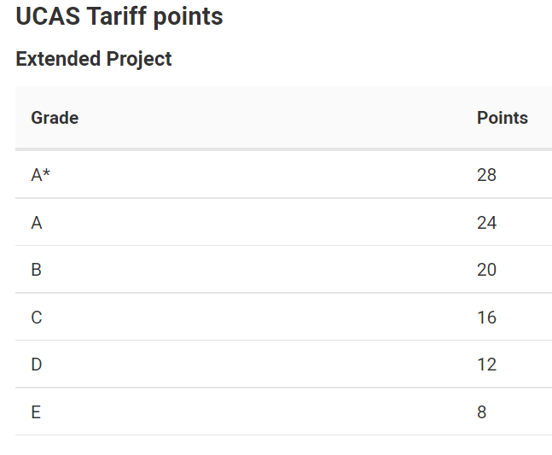
The admissions benefits for the student
Extra UCAS tariff points
Extra feeling of security (alternative offers)
Strengthening their application

Slide 9

Alternative offers
Some universities will make an alternative offer if a student is completing a project qualification
Bath offers a reduced grade on all of our courses if the student is predicted/has achieved:
  grade A in an EPQ
  grade B in the Welsh Baccalaureate Skills Challenge Certificate
  grade A in an AQA or Cambridge IPQ
  grade M1 in Cambridge Pre-U Global Perspectives
  grade A in the International Baccalaureate Extended Essay*

Slide 10
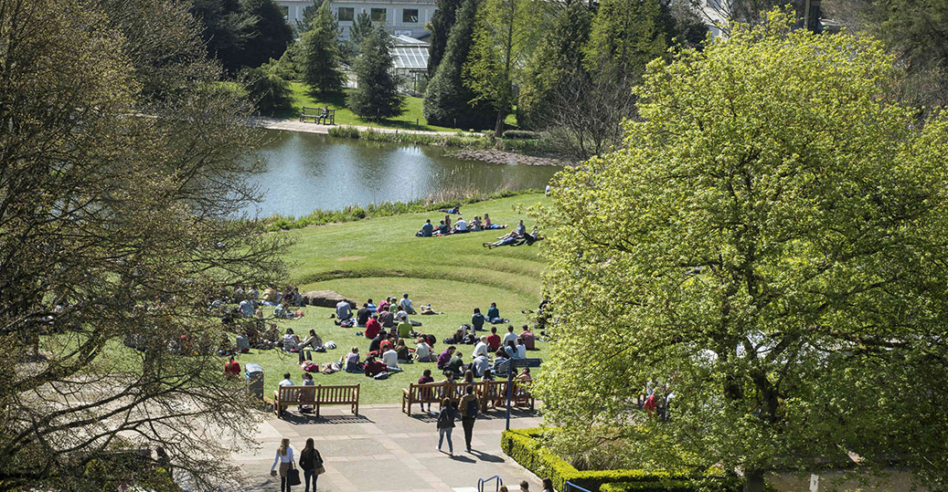
What are university offers based on?
Prior academic performance
Predicted academic performance
Personal Statement
School or College Reference
Interview
Contextual data
Mitigating circumstances
Admissions or aptitude tests

Slide 11
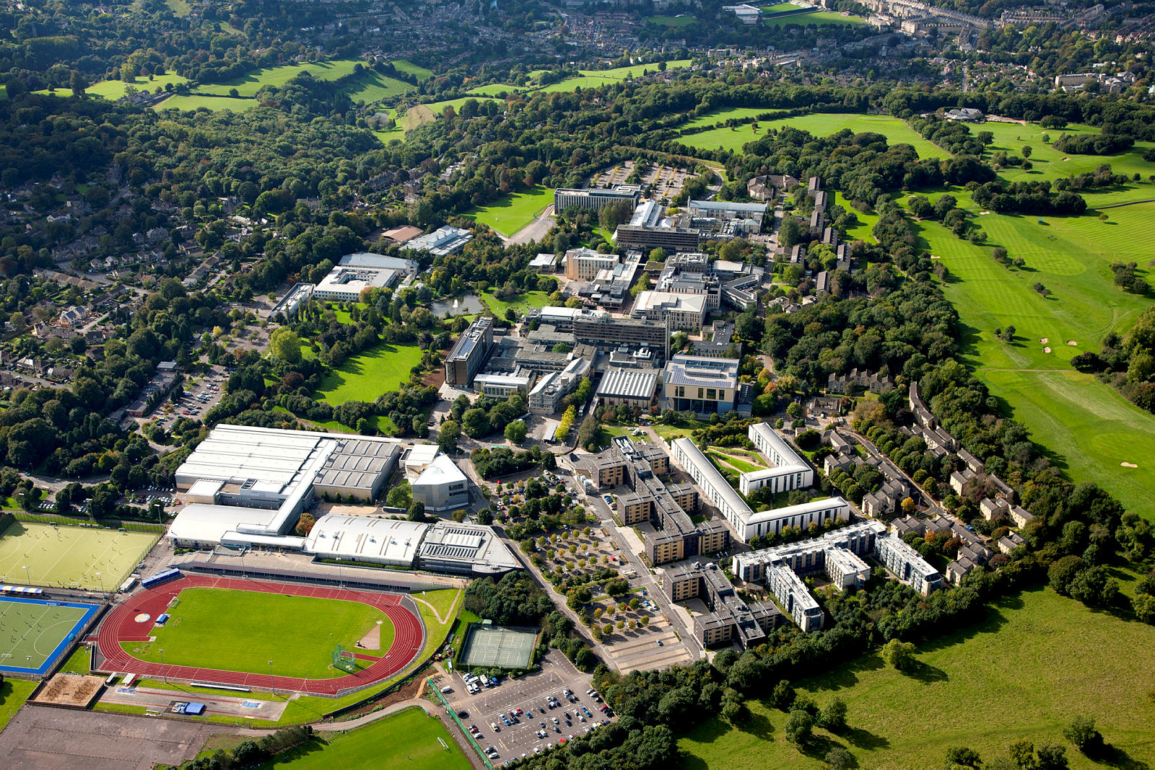
Personal Statements
A personal statement is a maximum of 4000 characters, or around 47 lines
Only place to focus on relevant skills, achievements and work experience
It may be read by two or more university staff at each university
One personal statement for up to 5 choices

Slide 12
Personal Statement Structure
1. Why do you want to study the course?
2. Academic interests
3. Your life / work experience, skills and achievements
4. Concluding Statements

Slide 13
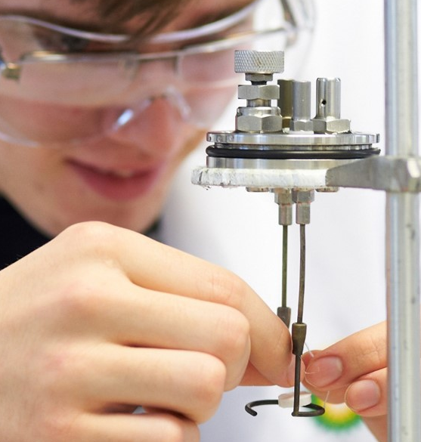
Super-curriculars
Super-curriculars can be an excellent way to show skills, enthusiasm and academic potential.
‘Super-Curricular’ activity could help to:
Choose a course, by helping to pinpoint exactly what a student is most interested in studying
Get a place on a course, by looking impressive on the personal statement
Succeed on the course, by helping to develop important research skills and independence.

Slide 14








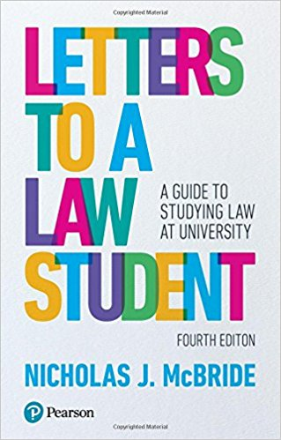





Wider Reading

Slide 15



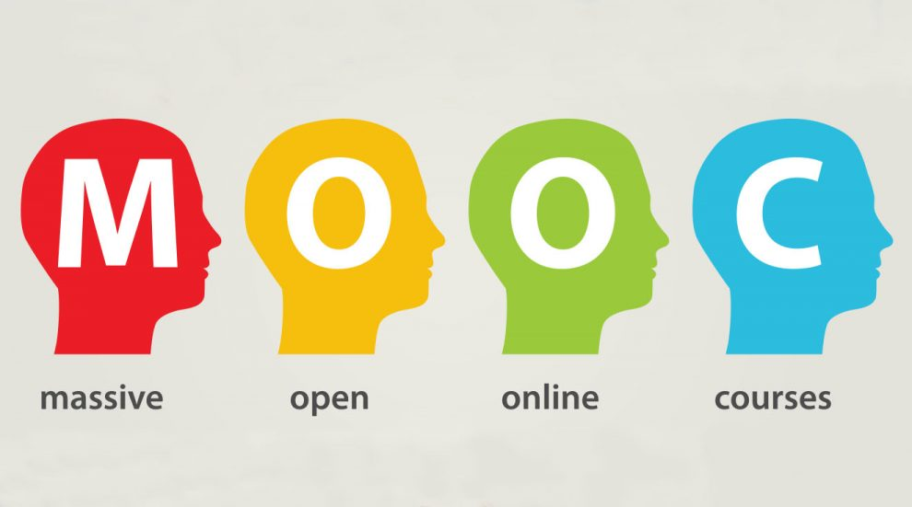






Online Resources

Slide 16
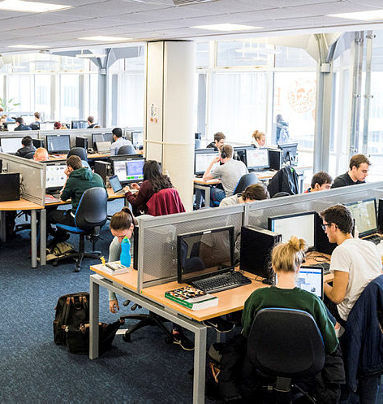
Wider Research
When talking about what you’ve read, experienced, or done, give evidence and detail. Quality over quantity is best.
For example, if you’ve completed a work experience placement or attended an interesting lecture, tell us what you learned and why it was interesting.
Reflection is what distinguishes between an okay personal statement and a great one

Slide 17
A few questions for students to ask themselves while completing their project
What am I learning? What are my findings/outcome of my research?
Has his made me want to research further?
Have I picked up/developed any useful skills?
Did I come across anything I disagree with?

Slide 18
Some strong examples…

Slide 19
This applicant discusses her EPQ topic and then expands on it, discussing the further research she undertook as a result:
“My EPQ compared greenhouse gases released from beef, dairy and arable farming. I gained a deeper scientific understanding of the detrimental effects the agricultural industry has on our planet whilst developing essential organisational skills. Wanting to further research the topic of conservation, I completed the online course "Ecology and Wildlife Conservation" run by the University of Leeds. I learnt about the ecological network of interactions between different species and how the removal of one species can stimulate the loss of many others. The course covered methods of tracking and collecting data to aid conservation, such as using GPS to monitor the flight paths of birds.”

Slide 20
This student talks about a conference he has attended and how in his EPQ he went on to expand on some of the themes that were covered, which then led him to further question what he had learnt/heard:
“Participating in the McWhirter Conference, I was part of a small group which studied the growing prominence of AI, with lectures on machine learning, superintelligence, and algorithmic fairness…It led me to think further about the use of AI through a Marxist lens: if technological improvement continues to advance so rapidly, its consequences will not be collective prosperity but instead unemployment, environmental degradation, and inequality. Whilst writing my EPQ, I developed on this theme of inequalities along international lines, focusing on the global distribution of vaccines between countries, and whether the COVID-19 pandemic could mark a shift in the way nations act, with developed states perhaps taking a more equitable approach to their international interactions. It also made me question whether the West's approach to globalisation has changed, as China and Russia take much more ambitious steps to vaccinate the world, or whether authoritarianism is perhaps more effective in global crises of this magnitude.”

Slide 21
This student talks about a book she has read, which especially interested her; she then links it to her EPQ (and some additional reading) and explains how her EPQ caused her to question the argument in that book:
"Through A-level Economics, I have learnt about the intertwined nature of politics and economics, leading me to read Hayek's 'The Road to Serfdom'. Other than disagreeing with the inherent inequality of laissez-faire political and economic policy, a point Hayek made which I found both particularly interesting and jarring was his view that democracy is only possible under capitalism. This caught my attention as it linked to my EPQ, as well as what I had learnt about the fragility of democracy through Zuboff's 'The Age of Surveillance Capitalism'. My EPQ explored the threat that social media, which exists with few regulations, poses to democracy in the context of the EU referendum and the election of Jair Bolsonaro and Donald Trump, causing me to question Hayek's argument."

Slide 22
Some weaker examples…

Slide 23
This student has not expanded on his Welsh Baccalaureate studies – what did the projects teach him; do they relate to his chosen course (Architecture); did they encourage him to undertake further research or challenge a pre-conceived understanding/knowledge of Architecture….?
“Additionally, throughout my Welsh Baccalaureate Skills Challenge projects, I am usually assigned imaginative and artistic roles, such as product designer during the enterprise section, and being in charge of statistical/numerical roles, such as finance, as I am organised, innovative and neat, hence, trusted to follow through with these roles. The Skills Challenge has also allowed me to build on and learn new skills that will be beneficial for studying architecture, such as my digital competence, time management and critical thinking.”

Slide 24
This student has simply explained what she explored in her EPQ; she does not develop it further and has missed an opportunity to link her research to her chosen course:
“For my Extended Project Qualification (EPQ), I chose to explore diversity and inclusion within the UK workplace. In this project I found the psychological debate of nature and nurture intriguing and how racist views and behaviour can be easily passed on to children who then adopt these traits as their own, unaware that they are socially unacceptable today. I received an A* grade in my EPQ.”

Slide 25
This student has simply written about what he explored in his EPQ and listed the concepts he learnt about; he has not expanded on these or explained why he was so fascinated by what he learnt and has not related his EPQ studies to his chosen course/career:
“In my EPQ, I answered the question 'Is supersonic travel an unrealistic and unsustainable idea?'. The project focused on Concorde and the factors for failure of the supersonic airliner. As well as being a fascinating topic, it introduced me to daunting concepts such as engine design, material choice for airframes and the mechanics of travel above Mach 1. Studying original documents on the airframe design and development, I was fascinated by the development process in a time where Concorde was the first of its time in a relatively new area of flight.”

Slide 26
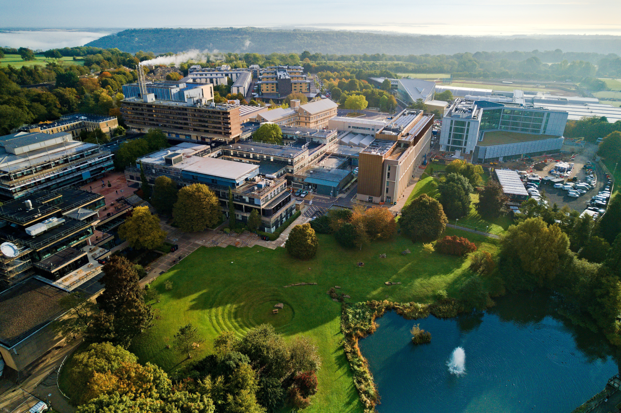


Thanks for listening!

Slide 27
Next up:
10:30 | The benefits of project qualifications for students, schools, and transition with Jennifer Osler from AQA
11:15 | Research skills for project qualifications
12:00 | Science for non-scientists
13:20 | Social sciences for non-social scientists
14:05 | Presentation skills
14:50 | Quantitative techniques
15:35 | Academic writing

