Slide 1
Spotlight On:
Project Qualifications
Presentation Skills
Daniel Winwood – Skills Development Manager

Slide 2
Overview
Successful reflection
Presentation stages
Dealing with questions
Use of visual aids

Slide 3
Successful Reflection
Describe / Analyse
Evaluate
Action plan

Slide 4
Successful Reflection
Describe / Analyse
  What happened?
  What was the result?
  What did you expect to happen?
  Why did things go well / badly?
  What other knowledge do you have that can help you analyse the event?

Slide 5
Successful Reflection
Evaluation
  What went well / badly?
  What does this mean for your learning?

Slide 6
Successful Reflection
Action planning
  Will you continue to work in the same way?
  Will you change the way you work? What will this be?
  How can you ensure success next time?

Slide 7
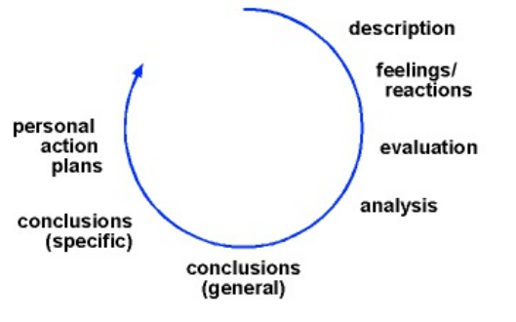
The Reflective Cycle
Gibbs (1988)

Slide 8
Successful Reflection
Modelling
Journals
Voice notes
Response cards / One minute papers / Exit tickets

Slide 9
Presentation Stages
Planning
Delivery
Reflection

Slide 10
Planning
Marking criteria
Aims and outcomes
Audience
  Non-specialist audience
Appropriate visual aids
Spoken vs written language
Structure
  Introduction
  Body
  Conclusion
Timing
Format
Content

Slide 11
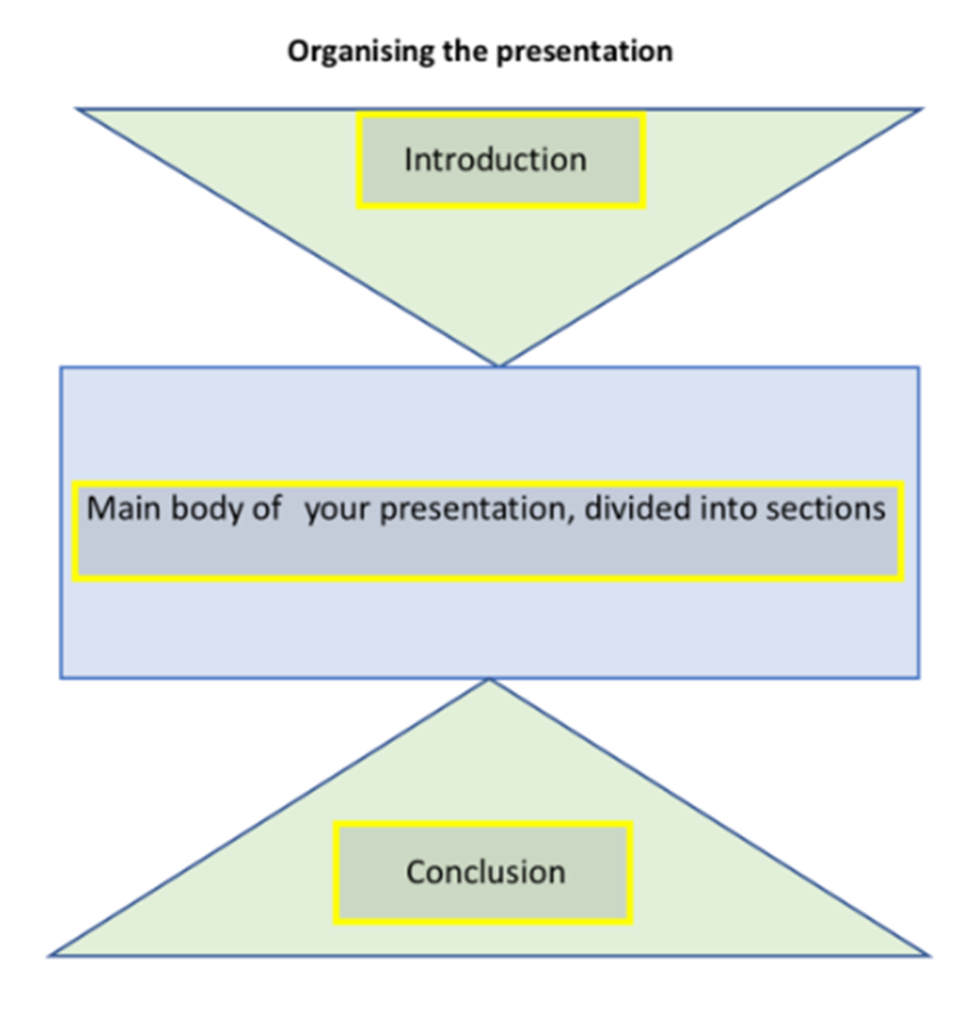
Planning

Slide 12
Planning
Script to note cards
Transcript analysis
Functional language – signalling phrases or signposting language
Scaffolding and joint construction
Peer feedback

Slide 13
Delivery
Register
Body language
Pace
Volume
Pauses
Intonation
Emphasis
Articulation

Slide 14
Delivery
Conveying meaning through voice
Non verbal communication
Simplifying language
Transcript analysis
Spoken vs written language
Mini presentations
PechaKucha
Modelling bad presentation

Slide 15
Dealing with Questions
Anticipate questions
Rephrase questions
Functional language

Slide 16
Visual Aids
Audience
Students the focus, not the visual aid
Use of different visual aids
Group work
Modelling

Slide 17
References
Gibbs, G., (1988). Learning by Doing: A guide to teaching and learning methods. Oxford: Oxford Polytechnic.

