Slide 1


Quantitative Research Methods and Techniques
Dr. Iulia Cioroianu
Department of Politics, Languages and International Studies
University of Bath

Slide 2
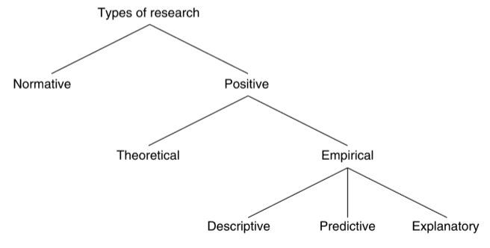
Quantitative research is a type of:
Positive (describing and explaining “what is”; objective and fact-based, verifiable and testable), empirical (applied) research.
Exploratory (often first step in formulating questions and hypotheses)
Can be:
Descriptive (the goal is systematic description)
Explanatory (the goal is to explain phenomena, test hypotheses, make predictions)

Slide 3
Elements of a research project
Formulate a clearly-articulated research question or problem. Explain why it is relevant and important.
Identify and specify the research context in which the question or problem will be addressed. What do existing theories say?
Building upon existing knowledge and research, explain the particular contribution of the proposed research. What knowledge gap does it fill?
Specify and briefly explain the research methods to be used, and explain the rationale for their choice.
Select or collect data and/or evidence. Describe the data collection process.
Analyse the data and evidence, and present the results of the analysis.
Discuss and interpret the results in relation to existing literature and theories.
Discuss the generalizability potential and implications, but also the limitations of the research conducted. Briefly suggest potential future areas of enquiry.
Clearly state the research hypothesis (or hypotheses) to be tested.
Notes:
A good

Slide 4
A good research hypothesis..
is testable
is stated in declarative form
is brief and to the point
posits a clear relationship between different factors
is plausible
is written in a focused and short form

Slide 5
Types of data
Secondary data
Data that has already been collected by other researchers, but which can be further used for research.
government, academic and industry-released public statistics, opinion polls, other existing datasets
Primary data
Data collected by the researcher for the purpose of the project.
surveys conducted by the researcher
Government data portals: https://data.gov.uk/
Survey data:
World Values Surveys
Eurobarometer
British Election Study
data from experiments
sensor data
observations of the natural world
other data collected by the researcher

Slide 6
Descriptive/exploratory research
Answering questions on distributions, characteristics, meanings and processes.
  “What is?”
Not just fact reporting, but also sometimes grouping into categories, trying to identify patterns.
Describing the data used is always the first step in any quantitative project.
Variety of data collection methods and sources
  observational data on different units of analysis (individuals, families, households, companies, local authorities, countries, various aspects of the natural world, etc.)
Used to identify associations, but not test causal relations.
Required data analysis skills:
  descriptive statistics – tables of summary statistics and cross-tabulations, graphs (bar charts, line charts, boxplots, histograms, etc.)

Slide 7
Predictive research
Forecasting: projections about empirical phenomena into the future, based on existing data.
  “What will be?”
Can formulate predictions without a causal theory, by building upon descriptive research.
Can be entirely data-driven.
Similar data sources to descriptive research.
Required data analysis skills:
  Descriptive statistics
  A-level statistics – statistical inference, correlation, regression

Slide 8
Explanatory/causal research
Identify the causes of events and phenomena, study general causal effects and evaluate causal mechanisms.
  “Why?”
Evaluating the effect of an input (or independent) variable on an output (or dependent) variable.
  Sometimes also focusing on the mechanism of action – a moderator or mediator variable.
Questions about impacts and effects are always explanatory.
Using experimental OR observational data
Required data analysis skills:
  Descriptive statistics
  A-level Maths/Statistics – statistical inference, statistical tests, correlation, regression
    Statistical tests meant to establish if the relation we are observing could just be due to chance or not.
  More advanced analyses may require the type of knowledge provided in Further Maths

Slide 9
Types of research designs
Experimental
Two conditions:
Lab experiments
Observational
Cross-sectional
Longitudinal
Comparative
Good for description, weaker for explanations.
1. random assignment
2. experimental control
Natural and policy experiments
Field experiments and lab in the field experiments
Good for some explanations and testing causal claims, not great for description.

Slide 10
Experimental research
 | Control group | Experimental group
Pre-test | Measure on outcome variable (Y) | Measure on outcome variable (Y)
Intervention | No treatment | Treatment
Post-test | Measure on outcome variable (Y) | Measure on outcome variable (Y)
Control group (in which no intervention takes place)
Experimental group (in which interventions do take place)
Random assignment of subjects (participants) to control and experimental groups – ensuring similar groups.
The control group provides a point of reference to which the effect of the intervention can be compared.
The random assignment of subjects to control and experimental groups ensures (as far as possible) that the two groups are similar to each other.
Groups are then treated in the same way in every respect apart from the intervention that is carried out on the experimental group.
Any differences that are then observed between the groups on the outcome variable of interest (the dependent variable) can then be attributed to the intervention that took place.
RCTs are the gold standard for causal inference, but not always feasible.

Slide 11
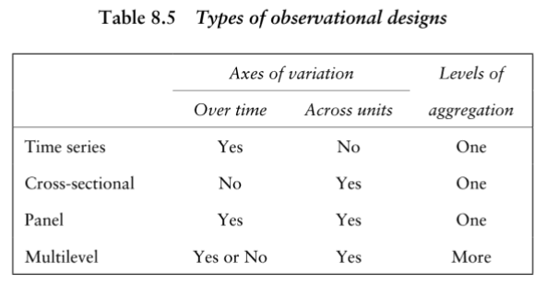
Observational designs
Different types of variation possible:
  Between studied units
  Within units, over time
  Most projects at this level with work with cross-sectional data (for example cross-sectional survey data, measurements of different units) or time series data (more common in science)
Toshkov, 2016

Slide 12

Statistical inference
Population
(Representative) sample
Statistical inference: the process of using what we know about a sample to make probabilistic statements about the broader population.
  AIM: say something about the population based on the available sample.

Slide 13
Answering causal/explanatory questions with observational data
Mimicking experimental logic with observational data by exploiting different sources of variation.
Between the studied units
Over time variation
Controlling for or keeping constant other factors
Data analysis skills:
Regression analysis (A-Level Maths/Statistics)
  Allowing researchers to control for, or hold constant confounding variables, estimate associations when these other confounders are accounted for, and predict changes in the dependent variable at different values or combinations of values of the independent variables.
  Controlling for other relevant factors, a one-unit increase in the independent variable is associated with 2-units increase in the dependent variable.
  Still association, but closer to a causal relation.

Slide 14
Software and tools for visualizing, describing and analysing data
Microsoft Excel can be used for descriptive statistics and basic statistical analysis
Cleff, T. (2019). Applied Statistics and Multivariate Data Analysis for Business and Economics: A Modern Approach Using SPSS, Stata, and Excel. Springer.
Salkind, N. J., & Frey, B. B. (2021). Statistics for People Who (Think They) Hate Statistics - International Student Edition: Using Microsoft Excel (Fifth edition). SAGE Publications, Inc.
Specialized Software
Free:
The R Project for Statistical Computing Steep learning curve, but excellent skill to have.
Jamovi Statistical software based on R, but with a graphical user interface similar to SPSS Statistics.
Tableau has a free, public version (not to be used for public data). Excellent for data visualization.
Paid: Stata, SPSS, SAS

Slide 15
Resources
General resources on research design:
  Walliman, N. (2021). Research Methods: The Basics (3rd edition). Routledge.
  Adams, J., Khan, H. T. A., & Raeside, R. (2014). Research Methods for Business and Social Science Students. SAGE Publications.
Core resources for descriptive statistics, statistical inference and analysis:
  A-Level Maths and Statistics materials.
Additional materials on quantitative research and outputs:
  Agresti, A. (2018). Statistical Methods for the Social Sciences, Global Edition (5th edition). Pearson.
  Balnaves, M., & Caputi, P. (2001). Introduction to Quantitative Research Methods: An Investigative Approach (First edition). SAGE Publications Ltd.
  Bergin, T. (2018). An Introduction to Data Analysis: Quantitative, Qualitative and Mixed Methods (1st edition). SAGE Publications Ltd.
  Cleff, T. (2019). Applied Statistics and Multivariate Data Analysis for Business and Economics: A Modern Approach Using SPSS, Stata, and Excel. Springer.
  Salkind, N. J., & Frey, B. B. (2021). Statistics for People Who (Think They) Hate Statistics - International Student Edition: Using Microsoft Excel (Fifth edition). SAGE Publications, Inc.
  Toshkov, D. (2016). Research Design in Political Science. Macmillan International Higher Education.

