Slide 1
Spotlight on Project Qualifications: Library Research Skills
Tom Rogers
Subject Librarian: Mechanical Engineering Electronic & Electrical Engineering
Liaison Librarian: Widening Participation & Learning Partnerships

Slide 2
Spotlight on Project Qualifications: Library Research Skills

Slide 3
Spotlight on Project Qualifications: Library Research Skills

Slide 4
Spotlight on Project Qualifications: Library Research Skills
Session aims:
Appreciation of how libraries can help with research
Understand importance of library and information skills in literature searching
Highlight the role of critical thinking at every stage of the process
Key points of referencing & reference management
More help and information

Slide 5

Libraries

Slide 6
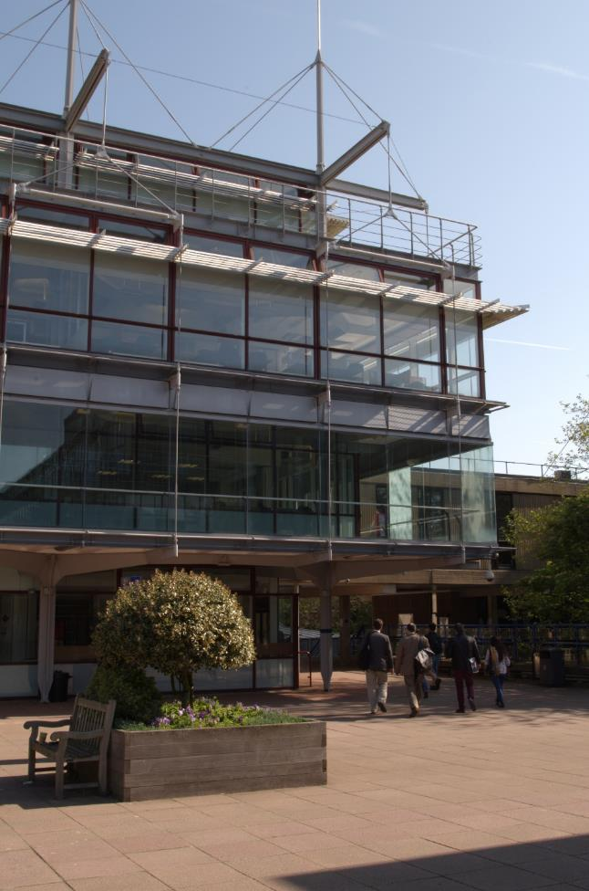
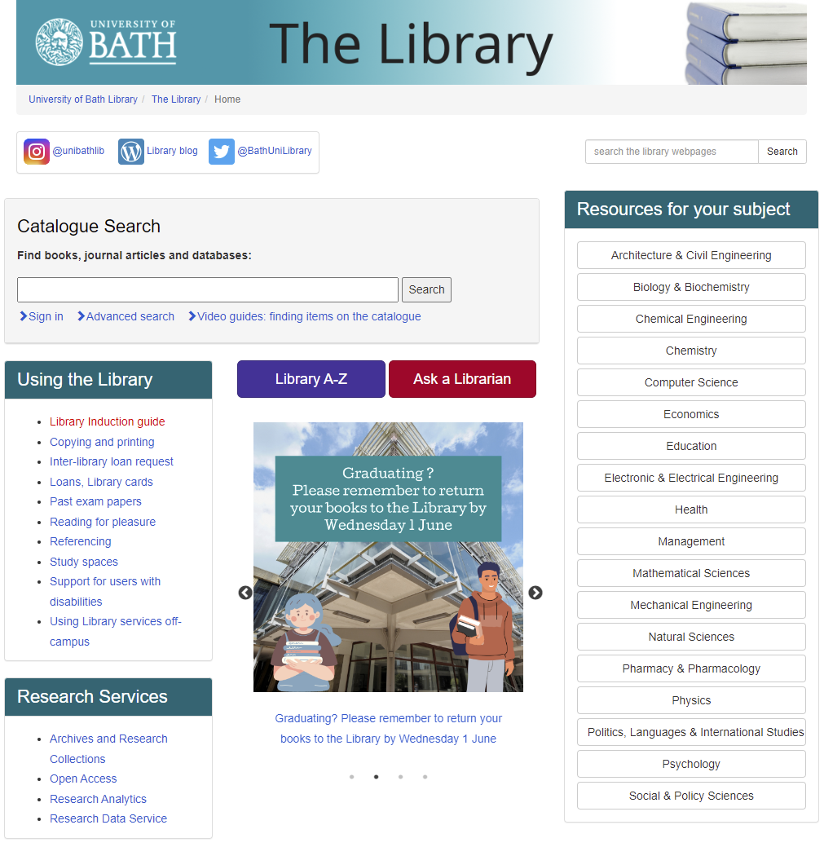
What the Library offers
Building
Online
332,000+ print books
200+ print journals
1,400 study spaces (including 500 with PCs)
Wireless internet access
Photocopiers & printers

Slide 7






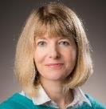




What the Library offer
Building
Online
332,000+ print books
200+ print journals
1,400 study spaces (including 500 with PCs)
Wireless internet access
Photocopiers & printers
Library catalogue
532,000+ e-books
27,000+ e-journals
100 subscribed databases
100 additional free databases
Website with guides, information and learning materials
Library staff

Slide 8
Great library resources …
Databases
Books
Conference papers
Journals
Statistics
Reference works
Supported by knowledgeable professionals
Complemented by burgeoning information landscape … more on that in a while
SO WHAT?

Slide 9
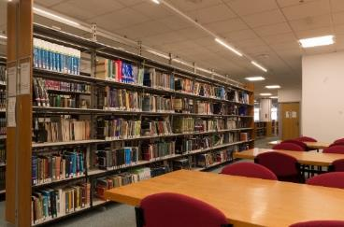
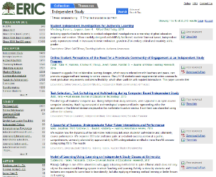
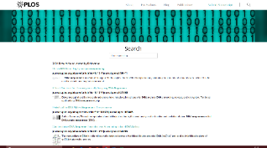

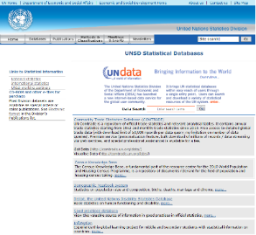

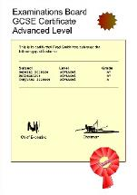
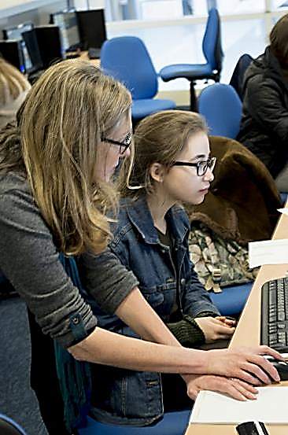
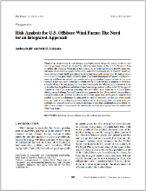

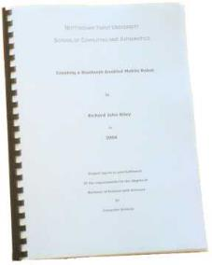
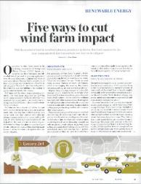
Why use a library?
Learning
Knowledge
Skills
Communication

Slide 10

Research Skills
Research Skills

Slide 11
Gathering your ideas
Write down your topic
What are the issues and key concepts?
What motivates you and what aspects of the topic are important and of interest?
What aims and goals does this work present?
Decide where to start …
11
Notes:
11

Slide 12
Thinking, Planning → Doing
Topic
General research goal
Specific research question
The great unknowns
What you already know?
What you know you need to find out
Things you don’t know about— essential to comprehension, interpretation, and communication

Slide 13
Develop your research question
Discuss the ethics of cloning animals for food production?
What are the key search terms?
ethics
ethic
ethical
moral
legal
cloning
clone
cloned
“genetically modified”
GM
animals
animal
livestock
“farm animals”
cattle
“food production”
agriculture
“food industry”
What are the ethical considerations in your question?
What is cloning? Are there different types of cloning?
What aspects of food production need to be considered?
Notes:
Discuss means to

Slide 14
Top tips for literature searching
Critical evaluation and reflection
Critically review at every stage
Credibility
Controversial?
Relevance
Authority … will it command the attention of your audience
Accuracy
Timeliness … forward looking … new thinking … current interest or understanding … of historical significance
Purpose

Slide 15
Choose good quality sources
Top tips for literature searching
Is it peer-reviewed? Is it presenting evidence or opinion?
Is it from a reputable author/institution? Have you heard of them?
For example, is it published in a high-quality journal?
Significance of the literature? Has it been cited?
Keep a record of the searches you’ve done – AND any useful articles!
Appropriate number of references – depends on your topic and search goal.
Don’t miss important papers
Don’t include irrelevant ones

Slide 16
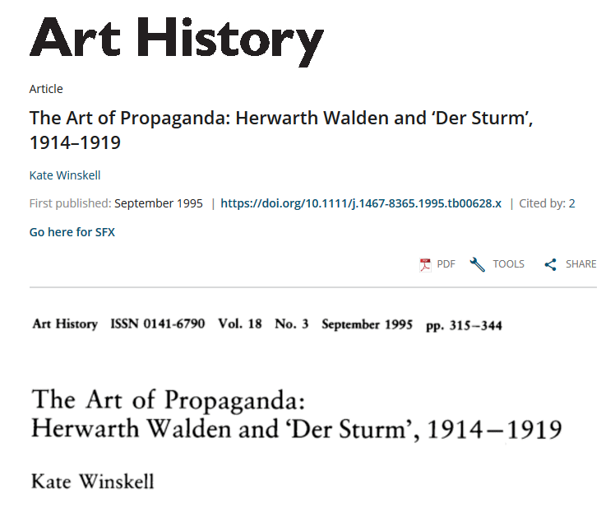
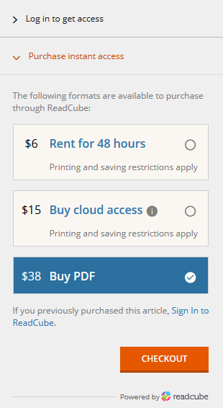
Where to look?
Paywall: not all information is free!

Slide 17
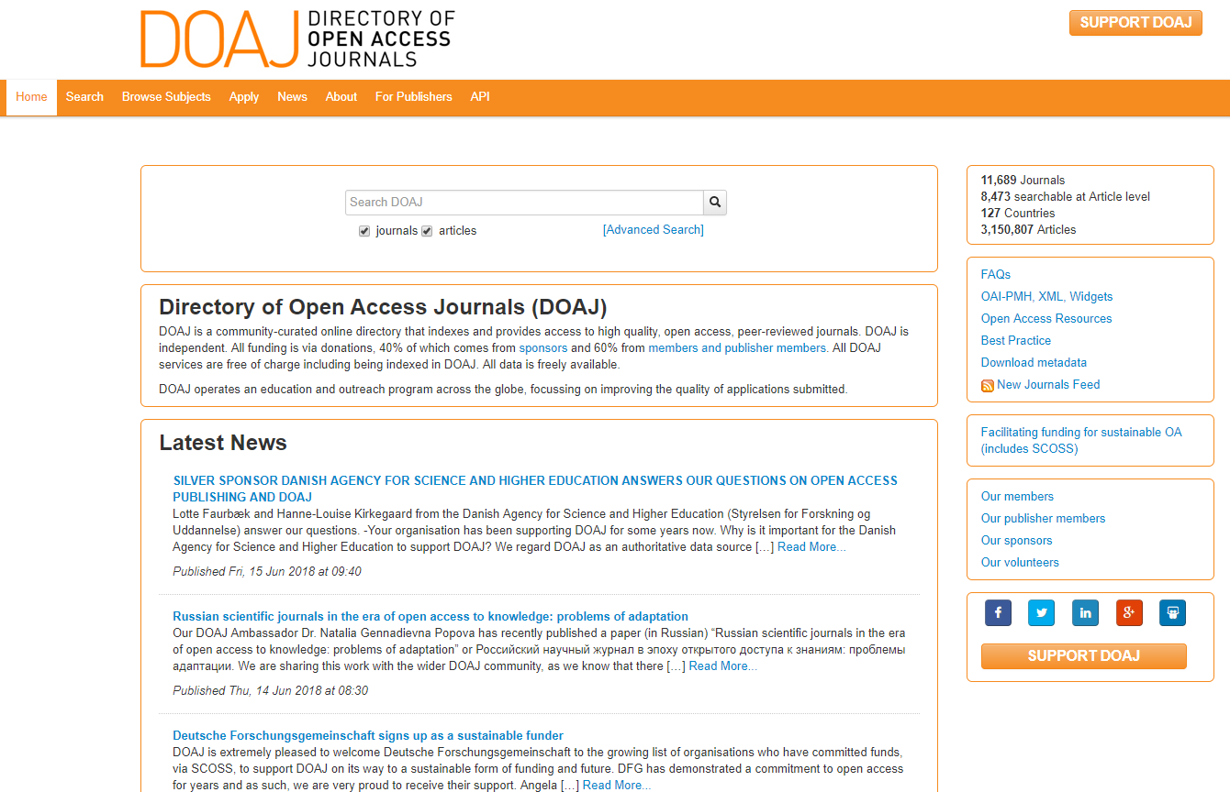
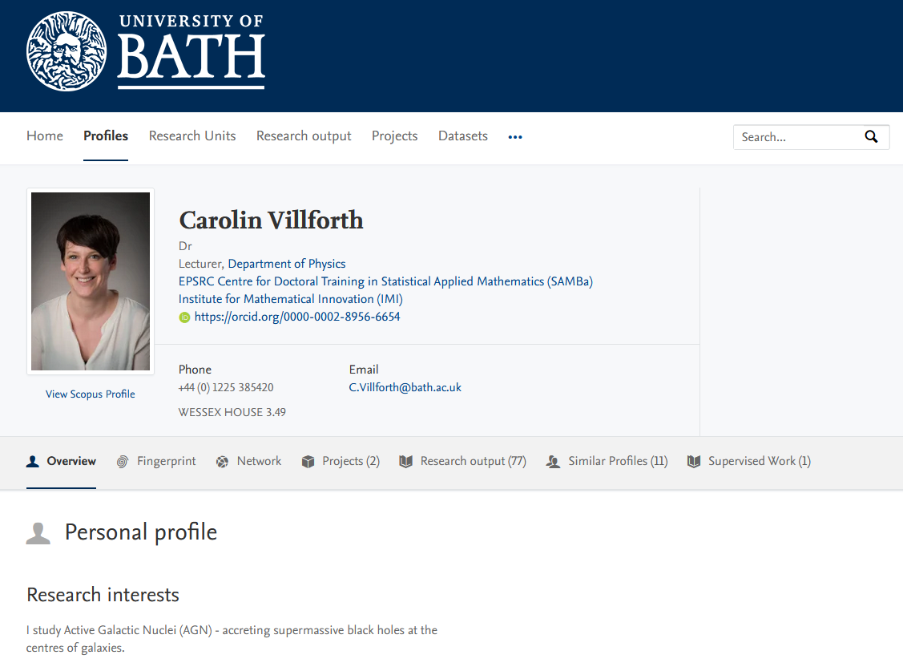
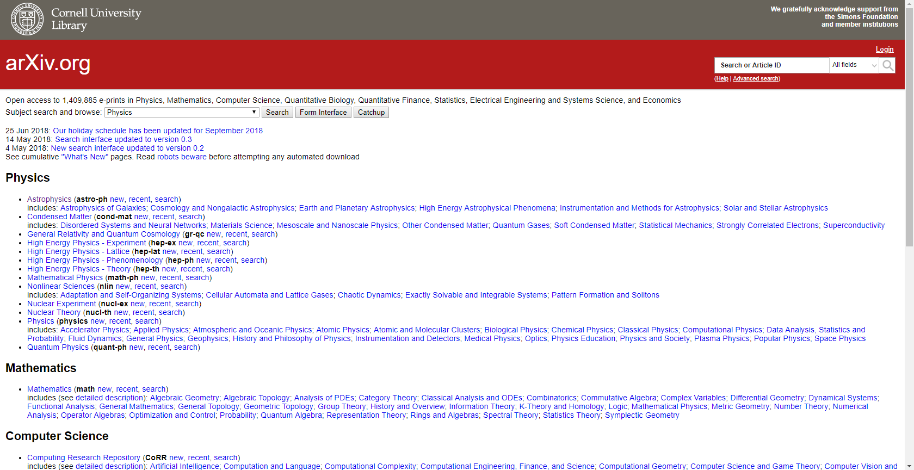
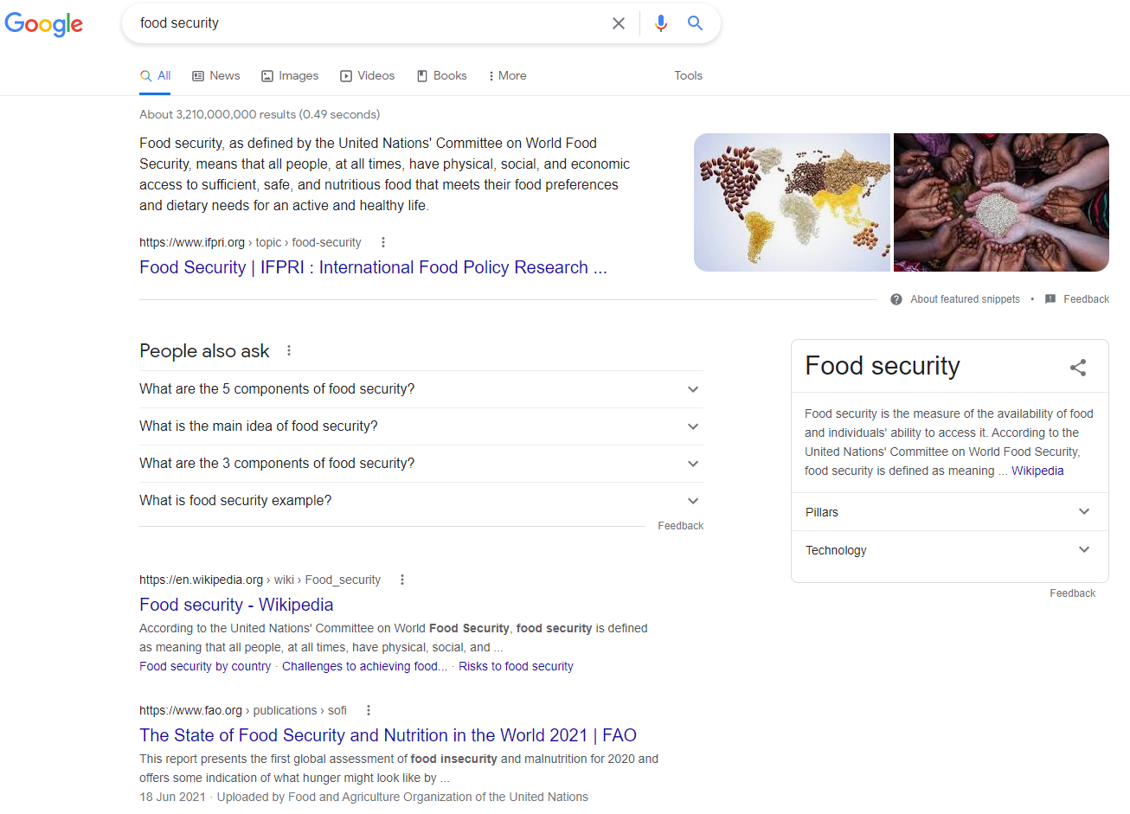
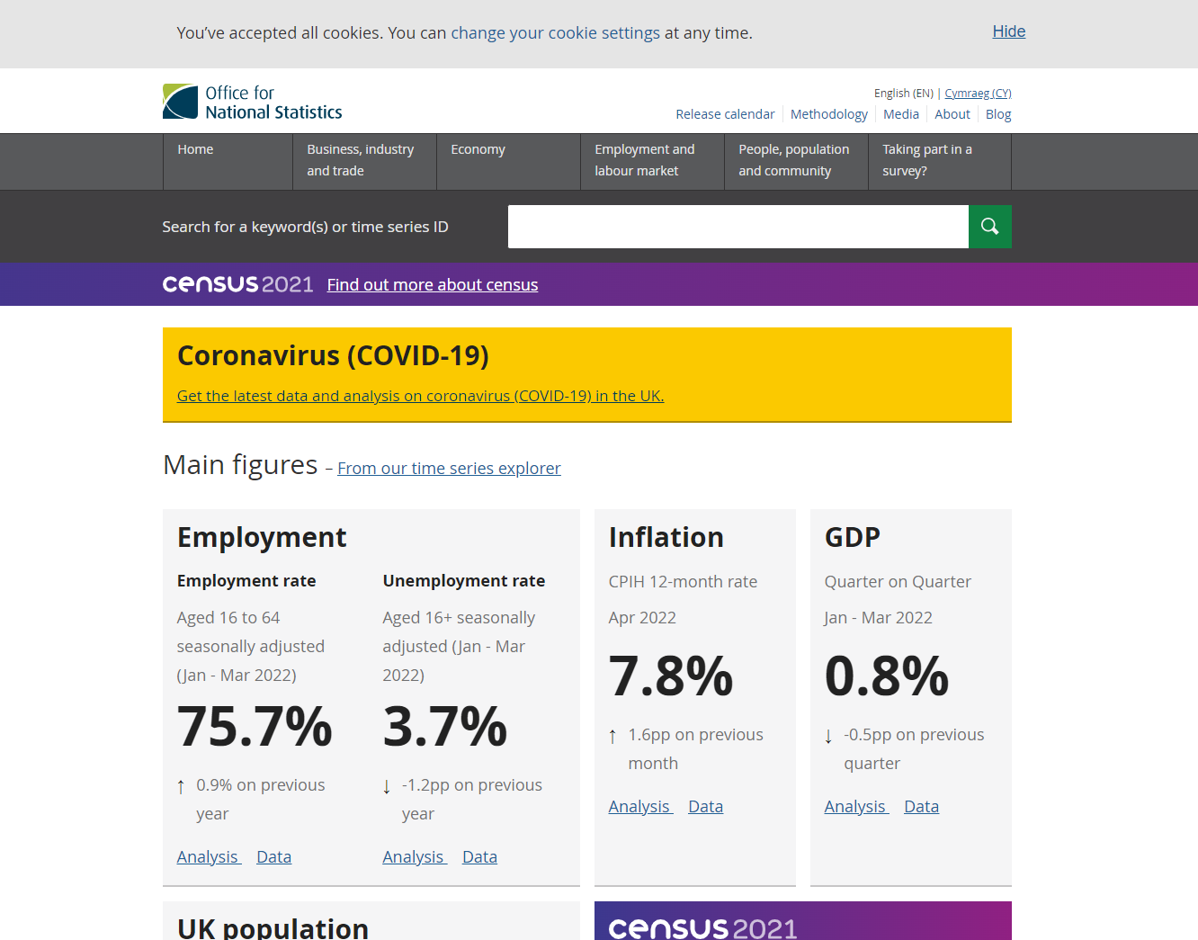
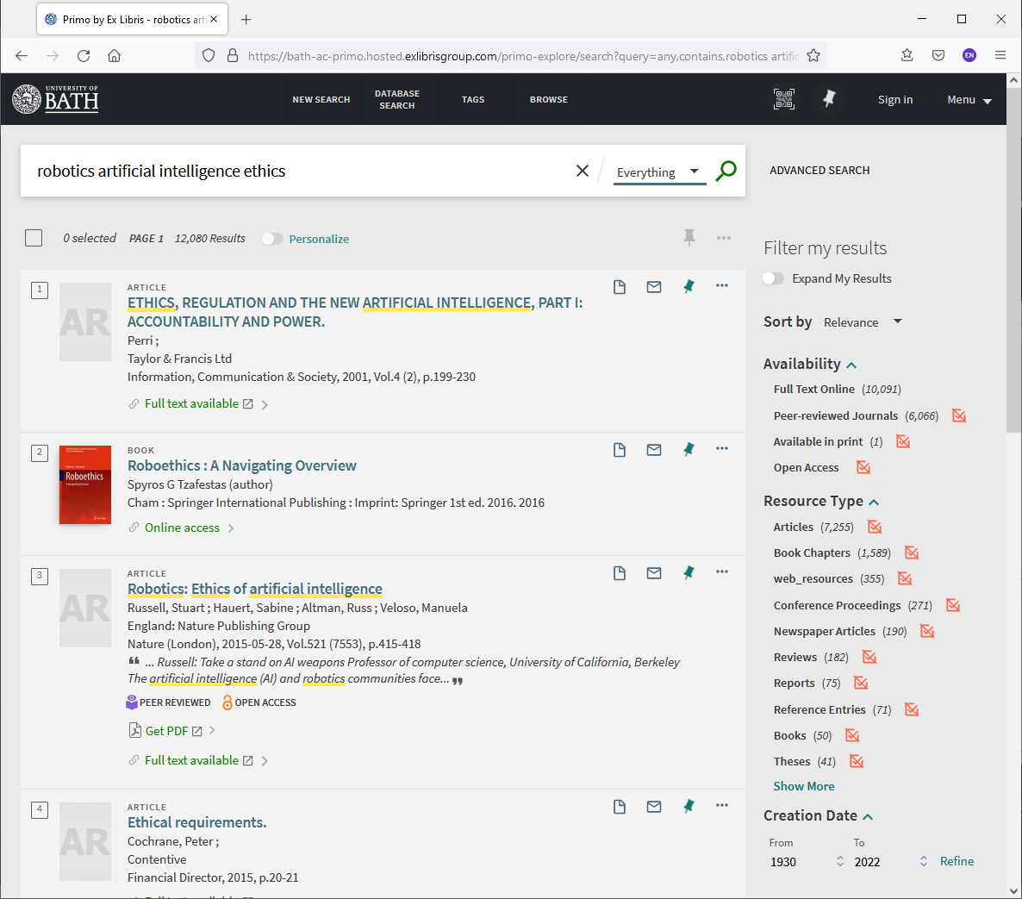
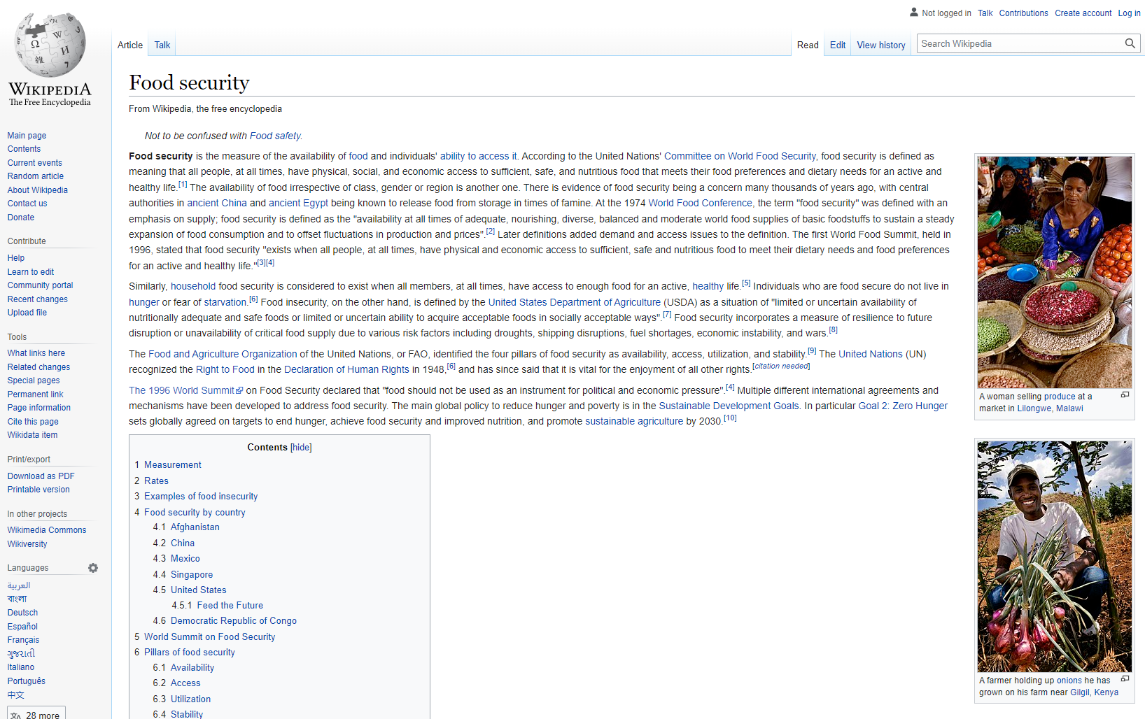
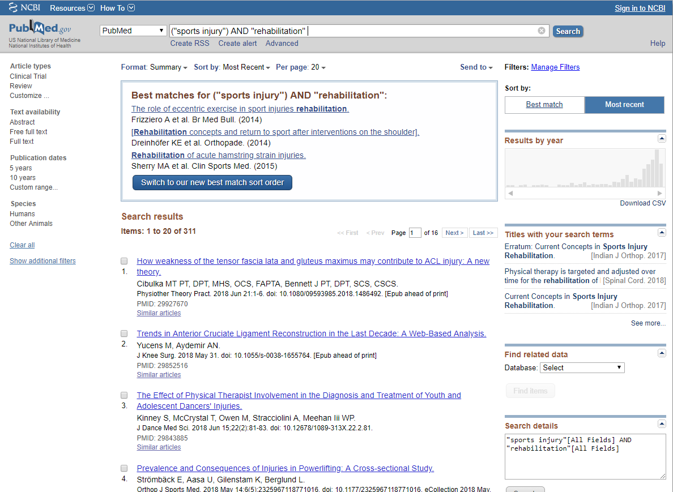
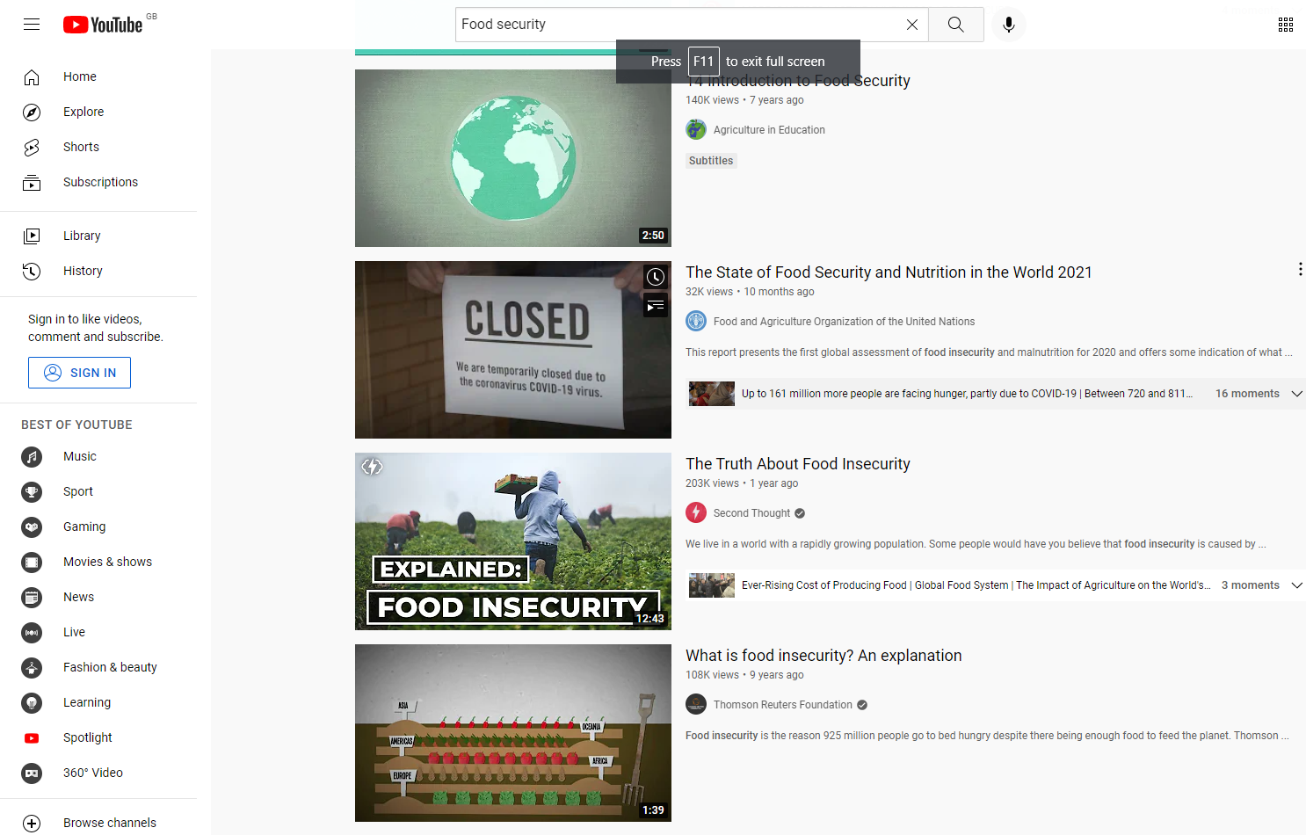
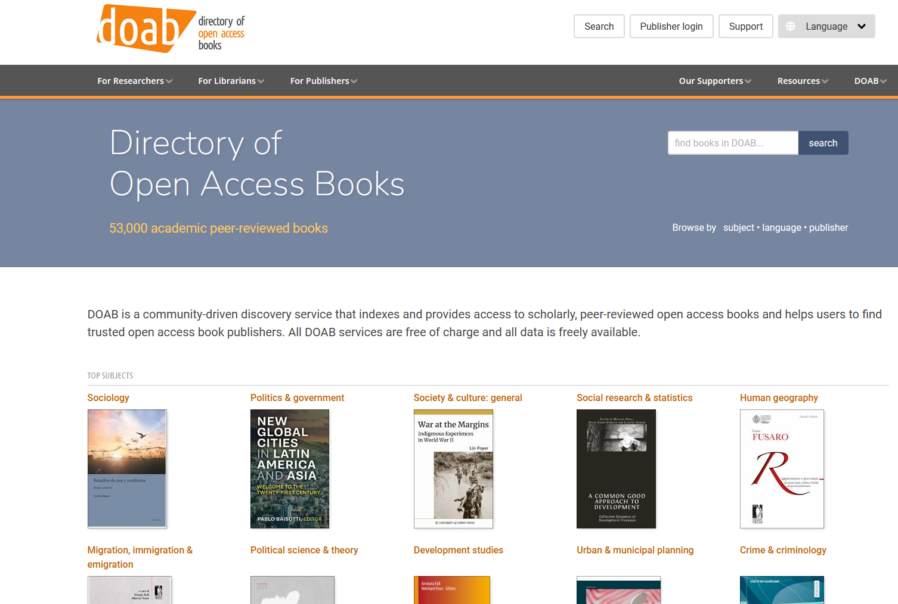
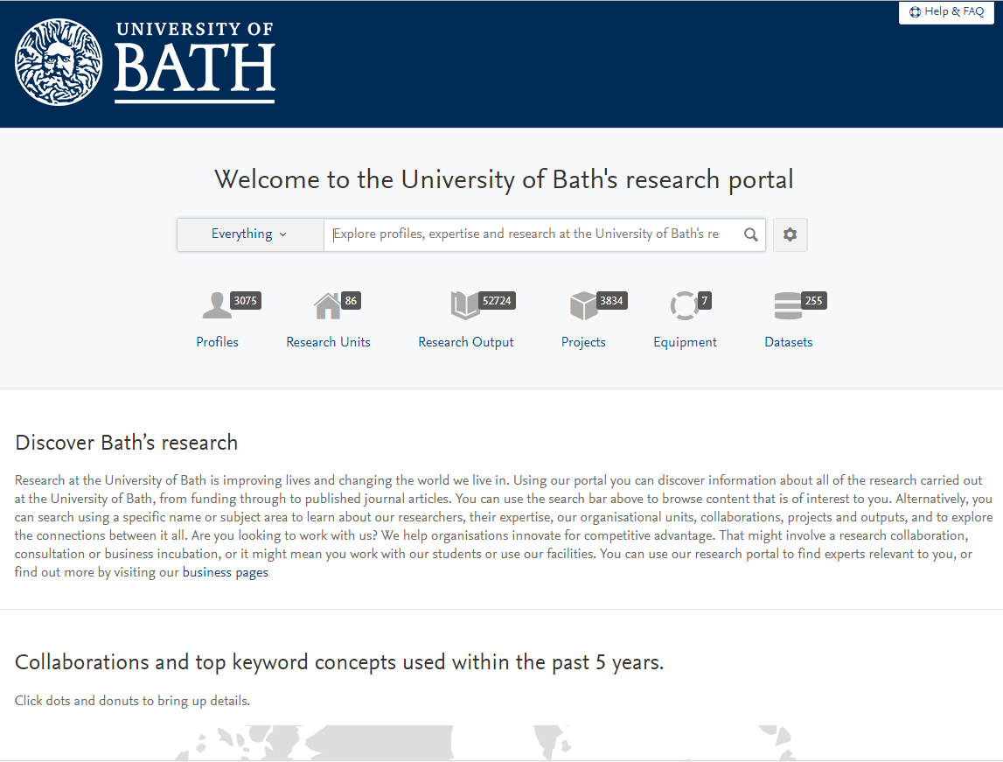
Where to look?
Library catalogues
Internet searching
Databases
Statistical information
Open access materials
Academic repositories
Authors and their online presence

Slide 18
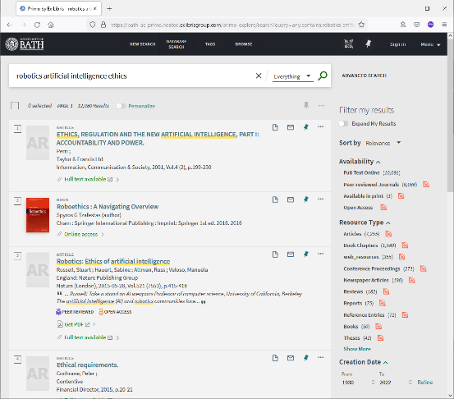
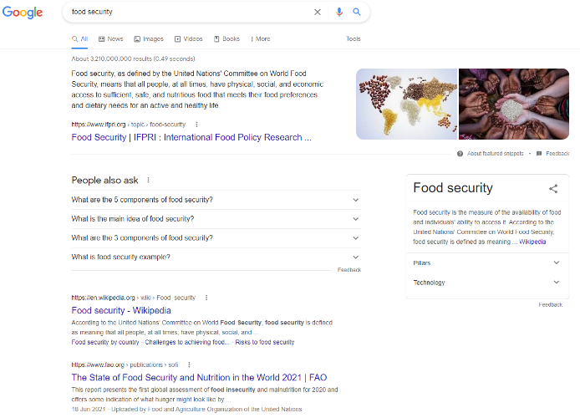
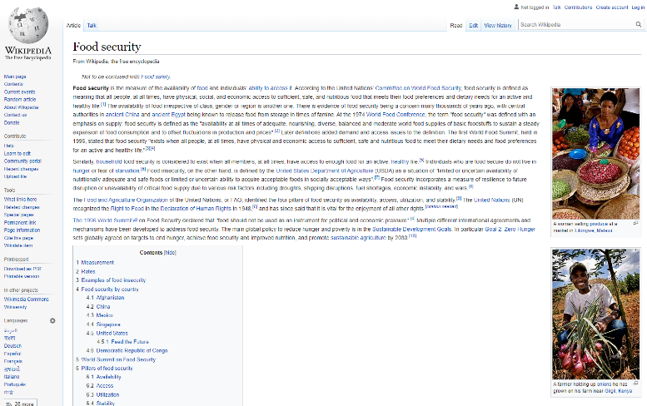

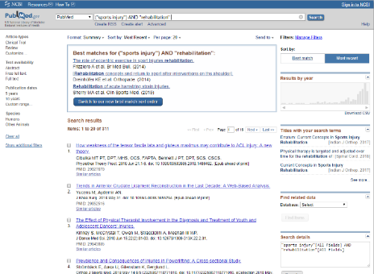

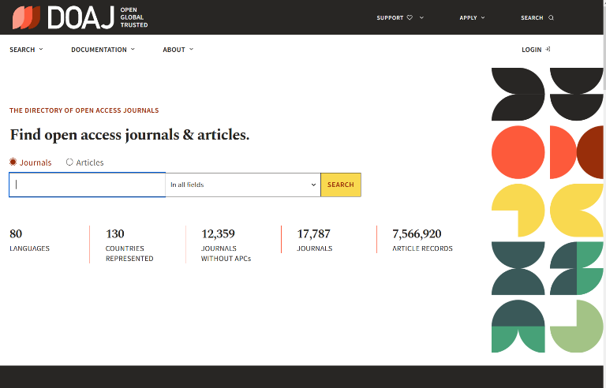


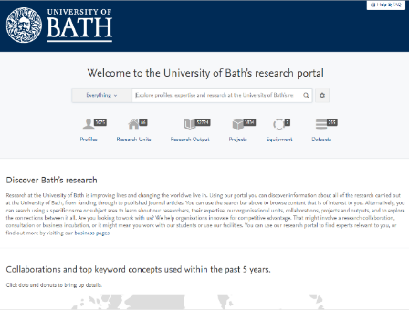
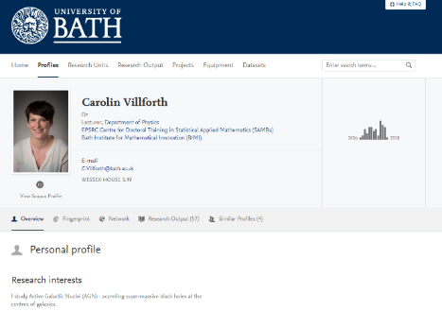
Where to look?
Library catalogues
Internet searching
Databases
Statistical information
Open access materials
Academic repositories
Authors and their online presence

Slide 19
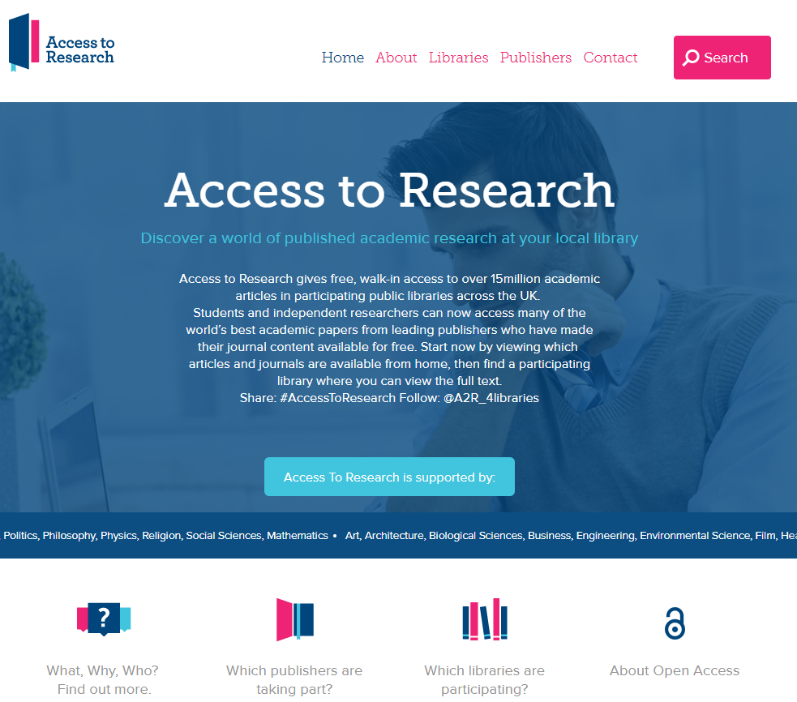
Public Libraries?
https://www.accesstoresearch.org.uk/

Slide 20
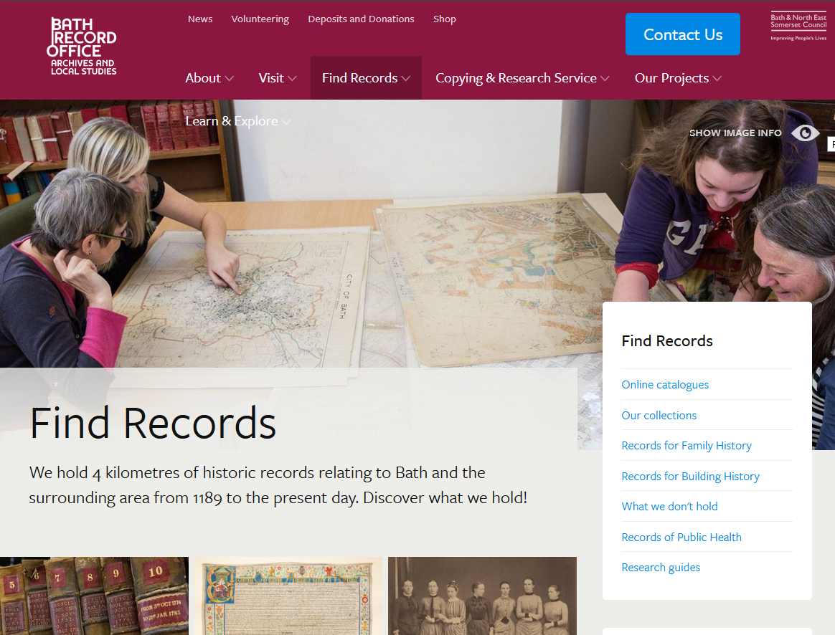
Public Libraries?
https://www.batharchives.co.uk/

Slide 21
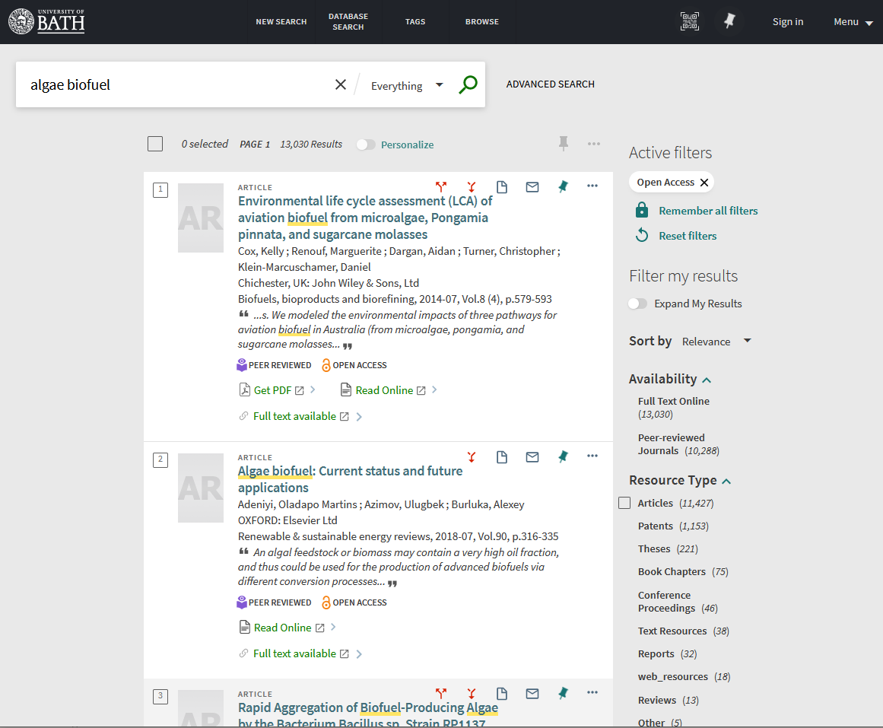
Catalogue search demonstration
algae biofuel

Slide 22
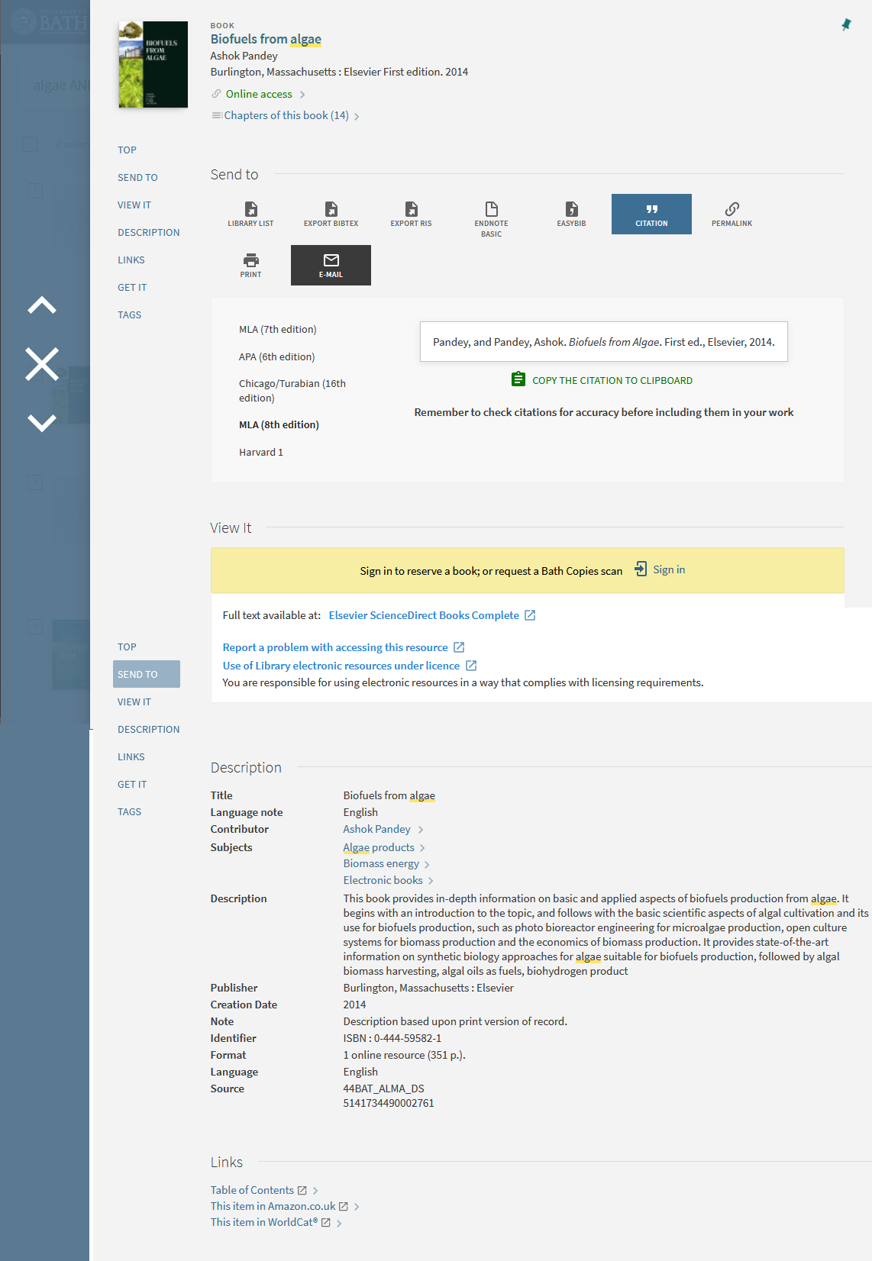
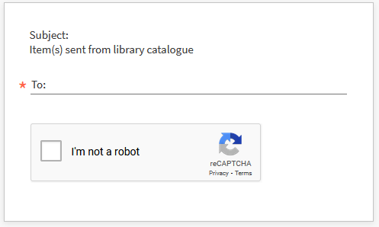
Email results from the library catalogue

Slide 23
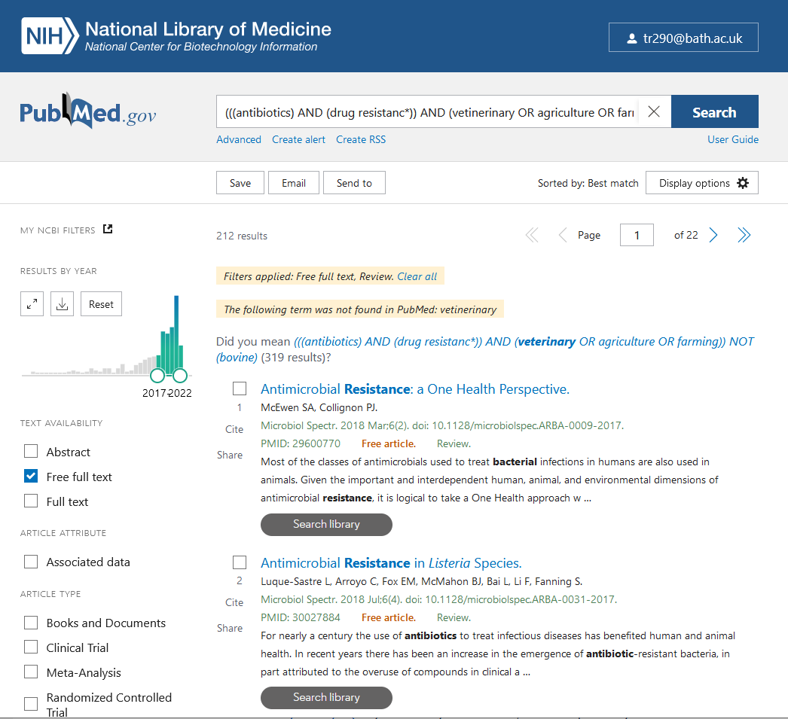
Database search demonstration

Slide 24
Using ‘AND’
bio-fuel*
environment
For connecting different concepts:
Bio fuel* AND environment
sunscreen* AND skin
medicine AND pregnancy

Slide 25
Using ‘OR’
sunscreen
sunblock
For different spellings, abbreviations or synonyms:
Haematology OR Hematology
HIV OR human immunodeficiency virus
bird flu OR avian influenza

Slide 26
Multiple search terms
pregnancy
drugs
medicines
(Pregnancy AND drugs) OR medicines
Pregnancy AND drugs OR medicines
Pregnancy AND (drugs OR medicines)

Slide 27
Using ‘NOT’
cheese
Cheddar
To exclude a word from your search
cheese NOT Cheddar
Note: Think before you do. What might be lost from your results?

Slide 28
Helpful comments
Research isn’t always easy or straightforward, and it doesn’t always go to plan
Research is an iterative process
Do not try and search for everything in one go or from one kind of resource or from one search tool
Seek to confirm information from different sources and look for different viewpoints and solutions
Adapt as you discover
Reflect on what you have found and when you have found enough
Keep notes/records of your searches, results and the resources you use

Slide 29
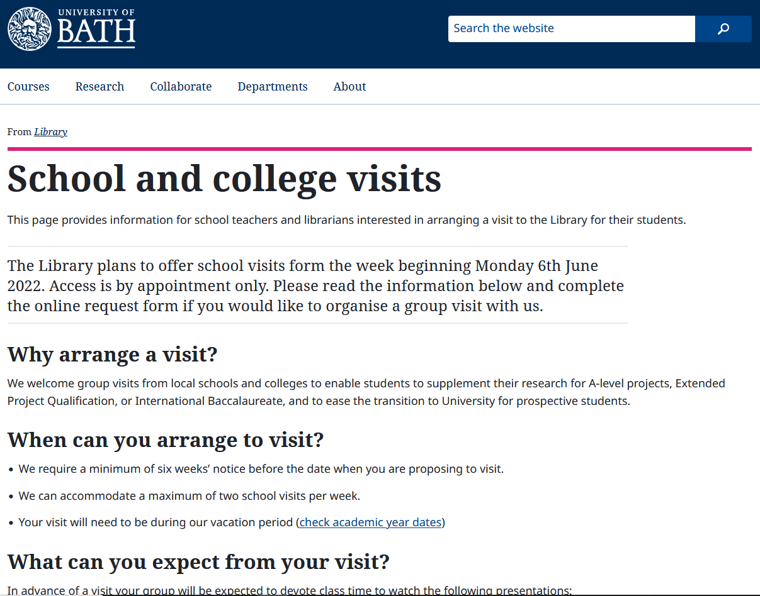
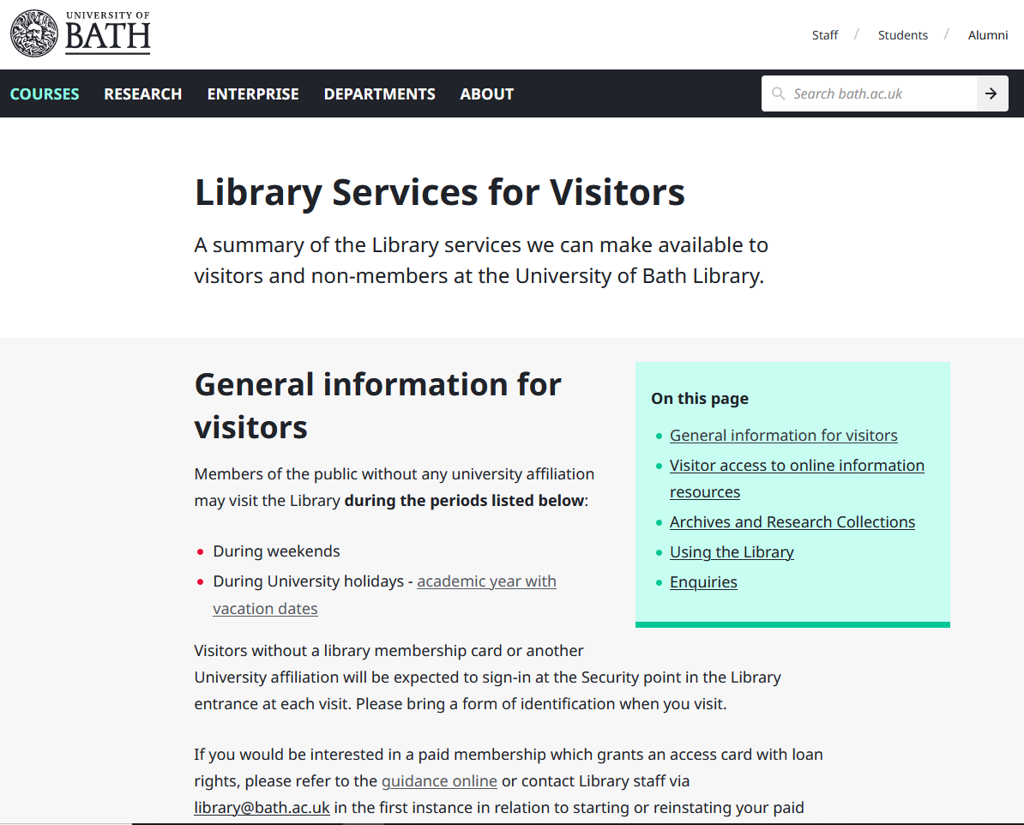
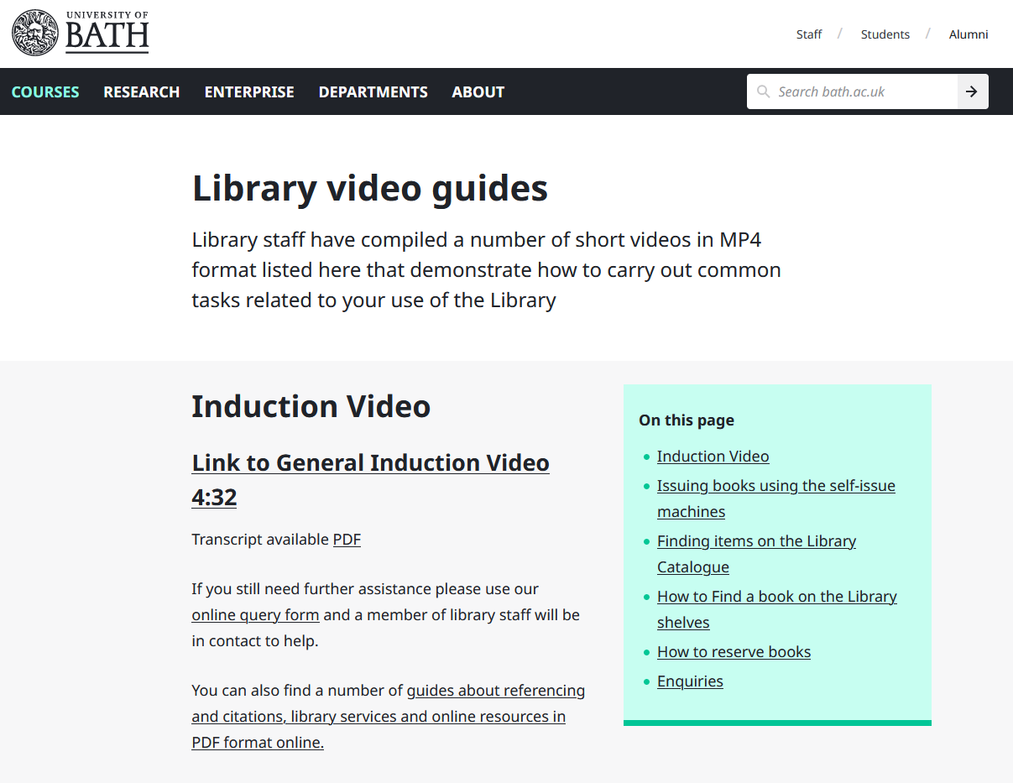
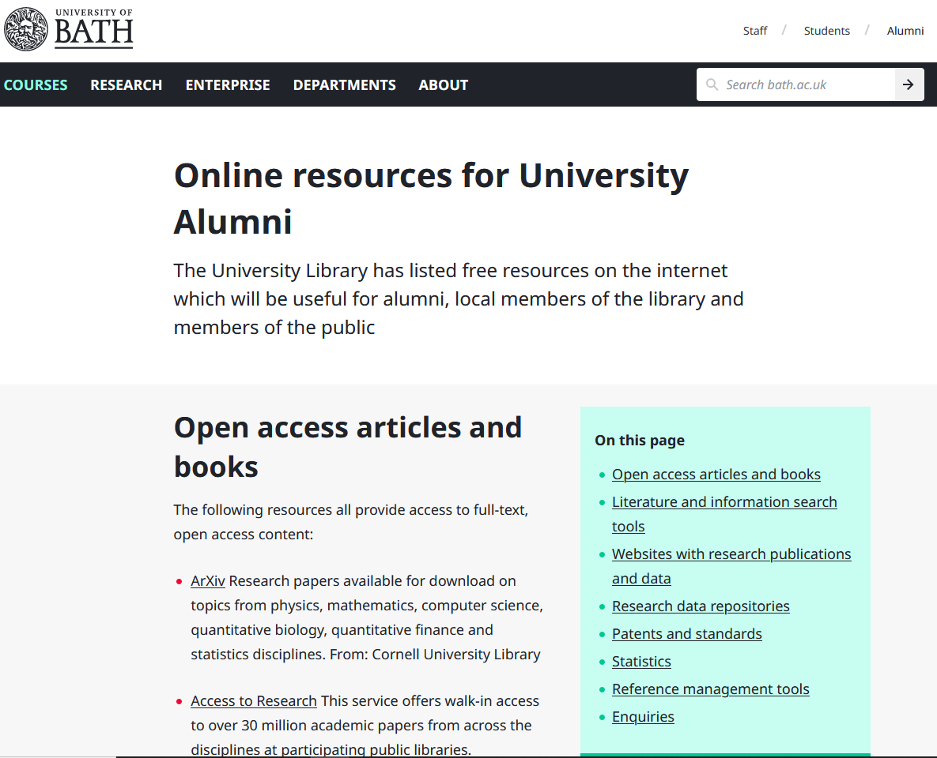

Slide 30
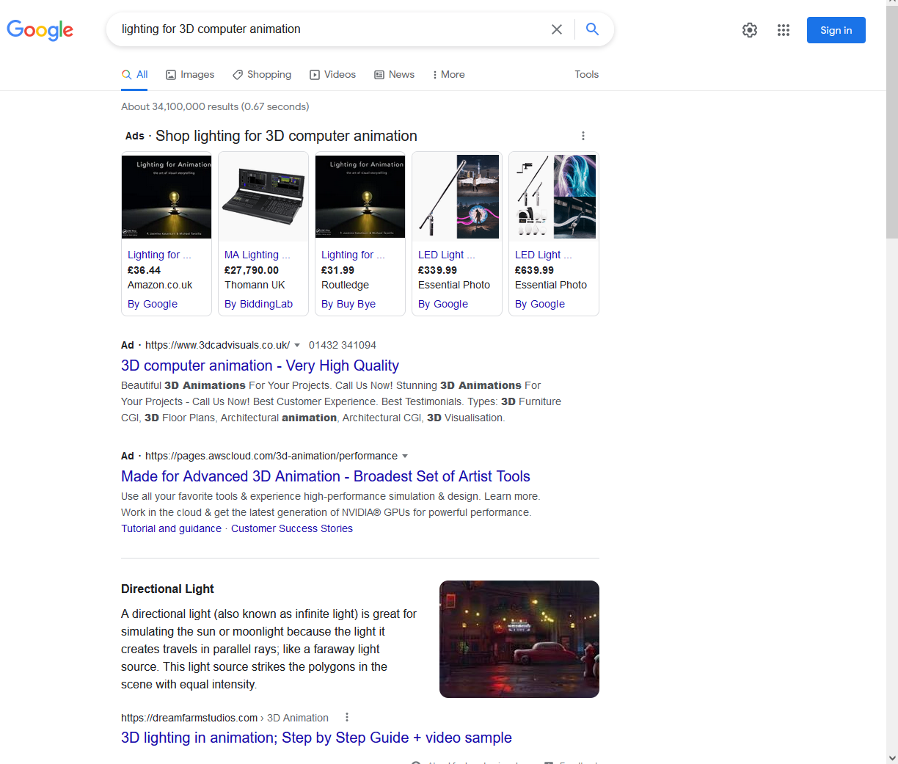
Google search engine

Slide 31
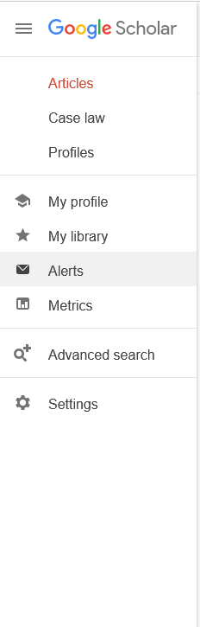
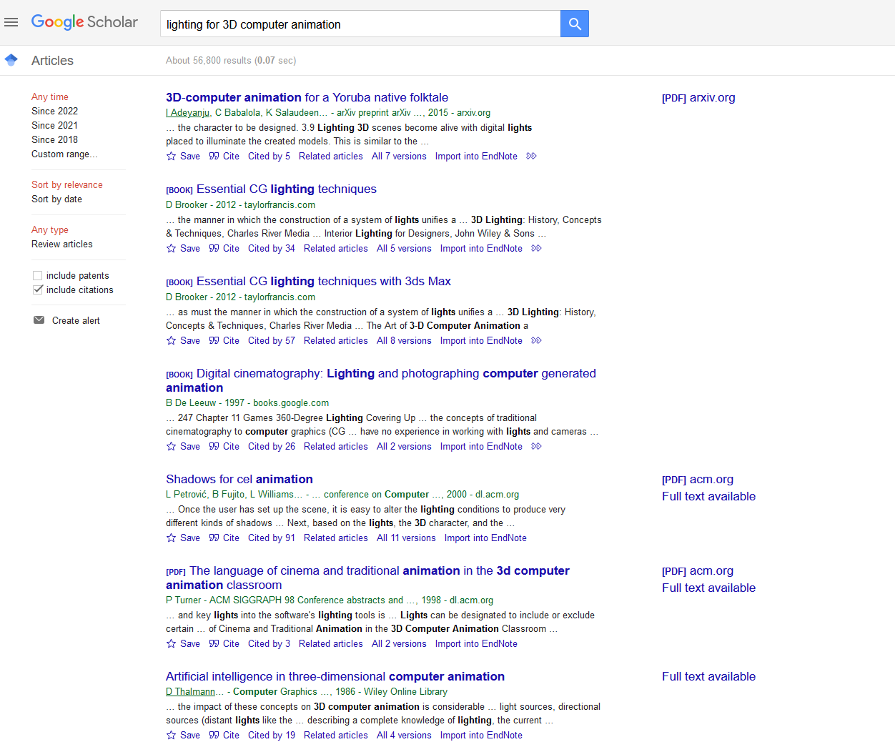

Slide 32
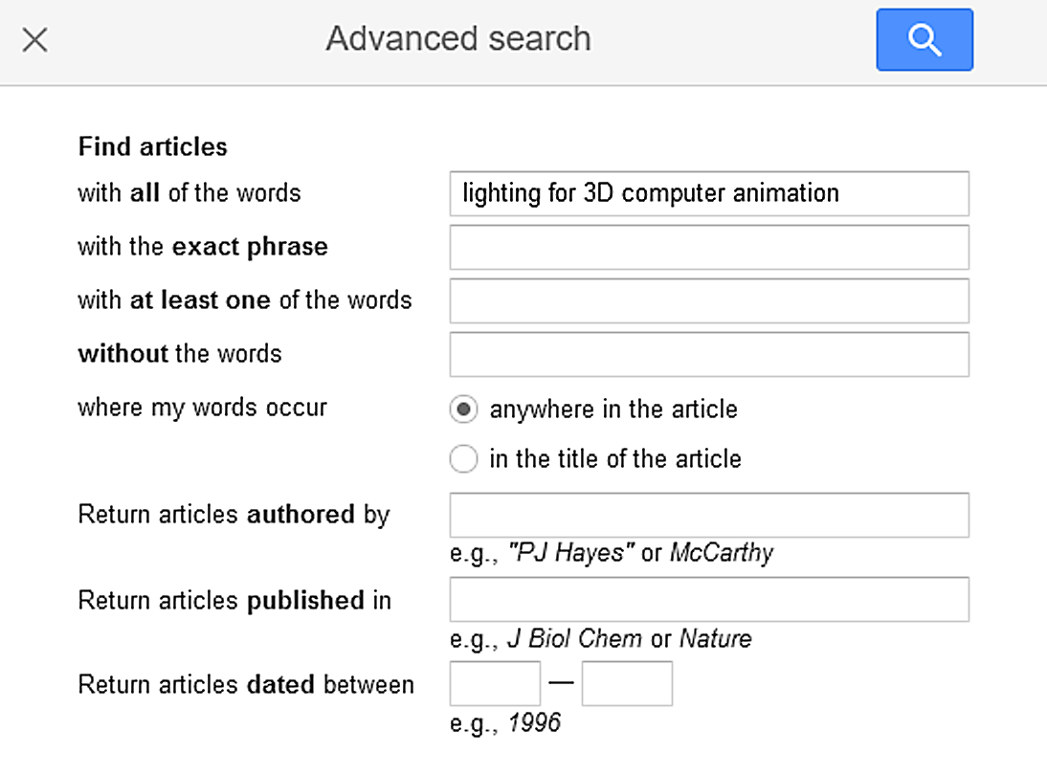

Slide 33
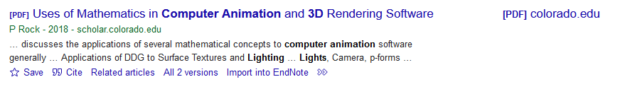
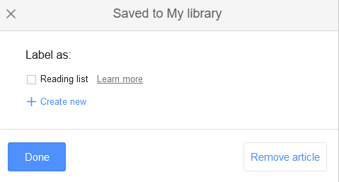
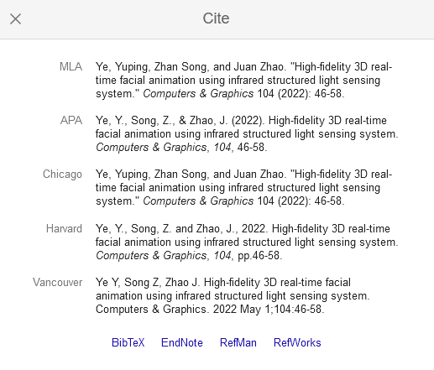

Slide 34
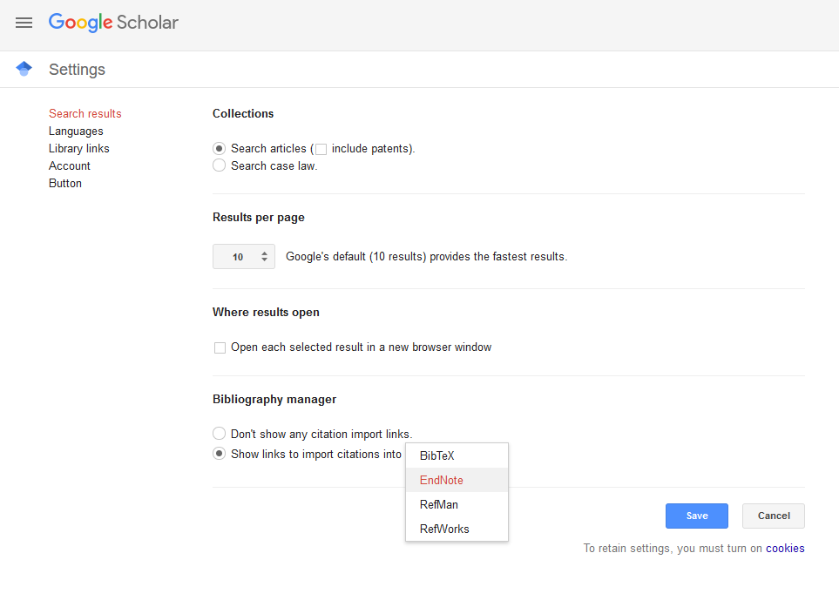

Slide 35

REFERENCING
REFERENCING

Slide 36
What do you cite/reference?
Any use of other peoples work
Direct quotations
Paraphrasing and summaries of others’ ideas
Not just text:
data and statistics
designs
graphs
tables
charts
models
diagrams
code
images
illustrations
artwork

Slide 37
Types of references, e.g.
Books
Magazine articles
Academic journal articles
web sites
Newspapers
Statistical sources
Images
Mathematical formula
Dissertations and theses
Company reports
Chemical technical data
Patents
Medical case notes
Government statutes
Conference papers
Film and video
Social media

Slide 38

Pears, R. and Shields, G.J., 2016. Cite them right: the essential referencing guide. 10th ed. Basingstoke: Palgrave.

Slide 39

https://library.bath.ac.uk/referencing

Slide 40


Reference management software

Slide 41



Reference management software
Reference management software helps you to:
create
download/import
save
organize
edit references in your own collection or ‘library’
Insert references from into your piece of work in Microsoft Word): ‘Cite while you write’ ribbon
Free online versions
EndNote online https://www.myendnoteweb.com
Mendeley https://www.mendeley.com/
Zotero https://www.zotero.org/
Mendeley

Slide 42
‘Health’ Warning
If you can’t reference manually. You will not be successful with reference management software.

Slide 43
Good referencing
Begins with choosing your topic, research planning
Good time management … leave referencing until the end at your peril
Get used to keeping the required details of each source
It’s part and parcel of effective note taking
Cite and reference sources: using quotations accurately and when paraphrasing others work
Reference all forms of knowledge: text, images, code etc.
Use features within the catalogue/database/Scholar to save or email records to yourself
Notes:
Common knowledge refers to information a member of public living in your country is likely to know. In academic practice it is a generally acknoweldged fact and doesn’t require a citation. Opinions can differ about what is common knowledge. A general rule of thumb is if it’s in your head then it’s common knowledge, ir you’ve read it in recent weeks it should be cited. If in doubt then cite.

Slide 44

Summary
This Photo by Unknown Author is licensed under CC BY-NC

Slide 45
Why use a Library
Library services
Library catalogue
Free database and portals
Freely available academic resources … books, journals, statistics, repositories
Google Scholar
Issues of referencing

Slide 46
More information
REFERENCING
Referencing guide: https://library.bath.ac.uk/referencing
Finding and referencing images: https://library.bath.ac.uk/images/referencing
Reference management software: https://library.bath.ac.uk/referencing/reference-management
How to evaluate journal articles and websites: https://www.bath.ac.uk/guides/how-to-evaluate-journal-articles-and-websites/
Understanding copyright and keeping your copying legal: https://www.bath.ac.uk/guides/understanding-copyright-and-keeping-your-copying-legal/
LINKS TO FREE DATABASES
Recommended free online resources: https://www.bath.ac.uk/guides/online-resources-for-university-alumni/
SEARCH GUIDES
How to do a Literature Search: https://library.bath.ac.uk/literaturesearch
How to find books and journal articles: https://www.bath.ac.uk/guides/how-to-find-books-and-journal-articles/
RESEARCH PORTAL
University of Bath's research portal: https://researchportal.bath.ac.uk/

Slide 47

ANY QUESTIONS?
This Photo by Unknown Author is licensed under CC BY-SA

