Slide 1
Science for non-scientists
Dr Dan Pantoș
Admissions Tutor, Department of Chemistry

Slide 2
Today’s agenda
What is science?
The Scientific Method
Structure
Referencing
Presentation

Slide 3
What is Science?
“Science is the process of separating the demonstrably false from the probably true.”
Michael Zimmerman
Science is:
The product of human creativity
Influenced by cultural, social and political norms
Aligned with the times
Subject to change

Slide 4
What is Science?
Science:
Impacts every aspect of our life
Allows us to evaluate information of all type
Helps us make correct judgements
Makes us keep an open mind
Is endless
It is impossible to be fluent in all aspects of science
Is inherently sceptical and conservative
It is hard work and seemingly cryptic
The more specialised the more difficult to communicate
Is it important?

Slide 5
What is Science?
Q&A:
John Steward (Q) - Neil deGrasse-Tyson (A)
Q: “Here’s my trouble with science; they always wanted me to know the right answer. Isn’t the trouble with your job the not knowing?”
A: “No, that’s not the trouble, that’s the seduction!”
Science is all about not knowing and asking questions

Slide 6
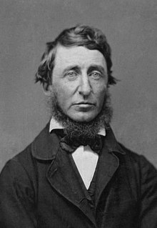
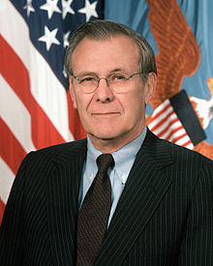
What is Science?
Henry David Thoreau (1817-1862)
“To know that we know what we know, and that we do not know what we do not know, that is true knowledge.”
Things we know and things we don’t know
… so how can we figure out what we don’t know and what we don’t know that we don’t know?
“There are known knowns. These are things we know that we know. There are known unknowns. That is to say, there are things that we now know we don’t know. But there are also unknown unknowns. These are things we do not know we don’t know.”
Donald Henry Rumsfeld (1932-2021)

Slide 7
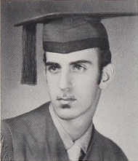
What is Science?
Science = Knowledge ?
Science consists of two things: a body of knowledge and the process by which that knowledge is produced. This second component of science provides us with a way of thinking and knowing about the world.¹
Wisdom
⇧
Knowledge
⇧
Information
⇧
Data
“Information is not knowledge. Knowledge is not wisdom. Wisdom is not truth. Truth is not beauty. Beauty is not love. Love is not music. Music is THE BEST.”
Frank Zappa (1940-1993)

Slide 8
The Scientific Method
Ways of Scientific Knowing
Induction (or inductive logic):
From examples to general rules or principles
Leads to empirical approaches of understanding
Observation!
Natural
Experimentation
Deduction (or deductive logic)
Uses rules to understand examples
Leads to theoretical approaches to understanding
Modelling!
Numerical
Statistical
…

Slide 9
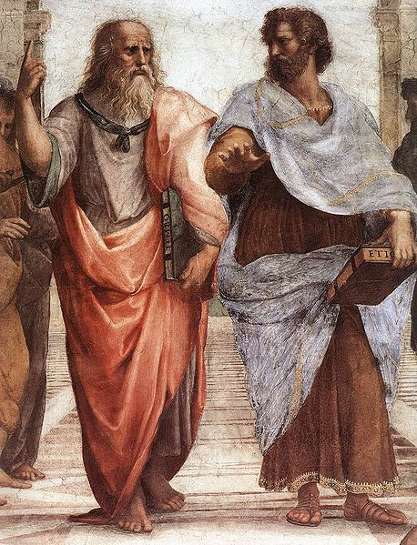
The Scientific Method
Raphael (1483 - 1520)
Ways of Scientific Knowing
Knowledge comes from the world
Empirical data
Inductive approach
Knowledge comes from pure thought
Theoretical models
Deductive approach
Plato Aristotle
(424-348) BC (384 - 322) BC

Slide 10
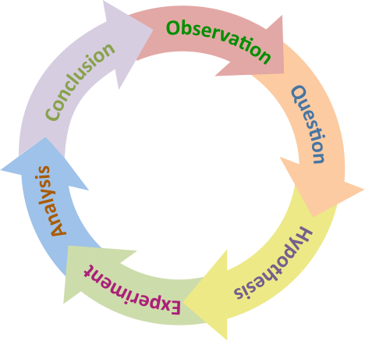
The Scientific Method
Observation
State the problem (Ask the Question)
Gather information about the problem
Form a hypothesis
Perform an experiment to test the hypothesis
Record and analyze your data
State a conclusion

Slide 11
The Scientific Method
Observation
State the problem (Ask the Question)
Gather information about the problem
Form a hypothesis
Perform an experiment to test the hypothesis
Record and analyze your data
State a conclusion

Slide 12
The Scientific Method
Observation
State the problem (Ask the Question)
Gather information about the problem
Form a hypothesis
Accept pre-existing hypotheses
Consider consequences
Design experiment to test both hypotheses
Record and analyze your data
Decide between hypotheses
State a conclusion
Observation
State the problem (Ask the Question)
Gather information about the problem
Form a hypothesis
Challenge pre-existing hypotheses
Record and analyze your data
Form new hypothesis
Design experiment to test new hypothesis
State a conclusion

Slide 13
The Scientific Method
Q: “Here’s my trouble with science; they always wanted me to know the right answer. Isn’t the trouble with your job the not knowing?”
Scientific hypothesis – a tentative explanation that accounts for a set of facts and can be tested by further investigation.
Scientific law – generalizations of observational data that describe patterns or relationships.
Scientific theory – systematic sets of concepts that provide explanations for observing patterns in nature.
All change as new data become available.

Slide 14
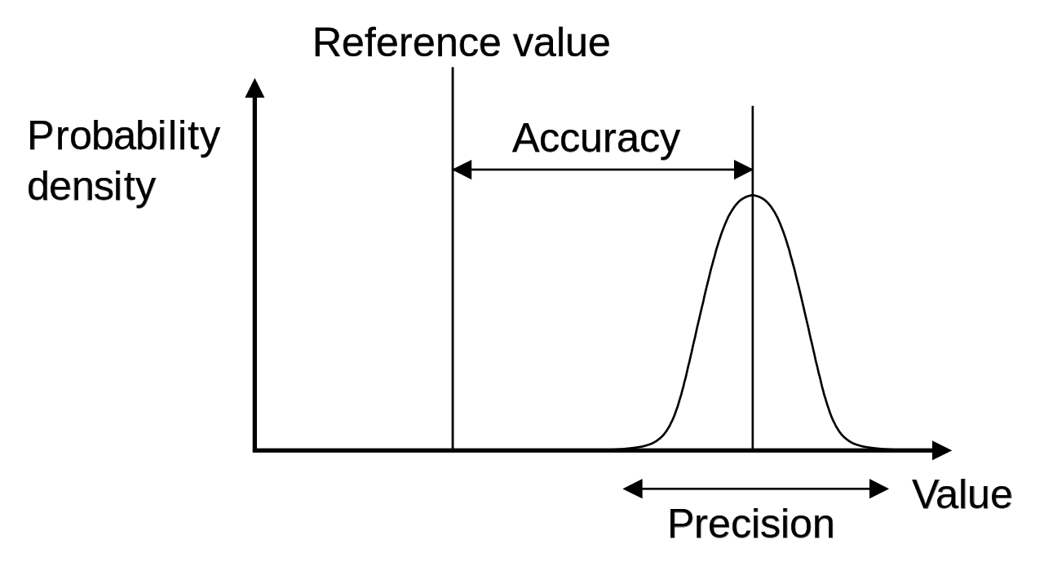
The Scientific Method
Uncertainty – Accuracy – Precision
Uncertainty¹:
Being in doubt / Dependent on chance (common)
Inherent / unable to tell the accuracy or precision beyond a certain limit (science)
Accuracy:
How close is the data to the “real” value
Precision:
A refinement in measurement that allows comparison between datasets
Accuracy
Precision

Slide 15
The Scientific Method (for EPQ)
(Observation)
State the problem (Ask the Question)
Find pre-existing hypotheses
Consider consequences
Gather information about the problem
Design experiment to test both hypotheses
Record and analyze your data
Decide between hypotheses
State a conclusion
(Observation)
Are Vaccines useful?
Yes / No
Yes – improve / No – detrimental to general health
Search literature for both hypotheses
Design experiment to test both hypotheses
Record and analyze literature data
Decide between hypotheses
State a conclusion

Slide 16
The QUESTION in EPQs
Nanotechnology
"The Ecocorona Complex” (microplastics)
”How Carbon Capture technologies can make the chemical manufacturing industry more sustainable”
“To what extent does the gender gap affect women's achievements within science?”
“What part of an explosive causes the biggest impact?”
“Eschatology through time”
"What is the future of nanotechnology in medicine?"
“Is dairy farming is inherently detrimental to the environment?”
”The future of gene technologies”

Slide 17
Sources of Information
Good
Caution Needed
General Scientific magazines:
New Scientist
Scientific American
Discover
American Scientist
Learned Societies magazines:
Chemistry World (RSC)
C&E News (ACS)
Physics World (IOP)
Geology Today (GeolSoc)
News & Views sections Science / Nature
Tabloids
Scientific Documentaries
on mainstream media
Learned Societies / University
Youtube Vimeo etc. channels
Scientific columns
in mainstream media
Blogs (politicised)
Partisan Media
(Twitter/Youtube/printed press/ etc.)

Slide 18
Referencing & Presentation
Useful tools & tips
Clear text & free of grammatical errors
NO scientific contradictions unless presented in antithesis
Use easy to read fonts (preferably sans-serif)
Graphs:
Consistent formatting & legible
Referenced if not self produced
Good resolution
Referencing:
Consistent and style from a scientific journal
Zotero (freeware)
Tips on making the presentation: http://clgiles.ist.psu.edu/research-presentation/ResearchPresentation.ppt
WHY and HOW are very important questions!
Don’t leave it until the last second.

Slide 19
Any questions?

Slide 20
go.bath.ac.uk/chem

