Slide 1


Social Science Research for Non-Social Scientists
Dr. Iulia Cioroianu
Department of Politics, Languages and International Studies
University of Bath

Slide 2
Social Sciences & Humanities
Environmental planning
Science and Technology Studies
Human Geography
History
Linguistics and languages
Area Studies
Sociology
Demography
Development studies
Political science & international studies
Education
Economics
Psychology
Law & legal studies
Public and social policy
Social anthropology
Literature
Classics
Philosophy
Religion studies
Visual and performing arts
Social work
Management & business studies
Archeology

Slide 3
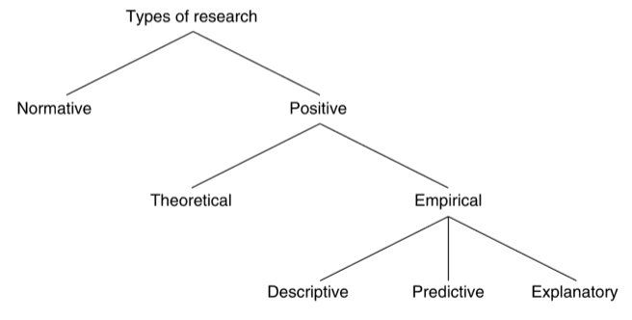
What is social science research? What forms does it take?
UKRI uses a very broad definition of research: “any form of disciplined enquiry that aims to contribute to a body of knowledge or theory”.
Types of enquiry:
Positive (describing and explaining “what is”; objective and fact-based, verifiable and testable) vs. normative (value judgements about what “ought to be”, subjective, non-testable)
Theoretical/conceptual (hypothetical discussion of concepts and the relations between them) vs. empirical (applied)
Quantitative (using numbers and statistical methods, seeking general description, inference or test of causal hypotheses) vs. qualitative (focus on one or a small number of cases, in-depth, detailed analysis, providing a comprehensive or interpretative account of the studied phenomenon).
Exploratory (often first step in formulating questions and hypotheses) vs. descriptive (the goal is systematic description) vs. explanatory (the goal is to explain phenomena, test hypotheses, make predictions).
Empirical research can be:
Primary research (collecting own data) or secondary research (analysing data collected by other researchers)

Slide 4
Choosing an area of interest and defining the problem
Based on student interests
Starting point can be:
Empirical observation (personal experience, current events, media reports, etc.)
Existing theories (assumes some pre-existing level of familiarity with the academic literature on the topic)
A good topic:
Can sustain the student’s interest over the longer term
Is relatively specific
Can be addressed with a feasible research design (timescale, resources, word counts)
Can lead to the development of research that is useful or interesting for the wider community

Slide 5
Elements of a social science research project
Formulate a clearly-articulated research question or problem. Explain why it is relevant and important.
Identify and specify the research context in which the question or problem will be addressed. What do existing theories say?
Building upon existing knowledge and research, explain the particular contribution of the proposed research. What knowledge gap does it fill?
Specify and briefly explain the research methods to be used, and explain the rationale for their choice.
Select or collect data and/or evidence. Describe the data collection process.
Analyse the data and evidence, and present the results of the analysis.
Discuss and interpret the results in relation to existing literature and theories.
Discuss the generalizability potential and implications, but also the limitations of the research conducted. Briefly suggest potential future areas of enquiry.
Notes:
A good

Slide 6
Elements of a research paper or report
Formulate a clearly-articulated research question or problem. Explain why it is relevant and important.
Identify and specify the research context in which the question or problem will be addressed. What do existing theories say?
Building upon existing knowledge and research, explain the particular contribution of the proposed research. What knowledge gap does it fill?
Introduction
Literature review
Specify and briefly explain the research methods to be used, and explain the rationale for their choice.
Select or collect data and/or evidence. Describe the data collection process.
Analyse the data and evidence, and present the results of the analysis.
Methodology
Results
Discuss and interpret the results in relation to existing literature and theories.
Discuss the generalizability potential and implications, but also the limitations of the research conducted. Briefly suggest potential future areas of enquiry.
Discussion
Conclusion

Slide 7
What proportion does each section take in the final output?
It depends on the type of output
Standard structure for a research paper:
Abstract (if needed)
Introduction: ~10%
Literature review: 20-25%
Data and methods: 10-20%
Results & discussion: 35-40%
Conclusion: ~10%
References
Appendices (if allowed or needed)
Research paper
Report
Blog post or media briefing, etc.

Slide 8
A good social science…
research question
is socially and scientifically relevant
literature review
uses academic sources (academic journal articles, books, scientific reports, etc.)
identifies the main theory or theories that the research engages with
data collection
uses appropriate sources and collection methods
data analysis
uses appropriate methods for analysing the collected data
interpretation and discussion of results
links back to the literature review and the identified theories, clearly explaining how the research conducted informs those debates
conclusion
shows the ability to place the research within the broader social and academic context
critically evaluates the implications of the results
discusses limitations
can suggest future areas of enquiry
builds upon existing knowledge
is amenable to investigation and narrow enough
uses research databases (Google Scholar, JSTOR, Web of Science)
quantitative data: survey data, official statistics, experiments
qualitative data: interviews, participant observation, ethnography, focus groups

Slide 9
Research ethics
Relevant for all projects, but in particular those in which the researcher interacts with human subjects
Principles:
No harm. Proportionality of any negative effects
Consent, debriefing and subject right to withdraw from the research
Case-by-case: confidentiality, privacy and/or anonymity
Included in the appendix or briefly mentioned in the methodology section

Slide 10
Resources
Walliman, N. (2021). Research Methods: The Basics (3rd edition). Routledge.
Adams, J., Khan, H. T. A., & Raeside, R. (2014). Research Methods for Business and Social Science Students. SAGE Publications.
Bhattacherjee, A. (2012). Social science research: Principles, methods, and practices.
Guthrie, G. (2010). Basic Research Methods: An Entry to Social Science Research. SAGE Publications.
Labaree, R. V. (n.d.). Research Guides: Organizing Your Social Sciences Research Paper: Purpose of Guide [Research Guide]. Retrieved June 16, 2022, from https://libguides.usc.edu/writingguide/purpose
Pasek, J. (2012). Writing the Empirical Social Science Research Paper: A Guide for the Perplexed. https://www.researchpublishers.org/pdf/56/Empirical-Social-Science-Research-Paper.pdf
Writing in the Social Science Format.pdf. (n.d.). Retrieved June 16, 2022, from https://www.una.edu/writingcenter/docs/Writing-Resources/Writing%20in%20the%20Social%20Science%20Format.pdf
Toshkov, D. (2016). Research Design in Political Science. Macmillan International Higher Education.

