Slide 1
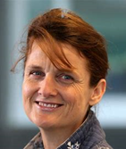
Barbara
Kasprzyk-
Hordern
Charles
Tyler
bkh20@bath.ac.uk
C.R.Tyler@exeter.ac.uk
durance@cardiff.ac.uk
d.jones@bangor.ac.uk
daniel.read@ceh.ac.uk
Pedro
Estrela
pmdlce20@bath.ac.uk
E.Santos@exeter.ac.uk
Weightman@cardiff.ac.uk
d.chadwick@bangor.ac.uk
acsi@ceh.ac.uk
The Executive Board is made up of members
from each of the Red-ALERT Partner Institutions.

