Slide 1
Training programme
RED-ALERT is structured around 5 themes:
Theme 1: Water Fingerprinting.
Theme 2: Environmental Sensor development.
Theme 3: One Health Modelling.
Theme 4: Ecosystem Services & Socioecological.
Theme 5: Co-creation of One Health.
Our 5 themes span 4 cross-cutting areas: genes, molecules, organisms and ecosystems
and 3 key skills areas:
Modelling and handling of large data sets for environmental system analysis and linkage with ecosystem function and services at a variety of temporal / spatial scales
(b) Environmental legislation and water policy
(c) Fieldwork and data acquisition
Notes:
THEMES

Slide 2
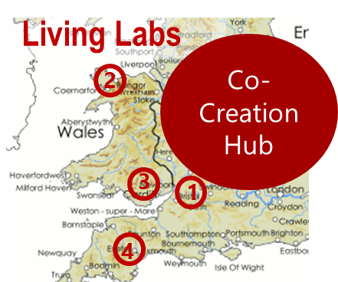
Training programme
Living Labs
Training will be delivered via student-stakeholder co-creation of Real-Time Digital Water-Based Systems focused around 4 UK sentinel catchment sites (Living Labs) utilizing new and existing long-term data and partnerships:
Cam/Wellow Living Lab (SW England)
Conwy Living Lab (N.Wales)
Taff/Ely Living Lab (S.Wales)
Exe/Tamar/Dart (S.England)
RED-ALERT will also connect with Global Living Labs through established
collaborations to enable translation of knowledge we generate in RED-ALERT to
the global stage:
The Eerste River (South Africa)
The Arrone River (Italy)
Central Kalimantan (Borneo)
Notes:
THEMES

