Slide 1
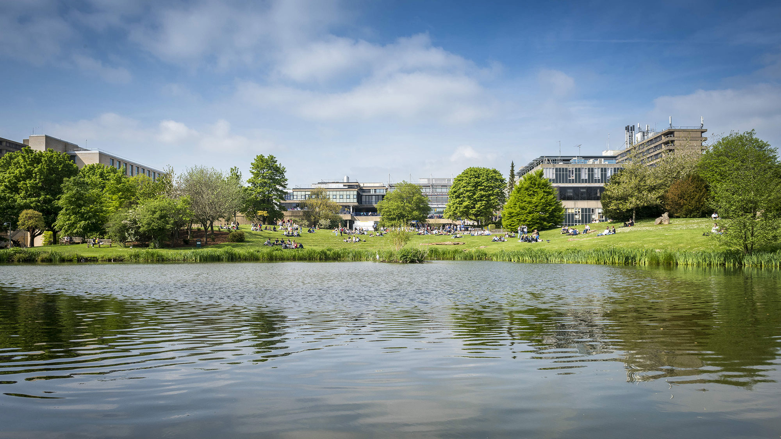

Supporting students to write effective personal statements Part 1

Slide 2

Part 1
What does the personal statement add to the UCAS application?
An overview of the form it takes and what should be included
A technique students could use to research and start planning a personal statement
Part 2
Techniques for helping students put pen to paper and write powerful paragraphs
How to assess a personal statement and advise on what needs to be done to improve it
Notes:
Some universities are particularly competitive to gain entry to!
https://www.ucas.com/data-and-analysis/undergraduate-statistics-and-reports/ucas-undergraduate-end-cycle-data-resources/applicants-and-acceptances-universities-and-colleges-2018

Slide 3

Applying to University
All applications must go through UCAS​
UCAS allows students to make up to five university/course choices​
Apply online at www.ucas.com​
Top universities are competitive – in a typical year Bath receives 27,000-29,000 applications for 3,000 places

Slide 4
Personal Statements as part of the UCAS application
1
2
3
4
5
6
Personal information
Qualifications
Work history
Course Choices
Personal statement
Teacher/
Tutor reference
- School details
- Support needs
- Contact details
- Jobs, part-time
or full-time
- Up to 5 courses

Slide 5

Personal Statements: An overview
A maximum 4000 characters, or around 47 lines (95 characters inc spaces per line)
​The personal statement is the only place on the UCAS application to focus on relevant knowledge, skills, achievements, and experience.
​It demonstrates very specifically how these are relevant to their choice of study.​
It may be read by two or more university staff at each university applied to. It should make sense to everyone.
It will also be used when considering ‘near miss’ applications
Notes:
Some universities are particularly competitive to gain entry to!
https://www.ucas.com/data-and-analysis/undergraduate-statistics-and-reports/ucas-undergraduate-end-cycle-data-resources/applicants-and-acceptances-universities-and-colleges-2018

Slide 6
Personal Statements: An overview
Neuroscience is a new fascinating interdisciplinary science with many lingering crucial problems to be answered. The complexity of the brain, the most crucial organ as to which we know so little about and an innate desire to explore the unknown has inspired me to apply for this course as an opportunity to embark myself on a new exciting journey in the field of neuroscientific research.
Over the summer, I was invited to participate in a research study at the University of Bath. I was tasked to evaluate three anti-cancer medications - cobalt chloride, curcumin, and aspirin, and a controlled placebo drug made up of glucose using qualitative methods gathered from cell-grown models. I assessed their performance on HeLa Cancer cells and chose the best drug for clinical trials out of the three using methods like MTT assay and studying the morphology of the cells under an Evos Microscope. Upon doing my research I came to learn that the source of the HeLa cell line was a Black African American woman named Henrietta Lacks. Intrigued to learn more about her life has led me to read “The Immortal Life of Henrietta Lacks” by Rebecca Skloot. Reading about how her cell was extracted without her formal consent, I was curious to learn more about ethical rules and regulations in the field of science. Therefore, I took an Open University online course and earned certification in ethical issues in scientific research.
In my A-level psychology class, I enjoyed learning about severe mental health disorders like schizophrenia and the neural explanation for the disease. Such as, how imbalanced levels of neurotransmitters like dopamine in certain parts of the brain like the subcortex to Broca’s area can cause the disorder. I learned dopamine more in-depth whilst reading Judith Grisel’s “Never Enough Neuroscience of Addiction” low levels of dopamine in the nigrostriatal pathway that is vital for motor movement cause symptoms of Parkinson’s disease. The vital role dopamine plays in our body, inspires me to learn more about the neurotransmitter at an undergraduate level. I enjoyed studying how the cells in our bodies interact in my A-level Biology classes and began to gain popular interest in stem cells. Over the half-term, I did a stem cell work experience with King College London and read scholarly articles to learn more about the topic. That's how I discovered neural stem cells. In the case of neurodegenerative disorders, such as Parkinson's disease, neural stem cells can help restore dopamine lost in the nigrostriatal pathway and alleviate symptoms. I'm excited about working on stem cells as part of my postgraduate research career.
I was invited to volunteer at a Kumasi children's home in Ghana to volunteer with over 100 children with neurodegenerative diseases and as a result, were shunned, marginalized, and neglected by their local community. I was later awarded the Lord 800th Mayor Anniversary Award Trust by the Lord Mayor of London. I also ran an online zoom workshop with the guidance of a consultant psychiatrist, Dr. Fido, to educate Somali parents who had little knowledge of disabilities and mental health disorders believing it was a religious demonic affliction rather than a medical illness. I was surprised to learn that the Somali language has no word nor meaning for the word autism. This pushes me to spread awareness to minority groups regarding neurological disorders, especially given that 1 in 6 of the world’s population suffers from it. In my spare time, I love playing football and recently played in a friendly tournament in Helsinki, Finland. Playing football has given me communication and teamwork skills that I have implemented on and off the pitch
Brain imbalances can cause a variety of problems from mental health problems to neurodegeneration. I find that establishing solutions is critical due to these diseases having significant emotional, social, and economical consequences for society. Studying Neuroscience at your institution will equip me with the knowledge and skill needed to succeed in my dream of becoming a neuroscientist.
Introduction: 4-5 sentences
Should answer one of the following:
What was the moment you became interested in the subject you are applying for? What was it about that moment that caused the interest?
What is it about the subject that you are applying for that you are passionate about? Why?

Slide 7
Personal Statements: An overview
Neuroscience is a new fascinating interdisciplinary science with many lingering crucial problems to be answered. The complexity of the brain, the most crucial organ as to which we know so little about and an innate desire to explore the unknown has inspired me to apply for this course as an opportunity to embark myself on a new exciting journey in the field of neuroscientific research.
Over the summer, I was invited to participate in a research study at the University of Bath. I was tasked to evaluate three anti-cancer medications - cobalt chloride, curcumin, and aspirin, and a controlled placebo drug made up of glucose using qualitative methods gathered from cell-grown models. I assessed their performance on HeLa Cancer cells and chose the best drug for clinical trials out of the three using methods like MTT assay and studying the morphology of the cells under an Evos Microscope. Upon doing my research I came to learn that the source of the HeLa cell line was a Black African American woman named Henrietta Lacks. Intrigued to learn more about her life has led me to read “The Immortal Life of Henrietta Lacks” by Rebecca Skloot. Reading about how her cell was extracted without her formal consent, I was curious to learn more about ethical rules and regulations in the field of science. Therefore, I took an Open University online course and earned certification in ethical issues in scientific research.
In my A-level psychology class, I enjoyed learning about severe mental health disorders like schizophrenia and the neural explanation for the disease. Such as, how imbalanced levels of neurotransmitters like dopamine in certain parts of the brain like the subcortex to Broca’s area can cause the disorder. I learned dopamine more in-depth whilst reading Judith Grisel’s “Never Enough Neuroscience of Addiction” low levels of dopamine in the nigrostriatal pathway that is vital for motor movement cause symptoms of Parkinson’s disease. The vital role dopamine plays in our body, inspires me to learn more about the neurotransmitter at an undergraduate level. I enjoyed studying how the cells in our bodies interact in my A-level Biology classes and began to gain popular interest in stem cells. Over the half-term, I did a stem cell work experience with King College London and read scholarly articles to learn more about the topic. That's how I discovered neural stem cells. In the case of neurodegenerative disorders, such as Parkinson's disease, neural stem cells can help restore dopamine lost in the nigrostriatal pathway and alleviate symptoms. I'm excited about working on stem cells as part of my postgraduate research career.
I was invited to volunteer at a Kumasi children's home in Ghana to volunteer with over 100 children with neurodegenerative diseases and as a result, were shunned, marginalized, and neglected by their local community. I was later awarded the Lord 800th Mayor Anniversary Award Trust by the Lord Mayor of London. I also ran an online zoom workshop with the guidance of a consultant psychiatrist, Dr. Fido, to educate Somali parents who had little knowledge of disabilities and mental health disorders believing it was a religious demonic affliction rather than a medical illness. I was surprised to learn that the Somali language has no word nor meaning for the word autism. This pushes me to spread awareness to minority groups regarding neurological disorders, especially given that 1 in 6 of the world’s population suffers from it. In my spare time, I love playing football and recently played in a friendly tournament in Helsinki, Finland. Playing football has given me communication and teamwork skills that I have implemented on and off the pitch
Brain imbalances can cause a variety of problems from mental health problems to neurodegeneration. I find that establishing solutions is critical due to these diseases having significant emotional, social, and economical consequences for society. Studying Neuroscience at your institution will equip me with the knowledge and skill needed to succeed in my dream of becoming a neuroscientist.
3-4 ‘main paragraphs’
Should demonstrate:
How the applicant is right for the course.
Passion for the subject.
Responsibility to their own learning.
Can be organised around relevant ‘themes’.
These could include:
Current studies
A particular area of theory/knowledge
An example of how the subject can be applied
Research
Subject skills
Wider reading

Slide 8
Personal Statements: An overview
Neuroscience is a new fascinating interdisciplinary science with many lingering crucial problems to be answered. The complexity of the brain, the most crucial organ as to which we know so little about and an innate desire to explore the unknown has inspired me to apply for this course as an opportunity to embark myself on a new exciting journey in the field of neuroscientific research.
Over the summer, I was invited to participate in a research study at the University of Bath. I was tasked to evaluate three anti-cancer medications - cobalt chloride, curcumin, and aspirin, and a controlled placebo drug made up of glucose using qualitative methods gathered from cell-grown models. I assessed their performance on HeLa Cancer cells and chose the best drug for clinical trials out of the three using methods like MTT assay and studying the morphology of the cells under an Evos Microscope. Upon doing my research I came to learn that the source of the HeLa cell line was a Black African American woman named Henrietta Lacks. Intrigued to learn more about her life has led me to read “The Immortal Life of Henrietta Lacks” by Rebecca Skloot. Reading about how her cell was extracted without her formal consent, I was curious to learn more about ethical rules and regulations in the field of science. Therefore, I took an Open University online course and earned certification in ethical issues in scientific research.
In my A-level psychology class, I enjoyed learning about severe mental health disorders like schizophrenia and the neural explanation for the disease. Such as, how imbalanced levels of neurotransmitters like dopamine in certain parts of the brain like the subcortex to Broca’s area can cause the disorder. I learned dopamine more in-depth whilst reading Judith Grisel’s “Never Enough Neuroscience of Addiction” low levels of dopamine in the nigrostriatal pathway that is vital for motor movement cause symptoms of Parkinson’s disease. The vital role dopamine plays in our body, inspires me to learn more about the neurotransmitter at an undergraduate level. I enjoyed studying how the cells in our bodies interact in my A-level Biology classes and began to gain popular interest in stem cells. Over the half-term, I did a stem cell work experience with King College London and read scholarly articles to learn more about the topic. That's how I discovered neural stem cells. In the case of neurodegenerative disorders, such as Parkinson's disease, neural stem cells can help restore dopamine lost in the nigrostriatal pathway and alleviate symptoms. I'm excited about working on stem cells as part of my postgraduate research career.
I was invited to volunteer at a Kumasi children's home in Ghana to volunteer with over 100 children with neurodegenerative diseases and as a result, were shunned, marginalized, and neglected by their local community. I was later awarded the Lord 800th Mayor Anniversary Award Trust by the Lord Mayor of London. I also ran an online zoom workshop with the guidance of a consultant psychiatrist, Dr. Fido, to educate Somali parents who had little knowledge of disabilities and mental health disorders believing it was a religious demonic affliction rather than a medical illness. I was surprised to learn that the Somali language has no word nor meaning for the word autism. This pushes me to spread awareness to minority groups regarding neurological disorders, especially given that 1 in 6 of the world’s population suffers from it. In my spare time, I love playing football and recently played in a friendly tournament in Helsinki, Finland. Playing football has given me communication and teamwork skills that I have implemented on and off the pitch
Brain imbalances can cause a variety of problems from mental health problems to neurodegeneration. I find that establishing solutions is critical due to these diseases having significant emotional, social, and economical consequences for society. Studying Neuroscience at your institution will equip me with the knowledge and skill needed to succeed in my dream of becoming a neuroscientist.
Conclusion: 4-5 sentences
Can answer one of the following –
How will studying this subject help you in your career/ personal development?
How does this tie into what you have been saying throughout your personal statement?

Slide 9


Finding examples from a student’s experience
Personal Statement Plan
Academic studies (current courses)
Wider reading
Hobbies and interests
Work experience/volunteering

Slide 10
How to do research for an effective personal statement
 | SKILLS | KNOWLEDGE | EXPERIENCE
CHOICE 1
CHOICE 2
CHOICE 3
CHOICE 4
CHOICE 5
DDD
DDD
DDD
DDD
DDD
DDD
DDD
Notes:
Some universities are particularly competitive to gain entry to!
https://www.ucas.com/data-and-analysis/undergraduate-statistics-and-reports/ucas-undergraduate-end-cycle-data-resources/applicants-and-acceptances-universities-and-colleges-2018

Slide 11




?
?

Slide 12
Supporting students to write effective personal statements Part 2

Slide 13
Part 1
What does the personal statement add to the UCAS application?
An overview of the form it takes and what should be included
A technique students could use to research and start planning a personal statement
Part 2
Techniques for helping students put pen to paper and write powerful paragraphs
How to assess a personal statement and advise on what needs to be done to improve it
Notes:
Some universities are particularly competitive to gain entry to!
https://www.ucas.com/data-and-analysis/undergraduate-statistics-and-reports/ucas-undergraduate-end-cycle-data-resources/applicants-and-acceptances-universities-and-colleges-2018

Slide 14
Personal Statements: An overview
A maximum 4000 characters, or around 47 lines (95 characters inc spaces per line)
​The personal statement is the only place on the UCAS application to focus on relevant knowledge, skills, achievements, and experience.
​It demonstrates very specifically how these are relevant to their choice of study.​
It may be read by two or more university staff at each university applied to. It should make sense to everyone.
It will also be used when considering ‘near miss’ applications
Notes:
Some universities are particularly competitive to gain entry to!
https://www.ucas.com/data-and-analysis/undergraduate-statistics-and-reports/ucas-undergraduate-end-cycle-data-resources/applicants-and-acceptances-universities-and-colleges-2018

Slide 15
Finding examples from a student’s experience
Personal Statement Plan
Academic studies (current courses)
Wider reading
Hobbies and interests
Work experience/volunteering

Slide 16
Step 1:
Identifying key skills, knowledge and qualities/behaviours that make a good student

Slide 17
How to do research for an effective personal statement
 | SKILLS | KNOWLEDGE | EXPERIENCE
CHOICE 1
CHOICE 2
CHOICE 3
CHOICE 4
CHOICE 5
DDD
DDD
DDD
DDD
DDD
DDD
DDD
Notes:
Some universities are particularly competitive to gain entry to!
https://www.ucas.com/data-and-analysis/undergraduate-statistics-and-reports/ucas-undergraduate-end-cycle-data-resources/applicants-and-acceptances-universities-and-colleges-2018

Slide 18


University websites – Open days, Fairs
University of Bath
UCAS website
It’s all about research!

Slide 19
Step 2:
Identifying where they have gained some of the skills, knowledge, qualities/behaviours

Slide 20
Make a list of experiences where they have learnt or developed some of the skills, knowledge, qualities/behaviours.
They can use the same example more than once
They can reference any part of their life e.g. current studies, work experience, wider reading, interests/hobbies, Saturday job
Skill/Knowledge/Quality/Behaviour | Example
Teamwork
Sports team, Drama club, Band,
Duke of Edinburgh’s Award

Slide 21
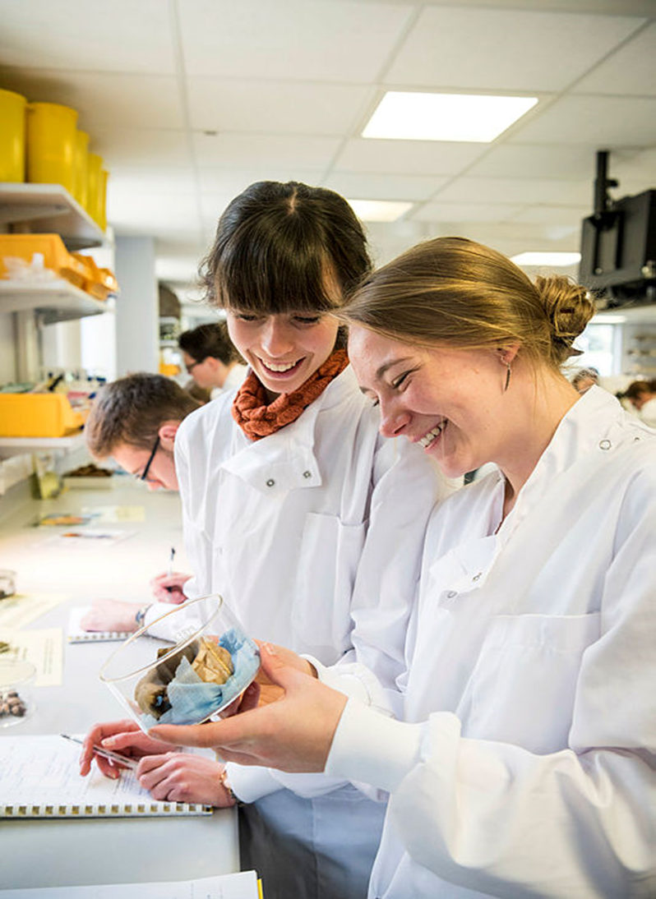

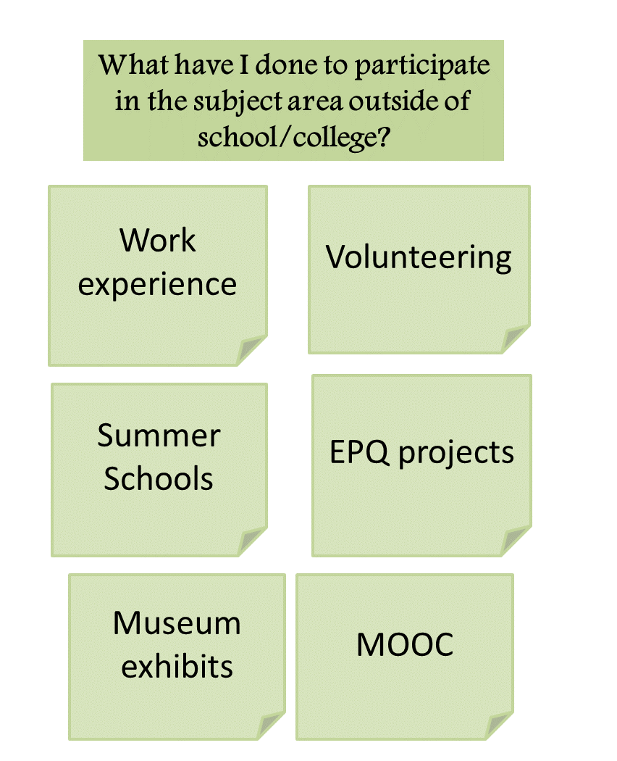
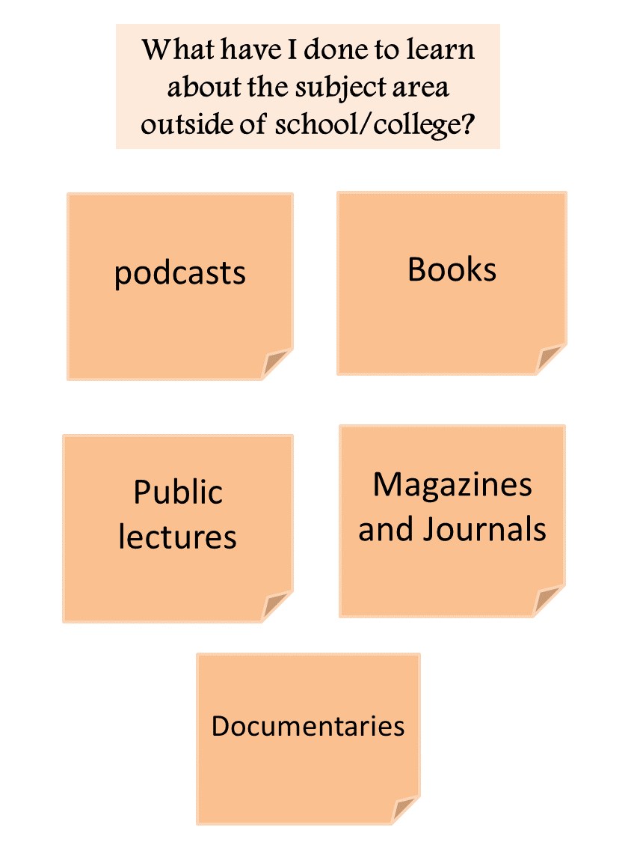
Enhance relevant knowledge and skills
What have I done to learn about the subject area outside of school/college?
Actively pursue opportunities to enhance your knowledge and skills accordingly
If during your research you find you that universities value skills, knowledge or experience you don’t have do what you can to acquire and develop them.
This must come second to your studies but will be necessary to standing out to competitive universities.
This will help you to talk about what part of the subject fascinates you the most and why
podcasts
Books
Public lectures
Magazines and Journals
Documentaries
What have I done to participate in the subject area outside of school/college?
Work experience
Volunteering
Summer Schools
EPQ projects
Museum exhibits
MOOC
Notes:
Type of personal statement: Oxford and Cambridge want minimal extra-curricular and more on academic ability and potential
NB: There are three images on the left to click through

Slide 22
Step 3:
The 4-part method for putting pen to paper on a personal statement

Slide 23

A statement of fact….
Outside of study I am part of the senior prefect team.
Better would be…
Outside of study I am part of the senior prefect team. This shows I have leadership and communication skills.
Even better…
Outside of study I am part of the senior prefect team. This involves helping to organise school events, as well as mentoring students from years 7 through 12 and has greatly improved my leadership and communication skills.
Better Still…
Outside of study I am part of the senior prefect team. This involves helping to organise school events, as well as mentoring students from years 7 through 12 and has greatly improved my leadership and communication skills. I look forward to developing these skills further at university and particularly in the project and presentation work that will be required on the Business course.

Slide 24
Outside of study I am part of the senior prefect team. This involves helping to organise school events, as well as mentoring students from years 7 through 12 and has greatly improved my leadership and communication skills. I look forward to developing these skills further at university and particularly in the project and presentation work that will be required on a Business course.
They demonstrate…
An awareness of the requirements of the course and course content.
An understanding of the skills required to succeed.
An example of where and how they have experience of developing these skills already.
Their enthusiasm to develop the skills further in the university context.

Slide 25
How to put pen to paper
Try this approach….
1: Write down something you did from worksheet 2.
I took part in a Geography field trip as part of my A level. I developed research and recording skills. I did this by practicing observation and questioning techniques and using GIS as a recording tool before presenting my in a range of suitable formats in Excel. The opportunity to continue to develop and apply these skills as part of a research team is one of the main reasons I want to study geography at university.
DDD
DDD
DDD
DDD
DDD
DDD
DDD
Notes:
Some universities are particularly competitive to gain entry to!
https://www.ucas.com/data-and-analysis/undergraduate-statistics-and-reports/ucas-undergraduate-end-cycle-data-resources/applicants-and-acceptances-universities-and-colleges-2018

Slide 26
How to put pen to paper
Try this approach….
2: Write down the connected experience/knowledge/skills you developed as part of the activity. (from worksheet 1)
I took part in a Geography field trip as part of my A level. I developed research and recording skills. I did this by practicing observation and questioning techniques and using GIS as a recording tool before presenting my in a range of suitable formats in Excel. The opportunity to continue to develop and apply these skills as part of a research team is one of the main reasons I want to study geography at university.
DDD
DDD
DDD
DDD
DDD
DDD
DDD
Notes:
Some universities are particularly competitive to gain entry to!
https://www.ucas.com/data-and-analysis/undergraduate-statistics-and-reports/ucas-undergraduate-end-cycle-data-resources/applicants-and-acceptances-universities-and-colleges-2018

Slide 27
How to put pen to paper
Try this approach….
3: Add an example what you did during that activity to develop the skill or gain the knowledge.
I took part in a Geography field trip as part of my A level. I developed research and recording skills. I did this by practicing observation and questioning techniques and using GIS as a recording tool before presenting my findings in a range of suitable formats. The opportunity to continue to develop and apply these skills as part of a research team is one of the main reasons I want to study geography at university.
DDD
DDD
DDD
DDD
DDD
Notes:
Some universities are particularly competitive to gain entry to!
https://www.ucas.com/data-and-analysis/undergraduate-statistics-and-reports/ucas-undergraduate-end-cycle-data-resources/applicants-and-acceptances-universities-and-colleges-2018

Slide 28
How to put pen to paper
Try this approach….
4: Make a connection to the course you are applying to or to the experience of university more generally.
I took part in a Geography field trip as part of my A level. I developed research and recording skills. I did this by practising observation and questioning techniques and using GIS as a recording tool before presenting my findings in a range of suitable formats. The opportunity to continue to develop and apply these skills as part of a research team is one of the main reasons I want to study geography at university.
DDD
DDD
DDD
Notes:
Some universities are particularly competitive to gain entry to!
https://www.ucas.com/data-and-analysis/undergraduate-statistics-and-reports/ucas-undergraduate-end-cycle-data-resources/applicants-and-acceptances-universities-and-colleges-2018

Slide 29
Connecting two passages to make a paragraph
Two linked passages:
I took part in a Geography field trip as part of my A level. I developed research and recording skills. I did this by practising observation and questioning techniques and using GIS as a recording tool before presenting my findings in a range of suitable formats. The opportunity to continue to develop and apply these skills as part of a research team is one of the main reasons I want to study geography at university.
DDD
I took part in a Geography field trip as part of my A level. As part of the trip I volunteered for the role of a group leader. In the role I had to communicate the teams goals, give each member a role and set of tasks and then facilitate their feedback at the end of the task. The opportunity to continue to develop and apply these skills as part of a research team is one of the main reasons I want to study geography at university.
Notes:
Some universities are particularly competitive to gain entry to!
https://www.ucas.com/data-and-analysis/undergraduate-statistics-and-reports/ucas-undergraduate-end-cycle-data-resources/applicants-and-acceptances-universities-and-colleges-2018

Slide 30
Connecting two passages to make a paragraph
A paragraph made from connecting them..
I enjoy taking on responsibilities as part of a team and especially in a research context. As part of my Geography A level I took part in a field trip where I volunteered to be a group leader. In the role I had to communicate the teams goals, give each member a role and set of tasks and then facilitate their feedback at the end of the task. To complete the task I also developed my research and recording skills. We practiced our observation and questioning techniques and used GIS as a recording tool before presenting findings in a range of suitable formats. The opportunity to continue to develop and apply these skills as part of a research team is one of the main reasons I want to study Geography at university.
Notes:
Some universities are particularly competitive to gain entry to!
https://www.ucas.com/data-and-analysis/undergraduate-statistics-and-reports/ucas-undergraduate-end-cycle-data-resources/applicants-and-acceptances-universities-and-colleges-2018

Slide 31
The 4 part writing method
The experience they had/something they did
What they learnt/developed as a result
An example to illustrate how the experience allowed them to learn/develop or what it is they think about what they learnt
A connection to the course and/or their learning and interests
Once they have a number of these they can…
Start tying these together to make paragraphs

Slide 32
Use ‘themes’ to organise each paragraph
The main body paragraphs should be organised around an appropriate theme
These could include but are not exclusive to:
A particular area of theory/knowledge
An example of how the subject can be applied
Research
Subject skills

Slide 33
Use topping and tailing for fluency
Topping:
A clear statement at the beginning of the paragraph
Defines an interest/aspiration/point of view
Touches on the ‘theme’ of the paragraph
Tailing:
A link back to the statement
And/or a clear link to the course

Slide 34
In my A-level psychology class, I enjoyed learning about severe mental health disorders like schizophrenia and the neural explanation for the disease. Such as, how imbalanced levels of neurotransmitters like dopamine in certain parts of the brain like the subcortex to Broca’s area can cause the disorder. I learned dopamine more in-depth whilst reading Judith Grisel’s “Never Enough Neuroscience of Addiction” low levels of dopamine in the nigrostriatal pathway that is vital for motor movement cause symptoms of Parkinson’s disease. The vital role dopamine plays in our body, inspires me to learn more about the neurotransmitter at an undergraduate level. I enjoyed studying how the cells in our bodies interact in my A-level Biology classes and began to gain popular interest in stem cells. Over the half-term, I did a stem cell work experience with King College London and read scholarly articles to learn more about the topic. That's how I discovered neural stem cells. In the case of neurodegenerative disorders, such as Parkinson's disease, neural stem cells can help restore dopamine lost in the nigrostriatal pathway and alleviate symptoms. I'm excited about working on stem cells as part of my postgraduate research career.

Slide 35
I would like to eventually take up a postgraduate research role. I am particularly interested in working on stems cells to better understand how they can help prevent neurodegenerative disorders. In my A-level psychology class, I enjoyed learning about severe mental health disorders like schizophrenia and the neural explanation for the disease. Such as, how imbalanced levels of neurotransmitters like dopamine in certain parts of the brain like the subcortex to Broca’s area can cause the disorder. I learned dopamine more in-depth whilst reading Judith Grisel’s “Never Enough Neuroscience of Addiction” low levels of dopamine in the nigrostriatal pathway that is vital for motor movement cause symptoms of Parkinson’s disease. I enjoyed studying how the cells in our bodies interact in my A-level Biology classes and began to gain popular interest in stem cells. Over the half-term, I did a stem cell work experience with King College London and read scholarly articles to learn more about the topic. That's how I discovered neural stem cells. In the case of neurodegenerative disorders, such as Parkinson's disease, neural stem cells can help restore dopamine lost in the nigrostriatal pathway and alleviate symptoms. What I found interesting was the link to my studies of dopamine and its role in this process. Understanding the vital role dopamine plays in our body, inspires me to want to understand better at an undergraduate level about its role as a neurotransmitter.

Slide 36
At which stage is this personal statement?
No research, just notes, list of achievements
Some complete paragraphs, some incomplete or barely started, some full but confused
Complete/fairly complete - Paragraphs have all/most parts of the 4 stage model, the ‘theme’ is clear/fairly clear and it reads well/fairly well
Notes:
Some universities are particularly competitive to gain entry to!
https://www.ucas.com/data-and-analysis/undergraduate-statistics-and-reports/ucas-undergraduate-end-cycle-data-resources/applicants-and-acceptances-universities-and-colleges-2018

Slide 37
Advice at stage 1:
No research, just notes, list of achievements
Go to the beginning of the process - research required/desired skills, knowledge and experience
Make a list of experiences that have helped to develop these and link the two lists
Notes:
Some universities are particularly competitive to gain entry to!
https://www.ucas.com/data-and-analysis/undergraduate-statistics-and-reports/ucas-undergraduate-end-cycle-data-resources/applicants-and-acceptances-universities-and-colleges-2018

Slide 38
Advice at stage 2:
2. Some complete paragraphs, some incomplete or barely started, some full but confused
Go back to the 4 stage writing model.
Do the paragraphs include…….
What they did/Where they did it
What they learned/developed as a result and which is relevant to the course
An example to illustrate how they did it
A connection to the course/link to their point
Use the ‘So what?’ rule
Notes:
Some universities are particularly competitive to gain entry to!
https://www.ucas.com/data-and-analysis/undergraduate-statistics-and-reports/ucas-undergraduate-end-cycle-data-resources/applicants-and-acceptances-universities-and-colleges-2018

Slide 39
Advice at stage 3:
3. Complete/fairly complete
Paragraphs have all/most parts of the 4 stage model, the ‘theme’ is clear/fairly clear and it reads well/fairly well
Improvements usually focus around:
Language
Rigorously applying the ‘So what?’ rule
Topping and tailing
Clarifying the themes
Notes:
Some universities are particularly competitive to gain entry to!
https://www.ucas.com/data-and-analysis/undergraduate-statistics-and-reports/ucas-undergraduate-end-cycle-data-resources/applicants-and-acceptances-universities-and-colleges-2018

Slide 40
Step 4:
Writing introductions and summary paragraphs that leave an impression

Slide 41
Writing an introduction:
What was the moment you became interested in the subject you are applying for? What was it about that moment that caused the interest?
What is it about that subject that you are applying for that you are passionate about? Why?
Writing a final paragraph:
How will studying this subject help you in your career?
And/Or
How will studying this subject help you in your personal development?
Can touch on….
How does this tie into what you have been saying throughout your personal statement?

Slide 42
Useful links
Personal statement overviews:
https://www.ucas.com/undergraduate/applying-university/writing-personal-statement/how-write-personal-statement#what%E2%80%99s-a-personal-statement-
https://www.theuniguide.co.uk/advice/personal-statements/personal-statement-faqs
Intros:
https://www.ucas.com/undergraduate/applying-university/writing-your-personal-statement/how-start-personal-statement-attention-grabber
https://www.immerse.education/university/how-to-write-a-personal-statement/start/
Notes:
Some universities are particularly competitive to gain entry to!
https://www.ucas.com/data-and-analysis/undergraduate-statistics-and-reports/ucas-undergraduate-end-cycle-data-resources/applicants-and-acceptances-universities-and-colleges-2018

