Slide 1
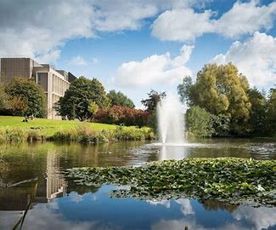
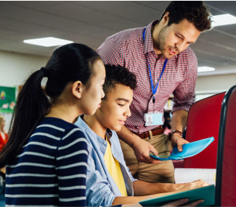
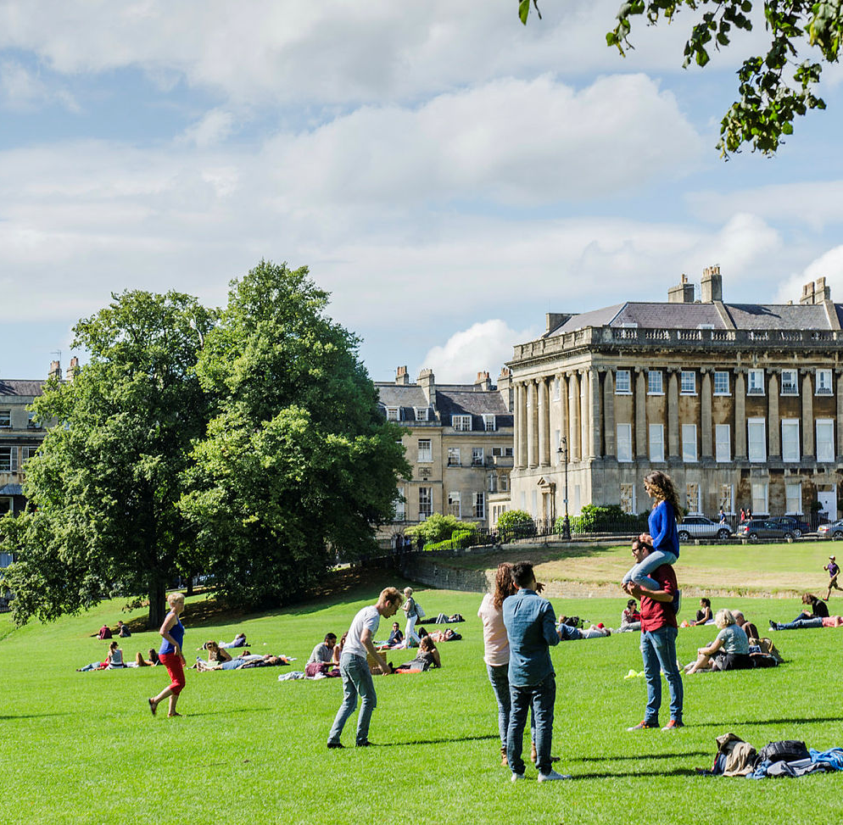
Welcome
Notes:
Steve – welcome attendees
Good morning and welcome to the University of Bath. We really appreciate you coming to spend the day or for some of you part of your weekend here with us and we know some of you have travelled from quite far to be here today so really thank you.

Slide 2
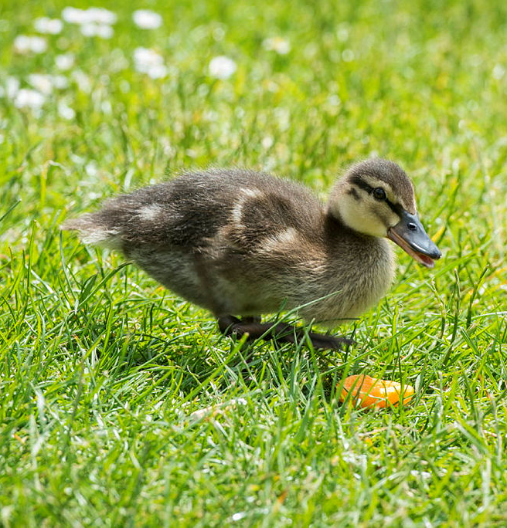
Housekeeping
Toilets directly outside in corridor
If lost, go to security desk in library
In case of fire alarm, please follow instructions
First aiders available
If taking photos, please make sure you have consent
Be wary of the ducks!
Notes:
Steve – general housekeeping
ENSURE YOU MAKE STAFF AWARE OF YOUR DIETARY REQUIREMENTS AND ALLERGIES AT MEALTIMES
If you get lost, go to the library
Toilets can be found in the corridor
If there's a fire alarm, please follow a member of staff or ambassador. Fire alarms are tested once a week
We have trained first aiders on campus, so let us know if you have a medical issue
Please put your phones on silent if possible during sessions
Please be aware that some people have not given permission for their photo to be taken and be aware that you shouldn't be sharing images of others through social media without their permission.
BEWARE OF THE DUCKS!! THEY BITE!! AND THEY'RE LUNCH –STEALERS!!

Slide 3
What to Expect
 | When | Where
UCAS speaker | 9:30 | 1W 2.101
Updates from Admissions at Bath | 10:15 | 1W 2.101
Break | 10:45 – 11:00 | Foyer
Choice of morning sessions | 11:00-12:30 | 1W 2.101 and surrounding rooms
Lunch - provided | 12:30 | Collect from 1W 2.101 foyer
Choice of afternoon sessions | 13:30 – 15:15 | 1W 2.101 Plus breakout rooms
Wrap up and close | 15:30 | 1W 2.101
Teacher Champion Awards Ceremony | 16:00 | 3WN 2.1
Notes:
Steve
Please show attendees the overview timetable for the day (they have a more detailed one in their welcome pack)

Slide 4
Morning Sessions
 | When | Where
Q & A/Updates on reference changes with Head of Admissions | 11:00- 11:45 | 1W 2.101
How to Support Students with Personal Statement Writing- Part A (workshop) | 11:00- 11:45 | 1W 2.01
Project Qualifications: Benefits and Q&A (with Rebecca Crumpton from AQA) | 11:00- 11:45 | 1W 2.104
Outreach Opportunities at Bath | 11:45 – 12:30 | 1W 2.02
How to Support Students with Personal Statement Writing- Part B (workshop) | 11:45 – 12:30 | 1W 2.01
Contextual Admissions at Bath | 11:45 – 12:30 | 1W 2.03
Lunch | 12:30 | Collect from 1W 2.101 foyer
Notes:
Steve
Explain that after our break at 10:45 – 11:00 attendees have a choice of sessions to attend. They can find these and their locations on the timetables printed in their welcome packs.

Slide 5
Afternoon Sessions
 | When | Where
Academic Knowledge Exchanges -Maths, Biology, Politics, Psychology, | 13:30 – 14:15 | 1W 2.101
Student Finance England Updates (with Stacie-May Fox from SFE) | 13:30 – 14:15 | 1W 2.104
Careers Support at Bath | 13:30 – 14:15 | 1W 2.01
Campus Tours with Student Ambassadors | 14:30 – 15:15 | Meet in 1W 2.101 foyer
Supporting Transition to HE – Study Skills | 14:30 – 15:15 | 1W 2.02
Notes:
Charlie
Run through afternoon choices available
Ask attendees to gather back in 1W 2.101 for wrap up/close at 3:15

Slide 6
Next steps…
Collect room keys from 1W 2.101 foyer (if staying overnight).
Teacher Champion Awards Reception, 4pm in 3WN 2.1
Have a safe journey home!
Notes:
Charlie
Thank attendees and signpost to either collect accommodation keys from foyer (if staying overnight), to go to 3WN 2.1 if attending Teacher Champion Awards Ceremony or have a safe onward journey home if leaving us.

Slide 7
Thank You
Notes:
Charlie
Thank attendees and signpost to either collect accommodation keys from foyer (if staying overnight), to go to 3WN 2.1 if attending Teacher Champion Awards Ceremony or have a safe onward journey home if leaving us.

Slide 8
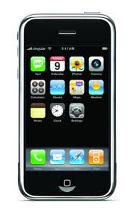
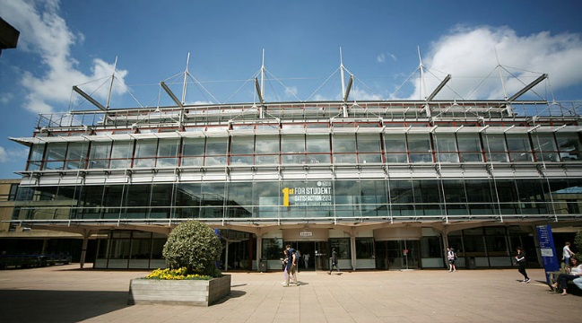
Please Be Aware!
Notes:
Steve – general housekeeping
ENSURE YOU MAKE STAFF AWARE OF YOUR DIETARY REQUIREMENTS AND ALLERGIES AT MEALTIMES
If you get lost, go to the library
Toilets can be found in the corridor
If there's a fire alarm, please follow a member of staff or ambassador. Fire alarms are tested once a week
We have trained first aiders on campus, so let us know if you have a medical issue
Please put your phones on silent if possible during sessions
Please be aware that some people have not given permission for their photo to be taken and be aware that you shouldn't be sharing images of others through social media without their permission.
BEWARE OF THE DUCKS!! THEY BITE!! AND THEY'RE LUNCH –STEALERS!!

