Slide 1
Admissions Insights from the University of Bath
Andrew Eagleton UG Insights Manager

Slide 2
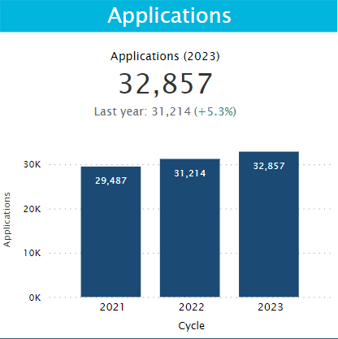
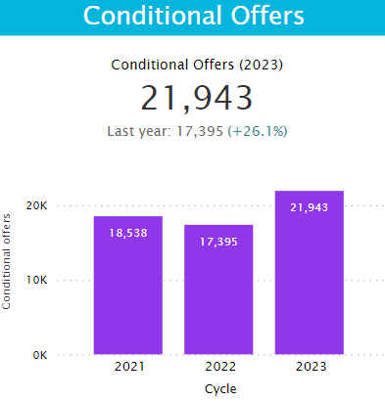
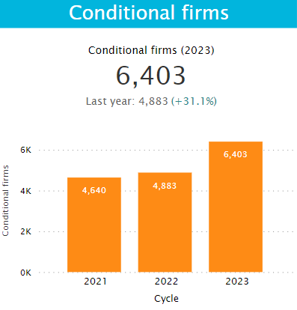
Our Numbers

Slide 3
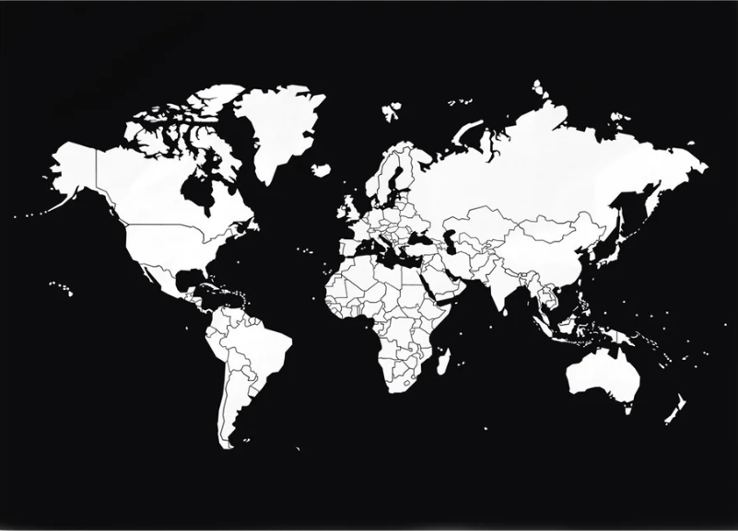

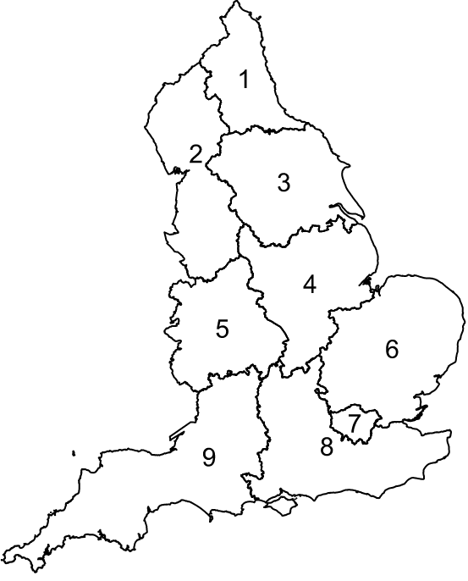
Our Applicants: Place
Domicile
UK: 77%
School Type
EU: 6%
Non-selective: 51%
RoW: 17%
Selective: 3%
College: 24%
Region
London: 25%
Independent: 22%
South East: 22%
South West: 15%
East of England: 10%

Slide 4





Our Applicants: Demographics
Gender
Participation
Male: 56%
Most Likely: 66%
Female: 44%
Least Likely: 18%
Socio-Economic
UK Ethnicity
Least deprived: 60%
White: 62%
Most deprived: 20%
BAME: 21%
Disability
Undisclosed: 17%
Not Declared: 85%
Declared: 15%

Slide 5




Our Applicants: Discipline
Engineering: 20%
Mechanical Engineering: 46%
Architecture: 20%
Management: 15%
Science: 31%
Computer Science: 24%
Maths: 14%
Humanities: 34%
Business: 23%
Accounting: 23%
Management: 22%
Psychology: 22%
Economics: 17%
Sport and Exercise: 11%

Slide 6
Our Applicants: Discipline Change since 2021
Engineering: +17%
Electrical Engineering: +35%
Civil Engineering: +1%
Management: +7%
Science: +13%
Pharmacy: +64%
Natural Sciences: -13%
Humanities: +10%
Business: +24%
Management: -12%
Politics: +31%
Social Work: -43%

Slide 7
What Now for 2023 and 2024?
Update applicant contact details
We receive a very high number of applications, some courses more than others
Check what’s in Clearing
Consider Firm and Insurance choices
Places available for ‘Near Misses’
Applicants, teachers and advisors can always engage with us

Slide 8
Any questions or comments?
You can always email me: ae23@bath.ac.uk

