Slide 1

University of Bath T&A Conference
Student Finance Update for Academic Year 2023/24
Student Finance England session
By Stacey-May Fox
Funding Information Services Team
Student Loans Company
7th July 2023

Slide 2

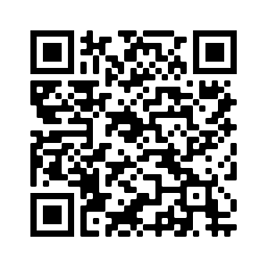
Contents
New Figures for 2023/24 (What You Can Get and What You Repay)
Tuition Fee Loans
Maintenance Loans
Household Income Assessments
Independent Student criteria
Disabled Students Allowance
Grants for Dependants
New Repayment Plan 5
Policy Review 2022/23
Ukrainian Nationals for 2023/24
Digital Evidence Uploads and Application Review
Birth Certificates
Cost of Living Considerations
New Guidance for students
Financial Hardship Guidance
Up and Coming
HE Short Courses
HTQs

Slide 3
What is available?

Slide 4
Tuition Fee Loans
Maximum tuition fees for 2023/24 in England will be maintained at the levels that applied in 2022/23
academic year. The sixth year in succession that fees have been frozen and maximum fee levels will
be frozen for until 2024/25
Maximum tuition fee for standard full-time courses offered will remain at £9,250
Maximum tuition fee for standard part-time courses offered will remain at £6,935
Key Points to Note :
Tuition Fee Loans are non means tested (we don’t need parents income for this bit!)
Loans are paid directly to the university on behalf of the student
Most of the 1.6m students every year apply for the maximum loan available
It is the easy part of the application – just tell us which university you are going to and how much you want to borrow (usually students tick ‘max’)

Slide 5
Maintenance Loans – Which Tier?
Maximum (Maintenance) loan for living costs for new full-time students and eligible continuing full
time 2016 cohort students:
Loan Rate | 2016 Cohort Full-Time Students | Entitled to Benefits | Aged Over 60 First Day of First AY
Parental Home | £8,400 | £9,910 | £4,221
Elsewhere | £9,978 | £11,374
London | £13,022 | £14,202
Overseas | £11,427 | £12,720

Slide 6
Maintenance Loans – Household Contribution
2016 cohort FT students, not eligible for benefits or aged over 60
Household Income | Home (£58,291) | Elsewhere (£62,343) | London (£70,040)
£25,000 & under | £8,400 | £9,978 | £13,022
£30,000 | £7,694 | £9,265 | £12,297
£35,000 | £6,988 | £8,552 | £11,571
£40,000 | £6,282 | £7,839 | £10,845
£45,000 | £5,576 | £7,125 | £10,120
£50,000 | £4,869 | £6,412 | £9,394
£55,000 | £4,163 | £5,699 | £8,668
£60,000 | £3,698 | £4,986 | £7,943
£65,000 | £3,698 | £4,651 | £7,217
£70,040 & over | £3,698 | £4,651 | £6,485
Notes:
Students on household incomes of £25,000 or less qualify for the maximum loan for living costs at the respective Home, Elsewhere or London rate of loan.
The income assessment for full year and final year rates of loans for living costs is calculated as follows:
Parental Home Rate: £1 reduction in loan for every complete £7.08 increase in income above £25,000.
London Rate: £1 reduction in loan for every complete £6.89 increase in income above £25,000.
Elsewhere Rate: £1 reduction in loan for every complete £7.01 increase in income above £25,000.
Overseas Rate: £1 reduction in loan for every complete £6.94 increase in income above £25,000.
The income threshold for the minimum non-income assessed full rate of overseas loan is: £65,967.
The income thresholds for the minimum non-income assessed final year rates of loans are: £56,910 (Home), £67,422 (London), £60,836 (Elsewhere), and £62,678 (Overseas).

Slide 7





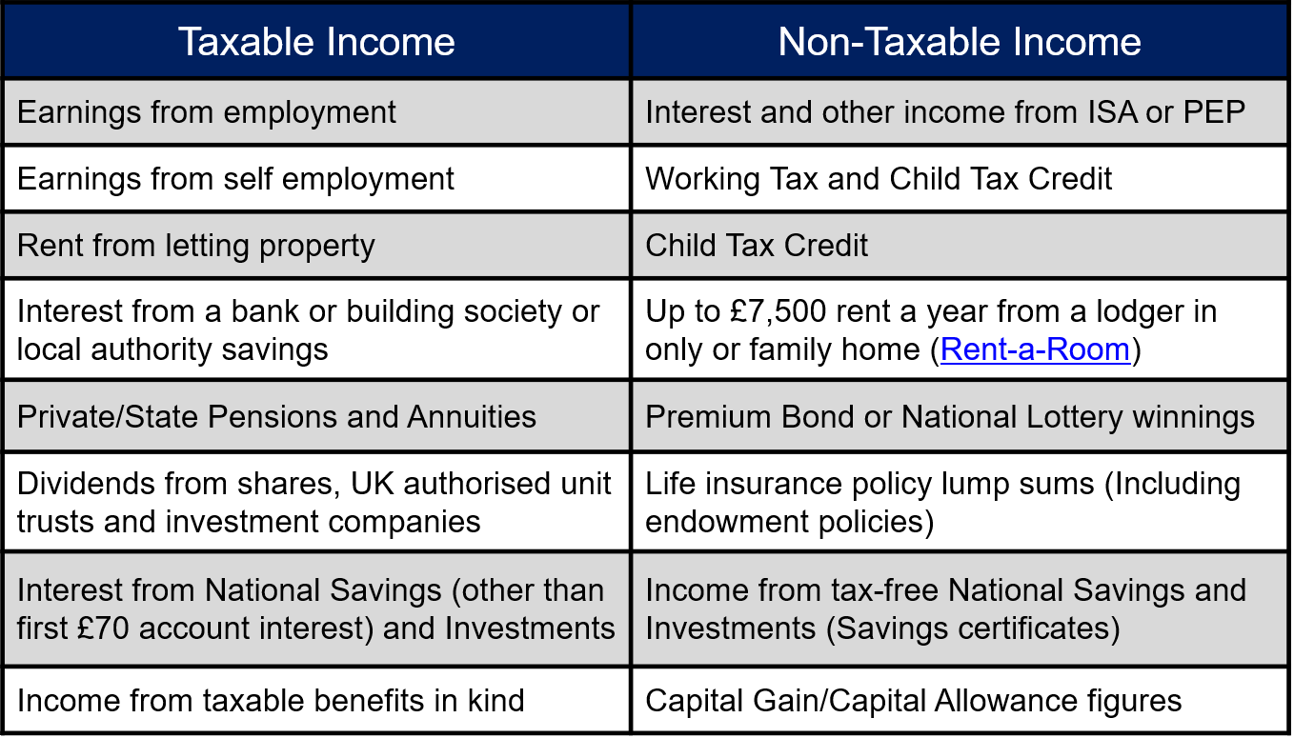
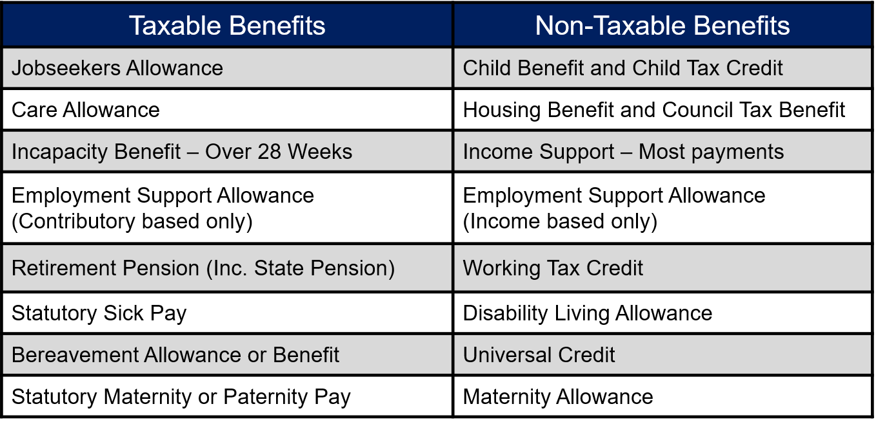
WE WILL USE INCOME DETAILS FROM APRIL 2022…UNLESS THERE HAS BEEN A 15% DROP
FIND OUT MORE
STUDENT FINANCE 2023/24
WHAT IS HOUSEHOLD INCOME?
Combined parental income if student lives with both
Father Income if student lives with Dad
Mother Income if student lives with Mum
Dad and step-parent or new partner if living with student
Mum and step-parent or new partner if living with student
Partner Income if student is married or aged 25+ and living with partner
A Step by Step Guide to Applying and Supporting an application is available at www.gov.uk/slc

Slide 8
Independent Students
Reason for Independence | Evidence Required
Student under the age of 25 has care of a person under the age 18 on the 1st day of the academic year | Photocopies of birth certificates to confirm their dates of birth and evidence of Child Benefit or Child Tax Credit for that child
3 years self-support | Full evidence required for 36 months
Both parents deceased | Both death certificates
Not under legal care of parents for 3 months | Letter from Local Authority or letter from a professional person confirming the current situation, together with a copy of the care / residency order
Student applied for student finance before, and the parent who provided income details is deceased | Death certificate for parent
It is impossible for the student to get in touch with their parents | Evidence of their circumstances from a professional person
Irreconcilably Estranged from parents | A social worker’s report confirming their circumstances. If no social workers report has been prepared, a report from another professional person who can confirm their circumstances as well as a more detailed explanation of the reason for their estrangement from their parents
Parents are living outside the EU and the assessment of their financial circumstances would place them in jeopardy or it would not be reasonably practicable or possible for them to send money | Evidence of their circumstances and an explanation as to how it is impracticable or dangerous for them to finally support them.
Notes:
The government has also published two consultations..
The second will set out plans to deliver the Lifelong Loan Entitlement (LLE) worth the equivalent of four years of post-18 education (i.e. £37,000 in today’s fees) to support students to study, train, retrain or upskill at any stage throughout their lives through flexible and modular courses.
LLE Consultation note
The LLE consultation includes proposals to introduce more flexible funding to deliver a major transformation in further and higher education. It will seek views on the government’s ambition and objectives for the LLE. It will also ask for views on:
The Government’s ambition to replace the two existing student finance systems at levels 4-6 with a new, unified LLE system.
How the government should set fees for modules and shorter courses.
The groups of people and courses which should be eligible to access the new flexible student finance.
How maintenance support system could work.
How to support quality provision and flexible learning.
What regulatory changes might be required to support the introduction of the LLE.
The current barriers to transferring credit for study between providers,

Slide 9
Disabled Students Allowance
The maximum allowance (£26,291) will apply to both full-time and part-time undergraduate and postgraduate DSA recipients in 2023/24. This replaced the four DSA allowances available in previous years
Work on DSA Reforms
Work on DSA Assessment Improvements
Previous Allowance Categories | Single DSA Rate 23/24
Non-Medical Helper | £26,291 + Further DSA support above the regulated maximum to pay for additional disability related travel costs
Specialist Equipment
General Allowance
Travel Allowance
Notes:
DISABLED STUDENTS ALLOWANCE FOR FULL-TIME UNDERGRADUATE STUDENTS (Not means-tested).
The undergraduate DSA allowance was simplified into one allowance for 2021/22. The same maximum allowance - £26,291 - will apply to both full-time and part-time undergraduate and postgraduate DSA recipients in 2023/24.
This will apply for both new and continuing students. An exception for travel costs will be made to this maximum cap, which means that travel costs will in effect be uncapped.

Slide 10
Dependants Grants
GFD AY 23/24 Income Assessments | PLA | ADG | CCG (*52 Week Rate)
 |  |  | 1 Child | 2+ Children
Maximum entitlement | £1,915 | £3,354 | £9,822.80* | £16,840.20*
Minimum payable | £50 | £0.01 | £0.01 | £0.01
Lower income threshold for maximum grant | £14,910 | £8,746 | £9,727 | £11,118
Upper income threshold for minimum grant | £18,739.98 | £15,453.98 | £19,549.79 | £27,958.19
i
*Weekly maximum CCG amount for one child: £188.90
*Weekly maximum CCG amount for two or more children: £323.85
Notes:
Where dependants’ incomes are from £18,640 to £18,739.98 students qualify for a minimum £50 PLA.
Weekly maximum CCG for one child is £188.90.
Weekly maximum CCG for two or more children is £323.85.

Slide 11

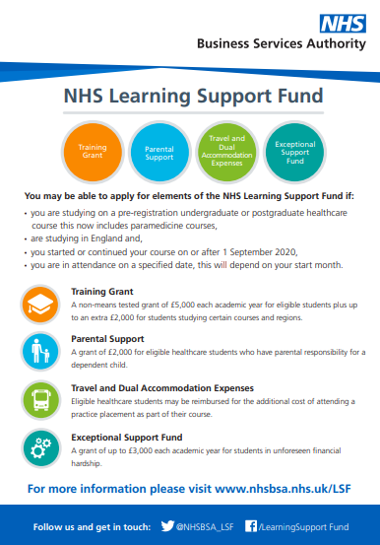

NHSBSA Training Grant
OVERVIEW
From AY 2020/21, new and continuing UK domiciled nursing, midwifery and many allied health students
undertaking pre-registration courses at English universities will receive a £5,000 Training Grant each year:
Dietetics | Occupational Therapy
Dental Hygiene or Dental Therapy (Level 5 and Level 6 courses) | Operating Department Practitioner (Level 5 and Level 6 courses)
Orthoptics | Orthotics and Prosthetics
Physiotherapy | Podiatry or Chiropody
Radiography (diagnostic and therapeutic) | Speech and Language Therapy
Paramedicine | Midwifery
Nursing (adult, child, mental health, learning disability, joint nursing/social work)
Extra payments worth up to £3,000 per academic year
will be available for eligible student’s and they could receive;
£2,000 towards childcare costs (Parental Support)
£1,000 if they’re a new student studying a shortage specialism*
Areas which will attract ‘specialist subject payments’ have been confirmed:
Mental Health Nursing | Learning Disability Nursing
Prosthetics and Orthotics | Orthoptics and Podiatry
Radiography (diagnostic and therapeutic)
NHSBSA have created a HEI LSF communications toolkit which contains a suite
of materials practitioners can use to promote the new funding support

Slide 12
Up and Coming – SSIN and Alternative Loans
HE Short Courses:
Loan support for eligible students undertaking 30 and 40 credit HE Short Courses at levels 4 to 6 delivered by the providers in England who have been granted designation and funding from the DfE and OfS
Loans will be available for the duration of the HE Short Courses trial (1st September 2022 to 31st August 2025)
Higher Technical Qualifications (HTQ):
From AY 2023/24, designation for HE student finance will extend to Level 4 and 5 courses and qualification types that are not recognised as standard HE qualification types (e.g. Level 4 and 5 Certificates and Diplomas)
These courses and qualification types would have previously qualified for ALL support
Notes:
The government has also published two consultations..
The second will set out plans to deliver the Lifelong Loan Entitlement (LLE) worth the equivalent of four years of post-18 education (i.e. £37,000 in today’s fees) to support students to study, train, retrain or upskill at any stage throughout their lives through flexible and modular courses.
LLE Consultation note
The LLE consultation includes proposals to introduce more flexible funding to deliver a major transformation in further and higher education. It will seek views on the government’s ambition and objectives for the LLE. It will also ask for views on:
The Government’s ambition to replace the two existing student finance systems at levels 4-6 with a new, unified LLE system.
How the government should set fees for modules and shorter courses.
The groups of people and courses which should be eligible to access the new flexible student finance.
How maintenance support system could work.
How to support quality provision and flexible learning.
What regulatory changes might be required to support the introduction of the LLE.
The current barriers to transferring credit for study between providers,

Slide 13
Repayments

Slide 14
STUDENT LOAN REPAYMENT
THE INCOME CONTINGENT PLAN 5 BASICS AY 23/24
Students won’t make repayments until their future income is over £25,000 a year (gross) or the weekly
(£480) or monthly (£2,083) equivalent:
You won’t have to make repayments until your income is over a set threshold, which will be £25,000 a year until April 2027
From April 2027 the threshold is set to rise annually with inflation (RPI)
If they study full-time, students will be due to start repaying in the April after completing or leaving/withdrawing from their course
They’ll repay 9% of any income earned over £25,000 and if employed, deductions will be made from their pay through the HMRC tax system
If their income falls below the threshold, their repayments will stop
i
*Any outstanding loan balance will be written off 40 years after
entering repayment
Notes:
Changes for Plan 2 borrowers
The repayment threshold HE can deliver real benefits to individuals, society, and the economy. However, it is vital that we ensure the student finance system is sustainable for the taxpayer and delivers good value for money at a time of rising costs.
This must be the case for both existing and future student loan borrowers, to maintain the long-term viability of the system.
The government will maintain the repayment threshold for all borrowers on Plan 2 (post2012) loan terms at its current level of £27,295 up to and including FY2024-25.
This will apply to: (i) students who began study in or after 2012 and have reached their statutory repayment due date; (ii) students who are currently studying; and (iii) students who commence study and take out student loans on current terms in AY2022/23.
Maintaining the Plan 2 repayment threshold at its current level of £27,295 up to and including FY2024-25 will generate significant savings for the taxpayer and ensure that individuals who are benefiting financially from their qualification continue to contribute towards the cost of their studies.
The uprating mechanism From April 2025, the repayment threshold for Plan 2 loans will increase annually by RPI, rather than average earnings growth.
This will align the uprating mechanism for the Plan 2 and pre-2012 (Plan 1) repayment thresholds, and further help to reinforce the sustainability of the HE funding system for future years. We will continue to keep these terms under review to ensure that they deliver value for money for both students and the taxpayer.

Slide 15
Repayment as of 2023/24
Government Rationale for £25,000 Threshold:
How much per month? (projected figures)
Gross Annual Income | Approx Monthly (2023/24) @ £25,000 | Approx Monthly (2027/28) @ £25,710
£25,000 | £0 | £0
£28,000 | £22 | £17
£30,000 | £37 | £32
£35,000 | £75 | £69
£40,000 | £112 | £107
£45,000 | £150 | £144
£50,000 | £187 | £182
Notes:
Plan 2
The thresholds are £524 a week or £2,274 a month (before tax and other deductions). They change on 6 April every year.
Example
You’re paid weekly and your income changes each week. This week your income was £600, which is over the Plan 2 weekly threshold of £524.
Your income was £76 over the threshold (£600 minus £524). You will pay back £6 (9% of £76) this week.
Example
Your annual income is £28,800 and you are paid a regular monthly wage. This means that each month your income is £2,400 (£28,800 divided by 12). This is over the Plan 2 monthly threshold of £2,274.
Your income is £126 over the threshold (£2,400 minus £2,274). You will pay back £11 (9% of £126) each month.

Slide 16
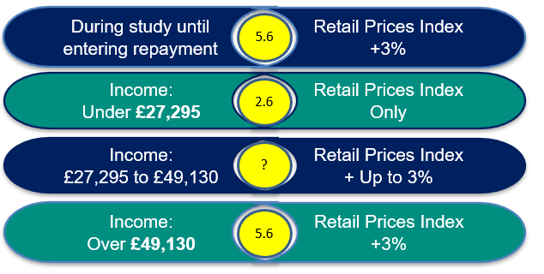
STUDENT LOAN REPAYMENT
PLAN 2 INTEREST
PLAN 5 INTEREST – New students starting in AY 23/24
Interest will not be tiered and will be set at RPI + 0%
Notes:
Plan 2
The thresholds are £524 a week or £2,274 a month (before tax and other deductions). They change on 6 April every year.
Example
You’re paid weekly and your income changes each week. This week your income was £600, which is over the Plan 2 weekly threshold of £524.
Your income was £76 over the threshold (£600 minus £524). You will pay back £6 (9% of £76) this week.
Example
Your annual income is £28,800 and you are paid a regular monthly wage. This means that each month your income is £2,400 (£28,800 divided by 12). This is over the Plan 2 monthly threshold of £2,274.
Your income is £126 over the threshold (£2,400 minus £2,274). You will pay back £11 (9% of £126) each month.

Slide 17
Residency updates

Slide 18
Ukrainian Conflict
DfE instructed policy change has been made to provide support to individuals granted leave to remain or enter in
the UK under one of the following Ukraine Schemes:
This change will apply from AY 2022/23 and covers SFE undergraduate, postgraduate, Advanced Learner Loan and HE Short Courses support
Ukraine Family Scheme: Allows Ukrainian nationals and their family members to come to the UK or to extend their stay in the UK if they have family members who already have leave to remain in the UK
Homes for Ukraine Sponsorship Scheme: Allows Ukrainian nationals and their family members to come to the UK if they have an approved sponsor
Ukraine Extension Scheme, Allows Ukrainian nationals and their family members who already have leave to remain in the UK to extend the leave in the UK
Policy rules from academic year (AY) 2023/24:
Change to Ordinary Residence: Ordinary residence in England on the day on which the first term of the first AY actually begins’ as opposed to the 1st day of the first Academic Year
The eligible family members of Ukraine Scheme or ARAP/ACRS leave holders will be eligible to apply for student funding and will be eligible for home fee status
This will be the policy rule without any requirement for the applicant to have been granted leave under the scheme themselves
Notes:
As events unfold in Ukraine, we appreciate many of you may be looking for guidance on how to support students during this period of conflict.
We're taking steps to help SLC customers affected by the situation. Our Customer Experience team is working closely with colleagues in Operations and Repayments to respond to their individual circumstances.
If you've agreed with any students to suspend or withdraw them, please see our updated guidance on the HEP Services website.
https://www.heinfo.slc.co.uk/
https://www.heinfo.slc.co.uk/resources/guidance/student-information-service-user-guide/change-of-circumstances/coc-due-to-ukrainian-conflict/

Slide 19
Application Review

Slide 20
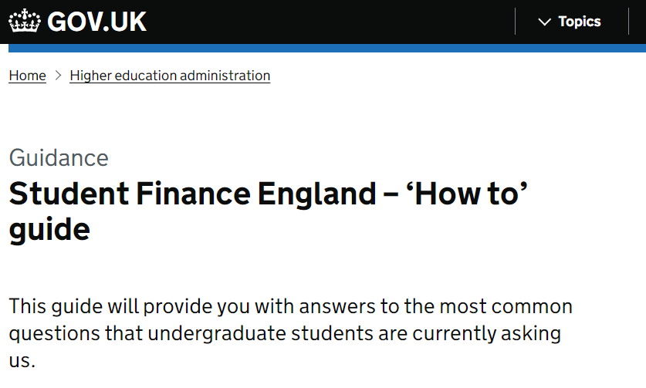
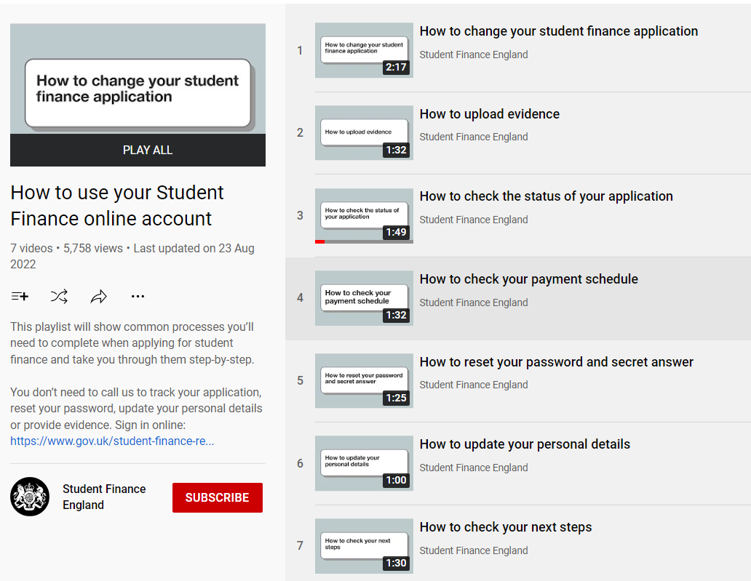
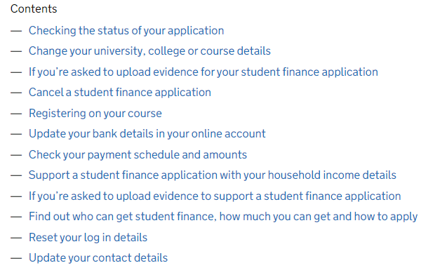
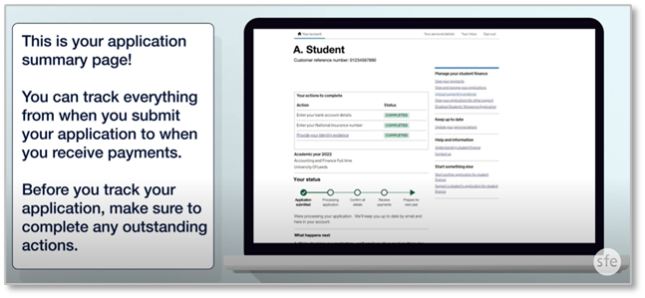
Application Enhancement – “How To”
A guidance page has been added to GOV.UK providing an answer to some of the most common
questions asked on student finance and applications. Essential messages are provided for each
subject along with a selection of short films and links to additional information or resources
Notes:
Links in pictures
https://www.gov.uk/guidance/student-finance-england-how-to-guide

Slide 21
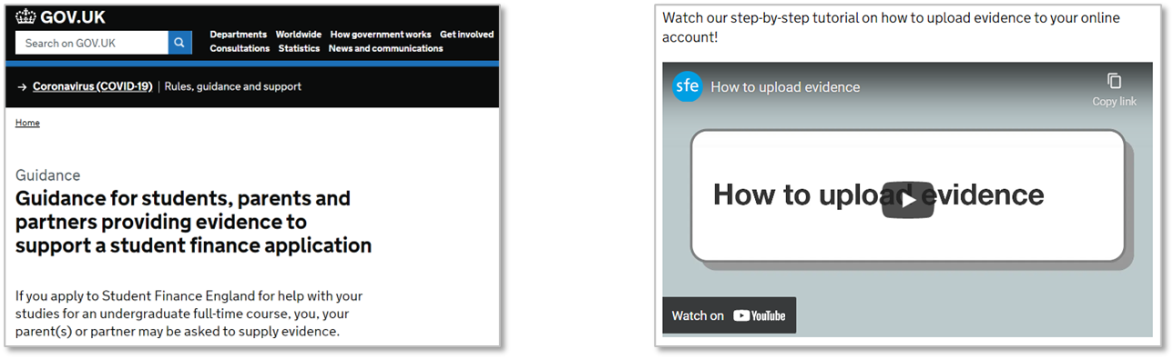
Application Enhancement – Digital Evidence Upload
Providing SFE with the right evidence in the right way at the right time can seem confusing for many
students and their parents or partners:
To address this we have created guidance and a short film to explain evidence requirements and submission, including digital upload
Notes:
Links in pictures
https://www.gov.uk/guidance/guidance-for-students-parents-and-partners-providing-evidence-to-support-a-student-finance-application

Slide 22
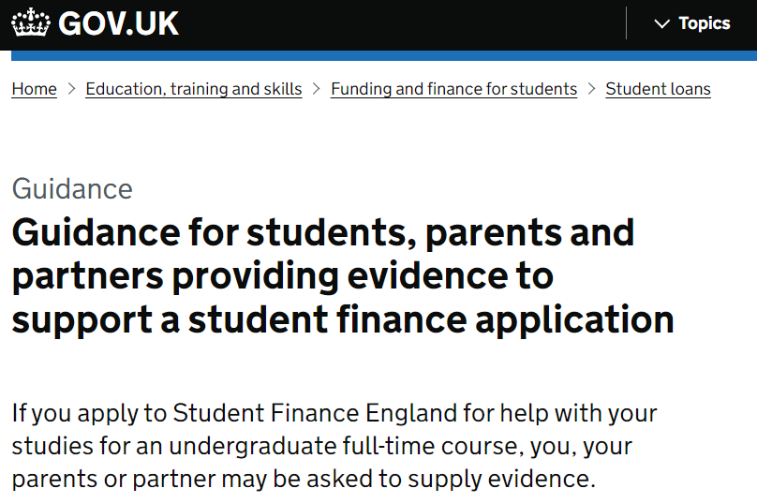
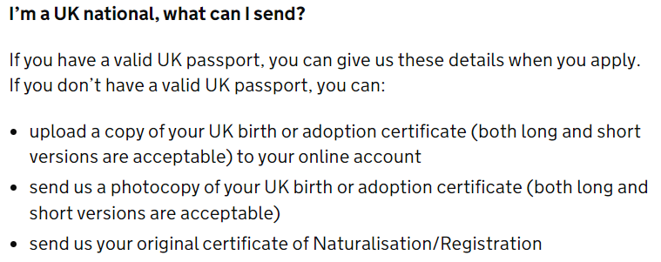
Application Enhancement – Digital Evidence Upload
UK customers applying for SFE undergraduate products will no longer be required to submit an original physical copy of their birth certificate to SFE. Instead, they will be able to upload a digital copy of their birth certificate using the evidence upload functionality from their online accounts
The customer facing guidance pages on GOV.UK have been updated to include this message
Our Customer Experience Team are leading an initiative to reduce the evidence burden on customers
This includes, where we can, to reduce the physical/original evidence burden by moving to digital alternatives
Or where we can, remove/reduce the evidence requirement in specific customer journeys
Notes:
Summary of Change
UK Customers applying for SFE UG products will no longer be required to submit an original physical copy of their birth certificate to SFE, instead they will be able to upload a digital copy of their birth certificate using the evidence upload functionality.
For background Information
CX are leading an initiative to reduce the evidence burden on customers, this includes scenarios where we can reduce the physical/original evidence burden by moving to digital alternatives or where we can remove or reduce the evidence requirement in specific customer journeys.
The focus of the first piece of work has been on UK customers who submit original physical birth certificates to support SFE UG applications, the reasoning behind this approach is there is functionality existing to already support a move to digital evidence, the regulatory policy in this space does not stipulate we need to see an original physical copy of a birth certificate and from a security risk position we have confidence that we can support the change without greater risk exposure for SLC.
Conclusion
This reduction in evidence, if greenlit will be a significant reduction in physical/original evidence for customers and will greatly enhance the customer journey.

Slide 23
Application Enhancement – Digital Evidence Upload
As of 6th April 2022, changes have been made to divorce and separation processes as per the Divorce, Dissolution and Separation Act 2020:
This will see new documents issued for divorces and separations
A ‘Conditional Order’ will replace a Decree Nisi, and a ‘Final Order’ will replace a Decree Absolute
Guidance and customer communications will be updated to reflect the changes, and include reference to the new documents
Consideration will also be given to the fact that Decree Nisi and Decree Absolute will still be valid and accepted as they remain in circulation
However, they are likely to become obsolete at a later date
Notes:
As of 6th April 2022, changes will be made to divorce and separation process as per the Divorce, Dissolution and Separation Act 2020.
This will see new documents issued for both divorces and separations.
A “conditional order” will replace a decree nisi, and a “final order” will replace a decree absolute.
Guidance and customer communications will be updated to reflect these changes, and include the new documents.
Consideration will also be given to the fact that decree nisi’s and decree absolute’s will still be valid and accepted as they remain in circulation. However, they are likely to become obsolete at a later date.

Slide 24
Cost of Living Considerations

Slide 25
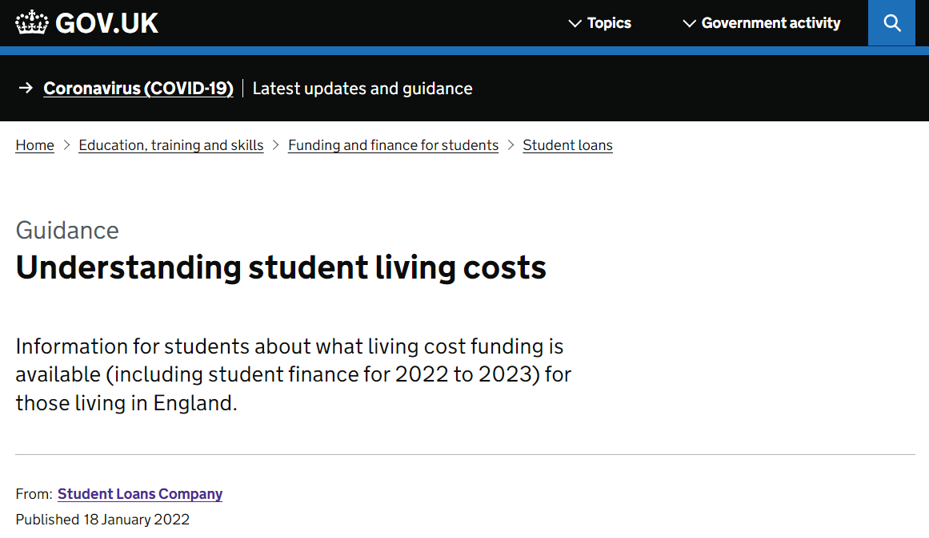
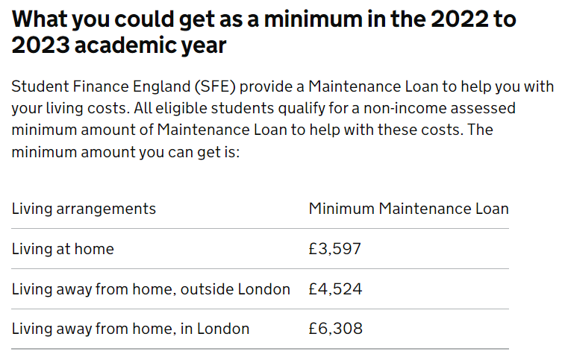
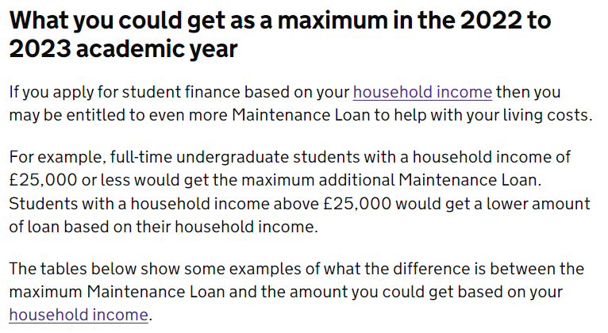
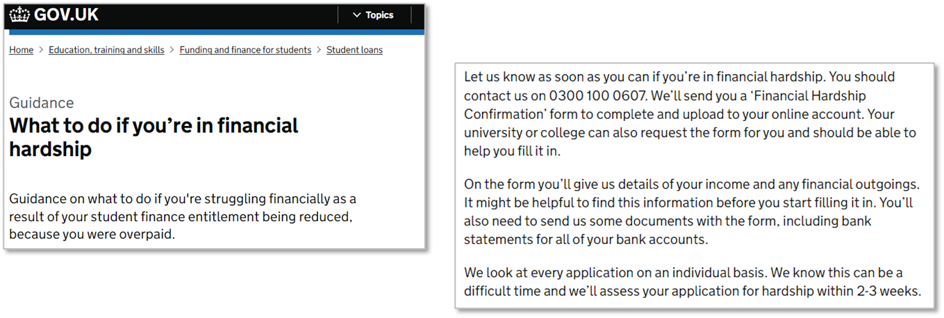
Cost of Living Consideration – Guidance
A GOV.UK page has been designed to
Help students consider the range of
living costs they may face and
understand the funding they can access.
The information covers means testing,
budgeting, sources of additional support
and links to useful resources, including
Student Space
Specific advice has been updated for
students who are experiencing financial
hardship.

Slide 26
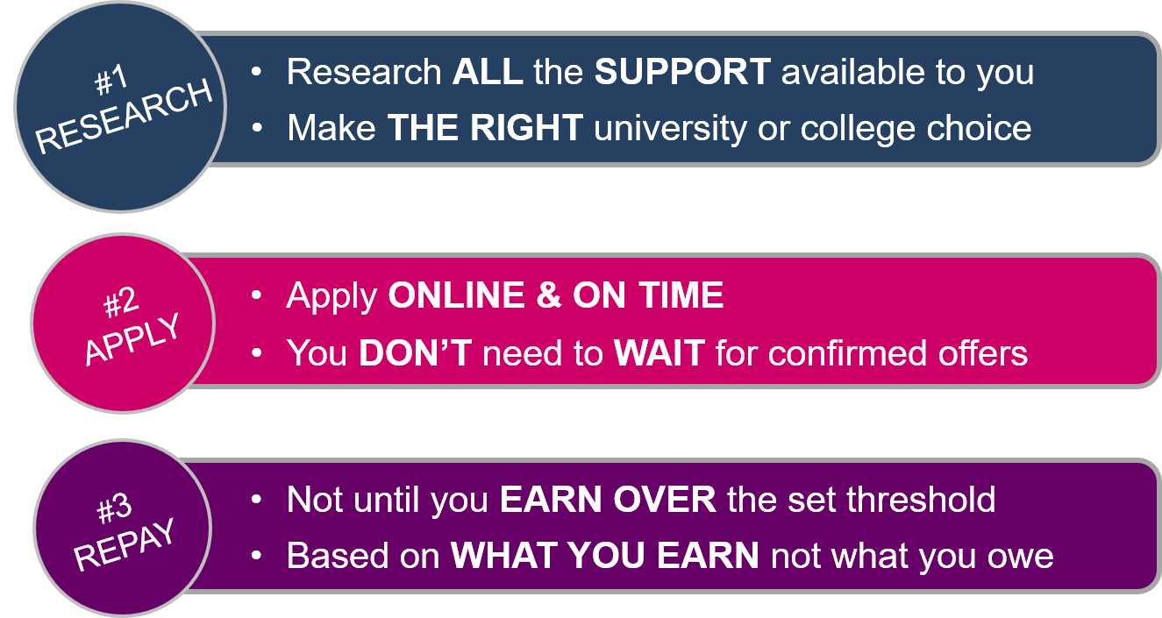
KEY MESSAGES
THREE POINTS TO REMEMBER
There is a lot of information available on student finance, from applying to repayment,
but it is vital to understand what it will mean to students and remind them of the three
key points:

Slide 27
Resources

Slide 28
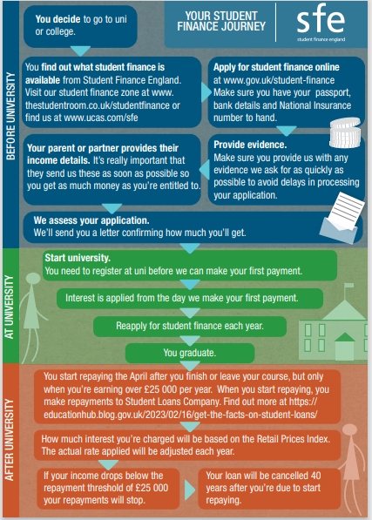
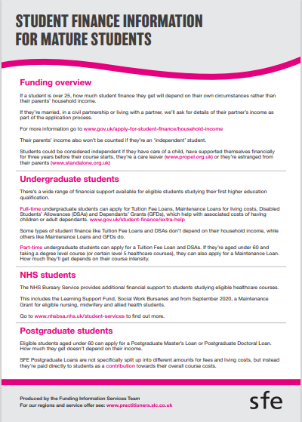
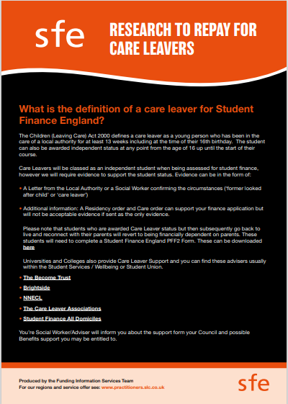
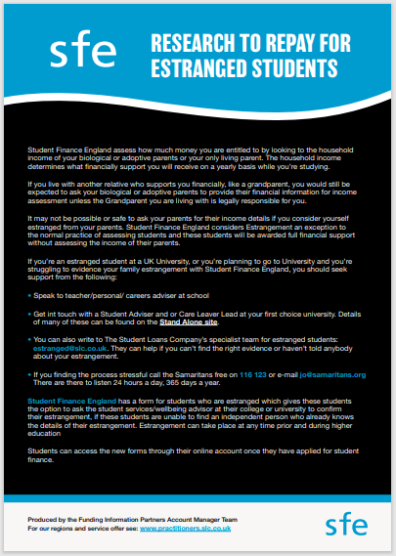
Resources
We have recently updated our resources for AY 23/24, some examples of the leaflets we have available:

Slide 29
This now concludes today’s session. Many thanks for attending.
If you want to discuss any Student Finance issues, ask questions or arrange a visit, please don’t hesitate to contact me using the details below.
Stacey-May Fox
Account Manager – South-West England & South Wales
07815602225
Stacey-may_fox@slc.co.uk

