Slide 1
SFE Student Finance AY 2026/27
HE Student Funding Arrangements, and
The Lifelong Learning Entitlement (LLE)

Slide 2
Session Content and Focus
This presentation will provide delegates with the essential details needed to discuss, understand and
communicate key student finance IAG messages for academic year (AY) 2026/27:
Presentation Content:
Student Finance England (SFE) undergraduate funding arrangements for AY 2026/27:
Including tuition fee and living cost loan rate increases, call to action to promote early application submission and essential messages on repayment
The Lifelong Learning Entitlement:
Including an overview of eligibility, funding entitlement, applications and current resource offer
Questions and Comments
Notes:
This presentation will provide delegates with the essential details needed to discuss, understand and communicate key student finance IAG messages for academic year (AY) 2026/27:
Presentation Content:
Student Finance England (SFE) undergraduate funding arrangements for AY 2026/27:
Including tuition fee and living cost loan rate increases, call to action to promote early application submission and other announced policy and eligibility changes
The Lifelong Learning Entitlement:
Including an overview of eligibility, student funding entitlement and current resource offer
Questions and Comments

Slide 3
HE Student Finance Arrangements
SFE Tuition Fee, Living Cost and Targeted
Support Rates for AY 2026/27

Slide 4
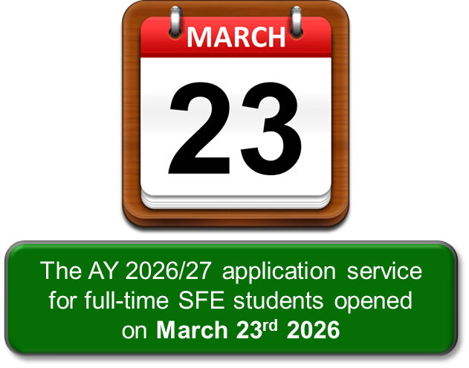
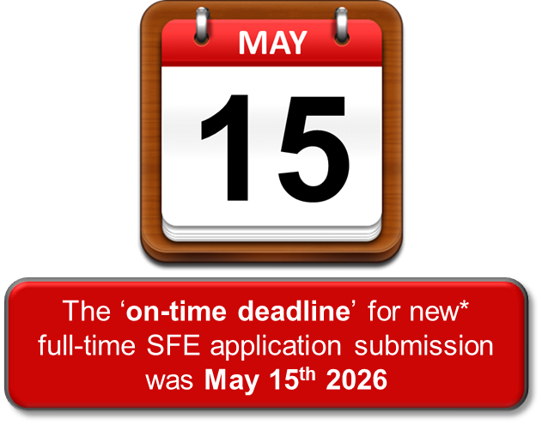
SFE HE Student Finance AY 2026/27 – Application Dates
The full-time SFE undergraduate application service for AY 2026/27 opened on March 23rd and students
should apply as soon as possible, as the on-time deadline has now passed:
Continuing SFE students have a ‘deadline’ of June 19th and they will receive notifications, prompting
them to reapply for their funding for the new academic year
Notes:
Each year, too many students apply late for their finance and could have no way to pay for courses or accommodation at the start of term.!
The full-time SFE application service for AY 2026/27 is now open
Students can create and account and apply at: www.gov.uk/apply-online-for-student-finance
Tips to help make sure student finance gets paid on time:
Students do not need a confirmed place at university or college to apply
They should apply with their first choice, and can change the details later if necessary
Make sure any evidence and information needed to support the application is supplied ‘right first time’ both from the student and any relevant parents (or partner)
https://www.gov.uk/guidance/download-the-hmrc-app
The easiest way for a student to prove their identity is to give us their valid UK passport number online, when they apply. We can then check and confirm their identity without them having to actually send us their passport.
If a student doesn’t have a valid UK passport, they’ll need to upload a copy of their original birth certificate or where necessary provide a copy of their original birth certificate.
UK Customers applying for SFE UG products will no longer be required to submit an original physical copy of their birth certificate to SFE, instead they will be able to upload a digital copy of their birth certificate using the evidence upload functionality.
If the student is a non-UK passport holder, they’ll need to provide the necessary details from their official documents on their application form (passport or UKVI status etc) which can be used to verify identity and immigration status directly with the Home Office.
Additional identity and status evidence may also be requested if required.
Sponsors can now give us consent to send their NINO to HMRC for a VHI check each AY and we will use the income returned to MT the application.
They will still have to provide us with the following;
Income from savings*
Income from property*
Income earned overseas
Income from casual or freelance earnings
Deductions – Private Pension Contributions (PPCs) and/or Additional Voluntary Contributions (AVCs)
*Only include where the income is less than the amount required to declare to HMRC.
If it is over this will already be part of the income HMRC will return.
If they include income deductions, we may require evidence. If they support online we'll contact them after the VHI check if evidence is required (if they complete a PFF2 they'll be asked to provide evidence with the form to avoid any delays).
If they have no NINO or decline to link the application (even in error) they will need to complete a PFF2 in full and upload or post this to us.

Slide 5
SFE HE Student Finance AY 2026/27 – Tuition Fee Levels
The maximum tuition fees for undergraduate students starting or continuing full-time and part-time courses
at Approved (fee cap) Providers in academic year (AY) 2026/27 will be increased by 2.71%:
Tuition fees and loans for foundation years in classroom-based subjects will remain at academic year 2025/26 levels (£5,760)
In academic year 2027/28, the maximum tuition fee level will be increased by a further 2.68%
Eligible students undertaking courses at Approved (fee cap) Providers will qualify for Tuition Fee Loan support to meet the full cost of their tuition
Course Type | Tuition Fees AY 2025/26 | Uplift | Tuition Fees AY 2026/27 | Uplift | Tuition Fees AY 2027/28 | Uplift
Full-Time | £9,535 | 3.1% | £9,790 | 2.71% | £10,050 | 2.68%
Part-Time | £7,145 | 3.1% | £7,335 | 2.71% | £7,530 | 2.68%
Accelerated | £11,440 | 3.1% | £11,750 | 2.71% | £12,060 | 2.68%
Notes:
Courses offered by approved (fee cap) providers
Maximum tuition fees for undergraduate students starting or continuing full-time and part-time courses at approved (fee cap) providers in the 2026 to 2027 academic year and the 2027 to 2028 academic year will be increased by 2.71% and then by 2.68% respectively.
Tuition fees and loans for foundation years in classroom-based subjects will remain frozen at academic year 2025 to 2026 levels.
The maximum tuition fee in the 2026 to 2027 academic year for approved (fee cap) providers with a TEF award and with an APP will increase to:
£9,790 for standard full-time courses
£11,750 for full-time accelerated courses
£7,335 for part-time courses
The maximum tuition fee in the 2027 to 2028 academic year for approved (fee cap) providers with a TEF award and with an APP will increase to:
£10,050 for standard full-time courses
£12,060 for full-time accelerated courses
£7,530 for part-time courses

Slide 6
SFE HE Student Finance AY 2026/27 – Living Cost Loans
For AY 2026/27, eligible new and continuing undergraduate students will qualify for a 2.71% increase to
the maximum rates of loans for living costs (Maintenance Support):
The maximum loans for living costs for undergraduate courses will continue to increase in line with forecast inflation in future academic years
Maximum (Maintenance) loan for living costs for new full-time students and eligible continuing full-time
2016 cohort students in AY 2026/27 (courses started before 1st January 2027):
Loan Rate | 2016 Cohort Full-Time Students | Entitled to Benefits
Parental Home | £9,118 | £10,757
Elsewhere | £10,830 | £12,345
London | £14,135 | £15,415
Overseas | £12,403 | £13,806
Special Support Loan of up to £4,583 for eligible full-time students aged over 60
Notes:
Undergraduate students starting or continuing their courses in the 2026 to 2027 academic year will qualify for a 2.71% increase to maximum loans for living costs.
The same percentage increase will apply to maximum long courses loans for full-time courses where attendance exceeds 30 weeks and 3 days in an academic year.
All students will qualify for an uplift in support for the 2026 to 2027 academic year with the most support being paid to students on household incomes of £25,000 or less.
Maximum loans for living costs for undergraduate courses will continue to increase in line with forecast inflation in future academic years.
The government will confirm changes for the 2027 to 2028 academic year in autumn 2026.

Slide 7
SFE HE Student Finance AY 2026/27 – Household Income
For AY 2026/27, eligible new and continuing undergraduate students with household incomes of £25,000 or
less qualify for the maximum loan for living costs at the respective Home, Elsewhere or London rate:
Students can get an entitlement estimate using the calculator on: www.gov.uk/studentfinance
2016 cohort full-time SFE students, not eligible for benefits or aged over 60:
Household Income | Home (£58,387) | Elsewhere (£62,410) | London (£70,131)
£25,000 & under | £9,118 | £10,830 | £14,135
£35,000 | £7,589 | £9,285 | £12,563
£45,000 | £6,060 | £7,739 | £10,991
£55,000 | £4,531 | £6,194 | £9,419
£60,000 | £4,013 | £5,421 | £8,632
£65,000 | £4,013 | £5,048 | £7,846
£70,131 & over | £4,013 | £5,048 | £7,039
Notes:
https://www.gov.uk/student-finance-calculator
Students on household incomes of £25,000 or less qualify for the maximum loan for living costs at the respective Home, Elsewhere or London rate of loan.
Household Income Assessment
The income assessment for full year and final year rates of loans for living costs is calculated as follows:
Parental Home Rate: £1 reduction in loan for every complete £6.54 increase in income above £25,000.
London Rate: £1 reduction in loan for every complete £6.36 increase in income above £25,000.
Elsewhere Rate: £1 reduction in loan for every complete £6.47 increase in income above £25,000.
Overseas Rate: £1 reduction in loan for every complete £6.41 increase in income above £25,000.
The income threshold for the minimum non-income assessed full rate of overseas loan is: £66,069.
The income thresholds for the minimum non-income assessed final year rates of loans are:
£56,994 (Home),
£67,504 (London),
£60,903 (Elsewhere), and
£62,775 (Overseas).

Slide 8
SFE HE Student Finance AY 2026/27 – Targeted Support
For AY 2026/27, Maximum Dependants’ Grant support rates for eligible full-time students in AY 2026/27
will remain at the levels that applied in AY 2025/26:
Disabled Students’ Allowance (DSA):
Maximum Disabled Students’ Allowance for eligible full-time and part-time undergraduate students will be maintained at £27,783 in AY 2026/27
Dependants’ Grant | AY 2026/27 Maximum
Adult Dependants’ Grant | £3,545
Childcare Grant for one child | £199.62 per week
Childcare Grant for two or more children | £342.24 per week
Parents’ Learning Allowance | £2,024
Notes:
For AY 2026/27, Maximum Dependants’ Grant support rates for eligible full-time students in AY 2026/27 will remain at the levels that applied in AY 2025/26:
Adult Dependants’ Grant £3,545
Childcare Grant for one child £199.62 per week
Childcare Grant for two or more children £342.24 per week
Parents’ Learning Allowance £2,024
Disabled Students’ Allowance (DSA):
Maximum Disabled Students’ Allowance for eligible full-time and part-time undergraduate students will be maintained at £27,783 in AY 2026/27

Slide 9
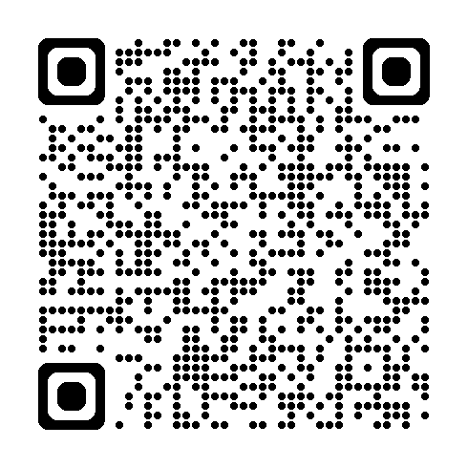
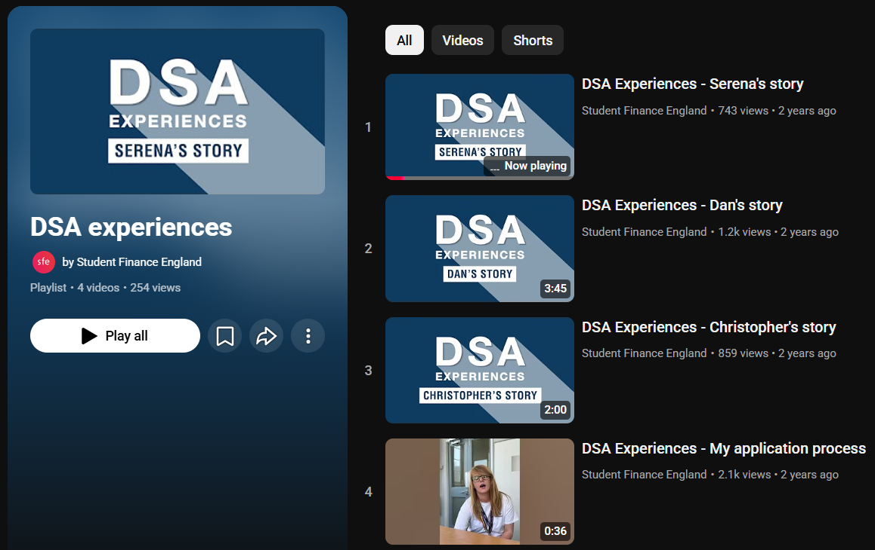

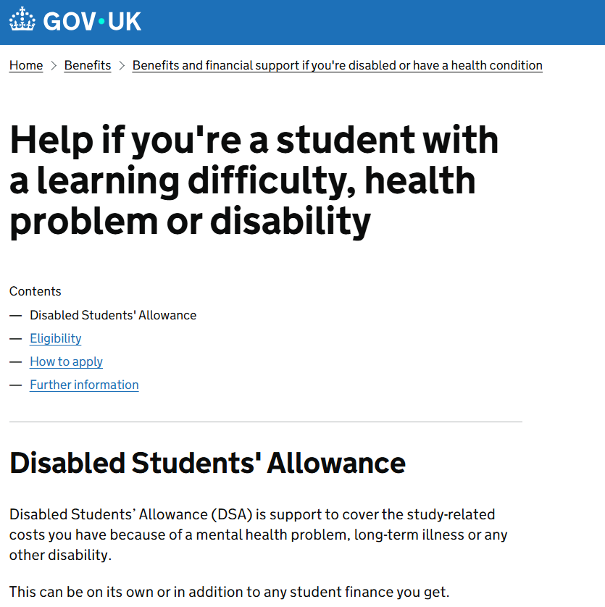
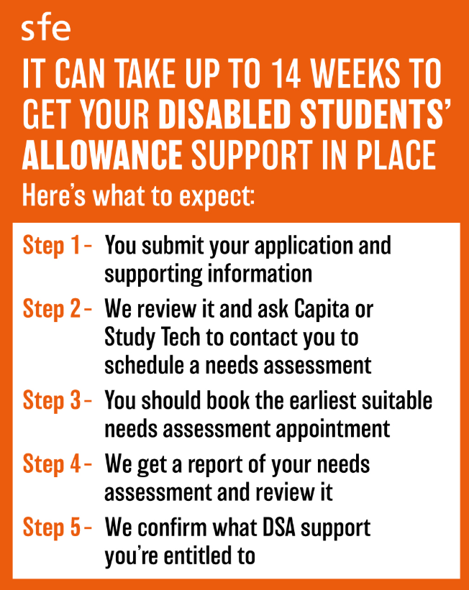
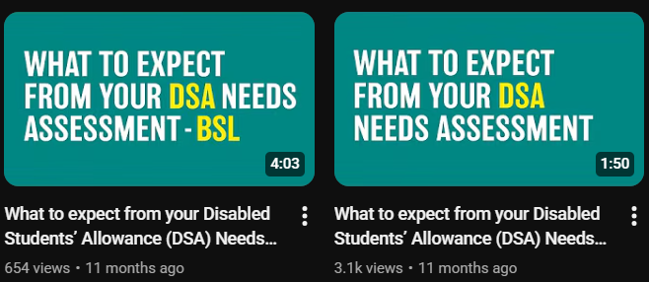
Disabled Students’ Allowance – Supporting Resources
To raise awareness of DSA support and the application process, dedicated guidance, resources and focused
content have been introduced across GOV.UK and the SFE social media channels:
www.gov.uk/guidance/what-to-expect-from-your-disabled-students-allowance-dsa-needs-assessment
www.youtube.com/@SFEFILM/videos
Notes:
Disabled Students’ Allowance (DSA), which is available for students to fund extra support they may need if they are living with a disability, learning difficulty or mental health condition, including:
specific learning difficulty
mental health condition
physical disability
sensory disability
long-term health condition
We understand that personal circumstances and the support required is very individual to that student and will vary from person to person.
However, in the widest terms, DSA support covers:
Specialist equipment – for example if a student needs a computer to run specialist software or braille display.
Non-medical helpers – for example, if a British Sign Language interpreter is required to attend lectures.
Travel – for example, if a taxi is needed to attend university, rather than using public transport.
A range of general costs may also be considered, related to a student’s disability.
DSA doesn’t depend on household income and doesn’t need to be repaid.

Slide 10
Student Loan Repayments
Income Contingent (ICR) Student Loans

Slide 11
Student Loan Repayment – Plan 5 Loan Key Messages
The Income Contingent (ICR) student loans taken out by new English domiciled (SFE) borrowers for courses
beginning on or after 1st August 2023 are under the Plan 5 repayment terms and conditions:
Plan 5 loan repayment thresholds are currently £25,000 a year (£2,083 a month or £480 a week)
From April 2027, Plan 5 thresholds will be uprated annually in line with RPI inflation (TBC)
Interest will be applied to Plan 5 loan balances at a rate of RPI (3.2% for the period 1st September 2025 to 31st August 2026 & then 4.1% which will apply from 1st September 2026 to 31st August 2026)
Repayment of Plan 5 loans for full-time students will begin the April after completes, leaves or withdraws from their course (the Statutory Repayment Due Date)
Borrowers will repay 9% of any income earned over the set threshold and if employed in the UK, deductions will be made from their pay through the HMRC tax system
During the repayment term, if a borrower’s income drops below the relevant threshold, repayments will pause, with any outstanding balance cancelled 40 years after the borrower enters repayment
Notes:
The meaning of a Plan 5 loan for English-funded borrowers is as set out in Regulation 3E:
Plan 5 - HE borrowers (except Postgraduate Masters and Doctoral)
A student loan that doesn’t fall within the definition of a Plan 2 loan and is taken out by an English-funded borrower in respect of a designated FT course or a designated PT course the borrower starts on or after 1 August 2023.
Plan 5 - FE borrowers
An Advanced Learner Loan (ALL) that doesn’t fall within the definition of a Plan 2 loan and is taken out by a borrower in respect of a designated Learning Aim that starts on or after 1 August 2023
Plan 5 loans include the following key elements:
A repayment threshold of £25,000, maintained at this level up to and including FY2026-27 then uprated annually with RPI inflation from April 2027
An interest rate of RPI only, and
A repayment term of 40 years
A Plan 5 borrower repays 9% of income above the repayment threshold related to their pay period (Regulation 29(3) and Regulation 44(1)).
The Plan 5 repayment thresholds in FY26-27 are:
• £25,000 per year
• £2,083.33 per calendar month
• £480.76 per week
From FY27-28 the Plan 5 repayment threshold will be adjusted annually in line with RPI at the start of each FY
The SRDD for a Plan 5 loan taken out for a FT course is the start of the FY beginning 6 April following the date that the borrower completes or withdraws from their course (Regulation
15(2)).
The earliest SRDD for a Plan 5 loan is 6 April 2026 (Regulation 15(2BA)) therefore a borrower will not be liable to make statutory repayments to their Plan 5 loan until 6 April
2026.
The SRDD for a Plan 5 loan taken out for a PT course is whichever of the following dates occurs first:
The start of the FY beginning 6 April following the date that the borrower completes or withdraws from their course (Regulation 15(2A)(a)), or
The start of the FY beginning 6 April following the fourth anniversary of the course start date (Regulation 15(2A)(b)).
Where a borrower is undertaking a period of PT study where their PT course continues beyond the SRDD any future loan payments made during this period of study will enter
repayment immediately on the date they are paid.
The effective date of the cancellation of a borrower’s liability to repay an outstanding Plan 5 loan balance is the 40th anniversary of the SRDD, (i.e. the 40th anniversary of the date on which the Plan 5 loan entered repayment status) (Regulation 19(3)(h)).
Interest will begin to accrue on Plan 5 balances from the date that the loan is paid to the borrower (Regulation 21C(2)).
Interest will be applied to Plan 5 balances at a rate of RPI (Regulation 21C(1)).
This rate will apply whether the loan balance is in payment or repayment status and will be calculated daily and applied to the total balance outstanding monthly
throughout the life of the loan (Regulation 21C(3)).

Slide 12
Student Loan Repayment – Plan 5 Example Figures
Approximate monthly repayment figures based on 9% of the income a borrower earns over the current
£25,000 Plan 5 loan threshold:
Students can monitor their loan balance and update SLC on any changes to their circumstances using the Online Repayment Service: www.gov.uk/sign-in-to-manage-your-student-loan-balance
Gross Annual Income | Monthly Income (Approximate) | 9% Repayment Deducted From | Monthly Repayment (Approximate)
£25,000 | £2,083 | £0 | £0
£28,000 | £2,333 | £3,000 | £22
£30,000 | £2,500 | £5,000 | £37
£35,000 | £2,916 | £10,000 | £75
£40,000 | £3,333 | £15,000 | £112
£45,000 | £3,750 | £20,000 | £150
£50,000 | £4,166 | £25,000 | £187
Notes:
The meaning of a Plan 5 loan for English-funded borrowers is as set out in Regulation 3E:
Plan 5 - HE borrowers (except Postgraduate Masters and Doctoral)
A student loan that doesn’t fall within the definition of a Plan 2 loan and is taken out by an English-funded borrower in respect of a designated FT course or a designated PT course the borrower starts on or after 1 August 2023.
Plan 5 - FE borrowers
An Advanced Learner Loan (ALL) that doesn’t fall within the definition of a Plan 2 loan and is taken out by a borrower in respect of a designated Learning Aim that starts on or after 1 August 2023
Plan 5 loans include the following key elements:
A repayment threshold of £25,000, maintained at this level up to and including FY2026-27 then uprated annually with RPI inflation from April 2027
An interest rate of RPI only, and
A repayment term of 40 years
A Plan 5 borrower repays 9% of income above the repayment threshold related to their pay period (Regulation 29(3) and Regulation 44(1)).
The Plan 5 repayment thresholds in FY26-27 are:
• £25,000 per year
• £2,083.33 per calendar month
• £480.76 per week
From FY27-28 the Plan 5 repayment threshold will be adjusted annually in line with RPI at the start of each FY
The SRDD for a Plan 5 loan taken out for a FT course is the start of the FY beginning 6 April following the date that the borrower completes or withdraws from their course (Regulation
15(2)).
The earliest SRDD for a Plan 5 loan is 6 April 2026 (Regulation 15(2BA)) therefore a borrower will not be liable to make statutory repayments to their Plan 5 loan until 6 April
2026.
The SRDD for a Plan 5 loan taken out for a PT course is whichever of the following dates occurs first:
The start of the FY beginning 6 April following the date that the borrower completes or withdraws from their course (Regulation 15(2A)(a)), or
The start of the FY beginning 6 April following the fourth anniversary of the course start date (Regulation 15(2A)(b)).
Where a borrower is undertaking a period of PT study where their PT course continues beyond the SRDD any future loan payments made during this period of study will enter
repayment immediately on the date they are paid.
The effective date of the cancellation of a borrower’s liability to repay an outstanding Plan 5 loan balance is the 40th anniversary of the SRDD, (i.e. the 40th anniversary of the date on which the Plan 5 loan entered repayment status) (Regulation 19(3)(h)).
Students can monitor their loan balance and update SLC on any changes to their circumstances using the Online Repayment Service:
www.gov.uk/sign-in-to-manage-your-student-loan-balance

Slide 13
The Lifelong Learning Entitlement
Student Eligibility and Funding Entitlement
Tuition Fee Loan and Living Cost Support

Slide 14
The Lifelong Learning Entitlement
The Lifelong Learning Entitlement (LLE) will transform the post-18 student finance system in England, and
it will be essential for students and those supporting their HE journey to understand this new funding model:
This presentation will introduce core elements of funding eligibility and entitlement under the LLE, split into
6 key components that will be essential to effective Information, Advice and Guidance (IAG) provision:
Presentation Points of Note:
Comprehensive details on all elements of LLE eligibility and funding policies will be included in the associated Regulations and when published, the dedicated Guidance Chapters
Specific awareness raising IAG Notes have been highlighted throughout the slides
1. Introducing the LLE
2. Eligibility Criteria
3. Study
Options
4. Funding Entitlement
5. Loan Repayment
6. Guidance
and Resources
Notes:
The Lifelong Learning Entitlement (LLE) will transform the post-18 student finance system in England, and it will be essential for students and those supporting their HE journey to understand this new funding model:
This presentation will introduce core elements of funding eligibility and entitlement under the LLE, split into 6 key components that will be essential to effective Information, Advice and Guidance (IAG) provision:
1. Introducing the LLE
2. Eligibility Criteria
3. Study Options
4. Funding Entitlement
5. Loan Repayment
6. Guidance and Resources
Presentation Points of Note:
Comprehensive details on all elements of LLE eligibility and funding policies will be included in the associated Regulations and when published, the dedicated Guidance Chapters
https://www.gov.uk/government/publications/lifelong-learning-entitlement-lle-secondary-legislation
https://www.practitioners.slc.co.uk/policy/
Specific awareness raising IAG Notes have been highlighted throughout the slides

Slide 15
Introducing the LLE – IAG Content Considerations
Establising consistency in the adoption of LLE-related terminology, and promoting the understanding of
study options and funding entitlement will contribute to effective IAG content creation and delivery:
Embedding
LLE-Related
Terminology
Course Levels
and
Credit Values
Course Year
and
Service Year
Periods of Eligibility
and
Concurrent Study
Communicating
Study Routes and
Course Costs
Designated Courses
and
Credit-Based Fees
Modular Study
and
Parent Courses
Maximum
Fundable Credits
in a Service Year
Ensuring
Understanding of Entitlement
Full Funding
and
Residual Entitlement
Additional Entitlement
and
Special Periods
Maintenance Loans
and
Supplementary Support
Notes:
Establising consistency in the adoption of LLE-related terminology, and promoting the understanding of study options and funding entitlement will contribute to effective IAG content creation and delivery:
Embedding LLE-Related Terminology, including:
Course Levels and Credit Values
Course Year and Service Year
Periods of Eligibility and Concurrent Study
Communicating Study Routes and Course Costs:
Designated Courses and Credit-Based Fees
Modular Study Options and Parent Courses
Maximum Fundable Credits in a Service Year
Ensuring Understanding of Entitlement:
Full Funding and Residual Entitlement
Additional Entitlement and Special Periods
Maintenance Loans and Supplementary Support
To fully understand their end-to-end LLE funding journey, students will need to be aware of the following areas of funding entitlement and how the repayment of their LLE Loans will work:
Maintenance and Special Support Loans
Loan Rates and Payment Schedule
Disabled Students’ Allowance
Grants for Dependants
Travel Grants
Loan Repayment
Funding Information Services (FIS) Team Engagement and Training Delivery:
Following the seminar series, the FIS Team will be incorporating the LLE into our engagement delivery, so please contact your regional account manager to arrange tailored staff updates or training sessions
For FIS Team contact details, guidance material and resources, visit www.practitioners.slc.co.uk

Slide 16
The Lifelong Learning Entitlement
An Introduction to the LLE
Essential Course and Funding Messages
1. Introducing the LLE
Policy information and illustrative figures are subject to final LLE Regulations!

Slide 17
Introduction to the LLE – A Single Student Funding System
The Lifelong Learning Entitlement (LLE) will create a single funding system for eligible England domiciled
students starting designated higher education courses and modules from January 2027:
From January 2027, LLE funding will replace:
Higher Education Student Finance (HESF) loans, and
Advanced Learner Loans (ALL) for Level 4, 5 and 6 qualifications at OfS registered providers
The LLE will provide new eligible students with Tuition Fee Loan entitlement to the equivalent of four years
study to use, up to the age of 60:
The LLE will allow for flexible and modular study routes for courses
This will enable students to develop new skills and gain qualifications at a time that is right for them
IAG Note: The student application service for LLE-funded courses and designated modules starting
from January 2027 is expected to open in September 2026 (Date TBC)
Notes:
The Lifelong Learning Entitlement (LLE) will transform the post-18 student finance system in England, and will create a single funding system:
From January 2027, LLE funding will replace:
Higher Education Student Finance (HESF) loans, and
Advanced Learner Loans (ALL) for Level 4, 5 and 6 qualifications at OfS registered providers
LLE will provide new eligible students with Tuition Fee Loan entitlement to the equivalent of four years study to use, up to the age of 60:
The LLE will allow for flexible and modular study routes for courses
This delivery model will enable students to develop new skills and gain new qualifications at a time that is right for them

Slide 18
The Lifelong Learning Entitlement
Establishing Student Eligibility
2. Eligibility
Criteria
Policy information and illustrative figures are subject to final LLE Regulations!

Slide 19
LLE Student Eligibility – General Requirements
A student will be eligible for LLE funding support to undertake a designated course or module starting on or
after 1st January 2027 if they satisfy the set residency and other associated eligibility requirements:
Personal eligibility requirements for students to access support under the LLE:
Personal eligibility rules will align to the existing HE Student Finance (HESF) eligibility rules, with some necessary changes made to incorporate the flexible and modular nature of the LLE
To be eligible for LLE support, students need to meet regulatory residency rules on a specific date, which will be the first day of the first year of the course or the course start date (the relevant day)
Once a student has been assessed as eligible for LLE support to undertake a designated course, they will retain their eligible status in relation to that course for a defined period of eligibility
A student’s period of eligibility will be tied to the concept of a ‘course year’
IAG Note: Courses starting earlier in AY 2026/27 (prior to 1st January 2027), will qualify for HESF
or ALL support as applicable, providing they meet designation requirements
Notes:
The personal eligibility requirements for students to access student support under the LLE. Personal eligibility rules will align to the existing HESF eligibility rules, with some changes to incorporate the flexible/modular nature of the LLE.
The rules in respect of the duration of the period of eligibility (i.e. the period during which a student’s eligibility applies for the purposes of LLE funding).
A student’s period of eligibility will be tied to the concept of the ‘course year’.
This will replace the current HESF model which sets the duration of the period of eligibility in conjunction with “academic years”.
Other product-specific qualifying criteria, entitlement rules or course designation rules, can also impact a student’s ability to qualify for support.
The relevant funding system under which a student may be able to access student support is determined by the regulations that the course is designated for student support under.
In summary, courses that begin on or after 1 January 2027 (and meet designation criteria set out in the Designated Courses and Fee Limits policy specification) will be funded under the LLE.
Courses that begin prior to that date (or in the case of certain Advanced Learner Loan courses, that do not meet the LLE designation criteria as they are not offered by OfS registered providers) will continue to be funded via the HESF/ALL systems (as applicable).
This is providing those courses continue to meet the course designation requirements of those systems.
This means that courses starting in AY 26/27 (i.e. on or after 1 August 2026) but prior to 1 January 2027, will continue to qualify for HESF or ALL (as applicable).
Regulatory residency rules are required to be met in respect of a specific date (the relevant day).
Under the LLE, the relevant day will be:
The first day of the first course year of the course (for residence categories where the corresponding relevant day in HESF is the first day of the first AY),
Or the course start date (for residence categories where the corresponding relevant day in HESF is the course start date).
To be determined as an eligible person for support under LLE a student must:
Hold a relevant eligible residence status; and
Satisfy ordinary residence rules in relation to the relevant residence status held:
o be ordinarily resident in England on the relevant day, or be undertaking study while living in England, and
o have been ordinarily resident in the relevant territory for the required period prior to the relevant day.
Persons who become eligible for LLE due to an event:
A student may become eligible for LLE support after the applicable relevant day, and in-turn qualify for funding under LLE via a regulatory event. Regulatory events categories under LLE will align with events categories under HESF
Period of eligibility
Once a student has been established as an eligible LLE student in relation to an application for support for a designated course, they will retain their eligible status in relation to that course for a defined period (period of eligibility).
The period of eligibility is dependent on the length of the relevant designated course.
Courses lasting longer than twelve calendar months
Where a student is undertaking a designated course that lasts longer than a period of twelve calendar months, the period of eligibility in relation to that course will begin on the first day of the course and will be retained until the end date of the course year in which they complete the course unless the student’s eligibility is terminated early due to withdrawal or abandonment of a course etc
Courses lasting twelve calendar months or less
Where a student is undertaking a designated course that lasts for a period of twelve calendar months or less, the period of eligibility in relation to that course will begin on the first day of the course, and will be retained for a period of twelve months from the course start date unless the student’s eligibility is terminated early due to withdrawal or abandonment of a course etc.
Determining personal eligibility for support for a course starting within an existing period of eligibility:
A student who has previously been established as an eligible LLE student in relation to a designated LLE course may be deemed to be an eligible returning student for a subsequent designated LLE course they undertake within an existing period of eligibility.
A student will be deemed to be an eligible person as a returning student in relation to a subsequent course if:
they have been awarded LLE support for a course that started prior to the course they are applying for support in respect of (the current course)
the current course has a course start date within an existing period of eligibility (the relevant period of eligibility), and
there have been no relevant changes to their personal circumstances since they were established as an eligible LLE student.
In cases where the student is deemed to be a returning student, SLC will not be required to re-establish their status as an eligible person in relation to their new course, therefore they may benefit from an expedited application process.
However, in circumstances where a student has been deemed to be eligible as a returning student, SLC will ensure that the student does not fall within any of the eligibility exclusion conditions in relation to the course they are applying for support for
In circumstances where a student begins study on a new course, SLC will consider whether the period of eligibility in relation to the new course extends the overall period during which the student is deemed to be an eligible person.

Slide 20
LLE Student Eligibility – Course Year and Service Year
The terms ‘course year’ and ‘service year’ will largely replace the use of ‘academic year’ terminology for
the purposes of assessing a student’s eligibility and funding entitlement under the LLE:
IAG Note: The concept of an academic year (AY) is expected to still be used across the sector to refer
to the annual application cycle and will be retained for some functions following launch of the LLE
LLE Course Year High-Level Definition
The 12-month period starting on the first day of the calendar month in which the student’s course begins (the first course year), and Each subsequent period of 12 months in which part of the course is undertaken
LLE Service Year High-Level Definition
The 12-calendar month period beginning 1st August and ending 31st July each year
Notes:
The terms ‘course year’ and ‘service year’ will largely replace the use of ‘academic year’ terminology for the purposes of assessing a student’s eligibility and
Funding entitlement under the LLE:
The High-Level Definition of course year under the LLE is:
The 12-month period starting on the first day of the calendar month in which the student’s course begins (the first course year), and each subsequent period of 12 months in which part of the course is undertaken
The high-level definition of an LLE Service is:
The 12-calendar month period beginning 1st August and ending 31st July each year
The concept of an academic year (AY) is expected to still be used informally across the sector to refer to the annual application cycle and will be retained for some functions following launch
of the LLE.
Differentiating between students eligible for HE Student Finance (HESF) or Advanced Learner Loans (ALL) and those eligible for LLE support following the initial introduction of LLE and
Tuition fee limits in the Devolved Administrations will continue to be set based on the AY model.
Interaction of yearly concepts under LLE:
Under the LLE, it will be necessary to understand the relationship between course years and service years for the purposes of determining a student’s eligibility and entitlement for student
finance.
Where a course year cuts across two service years the applicable service year in which the course year is considered to fall is determined by the first day of the course year.

Slide 21
LLE Student Eligibility – Concurrent Study
A key feature of the LLE is a student’s ability to receive student support for multiple courses concurrently:
Therefore, there will be no restrictions on a student’s personal eligibility to receive support towards multiple courses concurrently within the LLE (although limits may apply to certain products)
Students can be eligible for support to undertake more than one designated course under the LLE simultaneously, regardless of the level of the course
As examples of concurrent study, eligible students will be eligible to receive LLE support towards:
IAG Note: An eligible LLE student may only be funded for up to a maximum of 180 credits of study
within a single service year (either within a single course, or across multiple courses)
Multiple designated courses or modules at the same time, or
One or more designated modules alongside a full designated course (E.g. a standard Honours Degree)
Notes:
A key feature of the LLE is a student’s ability to receive student support for multiple courses concurrently:
Therefore, there will be no restrictions on a student’s personal eligibility to receive support towards multiple courses concurrently within the LLE (although limits may apply to certain products)
Students can be eligible for support for more than one designated course under LLE simultaneously regardless of the level of the course
Students will be eligible to receive support under the LLE towards:
Multiple designated courses or modules at the same time, or
One or more designated modules alongside a full designated course (e.g. a standard Honours degree)
However, an eligible LLE student may only be funded for up to a maximum of 180 credits of study within a single service year (either within a single course, or across multiple courses)

Slide 22
The Lifelong Learning Entitlement
LLE-Funded Study Options
Designated Courses and Modules
3. Study Options
Policy information and illustrative figures are subject to final LLE Regulations!

Slide 23
Study Options – LLE-Funded Courses 1
A main principle behind the LLE is enabling students to undertake the right study at the right time and this
is reflected in the range of courses that will be designated for LLE funding in January 2027, including:
Full years of study on courses currently funded by HE Student Finance (HESF), for example:
IAG Note: Information on the various qualification levels and what they mean is available online
from www.gov.uk/what-different-qualification-levels-mean/list-of-qualification-levels
Bachelor’s Degrees and Integrated Master’s Degrees
Foundation years available before some degree courses start (Providing these form part of an overall Bachelor’s Degree)
Foundation Degrees
Postgraduate Certificate in Education (PGCE)
The tuition fees for designated Distance Learning and online courses
Notes:
The LLE will fund full years of study on courses currently funded by HE student finance, including:
bachelors degrees
postgraduate certificates in education (PGCE)
integrated masters degrees – a 4-year programme that awards a masters degree on top of a bachelors degree
foundation years available before some degree courses start, as long as these form part of an overall bachelors degree
foundation degrees
LLE will fund the tuition fees for designated distance learning and online courses
Students will only get maintenance loans and grants if they are required to attend in person, unless they do not attend because of a disability.
Information on the various qualification levels and what they mean is available online from
www.gov.uk/what-different-qualification-levels-mean/list-of-qualification-levels

Slide 24
Study Options – LLE-Funded Courses 2
From its introduction in January 2027, eligible students will be able to access LLE funding to undertake:
IAG Note: LLE modular funding will only be available to students living and studying in England at
a provider registered with the Office for Students (OfS)
All Higher Technical Qualifications (HTQs)
Including both full courses and modules of those courses
Level 4 to 6 qualifications currently funded by Advanced Learner Loans at OfS registered providers
That have been successful in the Advanced Learner Loan transfer process www.gov.uk/government/publications/transfer-of-advanced-learner-loans-to-lifelong-learning-entitlement-approved-qualifications
Level 4, 5 and 6 modules from full Level 6 parent qualifications (such as degrees)
In subject groups that: Address priority skills needs and align with the government’s industrial strategy
Notes:
LLE will fund all higher technical qualifications (HTQs), including both full courses and modules of those courses.
LLE will fund level 4, 5 and 6 modules from full level 6 parent qualifications
For example, degrees – in subject groups that address priority skills needs and align with the government’s industrial strategy.
It will also fund level 4 to 6 qualifications currently funded by advanced learner loans, if there is clear learner demand and employer endorsement.
DfE invited awarding organisations to apply to have level 4 to 6 qualifications transferred from ALL into LLE funding in March 2024.
A list has been published to show the qualifications that were approved following those applications.
https://www.gov.uk/government/publications/transfer-of-advanced-learner-loans-to-lifelong-learning-entitlement-approved-qualifications
From January 2027, alongside the introduction of the LLE, DfE will launch the LLE qualifications gateway.
This gateway will mean that qualifications previously funded under the Advanced Learner Loans scheme will now become eligible for LLE funding.
This does not apply to higher technical qualifications.
Applications to the gateway will be integrated into the HTQ approval process.
LLE will fund all higher technical qualifications (HTQs), including both full courses and modules of those courses.
LLE funding will also be available for designated level 4, 5 and 6 modules from full level 6 parent qualifications
For example, degrees – in subject groups that address priority skills needs and align with the government’s industrial strategy.
The specified subject areas (which align to Common Aggregation Hierarchy (CAH) 2/3 groups) are:
computing
engineering
architecture, building and planning, excluding the landscape gardening subgroup
physics and astronomy
mathematical sciences
nursing and midwifery
allied health professions
chemistry
economics
health and social care
To be designated for LLE funding, modules must:
be part of an existing designated full course, its parent course delivered by the provider
be worth at least 30 credits, or a bundle of modules from the same parent course equalling at least 30 credits
have a single qualification level that should be level 4, 5 or 6 to determine if they are eligible for funding
be assessed and given a standardised transcript when they’re completed, to support credit transfer and facilitate labour market currency
not be delivered through franchised arrangements
LLE modular funding will only be available to students living and studying in England at a provider registered with the Office for Students (OfS)
To be eligible for LLE funding, modules must:
Be worth at least 30 credits, or a bundle of modules from the same parent course equalling at least 30 credits
Examples of modules that equal at least 30 credits are:
two 20-credit modules (40 credits)
one 10-credit module and a 20-credit module (30 credits)
two 15-credit modules (30 credits)
three 10-credit modules (30 credits)
Unless they wish to, there is no need for providers to redesign their course structures if they do not already operate on a 30-credit basis.
Information for providers intending to deliver LLE modular provision from January 2027 is available from:
www.gov.uk/government/publications/expression-of-interest-lifelong-learning-entitlement-lle-modular-funding

Slide 25
LLE Modular Study – Specified Subject Areas
From January 2027, LLE funding will be available for modules of Higher Technical Qualifications, and:
Level 4, 5 and 6 modules taken from full Level 6 parent qualifications (such as degrees) in subject areas that address skills gaps and align with the government industrial strategy
The specified subject areas (which align to Common Aggregation Hierarchy (CAH) 2/3 groups) are:
Computing | Engineering
Economics | Mathematical Sciences
Physics and Astronomy | Architecture, Building and Planning Excluding the Landscape Gardening Subgroup
Allied Health Professions | Chemistry
Nursing and Midwifery | Health and Social Care
Notes:
LLE will fund all higher technical qualifications (HTQs), including both full courses and modules of those courses.
LLE funding will also be available for designated level 4, 5 and 6 modules from full level 6 parent qualifications
For example, degrees – in subject groups that address priority skills needs and align with the government’s industrial strategy.
The specified subject areas (which align to Common Aggregation Hierarchy (CAH) 2/3 groups) are:
from 1 January 2027 the courses available for modularisation will be HTQs and Level 6 parent courses in priority subject areas as influenced by the work of Skills England.
The LLE will fund level 4, 5 and 6 modules from full level 6 parent qualifications in the following CAH2 subjects – each is listed with its CAH2 code.
Approved subjects:
11-01, Computing
10-01, Engineering
13-01, Architecture, building and planning, excluding the landscape gardening subgroup*
07-01, Physics and astronomy
09-01, Mathematical sciences
02-04, Nursing and midwifery
02-06, Allied health
07-02, Chemistry
15-02, Economics
15-04, Health and social care
Note this subject area will be aggregated to CAH3 level for the purposes of excluding qualifications in landscape design.
While modules can be included in a number of different courses a provider will only need to link one parent course per module.

Slide 26

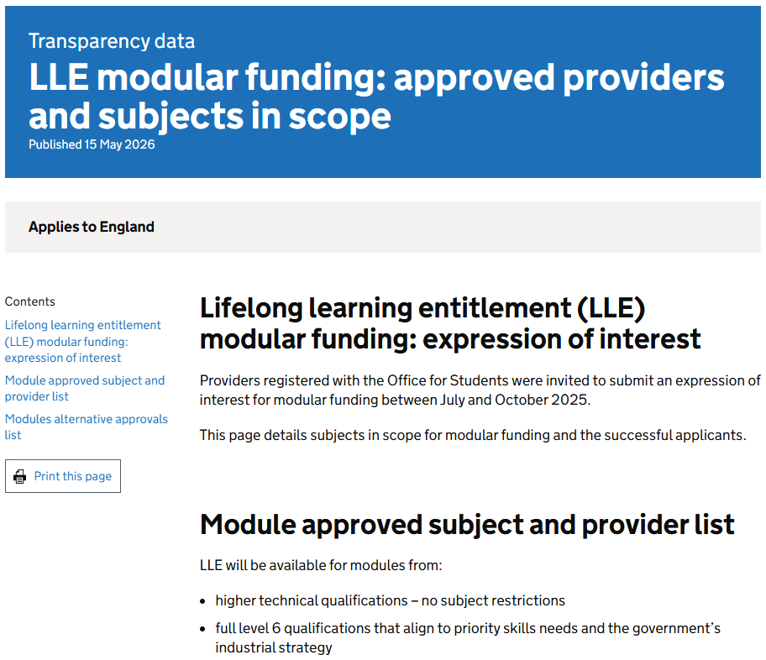
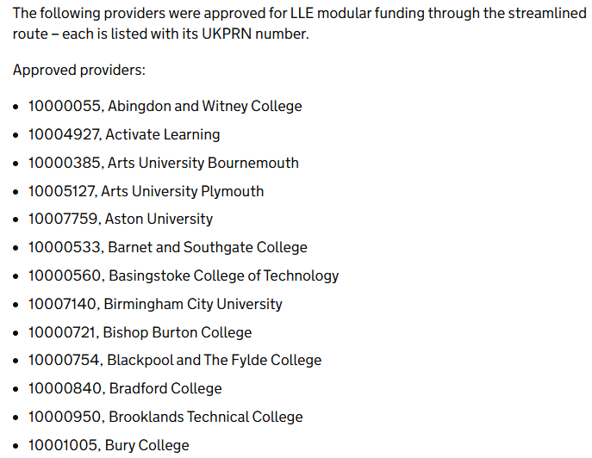
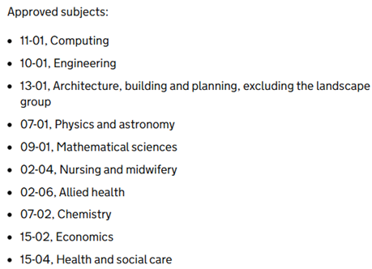
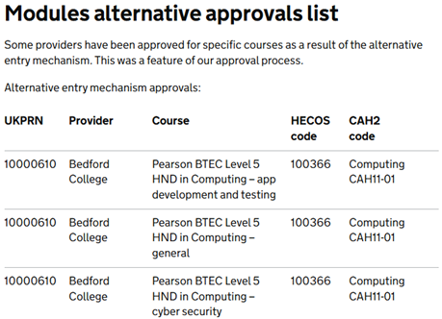
LLE Modular Study – Approved Provider Information Page
Details on the providers who have been approved to deliver LLE-funded modular study options following
the first DfE Expression of Interest (EOI) process have been published on GOV.UK:
www.gov.uk/government/publications/providers-approved-for-lifelong-learning-entitlement-modular-funding
IAG Note: The initial Expression of Interest application window was open between July and October 2025,
with the next iteration of the process to take place later in 2026 (Date TBC)
Notes:
Lifelong learning entitlement (LLE) modular funding: expression of interest
Providers registered with the Office for Students were invited to submit an expression of interest for modular funding between July and October 2025.
The dedicated GOV.UK Transparency Data page provides details of the subjects in scope for modular funding and the providers who were successful in the first EOI application process.
https://www.gov.uk/government/publications/providers-approved-for-lifelong-learning-entitlement-modular-funding
LLE will be available for modules from:
higher technical qualifications – no subject restrictions
full level 6 qualifications that align to priority skills needs and the government’s industrial strategy
It will fund level 4, 5 and 6 modules from full level 6 parent qualifications in CAH2 subjects listed on the GOV.UK guidance page.
Each is listed with its CAH2 code.

Slide 27
The Lifelong Learning Entitlement
Tuition Fee Loan Support
Standard, Residual and Additional Entitlement
4. Funding Entitlement
Policy information and illustrative figures are subject to final LLE Regulations!

Slide 28
LLE Tuition Fee Loan – Standard Support Entitlement
Under the LLE, eligible students will be provided with a Tuition Fee Loan (TFL) balance up to the full standard
entitlement, equal to four years of full-time study:
The standard entitlement is equivalent to the tuition fee cost of 480 credits worth of study
The rate used in calculating standard LLE TFL entitlement is aligned to the fee limits that apply to providers
registered in the OfS Approved (Fee Cap) category with an Access and Participation Plan (APP):
The maximum per-credit Tuition Fee Loan entitlement rates for study on designated courses at English providers will be set by dividing the relevant rate by 120 credits
Based on the maximum rates for Service Year 2026/27, standard LLE TFL entitlement is calculated as:
IAG Note: 120 credits represents the typical value for a full-time study year on an Honours Degree
(£9,790 / 120) x 480 Credits = £39,160 Tuition Fee Loan Entitlement
Notes:
Standard entitlement
An individual will be provided with a cash-based TFL balance up to the full standard entitlement.
The standard entitlement is calculated as the maximum TFL entitlement for the equivalent tuition fee cost of 480 credits worth of study.
120 credits represents the typical credit value associated with a single year of FT study of a UK honours degree course.
As such, the full standard entitlement provides a TFL entitlement equal to four years of FT study.
The TFL entitlement rate used in calculating the standard entitlement is aligned to the maximum fee limit that applies to providers who are registered in the Approved (Fee Cap) OfS registration category and have an Access and Participation Plan (APP).
Based on the maximum rate in service year 26/27 the standard entitlement is calculated as:
(£9,790/120) x 480 credits = £39,160
Note that the cash-based standard entitlement will change in line with any future changes to maximum TFL entitlement rates.
A credit-based method for setting tuition fee limits will be implemented under the LLE which will apply to all LLE funded higher-level courses and modules undertaken on a full-time,
part-time or accelerated basis.
The fee limit will relate to the amount of study in the course, rather than the number of years studied
Per-credit TFL entitlement rates will be differentiated based on a provider’s OfS registration status and TEF award status:
Where the provider is registered in the Approved (Fee Cap) section of the OfS register, either with or without an Access and Participation Plan (APP) and / or TEF award, the maximum per-credit TFL entitlement rate will match the maximum per-credit tuition fee limit that the provider can charge.
Where the provider is registered in the Approved section of the OfS register then no tuition fee limit is applicable (i.e. the provider can charge tuition fees with no limit imposed).
However, the Tuition Fee Loan support available to students will be capped at the set levels.

Slide 29
LLE Tuition Fee Loan – Residual Entitlement
Students who have previously undertaken relevant government-funded study may be eligible for a residual
amount of LLE Tuition Fee support, enabling them to fund additional qualifications and gain new skills:
Students will have their standard LLE Tuition Fee Loan entitlement reduced to reflect any non-LLE study for which they received applicable government tuition fee support (their relevant funded study)
Applicable tuition fee support means support for tuition fees provided by the government administrations
of England, Wales, Northern Ireland or Scotland in the form of:
A student loan for tuition fees
A student grant for tuition fees
SAAS tuition fee funding for study at a Scottish provider
Block grant funding paid directly to providers by government
Funding paid directly to providers in respect of modules of HTQ courses eligible for funding via the Modular Acceleration Programme (MAP)
Notes:
Students who have previously undertaken relevant government-funded study may be eligible for a residual amount of LLE Tuition Fee support, enabling them to fund additional qualifications and gain new skills:
An individual who has accessed government funding for periods of non-LLE study will have their TFL balance reduced to reflect the government funding contribution made to the tuition cost of their non-LLE related studies.
The standard entitlement will be reduced to take into consideration any non-LLE study for which the individual has received applicable tuition fee support (relevant funded study).
An individual who has undertaken relevant funded study will be subject to a Residual Entitlement Calculation (REC) to establish the amount to be deducted from the standard entitlement and determine their residual entitlement balance.
This will be the student’s remaining TFL balance.
Definition of applicable tuition fee support
Applicable tuition fee support means support for tuition fees provided by the government administrations of England, Wales, Northern Ireland and/or Scotland in the form of:
a student loan for tuition fees,
a student grant for tuition fees,
SAAS tuition fee funding for study at a Scottish provider (i.e. non-repayable tuition fee payments to a Scottish provider by the Scottish Government on behalf of an eligible student),
block grant funding paid directly to providers by government, and/or
funding paid directly to providers in respect of modules of HTQ courses eligible for funding via the Modular Acceleration Programme (MAP)).
For the purposes of the Residual Entitlement Calculation, relevant funded study means non-LLE study for which applicable tuition fee support was provided towards the student’s tuition fee costs in relation to study on a course undertaken with a provider in the UK for:
a period of HE UG study at level 4 – 6 (or equivalent level in Scotland). This includes all qualification types designated via the existing HE student support regulations that apply in each relevant UK domicile,
study on a foundation year,
a period of study leading to a PG qualification that is funded under the Higher Education Student Finance (HESF) system, e.g. an integrated Master’s degree, a postgraduate certificate in education (PGCE) or a PG pre-registration healthcare qualification,
a period of FE study at level 4 – 6 beginning on or after 1 August 2013 for which the student received ALL support,
a period of study on a module of an HTQ course for which the student’s tuition costs were funded under the MAP.
The following is not considered as relevant funded study, and is therefore disregarded for the purposes of a student’s Residual Entitlement Calculation (REC):
a period of study below level 4 or equivalent (with the exception of study on a foundation year as set out in the definition of relevant funded study),
a period of study on a HE Short Course (undertaken during the HE Short Course trial period between 1 August 2023 and 31 August 2025 inclusive),
a period of PG study (with the exception of PG study funded under the Higher Education Student Finance (HESF) system),
a period of study on an FE course that was not funded under the ALL system,
relevant funded study that was impacted by CPR,
relevant funded study on an FE course where an ALL balance has been cancelled under Regulation 25 of the Further Education Loans Regulations 2012 (as amended)

Slide 30
LLE Tuition Fee Loan – Additional Entitlement Summary
Additional Tuition Fee Loan support, in excess of the standard entitlement balance will be made available
to eligible LLE students in certain circumstances:
Priority Additional Entitlement:
Designated courses in an identified UK Government priority subject area (a Priority Course)
Additional Entitlement for a Special Period:
Specific additional fee costs associated with certain types of study, including Study Abroad, Sandwich Placement, or Foundation Year
Additional Entitlement for Taught Study Years of Certain Longer Courses:
Eligible longer courses in specified subjects (Architecture, Veterinary Surgery and longer Scottish courses)
Repeat Study and Compelling Personal Reasons (CPR) Additional Entitlement:
For qualifying courses with a full-time equivalent duration of 4-years or 6-years of normal taught study and for study negatively affected by a CPR
Notes:
Additional entitlement
While the LLE creates a finite TFL balance that an eligible LLE student can draw down from, there remain instances where the UK Government may wish to continue to provide additional TFL support in excess of the TFL balance to students in particular circumstances.
Priority additional entitlement:
In order to support wider UK Government intent of boosting employment numbers within identified priority sectors an eligible LLE student studying on a designated course in a UK Government priority subject area (a priority course) may be able to access Priority Additional Entitlement (PAE).
Special additional entitlement:
An eligible LLE student may be able to access Special Additional Entitlement (SAE) on top of their TFL balance.
Special Additional Entitlement SAE provides students with an additional amount of TFL to cover certain specific additional fee costs associated with certain types of study
Additional entitlement for taught study years of certain longer courses (Long Course Additional Entitlement):
An eligible LLE student may be able to access additional entitlement if they are undertaking a longer course or programme of study that have a standard full-time equivalent (FTE) duration of at least five taught study years
Repeat Study Additional Entitlement:
An eligible LLE student may be able to access additional entitlement for periods of repeat study (“Repeat Study AE”) if they are undertaking a qualifying course that is not a priority course and consists of:
A FTE duration of more than three taught study years but less than five taught study years, i.e. the course must consist of more than 360 taught study credits but less than 600 taught study credits, (or where the course is non-credit bearing, be in excess of 3,600 of notional learning hours of taught study but less than 6,000 notional learning hours of taught study), or
A FTE duration of more than five taught study years, i.e. the course must consist of more than 600 taught study credits, (or where the course is non-credit bearing, be in excess of 6,000 notional learning hours of taught study).
A priority course does not qualify for Repeat Study AE because the full fundable cost of any repeat study periods is already covered by the availability of PAE.
A student can get Repeat Study AE for multiple repeat periods up to an absolute maximum of 120 credits (i.e. the equivalent of one FT course year) within a single course.
CPR-related additional entitlement:
An eligible LLE student whose funded study under LLE has been negatively affected by compelling personal reasons (i.e. where a student has been unable to complete a course or has been required to repeat an element of a course due to CPR) will be able to get additional fee support to replace the entitlement used to fund the CPR affected period of study.

Slide 31
The Lifelong Learning Entitlement
Living Cost Support
Maintenance Support and Supplementary Grants
4. Funding Entitlement
Policy information and illustrative figures are subject to final LLE Regulations!

Slide 32
Maintenance Support Under the LLE
Under the LLE, eligible students undertaking courses which require face-to-face attendance will be able to
apply for Maintenance Loan support to help with their living costs:
The amount of loan support available to a student will depend on:
The rules for assessing household income and calculating any required deductions to the Maintenance Loan
support will apply to both eligible full-time and part-time LLE-funded students:
Where a student’s household income is £25,000 or less, they will be entitled to the full base Maintenance Loan Element entitlement (subject to intensity and credits per week adjustments)
Students who choose not to provide the relevant household income information will only be eligible for the minimum (non-means tested) amount of loan support
Their ‘characteristics’ including where they live
What they study and how
Their household income
Notes:
Under the LLE eligible students attending courses which require face-to-face attendance, will be able to apply for a Maintenance Loan, to help with living
costs.
The loan amount available to a student will depend on:
Their ‘characteristics’, such as their age, where they live (London, Elsewhere, Parental Home, Overseas) and their eligibility for benefits.
What they study and how, including the type of course they’re studying and how they’re studying it, such as modules or short courses and how much
they study, in other words the intensity.
It will also depend on their household income
In a change from the current system, maintenance support under the LLE, will not have different sets of rules for full-time and part-time students.
The existing HESF rules for assessing household income and calculating any deductions will not change, and this applies for both full-time and part-time
students.
The rules for calculating entitlement for part-time students will closely reflect the system used for full-time students.
This means that household income will be used to assess eligibility for maintenance support – just as it is for full-time students.
This will create a more streamlined student finance system, which treats all students consistently.
Students who choose not to provide household income information, will only be eligible for the minimum loan amount, as is the case under the current HESF
system.
Distance learning courses will be out of scope for maintenance support under the LLE, unless the student is unable to attend in person, due to a disability, so
the same rule as we have in the current HE student finance system.
Students undertaking distance learning courses will still be able to use LLE funding to pay tuition fees and access Disabled Students’ Allowance.
For the first time, under the LLE, students may have entitlement to loans for living cost across multiple concurrent courses, during the service year.
Many features of the current system will remain the same.
Students aged 60 or over may get limited funding for maintenance loans through a special support loan which is means-tested.
Students who are eligible for an NHS bursary will be able to apply for a reduced rate of maintenance loan.
Students on a sandwich course with a qualifying placement can apply for a reduced maintenance loan.
If a student has a placement in a service-based field that already exists (such as healthcare, education or social work), they will still be eligible to apply for full
maintenance support.

Slide 33
LLE Maintenance Support – Elements and Categories
LLE loans for living cost (maintenance) support can be broken down into three distinct elements:
Maintenance Loan Element (MLE)
Available to most students, including individuals not on specific benefits Partially income assessed Made up of a base non-income assessed portion and an additional income assessed portion Considered income by DWP for benefit entitlement calculations
Special Support Loan Element (SSLE)
An additional element of support awarded to students who are in receipt of certain benefits In addition to the Maintenance Element Available to those aged 60 or over on the first day of the course year Entirely income assessed
Reduced Loan Element (RLE)
A lower non-income assessed element of loans for living costs Awarded to students studying on qualifying course years: Those that attract specific bursaries, and Some qualifying placements
Notes:
Under the LLE, loans for living costs are broken down into three distinct elements:
The Maintenance Loan Element, the Special Support Loan Element and the Reduced Loan Element.
The Maintenance Loan Element (MLE) is available to most eligible LLE students, including individuals not on specific benefits.
This element is partially income assessed, being made up of a base non-income assessed portion and an additional income assessed portion, similar to the current HESF system
It is anticipated to cover the core expenditure of students.
This element is considered as income by the Department of Work & Pensions for benefit entitlement calculations.
The Special Support Loan Element or SSLE is an additional element of support awarded to students who are in receipt of certain benefits and is given in addition to the Maintenance Element.
This element is also the only loan support available to those who are aged 60 or over, on the first day of the course year.
The SSE is entirely income assessed.
The Reduced Loan Element or RLE is a lower, non-income assessed element of loans for living costs, which is awarded to students studying on course years that attract specific bursaries, and some qualifying placements.

Slide 34
Calculating Entitlement – Maintenance Loan Base Element
The base Maintenance Loan Element (MLE) for eligible course years will be calculated using the relevant weekly rate, multiplied by 30, then subject to any household income or credit-linked deductions:
Base Maintenance Loan: LLE students aged under 60, not entitled to benefits (2026/27 Rates)
Eligible students in their final year of study who undertake 110 or more credits in the course year, will qualify for the lower ‘final year’ rate of loan
Eligible students aged 60 or over on the first day of their course will be entitled to receive the Special Support Loan Element only, up to a maximum entitlement of £4,582
Location Rate | Full Year Rate | Full Weekly Rate | Reduction Taper | Minimum Loan
Parental Home | £9,118 | £303.93 | £6.54 | £4,013
Elsewhere | £10,830 | £360.99 | £6.47 | £5,048
London | £14,135 | £471.16 | £6.36 | £7,039
Overseas | £12,403 | £413.43 | £6.41 | £5,996
Notes:
Eligible LLE students who qualify for loans for living cost and have provided details of their household and household income are (depending on the level of household income) entitled to the income assessed amount loans for living cost. The amount of additional support available will depend on whether the student is in receipt of certain benefits.
Students who are not entitled to certain benefits will be entitled to the additional income assessed portion of the maintenance element, which is then to be reduced by the income assessed loan reduction until the non-income assessed weekly value is reached.
The LRV is then used to reduce the loan for living cost down to the minimum amount (non-income assessed amount).
For students under 60 not entitled to benefits a single taper is used to calculate the loan reduction value (LRV).
Students who are entitled to the benefits will also be entitled to the additional income assessed portion of the maintenance element, plus the additional special support element which is treated as additional income assessed support. This is then reduced to the relevant non-income assessed base value.
Special Support element is a fixed maximum entitlement of £4,582 annual maximum regardless of the living/study rate and there is not an additional week’s rate of Special Support Element.
A student’s Special Support element entitlement will continue to be disregarded by the DWP for the purpose of benefit entitlement calculation.
For students under 60 and entitled to benefits the tapers for both final and non-final years are stepped to produce a single loan reduction value that accounts for reducing special support element as well as maintenance element.
Final Year Loan Rates
Eligible LLE Students in their final year of study who are studying 110 or more credits in the course year, will qualify for a lower rate of loan known as the “final year rate”,
This is still dependent on variation due to living/study location.
This will mean that in practice final year rate will only apply to the last year of standard full-time courses as is the case in the current system
Part-time courses and modules are not expected to meet this credit value.
Students over the age of 60 who provide household income details:
An eligible LLE student who is aged 60 or over on the first day of their course will be entitled to the Special Support element only.
Special Support element is a fixed maximum entitlement of £4,582 annual maximum regardless of the living/study rate and there is not an additional week’s rate in relation to Special Support Element.
In instances where a student is studying concurrently, being under 60 at the beginning of their first course, and then over 60 at the beginning of their second course, the student could receive the Special Support element only for support on their second course.
For students over 60 and only entitled to the special support element the taper is £1 for every complete £4.16 above £25,000 until £43,835 at which point they will not be entitled to any loan for living cost.

Slide 35
Calculating Entitlement – Maintenance Loan Example
Example: Student under 60 and not entitled to benefits, course year containing 30 weeks of study
Esme is an eligible student who is not entitled to benefits She is 24 and is studying the first year of a degree starting in 2027/28
Esme’s course year is 30 weeks long, she will be studying in London and living away from home, her household income is £43,000
Esme qualifies for the non-final year London rate of loan
The calculation to determine Esme’s base entitlement is: 30 x £471.16 = £14,135
As her household income is £43,000, Esme’s base entitlement is reduced The Loan Reduction Value (LRV) is calculated: £43,000 - £25,000 / £6.36 = £2,830
The base entitlement is then reduced by the LRV: £14,135 - £2,830 = £11,305
Esme’s income assessed loan entitlement for the course year is £11,305
Notes:
To calculate the Base Maintenance Loan Element for students studying on course years with 30 or fewer study weeks, we always use the relevant weekly rate, multiplied by 30.
If the student’s household income is £25,000 or less, then they’re entitled to the full base MLE Only entitlement.
Otherwise, the base MLE Only entitlement is reduced by the calculated loan reduction value, until the income assessed portion of the loan amount is 0, at which point the student is only entitled to the non-income assessed loan amount.
Whilst the term LRV may be new to some of you, the process of the pound-to-pound reduction to calculate a student's entitlement, based on household income, is the same as it is in the current HESF system
Esme is an eligible student who is not entitled to benefits, she is 24 and is studying the first year of a degree course starting in AY 27/28.
Her course year is 30 weeks long; she will be studying her course in London and living away from home. Her household income is £43,000.
Esme qualifies for non-final year London rate of loan and the calculation to determine her base entitlement is:
(30 x £471.16) = £14,135
However, as Esme’s household income is £43,000, her base entitlement is reduced. First, we calculate the loan reduction value (LRV):
((£43,000 - £25,000)/£6.36) = £2,830
Then we reduce the base entitlement by the LRV:
(£14,135- £2,830) = £11,305
Esme’s income assessed entitlement for the course year is £11,305

Slide 36
LLE Maintenance Support – Calculation and Payment
A base annual entitlement amount (using a 30-week value) will be used to provide living cost support
comparable to the current HE Student Finance (HESF) system:
An eligible LLE student’s loan for living cost entitlement will be determined based on a combination of:
  The number of credits studied (intensity), and their course duration (Additional Weeks Entitlement)
To calculate a student’s entitlement to loans for living costs, SLC will:
For launch of the LLE, loans for living cost support will be paid to students in up to three instalments,
broadly in line with existing arrangements:
DfE will set out details for future years in due course
Establish the course year maximum value
Reduce this by the income assessment
(Loan Reduction Value)
Reduce this by study intensity
Notes:
An eligible LLE student’s entitlement will be determined based on a combination of their credits study so intensity, and their course duration so additional weeks entitlement, with a base annual amount (so a 30-week value), providing a comparable loan for living cost entitlement outcome as the current HESF system.
To calculate a student’s entitlement to loans for living costs, first SLC will have to establish the course year maximum value.
This is then reduced by the income assessment (which will also be known as the loan reduction value or LRV) and then subsequently by intensity.
Maintenance Loan Payments:
For the launch of the Lifelong Learning Entitlement (LLE), maintenance loans will be paid to students in up to three instalments, broadly in line with existing arrangements.
DfE will set out details for future years in due course.

Slide 37
The Lifelong Learning Entitlement
Maintenance Support Linked to Tuition Fee Loan Balance
4. Funding Entitlement
Policy information and illustrative figures are subject to final LLE Regulations!

Slide 38
LLE Maintenance Support – Link to Tuition Fee Loan Balance
Students with an LLE Tuition Fee Loan balance of £0 will not be entitled to Maintenance Loan support:
Students with ‘Limited Remaining Tuition Fee Loan Entitlement’ (less than 30 credits):
Will only be entitled to Maintenance Loans if they use part of their remaining LLE Tuition Fee Loan (TFL) balance to pay for the course, they are seeking maintenance support for
For Service Year 1 of the LLE, 30 credits has a value of £1,587.50
This value is based on the lowest Tuition Fee Loan amount for 30 credits of study in 2026/27 at providers with no TEF rating or APP, and may change with fee amounts in subsequent years
Students who are undertaking less than 30 credits in a course year:
An LLE student will not qualify for any maintenance support for any course or course year on which they are studying less than 30 credits or 300 notional learning hours
Notes:
Maintenance Loan Entitlement will also be linked to a student’s Tuition Fee Loan balance.
Therefore, students with an LLE Tuition Fee Loan balance of £0, will not be entitled to Maintenance Loan support
Students with Limited Remaining Tuition Fee Loan Entitlement so a balance of less than 30 credits:
Will only be entitled to Maintenance Loans if they use part of their remaining Tuition Fee Loan balance, to pay for the course, which they’re seeking maintenance support for.
Students will not qualify for any maintenance support for any course or course year on which they are studying less than 30 credits or 300 notional learning hours.
For LLE Service Year 1, 30 credits has a value of £1,587.50. This is based on the current lowest tuition fee loan amount for 30 credits of study, and may change in subsequent years, if fee loan amounts change.
Sub-level (basic) amount (No TEF rating or APP) £6,350/120 (£52.9166)

Slide 39
LLE Maintenance Support – Limited TFL Balance Example
Example: Student with a limited LLE Tuition Fee Loan (TFL) balance of less than £1,587.50
Andreas is an eligible student studying a module starting in 2027/28 The module fee amount is £500
Andreas has previously studied and used some of his standard Tuition Fee Loan (TFL) entitlement before, leaving him with a balance of £1,000
Andreas uses his remaining TFL balance to cover the fee cost of his module
As Andreas is using some of his remaining balance to fund his module Even though his TFL balance is less than £1,587.50, he will qualify for loan for living cost (maintenance) support for the duration of the module
Notes:
Andreas is an eligible student studying a module starting in AY 27/28. The module fee amount is £500.
Andreas has previously studied and has used some TFL entitlement before, leaving a TFL balance of £1,000.
Andreas uses his remaining balance to cover the fee cost of his module.
As Andreas is using some of his remaining balance to fund his module, even though his TFL balance is less than £1,587.50, he will qualify for loan for living cost support for the duration of his module.

Slide 40
The Lifelong Learning Entitlement
Maintenance Support and Study Intensity
4. Funding Entitlement
Policy information and illustrative figures are subject to final LLE Regulations!

Slide 41
LLE Maintenance Support – Intensity of Study
To provide support proportionate to the number of credits being undertaken in a course year, an eligible
LLE student’s intensity of study is calculated as:
The default value of 120 credits is used as standard intensity (HE Student Finance equivalence)
Students undertaking course years with less credits than the standard value will see their entitlement to loans for living costs (all elements) reduced by the intensity of study
Eligible LLE students studying on course years with more credits than the standard value will:
Have their intensity capped at a maximum of 100%, and
Be subject to the credit per week adjustment
Students on higher-credit, longer duration courses may qualify for Additional Weeks Entitlement
Intensity (%) = Course Year Credits / 120 x 100
Notes:
To provide support proportionate to the number of credits being undertaken in a course year the eligible LLE student’s intensity of study is calculated using the formula shown on this slide.
The intensity calculation is based on an equivalence to HESF and therefore uses the default standard value of 120 credits as “standard intensity”.
Eligible LLE students studying on course years with less credits than the standard value will see their entitlement to loans for living costs (all elements) reduced by the intensity.
However, eligible LLE students studying on course years with more credits than the standard value will have their intensity capped at a maximum of 100% and subject to the credit per week adjustment.
However, higher-credit courses are typically delivered over a longer duration, so students are not likely to disadvantaged by this cap as they will qualify for AWE.
The calculated intensity is then used to reduce the student’s entitlement

Slide 42
Intensity of Study – Intensity of Study Example, Part 1
Example, Part 1: Intensity calculation used to reduce loan entitlement, course year under 30 weeks
Donald is an eligible LLE student who is not entitled to benefits, he is 22 and is studying a 30-credit module starting in 2027/28
Donald’s module is 20 weeks long, and he will be living with his parents during the course, his household income is £18,000
Donald qualifies for the non-final year Parental Home rate of loan for living cost
As his household income is under £25,000, Donald will not be subject to an income assessed reduction
However, as his credits for the course year are lower than 120 credits, Donald will be subject to an intensity reduction
Notes:
Donald is an eligible student who is not entitled to benefits, he is 22 and is studying a 30-credit module starting in AY 27/28.
His module is 20 weeks long, and he will be living with his parents during his course. His household income is £18,000.
Donald qualifies for the non-final year parental home rate of loan for living cost, and as his household income is under £25,000, he will not be subject to an income assessed reduction but as his credits for the course year are lower than 120 credits, he will be subject to an intensity reduction.
Donald’s base entitlement is £9,118 (30 x £303.93)
His intensity is calculated as follows:
Intensity (%) = (30/120) x 100 = 25%
Donald’s base income assessed entitlement is reduced by his intensity of study:
£9,118 x 25% = £2,279.50
Donald’s income assessed intensity adjusted entitlement for the course year is £2,279.50.

Slide 43
Intensity of Study – Intensity of Study Example, Part 2
Example, Part 2: Intensity calculation used to reduce loan entitlement, course year under 30 weeks
Donald is studying a 30-credit module in 2027/28, with a 20-week duration His household income is £18,000
As his household income is under £25,000, Donald will not be subject to an income assessed reduction, but he will be subject to an intensity reduction
Donald’s base entitlement is £9,118 (30 x £303.93)
His intensity is calculated as: Intensity (%) = 30 / 120 x 100 = 25%
Donald’s base income assessed entitlement is reduced by his intensity of study: £9,118 x 25% = £2,279.50
Donald’s income assessed, intensity adjusted entitlement for the module is £2,279.50
Notes:
Donald example continued
Donald’s base entitlement is £9,118 (30 x £303.93)
His intensity is calculated as follows:
Intensity (%) = (30/120) x 100 = 25%
Donald’s base income assessed entitlement is reduced by his intensity of study:
£9,118 x 25% = £2,279.50
Donald’s income assessed intensity adjusted entitlement for the course year is £2,279.50.

Slide 44
The Lifelong Learning Entitlement
Living Cost Support
Supplementary Grants, Eligibility Summary
4. Funding Entitlement
Policy information and illustrative figures are subject to final LLE Regulations!

Slide 45
LLE Targeted Support Grants and DSA
Under the LLE, targeted grant support will be available for eligible students undertaking study on a full-time
basis (equivalent to at least 120 credits per course year):
This applies to:
Grants for Dependants (GFDs), and
Travel Grants
The government intends to continue its evaluation of how these grants are used
Disabled Students’ Allowance (DSA) will also continue to be available for eligible LLE students:
This is providing they are undertaking 30 or more credits per course
Notes:
For new learners under the LLE, targeted support grants will be made available for those studying on a full-time basis (equivalent to at least 120 credits per course year).
This covers grants for dependants and travel grants.
The government intends to continue its evaluation of how these grants are used.
The Disabled Students Allowance (DSA) will also continue to be available for those studying 30 or more credits per course under the LLE.
The LLE will not affect learners who are already eligible for targeted support grants.
This money does not need to be repaid.

Slide 46
The Lifelong Learning Entitlement
Loan Repayment Overview
5. Loan Repayment
Policy information and illustrative figures are subject to final LLE Regulations!

Slide 47
Loan Repayment Under the LLE – Plan 5 Terms
Loans taken out under the LLE will be subject to Plan 5 repayment terms and conditions:
Where a student takes out a loan under the LLE, they will be liable to make statutory repayments toward their loan balance from the Statutory Repayment Due Date (SRDD)
IAG Note: Where a student takes out loans under the LLE for multiple courses or modules that are being studied concurrently, a separate SRDD will be set for each individual course or module
Key Repayment Terms and Conditions for Plan 5 Student Loans:
The annual repayment threshold is currently set at £25,000 Increasing by Retail Price Index (RPI) each tax year from 2027-28 (TBC)
Interest rates are linked to RPI only (no variable interest rate applies) The interest rate applied is subject to Prevailing Market Rate capping rules
SRDD set as the start of the tax year following course completion or withdrawal
A loan term cancellation of 40 years from the SRDD
Notes:
Repayment
Loans taken out under LLE will be subject to Plan 5 repayment terms and conditions.
Where a student takes out a loan under LLE, they will be liable to make statutory repayments to their loan balance from the Statutory Repayment Due Date (SRDD).
Where a student takes out loans under LLE for multiple courses or modules that are being studied concurrently, a separate SRDD will be set in relation to each individual course or module that the student receives loan funding towards.
The following information offers a brief summary of the existing Plan 5 terms and conditions, as well as an overview of the small amount of policy changes required within repayment policy rules following the introduction of the LLE.
Plan 5 Overview
Plan 5 loans contain the following key repayment terms and conditions:
The annual repayment threshold is set at £25,000 (increasing by Retail Price Index (RPI) at the start of each tax year from tax year 27/28).
Interest rates are linked to RPI only (i.e. no variable interest rate applies), which is subject to PMR capping rules.
The SRDD set as the start of tax year following course completion or withdrawal
Loan term cancellation of 40 years from SRDD.

Slide 48
The Lifelong Learning Entitlement
Guidance Material and Resources
6. Guidance
and Resources

Slide 49
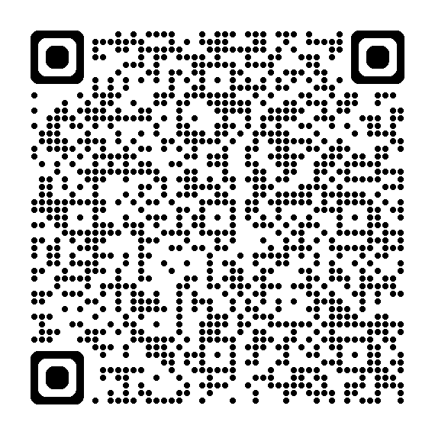
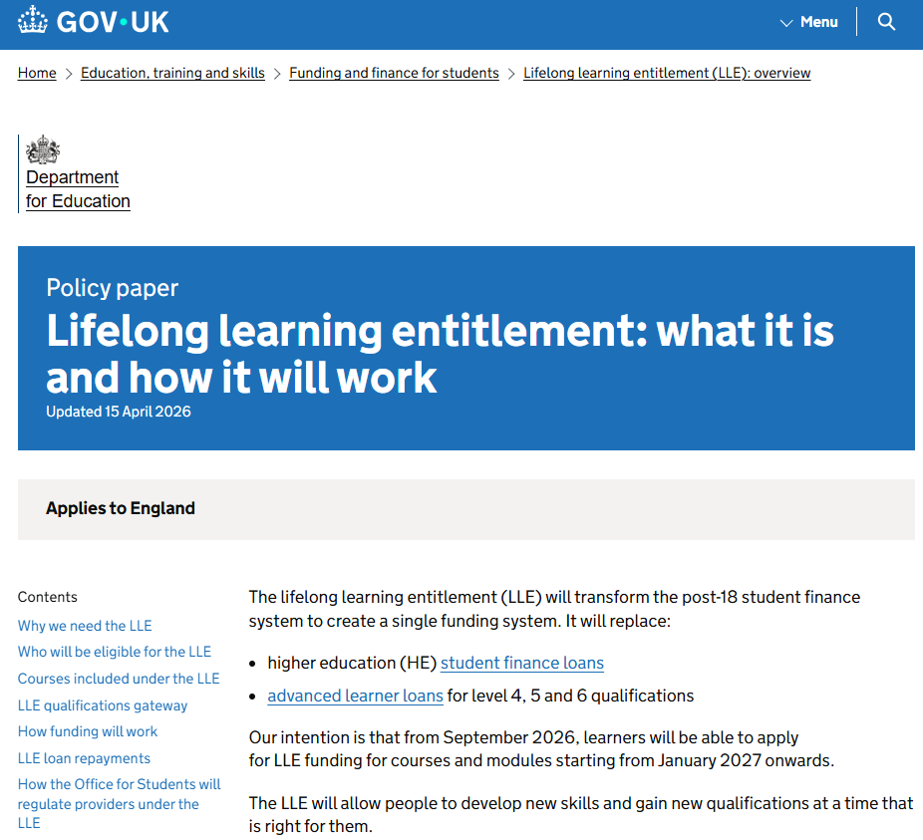
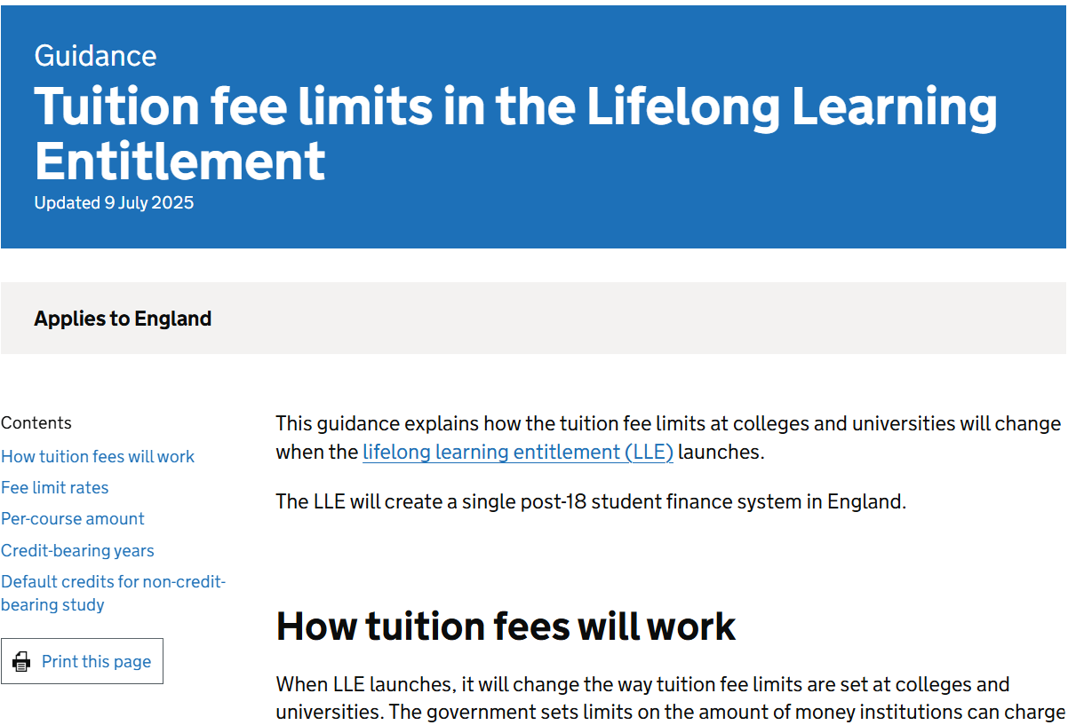
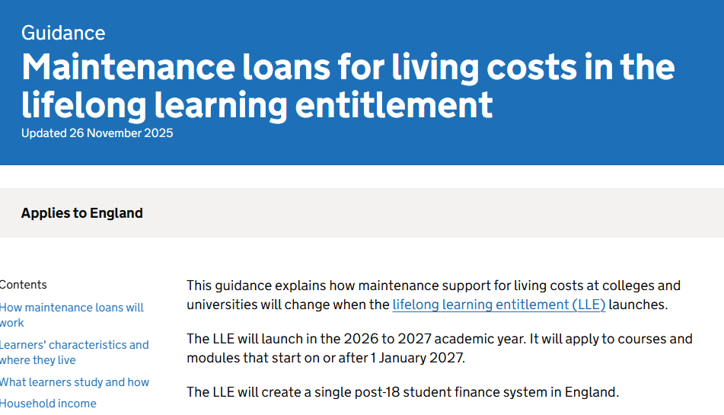
LLE Policy Information – DfE Guidance Summary
DfE have published an overview page and supporting guidance material covering essential LLE policy,
funding entitlement and implementation information:
www.gov.uk/government/publications/lifelong-learning-entitlement-lle-overview/lifelong-learning-entitlement-overview
www.gov.uk/government/publications/lifelong-learning-entitlement-tuition-fee-limits
www.gov.uk/government/publications/lifelong-learning-entitlement-maintenance-loans-for-living-costs
Notes:
DfE have published an overview page and supporting online material covering essential LLE policy, loan entitlement and implementation information:
This includes individual guidance pages covering tuition fee limits, and maintenance support under the LLE.
The tuition fee limits page covers areas such as:
Fee limit rates for courses, modules and special periods
Credits per-course amount, including a list of course types and the associated credits
Credit-bearing years and default credits for non-credit-bearing study
The Maintenance Support page explains how living cost support for students at colleges and universities will change when the lifelong learning entitlement (LLE) launches, with
content covering:
How Maintenance Loans will work under the LLE
Student eligibility, based on circumstances and course choice
Household income assessment and calculation
www.gov.uk/government/publications/lifelong-learning-entitlement-lle-overview/lifelong-learning-entitlement-overview
www.gov.uk/government/publications/lifelong-learning-entitlement-tuition-fee-limits
www.gov.uk/government/publications/lifelong-learning-entitlement-maintenance-loans-for-living-costs

Slide 50
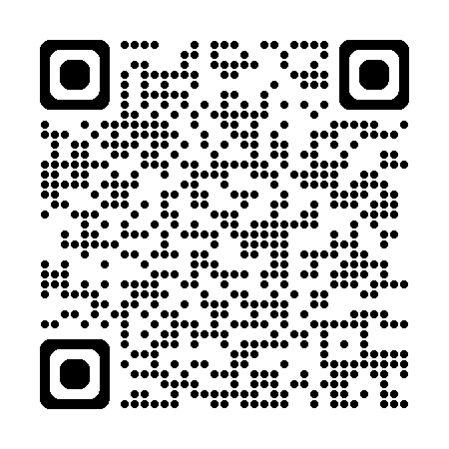

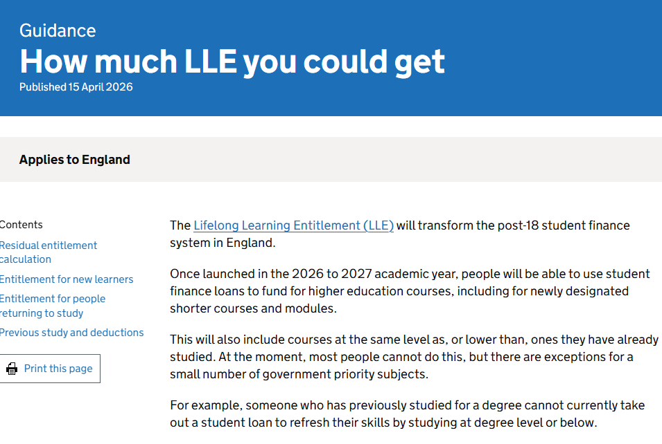

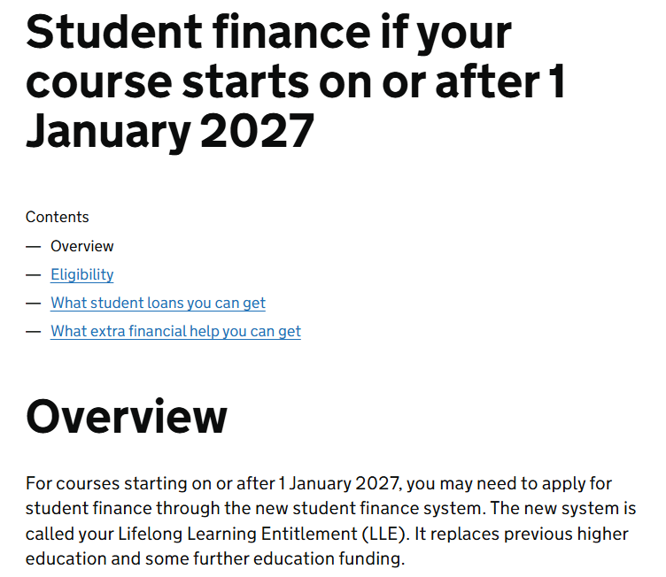
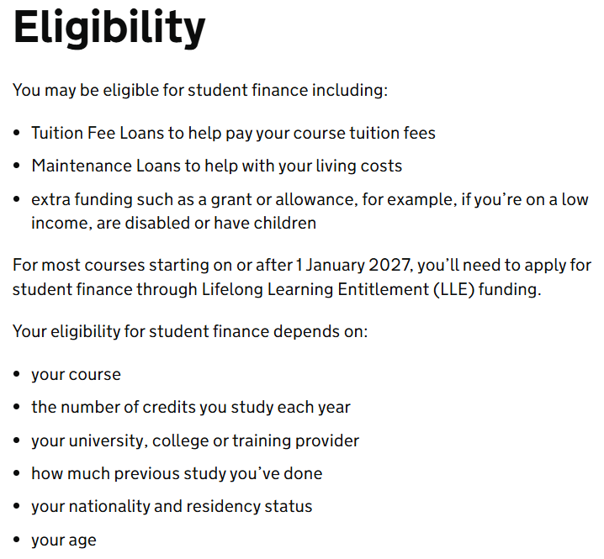
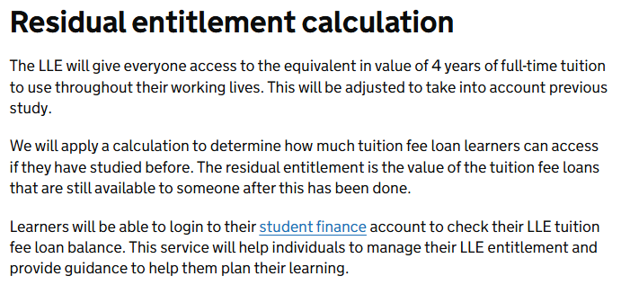
LLE Student Information – SFE Campaign Page and GOV.UK
Dedicated student guidance covering essential elements of the LLE including eligibility, funding entitlement
and study options has been published on GOV.UK, the SFE campaign page and the DfE Education Hub:
https://studentfinance.campaign.gov.uk/lifelong-learning-entitlement
www.gov.uk/student-finance-on-or-after-1-january-2027
www.gov.uk/government/publications/how-much-lifelong-learning-entitlement-lle-you-could-get
https://educationhub.blog.gov.uk/2026/05/what-the-lifelong-learning-entitlement-means-for-you
Notes:
In readiness for introduction of the LLE, dedicated student guidance has been published on GOV.UK, the SFE campaign page and in a supporting article posted on the DfE Education
Hub:
Content delivers essential LLE funding messages and illustrative examples covering eligibility, loan entitlement, maintenance support, course and modular study options, extra financial help and repayment:
https://studentfinance.campaign.gov.uk/lifelong-learning-entitlement
www.gov.uk/student-finance-on-or-after-1-january-2027
www.gov.uk/government/publications/how-much-lifelong-learning-entitlement-lle-you-could-get
https://educationhub.blog.gov.uk/2026/05/what-the-lifelong-learning-entitlement-means-for-you

Slide 51
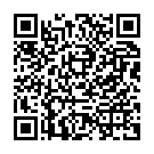



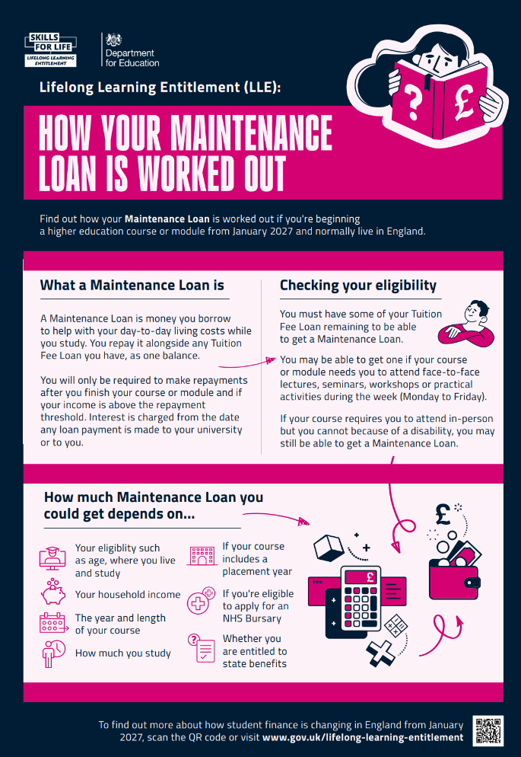
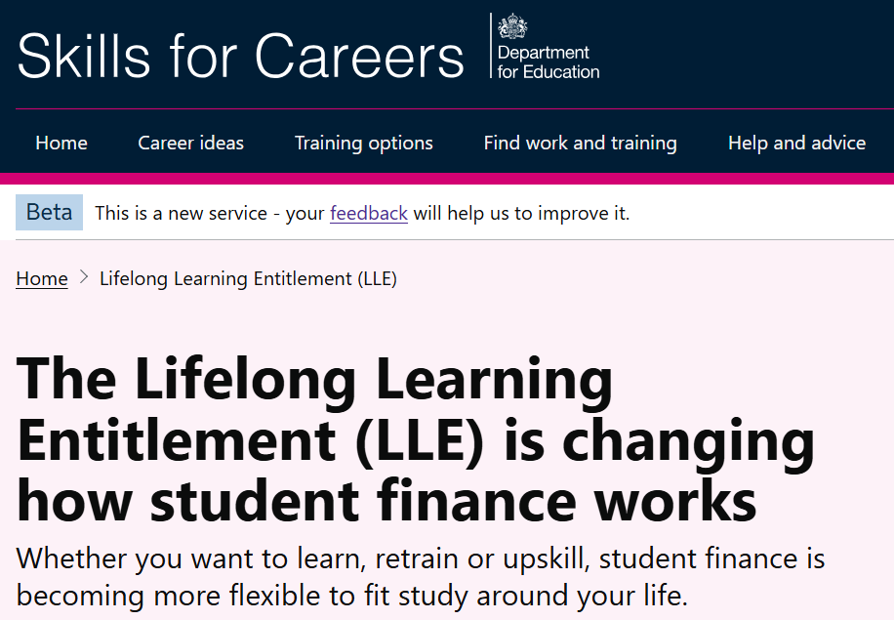
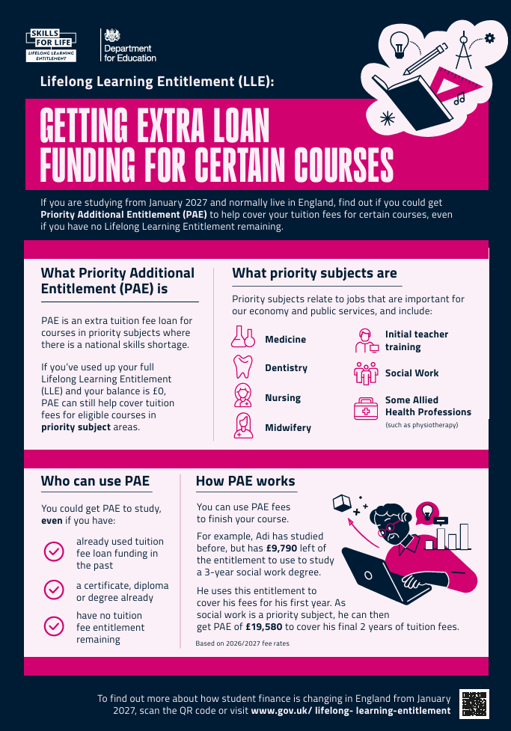
LLE Student Information – DfE Campaign and Resources
From summer 2026, the LLE will be integrated into the ‘Skills for Life’ campaign as national messaging
and activity begins to appear across multiple online and offline channels:
To support this activity, DFE will introduce promotional content and supporting resources, including a Communication Asset Pack to help providers, advisors and influencers engage with students
www.skillsforcareers.education.gov.uk/pages/skills-for-life
www.skillsforcareers.education.gov.uk/pages/lifelong-learning-entitlement
Illustrative examples – subject to final design
Notes:
National LLE communication and campaign activity will commence from Summer 2026
From this summer, the LLE be integrated into the existing ‘Skills for Life’ campaign as national messaging and activity begins to appear across multiple online and offline channels
www.skillsforcareers.education.gov.uk/pages/skills-for-life
www.skillsforcareers.education.gov.uk/pages/lifelong-learning-entitlement
To help providers, advisors and influencers to engage students, DfE’s LLE Promotion and Supporting resources will include:
LLE communications asset pack: practical, ready‑to‑use assets to support conversations and engagement with learners
New LLE guidance chapters: to bring LLE regulations to life and support understanding and the application of LLE policy
LLE persona toolkit: to help providers and advisors navigate and understand the impact of the changes across different user groups
Joining up the learner journey: Ongoing review of student finance IAG with refreshed content across online and offline channels, + greater join up with DWP career guidance
New LLE ready student finance calculator: To help learners get an early understanding of what they might be entitled to through the LLE.
The DfE communication asset pack which will contain a range of practical, ready‑to‑use assets to support conversations and engagement with prospective students.
Plain English factsheets: key policy explained clearly, shaped with communications experts
A4 infographics: simple, visual explanations that bring policy to life
Short animations: quick, engaging videos on core topics
Outreach posters: ready for display to support engagement
Messaging framework: with clear, consistent narratives to support conversations
Social content: ready‑made posts to amplify reach
From this summer, the LLE will be integrated into the Government’s Skills for Life Campaign.
The Skills for Life campaign ‘It all starts with skills’ invites young people, adults and businesses to make the most of their potential by engaging in a range of government skills and
technical education offers.
As part of this activity, DfE will be launching a brand new LLE campaign page on the existing Skills for Careers website.
This landing page will act as the front door to LLE information,
advice and guidance helping learners (and other stakeholders) navigate the range of existing guidance.

Slide 52
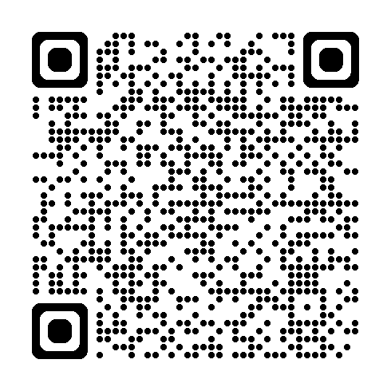
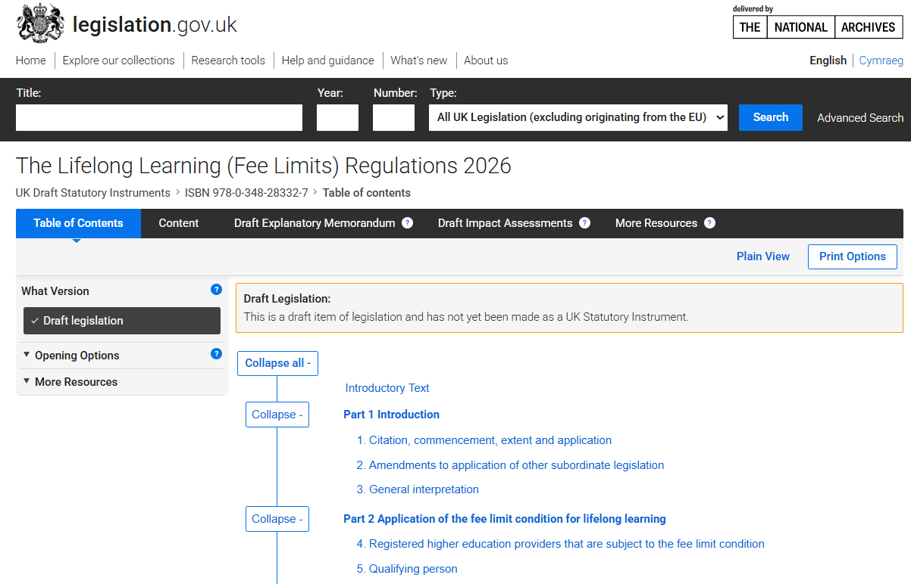
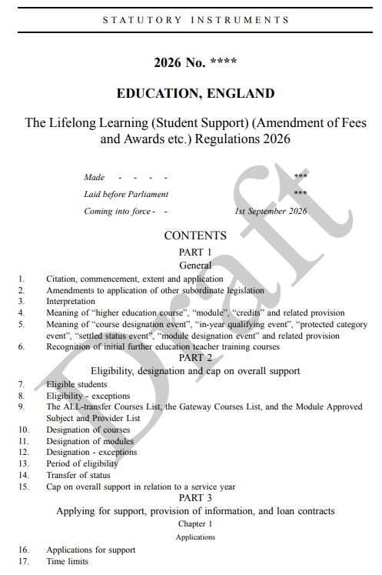
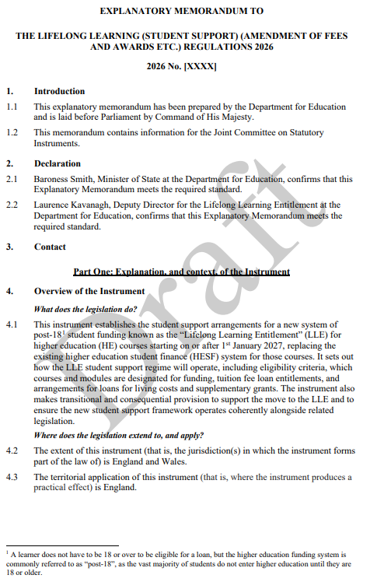
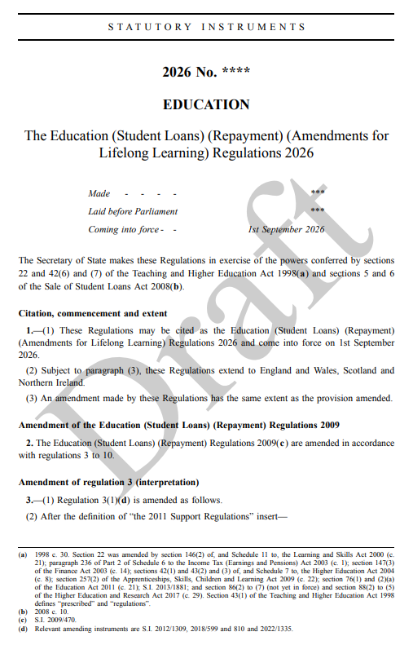
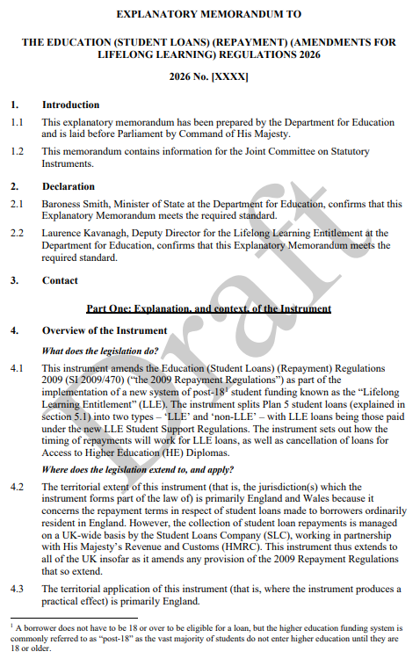
LLE Policy Information – Legislation and Regulations
The Lifelong Learning (Fee Limits) Regulations 2026 have been laid in draft and can be tracked through
Parliament:
Drafts of the 2 additional statutory instruments (Student Support and Repayment) have also been made available to provide a full picture of how the entire LLE policy is intended to operate
www.legislation.gov.uk/ukdsi/2026/9780348283327/contents
www.gov.uk/government/publications/lifelong-learning-entitlement-lle-secondary-legislation
Notes:
DfE have started to lay secondary legislation in Parliament to implement the LLE fee limits and funding system.
This is made up of 3 key statutory instruments (SIs):
The Lifelong Learning (Fee Limits) Regulations 2026 - these have been laid in draft and can be tracked through Parliament
https://www.legislation.gov.uk/ukdsi/2026/9780348283327/contents
The Lifelong Learning (Student Support) (Amendment of Fees and Awards etc.) Regulations 2026
The Education (Student Loans) (Repayment) (Amendments for Lifelong Learning) Regulations 2026
The latter 2 instruments will be laid if and when Parliament approves the Lifelong Learning (Fee Limits) Regulations.
DfE have provided drafts of these 2 SIs and their explanatory memorandums to provide a full picture of how the entire LLE policy is intended to operate.
https://www.gov.uk/government/publications/lifelong-learning-entitlement-lle-secondary-legislation

Slide 53

Questions or Comments
Notes:
Any questions or comments?
Answers to LLE related policy, process and administration questions received from SLC’s partner network can be found on the FAQ Page on the HEP Services website: www.heinfo.slc.co.uk/lle/lle-faq

Slide 54

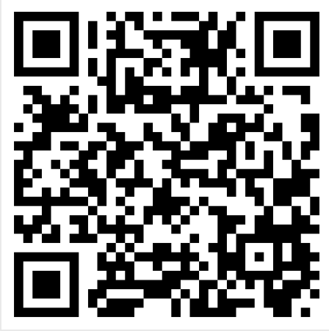
Stacey-May Fox:
Funding Information Services Account Manager
South-West England and South Wales
Stacey-May_Fox@slc.co.uk
For detailed LLE policy related questions:
lle_enquiries@slc.co.uk
Your Opinion Matters!
To provide feedback on this session, please scan the QR Code
and complete our short survey
Notes:
Survey link:
https://www.surveymonkey.com/r/LWCLTHH

