Slide 1


Slide 2
Context
This pack provides resources to help you, as a manager in Professional Services, work with your teams to agree and implement Future Ways of Working for the academic year 2021/22.
Pick and choose the tools and techniques that are most useful for you and your team.
If you would like further support in using these tools, please contact: staffdev@bath.ac.uk

Slide 3
Guiding principles
We want to enable a thriving and caring University campus community, in which every staff member is able to work as successfully as possible in a safe and secure way.
We seek to develop ways of working to deliver our strategy as successfully as possible for the benefit of all students and staff.
We want to support sustainable and productive staff working practices that make maximum use of our learning from the pandemic.
Future ways of working will look different for different teams and departments, so we will adopt a flexible framework, from which we will learn and iterate.

Slide 4
Assessing a role for hybrid working
Can any of the employees role be undertaken away from the office/campus?
Do any other stakeholders need to be consulted?
Does anything need to be put in place to ensure the employee can be effective?
High: A high in-person campus presence means working on campus/in University buildings for 80% or more of your working hours.
Medium: A medium in-person presence means working on campus/in University buildings 60% or more your working hours.
Low: A low in-person presence means working on campus/in University buildings 40% or more of your working hours.

Slide 5
1 to 1 conversation questions
Have you reviewed the organisation's different categories of hybrid work? Can you confirm which category you believe applies to your role
What is your preferred pattern of work for 2021/22?
What do you believe needs to be in place in order for this pattern to ensure you can be effective for your role / team?
From a wellbeing perspective, do you feel you would need additional support if you were to continue to work from home / remotely longer term?
Do you feel you have the equipment and communication methods to make this possible?
If hybrid working is to be agreed, do you feel that you would need any training or development in order to be effective and successful?
Do you have any questions about working remotely / undertaking hybrid work?

Slide 6
Emotion based check-ins
Emotion based check-ins are a great way to open a team session and can help to build engagement, trust and openness.
We suggest asking each member to share:
‘Hello, I’m [...]’
‘Right now I notice I am feeling […]’
The thing that has the potential to distract me today is […]

Slide 7
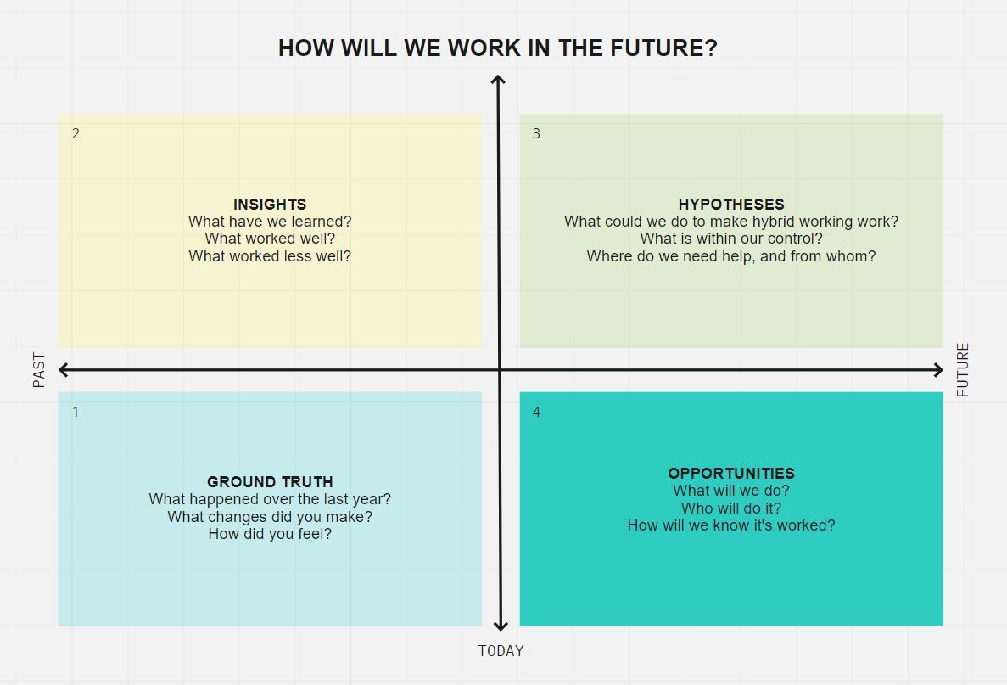
Emergent Learning Map
You can use this tool as a way to structure your team conversation. Work your way around the quadrant from 1-4
You may find it helpful to use a collaboration tool such as miro

Slide 8
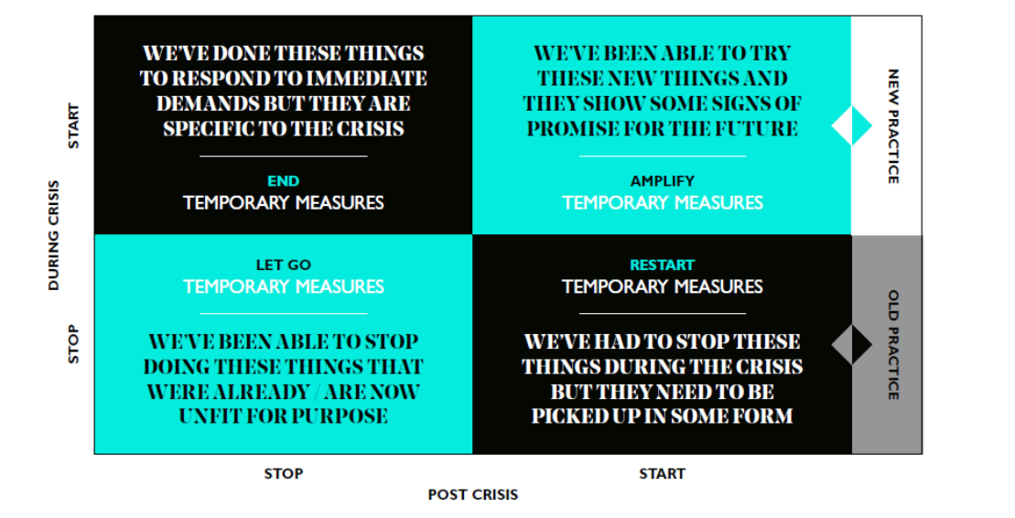
RSA framework
Use the RSA Future Change Framework to structure a conversation about what activities you can stop, restart or amplify. This will enable your team to focus on its priorities, and design ways of working that deliver the key aspects of your service.
The framework pictured here is usually enough to get a good conversation going, but a more in-depth version of the toolkit can be downloaded from here.

Slide 9
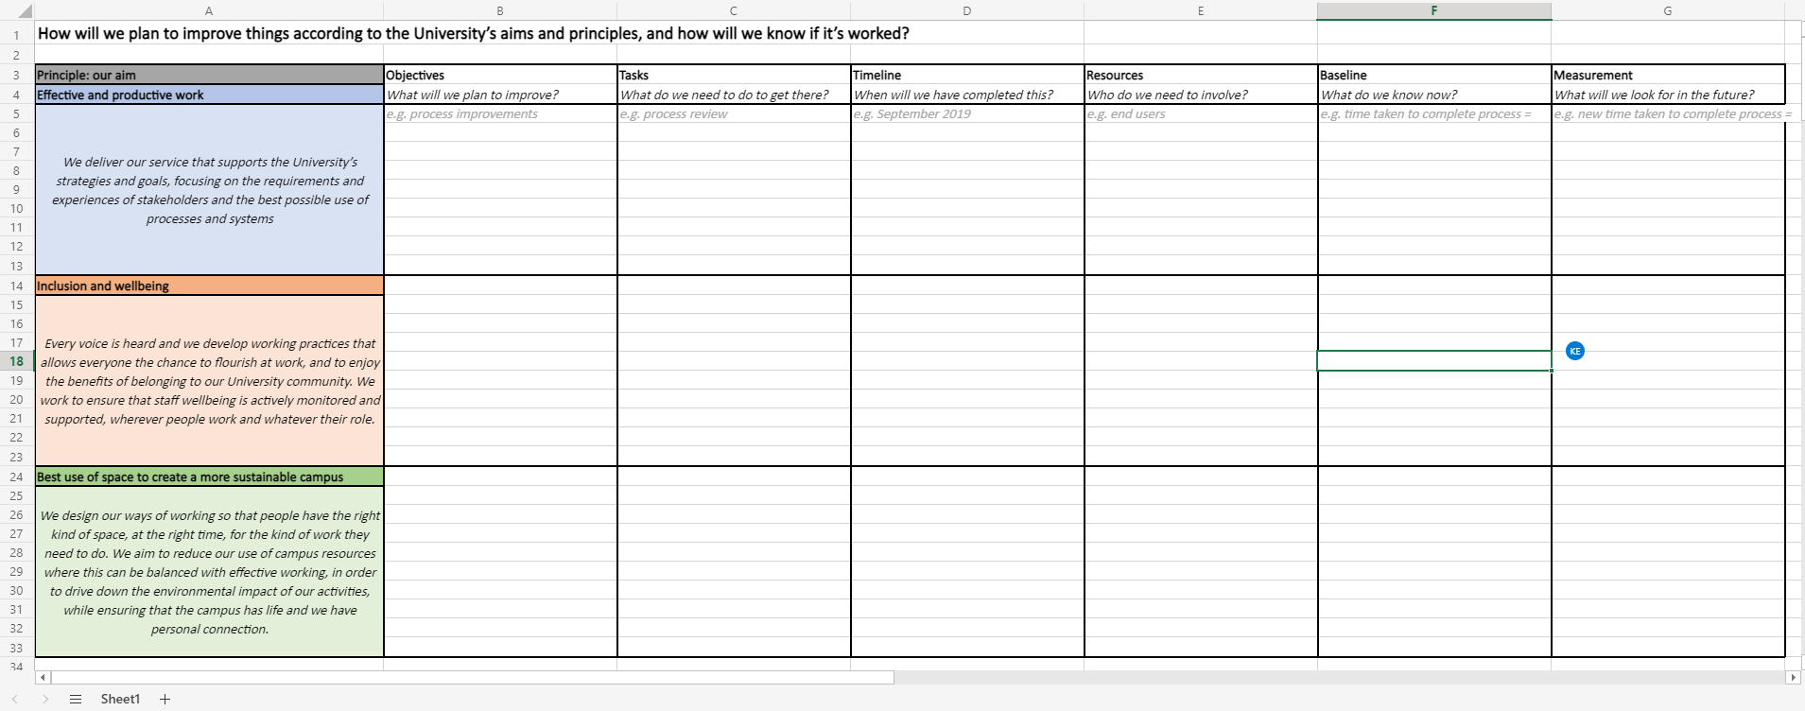
Planning tool
When you come to the stage of making plans and assigning actions, this planning tool can help.

Slide 10
Team charter
Mission | Who are we?
Define the team’s mission and purpose | Define team members, key strengths, interests etc
Core Values | Who will do what?
Define what’s important and what you care about | Define roles and responsibilities
Milestones | What are our expectations?
Define key activities and timelines | Define communications, ground rules, behaviours etc
You may find it helpful to collaborate as a team to create a team charter, which will help set expectations and provide clarity and direction

Slide 11
Tips
Trust and is a key fundamental in all relationships, but needs particular attention in hybrid teams:
Try to be open to wherever the conversation leads – you might nor be able to agree to every request but you can provide the space to listen
Try to surface any underlying concerns or issues and bear in mind that they may be presenting as resistance
Bear in mind that all individuals are different and will have different needs, experiences and preferences
There is no right answer - be prepared to try things, learn from experience and continue to adapt

