Slide 1
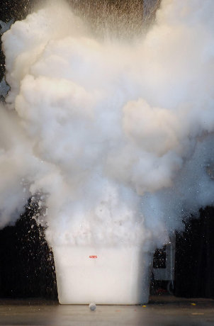
Safety Fact Sheet – Liquid Nitrogen
Liquid Nitrogen is a cryogen used where very low temperatures or rapid temperature reduction is required. It is colourless, odourless and non-toxic with a boiling point of -196°C.
Potential Harm
Severe Cold Burns
Frostbite
Eye Damage – retinal displacement
Pressure Build-up
Protect Yourself
Always wear dry thermally insulated gloves – NEVER handle with bare hands
Wear appropriate Eye Protection
Use tongs to retrieve objects
Dispense slowly – minimise boiling/ splashes
Use and store in well ventilated areas
Check equipment for frost damage
Only use containers designed for cryogenic use
Only use loose fitting lids – NEVER seal
KNOW what to do in an Emergency
Oxygen Displacement
Asphyxiation
Leak

