Slide 1




Research Project
Session 1
Notes:
Hello everyone my name is xxxxxx and I have come from the University of Bath today
Introduce ambassadors/colleagues
Over the next 6 weeks we will be helping you to carry out your own scientific research project (in groups) that you will present at a science fair.
At this festival you will explain your research to younger students in year 5 & 6 (aged 9 -11).
Who’s been to a science fair?

Slide 2
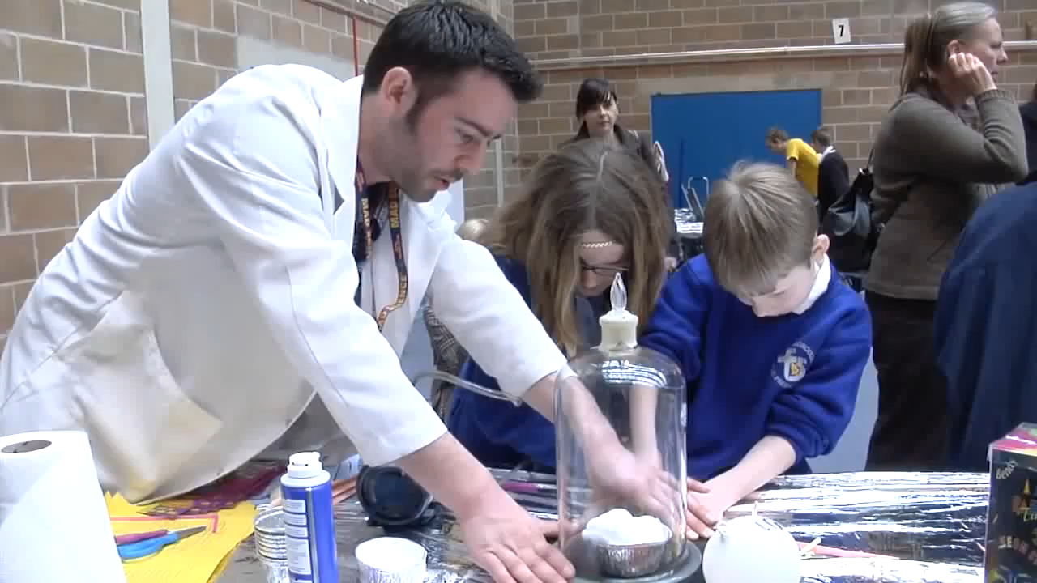

Notes:
This video provides a taster of what the Schools Fair is like
[VIDEO]
As you can see there are lots of people there presenting their research, not only school students like you but also researchers at the University of Bath and local companies. So it is also a great opportunity for you to show your work

Slide 3
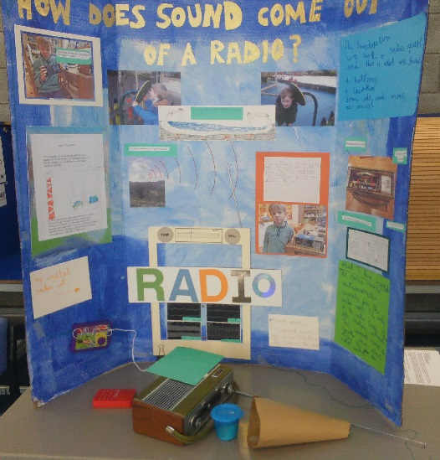
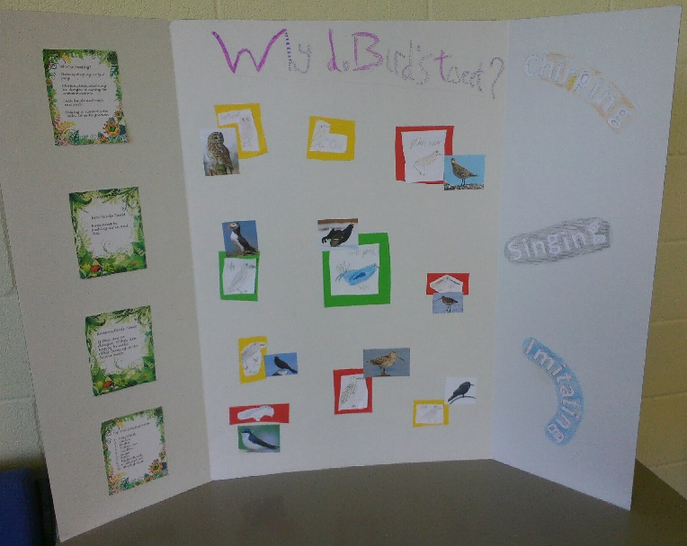
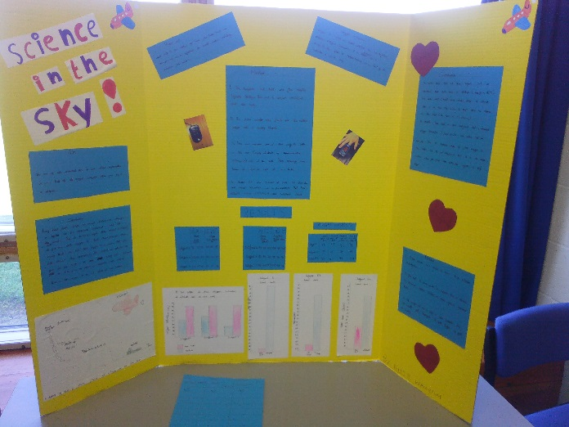
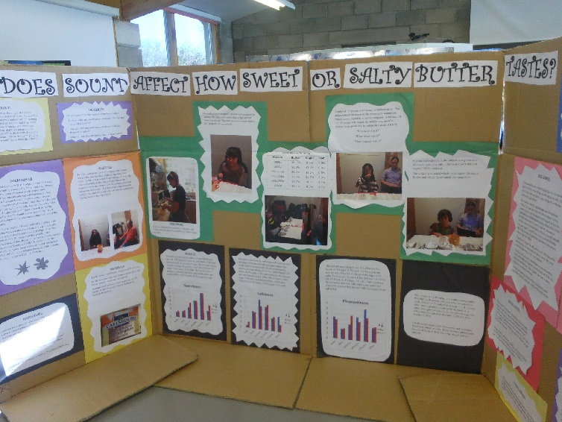
Notes:
To help you explain your research, when you have finished your project you will design a science stand demonstrating your project that you can use to help explain each stage of the project.
If possible you will also have the equipment required to run your experiment at your stand so the younger students can do the experiment.
Over the next few weeks we will be working on projects and at the end producing posterboards similar to these to present at the Schools Fair.
Examples of experiment to be included on stand
School use to put in classroom etc/ photos

Slide 4

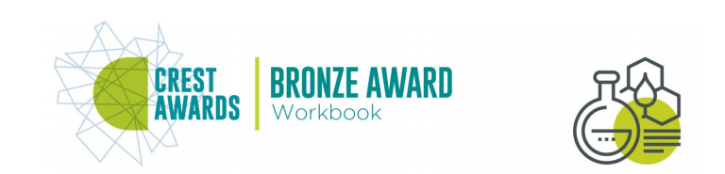
Notes:
At the end of the project you will also have to opportunity to submit your project for a prize.
CHECK You will only be awarded the prize if you complete the worksheets in the booklet that contain the trophies (?)
CREST bronze award 11-14 year olds, around 10 hours of work on one project
Recognition of the skills you will have learnt over the next 6 weeks (enquiry, problem solving and communication skills)
Costs £5 per student to enter
Students: work on a project for minimum of 10 hours, write about findings in profile form or workbook
Assessor: fill out reg form, send to local coordinator for assessment, support students, assess work
http://www.crestawards.org/run-crest-awards/crest-bronze/

Slide 5

?
Notes:
To help scientists answer questions, they use a process called the scientific method.
Scientists have been using this for centuries to help organise ideas and design appropriate experiments to answer scientific questions.
In this project you will go through each stage of the scientific method to answer your question.
But first you have to put the steps in order!
Activity 1: Groups of 5 – hand out cog activity; give 30 seconds to put the cogs in correct order
Explain correct order and explain this is what we’ll be doing over the next few weeks
Show correct order on powerpoint and hand out worksheet so they can fill out the correct order

Slide 6


Slide 7


Slide 8
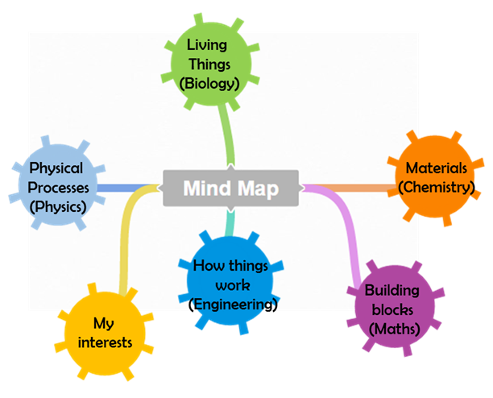

Slide 9


Slide 10

Ask a question
Now you have chosen a topic, you need to ask a scientific question based on your topic
It should be an interesting question that you want to work on for the next few weeks.
It helps if it is focused so that you can answer it with a simple experiment.
Science questions start with how, what, where, when, why, which or does.
My research question is…
Notes:
Run through bullet points and then hand out research question worksheet
Complete trophy questions at home if you want to apply for the award

Slide 11


Notes:
After asking a question, what is the next step?
The step is to research your question. This you can do at home or school. Ask your parents, teachers, friends, family, research on the internet.
Why is it important?
To help you design your experiment. The better you understand your question, the easier it will be to come up with a good way of testing it
WORKSHEET

Slide 12


Slide 13
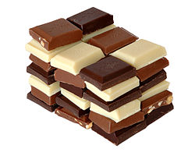
Create a hypothesis
A hypothesis is a prediction of what might happen if you try to test your problem.
Ask yourself the question – ‘what do you think will happen in my experiment?’
Example
‘How does the type of chocolate affect melting time?’
Dark chocolate melts faster than white chocolate
My hypothesis is…
Notes:
Who knows what a hypothesis is? (Fact: Hypothesis is derived from the Greek word ‘hupothesis’ meaning ‘foundation’ )
Run through bullet points
and example
So I really like chocolate, especially melting it to put in cakes
so my question my be ‘ How does the type of chocolate affect melting time?’
and then hand out research question worksheet
Complete trophy questions at home if you want to apply for the award

Slide 14
Notes:
Plenary:
Cog activity again if time
What have we covered today?

Slide 15
Research Project
Session 2

Slide 16

Make a paper airplane using the paper on your table

Slide 17


Variables
Independent variable | The variable you want to change
Dependent variable | The variable you are measuring
Fair test | Change one variable at a time whilst keeping all others the same
Control variables | Variables that remain constant throughout the experiment
Your parents/guardians/this hen are free and independent, they can do whatever they want
BUT you are dependent on what your parents decide such as where you live and where you go !

Slide 18
Who can throw their plane the furthest?
Independent variable (The variable you want to change) | The person
Dependent variable (the variable you are measuring) | Distance the plane flies
Control variables (Variables that remain constant throughout the experiment) | Size and shape of plane, material (e.g. paper), weight
This is a fair test because one variable is changed (the person) whilst keeping all other variables the same

Slide 19
How do you make a paper
airplane?

Slide 20
How to make a paper airplane
CORRECT ORDER:
1. Get a piece of paper
2. Fold the two long sides of a piece of paper together
3. Fold the top corners into the centre
4. Fold the angled edges into the centre
5. Bring the angled edges together along the centre line
6. Fold down the two top flaps to make the wings
7. Test fly your airplane and measure how far it has flown
Notes:
4, 6, 1, 7, 5, 2, 3

Slide 21
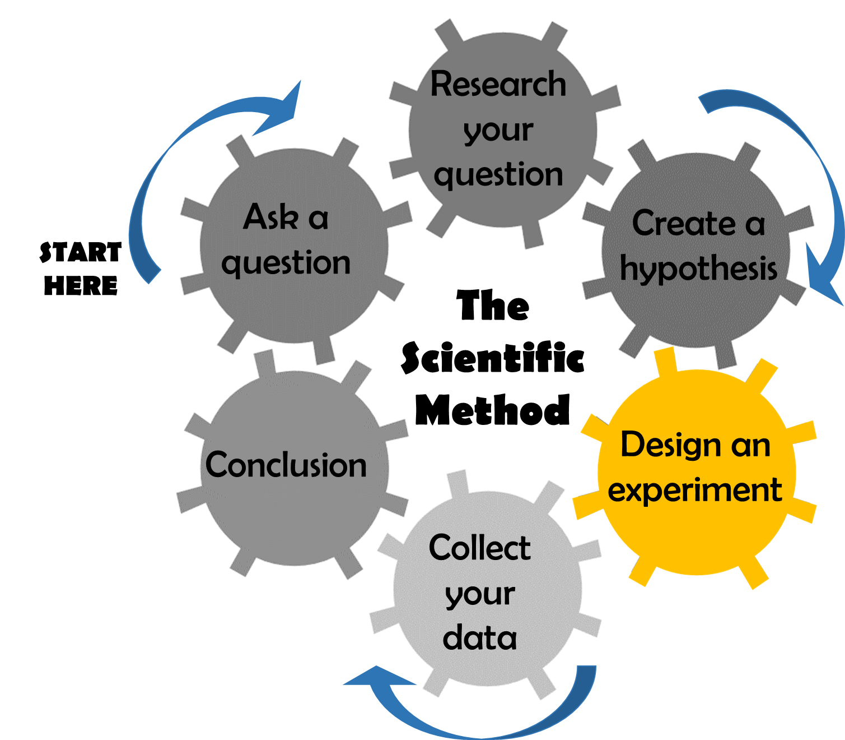

Slide 22
Notes:
Plenary:
Cog activity again if time
What have we covered today?

Slide 23
Research Project
Session 3

Slide 24
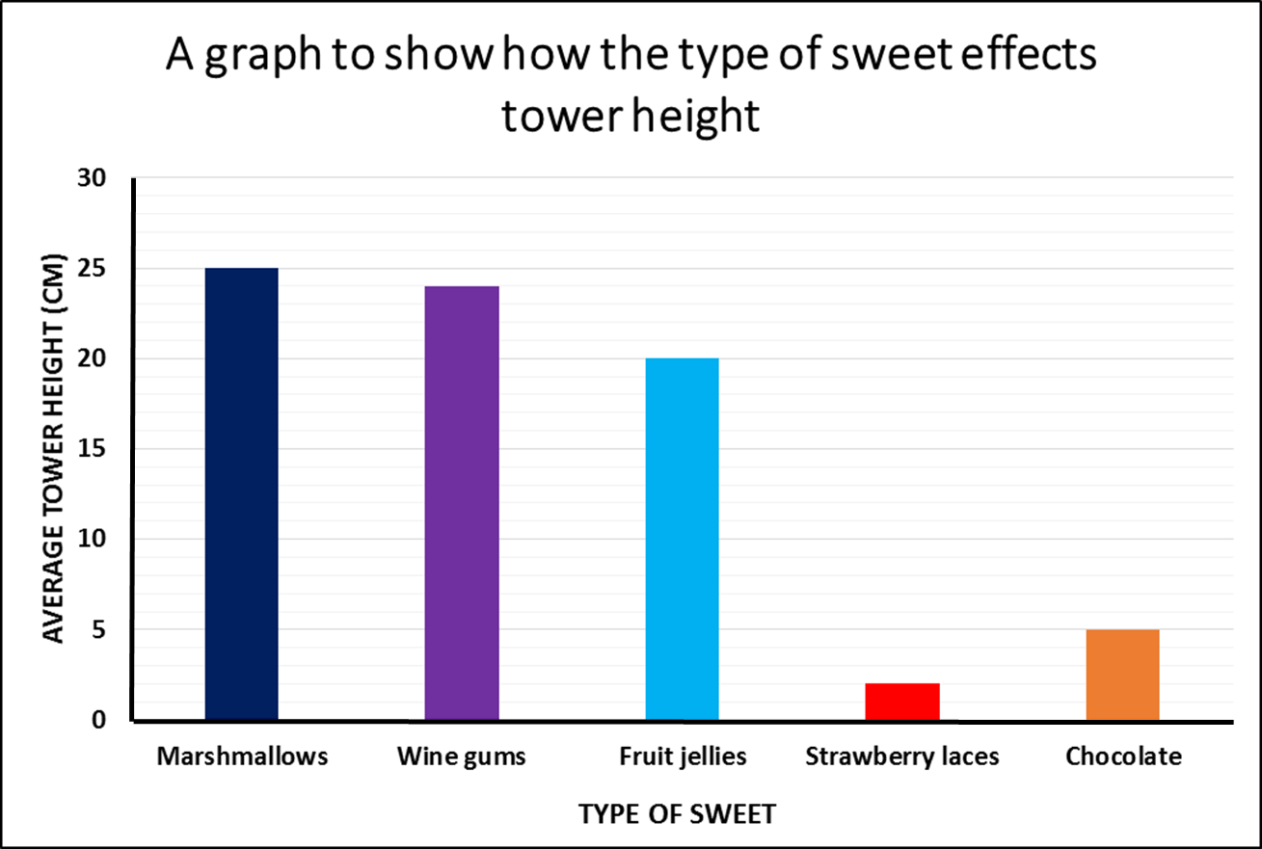
Y axis
dependent variable
X axis
independent variable
Notes:
Name of this graph? Bar graph
Who can describe the bar chart? What does the bar chart show? It shows that different types of sweets effects the height of the tower.
Point to x axis. What is the name of this axis? X axis
Point to y axis. What is the name of this axis? Y axis.
Which axis is your independent variable on? The x axis, your independent variable is always on your x axis. The one you change is always on the x axis.
Which axis is your dependent variable on? The y axis, your dependent variable is always on your x axis. The one you measure is always on the y axis.

Slide 25
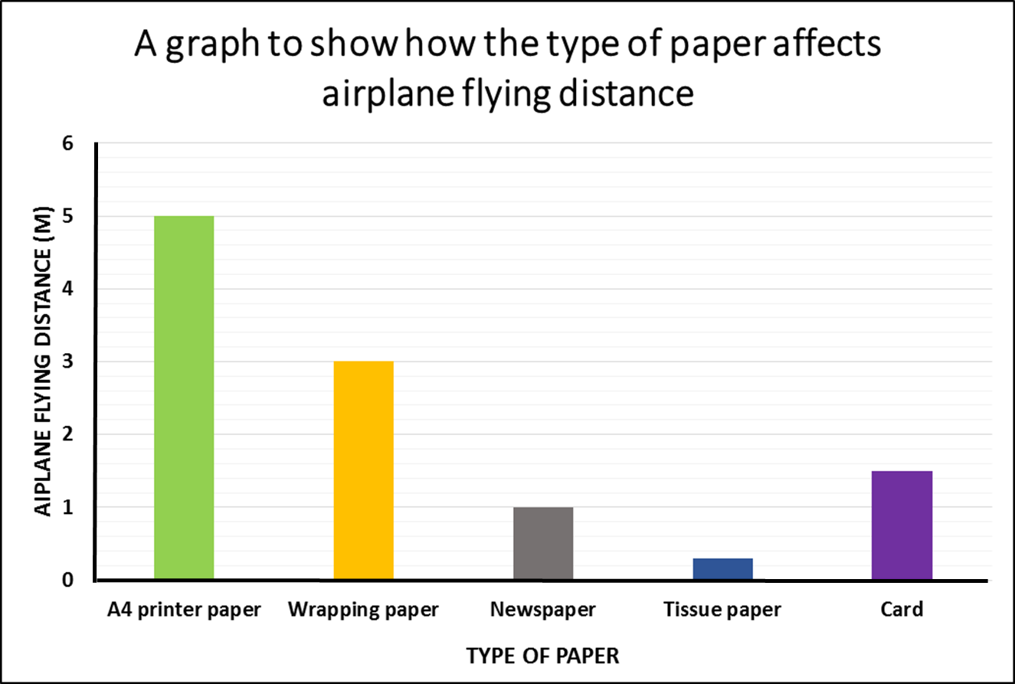
Y axis
dependent variable
?
?
X axis
A bar graph is useful when comparing different experimental groups. It is useful if your independent variable is not numerical.
independent variable
Notes:
Now over to you
Name of this graph? Bar graph
Who can describe the bar chart? What does the bar chart show? It shows that different types of paper effects the distance the airplane flies.
Point to x axis. What is the name of this axis? X axis
Point to y axis. What is the name of this axis? Y axis.
Which axis is your independent variable on? The x axis, your independent variable is always on your x axis. The one you change is always on the x axis.
Which axis is your dependent variable on? The y axis, your dependent variable is always on your x axis. The one you measure is always on the y axis

Slide 26
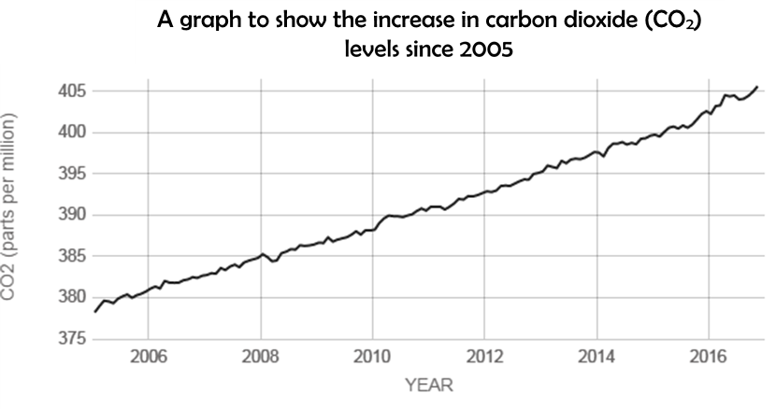
Y axis
dependent variable
X axis
A line graph can be used to show the relationship between your independent and dependent variable. Both variables have to be numerical for this graph.
independent variable
Notes:
Now it gets a bit more tricky…
Name of this graph? Line graph
Who can describe the bar chart? What does the bar chart show? It shows that since 2005 carbon dioxide levels are slowly rising (from 2005 to 2017 CO2 has increased by 25 ppm).
Point to x axis. What is the name of this axis? X axis
Point to y axis. What is the name of this axis? Y axis.
Which axis is your independent variable on? The x axis, your independent variable is always on your x axis. The one you change is always on the x axis.
Which axis is your dependent variable on? The y axis, your dependent variable is always on your x axis. The one you measure is always on the y axis
When would we use a line graph ? A line graph can be used to show the relationship between your independent and dependent variable. Both variables have to be numerical for this graph.

Slide 27
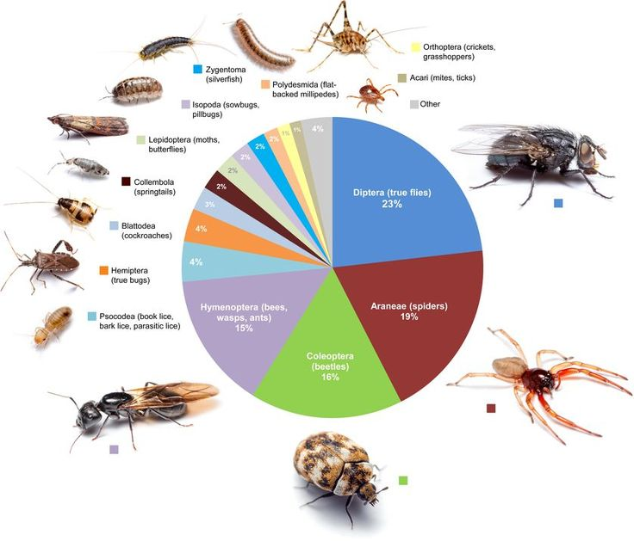

Slide 28
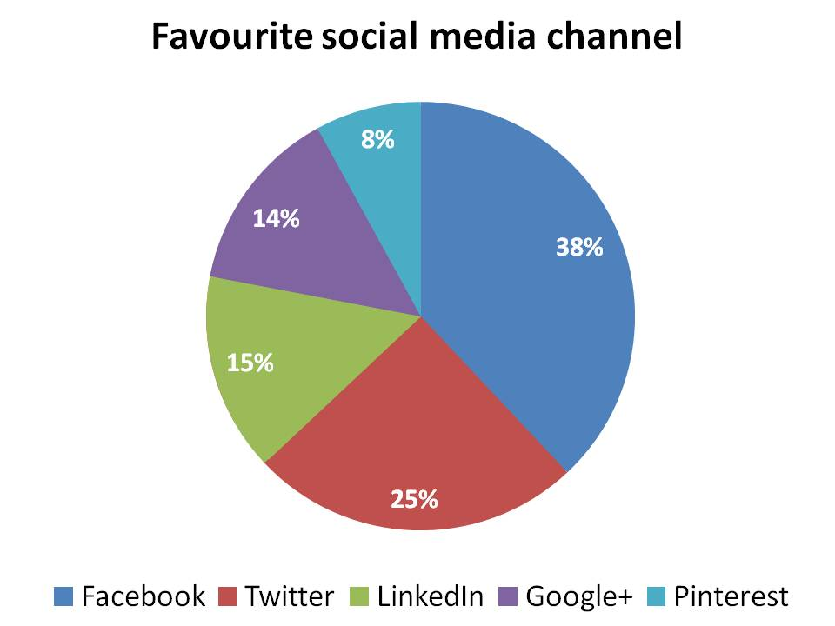
A pie chart is a good way to display percentages of groups or proportions of a whole group. All of the pieces of the pie need to add up to 100 %.
Notes:
A pie chart is a good way to display percentages of groups or proportions of a whole group. All of the pieces of the pie need to add up to 100 %.

Slide 29


Slide 30
Notes:
Plenary:
Cog activity again if time
What have we covered today?

Slide 31
Research Project
Session 4

Slide 32
Notes:
To help you explain your research, when you have finished your project you will design a science stand demonstrating your project that you can use to help explain each stage of the project.
If possible you will also have the equipment required to run your experiment at your stand so the younger students can do the experiment.
Over the next few weeks we will be working on projects and at the end producing posterboards similar to these to present at the Schools Fair.
Examples of experiment to be included on stand
School use to put in classroom etc/ photos

Slide 33
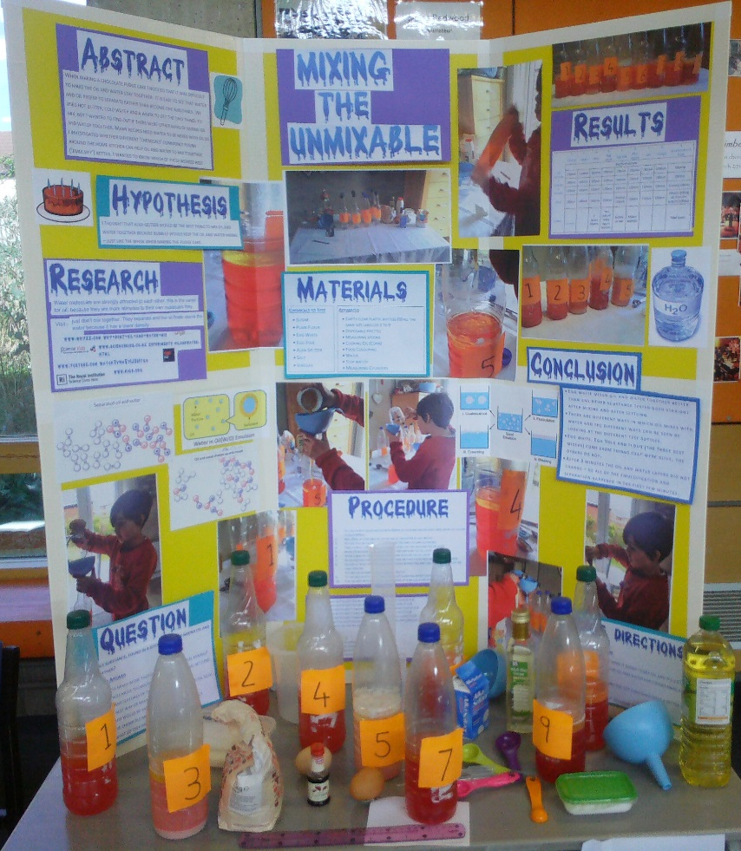
Catchy title
Photos of the results or you carrying out the experiments
Materials
Results: including graphs
Trifold cardboard display board
Conclusion and future directions/ further experiments
Abstract: Summary of your research
Experimental methods/ procedure
Background research
Examples of materials used in the experiments that you can use to help you explain your research
Clearly labelled sections with large text
Hypothesis

Slide 34
Poster boards
6 sheets of A4 paper to stick up on a board
Each person in the group takes 1 (or 2) sections:
title,
question and hypothesis,
method,
results (table and graph),
conclusion,
evaluation

Slide 36
Notes:
Plenary:
Cog activity again if time
What have we covered today?

Slide 37
Research Project
Session 5

Slide 38
Notes:
To help you explain your research, when you have finished your project you will design a science stand demonstrating your project that you can use to help explain each stage of the project.
If possible you will also have the equipment required to run your experiment at your stand so the younger students can do the experiment.
Over the next few weeks we will be working on projects and at the end producing posterboards similar to these to present at the Schools Fair.
Examples of experiment to be included on stand
School use to put in classroom etc/ photos

Slide 39
Catchy title
Photos of the results or you carrying out the experiments
Materials
Results: including graphs
Trifold cardboard display board
Conclusion and future directions/ further experiments
Abstract: Summary of your research
Experimental methods/ procedure
Background research
Examples of materials used in the experiments that you can use to help you explain your research
Clearly labelled sections with large text
Hypothesis

Slide 40
Poster boards
6 sheets of A4 paper to stick up on a board
Each person in the group takes 1 (or 2) sections:
title,
question and hypothesis,
method,
results (table and graph),
conclusion,
evaluation

Slide 41
Research Project
BACK UP ACTIVITIES

Slide 42

Go back and complete trophy questions

Slide 43
Work on poster board

Slide 44
How does exercise affect heart rate?
 | Heart rate measurement (beats per minute)
Name of student | Standing still | After laying down for 1 minute | After star jumps for 1 minute
AVERAGE
Notes:
INSTRUCTIONS
Find your pulse: put your first two fingers over just below your jaw; pressing GENTLY and feeling for the spot where you can feel your pulse. Or place your first 2 fingers on the thumb side of your wrist and press gently until you feel a pulse
Sit still and count number of beats in a minute (minute timed by lead); write value of post-it and ambassador collect and fills out table on powerpoint
Lay down for 1 minute, then sit still and measure heart rate for 1 minute; write value of post-it and ambassador collect and fills out table on powerpoint
Star jumps for one minute; then sit still and measure heart rate for 1 minute; write value of post-it and ambassador collect and fills out table on powerpoint
Calculate average: HR faster after jumping (hopefully!) The faster your body moves the more oxygen it requires for function so your heart has to work faster for the body to get all the oxygen it needs so it pumps faster.
QUESTIONS FOR CLASS
Identify the independent variable (variable you change) – activity eg standing still, lying down, jumping
Identify the dependent variable (variable you measured) – heart rate
Was it a fair test? Was everything else controlled?
Controlled: length of time students were laying down/star jumping for
Could have been improved by: measuring difference in heart rate

Slide 45
How does exercise affect heart rate?
Exercise | Heart rate measurement (beats per minute) |  |  |  |  |  |  |  |  |  |  |  |  |  |  | Average
 | 1 | 2 | 3 | 4 | 5 | 6 | 7 | 8 | 9 | 10 | 11 | 12 | 13 | 14 | 15
Standing still for 1 minute
After star jumps for 1 minute
After laying down for 1 minute
Notes:
Work in pairs
Recorder and experimenter
Recorder help your experiment to find pulse
Experimenter stand still for 1 min, recorder write pulse down on postit and stick on bboard
Repeat with next 2 ones
How will we record this data? What is your independent var? and dependant variable? How do you contrast a table?
INSTRUCTIONS
Find your pulse: put your first two fingers over just below your jaw; pressing GENTLY and feeling for the spot where you can feel your pulse. Or place your first 2 fingers on the thumb side of your wrist and press gently until you feel a pulse
Sit still and count number of beats in a minute (minute timed by lead); write value of post-it and ambassador collect and fills out table on powerpoint
Lay down for 1 minute, then sit still and measure heart rate for 1 minute; write value of post-it and ambassador collect and fills out table on powerpoint
Star jumps for one minute; then sit still and measure heart rate for 1 minute; write value of post-it and ambassador collect and fills out table on powerpoint
Calculate average: HR faster after jumping (hopefully!) The faster your body moves the more oxygen it requires for function so your heart has to work faster for the body to get all the oxygen it needs so it pumps faster.
QUESTIONS FOR CLASS
Identify the independent variable (variable you change) – activity eg standing still, lying down, jumping
Identify the dependent variable (variable you measured) – heart rate
Was it a fair test? Was everything else controlled?
Controlled: length of time students were laying down/star jumping for
Could have been improved by: measuring difference in heart rate

Slide 46
How does exercise affect heart rate?
Exercise | Average heart rate measurement (beats per minute)
Standing still for 1 minute
After star jumps for 1 minute
After laying down for 1 minute
Notes:
Work in pairs
Recorder and experimenter
Recorder help your experiment to find pulse
Experimenter stand still for 1 min, recorder write pulse down on postit and stick on bboard
Repeat with next 2 ones
How will we record this data? What is your independent var? and dependant variable? How do you construct a table? Whilst doing this get ambassadors to calculate averages Draw table on board
Then go to slide insert averages
INSTRUCTIONS
Find your pulse: put your first two fingers over just below your jaw; pressing GENTLY and feeling for the spot where you can feel your pulse. Or place your first 2 fingers on the thumb side of your wrist and press gently until you feel a pulse
Sit still and count number of beats in a minute (minute timed by lead); write value of post-it and ambassador collect and fills out table on powerpoint
Lay down for 1 minute, then sit still and measure heart rate for 1 minute; write value of post-it and ambassador collect and fills out table on powerpoint
Star jumps for one minute; then sit still and measure heart rate for 1 minute; write value of post-it and ambassador collect and fills out table on powerpoint
Calculate average: HR faster after jumping (hopefully!) The faster your body moves the more oxygen it requires for function so your heart has to work faster for the body to get all the oxygen it needs so it pumps faster.
QUESTIONS FOR CLASS
Identify the independent variable (variable you change) – activity eg standing still, lying down, jumping
Identify the dependent variable (variable you measured) – heart rate
Was it a fair test? Was everything else controlled?
Controlled: length of time students were laying down/star jumping for
Could have been improved by: measuring difference in heart rate

Slide 47
What is the best sweet to build the tallest tower?
Building equipment | Repeat number | Height of tower (cm) | Average height of tower (cm)
Marshmallows and cocktail sticks | 1
 | 2
 | 3
Wine gums and cocktail sticks | 1
 | 2
 | 3
Fruit jellies and cocktail sticks | 1
 | 2
 | 3
Strawberry laces and cocktail sticks | 1
 | 2
 | 3
Chocolate and cocktail sticks | 1
 | 2
 | 3
Notes:
INSTRUCTIONS
Split into groups of 2
Each group receives different building equipment
Ask each group to build the tallest tower – given 2 minutes
Measure the height at the end and record in the table on the powerpoint slide – shout out answers and ambassador types into powerpoint slide
At the end calculate average – can ask students to do this
Identify the tallest tower and therefore the best sweet

Slide 48
What is the best sweet to build the tallest tower?
Independent
variable
Building equipment | Average height of tower (cm)
Marshmallows and cocktail sticks
Wine gums and cocktail sticks
Fruit jellies and cocktail sticks
Strawberry laces and cocktail sticks
Chocolate and cocktail sticks
Dependent
variable
Was it a fair test?
Notes:
After completing table on previous slide, add the averages to this table.
Although the last table looked very complicated we can reduce it down to these 2 columns.
QUESTIONS FOR CLASS
1. Identify the independent variable (variable you change) – building equipment (sweets)
2. Identify the dependent variable (variable you measured) – height
3. Was it a fair test? Was everything else controlled? Controlled: number of sweets, number of cocktail sticks, time given, number of people in a group
4. Could it have been improved? Yes by: using the same people to make each tower, each group given the same tower to make
5. Each different sweet was repeated 3 times. Why do you think it is important to repeat an experiment?
Repeats - It is important to carry out your experiment more than once to confirm the results are consistent. Each time you repeat the experiment, under the same conditions, you should obtain similar values for your dependent variable. This tells you that the answer to your question was not down to chance. Each time you perform the experiment is called a repeat. The minimum number of repeats you should do is 3. If you have the time and resources to repeat your experiment more than 3 times then even better!

