Slide 1
Staff Homepage: December 2019
Key statistics

Slide 2
Summary and recommendations
The best-performing articles this month (slides 4 & 5) included a combination of appointment stories, Staff Spotlights and timely content such as the Christmas video. This aligns with previous data on the success of people stories and supports a strategy of using key dates as news hooks to get maximum engagement. Strategy pieces also continued to perform well.
There has been a short gap in reporting due to staffing changes, but it is interesting to compare December figures to September, as both months are characterised by a decrease of staff on campus due to term dates and holiday. With this in mind, the average views (slide 3) indicate that we have maintained a good level of engagement compared to September, although with considerably less output due to the Christmas break.
Comparing the distribution graphs for feature (slide 6) and standard (slide 7) items to September, the length of the tale is noticeably shorter, suggesting we’re giving people more of what they want. We will continue to monitor progress in this area.
7/10 of the top 10 standard items would now be classified in the ‘Service updates’ section of the new homepage. In next month’s report it will be interesting to see the impact this may have on engagement rates in each section. It will also be interesting to see if the addition of a strapline on the standard items increases engagement with certain types of content, as this now provides much needed context.

Slide 3
Homepage news items: overall numbers and visits
In December 2019:
27 photo features attracted 9,132 unique views (av. 338)
92 standard news items were also live, attracting 11,705 unique views (av. 127)
This compares to September 2019 (last report):
36 photo features attracted 12,266 unique views (av. 341)
131 standard news items were also live, attracting 11,306 unique views (av. 86)

Slide 4
Top ten most visited photo features
*Features that were also sent as all staff emails

Slide 5
Top ten most visited standard news items

Slide 6
Overall distribution of visits to photo features
The red bars indicate articles which have less than 200 views, and are under the threshold.

Slide 7
Overall distribution of visits to standard features
The red bars indicate articles which have less than 50 views, and are under the threshold.

Slide 8
2019/20 overview
Photo news items: overall numbers and average visits

Slide 9
2019/20 overview
Standard news items: overall numbers and average visits

Slide 10
@UniofBathStaff: December 2019
Key statistics

Slide 11
Summary and recommendations
NB: The Twitter data is pulling out a direct comparison to the previous month’s activity, as oppose to the homepage comparison to September.
There was a significant increase in the number of tweets, compared to November, which also seems to have resulted in an increase in engagements and organic impressions (slide 12). Ongoing measurement of quantity and quality is needed to establish the optimum number of Tweets per day/week/month for maximum engagement.
The top Tweet corresponds with the second most read standard item which is to be expected (slide 13). Interestingly, the top Tweet based on total engagements (slide 14) does not appear in the top 10 article lists. This implies that Twitter is an effective platform for Technical staff messages that may not be as relevant for a wider audience, as they are an active and engaged community on this platform.
In terms of the decrease in mentions and followers (slide 12), it would be interesting to do some more analysis of the drivers of these metrics. Do we encourage other platforms to @ us? Are we using other comms channels to sign up new Twitter followers? Should we be? Rather than growing our followers, how do we increase engagement and activity within the existing community?
In next month’s report it will be interesting to see the impact of minor improvements to our output, such as the inclusion of photos in the majority of posts and the continued use of strong calls to action. Going forward we’d also like to experiment with more colloquial copy and the use of emojis (when appropriate) to mirror the external Twitter account.

Slide 12
Key statistics
Metric | December | Change
Tweets sent | 58 | +56.8%
Total Engagements | 314 | +108%
Total Organic Impressions | 29.7k | +38.7%
Mentions received | 35 | -18.6%
Total number of followers | 1,859 | -0.2%

Slide 13
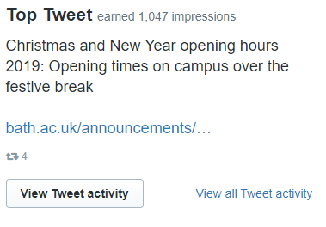
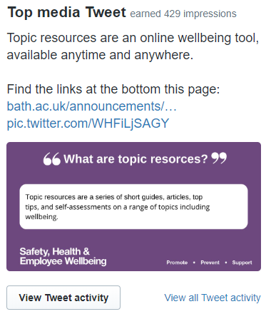
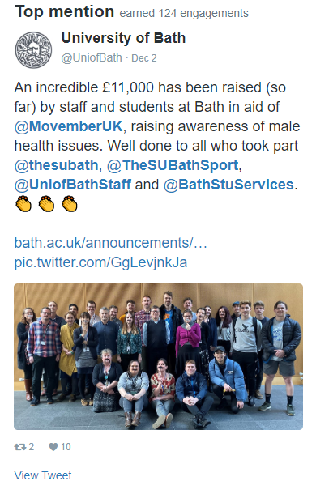
Tweet highlights

Slide 14
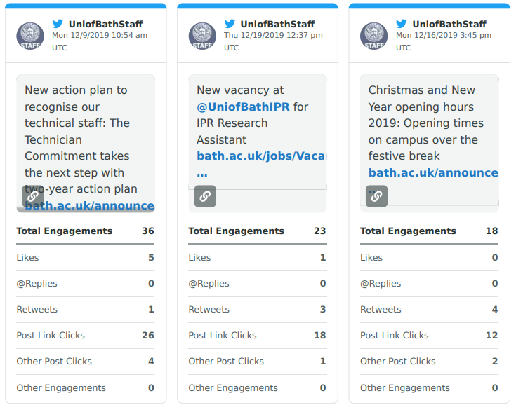
Top tweets based on total engagements

