Slide 1
Staff Homepage: January 2020
Monthly Report

Slide 2
Summary and recommendations
This month saw a decrease in average views for photo features and standards (slide 3). Several factors may have contributed:
The majority of staff returned to work on 6 January, so the figures for the first few days were very low, skewing the average.
We launched the new staff page on Wednesday 8 January, which saw an initial spike in interest before engagement levelled off. Adopting a new platform can take time – we will continue to monitor.
We had several ad-hoc announcements e.g. Brexit and Coronavirus, which meant items did not always run for the full 48 hours.
The most visited articles (slides 4 & 5) included a mix of content types spanning platform launches (homepage and noticeboard), Staff Spotlights, strategy, wellbeing and coronavirus. Once again, we found that topical/timely pieces e.g. the ‘frosty mornings’ drone video and ‘37 fat loss tips’, performed well.
After improvements to the tail last month, January’s figures show an increase in underperforming articles (slides 6 & 7), which may also be due to some of the factors listed above. We are about to distribute our guide to ‘what works well on the homepage’ to all contributors with the aim of reducing the number of articles below threshold. Post-event articles, media coverage, student stories, funding announcements and award shortlists/nominations consistently get the lowest engagement on the page, so other channels should be considered to reach key audiences.
Some of the statistics on slides 8 & 9 indicate that more content can lead to a decrease in average view rates, which is why we need to continue being selective about what we post on the homepage, prioritising quality over quantity.
Google Analytics tracking for the ‘events’ and ‘service update’ sections only went live at the end of the month, so have not been included in this report. The sections will be reported on separately from February 2020.

Slide 3
Homepage news items: overall numbers and visits
In January 2020:
36 photo features attracted 9,971 unique views (average views 277)
78 standard news items were also live, attracting 7,992 unique views (average views 102)
This compares to December 2019 (last report):
27 photo features attracted 9,132 unique views (average views 338)
92 standard news items were also live, attracting 11,705 unique views (average views 127)

Slide 4
Photo features: Top ten most visited

Slide 5
Standard items: Top ten most visited

Slide 6
Photo features: Overall distribution of visits (tail)
The red bars indicate articles that are under the 200 views threshold.

Slide 7
Standard items: Overall distribution of visits (tail)
The red bars indicate articles that are under the 50 views threshold.

Slide 8
2019/20 overview
Photo features: Overall numbers and average visits

Slide 9
2019/20 overview
Standard items: Overall numbers and average visits

Slide 10
@UniofBathStaff: January 2020
Monthly Report

Slide 11
Summary and recommendations
January has seen increases across the board on all Twitter analytic measures (slide 12). This implies that improvements to our output, such as the inclusion of photos in the majority of posts and the continued use of strong calls to action have been successful. We have also been experimenting with more colloquial, engaging copy e.g. ‘From gamma-ray bursts to Brazilian presidents…’ (slide 14) and the use of emojis. We will continue to tweak and hone these approaches over the next month.
Measurement of quantity and quality continues, to establish the optimum number of Tweets per day/week/month for maximum engagement. Based on current analytics it appears that more output = more engagement (slide 12) – we will continue to monitor.
Although engagement levels have improved, the conversion rate for ‘post link clicks’ is still low (slide 14). Next month we will explore a range of tactics to try and improve this number.
Going forward we are looking to share content more effectively with the external social team to avoid duplication of efforts and champion great content across all relevant platforms for all relevant audiences.
Ongoing: Rather than growing our followers, how do we increase engagement and activity within the existing community?

Slide 12
Key statistics
Metric | December | Change
Tweets sent | 79 | +36.2%
Total Engagements | 541 | +72.3%
Total Organic Impressions | 44.3k | +51.5%
Mentions received | 45 | +40.4%
Total number of followers | 1,879 | +1.2%

Slide 13


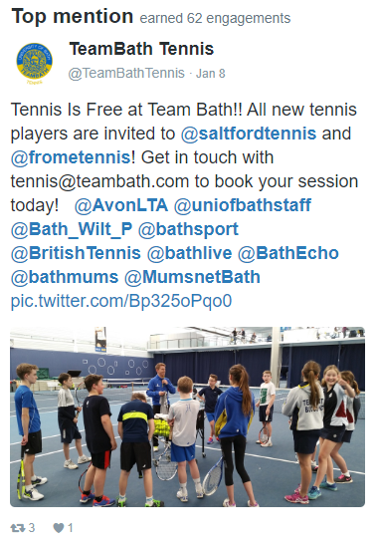

Tweet highlights
Celebrating individuals' achievements is a priority for the Vice-Chancellor, so it’s encouraging to see these types of posts performing well. We will continue to look for opportunities to promote on social.
The success of this post supports our strategy for timely content with strong calls to action, as well as our shift to including images in all posts.

Slide 14
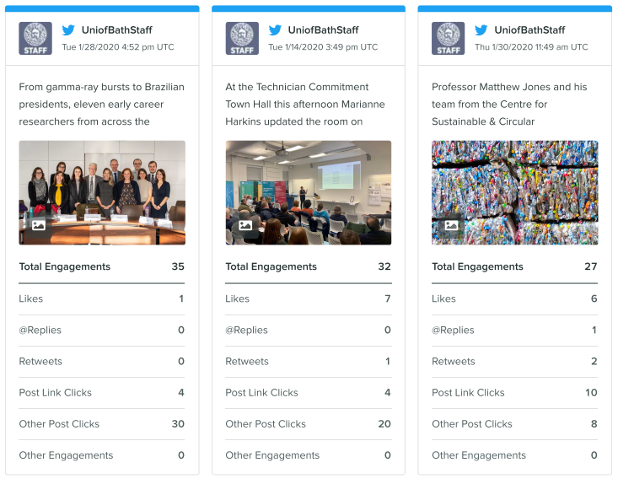
Top tweets based on total engagements
The top three posts based on engagement are not surprising as they all resonate with our most engaged Twitter audiences – academics and technicians.
Interestingly, the Matthew Jones article was one of the lowest performing on the homepage, confirming that Twitter may be a more effective way to reach academics than the staff page. Going forward we should explore how to use this information more strategically in comms planning.

