Slide 1
Sustainable energy and the impact on the environment over long time scales, solutions and handling waste from EDF’s perspective. Bath University ISEE seminar 31 October 2017 Humphrey Cadoux-Hudson Managing Director Nuclear Development

Slide 2
The UK’s leading generator and supplier of electricity
Meeting around one-fifth of the country’s demand and supplying millions of customers and businesses with electricity and gas.
We generate electricity with eight nuclear power stations, more than 30 wind farms, one gas and two coal power stations.
Leading the UK's nuclear renaissance with the construction of a new nuclear power station at Hinkley Point C.
The leading supplier of electricity to UK businesses.
1
7
2
PRESSURISED WATER REACTOR
Commissioned 1995
Lifetime expectation 2035+
AGR NUCLEAR STATIONS
14 Advanced gas-cooled reactors
Commissioned 1976-1988
Lifetime expected mid 2020s to 2030
COAL-FIRED STATIONS
Commissioned 1967-1969
Lifetime ambition 2020+
Co-fires biomass at Cottam
2
1
34
GAS STORAGE SITES
7 converted salt cavities
Fast injection/withdrawal – up to 7Mtherms/day
GAS STATION (CCGT)
Commissioned 2013
Lifetime 2040+
WIND FARMS
Total operated capacity of ~696 MW
EDF Energy is JV partner with EDF Energy Nouvelles
Providing gas and electricity for more than 5 million customer accounts.
1
2
NUCLEAR STATION UNDER CONSTRUCTION
Hinkley Point C – construction underway
PLANNED NEW NUCLEAR STATIONS
Sizewell C
Bradwell B

Slide 3
Sustainability
Volume
Capacity flexibility

Slide 4
Electricity Supply – why we need a managed market to be sustainable
Normal
Commodity Demand = Supply Overtime Volume achieved by international marginal cost of
production and normal economics transport/storage
Electricity
Demand = Supply by micro second Capacity to meet maximum demand in cold winter/hot summer and need to meet changing demand /supply
Transfer (transmission) is very expensive
Storage is inefficient /expensive
Supply needs to be ≥ demand 100% time
Short term power market = marginal cost of production
Low carbon will see the power market trend down
Hence a market price will despatch lowest cost generation but not supply adequate reliability for an
advanced economy
Notes:
2 – leave blank for now, I will need to find this chart

Slide 5
Electricity is fundamental to our economy…
But ~98% of the economy is reliant on electricity
% of UK GVA (2015p)
Electricity costs <1%
Cost of electricity to society
Value of electricity to society

Slide 6
...but electricity is challenging to manage… supply and demand has to be balanced each second and the system has to be resilient to faults.
Final demand, GW
System frequency, Hz
Normal operation
<10 seconds
50
System fault leading to rapid change in frequency
Response prevents disconnections
Customer disconnections threshold
Need for flexible generation or demand to manage hour by hour changes
Hour of day
The system needs to be resilient to faults to prevent customer disconnections.
Faults include generation disconnections, network failure.
Needs to be managed by a combination of fast-acting response and high capacity units.
There is a minimum demand set overnight in summer by the need for lighting, 24-hour telecommunications and manufacturing [TBC].
And a maximum demand in winter set by the need for heating, cooking and lighting in homes and businesses [TBC].

Slide 7
Intermittency cost increases with higher levels of decarbonisation
1.7TWh storage which represents storage capacity of 185 times the level of Dinorwig pumped storage
(or 170m 10kWh Tesla batteries)
100g/kWh
50g/kWh
(5.5TWh storage)
54GW Offshore
79GW Offshore
Intermittency explained
Intermittency costs reflect costs of backup, spill energy and additional transmission lines
With higher levels of decarbonisation, less and less gas is allowed
Therefore wind has to fill a larger proportion of the demand, even in low-wind periods
This requires either building disproportionate amounts of wind capacity (which is then wasted at times of high wind) or investing in expensive storage solutions
* Marginal intermittency cost represents the incremental system cost incurred by decarbonising with offshore and storage relative to nuclear. System model also includes 20GW solar, 20GW onshore and 11GW interconnection

Slide 8
Our energy mix is changing rapidly
Coal is no longer providing the majority of power
Since 2013 there has been a dramatic decrease in the contribution of coal to our energy mix
This has mostly been replaced by lower carbon gas, increased output from wind, alongside more imports and reduced demand
Nuclear is now the second largest contributor, supplying around 20% of our energy
The Grid is already having to adapt to increasingly variable output from solar and wind
Source: All time (quarterly averages) – http://nationalgrid.stephenmorley.org/
EDF Energy is the UK’s largest electricity generator
EDF Energy is the UK’s largest electricity generator – operating nuclear, coal, gas and renewables
We are part of this change and are adapting how we operate
Our 4GW of coal stations now only operate during peaks of demand, and we are investing across a range of technologies, including renewables, gas and battery storage
Our investment in the UK’s nuclear power stations has resulted in improved performance and an output that is now 60% higher than a decade ago
Total 2016 output (TWh)
Notes:
2 – leave blank for now, I will need to find this chart

Slide 9
The challenge: demand will increase as we lose capacity
Electricity demand will increase because of population and economic growth and more electric vehicles, partly offset by energy efficiency
Ageing infrastructure will need to be replaced, large amounts of capacity will have closed between 2016 and 2035
We need new low-carbon options if we are to achieve climate commitments (80% CO₂ reduction by 2050)
UK electricity demand forecast
TWh/year
Generation, TWh
(after net imports and storage)
2016-2035 capacity closing
CLOSING
7 Nuclear stations (8GW)
13 coal + oil stations (20GW)
32 gas stations (18GW)
NUCLEAR
GAS (INC. CHP)
OTHER FOSSIL
WIND AND SOLAR PV
OTHER RENEWABLES
Source: EDF Energy analysis
Notes:
RES means ‘Renewable Energy Sources’
‘Retirements by 2035’ means power stations / windfarms due to be closed down by 2035
These power stations need to be replaced with new gas stations (red bar showing 38), and new nuclear power stations or windfarms that don’t emit carbon dioxide

Slide 10
The solution: investment needed across technologies
The UK must find a solution that meets consumer requirements of reliable, affordable, low carbon electricity
This will require a mix of technologies, Government policies are designed to deliver the right mix for customers
Our analysis suggests that a mix with around one third gas, renewables and nuclear offers the best solution
Generation, TWh
(after net imports and storage)
2/3 of low carbon needed through CfDs has yet to be procured
A significant amount of new low-carbon capacity needs to be built
Some of this has already been secured through Contracts for Difference (Hinkley Point C, offshore wind and biomass)
Much more low-carbon capacity still needs to be procured through CfDs
Investment in new gas also needs to be secured
CfDs to date
26 TWh Nuclear
43 TWh Renewables
NUCLEAR
GAS (INC. CHP)
OTHER FOSSIL
WIND AND SOLAR
OTHER RENEWABLES

Slide 11
Gas can support a flexible low-carbon system – but is not low-carbon
GAS
WIND
SOLAR
NUCLEAR
Flexible
Relatively low capital cost
Will help balance renewables
Not low carbon
Volatile prices
Relies on international import markets and infrastructure
Gas prices are volatile
Continue to support the development of flexible gas generation
25GW of new gas capacity needed, with a mix of highly efficient stations, and smaller flexible plants - equivalent to 20 large gas stations
If we want to hit our climate change targets, gas can’t contribute more than 1/3 to our energy mix in the 2030s
Source: EDF Trading
Notes:
Some flexible gas capacity will help balance renewables in the generation mix
But its use will be limited because it is not low-carbon
By 2030s gas has to contribute at maximum ~1/3 of the energy mix (consistent with <100g/kWh) if we are to be on track to hit our climate change targets
Using gas also exposes consumers to volatile international gas prices and increasing reliance on imported gas

Slide 12

Make use of UK wind resources – but there are limitations
GAS
WIND
SOLAR
NUCLEAR
The UK is well positioned to use wind resources
A plentiful UK natural resource
Low carbon
Costs have fallen
Community support in Scotland and remote islands
Intermittent: wind farms on average only produce 30-45% of their potential power
Every new MW of capacity adds cost and complexity to managing the grid
Varying levels of public acceptability – more popular in Scotland where sites are best
Source: Map developed by 3Tier, www.3tier.com
Support the development of new low-cost onshore and offshore wind, including on Scotland’s remote islands
The UK has the potential to deliver 14% of demand from its onshore wind resources
The cheapest wind power will come from onshore sites in Scotland where there is local support
Wind projects on remote Scottish islands offer good value for money and significant community and industrial benefits
6x less when not windy
Windy week
Still week
GW
1 week (hours)
Notes:
ADD DATES
*****************************************
JD
Support RIW
Rethink onshore wind
Key point: you can’t build a reliable/affordable system on renewables alone – look at Denmark (attached to Sweden+Germany)
UK – Scotland in particular has one of the best wind resources in Europe
Onshore and remote island wind should be use to their full potential, plus best available offshore sites: but relying too heavily on renewables means costs will be higher
Above 20% penetration of intermittent generation, more and more of the energy is available at times when it isn’t needed: this pushes up the cost.

Slide 13
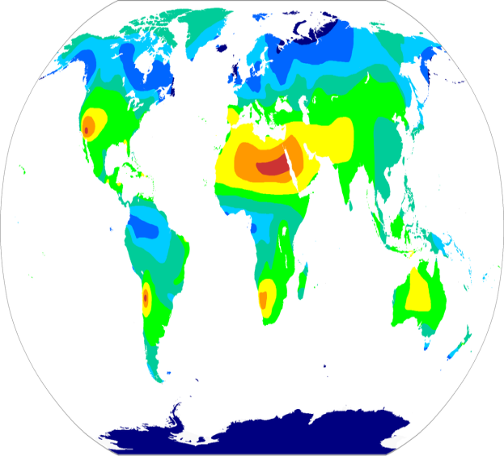
Solar can provide too much in summer and too little in winter
GAS
WIND
SOLAR
NUCLEAR
Low carbon – but higher CO₂ footprint than wind or nuclear
Solar is already helping to provide daytime power in the summer months
Prices are falling
Intermittent and highly seasonal
Not available when demand is highest
Adds cost and complexity to managing the grid
The UK is less ideally located for solar power
Support solar installation to a manageable limit
Too much solar is adding cost and making the grid hard to manage
UK demand is highest on cold, dark winter nights – when there is no sun
Without metering and controllability solar deployment should be limited to 20GW.
Solar output has great seasonal variability
Sunny summer week
Dull winter week
1 week (168 hours)
Source: Map developed by 3Tier, www.3tier.com

Slide 14
Nuclear is reliable and low-carbon
GAS
WIND
SOLAR
NUCLEAR
Nuclear output is much more predictable
Reliable power – will produce average of 91% of max capacity
Very long operating life
Low carbon
Cost competitive with other low carbon technologies
Majority of outages are planned
Long construction time and high financing costs
Decommissioning/waste management costs (included in HPC CfD)
Not particularly flexible
Nuclear’s always on power will be even more important in the future with more renewables and fewer fossil-fuelled power stations.
Any other low-carbon power mix that doesn’t use nuclear would cost consumers more
Large and small-scale nuclear power stations will support this mix, and a variety of technologies will provide further flexibility and choices for local communities
Large power stations support a stable grid frequency
BMRA Nuclear Generation data 2016
UK nuclear excellence
Last year the current UK nuclear fleet achieved its best output since 2003
Life extensions mean the fleet will operate well into 2020s
Two-thirds of outages are planned, and organised to minimise grid disruption
Notes:
Nuclear is low carbon, reliable, will reduce costs for consumers in the long term vs other options; is being built now
Don’t forget SMRs
This is the key point of the pack – without a contribution from nuclear, any other option for a low-carbon energy system would cost consumers more.
You need to ensure that nuclear capacity is replaced if you want a reliable, affordable low-carbon energy mix.
The best value low-carbon energy system includes nuclear
Graph is fairly clear, but needs a bit of reading/explaining before the point is obvious. Could be re-arranged to show a rising trend of prices when using different technology mixes. The current graph is good at explain that super-cheap wind/solar PV on their own don’t equal a good value energy system to consumers.
Map of NNB sites and progress?

Slide 15
Batteries can help manage these technologies but work best over short periods
GAS
WIND
SOLAR
NUCLEAR
Already providing services to help keep the grid stable on a minute by minute basis
Costs are high but reducing
Could help store energy from renewables overnight
The longer you store it the more expensive the power becomes
Cost is an addition to the cost of producing the electricity
Too expensive to store summer energy for use in the winter
Significant lifetime CO₂ content from manufacturing
Costs of domestic storage
£60/MWh renewables with current storage cost (£400/kWh) (£)
£60/MWh renewables with cheaper storage (£100/kWh) (£)
Battery storage is an emerging technology that has the potential to help stabilise the grid and store renewable power for a limited period of time
Market rules may need to change to help make the most of battery storage
Storing solar electricity in the day to use at night adds around £140/MWh to its cost, but this is expected to fall, and could reach £35/MWh
At today’s prices, it would cost £24 billion to build enough battery capacity to supply peak demand
Source: EDF Energy analysis
Notes:
£MWh – add label
Batteries will play a role, but they’re expensive and they can only viable on a minute by minute basis
For this – key point is that batteries are not expensive per se but ARE when they store over periods more than a day.
Energy storage is VERY expensive - currently only economically practical on an hourly basis.
Demonstrating the current and future costs of energy storage.
There is a perception that storage plus renewables is the holy grail – while forgetting what the cost is.
Storage plus renewables can deliver an affordable low-carbon energy system.
Review capacity market rules and network charges to ensure that the benefits of battery storage are awarded appropriately
Battery storage is currently very expensive, and only viable on a minute by minute basis.
The graph is pretty good, but could be simplified a bit. Simply language of text a bit, but overall content is good.

Slide 16
An equal balance of nuclear, renewables and gas deliver’s Britain’s energy needs
GAS
WIND
SOLAR
NUCLEAR
Nuclear will be an important part of the future mix
A mixed system made up of roughly one third nuclear, renewables and gas will create a reliable, low-carbon system that is affordable
This makes the most out of our natural resources, while providing back-up power when we need it
There is room for new and developing technologies, such as batteries, increased interconnection and marine
Typical winter week
Typical summer week
Generation after net imports
NUCLEAR
GAS (INC. CHP)
OTHER FOSSIL
SOLAR
WIND
OTHER RES
STORAGE
CSS
PEAKING
DEMAND
Notes:
Excludes interconnection flows – typical generation
after net imports

Slide 17
Do we have the right policies in place to deliver this investment ?
All technologies have a role to play:
Investment is required in gas, renewables, and new nuclear
Allowing onshore wind in Scotland could lower costs
Future new nuclear projects will need to be cheaper
EMR is working, allow it to continue
Carbon Price Floor
Capacity Market
Contracts for Difference
Carbon Price Floor
Supports switch from coal to gas, and investment across low-carbon technologies, including existing nuclear stations
Capacity Market
Has secured power demand for upcoming winters. Range of technologies supported, and is delivering battery storage
Contracts for Difference
Already bringing forward low-carbon investment, including construction of Hinkley Point C, while competitive pressure has already delivered significant falls in the price of low-carbon generation

Slide 18
Hinkley Point C strike price in context
EMR and competition between technologies is delivering cheaper low-carbon electricity
In 2025 there will be c135TWh of renewables at £111/MWh average price, adding c£90 to a typical customer bill
HPC will represent 26TWh at £92.5/MWh, adding around £12 to a typical customer bill once operational
There will be a further cost to customers of wind / solar intermittency which represents around £10/customer
HPC is lower cost than >80% of renewable generation procured to date, and costs for future nuclear will have to fall
Competition is driving down low-carbon costs
FIT
8 TWh
Integration costs
FIDER
22 TWh
RO
85 TWh
Auction 1
7 TWh
HPC
26 TWh
Auction 2
14 TWh
Cost of renewables by date of procurement, £/MWh (2012 prices)
Notes:
Excludes integration costs of £10/MWh for wind and solar PV. RO cost includes value of electricity sold based on historical prices 2012-2017; market forward prices 2018-2020 (as of Sept 2017) and BEIS UEP 2016 central prices 2021-2025.
Excludes large-scale hydro which is not qualify for renewable or low carbon support.
Integration costs for each procurement tranche are typically <£10/MWh as some generation is dispatchable biofuel rather than wind and solar PV.

Slide 19
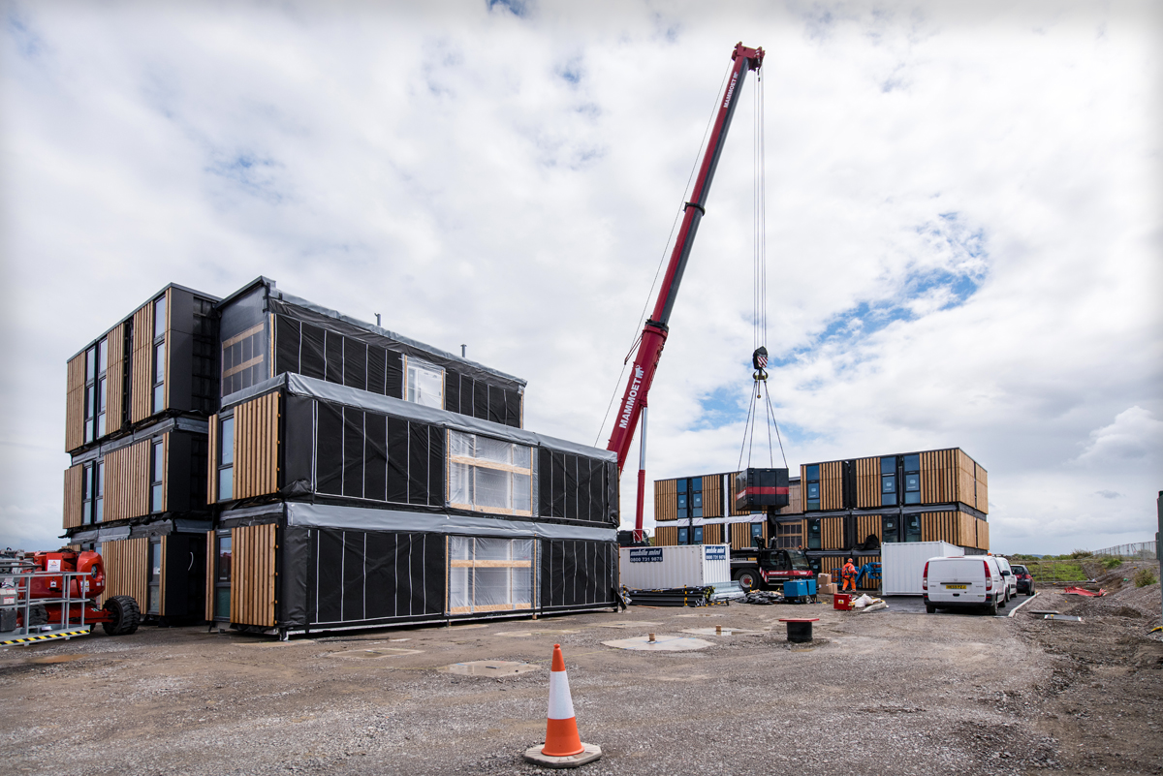
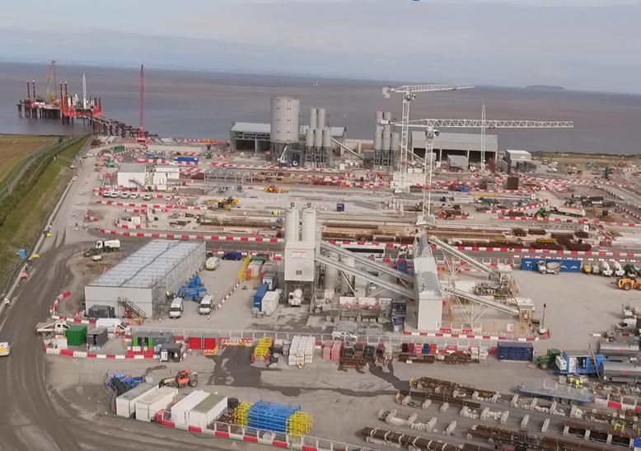
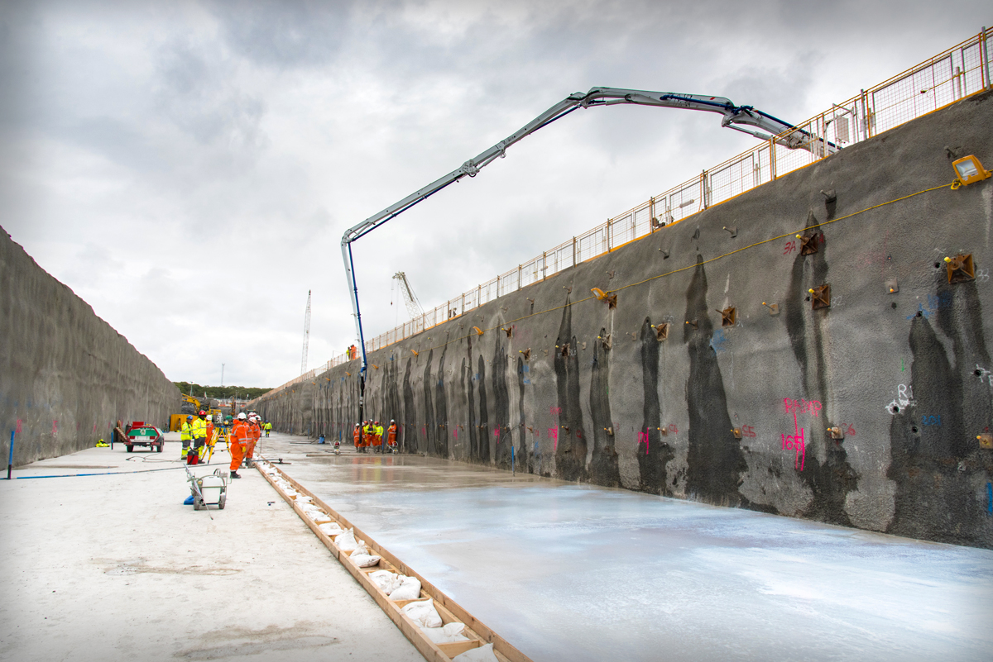
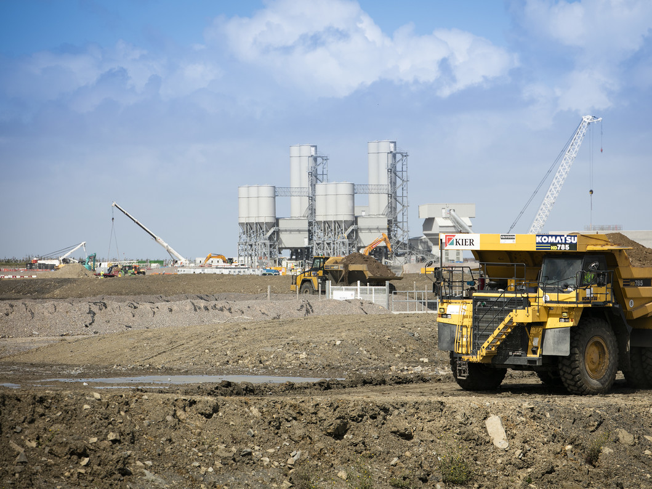

New nuclear programme making good progress
UK new nuclear
Flamanville 3, France
Taishan, China
Significant construction progress at Hinkley Point C a year on from Final Investment Decision
Sizewell C stage 2 consultation completed
Design assessment has begun for UK-HPR1000 to be used at Bradwell
Testing regime has begun
Due to begin operation at the end of 2018
Final testing of systems taking place
Unit one due to begin operation by the end of this year
Second unit due to follow in 2018
A year of progress at Hinkley Point C: 2,000 workers on site, 4 million m³ of earth moved, 10,000 tonnes of rock delivered for seawall, nuclear safety concrete poured for first permanent structures, construction of 500 meter jetty, onsite accommodation built, local road works complete

Slide 20
EPR Nuclear Waste Summary
Waste management assumptions based on prudent and practical Government Base Case
LLW minimised and disposed to LLWR or successor site
ILW stored and disposed of to GDF during decommissioning
Spent fuel stored and disposed of to GDF following further post decommissioning storage
Funded Decommissioning Programme to meet costs

Slide 21
Funding Arrangements
Approved Funded Decommissioning Programme needed before construction of first structural concrete with nuclear safety significance
Will set out costs of waste management and decommissioning and arrangements for establishment of independent fund
Legally binding on operator – failure to meet obligations is a criminal offence
Costs of waste disposal derived from a contract with Government
Liability and funding for waste management and disposal expected to transfer to Government at end of reactor decommissioning

Slide 22
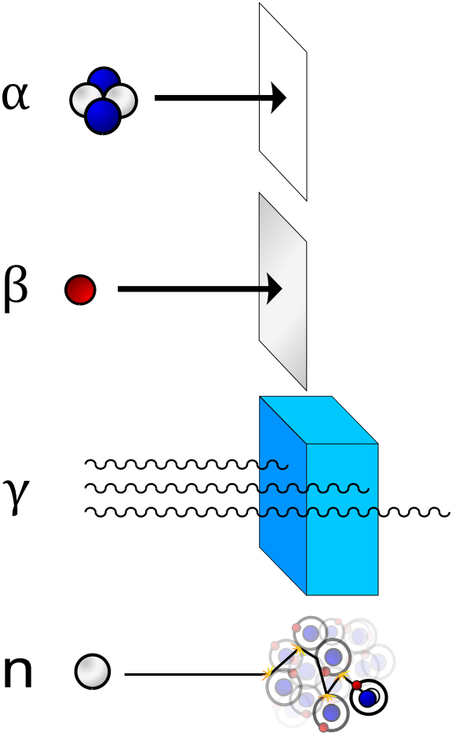
Radiation and routes to human harm
Direct Radiation
Alpha stopped by paper
Beta stopped by aluminium sheet
Gamma stopped by thick concrete / water
Neutrons stopped by thick concrete / water
Ingestion
Particularly dangerous radionuclides once absorbed into the body
Iodine 131 – beta radiation, concentrates in thyroid
Caesium 134/137 – beta gamma radiation, concentrates in soil and food chains Strontium 90 – beta radiation, concentrates in bones
But humans live with background radiation every day
Average public dose – 2.7 millisieverts
Average dose in Cornwall – 7.8 millisieverts
Long haul flight – 40 – 60 microsievrts (1000 microsieverts = 1 millisievert)

Slide 23
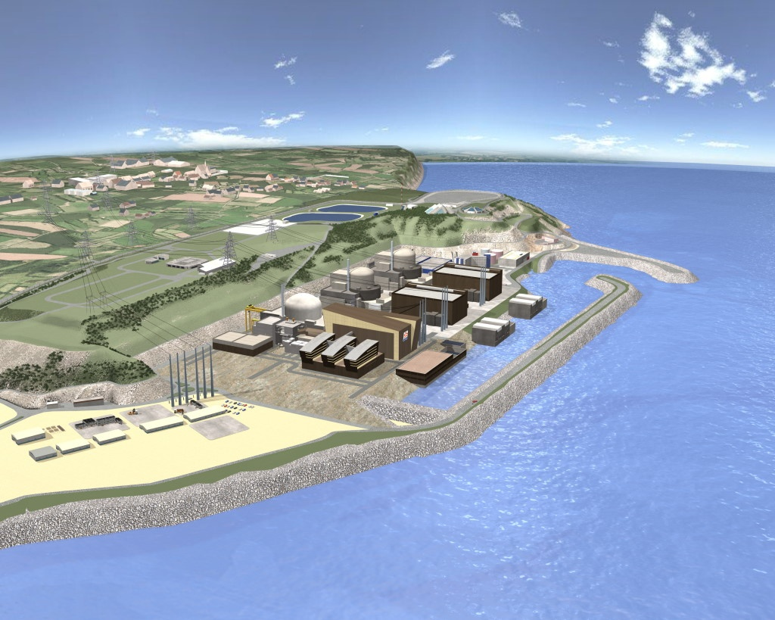
Annual outputs from a single UK EPR
Dose to most exposed Adult from Radioactivity discharged to air (0.004 mSv)**
Negligible CO₂, NO_{X}, SO₂
All data is average per year
of operation.
12.5TWh* of electricity produced per year - enough electricity for approx 2.5m homes.
* 1 TWh = 1 billion kWh
30 Te (U) spent fuel produced****
Photo of EPR
73.15 m³ LLW generated***
**** From GDA assessment:
1 fuel assembly = 527.5kg Uranium.
Total 3400 fuel assemblies/60 years.
Therefore, 57 SFA’s per year.
57 x 527.5 = 30067.5kg (1.5m³).
9.35 m³ ILW produced***
Dose to most exposed adult from Radioactivity discharged to sea (0.017 mSv)**
** Dose data from GDA. PCER
Chapter 11: Radiological Impact
Assessment, Issue 1.
Note: Individual typical total dose in the UK varies between 2.3 to 7.3 mSv per year.
*** Waste volumes from GDA. PCER
Chapter 6: Discharge and Waste, Issue 02.

Slide 24
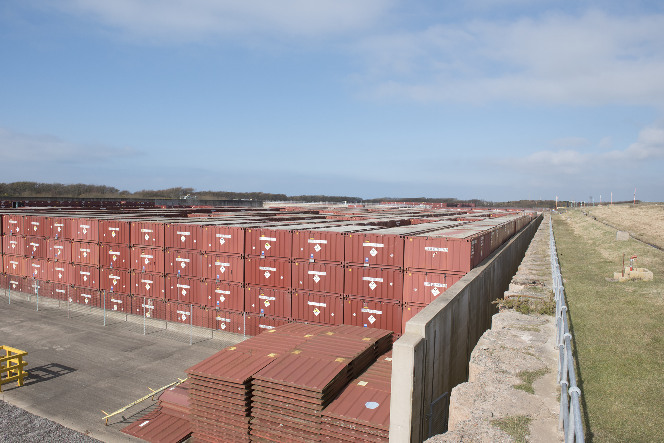
Low Level Waste (LLW)
Comprises materials from routine operations with low levels of radioactive contamination.
Treated and disposed of through a variety of routes including the national LLW Repository (the LLWR) and commercial incinerators
A sub-set of LLW is categorised as Very Low Level Waste (VLLW) which may be suitable for alternative disposal or treatment routes.

Slide 25
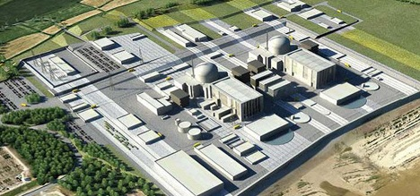
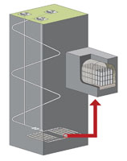
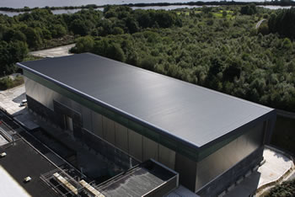
ILW Management
ILW generated from operation of nuclear power stations
Waste processed to meet RWMD requirements for a future GDF
ILW Transferred to on-site Interim Storage Facility
Disposal to future Geological Disposal Facility c.2080
Re-categorisation of ILW to LLW during storage
Notes:
The proposed strategy for ILW conditioning and packaging at HPC is that operational ILW would be conditioned and treated using the same procedures as applied during the operation of existing PWRs in France with due consideration for UK specific requirements.
Utilisation of C1 and C4 concrete packages.
Cementation for all waste except ion exchange resins which will be processed using Mecure machine (polymer solidification process).
LOC: Before conditioning and packaging of ILW, regulatory arrangements require that sites produce an ILW conditioning proposal. This would include a demonstration that, following conditioning, the waste would be compatible with existing or future planned management and disposal options. This requires that a Letter of Compliance (LoC) is obtained for the packaging proposal. The LoC process is the mechanism that the NDA Radioactive Waste Management Directorate (RWMD) utilises to provide confidence that a waste package can be accepted at a future GDF.
Decay Storage – Due to the long period of interim storage the radioactivity of a proportion of the ILW that would be generated during operation of the HPC UK EPRs (dominated at the time of arising by relatively short lived radionuclides including cobalt-60 (half life of 5.27 years), caesium-137 (half life of 30.2 years) and iron-55 (half-life of 2.7 years)) would have reduced to such levels that the waste would no longer be classified as ILW. This waste would therefore be managed as LLW.
Geological Disposal Facility – assumed that it will be ready to accept ILW from Hinkley Point C in 2080 - after the end of electricity generation.

Slide 26
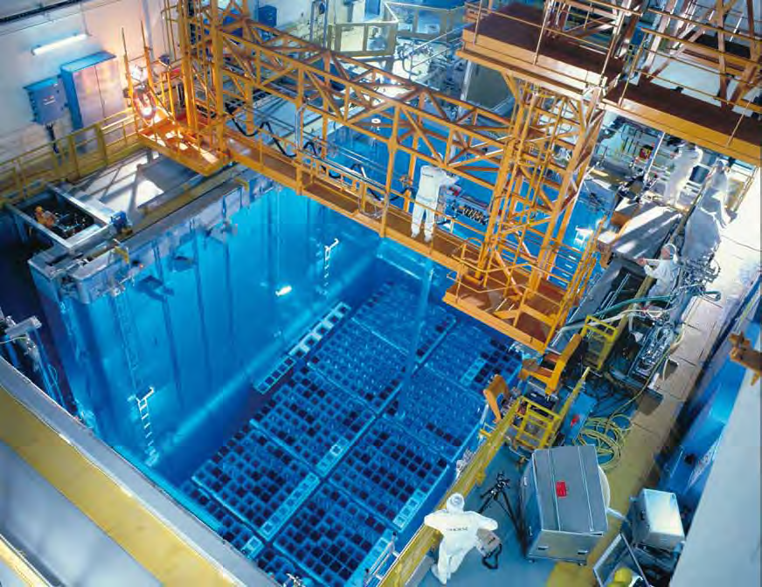
Spent Fuel Management
Initial Cooling in reactor pond
EPR design has limited reactor storage
Government base case assumes on-site storage of spent fuel
Need to develop additional on site spent fuel storage facility to take lifetime arisings
Chooz B1, (1,500 MWe) Fuel Building

Slide 27
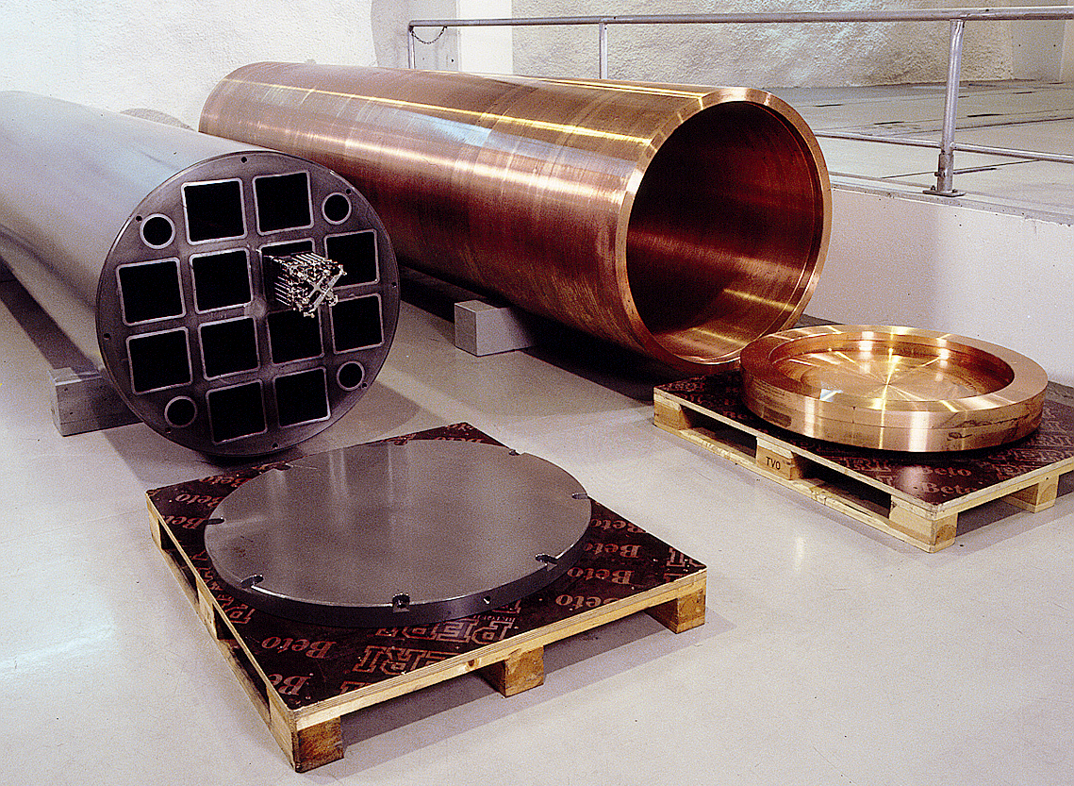
Spent Fuel Packaging
Current NDA repository assumptions based on Swedish model
Requires packaging of spent fuel in copper sheathed canister
Suitable for repository in hard or soft rock – but site and geology yet to be agreed
Conservative cost assumptions included in Funded Decommissioning Programme

Slide 28
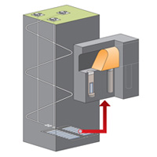
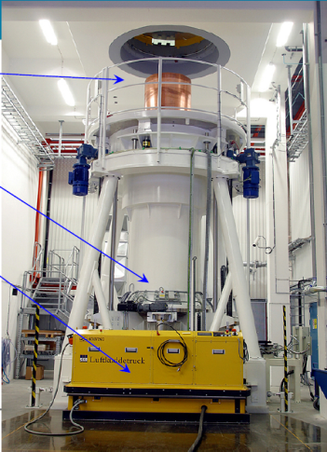
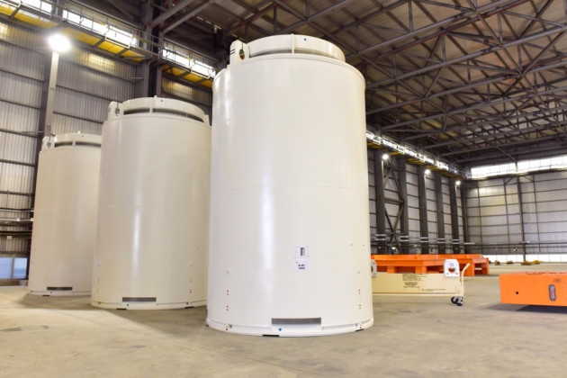
Hinkley Point C – Spent Fuel Management
Spent Fuel Transferred to Reactor Pool (storage for up to 10 years)
Spent Fuel generated from operation of nuclear power stations
Spent Fuel Transferred to on-site Spent Fuel Interim Storage Facility (stored for up to 50 yrs after End of Generation)
Disposal to future Geological Disposal Facility c.2130
Spent Fuel Transferred to Encapsulation Facility
UK PROTECT – COMMERCIAL in CONFIDENCE

