Slide 1
Teacher Champion Programme Welcome Pack
In this pack you will find useful information about who is running the programme and who you can contact if you have any questions.

Slide 2
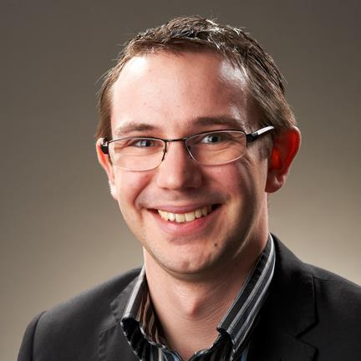
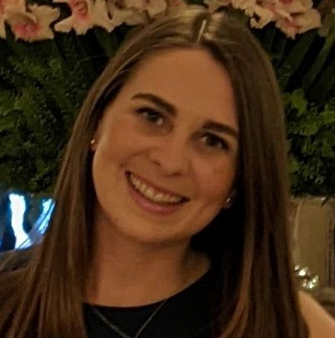
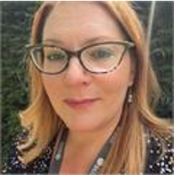
Andrew Ross
Head of Widening Access and Participation
Samantha Jones
Teacher Champion Programme Lead
Meet the Teacher Champions Programme Team
Esther Reeves
Outreach Programmes Manager

Slide 3
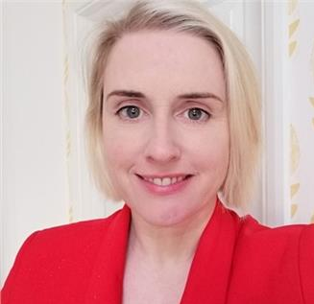
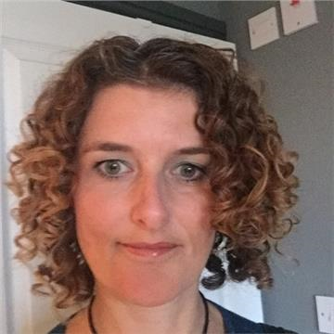
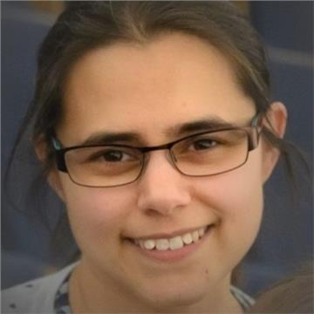
Meet your Peer Group Facilitators
Along with many more guest speakers from the university throughout the programme…
Andrew Eagleton
Student Recruitment & Admissions Insight Manager
Katherine Davis
Pathway to Bath Programme Lead
Hannah Kirby
Careers Advisors
Sara Wilsonlock
Undergraduate Admissions Selector
Nerys Shah
Widening Access & Participation Manager
Andrew Ross
Head of Widening Access and Participation

Slide 4
Contact details
Programme Email:
teacherchampions@bath.ac.uk
Samantha Jones:
sj2151@bath.ac.uk

