Slide 1

The Bath Award

Slide 2

What it is
A programme designed to:​
help students showcase to employers the key skills they have acquired during their time at university​
recognise the efforts of students who are carrying out student leader, volunteer, and employment roles​
empower students to take action and develop employability skills that will support their success ​
50 hours of student leadership / volunteering /employment activity​
+​
12 pieces of professional development​
= a certificate endorsed by the University and SU you can share with employers.

Slide 3


Who can take part
The award is open to everyone.
All students currently studying at the university are eligible to register and take part in the award. Students can be an undergrad or postgrad, be studying on campus or remotely, and be a full- or part-time student. It doesn't matter which course they are studying, the award is open to everyone.

Slide 4
Key dates
The Bath Award is open for registrations between 22 September – 1 November 2025. (You will not be able to take part this year if you have not registered by 1 November.)
Complete your award activities and submit them by 1 May 2026.
Receive your certificate in summer 2026.

Slide 5
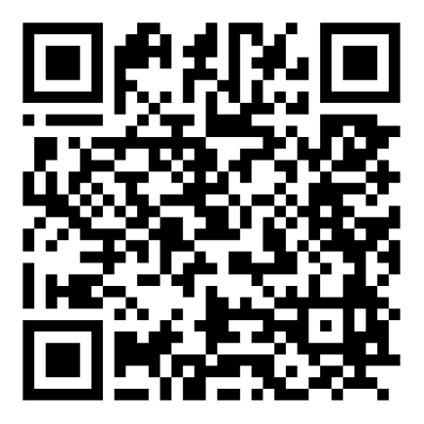
Find out more
Everything you need to know is in Unihub or search ‘the Bath Award’ on the website.

