Slide 1

The Bath Award 2026-27

Slide 2

What it is
The Bath Award is an annual programme that encourages you to get involved in activities beyond your studies and supports your professional development along the way. ​
To earn the award you need to:
Complete 50 hours of extra-curricular activity develop your employability​, support the university, contribute to your community​ or advocate for sustainability​
Attend four Bath Award-endorsed workshops
Log four pieces of online training / long read per capability)
Everyone who successfully completes the award receives a certificate signed by the University of Bath Vice-Chancellor and ​the SU President.

Slide 3
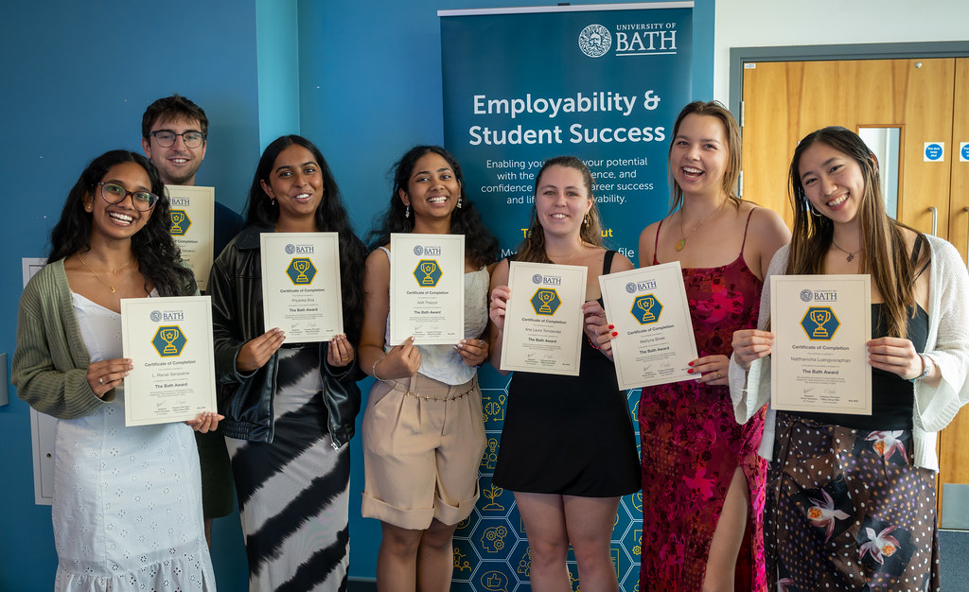

Who can take part
The Bath Award is open to all students currently studying at the university. You can be an undergraduate or postgraduate student, studying on campus or remotely, and full- or part-time. It doesn't matter which course you're studying or which year you're in, the award is open to everyone.

Slide 4
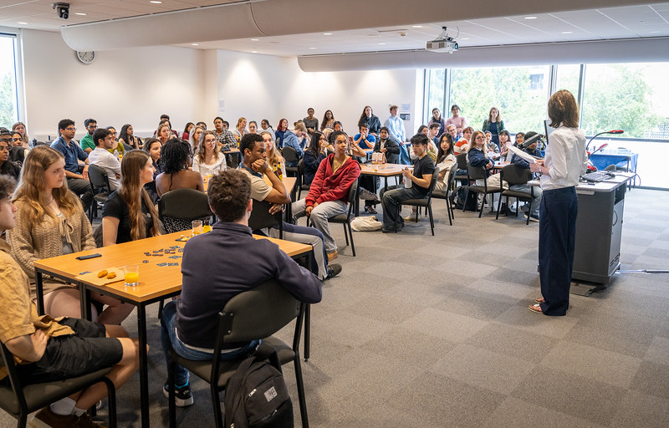
Find out more
Everything you need to know is on the website:
go.bath.ac.uk/thebathaward
or email
thebathaward@bath.ac.uk

Slide 5

Information for staff
As a member of staff, there are several ways you can support the Bath Award and your students:​
Share it with your students - mention the award in lectures, tutorials, or emails
Submit your workshop for endorsement so students can count attendance towards their award
Invite us to come and talk to your students about the award
Our staff webpage has everything you need to know:
www.bath.ac.uk/campaigns/the-bath-award-information-for-staff/
Or email thebathaward@bath.ac.uk.

