Slide 1

THE LATEST ON THE 2020 USS VALUATION
April 2021
Notes:
This presentation is to update scheme members on the latest with the 2020 USS valuation.

Slide 2
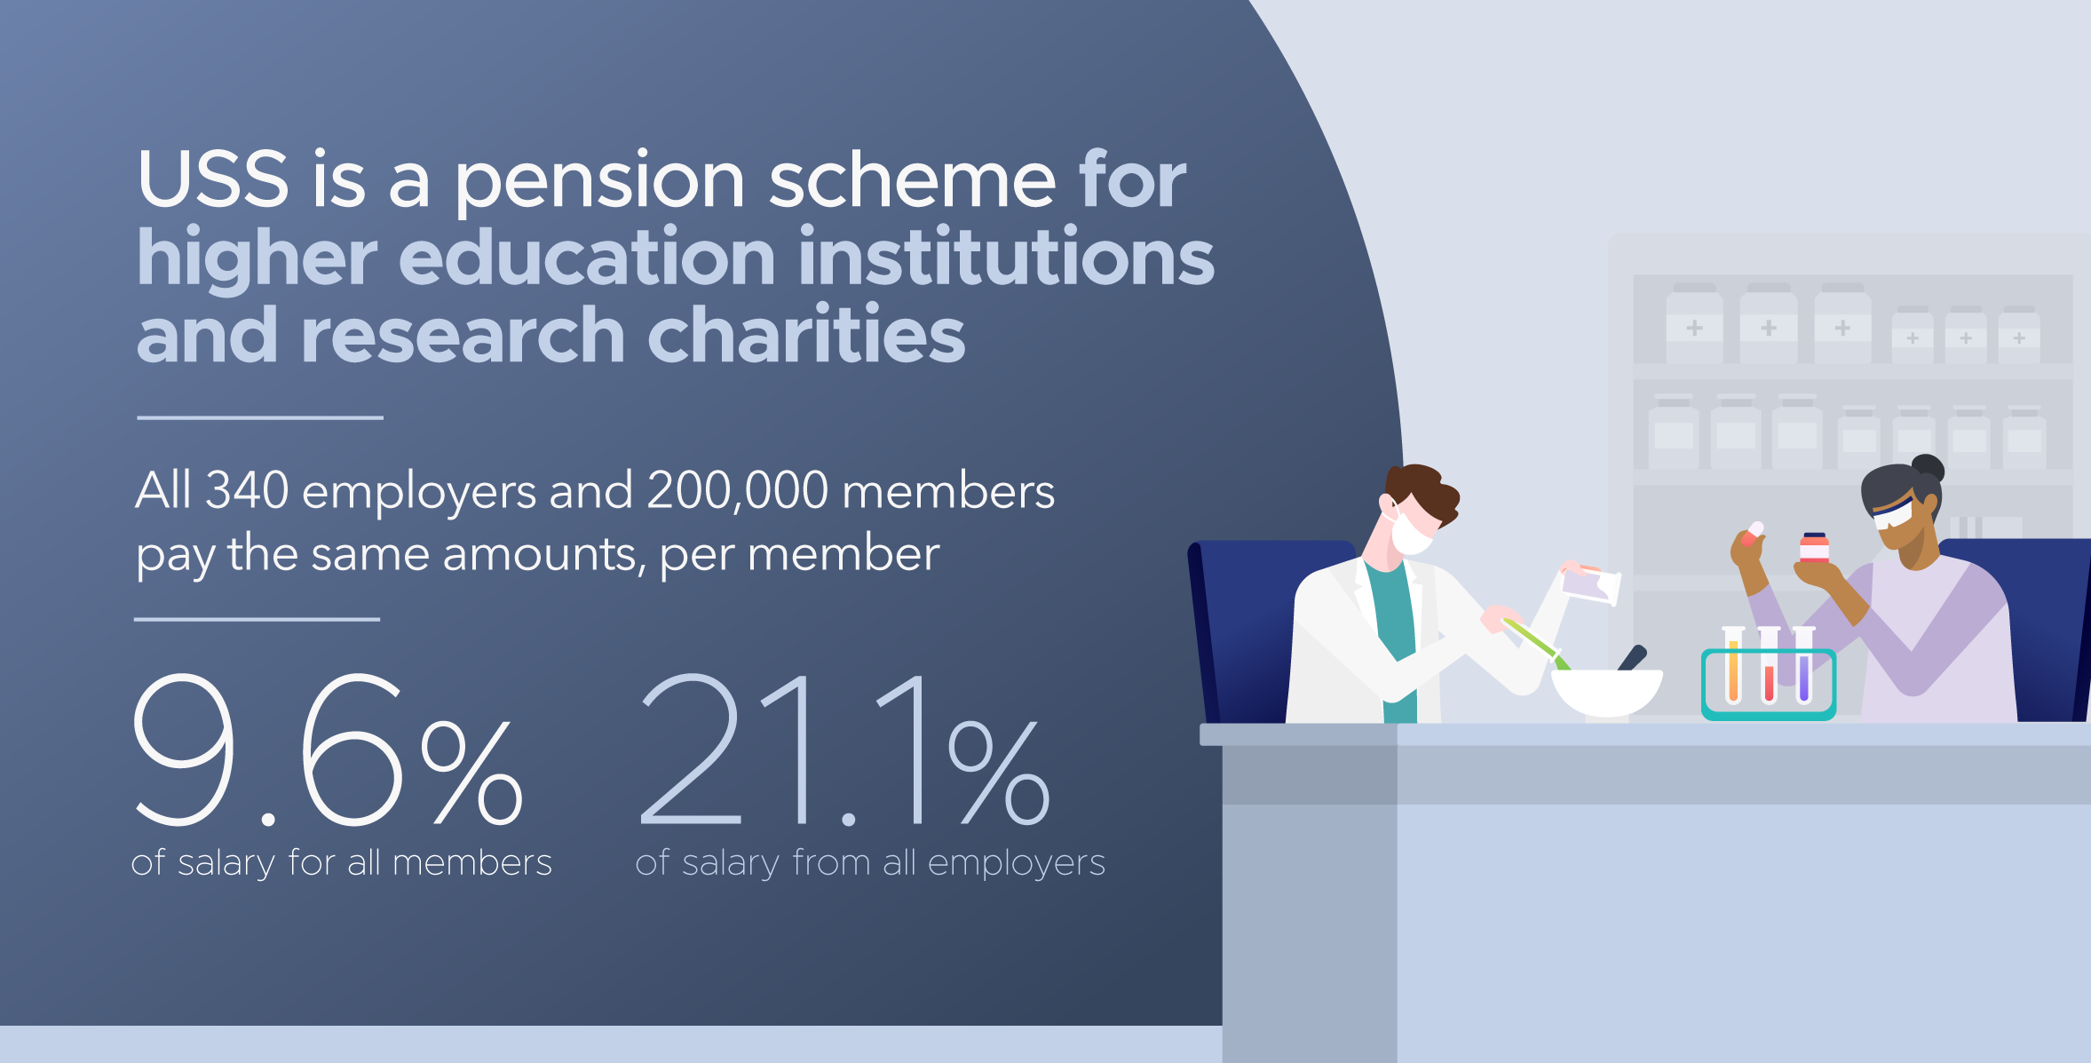
Notes:
USS is the main pension scheme for university staff and the largest private pension scheme in the country. There are 340 scheme employers and 200,000 active members.
A pension is a great way to save for your future. USS pensions are funded by money taken from the salaries of members and payments made by employers.
All scheme members currently contribute 9.6% of their salary (before tax).
All employers pay in 21.1% of salary for each employee within the scheme - whether the employer is a large university or one of the smaller research based charities, which form part of the scheme (the Overseas Development Institute, for example).
USS offers a mix of defined benefit (DB) and defined contribution (DC) pensions.

Slide 3
USS offers DB and DC pensions – what’s the difference?
Defined benefit (DB) pensions
Members are promised a set amount of pension benefits, based on their salary and length of service, which are (broadly) inflation-proofed.
Defined contribution (DC) pensions
Members are not promised a set amount of pension benefits. The total amount of benefits members receive will depend on how much they and their employers contribute, the level of charges applied, and how well the pension scheme's investments perform in the global money markets.
USS offers DB pensions for all up to the salary of ££59,883.65 and DC pensions on salary above this.
DB benefits provide certainty whereas DC benefits provide flexibility and more choice.
Notes:
A DB pension offers a set amount of benefits based on how long you’re a member and your salary
With DC pensions member and employer contributions are both invested and the proceeds used to buy a pension and/or other benefits on retirement.
Everyone in USS gets a defined benefit pension up to the salary threshold of £59,883.65 with salary above this on a defined contribution basis.
DB benefits provide certainty whereas DC offers better choice and flexibility for members. As a member, you can choose to pay in higher or lower amounts depending on your own stage of life, and financial circumstances.
You can access and use your pension pot in any way you wish from age 55. DC pensions are also easier to take with you when you move to a different employer. You also have choice over how your money is invested, which is increasingly important to many people who want to know that industries and companies with strong ethics benefit from their money.
So through the mix of DC and DB pensions, USS members have certainty, flexibility and choice.

Slide 4
Why join USS?
USS offers a secure monthly payment in retirement for the rest of your life.
You also get a tax-free lump sum on retirement (x3 annual pension)
Payments to your partner and children if you die before retiring
Notes:
USS offers a secure monthly payment in retirement for the rest of your life. It could help towards paying off your mortgage, planning getaways and get you the standard of living you’d like.
That’s why the opt-out rate of around 20% - members of staff deciding not to be part of the scheme – is concerning. Even if opting-out is a temporary measure, it can have negative consequences for people later in life.
You may receive the State Pension when you retire, but it might not be enough. Putting some income now into a pension scheme means you’ll have a bigger income in the future. Plus, your employer will be contributing too – making up a big chunk of your pension.
You get tax relief on your contributions and there’s life cover of three-times your annual salary to look after your loved ones in case you die while paying into the scheme.
With the DC part of the scheme, members can make additional voluntary contributions and transfer money in - tax efficient ways of saving on top of the hugely valuable employer contributions.
Staff should keep in mind the importance of joining a pension scheme, continuing to save, and benefit from the contributions employers make. This is especially important during these difficult times when members may be more tempted to withdraw from the scheme.

Slide 5
What is a valuation?
A valuation is an assessment of a pension scheme’s financial health.
It is a legal requirement for all defined benefit (DB) pension schemes to carry out a valuation at least once every three years.
USS estimates that the current deficit is as high as £17 billion.
When a scheme has a deficit, additional contributions are needed to get the funding back on track or the benefits on offer need to change.
Notes:
A valuation provides a snapshot at a point in time, to show whether a scheme is expected to have enough money to pay the benefits already promised to members. It also shows whether the combined member and employer contribution rate will be sufficient to fund the level of benefits currently provided to members.
The 2020 USS valuation is based on a snapshot of the scheme’s funding position on 31 March 2020, but the process itself will run well into 2021, as there’s a number of different steps.
A deficit means additional contributions will be needed to get the funding back on track or the benefits on offer need to change. USS estimates that the current deficit is as high as £17 billion – that kind of money would be sufficient to pay for the hosting of the London 2021 Olympics, twice.
If UCU, representing scheme members, and UUK representing employers, can’t reach an agreement on increased contributions, it would be necessary to consider reducing future benefits to make the scheme affordable.
Members’ pensions built up before the valuation date are protected by law and won’t be affected by any changes.

Slide 6
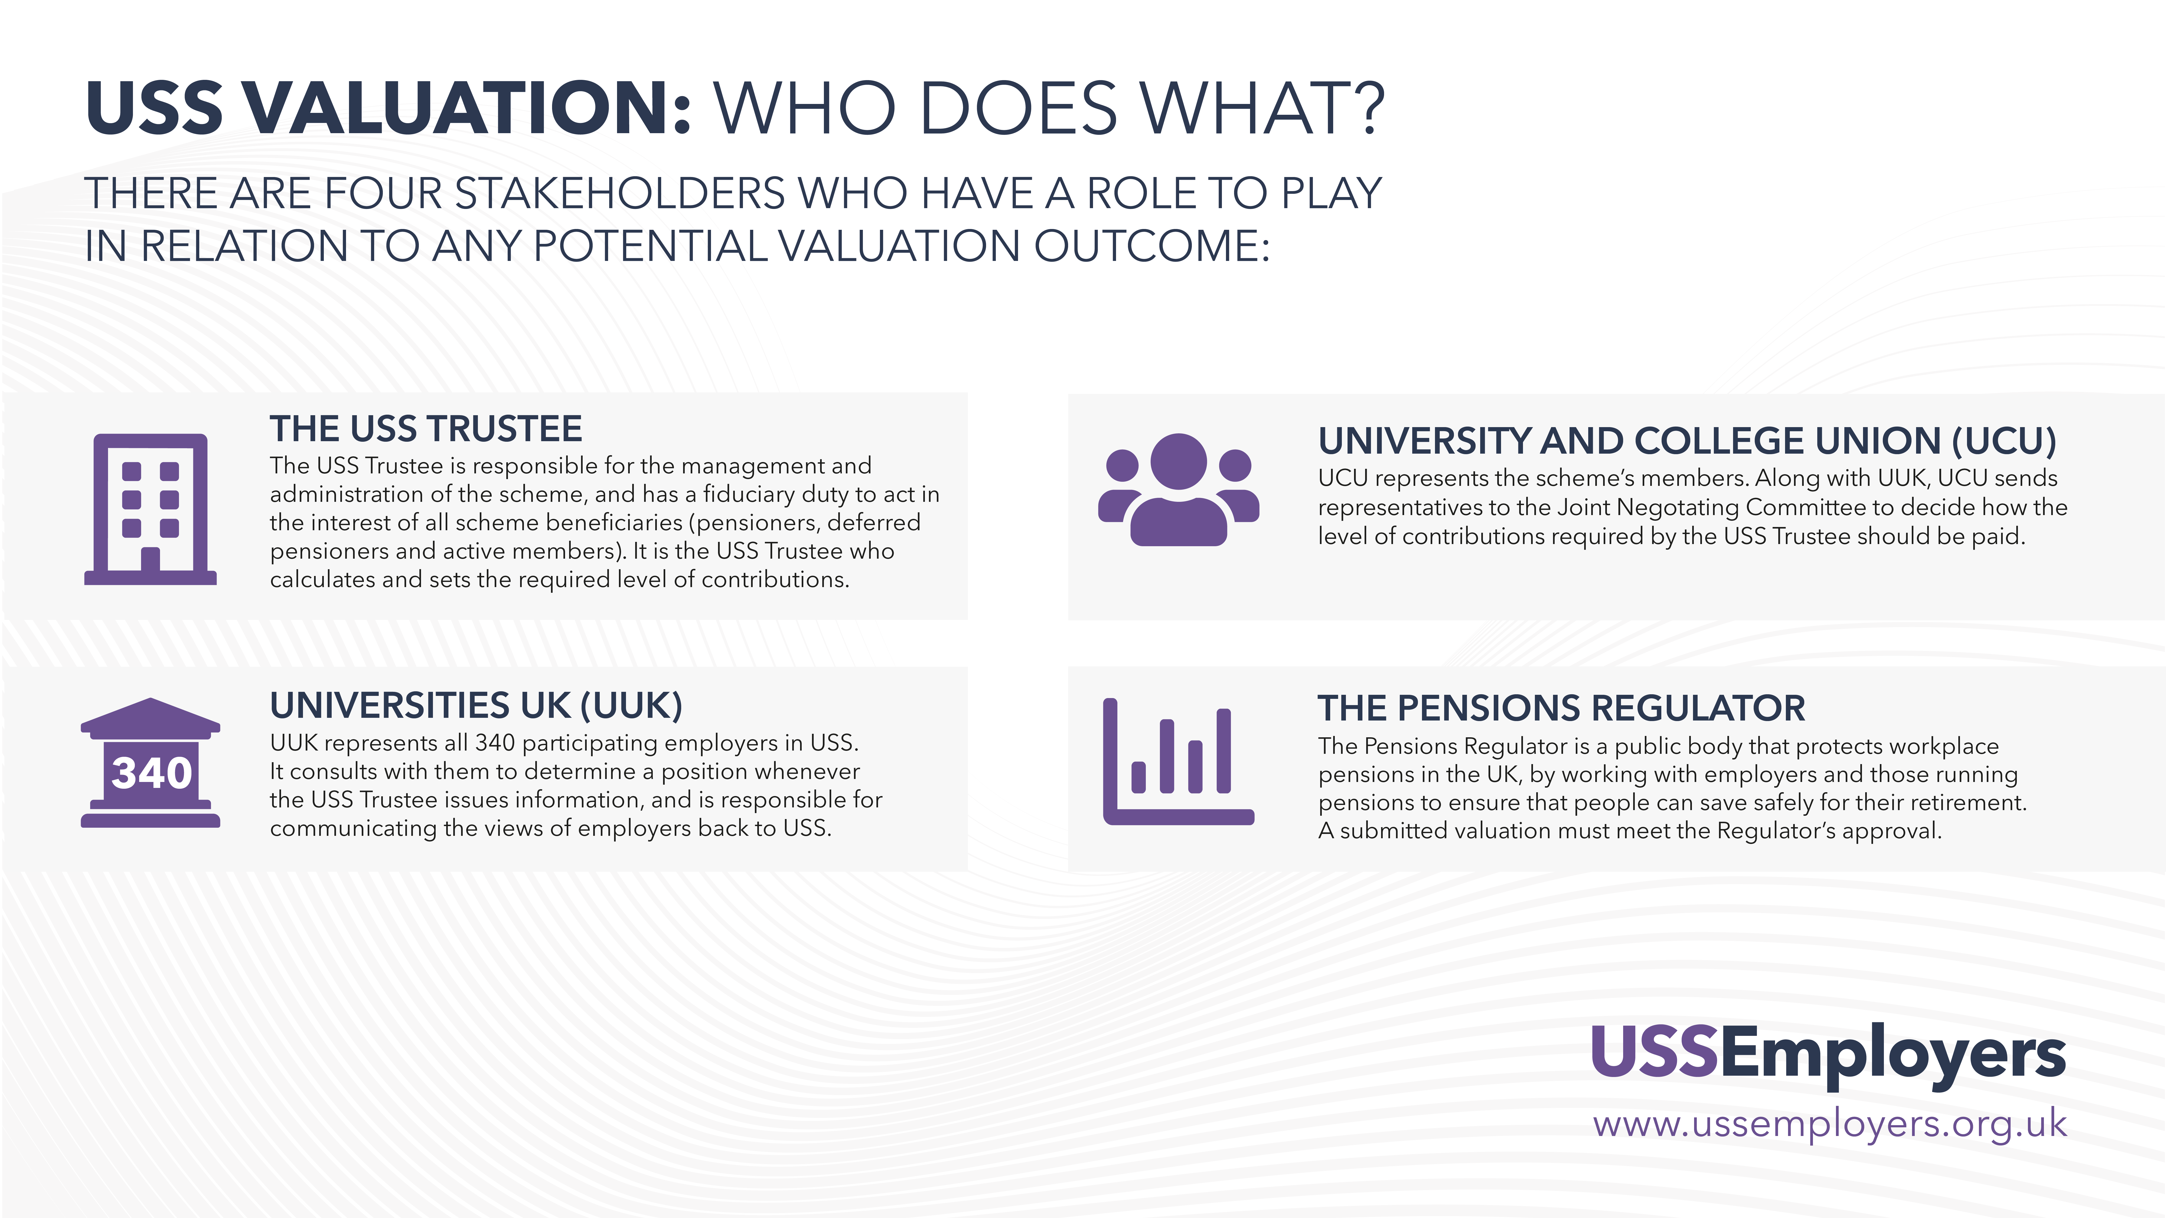
Notes:
There are four main stakeholders involved in the valuation:
The USS Trustee has legal responsibility for the running of the scheme and ensuring that pension promises are paid as they should be.
UUK represents all 340 employers in the scheme.
UCU represents all scheme members, even those who aren’t members of UCU
The Pensions Regulator is the public body responsible for regulating workplace pensions in the UK. All valuations must be submitted to the Regulator for approval, to satisfy it that the scheme is on a secure and sustainable footing.

Slide 7
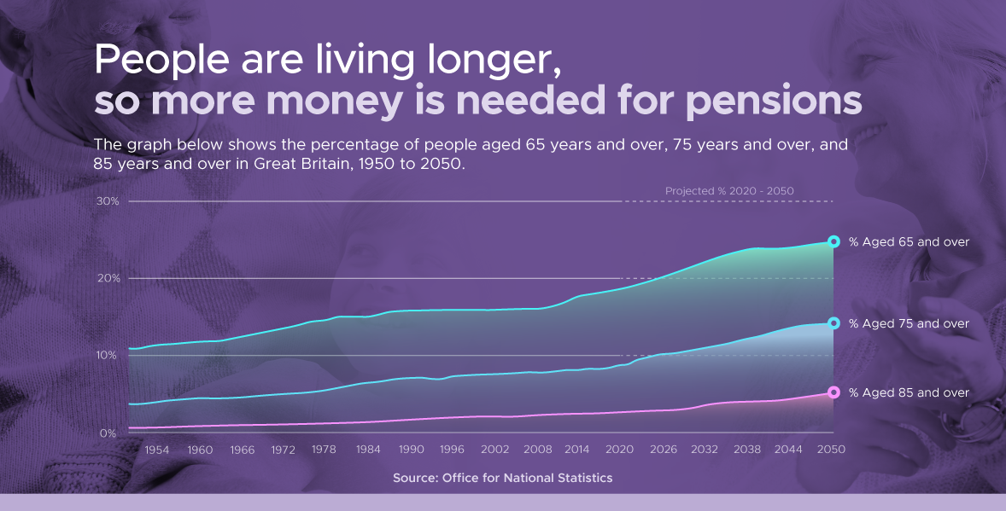
Notes:
In recent years, the cost of providing all defined benefit pensions in the UK has risen because people are living longer, and the economic environment has been challenging with long-term low interest rates and a weak outlook for investments, generally, in the future.
This has impacted all defined benefit pension schemes in the UK. The average cost has gone up by a quarter in six years. As a result, many defined benefit schemes have already closed.
The number of private sector schemes in the UK has reduced from 3,500 to less than 800 in the past 15 years.
USS is one of those to continue to offer DB pensions to new members of staff.

Slide 8

Financial impact of Covid-19
Notes:
Covid-19 has made the financial outlook worse for pension schemes.
The money markets have been hit hard and the value of investments has decreased. This means that more money has to be found to meet pension promises in the future.
The Institute of Fiscal Studies estimates that Covid could cost higher education sector institutions £10 billion in lost income.
Universities face several risks to their finances, including reduced income from accommodation, conferences and catering, and universities have spent much more compared to a ‘normal’ year on Covid-19 safety measures, enhanced digital learning platforms, and putting additional learning and wellbeing support in place.
Covid financial challenges come on top of the long-term decline in student financing across the UK and in England there is uncertainty over future tuition fee levels, with the UK Government considering a fee cut.

Slide 9
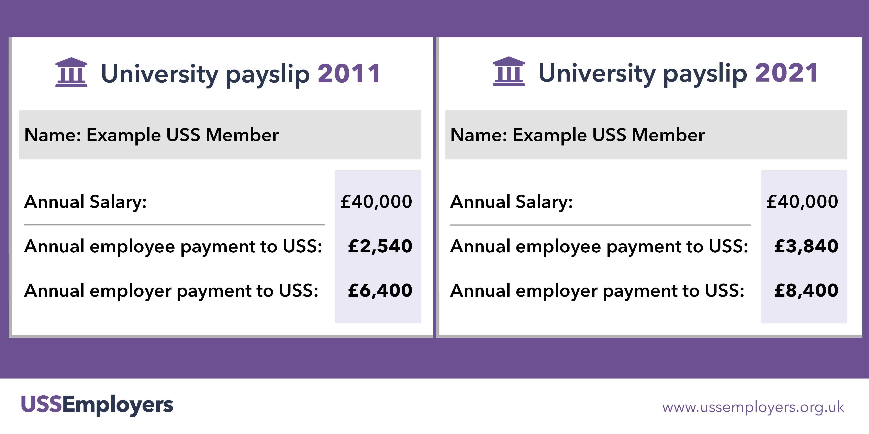
Contribution levels
Notes:
While the cost of providing pensions has gone up, so have the contributions of employers and you, scheme members, in order to keep the same level of benefits.
USS employers are paying in 21.1% of salary for each member. This is far higher than other private sector schemes – the average is 13% of salary for the combined employer and employee payments.

Slide 10
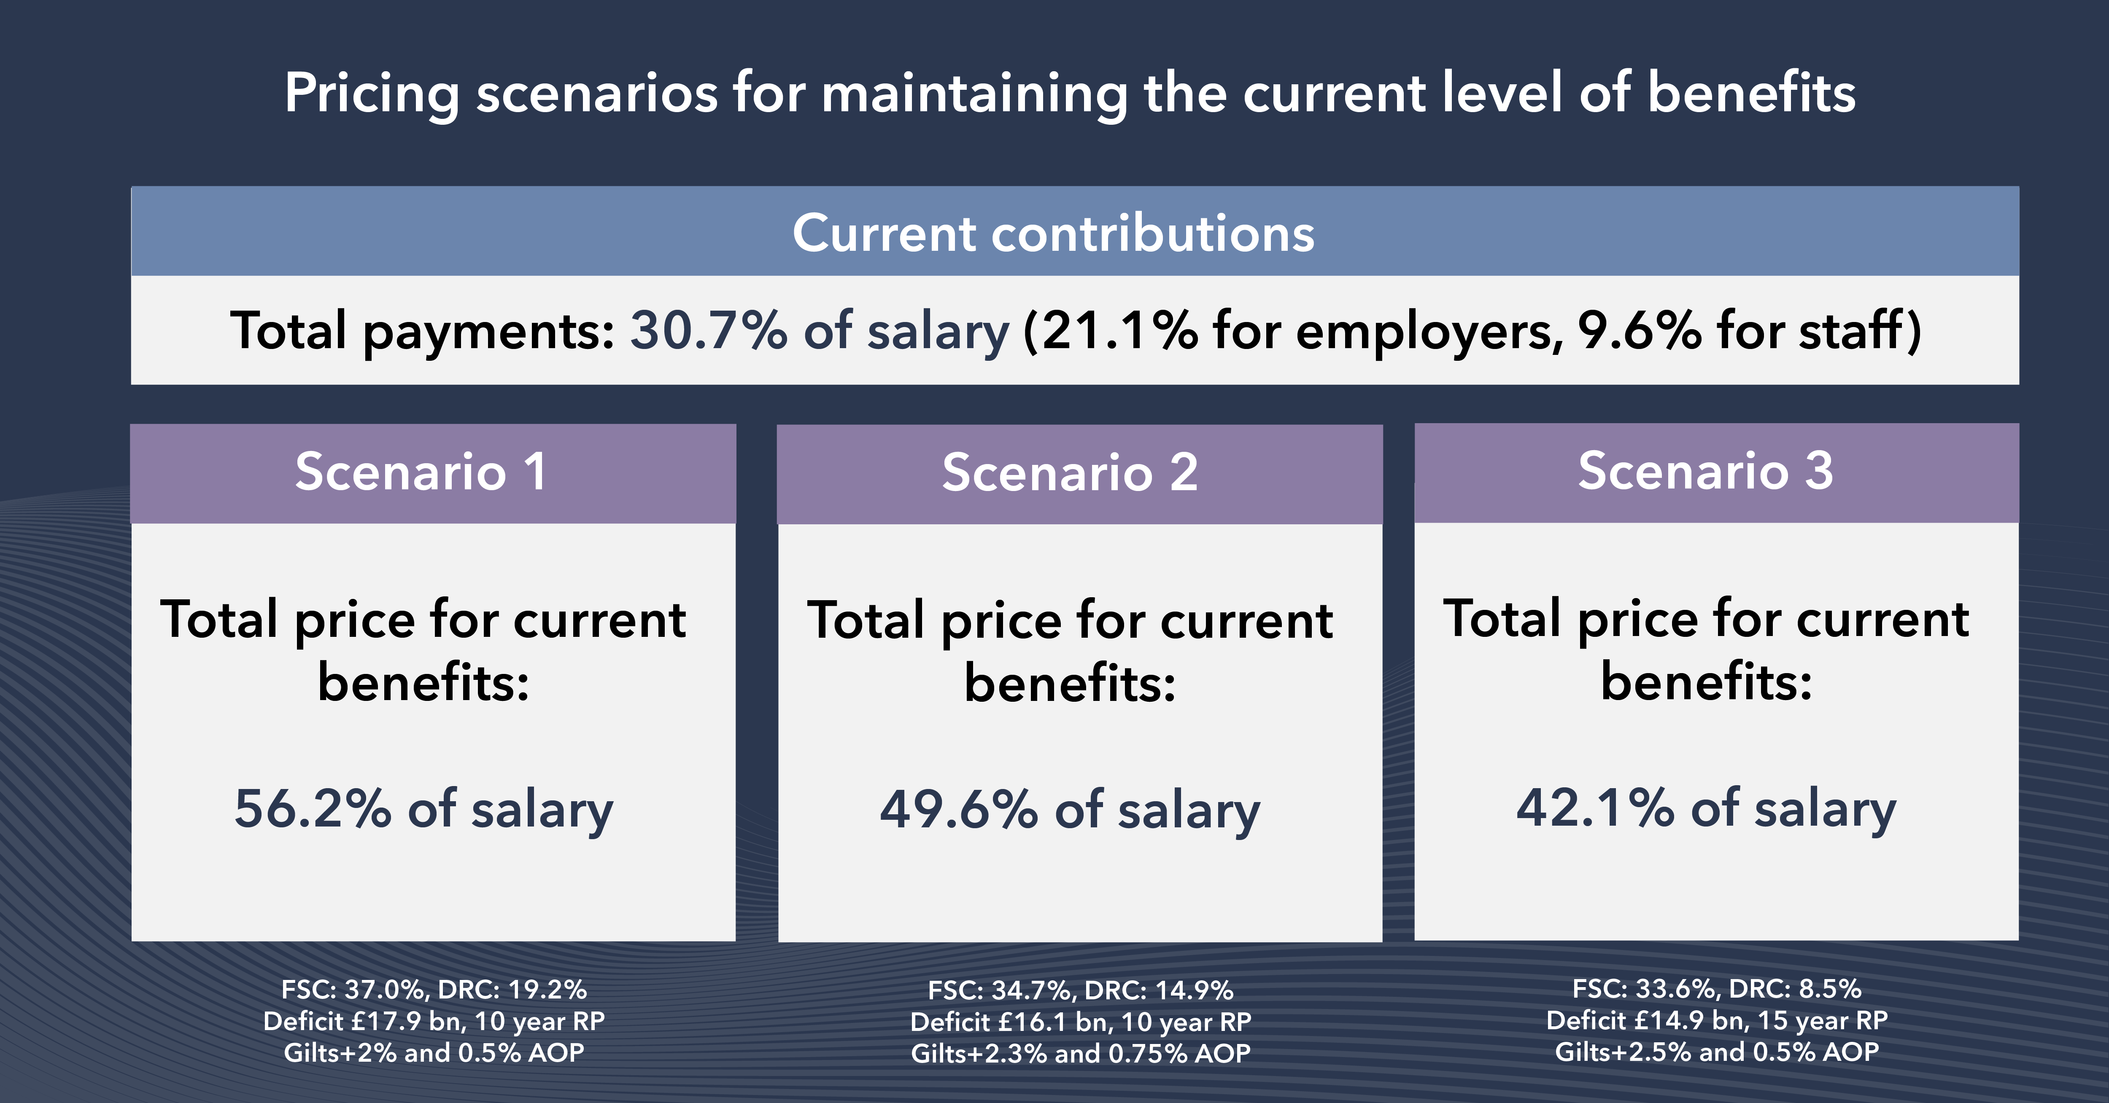
Notes:
In its announcement at the start of March 2021, the USS Trustee said it calculates the pension scheme faces a deficit of up to £17bn and that contributions to the scheme would need to increase from 30.7% (total current contributions for employers and employees) to at least 42.1% of salary to maintain the current level of benefits.
In response, employers said the very high prices for current benefits put forward by the USS Trustee would be unaffordable for employers, risk pricing even more staff out of the scheme, and undervalue the collective and enduring financial strength of the participating employers. UUK, on behalf of employers, continues to question the USS Trustee about its approach to the valuation and is questioning the role of The Pensions Regulator. You can see copies of their recent letters to the Pensions Regulator and the USS Trustee on the USS Employers website.
In the pricing put forward by USS there are three scenarios, which depend on how the ongoing discussions about covenant support conclude.
“Covenant strength” relates to long-term financial health of the universities that back the fund, and their commitment to it. UUK is proposing even more stringent covenant support measures as part of its current consultation. (PLEASE NOTE – this following sentence my be too technical. For example, this includes a longer moratorium on employer exists, 20 years, when under scenario 3 USS is asking for a 12-year moratorium. )
These commitments – if agreed by employers- would be substantial and go beyond the level of support USS has asked for in its scenarios.
In all scenarios, the USS Trustee is saying that the lowest price for current benefits is 42.1% of salary, which is unaffordable for employers and members alike and makes changes to the scheme inevitable.

Slide 11
How will benefits change?
It is too early to say how exactly pension benefits will change. It is important to stress that pensions built up to date are safe and can’t be changed.
Going forward, at the higher end of the USS Trustees’ pricing scenarios, DB pensions wouldn’t be a feasible option but at the lower end (scenario 3 – 42.1% contribution rate) it should be possible to offer defined benefits up to a lower salary threshold and a longer accrual rate.
Today
UUK alternative
Under the UUK alternative path, a better level of DB benefits would be possible than under the scenarios set out by the USS Trustee.
Accrual rate
1/75
1/85
DC threshold
£59,884
£40,000
Inflation cap
5% (10%)
2.5%
Notes:
It is too early to say how exactly pension benefits will change. Several factors will influence this, including the approach taken by the USS Trustee, the covenant support measures employers can provide, and the response of scheme members – how can the benefits package be best designed to suit their needs.
Remember that pensions built up to date are safe and can’t be changed retrospectively.
Going forward, at the higher end of the USS Trustees’ pricing scenarios, DB pensions wouldn’t be an affordable option. At the lower end (scenario 3 - 42% contribution rate) it should be possible to offer defined benefits up to a lower salary threshold and a longer accrual rate. The accrual rate is the proportion of salary a member receives annually as a pension in retirement under the defined benefit section of USS (it is currently 1/75th) and DB pensions are paid on earnings up to the salary threshold of £59,883.65. Under the USS Trustee’s scenario 3 the Trustee tells us that the accrual rate would be around 1/115 and the salary threshold around £40K.
Under the UUK alternative path, a better level of DB benefits would be possible – possibly with an accrual rate of 1/85 and DB up to the salary threshold of around £40K (with some inflation capping) and the same level of DC that currently exists above the threshold. USS would remain a valuable pension. However, it is important to stress that these figures are indicative at this stage and it would need compromise from all sides, including the USS Trustee, to be able to offer this sort of level of benefits.

Slide 12
Employers’ objectives for change
A valuable pension scheme for staff including a defined benefit element.
Fair valuation assumptions, leading to fair pricing by the USS Trustee.
Affordable contributions levels for members and employers.
Reducing the number of people priced out of the scheme by introducing an optional low-cost entry route for members.
Notes:
Universities UK is keeping up the pressure on the USS Trustee to reconsider its approach to the valuation and, as part of its consultation, launched on 7 April 2021, UUK is proposing an alternative path to the valuation which would reduce the headline costs put forward by USS and give scheme members the best possible level of benefits for more affordable contributions.
This alternative path includes employers offering further covenant support, the USS Trustee evolving their assumptions and affordable benefits which includes a defined benefit (DB) element.
UUK believes that the USS Trustee has the power and room for manoeuvre on its assumptions to lower its pricing to minimise the extent of the changes needed to the scheme and to keep alive a significant defined benefits element to the scheme. It would be a dreadful outcome if an overly cautious approach by the USS Trustee were to lead to unjustified and unnecessary cuts to the scheme.
The consultation also suggests ways of making USS appeal more to the generation of university staff being priced out of the scheme. The opt-out rate is currently around 20% - that’s one in five of eligible scheme members. The main reason given by those opting out is the high contribution level.
This means these colleagues are missing out on money from their employers, not saving for their future and not getting life cover or the other scheme benefits. This is more likely to impact on younger members of staff, adding to a sense of intergenerational unfairness in wider society.
USS is currently a one-size fits all scheme, so people can only be part of it if they are able to contribute 9.6% of their salary. One suggestion in the consultation is that an optional lower cost flexible pension payment could be introduced to help people at different stages in their lives. It would allow colleagues to choose to pay in less for a period but still benefit from a valuable employer contribution. This wouldn’t be a replacement for the main USS Scheme - it would be an optional short-term alternative for those who are currently unfairly priced out of the scheme.

Slide 13
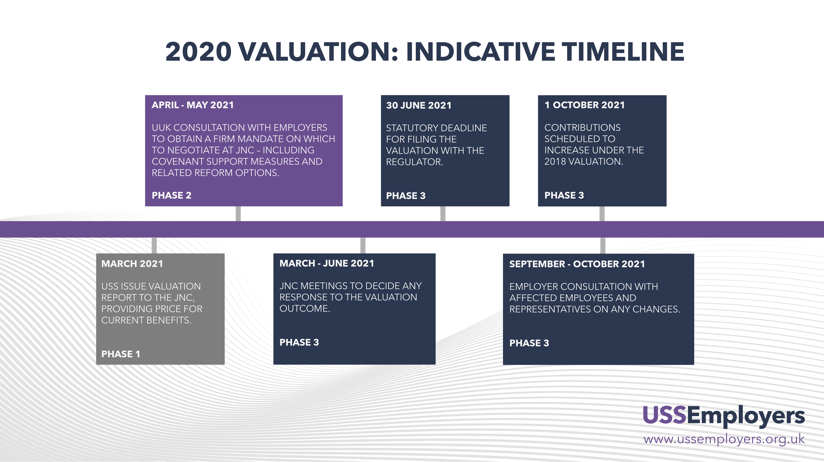
Notes:
So what’s the current state of play with the valuation?
In September, USS consulted Universities UK (UUK), on the technical provisions - key aspects of the valuation, including the methodology and the assumptions You can read the response of employers on the USS Employers website.
In March 2021, the USS Trustee published a series of prices for providing the current benefits – based upon different views of covenant support (the financial strength of employers sponsoring the scheme and their commitment to the scheme).
UUK is now consulting all employers on the issued raised and in turn employers are being urged to seek the views of all their staff eligible for USS. This will help inform discussions that continue to take place between UUK, UCU and USS and at the JNC. The JNC is made up of an equal number of representatives from UUK and member representatives from the University and College Union (UCU). It has an independent Chair. The JNC decides how any increase to the overall contribution rate should be shared between members and employers and whether any changes should be made to benefits or the structure of the scheme.

Slide 14

In summary
USS is a valuable pension scheme. Your pensions built up to date are secure and can’t be changed.
However, this is a challenging environment for pension schemes
USS has set very high prices to maintain current benefits in the 2020 valuation.
However the HE sector is facing short and medium term fiscal challenges made worse by financial impact of Covid-19.
UUK has proposed a way of bringing down these headline costs through covenant support and a different approach by the USS Trustee, with benefits including a defined benefit (DB) element.
New discussions will soon take place between UCU and UUK on potential changes to the scheme.
Universities have been asked to consult USS members on the proposals
We want therefore to hear from all of you how you feel the scheme could best work.
Notes:
In summary,
USS is facing long-term challenges created by rising life expectancy and low interest rates, and the financial outlook for universities has been made worse by the pandemic.
Employers and you, scheme members, have had to pay in increasing amounts of money to the scheme in recent years and the USS Trustee says even more money is needed to keep current benefits, at unaffordable levels for employers and scheme members alike.
We want USS to continue to be an excellent pension scheme which rewards and recognises your hard work – but the scheme needs to be sustainable and within the boundaries of the money available.
We know that talking about pension changes is unsettling, especially after the year everyone has had with Coronavirus. But doing nothing isn’t an option – the Trustee can impose much higher contributions without the agreement of employers and the union – but we can look at other options together. We want to reassure you that your USS pensions built up to date are secure and can’t be changed.
Through the UUK consultation, employers want to hear from you and the rest of the university community – including academic and professional services staff – as we look to tackle the deficit and make the scheme more appealing to staff.
With constructive engagement from everyone involved we can secure a valuable, inclusive, and sustainable pension scheme for the future
UUK is consulting employers on various options for achieving this and we will very much welcome your views as part of this process. You can read the full consultation document on the USS Employers website: www.ussemployers.org.uk

