Slide 1
Identity Formation in the Gig Economy
Dr Anna Roberts
Lecturer, School of Management
University of Bath Vice-Chancellor’s Research Day 2023

Slide 2

How do occupational identities form when work is for an gig economy organization?
Notes:
My research in this stream revolves around a central question:

Slide 3

Why is this question important?
At its best, work can be an important source of meaning, belonging, and identity in people’s lives.
Occupational identities – “self-defining beliefs, values, and assumptions about what it means to be a member of an occupational group” (DiBenigno, 2022) – are central drivers of behavior at work.
Notes:
Task rituals
Standards for proper and improper behavior
Work codes surrounding routine practices
Accounts attesting to the logic/value of these

Slide 4
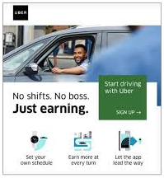
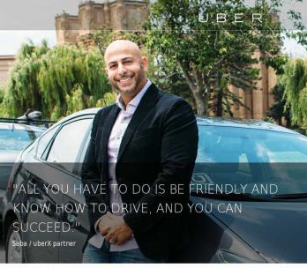
Why is this question relevant?
Increasing numbers of people now work in ‘nonstandard’ forms of work, either as platform workers or gig workers.
These platform organizations offer the prospect of independence and agency (Curchod et al., 2014).
However, research shows that this expectation is frustrated because algorithmic management and control reduce agency and therefore contradict the promise of independence (Cameron & Rahman, 2022; Curchod et al., 2019).
Notes:
Gig-working in England and Wales more than doubled from 2016-2021 and continues to grow.
Almost 15% of working adults now get paid by platform such as Deliveroo, Uber and Amazon’s delivery arm Flex, compared with about 6% in 2016 and just under 12% in 2019 (University of Hertfordshire & BritainThinks, 2021)

Slide 5


What happens when “what we do” is disconnected from “who we are”?
Certain expectations of what work will entail (Louis, 1980), even though the occupation itself is still undefined (Murphy & Kreiner, 2020).
Should trigger collective interactions with others in the occupation, such as on-the-job role modelling and mentorship (Ibarra, 1999) in order to adapt their identities (Ibarra & Barbulescu, 2010; Nelson & Irwin, 2014; Pratt et al., 2006).
Notes:
“What we do” and “who we are” are two elements of occupational identity formation (Ashcraft, 2013; DiBenigno, 2022; Galperin, 2017; Pratt et al., 2006).
People who enter nonstandard work still have certain expectations of what work will entail (Louis, 1980), even though the occupation itself is still undefined (Murphy & Kreiner, 2020).
Prior scholarship has suggested that identity-related expectations mismatched with work demands should trigger collective interactions with others in the occupation, such as on-the-job role modelling and mentorship (Ibarra, 1999) in order to adapt their identities (Ibarra & Barbulescu, 2010; Nelson & Irwin, 2014; Pratt et al., 2006).

Slide 6

Yet, this on-the-job identity formation is unavailable to gig economy workers.
Notes:
Gig economy workers are largely disconnected from each other and kept by the company at a distance.
Gig economy workers lack the identity content – occupational values, legitimating ideologies, clear goals, tasks, and/or routines – to form the nascent occupational identity as they are part of a new occupation (Curchod et al., 2014; Murphy & Kreiner, 2020).
Together, these conditions threaten their ability to form identities (Anicich, 2022).

Slide 7
How do occupational identities form when work is for an gig economy organization?
Notes:
This bring us back to my central question…

Slide 8


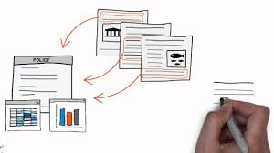
Qualitative Research Methods & Analysis
Netnography
Analytical Procedures
An online ethnography of a forum for Uber drivers (2015-2017)
Field site: Online watercooler + more
“Lurker”
Organizational media; journalistic accounts; popular blogs; books
Studied interactions between drivers on this site [threads]
Grounded theorizing (Charmaz)
Notes:
14-month netnography of a “online watercooler” website that Uber doesn’t monitor/control, as well as triangulated with org. media, news media, books, and popular blogs are about ridehailing work.
In my data analysis, my unit of analysis were interactions seen in online threads.

Slide 9
Interaction [Thread] within ShareSpot
ck2020 // 3:46 pm
Just started driving for some extra cash, advice? Anyone have any good tips for a brand new driver? Just trying to make the best of it!
LotusBoats
ck2020
Vomit bag
Ah, good idea.
MrFob
Use Waze or Google Map. [Double] Check destination [with the passenger] before you drive, sometimes GPS will lead you to the opposite side of the block(destination) which could be annoying and could affect your ratings.
CBRadioStar
This [incorrect location at opposite side of the block] happens a ton... then again, most riders are clueless how GPS works, so there's also that...
FatPalbert
If they don't show up to the car in 5 minutes, you can cancel and receive cancel fee of $5 minus Ubers cut. Often it will pay more than the ride would have. When cancelling be sure to select "rider no show". I didn't know this my first week, and was wasting up to 30 minutes trying to find some riders. Good luck!
HeyNBA
Hello, new member. Welcome to this fine forum, where you can learn all sorts of useful information, and you may also find a lot of watercooler chat. [Lists information and tips..]

Slide 10

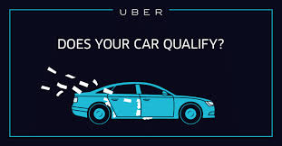
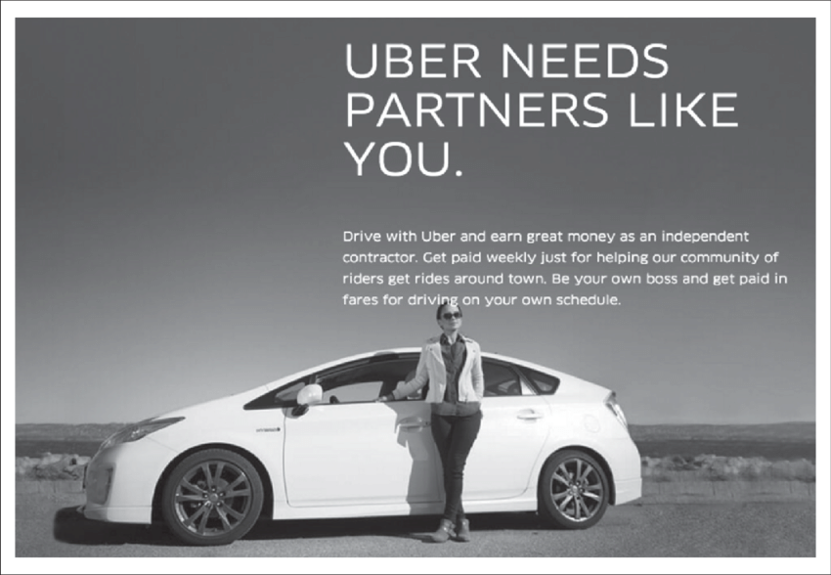

What did we find?
Extruded into “app users”
Effaced into “driver-bots”
Entrepreneurialized into “driver-partners”
(Roberts & Zietsma, 2019)
Fatalism and Cynicism
Notes:
Different identities were shaped by different types of discursive disconnection to the organization (Roberts & Zietsma, 2019)
While extrusions shape drivers into new
forms through organizational processes, effacements are “defined as occasions
where people or materials are treated as if they are no longer necessary to the
process, but neither are they actually eliminated or excluded from it,” according
to Munro (1997, p. 44). The effaced role constructed workers as expected to
execute organizational requirements and wishes flawlessly, as if they were
driverbots, at the same time as their visibility was minimized or eliminated by
boundary discourse.
These different identities were contradictory, prompting fatalism and cynicism (Roberts & Zietsma 2019)

Slide 11
“After my first month working with Uber (I won’t say for them because they will deny it in a court of law) I realize that this is what working with an algorithm is like, it is a cold heartless calculation, system on system off, arrogated feelings of several hundred people distilled to stars which is entered into another formula which monitors driver’s usage vs call demand, to say fire, incentivize, reduce rate, eliminate, there is no true human emotion or human relations within the company, so I don’t expect any from them, even with their "we're good friends and partners" emails that I ignore”
(Social Media, 6-22-2016).

Slide 12
What else?
This identity work is informed by logics of market capitalism through which they understand themselves and their work (Roberts, 2021).
They developed bifurcated identities that embrace both an ‘American dream’ of a meritocratic market where anyone can get ahead by working hard and a Hobbesian Jungle where competition makes their working lives “nasty, brutish, and short” (Hobbes, 1651).

Slide 13
Why does this research matter?
While online forums have been hailed by scholars as a space with potential for worker empowerment and knowledge sharing (Kellogg et al., 2020), this study shows both the “light” and the “dark” side of online community spaces.
On the positive side, participating in the forum gives workers access to meaningful, specialized knowledge from experienced workers.
On the negative side, my study gives greater insight into the identity alienation that is experienced when working with algorithms (Curchod et al., 2014).
Notes:
My research demonstrates variation in experiences of both algorithmic management and identity work across new occupations emerging as a result of digitalization. As seen in my study, ride-hail drivers have a different scope for autonomy than other gig economy workers that have been studied (Curchod et al., 2019; Petriglieri et al., 2019; Rahman & Valentine, 2021).
While online forums have been hailed by scholars as a space with potential for worker empowerment and knowledge sharing (Kellogg et al., 2020), this study shows both the “light” and the “dark” side of online community spaces.
On the positive side, participating in the forum gives workers access to meaningful, specialized knowledge from experienced workers
On the negative side, my study gives greater insight into the identity alienation that is experienced when working with algorithms (Curchod et al., 2014).

