Slide 1
AI in Healthcare: Dynamic surgery management under uncertainty
Dr. Elvan Gokalp
Information, Decision, Operations
School of Management
VC Research Day 2023

Slide 2
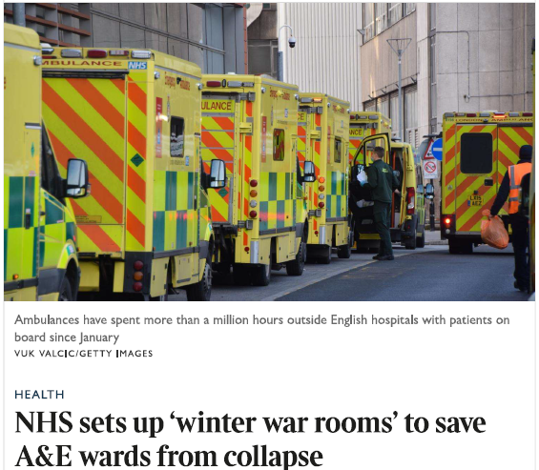

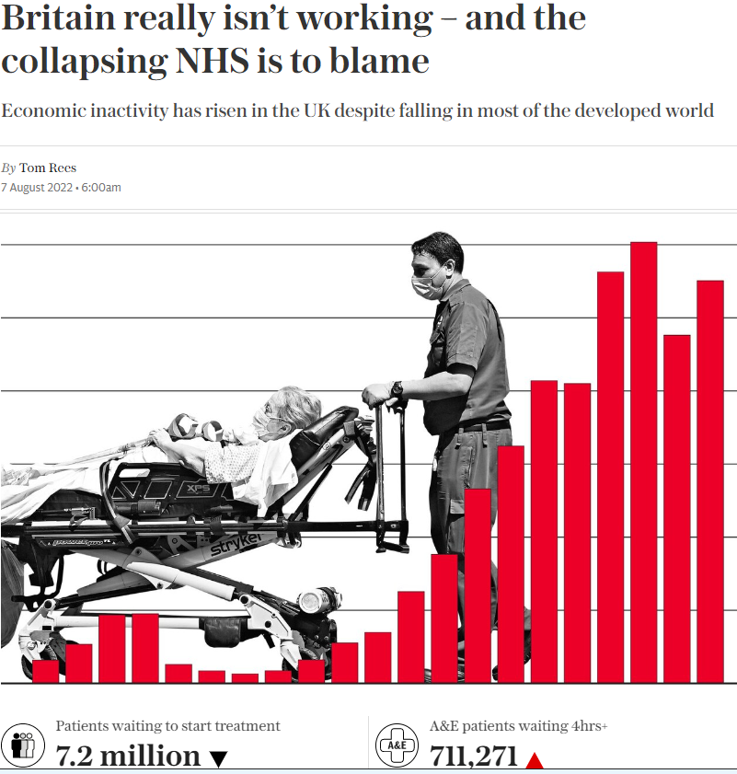
Problem
E Gökalp, N Gülpınar, XV Doan - European Journal of Operational Research, 2023
Notes:
NHS is collapsing
There is not enough capacity
Meaning we need to make more efficient operational decisions
AI can help us on making better decisions
My research looks at how we can use AI for healthcare
I will show one example here rearding operating theatres

Slide 3
Problem
E1, E2 … = Electives
N1, N2 … = Non-electives
start
Surgery completion
Surgery completion
E1
E2
N1
E2
N1
E3
N.e arrival
N.e arrival
end
E1-P1-T2
E3-P1-T1
E3-P1-T1
E4-P1-T1
E3-P1-T1
N2-P1-T2
E2-P1-T3
E4-P1-T1
N1-P2-T2
E4-P1-T1

Slide 4




What is the complexity?
Many rooms
Quick decision-making
Different types of surgeries
Surgery completions
Nonelective arrivals
Notes:
Number of rooms > 7

Slide 5



How is it handled in real life
40%
Non-electives
Revenue
RESERVE additional capacity for nes
INSERT within the schedule ad-hoc
79K
3.5K
Cancellations
Rejections
*HFMA, 2005
Notes:
Surgeries generate 40% of the revenue, so they need to be managed wisely

Slide 6

What we did?
Cannot solve it with classical methods (the size)
time =0
Completion t=1
Ne arrives t=1.5
t = 3
Reinforcement Learning (RL)
t = 4.5
Good decisions in very short period of time

Slide 7
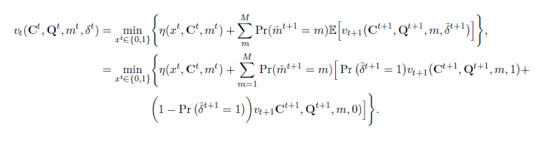
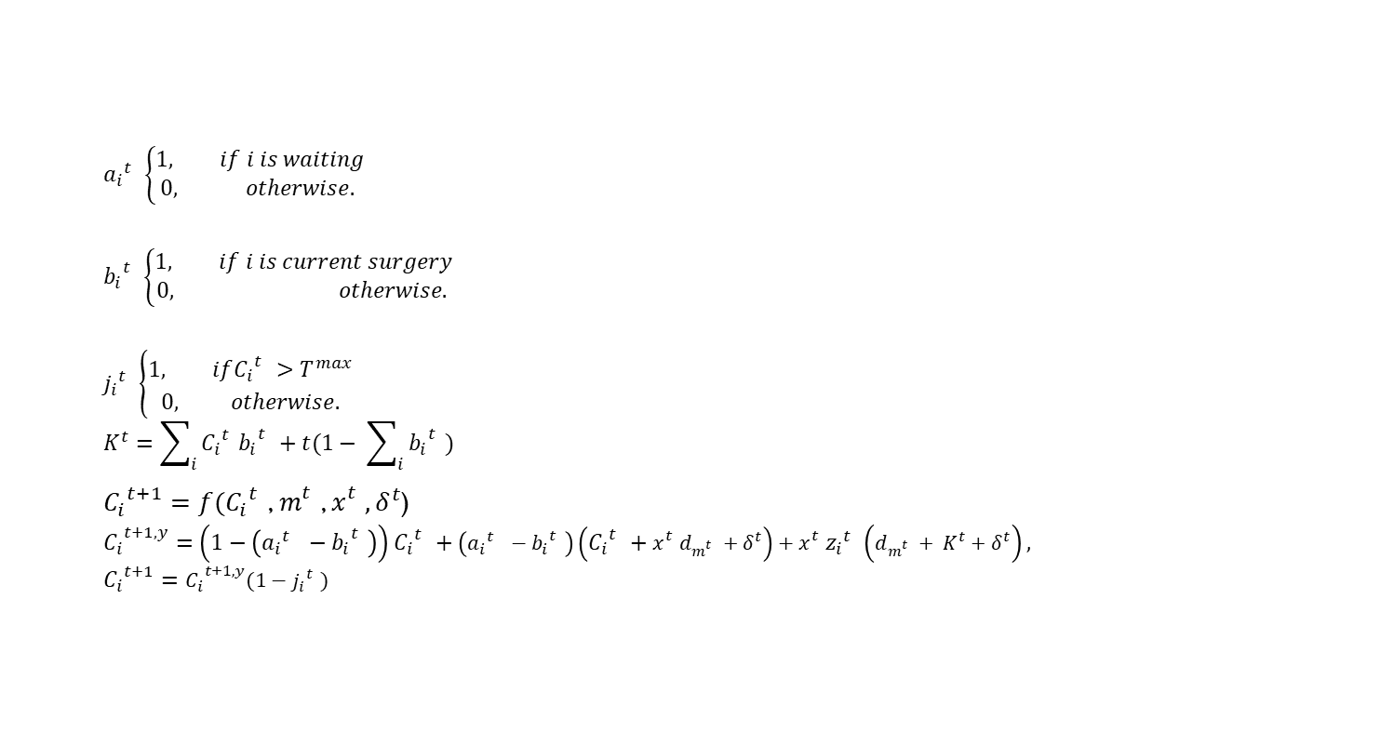
What we did?
$${a_{i}}_{}^{t}\left\{\begin{aligned}1, if i is waiting \\ 0, otherwise. \end{aligned}\right.$$
$${b_{i}}_{}^{t}\left\{\begin{aligned}1, if i is current surgery \\ 0, otherwise. \end{aligned}\right.$$
$${j_{i}}_{}^{t}\left\{\begin{aligned}1, if{C_{i}}_{}^{t}>T^{max} \\ 0, otherwise. \end{aligned}\right.$$
$$K^{t}=\sum_{i}{{C_{i}}_{}^{t}{b_{i}}_{}^{t}}+t(1− \sum_{i}{{b_{i}}_{}^{t}})$$
${C_{i}}_{}^{t+1}=f({C_{i}}_{}^{t}$, $m_{}^{t}$, $x_{}^{t},δ^{t}$)
$${C_{i}}_{}^{t+1, y}=\left(1−\left({a_{i}}_{}^{t} −{b_{i}}_{}^{t}\right)\right){C_{i}}_{}^{t}+\left({a_{i}}_{}^{t} −{b_{i}}_{}^{t}\right)\left({C_{i}}_{}^{t}+x_{}^{t}d_{m_{}^{t}}+δ^{t}\right)+x_{}^{t}{z_{i}}_{}^{t}\left(d_{m_{}^{t}}+ K^{t}+δ^{t}\right),$$
$${C_{i}}_{}^{t+1}={C_{i}}_{}^{t+1, y}(1−{j_{i}}_{}^{t})$$
Notes:
Develop a mathematical representation of the problem

Slide 8

What we did?
Code RL algorithm
Get real data
Algorithm tells us which surgery to operate at which room whenever a room is emptied
Notes:
Get real data from a Dutch database

Slide 9
Did it work?
Compare with real-life (via simulation)
-8%
-13%
Waiting
Rescheduling
Notes:
8% less waiting of surgeries during the day
13% less re-scheduling to another day (non-completion)

Slide 10


COMPLEXITY
When there is a dynamic and uncertain problem, usually difficult to find the best solution
REALITY
Many real-life problems are as such
AI
can be very useful for these problems
Insights

Slide 11

THANK YOU!

Slide 12
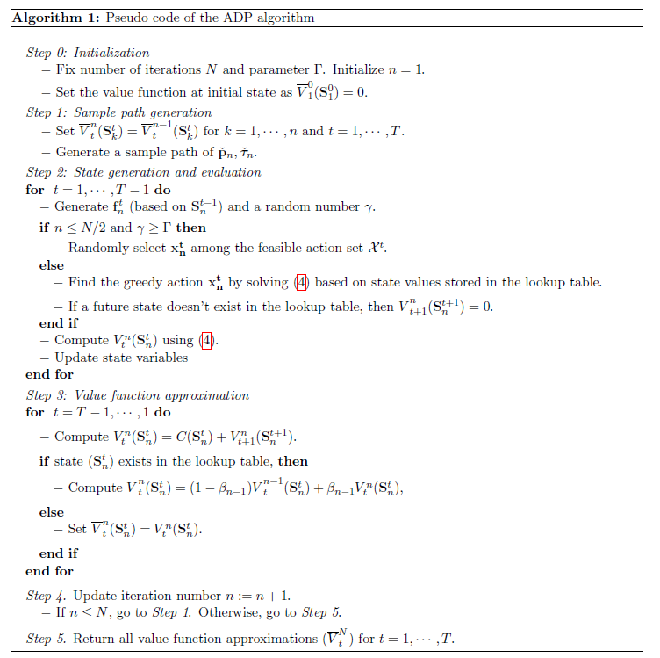
Extras

