Slide 1
Understanding Knowledge Challenges
Jordan Soukias Tchilingirian
Department of Social and Policy Sciences, CASP (co-director)
DoS Sociology, Social Policy, Social Sciences
Notes:
Sociology of Knowledge, Political Sociology, Policy Knowledge

Slide 2
The problem
Practical problem
Policy actors need knowledge!
There are multiple sites of ‘expertise’- not all good!
How do you get the best knowledge to those who need it?
Intellectual problem
Implicit rationalism in studies of evidence and policy
Beyond ‘Evidence Based Policy’, ‘Propaganda/Spin’,
Critique of case study/individualised view of research ‘impact’
Solution?
Focus on the wider ecology that produces and consumes different forms of knowledge in public policy

Slide 3
Research programme
Aim
Understanding Knowledge Challenges
the ability of policy actors to locate, distinguish, comprehend, create, and respond to competing sources of knowledge, expertise and ‘non-knowledge’ (from disinformation, amnesia, ignorance).
Output
Intellectual: New theoretical and methodological approach for studying knowledge and 'non-knowledge' in policy
Institutional: Establish a research and professional training groups around knowledge challenges

Slide 4
Achieved through two strands of research
Re-thinking knowledge regimes
Comparative, primarily quantitative
Based on social network analysis of ‘interventions’ of knowledge and non-knowledge
Mapping relational and institutional aspects of knowledge production/consumption
2. Confronting knowledge challenges
How knowledge and non-knowledge is used (qualitative)
Interviews and workshops with policy actors

Slide 5
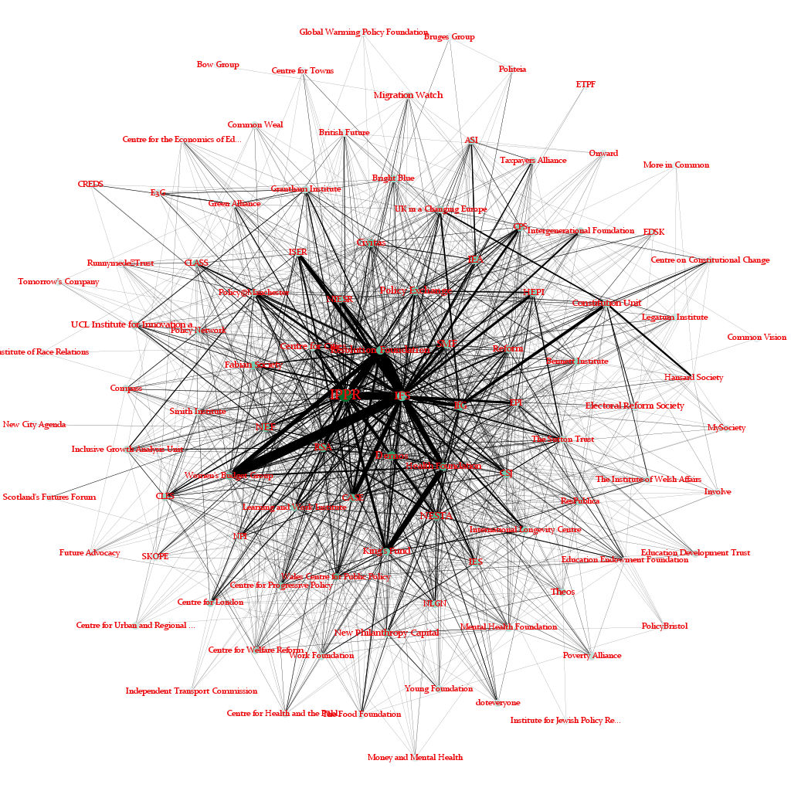
Westminster Minded: think tanks and the changing British knowledge regime Draws on a longitudinal database of co-funder, co-author, co-advice networks Analyses the structure and composition of the funding, advice, authorship and citation networks of the UK’s think-tanks

Slide 6
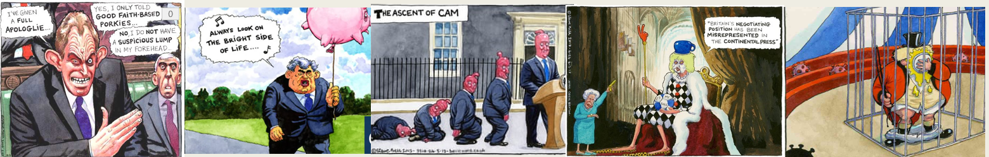
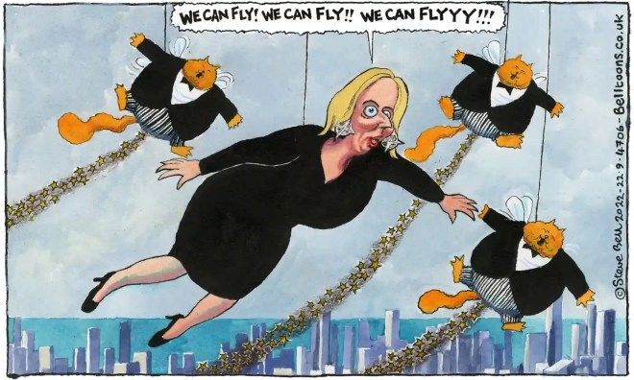
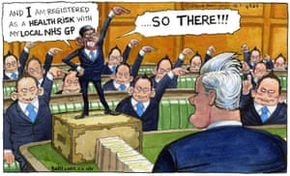
Longitudinal SNA to map changes in the British knowledge regime over a period of relative stability and crisis
‘Routine changes’ e.g. elections – but highlight significant developments
Continuing economic crisis
Rise of tech
Changes in (social) media
Referenda on Brexit & Scottish Independence
Rise of the culture wars and ‘populism’
Covid 19
Changes to HE and wider science system
End of New Labour 2005 - 10
Coalition and Cameron 2010 - 2016
Johnson, Truss, Sunack 2019 – to ????
May 2016 - 2019
Change in policy discourse?
Post Neo Liberalism?
Crisis of Expertise?

Slide 7
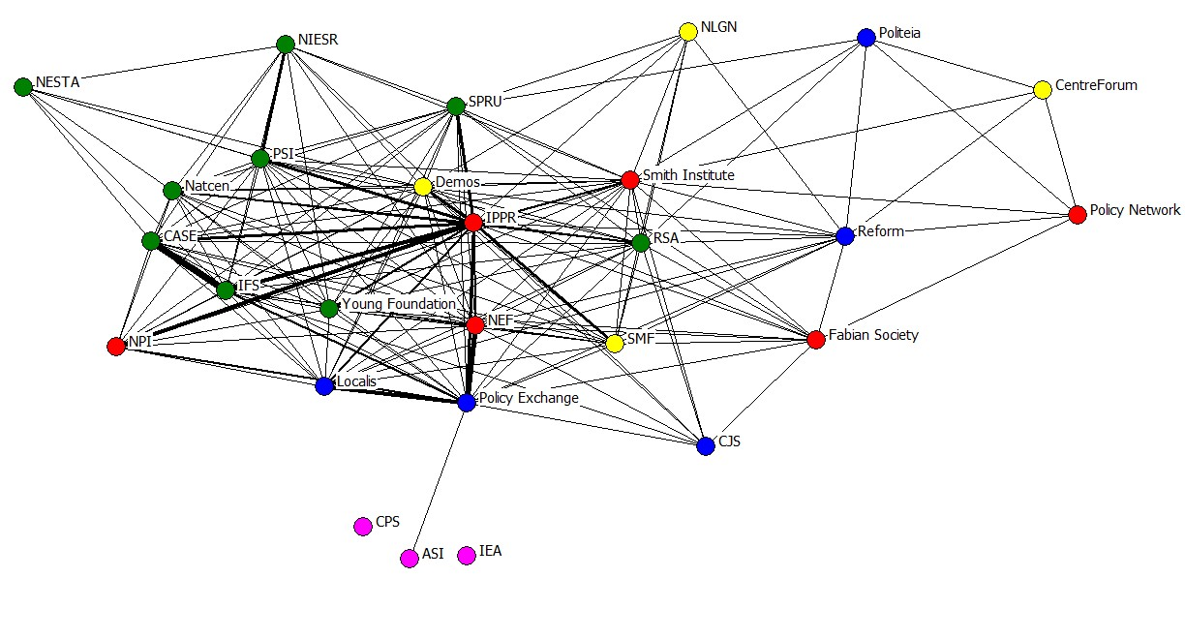
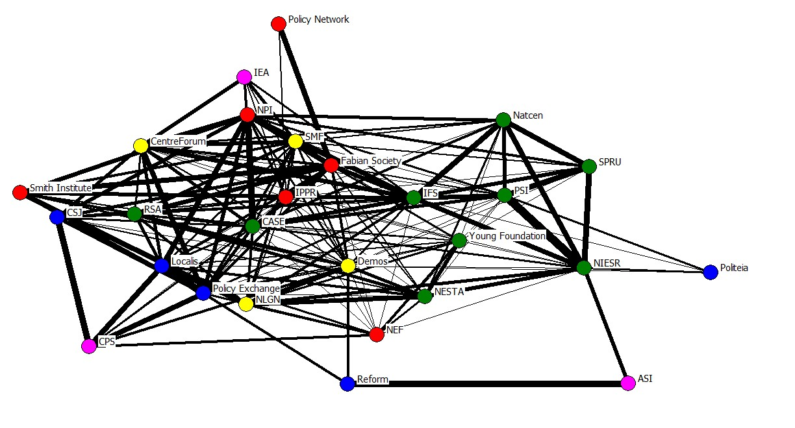
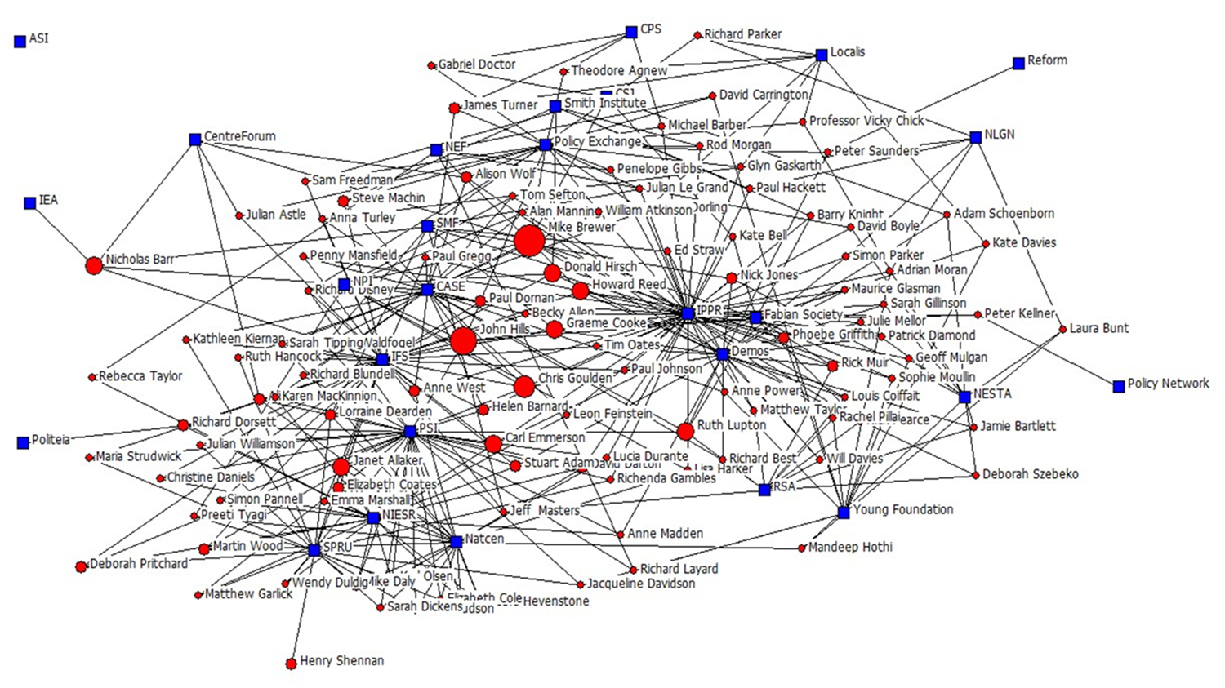
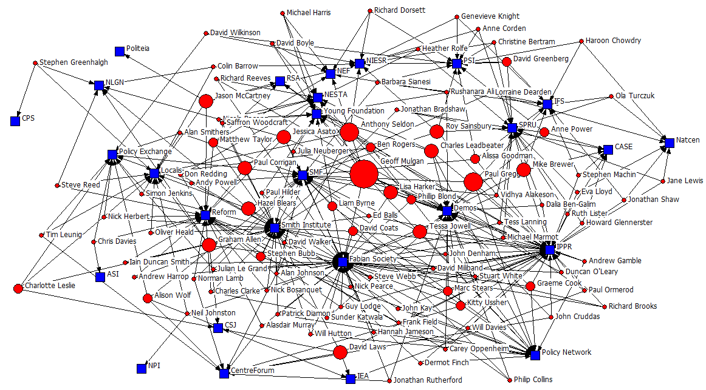
Resources and the structure of the knowledge regime
Changing relationships between think-tanks on shared resources
Fluctuations in ideological (or other forms of) polarisation across each network
Change or stability in the resources of knowledge production

Slide 8
The ‘revolving door’ and sustaining a regime
Quantitative SNA: Combining think tank database with publically available data on civil service/SPAD appointments, political appointments, announcement of jobs (on organisation websites, social media profiles, LinkedIn)
Biographical semi-structured interviews: Elucidate the strategies of a policy-intellectual’s career (practices and social capital)
Project also raises questions relating to career trajectories, and inequality amongst social and political elites (esp. university attendance, qualifications/disciplines, gender, class, race
All impact how knowledge circulates amongst policy elites
Think-tank 1
NGO
Business
Think-tank 2
SPAD
Notes:
Thought resoruces are helpful for understanding the production of knowledge at the individual and organisational level it is also important to think about the sustaining of the macro structure
I propose this can be done thrugh the study of individual career trajectories through the revolving door
During this 5 year period I will also seek funding for a project on the demographics and careers of policy workers to explore whether and how attributes such as educational background and gender interact with career prestige and ability to influence within the policy intellectual community. Using the longitudinal data I have gathered will enable me to explore the spectrum of policy intellectual career trajectories of network actors (and their associated expertise) who take on governmental and non-governmental roles. This project will be the first in-depth study of the machinations of, and power dynamics at play, within ‘the revolving door’ of the British knowledge-policy nexus. I will be able to identify the powerful professionals who not only shape policy discourses but also influence legislation, as well as those who become isolated or drop out of the nexus. I aim to apply to the Hewlett Foundation and the International Social Research Foundation in 2022 for a grant to fund in-depth fieldwork based on the initial quantitative research. This strand of research will make a significant contribution to the study of policy expertise and policy knowledge, as the vast majority of research focuses on the discursive or institutional arrangements rather than policy as an industry with a labour force

Slide 9
Collaborations at Bath and beyond: epistemic justice in transnational knowledge regimes
1. (Dis)Ordering justice in transition: The making of an unruly field
- Interdisciplinary collaboration with colleagues from Bath, Smithsonian, Uni of Sydney
‘Big Data’ SNA and discourse analysis of the development of knowledge about and for transitional justice from multiple disciplines and (nonacademic) practitioners
Under review for BA Knowledge Frontier
2. Mapping social policy and conflict prevention research about the MENA
- Collaboration with the MENASP Network (Bath) and the Centre for Muslim States and Societies (UWA)
How can an interdisciplinary area of research be created?
SNA to map internal structure of each discipline and find possible sites of collaboration (thematic, institutional etc) for researchers and research funders

Slide 10
Answers key questions
Who produces knowledge for public policy?
What disciplines and professions are active in public policy
Are their key attributes of experts (sector, gender, nationality and so on)?
Which actors remain active in producing policy relevant knowledge?
How impactful is academic knowledge compared to other sources of knowledge (business, activist, other professions)?
Are there better measures and strategies to allow impact?
What knowledge is excluded or missed?
How does ‘non-knowledge’ circulate in a regime?
Following the ideas and those who promote them
Understanding ‘grmpact’ and ‘impact’
How might a knowledge regime be ‘rewired’ to allow more equitable and ‘quality’ knowledge circulate?

Slide 11
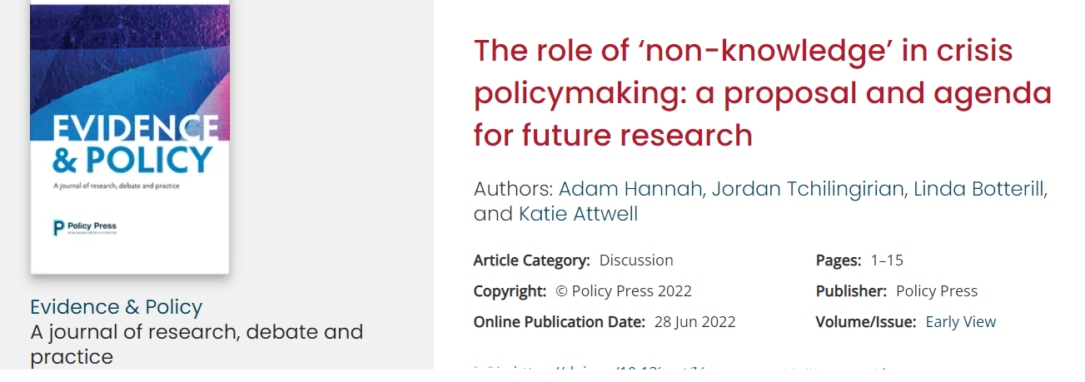
Confronting knowledge challenges
Mapping a regime is not enough!
Knowledge and non-knowledge in action
1.Comparative study of knowledge challenges in the UK and Australia
Primarily qualitative study of to understand how policy actors engage with knowledge/non-knowledge
Why do policy actors value certain forms of knowledge and non-knowledge?
What are the official and unofficial markers or credibility, trust, and quality?
How are they deployed?
What is the role of ignorance, (intuitional) amnesia in the selection and use of knowledge?
Do knowledge challenges change depending on policy areas and the intensity of crisis/non crisis moments?
2. Developing dialogical methods for academics and policy actors

Slide 12
Questions

