Slide 1

Exercise Snacking and Healthy Active Ageing
Dr Max J Western
Centre for Motivation and Health Behaviour Change
Department for Health

Slide 2
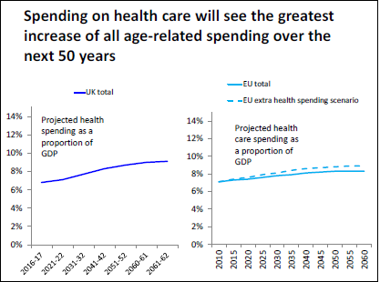
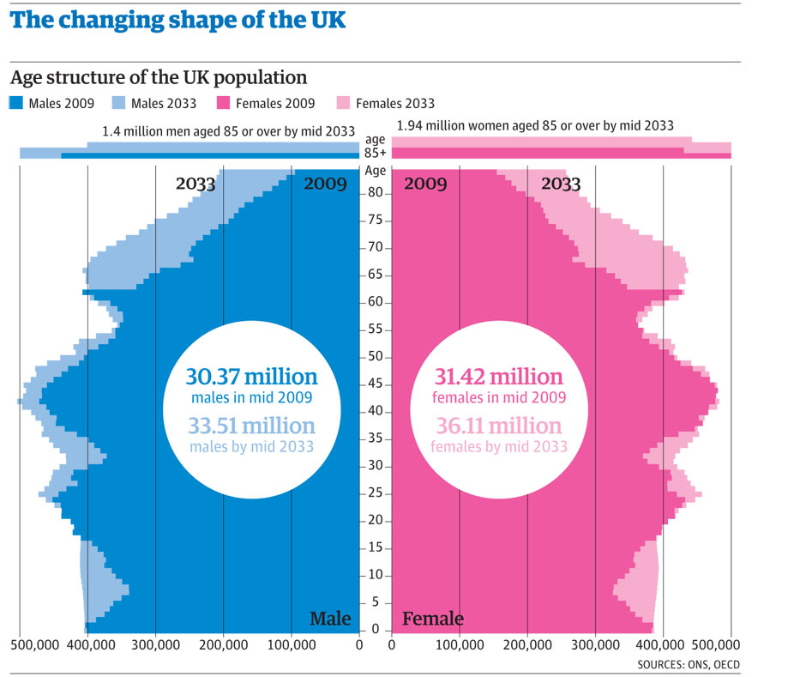
The Problem of Ageing
The total annual cost of fragility fractures to the UK has been estimated at £4.4 billion which includes £1.1 billion for social care; hip fractures account for around £2 billion of this sum

Slide 3
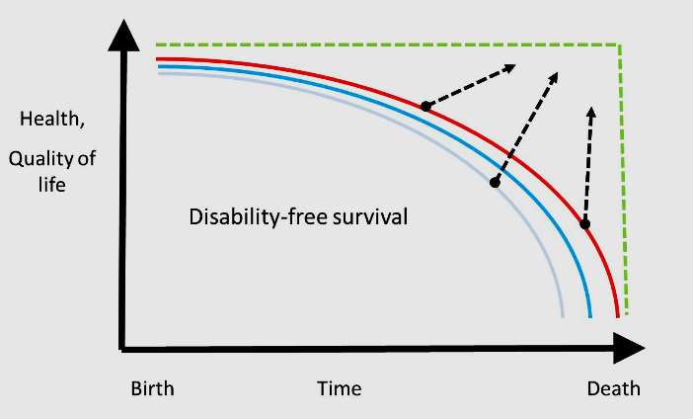
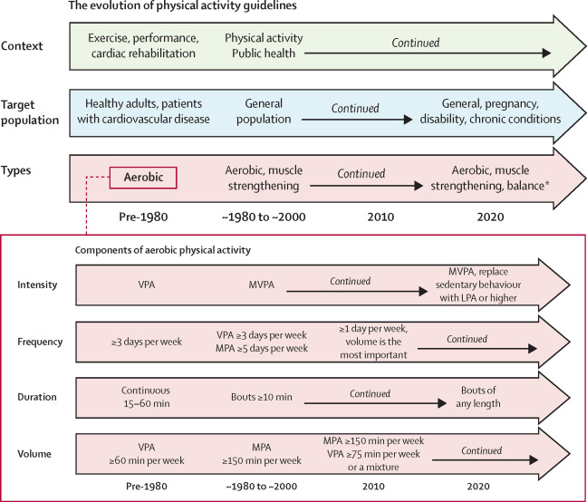
Exercise helps keep people strong, healthy and independent

Slide 4
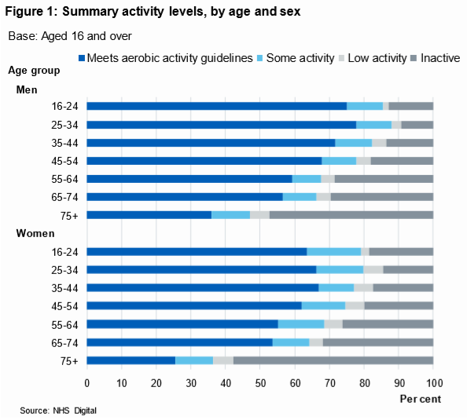
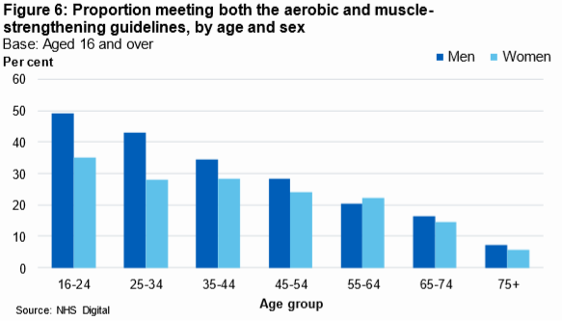
Not enough UK older adults do exercise
Health survey for England

Slide 5

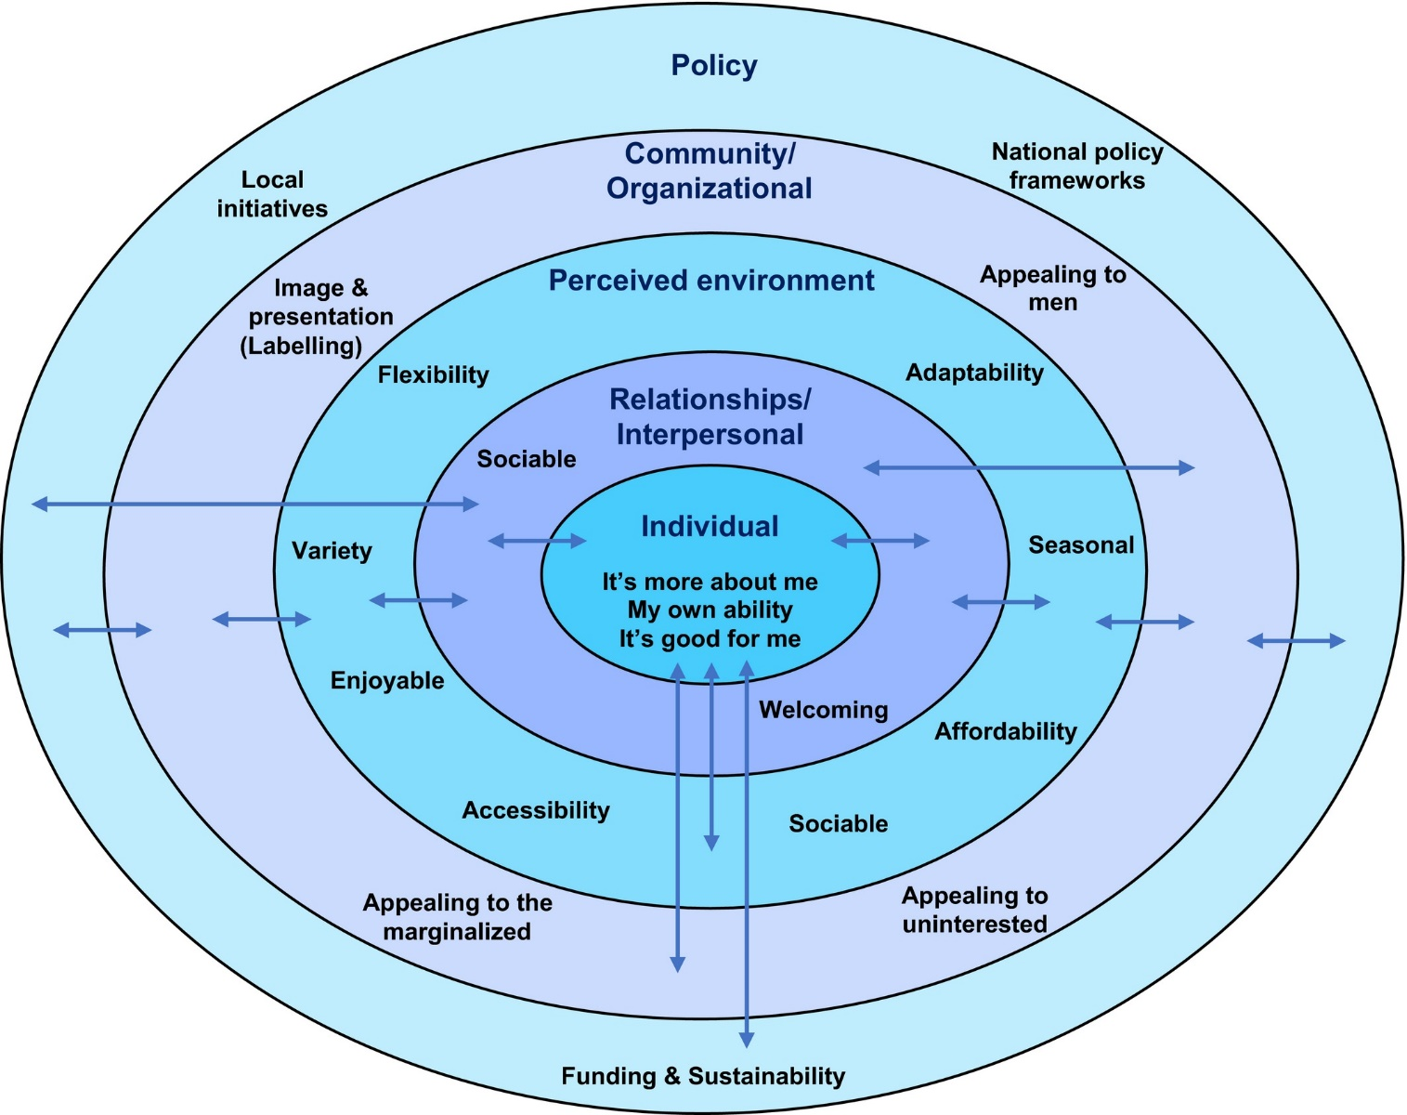
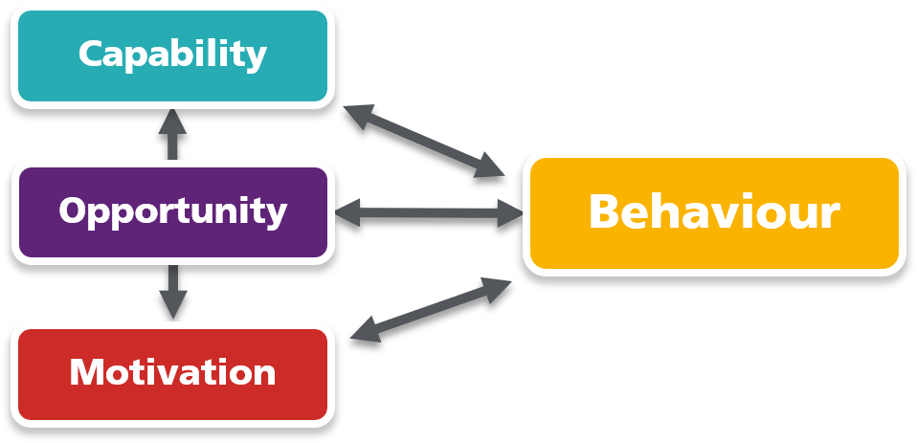
Age specific barriers to exercise

Slide 6
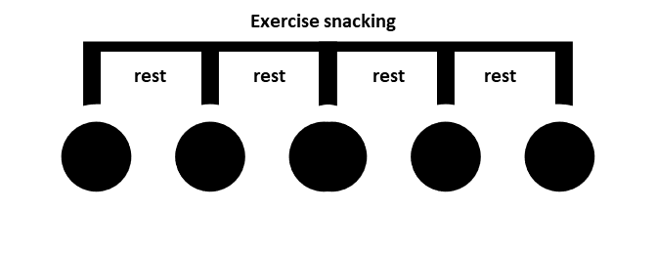
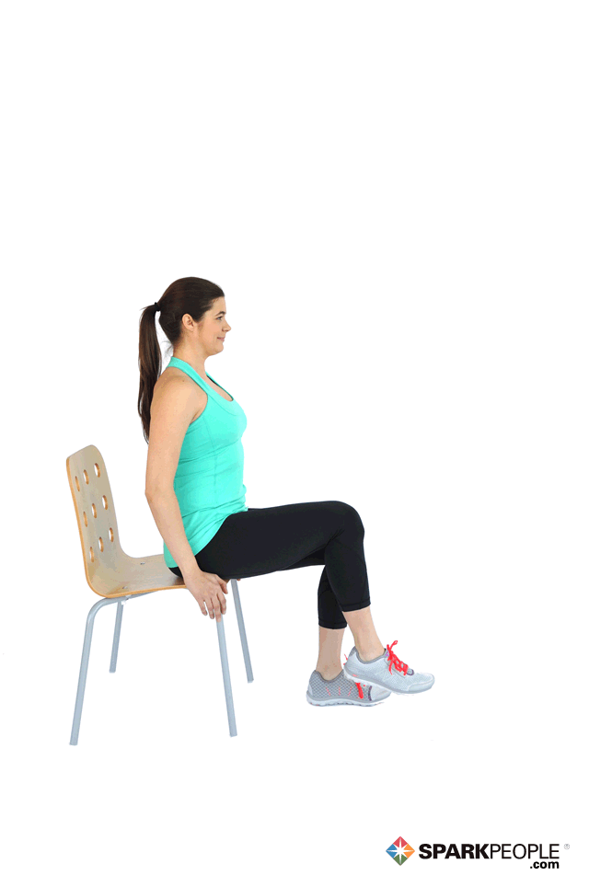
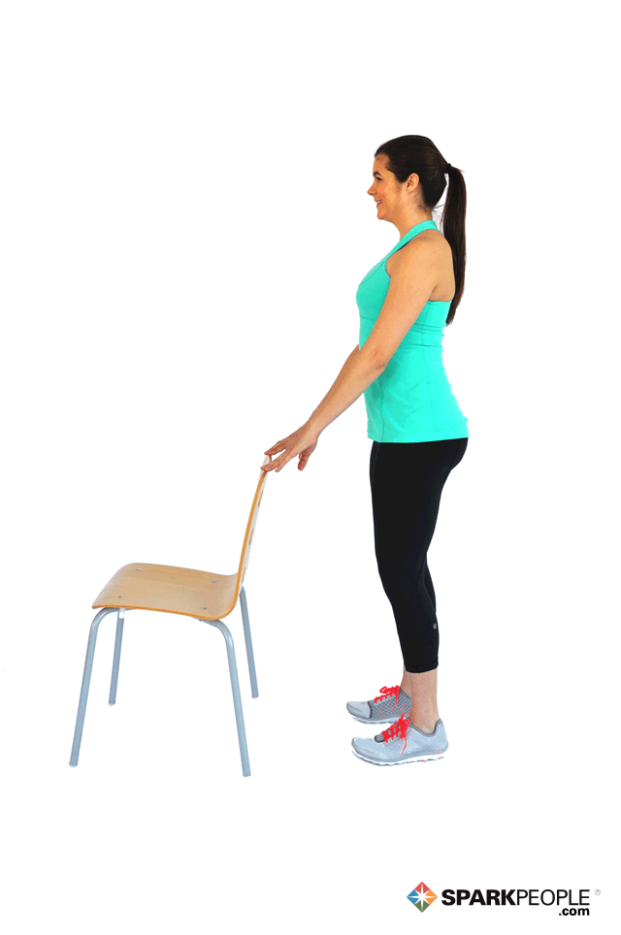
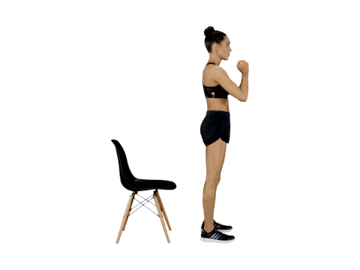
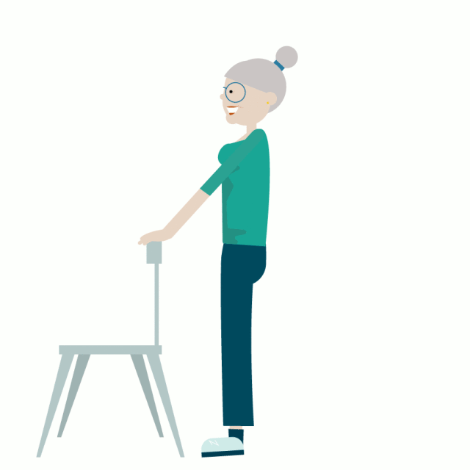
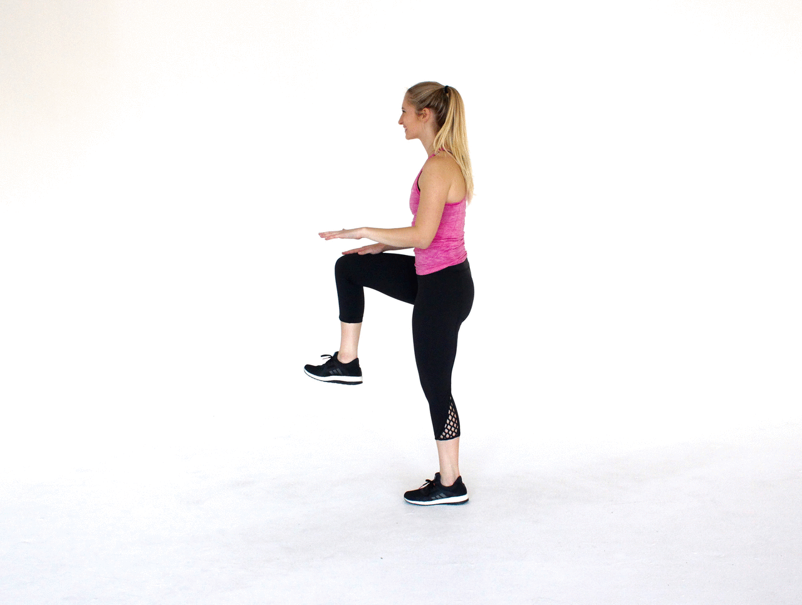
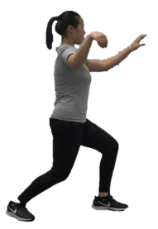
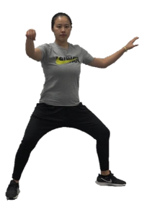
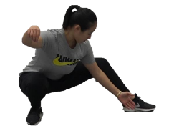
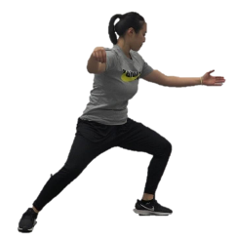
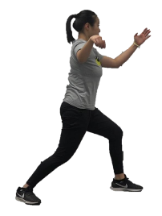
Exercise Snacking
“short bouts of exercise undertaken at a sporadic yet convenient time in the comfort of one’s own home”

Slide 7

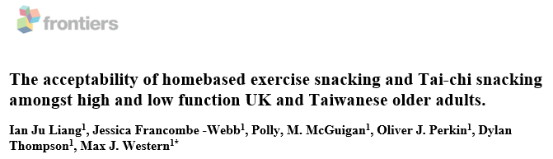
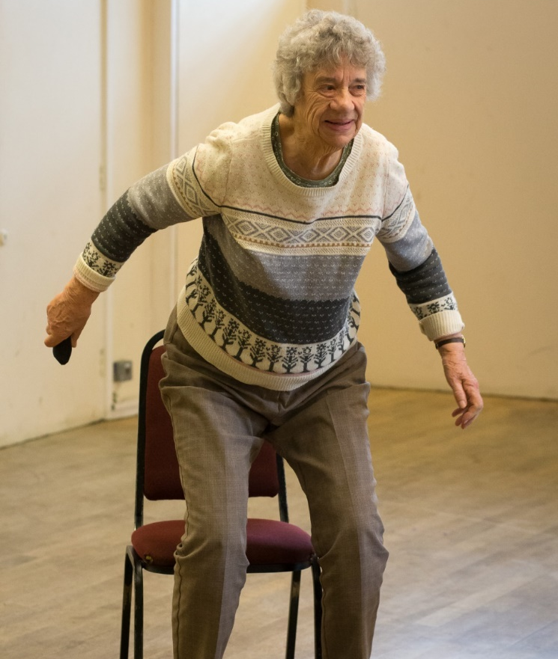
Exercise snacking is acceptable to older adults
Exercise snacking largely seen as:
A format that aligns to older adult identity
Is not burdensome
Is straightforward to master and record
Is safe and empowering to do
But:
Can be tedious for non exercisers
Requires adapting to differing levels of physical capability

Slide 8
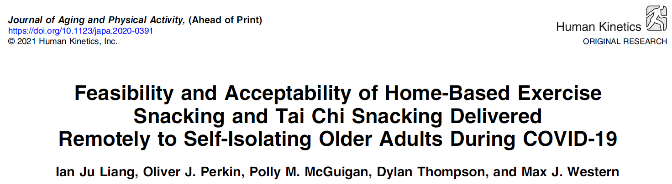
Exercise snacking in community dwelling older adults
Participants 63 self-isolating over 65’s in the first lockdown who did not do regular sport or exercise.
Intervention Randomised to do 28-days of exercise snacking, tai chi snacking or combination of the two. Video instructions and self-monitored adherence logs.
Comparison NHS web pages on physical activity in older adults
Outcomes feasibility of remote assessment of strength and balance; acceptability and adherence to the exercise programme; Reciprocal relationship with mood and feelings

Slide 9


Exercise snacking in clinical populations
20 Pre-frail memory clinic outpatients diagnosed mild cognitive impairment
28-day Exercise Snacking intervention
Basic functional outcomes:
Improved chair rising, walking and standing balance tests

Slide 10
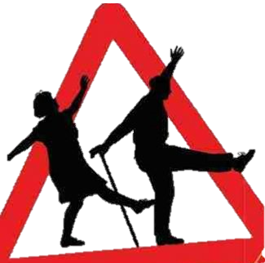




Next Steps for exercise snacking…
Build on formative work
Technology and exercise snacking
Currently undertaking a12-week randomized controlled trial to evaluate effectiveness in community dwelling OAs.
Pilot data from the RCF work with RICE is being submitted as a £250,000 NIHR application for a 12-month study to explore long term impact in people at heightened risk of falls.
EPSRC seed-funding to develop and pilot the use of smart/sensing technology to motivate and monitor home-based strength and balance ‘snacks’ and build habits.
£400,000 from Dunhill Medical Trust to integrate exercise snacking as part of a wholistic TV-enabled active ageing intervention.

Slide 11
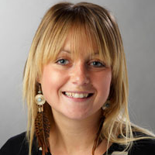
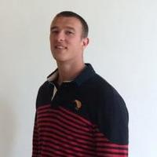



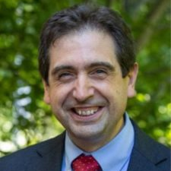
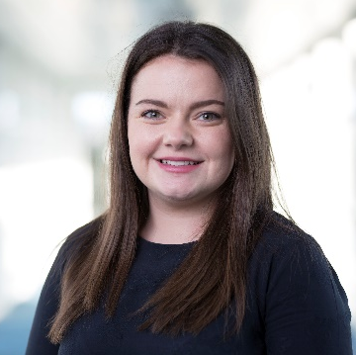







Thank you

