Slide 1
On the Politics of Responsibilization
Dr Friederike (Fritzi) Döbbe
Assistant Professor in Business & Society
University of Bath, School of Management
20 January 2025

Slide 2
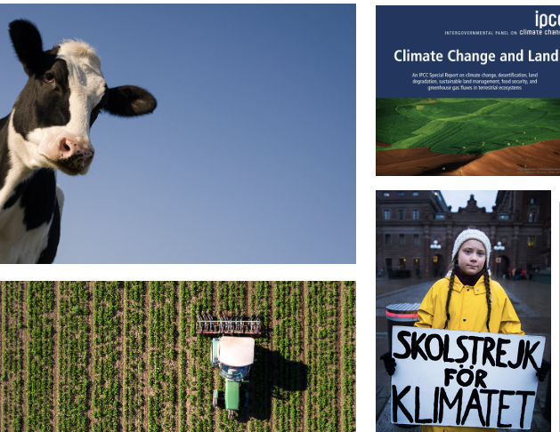
Overview
Assistant Professor in Business & Society
Marketing, Business and Society Division in the School of Management
Organizational and political responses to climate change and transforming food systems for greater sustainability
Focus on how responses and responsibilities are framed and constructed discursively
Notes:
PhD in Stockholm Sweden, joint in march
Discourse – how we talk about and understand certain subjects, often shaped by power structures

Slide 3
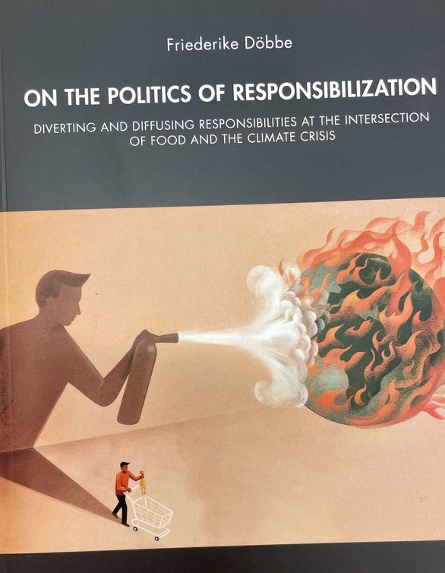
Overarching research approach
How is the responsibility to address socio-ecological issues discursively constructed, shifted and contested?
Consumer responsibilization:
Individualization of responsibility
Often through markets and consumer choice
Shared responsibility discourses:
Collectivization of responsibility
Global deliberation and negotiation arenas that focus on collaboration and consensus
2023 Oskar Sillén Prize, Sweden
Notes:
Research context: Societal debates about how to respond to climate change and food sustainability issues
Qualitative data: Documents (policy documents, press releases, public media), interviews, social media data, visual data
Discourse – how we talk about and understand certain subjects, often shaped by power structures

Slide 4
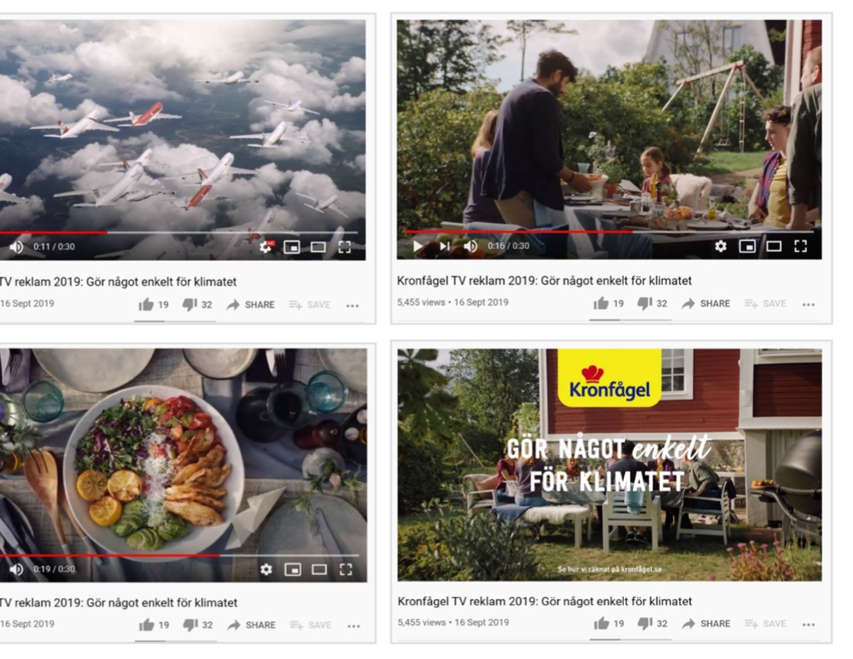
Consumer responsibilization I
Döbbe & Cederberg (2023) in Journal of Business Ethics
Kronfågel’s marketing campaign
Campaign asked consumers to “do something simple for the climate” by choosing chicken rather than beef as this would save emissions equivalent to a lot of aeroplane flights
Campaign as a form of consumer responsibilization: climate change to be addressed on a personal level; chicken as the sustainable choice; legitimized through emissions calculations and comparisons
Notes:
“So much better – the impact of chicken on the climate is only one-tenth that of beef”
RQ: How do consumers collectively contest consumer responsibilization?
Data collection and analysis
Marketing campaign + consumer reactions (n = 361)
documents (official complaints) and social media comments
Abductive, Foucault’s notion of counter-conduct
Four forms of counter-conducts: (1) demanding ‘more,’ (2) challenging truth claims, (3) constructing ‘the misled consumer,’ (4) rejecting vilification
Contributions: Consumers’ collective counter-conduct works by engaging others and forming responsibilizing communities; it reproduces, rather than undermines, responsibilization
Practical implications: complexity of sustainable food-climate nexus; ‘cautionary tale’ for corporate sustainability communication, consumer scepticism and knowledge mobilization

Slide 5

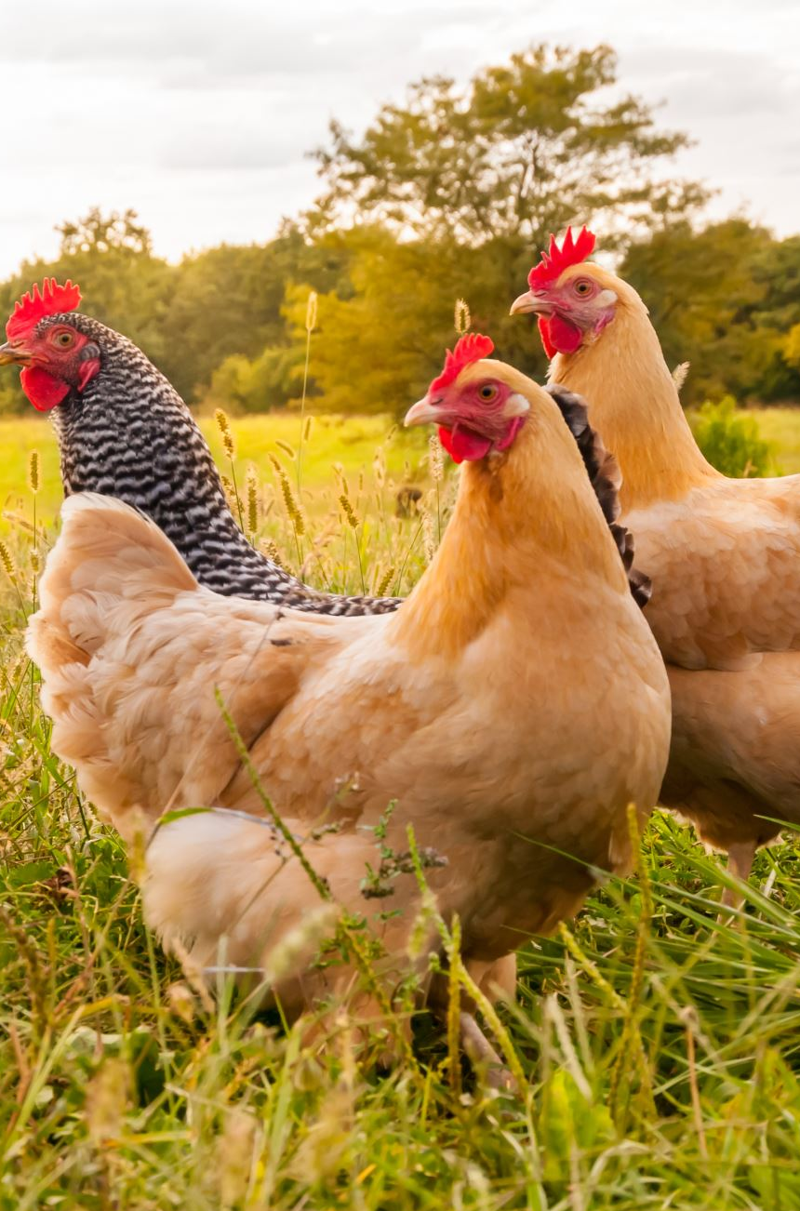
Consumer responsibilization II
Consumers collective contestations: on social media platforms and via the Swedish consumer agency
Concerns over interconnected sustainability issues: climate change, animal welfare, Swedish agriculture/farmer livelihoods
Accepting personal responsibility but requesting more nuances
Challenging others’ truth claims, e.g., emission calculations
Demanding more from each other, e.g., “chicken is not enough”
Responsibilizing communities that challenge the vilification of beef + position themselves as informed and others as misled
Reinforcing individual responsibility discourses
Notes:
Abductive, Foucault’s notion of counter-conduct
Four forms of counter-conducts: (1) demanding ‘more,’ (2) challenging truth claims, (3) constructing ‘the misled consumer,’ (4) rejecting vilification
Contributions: Consumers’ collective counter-conduct works by engaging others and forming responsibilizing communities; it reproduces, rather than undermines, responsibilization
Practical implications: complexity of sustainable food-climate nexus; ‘cautionary tale’ for corporate sustainability communication, consumer scepticism and knowledge mobilization

Slide 6
Shared responsibility contexts I
Shared responsibility discourses focus on collective action and collaboration on socio-ecological issues
On the global level, this occurs through partnerships and multi-stakeholder governance (e.g., Forest Stewardship Council) or multilateral processes (United Nations)
How do actors in the UN (member states, secretariats) derive at shared understandings when they negotiate about policy issues
Notes:
How are contested policy frames revised for agreement in multilateral contexts?
Study of discussions about food sustainability in the UN and the debates over the frame “sustainable diets” by member states
Frames was contested and lost its acceptance → revisions for new agreement (consensus) → frames are watered down

Slide 7

Shared responsibility contexts II
Frames and framing can help to explain how diverse actors construct a shared meaning
Frames are “schemata of interpretation” constructed in interactions
How we interpret social and environmental issues is often a matter of how problems (e.g., climate change) and responses (e.g., technologies, climate justice) are framed.
Ongoing research: contestations over and subsequent revisions of frames in the UN where actors try to maintain agreement
Notes:
Framing can help to explain how actors construct a shared meaning of policy issues and responses when they interact
Ongoing research: contestations over frames in the United Nations and implications of searching for consensus
In contexts like the United Nations, finding agreement on what is framed as an issue or response is typically based on consensus amongst member states.
How are contested policy frames revised for agreement in multilateral contexts?
Study of discussions about food sustainability in the UN and the debates over the frame “sustainable diets” by member states
Frames was contested and lost its acceptance → revisions for new agreement (consensus) → frames are watered down
political dynamics of consensus-based organizing in

Slide 8
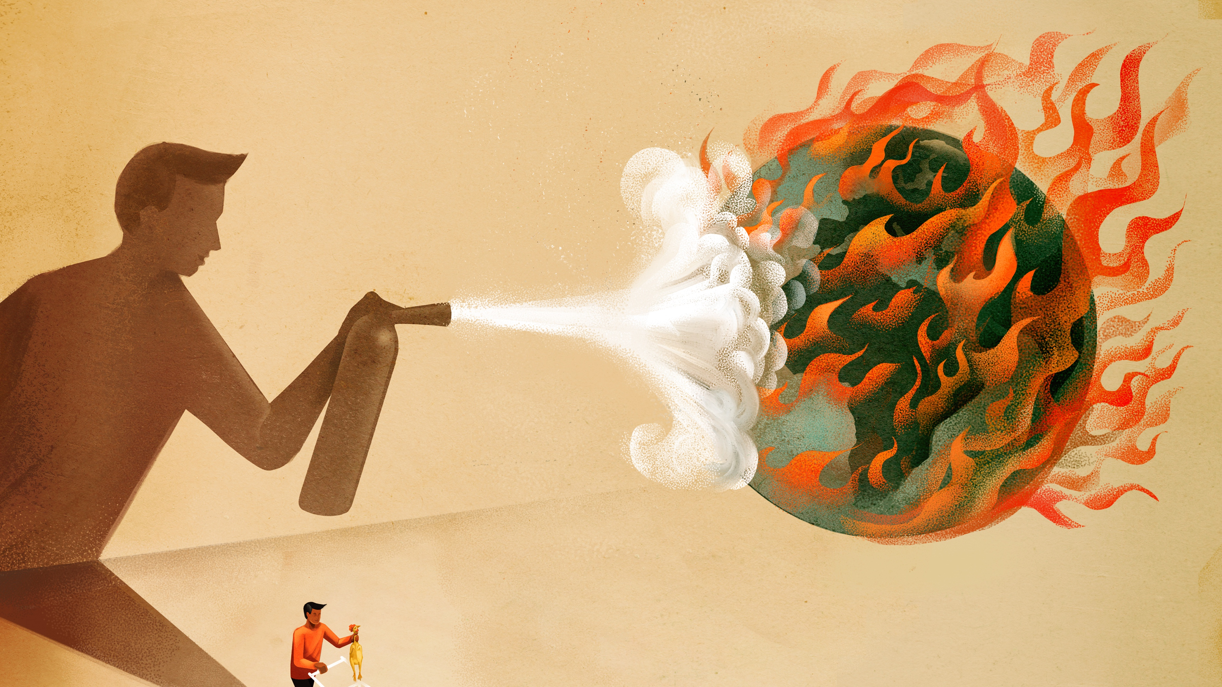
Questions?
Thank you
Dr Friederike Döbbe
Fd534@bath.ac.uk

