Slide 1
Sensory-inclusive spaces
for Autistic people
Dr Keren MacLennan
Lecturer, Department of Psychology

Slide 2
Background
We all experience the world in different ways - different sensory likes and dislikes
Up to 94% Autistic people experience sensory responsivity differences
(Baranek et al., 2007; Crane et al., 2009; MacLennan et al., 2021)
Some sensory experiences can be enjoyable, but others can be overwhelming, painful, and distressing
Dynamic and complex, e.g., loud, chaotic environments can be overwhelming, but listening to music can be enjoyable
(MacLennan et al., 2021)
Consequences for Autistic people’s quality of life and mental health
(Carpenter et al., 2018; Hwang et al., 2019; MacLennan et al., 2021)

Slide 3
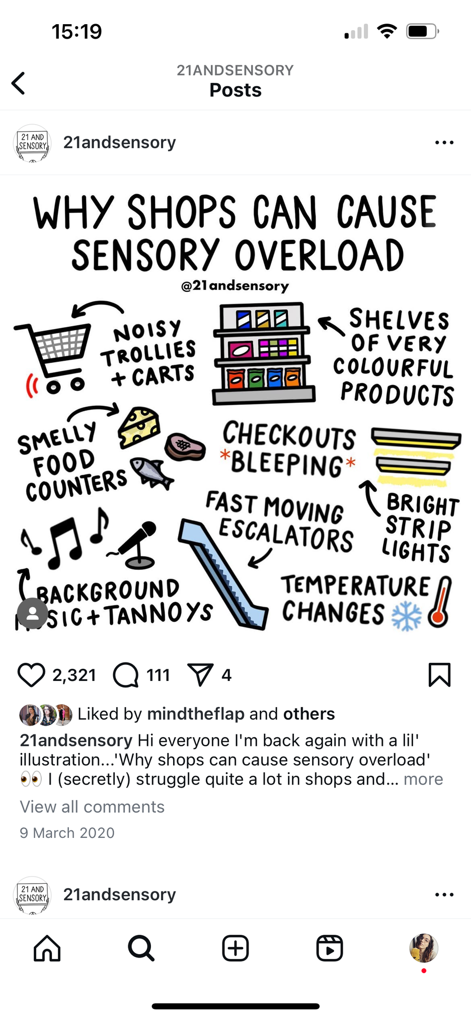
Research
Previously very little research into how to make environments more sensory-inclusive
Many public places can be disabling due to the sensory environment
E.g., supermarkets, restaurants, public transport, healthcare settings
Other places are more enjoyable
E.g., nature, music venues, museums
(MacLennan et al., 2023)

Slide 4
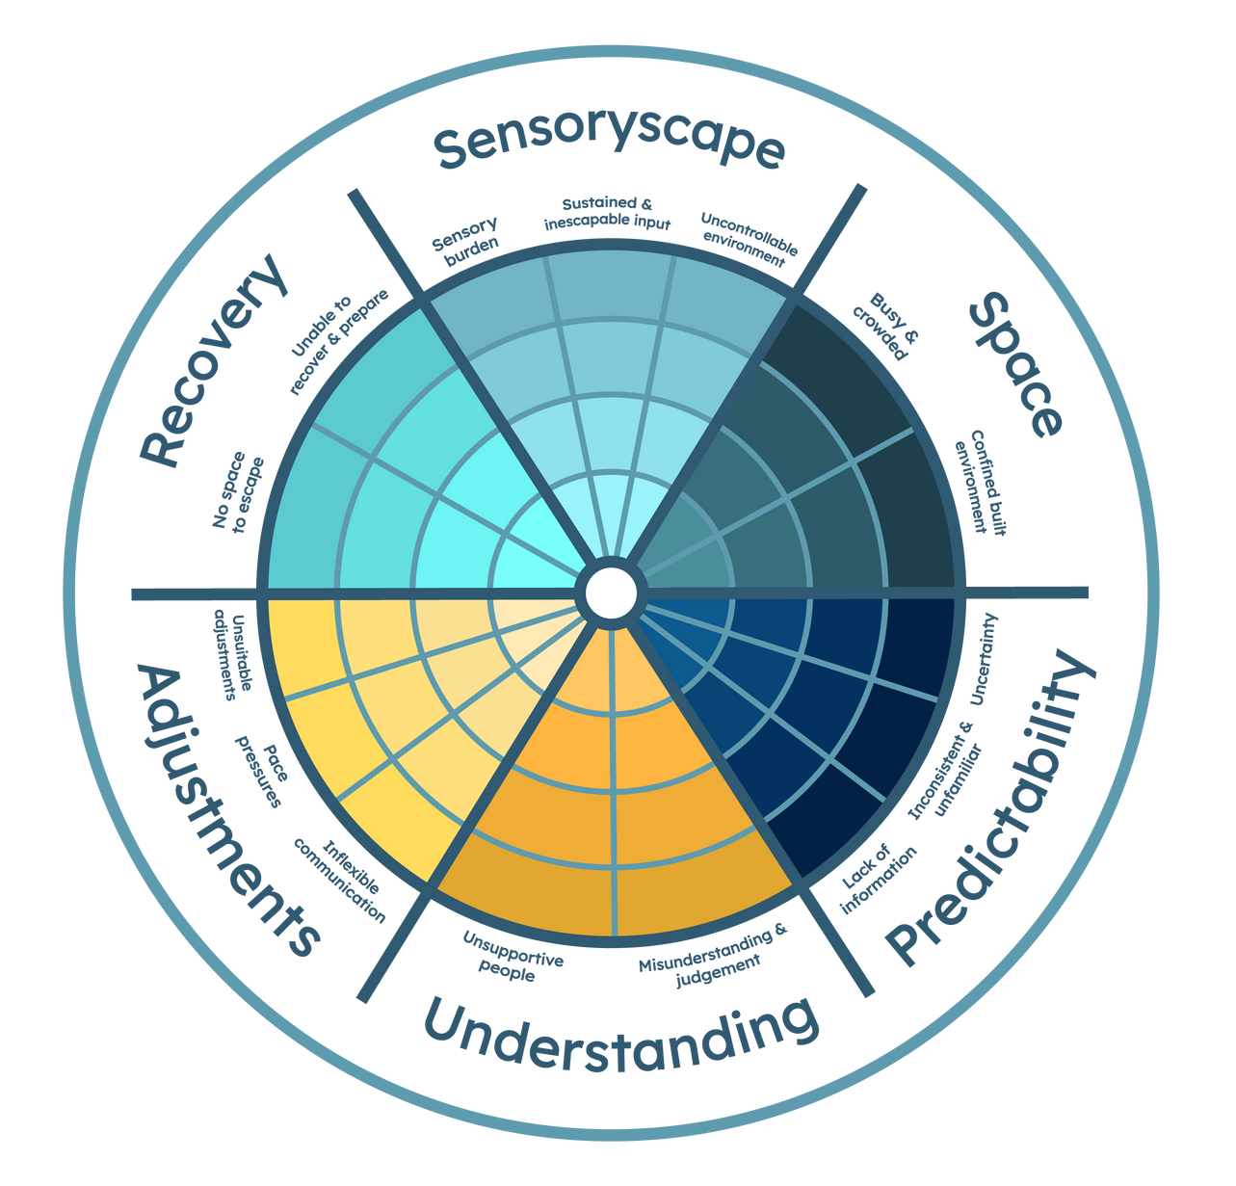
Most
challenging
Research
Least
challenging
6 principles underpin how disabling/enabling sensory environments are
(MacLennan et al., 2023)

Slide 5
Most
challenging
Research
Least
challenging
We are now:
Further exploring these principles in research
Applying these principles to real-world contexts to make spaces more sensory-inclusive

Slide 6
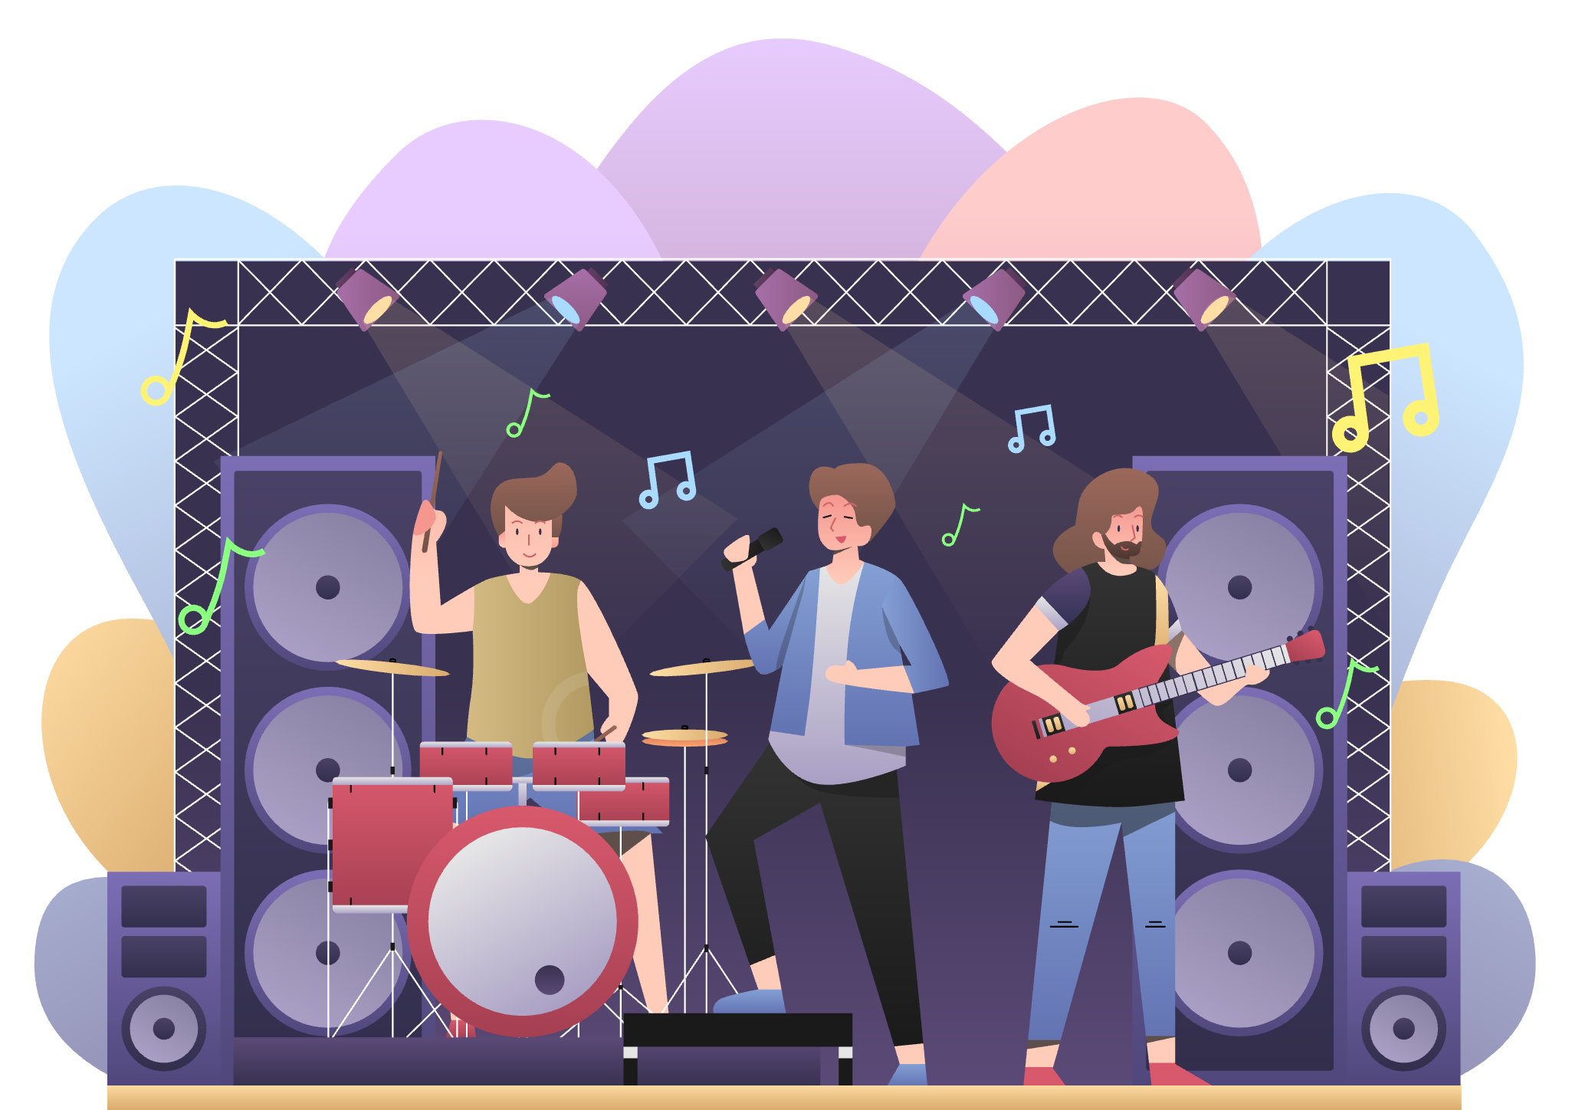


Research
Live music venues
and events
Autistic people’s experiences of attending live music
Museums
Evaluating the introduction of a restorative space -
Great North Museum
Nature
Autistic people’s sensory experiences engaging with nature

Slide 7
Research
Autistic adults’ experiences of live music:
Need for venues and events to provide more information online
Live music fosters social connection - there are still challenges
Sensory enjoyment - there are still challenges
Staff need to be trained - provide understanding support
(Herbert, Smith & MacLennan, under review)

Slide 8
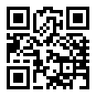
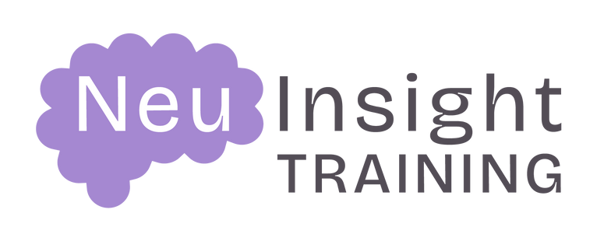
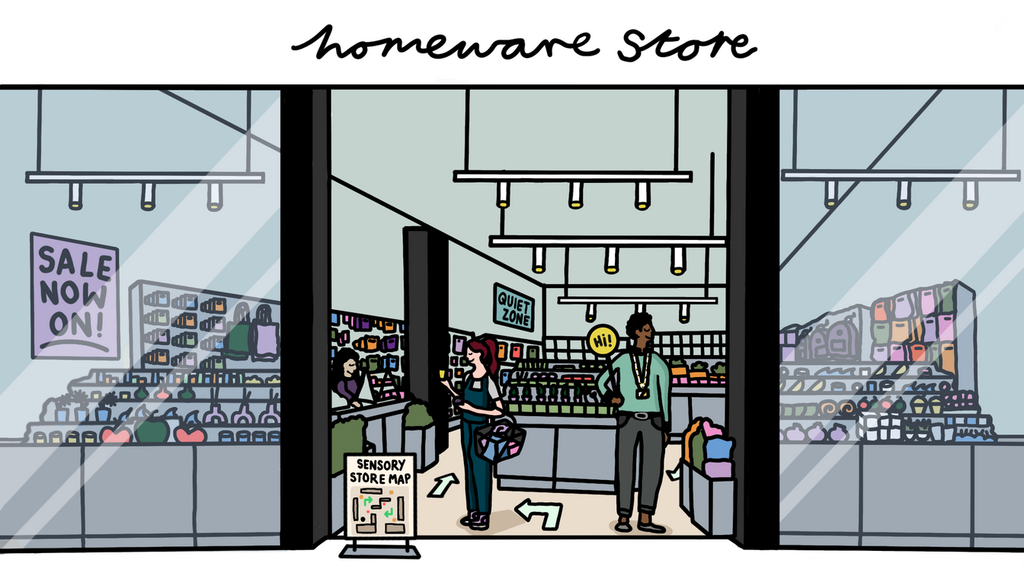



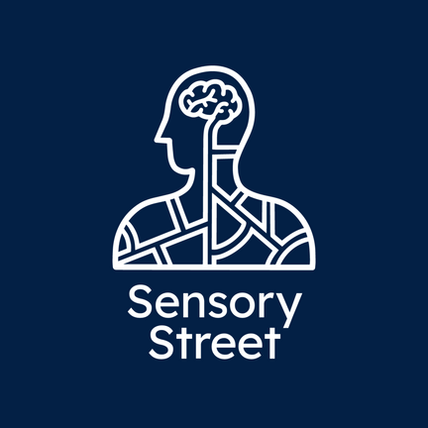
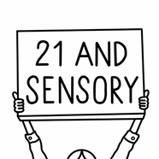

Impact
www.neuinsight.co.uk
Neurodiversity e-training informed by research and lived experience
Courses:
Introduction to Neurodiversity
Sensory-Inclusive Spaces for Autistic People
Emily @21andsensory

Slide 9
Impact
www.neuinsight.co.uk
“This course is a fab starting point for anyone who wants to understand Autism more. I think this should be given to all staff in every organisation.”
To date:
189 students since launch July 2024
Rated 4.69/5
More courses being developed...
“It's so nicely formatted into chunks and the language use is really nice, it doesn't ever say 'us' or 'them' always Autistic people or Neurotypical people”.

Slide 10
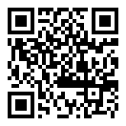

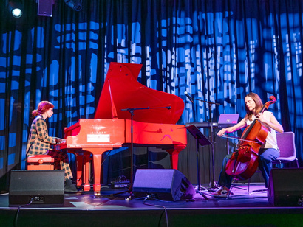
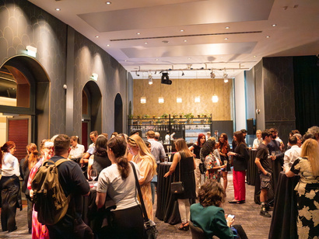
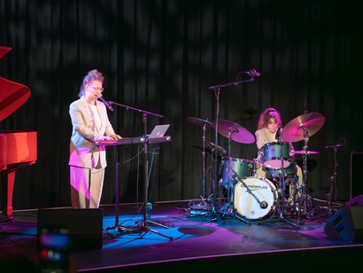
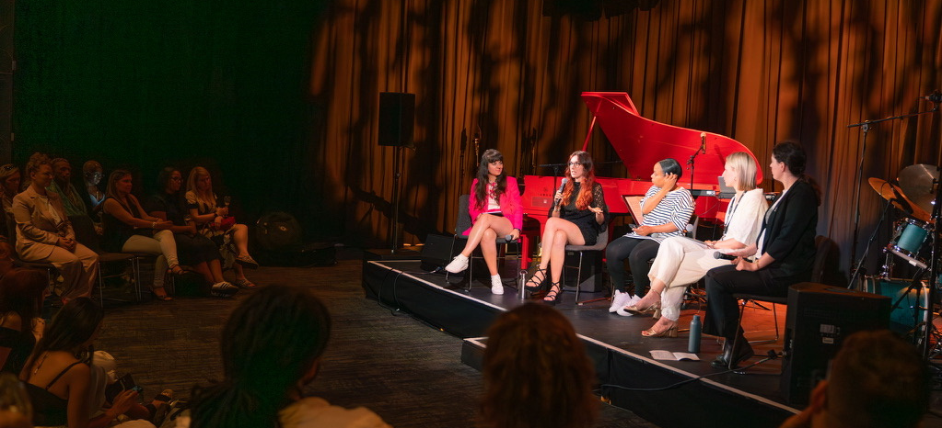

Impact
www.linkedin.com/company/livend/
LIVEND
Live Music Inclusion at Venues and Events for Neurodivergent People
Knowledge sharing
Sensory audit and resource development
Event to showcase project and connect with wide range of stakeholders

Slide 11
Cathy Manning, University of Birmingham
Hayleigh Bosher, Brunel University
Emily @21andsensory
Charlotte Featherstone, Autistica
Aelswith Parker, Community Partner
Gabriella Sepsik, Community Partner
Gaia Ramanathan, Community Partner
Malcolm Osborne, Community Partner
Tamsin Green, Community Partner
Priya Sarda, Community insights
Rose Matthews, Community insights
Thank you
Luke Poulton, Community insights
Samantha Friedman, University of Edinburgh
Amy Pearson, Durham University
Gemma Herbert, Durham University
Charlie Greenall, Durham University

