Slide 1


Prosthetics and Nerve Interfaces: The Path to Natural sensations
Dr Leen Jabban

Slide 2
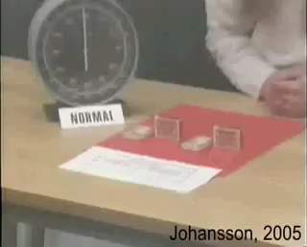
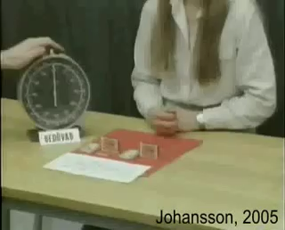
The Importance of Touch
Normal
Digital anaesthesia

Slide 3
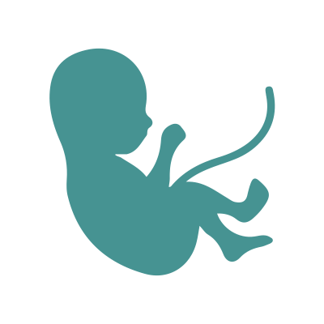


The Importance of Touch
Delivers the first sensory input before birth
The hand alone has 17,000 mechanoreceptors (sensors)
Losing sensation (touch and proprioception) leads to immobility

Slide 4
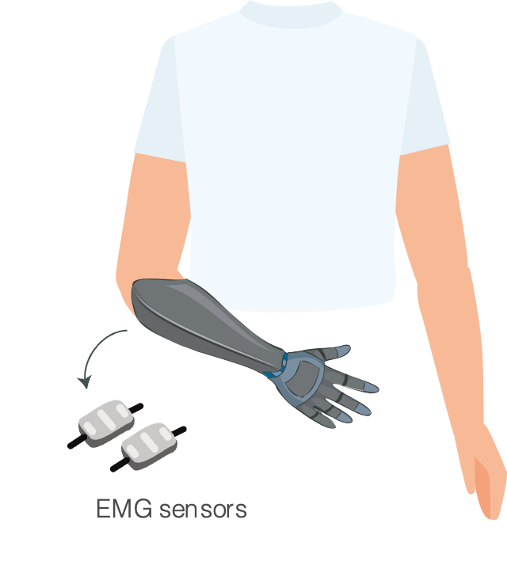
Upper-limb Difference
5,200/year
Upper-limb amputations in the UK alone
Up to 50%
Use electrical (myoelectric) prostheses
$60,000
Average cost of myoelectric prosthesis
Up to 75%
Reject their prosthesis

Slide 5
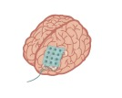
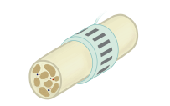
Interfacing with Peripheral Nerves
Regenerative
Selectivity
The ability of a nerve interface to target specific nerve fibres.
Intraneural
Extraneural
Surface electrodes
Invasiveness
The extent of tissue penetration or disruption

Slide 6
Challenges of Non-invasive Stimulation
Targeting the nerve without activating the nerve endings in the skin, which can cause uncomfortable sensations.
Eliciting “Natural” sensations
Selectivity
Invasiveness

Slide 7
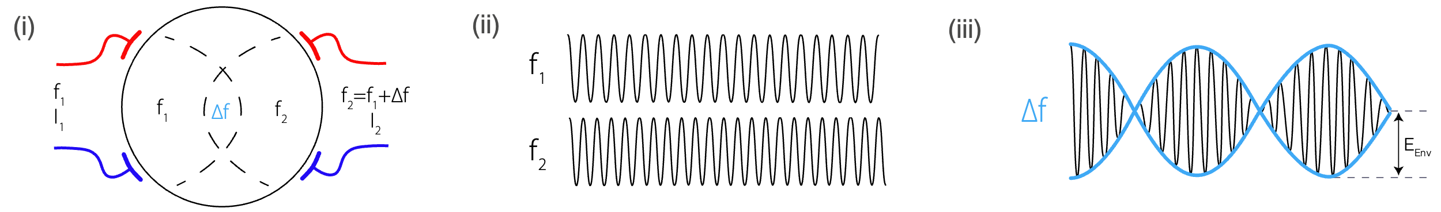


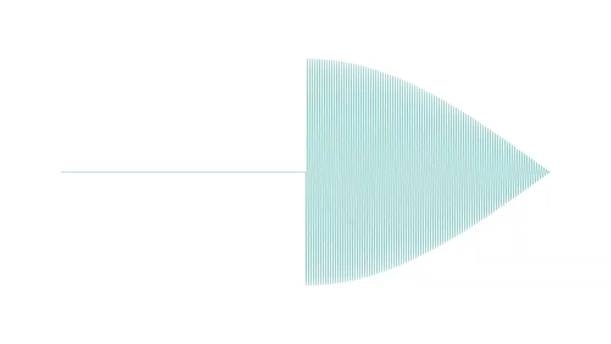
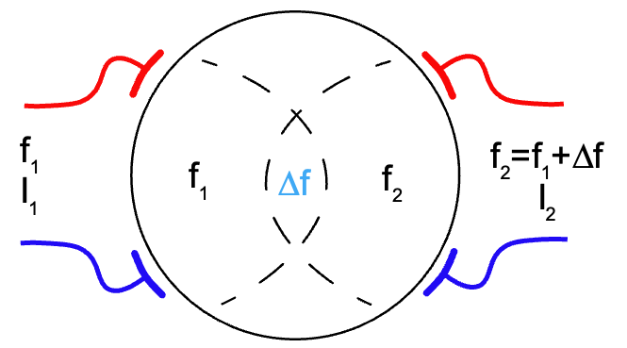


Is kHz Frequency the Solution?
Example 1
A= 200Hz
B= 201Hz
Beat= 1Hz
+
=
Example 2
A= 200Hz
B= 205Hz
Beat= 5Hz
Can control the location of interference based on the electrode arrangement around the arm.

Slide 8
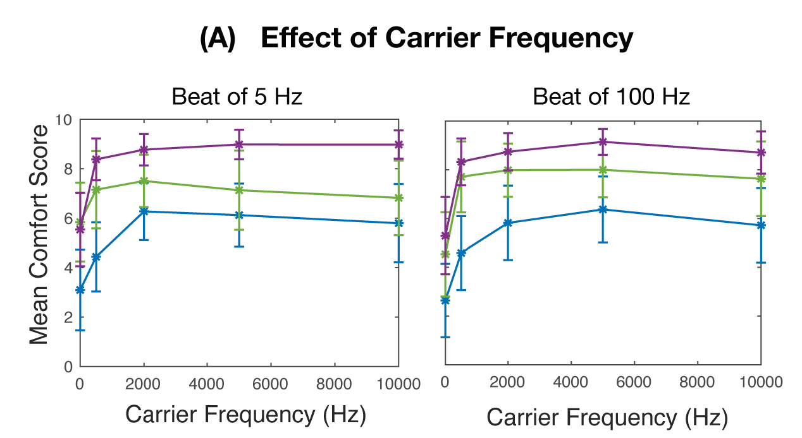
Is kHz Frequency the Solution?
Some promising results showing increased comfort
Needs further investigation into:
How does the current spread under the electrodes?
How are the nerves responding to those signals?
Answering those questions is a key to developing comfortable non-invasive sensory feedback

Slide 9

Thank you!
Dr Leen Jabban
lj386@bath.ac.uk

