Slide 1
Biogenic carbon in environmental assessment
Consensus building with UNEP / Life Cycle Initiative
Biogenic Carbon Project
Sam Cooper – en8sc@bath.ac.uk Vice Chancellor’s Research Day – 20th January 2025

Slide 2
Assessing environmental impacts
What is the environmental impact of a system?
Developing approaches for assessment

Slide 3










Biogenic carbon in LCA – developing guidance
The assessment of biogenic carbon in LCA can vary in several ways.
For example:
System boundaries
Allocation between life cycles
Variation with time

Slide 4
Biogenic carbon in LCA – developing guidance
The assessment of biogenic carbon in LCA can vary in several ways.
For example:
System boundaries
Allocation between life cycles
Variation with time
When? (“inventory”)
What is the value? (“impact”)

Slide 5
What is the value of delaying emissions?
Can’t just be biophysical approach:
“What do we want?” is an inherently interdisciplinary question.

Slide 6
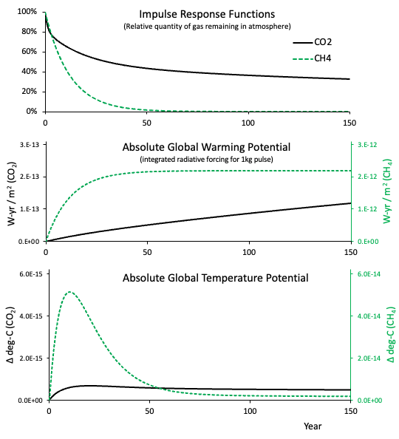
Physical effects

Slide 7
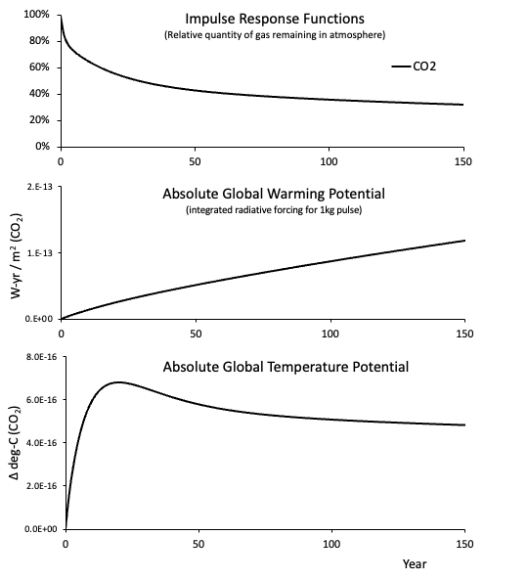
What if we delay emission?

Slide 8
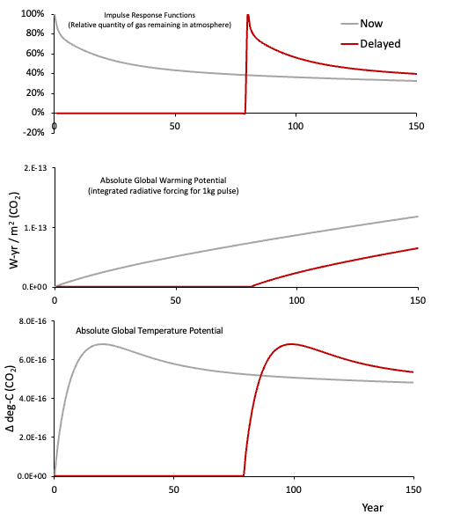
What if we delay emission?
(80 years)

Slide 9
Options…
Ignore the delay
Look at the effect at a fixed time horizon.
Present the full data set

Slide 10
Options…
Ignore the delay
Look at the effect at original time horizon.
Present the full data set
What do we want the impact to mean?

Slide 11
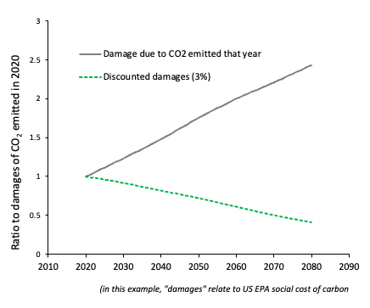
Option 4: what are the impacts (damages) we’re concerned with?
Actual damages increase!
It is only because of discounting that there is a value to delay
We cannot meaningfully determine a value to delaying emissions without interdisciplinary study and engaging with stakeholders

Slide 12
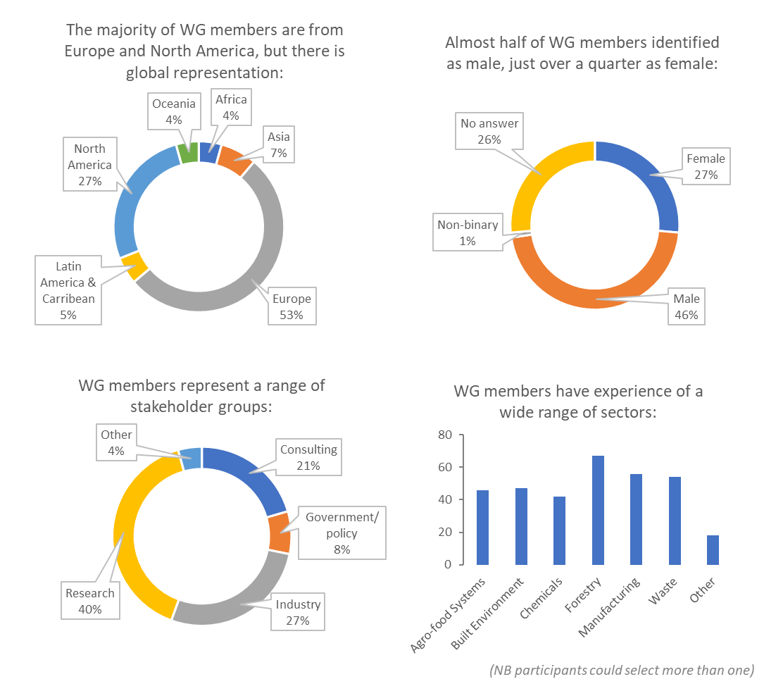


Next steps…
Stakeholder consultation
Consensus building
Broad, international group of interested participants
Researcher – Dr Lewis McDonald
Bath Investigators – Dr Will Hawkins, Prof. Marcelle McManus, Dr Steve Allen, Dr Rick Lupton

